Slide 1





FALLING BALL GAME
Minh Nguyen
Ishaan Patel
Karter Sanamo

Slide 2


How To
PLAY
Player Control
At the very base of the game lies the ability for the player to aim and shoot projectiles. This is done by grabbing the mouse position and calculating the direction they are looking.
Projectile Behavior
When a player's projectile successfully collides with a planet, a small audio cue is played. The planet is destroyed when its health is 0 and a loud explosion is played.
Scoring System
The game has a straightforward scoring system: awarding one point for each planet destroyed.
Difficulty Progression
The game also increases in difficulty as you progress. Every 5 waves, more planets spawn per wave.
Game Over Condition
When a planet reaches the top of the screen (the player), the player loses & the game ends.

Slide 3
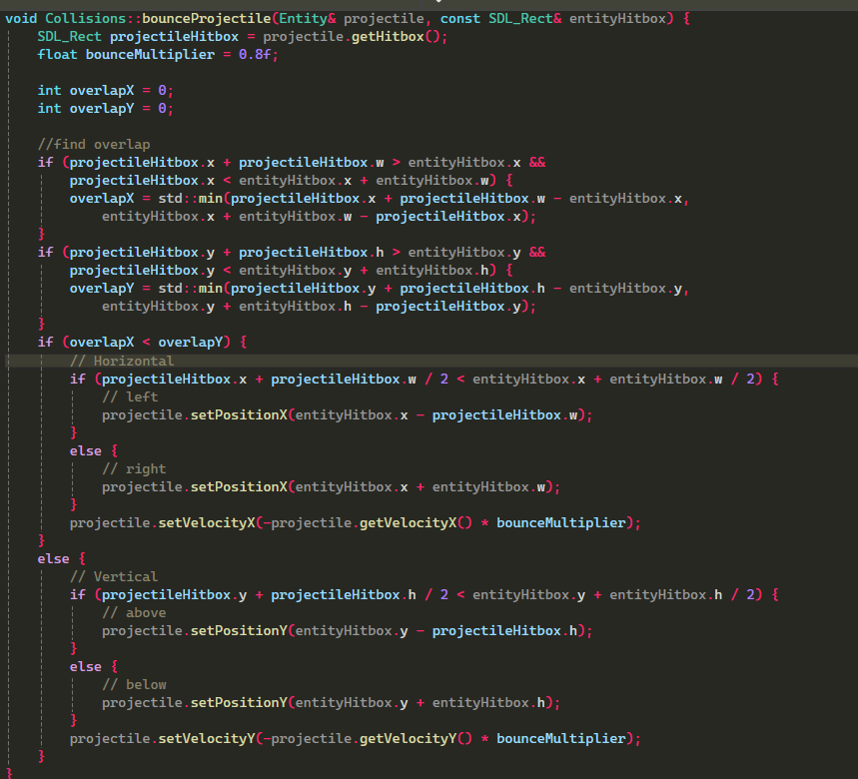


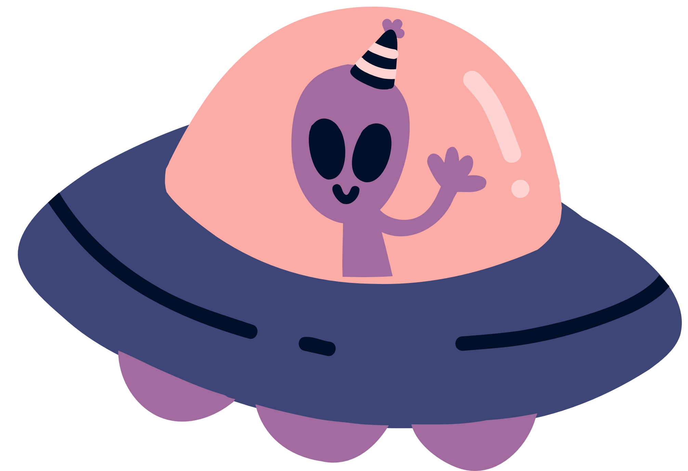
FUNCTION
01

Slide 4
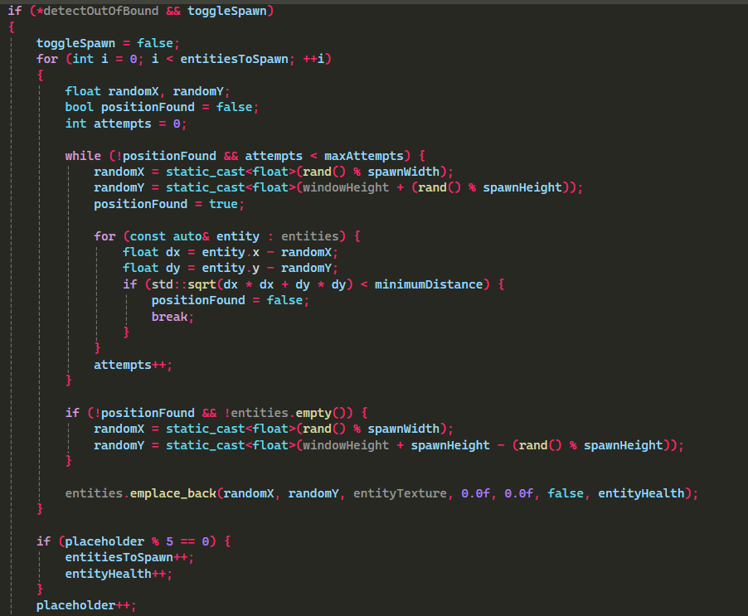
FUNCTION
02
void Entity::Spawn(SDL_Event& event, std::vector<Entity>& entities, SDL_Texture* entityTexture, int windowWidth, int windowHeight, bool* detectOutOfBound)

Slide 5
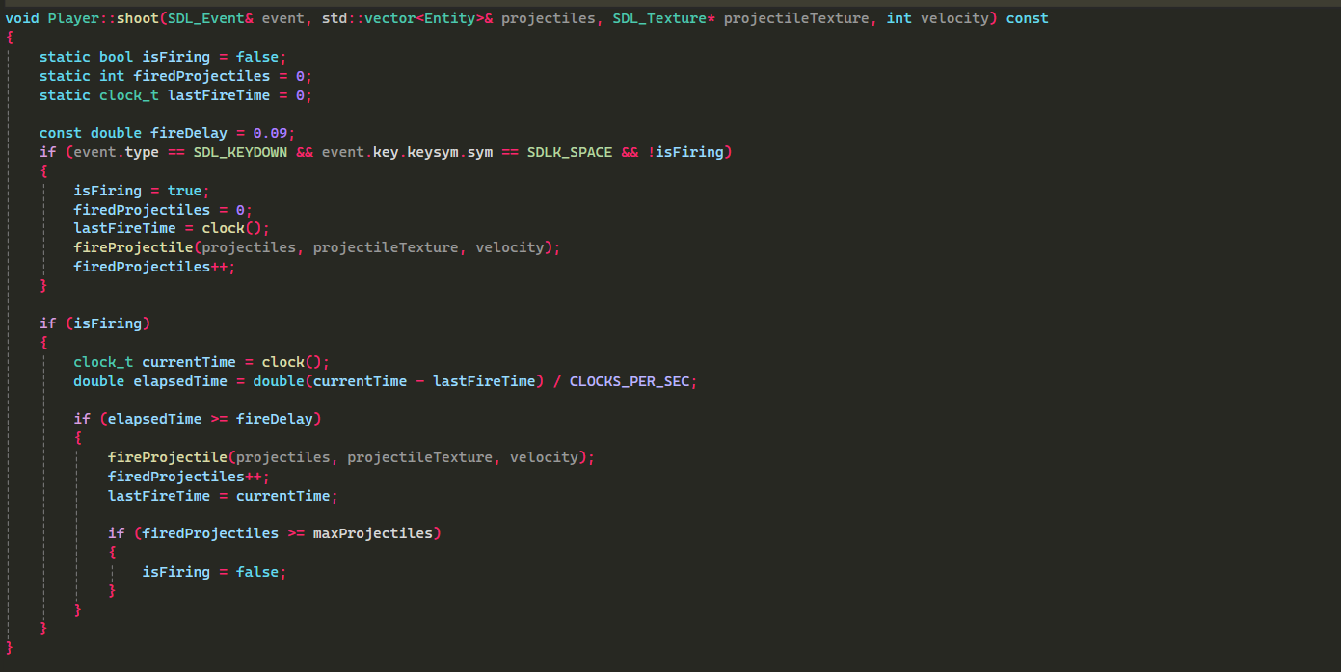
FUNCTION
03

Slide 6



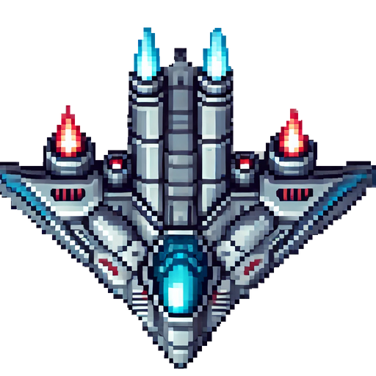


Design

Slide 7
Thank You
FOR PLAYING!

