Slide 1
Teton
PRODUCT RECOMMENDATION
Teton Foresight
From monitoring to prediction
An internal recommendation to make predictive care our 2026 flagship.
INTERNAL · PRODUCT STRATEGY · Q3 2026 · CONFIDENTIAL
Notes:
Open on the recommendation framing: an internal product decision built to investor-review polish. Foresight — predictive care on the data layer we already own — as the 2026 flagship.

Slide 2
The recommendation
Build Foresight as our 2026 flagship
RECOMMENDATION
WHAT WE'RE ASKING FOR
Fund a dedicated squad to ship Teton Foresight — predictive risk on the data layer we already own — beginning Q4 2026.
1 product squad
6 people, ring-fenced
2 pilot facilities
Extends monitoring into prediction — with no new hardware
Deepens our data moat ahead of the US launch
Ships on infrastructure and trust we've already proven
one hospital, one care home
Decision by 30 Sep
to hit a Q4 start
Teton — Product Recommendation
Confidential — Internal · 2
Notes:
Lead with the ask — recommendation decks put the conclusion first. Lavender card = the recommendation; right column = exactly what approval means. Pause on the 30 Sep date.

Slide 3
Why now
The care gap is widening
6 million
Projected global nursing shortage by 2025
29 million
Warm documentary photo — resident and carer
Falls per year among people aged 65+
31%
Lower life expectancy after a fall in a care setting
Teton — Product Recommendation
Confidential — Internal · 3
Notes:
Frame the problem with the market's own numbers, not fear. Warm, dignified photo — never clinical or alarming.

Slide 4
THE INSIGHT
We already capture the data.
We just don't predict from it — yet.
Every room already streams to our data layer. Foresight turns that stream into risk we can act on before a fall — not documentation after one.
Teton — Product Recommendation
Confidential — Internal · 4
Notes:
The pivot. One idea, lots of air. The whole recommendation rests on this: the data already exists; prediction is the unlock.

Slide 5
THE PRODUCT
Teton Foresight
Prediction on the layer we own
Risk scores, per resident
FORESIGHT · TONIGHT
Continuous fall- and deterioration-risk from ambient signals — no wearables.
Room 122 · Ingrid
High
Shift-level foresight
Room 118 · Bent
Elevated
Tells staff who needs eyes tonight, before the evening handover.
Room 130 · Maja
Low
Portfolio view
Cross-facility risk for operators and clinical leads, in one pane.
Illustrative — Foresight risk panel
Teton — Product Recommendation
Confidential — Internal · 5
Notes:
What we'd build, in three capabilities. Flag the panel as illustrative. The three colors map to the brand: periwinkle/butter/mint for high/elevated/low.

Slide 6
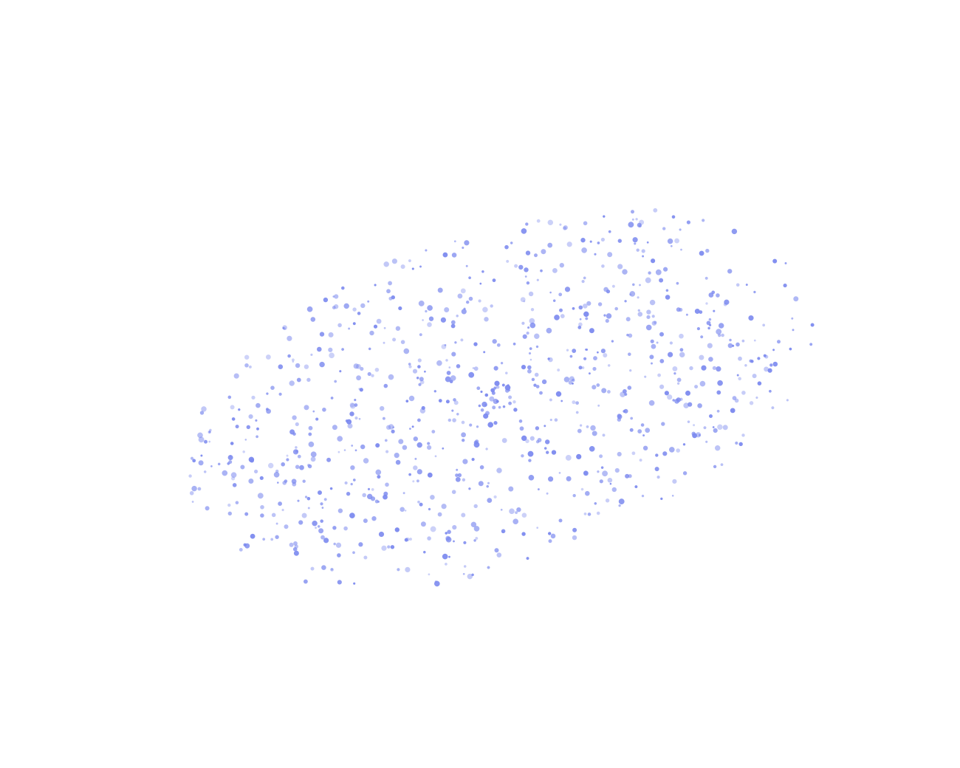
HOW IT WORKS
Real-time understanding,
privacy by design
01
Point of care
Sensors build a live, privacy-safe model of each room — no video leaves it.
02
Site-wide clarity
Signals roll up into ward and facility views for the team on shift.
03
Organisational foresight
Prediction across the whole portfolio — where Foresight lives.
Teton — Product Recommendation
Confidential — Internal · 6
Notes:
The 'real AI, not a camera' beat. The blue point cloud is the signature visual. Walk the three levels: room, site, organisation. Foresight is the third.

Slide 7
Tried and tested
Proven results at scale
40%
96%
Reduction in falls
Faster fall-response times
25%
10M+
Less staff workload, 8pm–8am
Hours of in-room monitoring
10,000
83%
Care staff supported
Fewer falls (Hjørring pilot)
Teton — Product Recommendation
Confidential — Internal · 7
Notes:
Credibility that we can ship and it works. Live results from Teton's base. Land on 83% (pilot) and 96% (response time).

Slide 8
What we considered
Three paths, one recommendation
RECOMMENDED
Build Foresight now
Partner for analytics
Defer to 2027
TIME TO VALUE
TIME TO VALUE
TIME TO VALUE
2 quarters
1–2 quarters
None yet
DATA MOAT
DATA MOAT
DATA MOAT
Deepens ours
Shared / erodes
Static
COST
COST
COST
1 squad
Rev-share
Opportunity
STRATEGIC RISK
STRATEGIC RISK
STRATEGIC RISK
Low — we own the layer
High — dependency
High — others move
Teton — Product Recommendation
Confidential — Internal · 8
Notes:
Show the decision was considered. Three honest options, four rows. Building now is the only path that deepens the moat instead of renting or freezing it.

Slide 9
PLAN
How we'd ship it
Four steps to general availability
01
STEP 01
Foundations
Stand up the prediction service on the existing data layer.
02
STEP 02
Pilot cohort
Two facilities, pre-agreed success metrics, tight tracking.
Team at work — care staff & product
03
STEP 03
Cross-facility rollout
Expand across the current base once the gate is passed.
04
STEP 04
GA & US launch
General availability, timed into the US expansion.
Teton — Product Recommendation
Confidential — Internal · 9
Notes:
The plan, four steps, with a real gate at the pilot (step 2). We don't roll out until the pilot clears its metrics — that's how we de-risk the spend.

Slide 10
Don't just take it from us
What care staff already say
“
HOSPITAL
“
HOSPITAL
“
CARE HOME
It's brilliant — our falls have decreased by 83%. It's changed the way we work.
When I've got lots of patients, it gives me peace of mind knowing Teton is there.
I can be at the other end of the building and still feel secure about a resident.
Tina Nurse Assistant
Maja Nurse
Lasse Nurse Assistant
Teton — Product Recommendation
Confidential — Internal · 10
Notes:
Proof in the users' own voices — the brand puts evidence in nurses' mouths, not adjectives. The 83% here is the same number, now human.

Slide 11
Risks we're watching
And how we de-risk them
RISK
MITIGATION
Clinicians don't trust the model
Explainable risk + clinician-in-the-loop from day one.
The pilot underdelivers
Pre-agreed metrics; a kill/scale gate at 90 days.
US regulatory exposure
Privacy-by-design already; compliance engaged in Step 1.
Squad gets pulled onto other work
Ring-fenced squad; no shared-roadmap dependencies.
Teton — Product Recommendation
Confidential — Internal · 11
Notes:
Investor-grade candor: name the real risks and specific mitigations. The kill/scale gate at 90 days caps the downside.

Slide 12
Teton
RECOMMENDATION
Approve Foresight
for 2026
1 squad
2 sites
30 Sep
dedicated, 6 people
hospital + care home pilot
decision requested by
Decision requested: 30 September 2026
INTERNAL · CONFIDENTIAL
Notes:
Close by mirroring the cover and restating the ask in one breath: one squad, two pilot sites, decision by 30 September. The mint pill is the single call to action.

