Slide 1
Northpeak
SERIES A
Northpeak
The work runs itself
Northpeak turns operational busywork into automatic, auditable actions — no rules to write.
SERIES A · 2026
Notes:
One-line pitch up front. Sample company "Northpeak" — replace with your own.

Slide 2
The problem
Ops still runs on manual work
9 hrs
a week the average ops team loses to manual busywork
60%
Add a customer-in-context photo
of that work is repetitive and rules-shaped
$40k
the yearly cost of it, per ops hire
Northpeak · Series A
2
Notes:
Frame the pain with numbers. Illustrative sample figures.

Slide 3
THE INSIGHT
The tools already know what to do.
They just don't do it — yet.
Every system already emits the signal. Northpeak reads it, decides, and takes the next action — then shows its work, so a human can trust it.
Northpeak · Series A
3
Notes:
The non-obvious reframe the whole pitch rests on.

Slide 4
THE PRODUCT
Northpeak
Automation that explains itself
Reads the work
NORTHPEAK · QUEUE
Connects to the systems you already run — no new data model.
Reconcile invoices
Done
Decides in context
Flag anomalies
Running
Chooses the next action and says why, in plain language.
Draft the follow-ups
Queued
Acts, with a trail
Executes and logs every step, so nothing is a black box.
Illustrative — Northpeak action queue
Northpeak · Series A
4
Notes:
What it is, in three capabilities. The panel is illustrative.

Slide 5
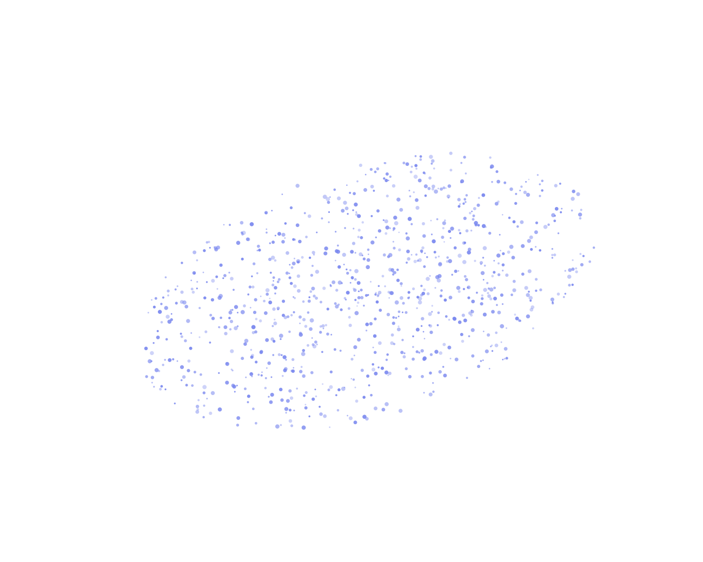
HOW IT WORKS
Watch. Decide.
Act.
01
Watch
Connects to your stack and learns the shape of the work — no rules to write.
02
Decide
Picks the next action and explains the reasoning behind it.
03
Act
Executes with a full audit trail; a human can approve or step in.
Northpeak · Series A
5
Notes:
The 'real, not magic' beat. Abstract hero — swap for a product still.

Slide 6
Traction
It's already working
$2.4M
140%
ARR, up 4× year on year
Net revenue retention
120+
8 wks
Teams live in production
Median payback for a customer
4.1M
<2%
Actions taken automatically
Monthly logo churn
Northpeak · Series A
6
Notes:
The proof. Sample startup metrics — replace with your real ones.

Slide 7
Customers say it best
Why they stay
“
FINTECH
“
MARKETPLACE
“
SAAS
Northpeak quietly does a job we were about to hire two people for.
We went live in a week and never looked back.
The audit trail is what got it past our risk team.
Devin Head of Ops
Priya COO
Marco VP Finance
Northpeak · Series A
7
Notes:
Proof in customers' voices. Fictional sample quotes.

Slide 8
Why now
The market just tipped
$48B
spent yearly on the ops work we automate
3×
Add a market or trend chart
faster tooling adoption since models got good
71%
of teams now piloting automation, up from 22%
Northpeak · Series A
8
Notes:
Why this, why now. Three market signals. Sample figures.

Slide 9
Why us
The alternatives fall short
NORTHPEAK
Northpeak
Build in-house
Legacy RPA
TIME TO VALUE
TIME TO VALUE
TIME TO VALUE
1 week
2–3 quarters
Months
EXPLAINABILITY
EXPLAINABILITY
EXPLAINABILITY
Full audit trail
You build it
Brittle scripts
SETUP
SETUP
SETUP
No rules to write
Heavy
Rule-by-rule
COVERAGE
COVERAGE
COVERAGE
Grows on its own
Only what you code
Breaks on change
Northpeak · Series A
9
Notes:
Position against the alternatives. Northpeak is the mint card.

Slide 10
The roadmap
Now, next, later
NOW
NEXT
LATER
Finance & ops workflows
Audit-trail dashboard
Self-serve onboarding
Open action API
Team approval flows
Two new verticals
Marketplace of actions
On-prem deployment
International expansion
Northpeak · Series A
10
Notes:
Where the product goes. Sequence, not exact dates.

Slide 11
Northpeak
THE ASK
Raising our Series A
to scale what's working
$12M
Go-to-market
$10M ARR
round size
primary use of funds
next milestone
Let's talk: hello@northpeak.example
Notes:
Close on the raise and what it buys. Then stop.

