Slide 1
Rocky Mountain
PRODUCT RECOMMENDATION
Project Summit
A recommendation to build
How we'd ship our next flagship — and why now is the moment.
PRODUCT STRATEGY · Q3 · V1
Notes:
Open on the recommendation framing. This is a reusable Rocky Mountain deck template; the 'Project Summit' content is sample — replace it with your own product recommendation.

Slide 2
The recommendation
Make Project Summit our flagship this year
RECOMMENDATION
WHAT WE'RE ASKING FOR
Fund a dedicated squad to build Project Summit — the capability our customers keep asking for — starting next quarter.
1 product squad
6 people, ring-fenced
2 pilot customers
Turns an existing strength into a new product line
Deepens our moat before competitors catch up
Ships on infrastructure we've already proven
design partners
Decision by end of Q3
to hit a Q4 start
Project Summit · Product Recommendation
2
Notes:
Lead with the ask — recommendation decks put the conclusion first.

Slide 3
Why now
The window is open
68%
of customers asked for this in the last quarter
3.4×
Add a customer or context photo
faster than the workaround teams use today
$1.2M
in at-risk renewals it directly addresses
Project Summit · Product Recommendation
3
Notes:
Frame the problem with numbers, not adjectives. Illustrative sample figures.

Slide 4
THE INSIGHT
We already have the hard part.
We just haven't shipped it — yet.
The core capability already lives inside the platform. Summit turns it into something customers can buy — before someone else builds it first.
Project Summit · Product Recommendation
4
Notes:
The pivot. One idea, lots of air.

Slide 5
THE PRODUCT
Project Summit
One capability, productised
Self-serve from day one
PROJECT SUMMIT · TODAY
Customers get value without a services engagement or long setup.
Priority A · Renewals
High
Insight, not just data
Priority B · Onboarding
Medium
It answers the question, instead of handing over another raw feed.
Priority C · Reporting
Low
Fits the existing workflow
It lands where the work already happens — no new tool to adopt.
Illustrative — Project Summit priority view
Project Summit · Product Recommendation
5
Notes:
What we'd build, in three capabilities. Flag the panel as illustrative.

Slide 6
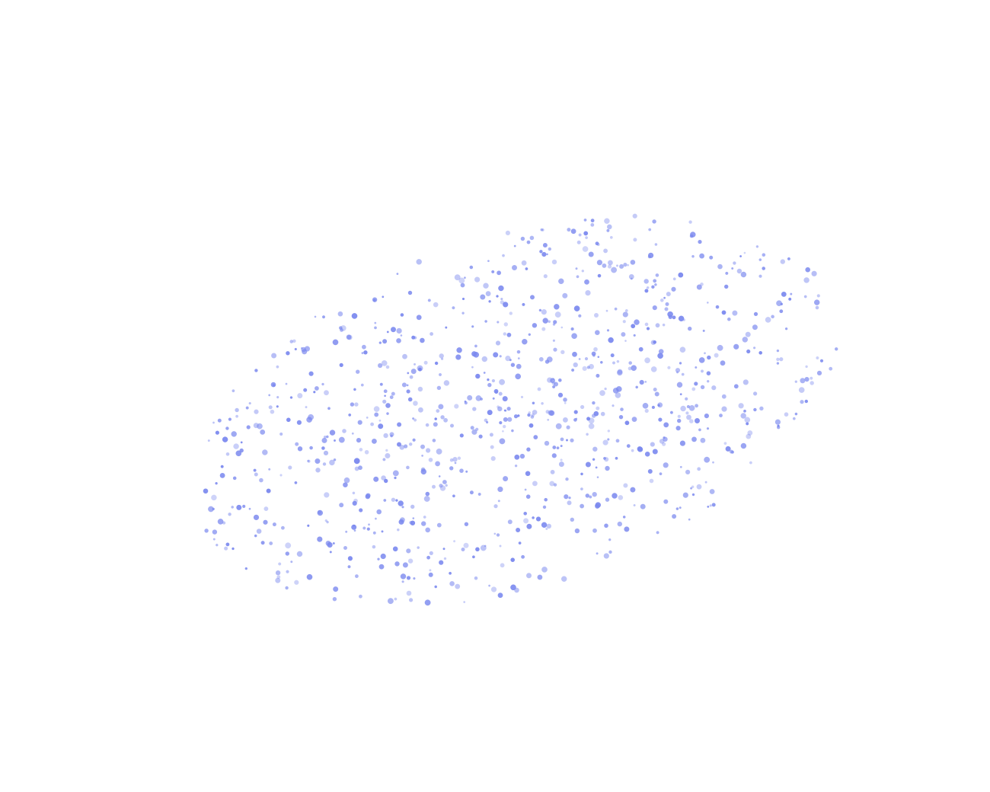
HOW IT WORKS
Built on what we
already know
01
Capture
The signal already flows through the platform — nothing new to instrument.
02
Model
We turn it into a live, structured view teams can actually read.
03
Act
Predictions and next steps, delivered where the work happens.
Project Summit · Product Recommendation
6
Notes:
The 'how it works' beat. The particle field is an abstract hero — swap for a product still if you have one.

Slide 7
Tried and tested
Proven in the pilot
40%
3.2×
Faster time-to-value
Return during the pilot
25%
10k+
Less manual work per week
Actions automated
9 / 10
2 wks
Pilot users would recommend
To first value, on average
Project Summit · Product Recommendation
7
Notes:
Credibility that it works. Sample pilot KPIs — replace with real ones.

Slide 8
What we considered
Three paths, one recommendation
RECOMMENDED
Build Project Summit now
Partner / buy
Defer a year
TIME TO VALUE
TIME TO VALUE
TIME TO VALUE
2 quarters
1–2 quarters
None yet
MOAT
MOAT
MOAT
Deepens ours
Shared / erodes
Static
COST
COST
COST
1 squad
Rev-share
Opportunity
STRATEGIC RISK
STRATEGIC RISK
STRATEGIC RISK
Low — we own it
High — dependency
High — others move
Project Summit · Product Recommendation
8
Notes:
Show the decision was considered. The recommended path is the mint card.

Slide 9
PLAN
How we'd ship it
Four steps to general availability
01
STEP 01
Foundations
Stand up the service on infrastructure we already run.
02
STEP 02
Pilot cohort
Two design partners, pre-agreed success metrics, tight tracking.
Add a team or product photo
03
STEP 03
Rollout
Expand across the base once the pilot gate is passed.
04
STEP 04
General availability
GA with a launch moment for the wider market.
Project Summit · Product Recommendation
9
Notes:
Four steps, with a real gate at the pilot (step 2).

Slide 10
Don't just take it from us
What pilot users say
“
PILOT A
“
PILOT B
“
DESIGN PARTNER
It's the first thing my team opens in the morning now.
It cut a two-hour job down to about ten minutes.
I finally trust the numbers I'm reporting upward.
Alex Team Lead
Sam Operations
Riley Analytics
Project Summit · Product Recommendation
10
Notes:
Proof in users' own voices. Fictional sample quotes.

Slide 11
Risks we're watching
And how we de-risk them
RISK
MITIGATION
Users don't adopt it
Guided onboarding + a design-partner feedback loop from day one.
The pilot underdelivers
Pre-agreed metrics and a kill/scale gate at 90 days.
Scope creeps past GA
One capability, GA-scoped; everything else is explicitly v2.
Squad gets pulled away
Ring-fenced squad; no shared-roadmap dependencies.
Project Summit · Product Recommendation
11
Notes:
Name the real risks and specific mitigations. The kill/scale gate caps the downside.

Slide 12
Rocky Mountain
RECOMMENDATION
Approve Project Summit
for this year
1 squad
2 partners
End of Q3
dedicated, 6 people
pilot design partners
decision requested by
Decision requested: end of Q3
Notes:
Close by mirroring the cover and restating the ask in one breath.

