Slide 1

INM 707 - Deep Reinforcement Learning
Oral presentation
Shared work:
Solving “Frozen Lake” and “Lunar Lander” with Q-Learning and Deep Q-Learning
Individual task:
Solving Atari Freeway with a Double DQN using RLlib
Alessandro Alviani
alessandro.alviani@city.ac.uk
Dimitrios Megkos
dimitrios.megkos@city.ac.uk
School of Mathematics, Computer Science and Engineering
City, University of London

Slide 2
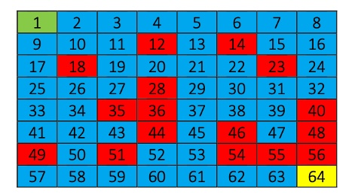
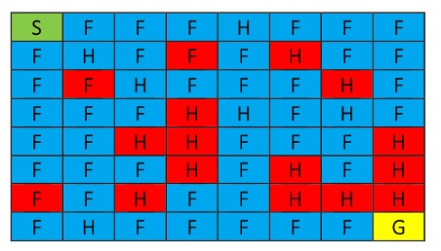
Environment
Custom 8x8 grid world, inspired by OpenAI Gym and FrozenLake.
Agent begins always from state 1, tries to find the exit which is always state 64.
There are 17 fixed holes, agent receives negative reward and begins again from starting state.
Rest of the path is frozen, adding extra functionality to the environment.
4 available actions: Up, Down, Left, Right.
Green is starting state, yellow is goal state, red is hole state, blue is frozen path state.
Part 1: Q-Learning
1/17

Slide 3
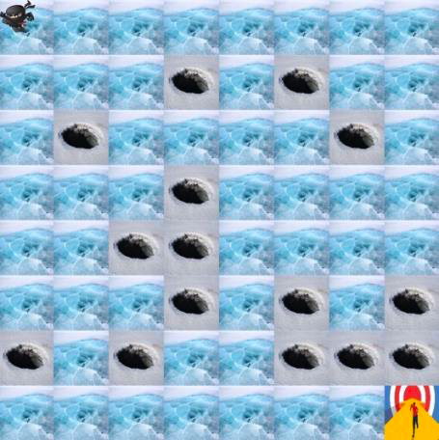
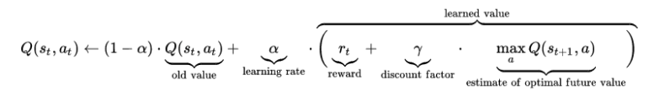
Problem to solve
Reward matrix: stores a reward for each state-action (64 X 4).
Q-matrix: same shape as R-matrix. Initially filled in with zeros.
Problem to solve: learning an optimal Q-matrix.
Method: Q-learning.
Mathematical approach: Bellman’s equation.
Part 1: Q-Learning
2/17

Slide 4
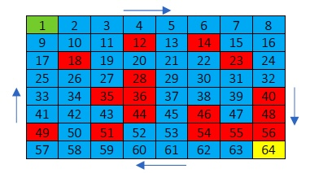

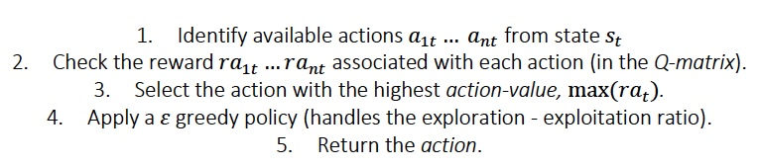
State transition function
Definition: the state transition function defines the next state (s_{t+1}) of an agent taking an action (a_{t}) from a state (s_{t}).
State transition function: in a Markov Decision Process (MDP) it is defined by:
Implementation: in our problem this is implemented in the following way:
Part 1: Q-Learning
3/17

Slide 5

Reward function
In a Markov Decision Process the reward function defines the immediate reward for taking an action a_{t} from state s_{t:}
Information stored in the 64x4 R matrix, contains all rewards for all actions from all states.
Falling into a hole (-10), reaching the goal (+10), moving to a frozen tile (-0.5).
Frozen tile reward pushes the agent into finding the shortest path.
The walls of the grid world are represented with np.nan reward, no available action for the agent at that state.
Part 1: Q-Learning
4/17

Slide 6

Learning rate (𝝰) and discount rate (ɣ)
Learning rate (𝝰) : how fast the model learns about the environment (e.g., the new learning changes the past one).
𝝰 = 0: no weight to the new learning.
𝝰 = 1: new learning overrides the previous one.
Discount rate (ɣ) : controls the weight assigned to future rewards.
ɣ = 0: no weight assigned to future rewards (policy of instant gratification).
ɣ = 1: future reward is valued as much as the present one (long term-high reward policy).
Learning rate (𝝰) and discount rate (ɣ) are the key parameters to control the Q-learning updates:
Part 1: Q-Learning
5/17

Slide 7
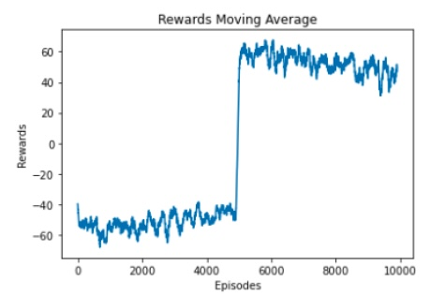
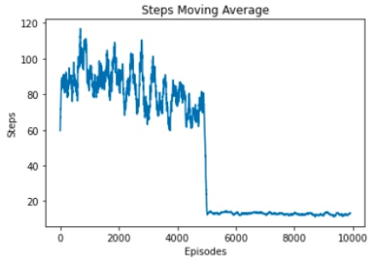
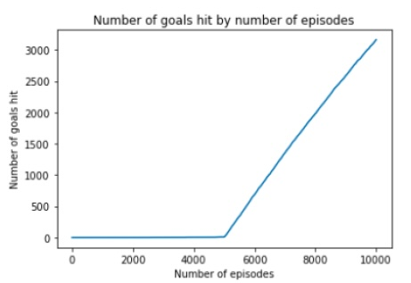
𝜺-greedy Policy
Policy tells the agent which action to take at each state.
Goal is to find the optimal policy that maximizes the rewards, leading to the shortest path.
ε-greedy policy: agent first explores the environment and then exploits the information gathered to find the shortest path.
Agent explores for the first 5000 episodes, low rewards and high number of steps.
Agent exploits for the rest 5000 episodes, high rewards and low number of steps.
Part 1: Q-Learning
6/17

Slide 8
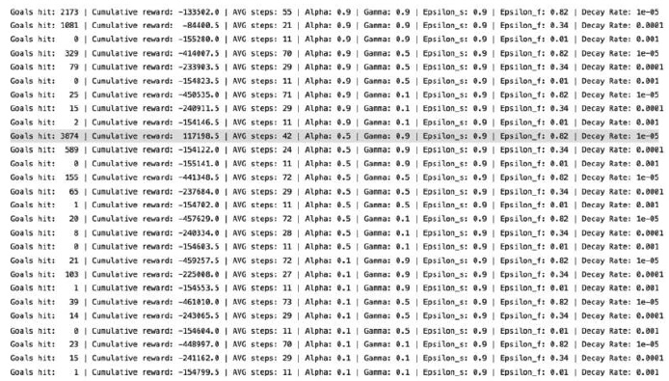
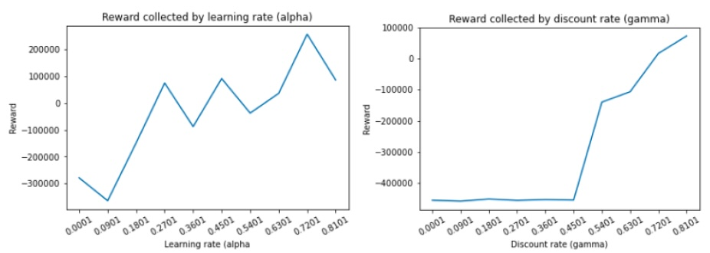
Conclusions
Final parameters selection: performed through a grid search.
Model’s hyperparameters: large values of 𝝰, ɣ and 𝜺 , indicating a model that needs to be “pushed” to explore.
Model’s behavior: the agent progressively learns the grid until it hits the goal and starts exploiting.
Grid-size: larger grid-worlds further challenge the models.
Q-learning limitations: growing environment’s sizes put this model under stress.
Part 1: Q-Learning
7/17

Slide 9
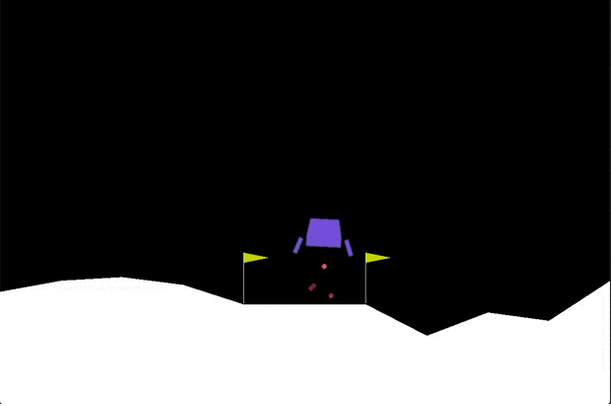
Environment
Environment: OpenAI Gym Lunar Lander V2 [2].
Complexity: Medium.
Choice: already solved in literature [3][4].
Actions: Main engine, left engine, right engine, no engine.
Goal: Smooth landing between the flags.
Rewards (points):
Landing: 100 – 200, depending on speed and position.
Ground contact: 10
Firing engine: - 0.3 (each frame).
Crashing: - 100
[2] https://gym.openai.com/envs/LunarLander-v2/
[3] S. Gadgil, Y. Xin and C. Xu, "Solving The Lunar Lander Problem under Uncertainty using Reinforcement Learning," 2020 SoutheastCon, 2020, pp. 1-8, doi: 10.1109/SoutheastCon44009.2020.9368267.
[4] Volodymyr Mnih et al., “Playing Atari with Deep Reinforcement Learning”, https://doi.org/10.48550/arXiv.1312.5602
Part 2: Deep Q-Learning
8/17

Slide 10
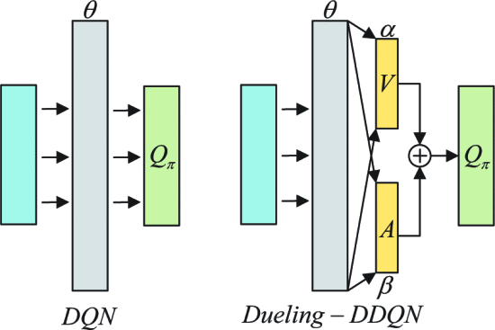
Implementation and Improvements
Compared vanilla DQN with two improvements chosen based on literature review.
Double DQN: Uses two NNs (Policy and Target) instead of one NN for value estimation.
Implemented by creating two instances of the NN Class.
Dueling DQN: Splits Q-Value into the state value function V (the value of being in a state) and the advantage function A (the advantage of taking an action from that state).
Implemented by using two different streams inside the NN.
Part 2: Deep Q-Learning
9/17

Slide 11
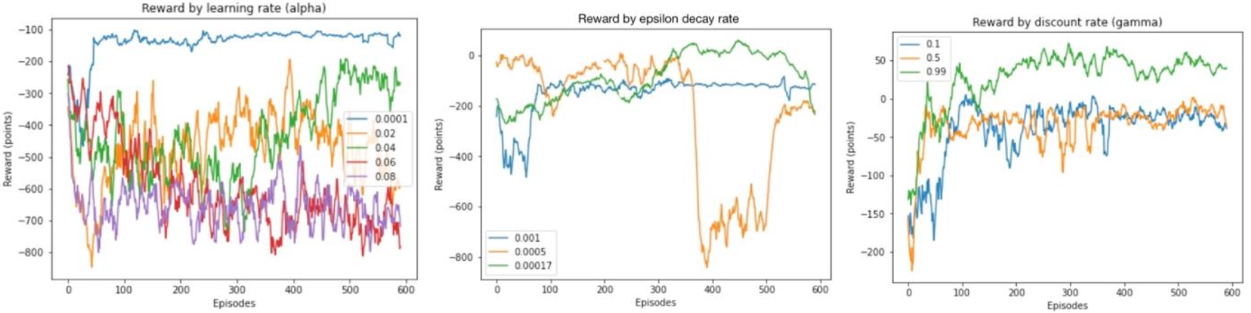
Implementation Results
Double DQN had the most impact on agent’s performance.
Combining the two improvements increased the performance slightly.
Part 2: Deep Q-Learning
10/17

Slide 12
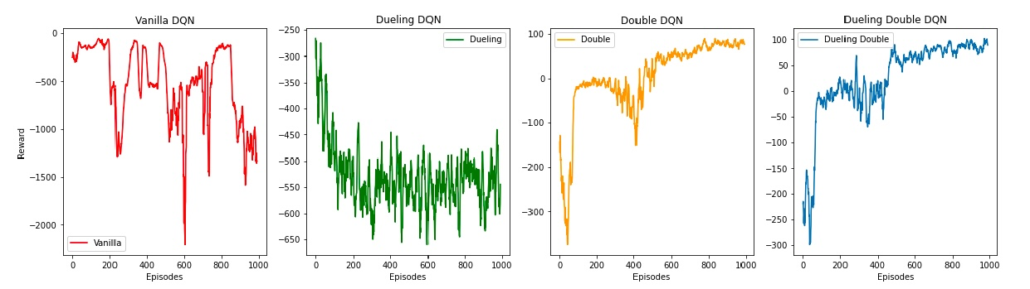
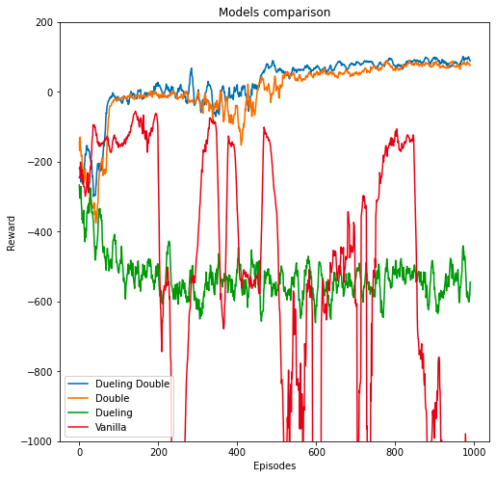
Performance comparison
Vanilla: High variance (e.g., high instability). The model is very challenged, and struggles to find a good policy [5].
Dueling DQN: Dummy implementation. The dueling layer results in a more stable model, yet ineffective.
Double DQN: Dramatic improvement. The addition of the second network results in an efficient optimization.
Double Dueling DQN: Further improvement. The addition of the dueling layer leads to the best performance [6].
[5] Hado Van Hassel, Arthur Guez, David Silver, “Deep Reinforcement Learning With Double Q-Learning”, arXiv:1509.06461v1 [cs.LG] 22 Sep 2015.
[6] Ziyu Wang, et al., “Dueling Network Architectures for Deep Reinforcement Learning”, arXiv:1511.06581, 2015.
Part 2: Deep Q-Learning
11/17

Slide 13

Individual Task – Atari Learning Environment
Activision’s Atari Freeway game
One player (the agent) controls a chicken
The goal is to make the chicken cross the road safely, without getting hit by a car
The agent receives a reward of 1 each time the chicken successfully crosses the road
If hit by a car, moved back to the beginning and loses 1 life
Part 3: Individual Task
12/17

Slide 14
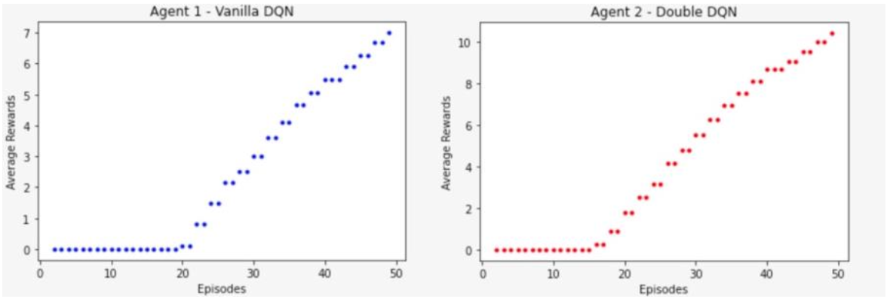
Vanilla DQN vs Double DQN
Activision’s Atari Freeway game
Rllib was used, a Reinforcement Learning environment that includes a variety of algorithms
Compared algorithms by training them for 50 episodes using same NN architectures
Double DQN returned better results and was selected for solving this problem
Part 3: Individual Task
13/17

Slide 15
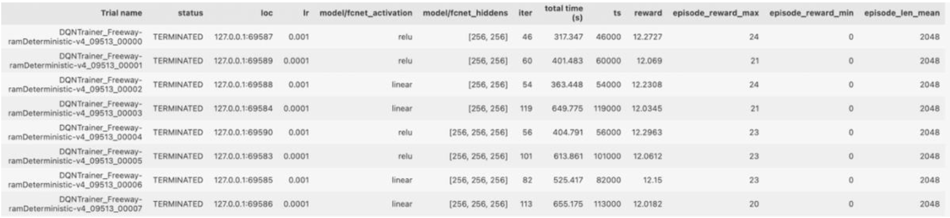
Ray Tune Grid Search
ActiVision’s Atari Freeway game
Rllib was used, a Reinforcement Learning environment that includes a variety of algorithms
Built-in Grid Search, tested different values for learning rate, number of hidden layers, number of hidden neurons, and type of activation function
Part 3: Individual Task
14/17

Slide 16
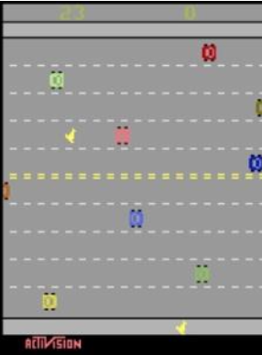
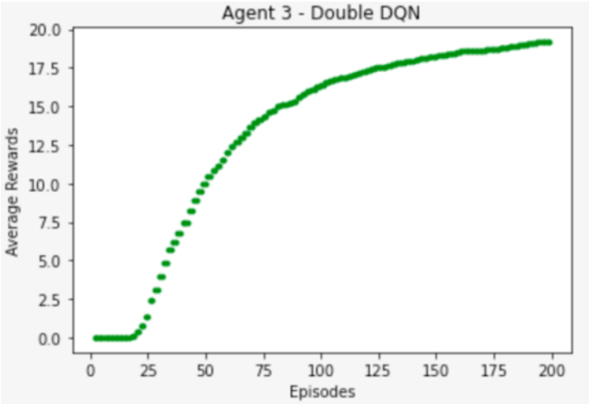
Final Training and Results
ActiVision’s Atari Freeway game
Final training for 200 episodes using best GS results
Achieved average reward of 20 per episode, very close to human level
Part 3: Individual Task
15/17

Slide 17
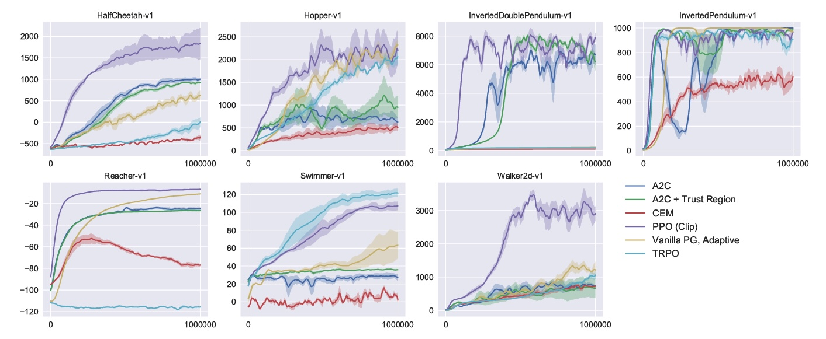
PPO - Introduction
Proximal Policy Optimization (PPO): new class of policy gradient reinforcement learning (RL) algorithms.
Advantages: performance equal or better than state-of-the-art RL algorithms but simpler and faster to implement.
Idea: sampling data through interaction with the environment and optimizing a clipped surrogate objective function using stochastic gradient ascent.
John Schulman et al., “Proximal Policy Optimization Algorithms”, arXiv:1707.06347v2 [cs.LG] 28 Aug 2017
Part 4: Extra Task
16/17

Slide 18
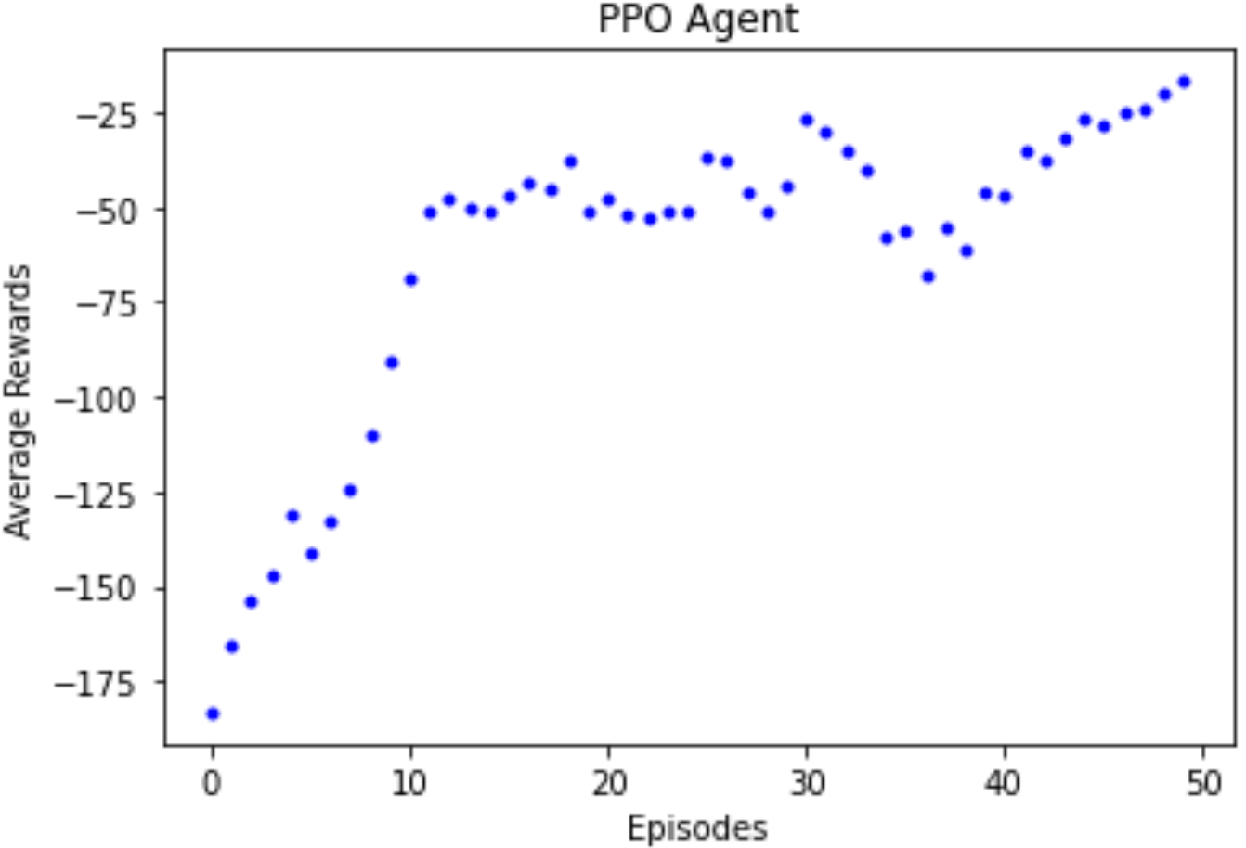
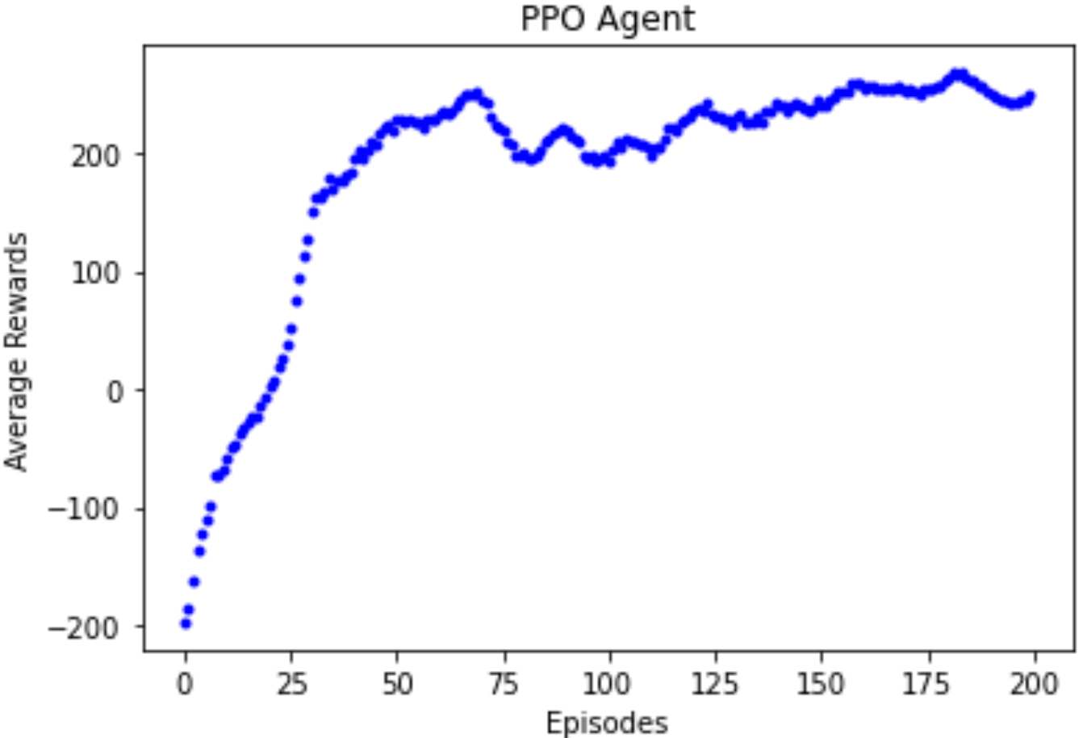
PPO – Implementation and Results
PPO outperformed Dueling Double DQN used in advanced task.
Initial tests with learning rate = 0.001, two hidden layers with 32 neurons and linear activation function.
Increased episodes to 200, doubled the number of hidden neurons, decreased the learning rate, and changed activation function to ReLU.
Part 4: Extra Task
17/17

