Slide 1
Project Luther
Dara Elass
September 19th, 2014

Slide 2


The Client
Goal:
Opening Weekend Domestic Gross
Notes:
My client is a movie studio that makes action movies.

Slide 3
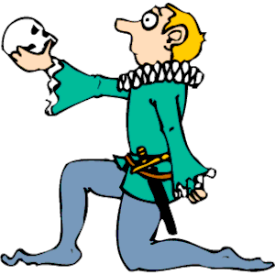


The Factors
Top 3 Actors
Director
Budget
Notes:
My client, the action movie studio, would like to know how well their movie will do opening weekend given its budget, top 3 actors and director.
When referring to director and top 3 actors in the future, I am speaking about the average success of previous movies they have worked on.

Slide 4
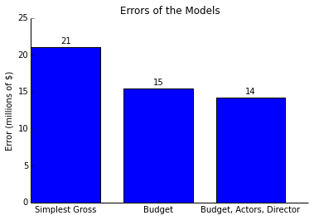
Errors of Models
Notes:
If I only looked at how well movies did opening weekend, I’d be able to predict the success at ±$42m. If I add budget as a factor, then I lower that range to $±30m. If I then also add the top 3 actors and director to the model, my error goes down to $±28m.

Slide 5
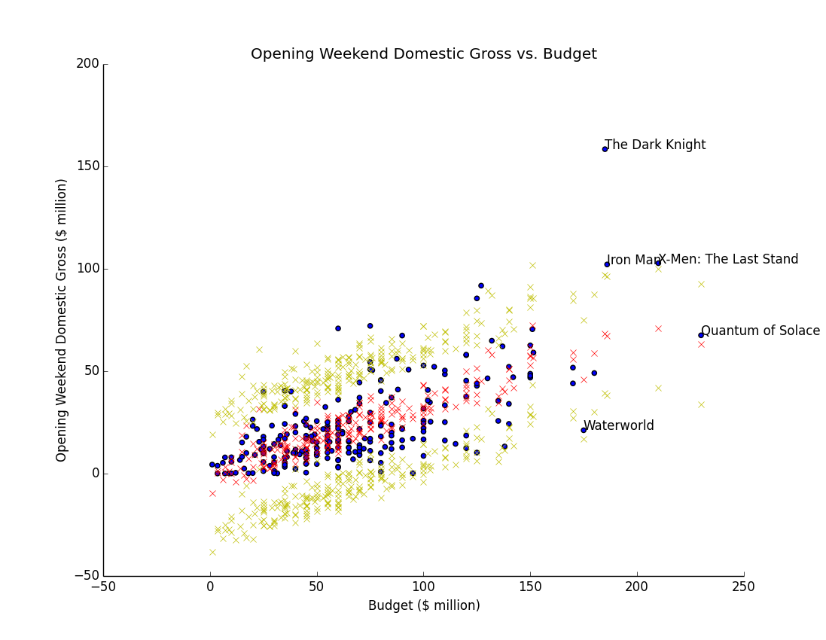
Results: Budget
Notes:
Blue dots represent the actual data I used to build the model. Red x’s represent predictions, and yellow x’s represent my margin of error (the range I’d expect predictions to fall in 95% of the time).
Some movies did exceptionally well given their budget (The Dark Knight, Iron Man).

Slide 6
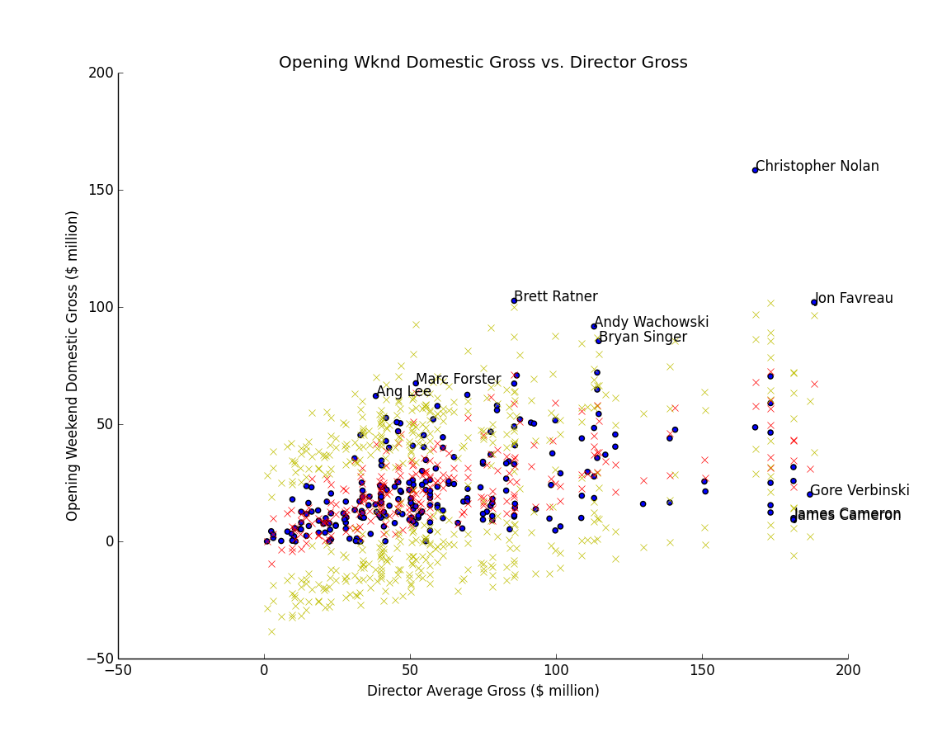
Results: Director Gross (Director)
Notes:
Blue dots represent the actual data I used to build the model. Red x’s represent predictions, and yellow x’s represent my margin of error (the range I’d expect predictions to fall in 95% of the time).
Looking at the data through the lens of the success of the director, we can see that the movies more or less fall into the expected range, but some are exceptional. Christopher Nolan did really well in this case. It is interesting to see two James Cameron movies at the lower end of the range – these were two horror movies produced in the 80s.

Slide 7
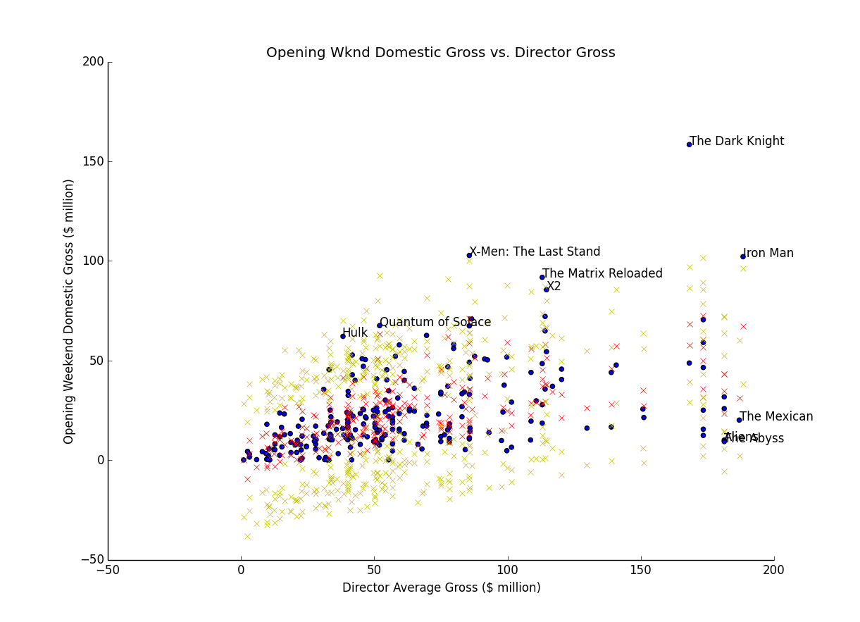
Results: Director Gross (Movie)
Notes:
This is the exact same graph as the previous slide but with movie names instead of the directors.

Slide 8
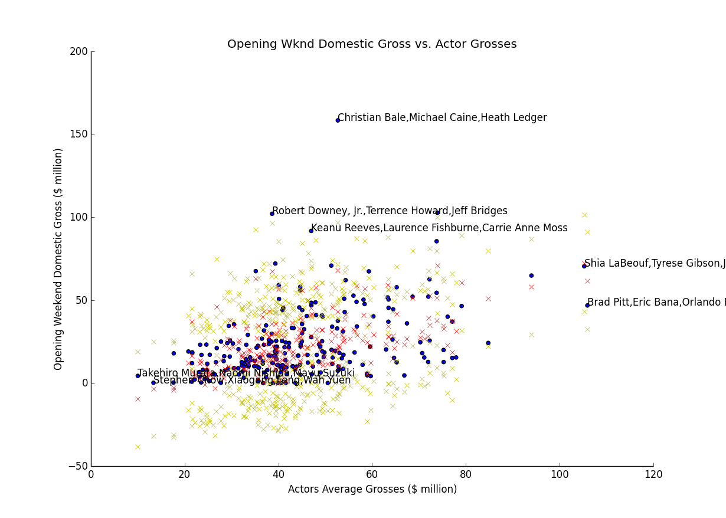
Results: Actor Grosses (Actors)
Notes:
Blue dots represent the actual data I used to build the model. Red x’s represent predictions, and yellow x’s represent my margin of error (the range I’d expect predictions to fall in 95% of the time).
This graph looks at the data with regards to their top three actors. Here some movies were beyond outside our prediction – movies with Christian Bale and Robert Downey Jr (Dark Knight and Iron Man).

Slide 9
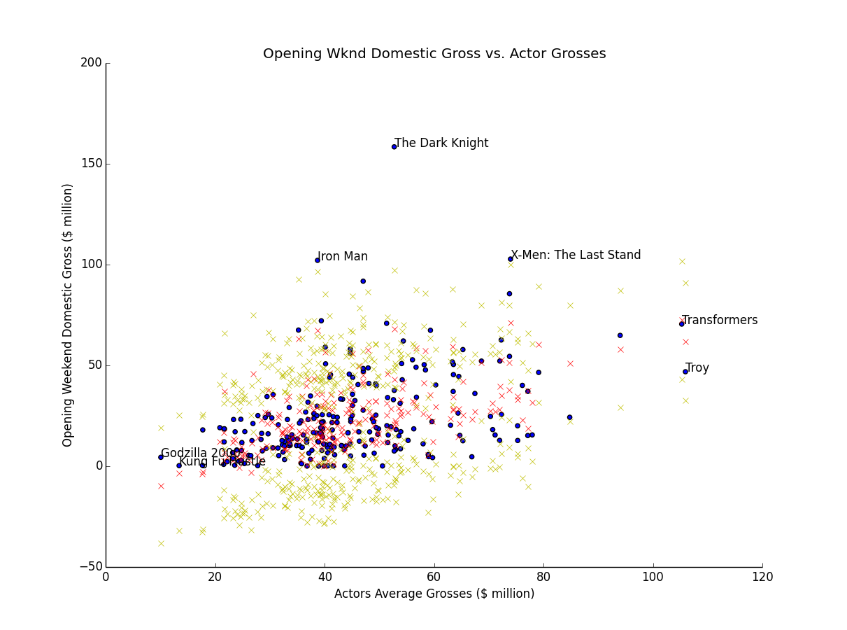
Results: Actor Grosses (Movie)
Notes:
This is the same graph as the previous slide but with movie names instead of actors.

Slide 10
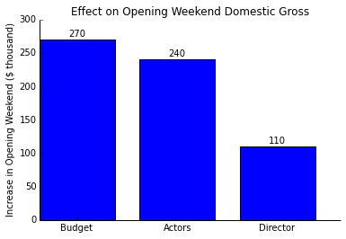
Effects of Factors
Notes:
Every $1m increase in budget results in $270k increase in opening weekend gross. Every $1m increase in past success of the top three actors, we can expect a $240k increase in the opening weekend gross. Finally, every $1m increase in the past success of a director can be expected to result in a $110k increase in opening weekend gross. This tells us that if a movie studio is deciding between a previously successful director and previously successful actors, they should perhaps put more weight in their decision on the actors than the director.

