Slide 1


Big Data for Dashboards and Scorecards

Slide 2
Mark Gamble, Ed Yu – Actuate David Inbar - Pervasive

Slide 3
Agenda
What is big data and why is it important?
Case Study – Telco Company
Telco Case Study Demo - themes: “Discover, Analyze, Improve”
BIRT 360 + Analytic Dashboard – “Discover/Analyze”
BIRT 360 + Map / Scorecard Briefing Book – “Improve”
Challenges Faced building the demo – “What did it take to achieve the application?”
Challenge one: access and prepare Big Data for analysis
Pervasive RushAnalyzer
Challenge two: visualize the Big Data
BIRT Visualizations, BIRT 360
Challenge three: measure and monitor the Big Data
BIRT Performance Analytics
Challenge four: Predict from Big Data
Predictions via Pervasive – “Look Ahead”

Slide 4
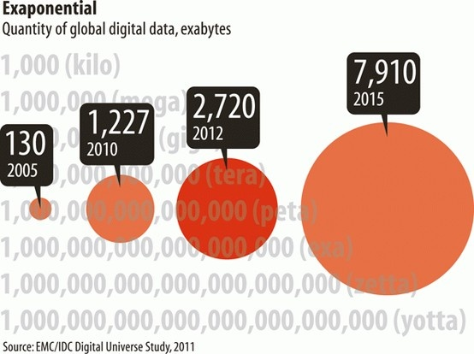
How Big is “Big”?
“Big Data” represents the most significant business and IT trend in years, and probably the biggest opportunity for major new Database, ETL and Analytics players and products to emerge since the arrival of the RDBMS in the early 1980s

Slide 5
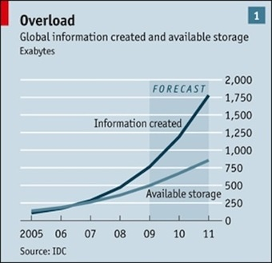
How Big? 800,000 Petabytes last Year!

Slide 6
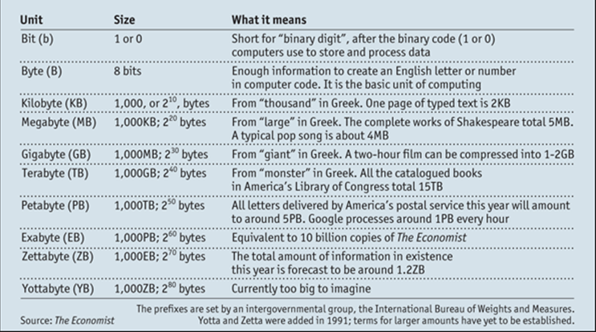
Data Inflation

Slide 7
Where is all this Big Data coming from?

Slide 8
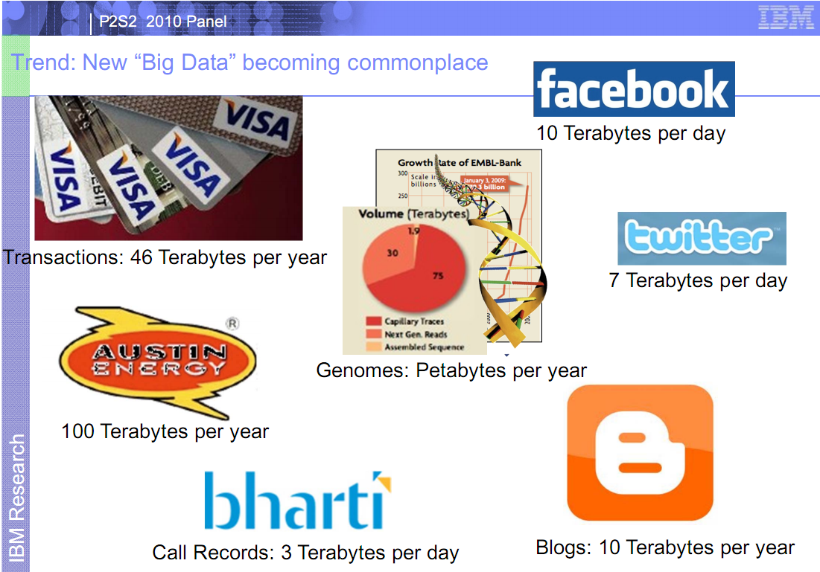
The Internet is a Driver

Slide 9
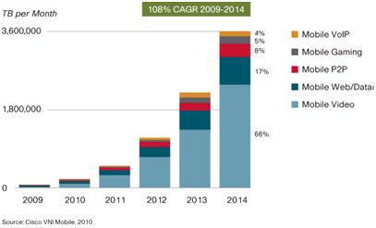
Mobile Data is a Driver

Slide 10
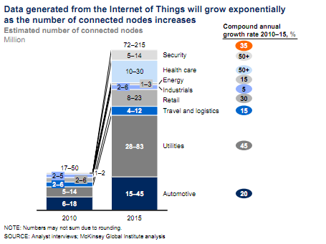
Connections: The Internet of Things

Slide 11

The Sensor Avalanche
As we transition from an analog past to a digital future by instrumenting the world with tens of billions of sensors, each sensor recording digital data events at ever-increasing frequency and granularity, data volumes will be machine-generated and captured on a scale so vast that it dwarfs all prior experience, and will simply overwhelm existing legacy software stacks
Notes:
Smartgrids example
Jet engine example
Imagine a modern enterprise: 500+ network devices, each generating 100,000+ digital data events per second, amounting to tens of millions of EPS (Events per Second). What existing Data Warehouse can handle that scale? How will threats be detected and avoided?
Entire new software stacks will have to be built to fully and efficiently exploit modern patterns of parallelism (Multicore for scale-up and Hadoop-like commodity clusters for scale-out) in order to efficiently and economically scale for these back-breaking data volumes

Slide 12
What to do with all this
Big Data?

Slide 13
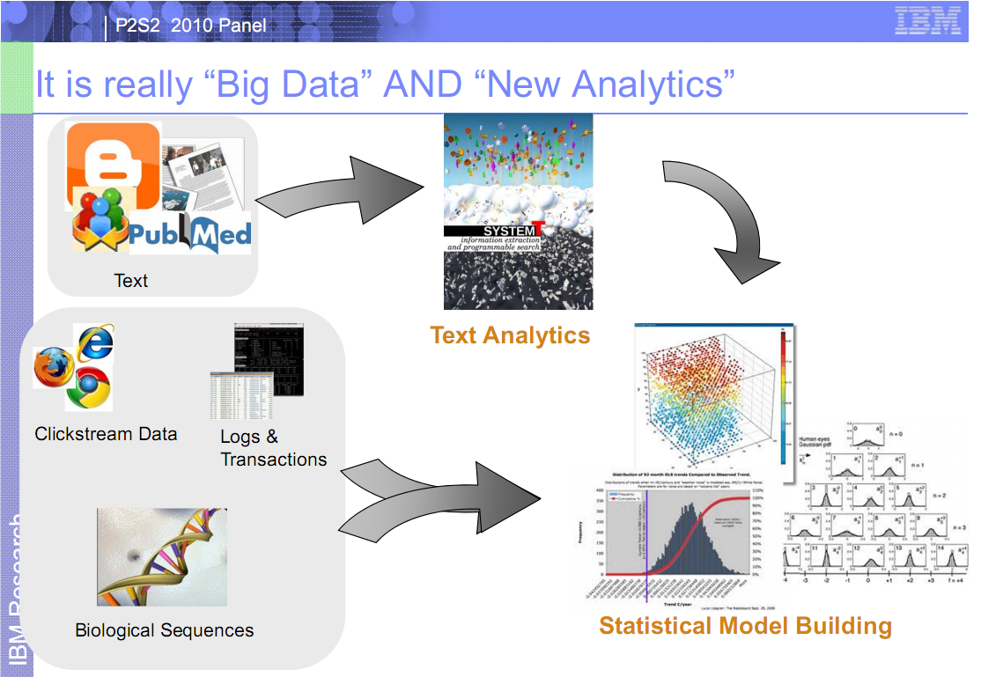
Analyze it!
Understanding Prediction Control Outcomes

Slide 14
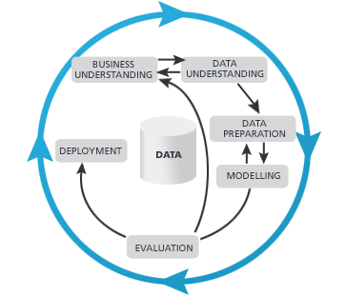
Understanding Prediction Control Outcomes
The Data Analytics Cycle
Data intensive
The 3 V’s
Compute intensive
The 4th V
Multi-variate algorithms
Data science
Bayesian functions?
Support vector machines?

Slide 15
Telco Case Study

Slide 16
Telecom Operational Analytics
Company
Commercial/Residential Communications Service Provider (CSP)
Planned growth with minimal staff impact
IT Group
Collects, manages, processes CDR, application server logs, and other data
Knowledge agent
Not data scientists, but are domain experts
Swamped with data
Network switches dump CDR’s every 5 minutes
Hundreds of thousands of records per drop; 170 columns each

Slide 17

Telecom Provider Challenges
Customer Experience
Capacity Optimization
Network Performance
Network OPS
Corporate
Operational Performance
Profitability Analysis
Customer Care
Churn
Segment Insights
Usage Trends
Off-net Usage
OSS/BSS Data
Sales/Marketing
Switches /
Network Elements
Vendor Performance
Pricing optimization
Product/Service Offers
Information Technology
Continuously Integrate
Problem Solving

Slide 18
Business Issues - Summary
Time to decision is critical
Missed opportunities; wasted resources
Customer issue reaction is too slow
Deeper granularity of data is critical
Understanding of trends is needed
Pricing optimization
Vendor performance
Cost of solution is critical
Limited budget
Notes:
In summary of the business issues: time to decision is critical. They need to move their time to decision from days to minutes. Opportunities for routing optimization are being missed. Network issues leading to multiple customer service calls are discovered late leading to wasted effort. These are just a few examples of how cutting down decision time can both make and save money.
Lower data granularity is critical to have the right information to find trends in

Slide 19
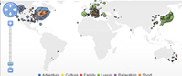
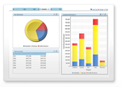
Solution
RushAnalytics
ActuateOne
BIRT
Extraction
Cleansing
Enrichment
Aggregation
Analysis
Mining
Alerting
OSS/BSS Data
Off-net Usage
BIRT 360 Analytics
For Desktop and Mobile Devices
Switches /
Network Elements
Data warehouse

Slide 20
CDR Analysis – jargon and acronyms
Answer Service Rate (ASR)
Calls completed versus attempts
Also computed per connection attempts made per vendor
Post Dial Delay (PDD)
Annoying delay until path through n/w selected
Opportunity Monitor
Opportunity cost for of vendor routing
Trends of these three and correlations
Quality Measures (call duration, jitter, …)

Slide 21
Telco Case Study Demo
DEMO

Slide 22
Results
Performance
Recurring CDR processing running in seconds
Including increased data analysis
Leaves head room for much larger data volumes
Data granularity increased to ingress/egress trunk groups and NPA/NXX level
In near-real time
Capturing data for trend analysis
Enabling predictive analytics
Scalable to multi-node
Scalable to growing data sizes

Slide 23
Results
Business Side
Decision time from days to minutes
Deeper understanding of operational issues
Which situations are problematic (or not)
Vendor knowledge increased
Price optimization for cost containment
Considering a vendor portal
Problem resolution more proactive
Understand issues before customers call
Re-routing around problematic n/w issues
Open to data mining of historical data

Slide 24
What did it take to achieve the Telco application?
CHALLENGE 1 – access and prepare big data for analysis
Solution: Pervasive RushAnalyzer
Pervasive RushAnalyzer
DEMO

Slide 25
What did it take to achieve the Telco application?
CHALLENGE 2 – visualize the Big Data
Solution: Actuate BIRT Designer
Drag-n-drop content development
WYSIWYG design
Powerful scripting capabilities
Solution: Actuate BIRT 360
BIRT Dashboard application
Leverages BIRT
Powerful scripting capabilities
Actuate BIRT 360
DEMO

Slide 26
What did it take to achieve the Telco application?
CHALLENGE 3 – measure and monitor the Big Data
Solution: Actuate BIRT 360+
Actuate BIRT 360+
DEMO

Slide 27
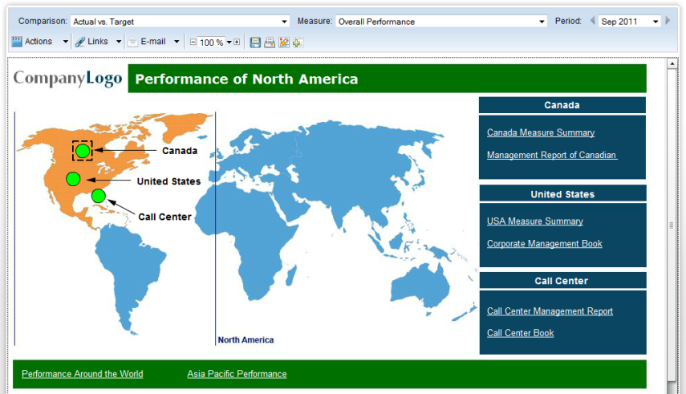
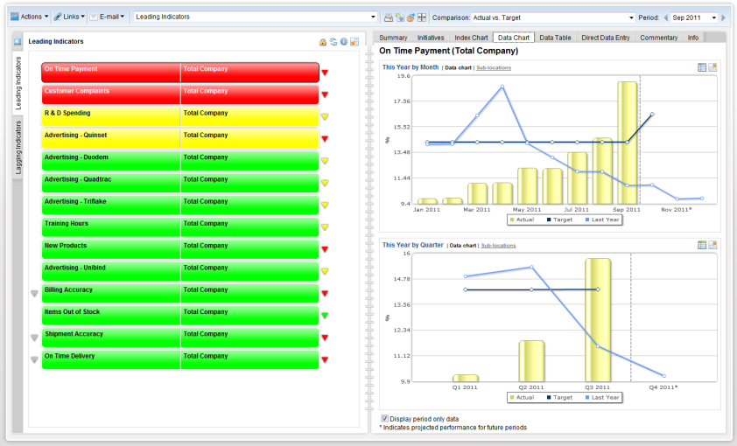
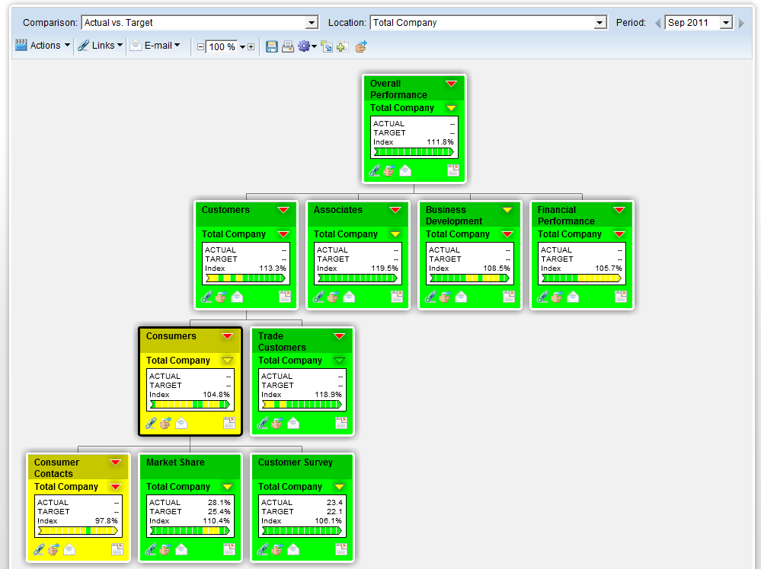
Calculation Engine
XML
Relational
Hadoop
Repository
Calculation Engine
Notes:
Performs multi-dimensional calculations based on business rules
Produces indexed performance results consolidated across time, variance and performance colors.
Results used in core OOTB visualizations and can be used for BIRT visualizations.

Slide 28
What did it take to achieve the Telco application?
CHALLENGE 4 – Predict from Big Data
Solution: Pervasive RushAnalyzer
Pervasive RushAnalyzer
DEMO

Slide 29
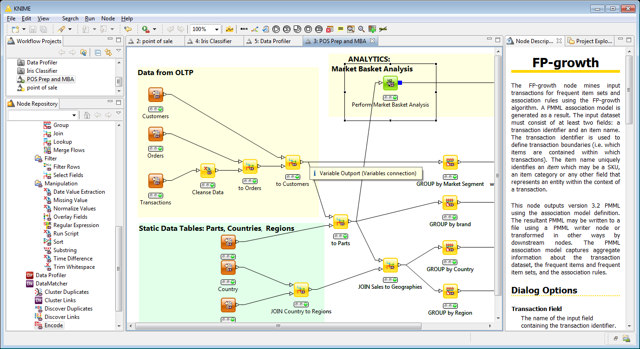
Pervasive RushAnalytics
MapReduce
Code
Visual + developer platform for Big Data Analytics and Preparation, with Dynamic Scaling
Quickly cleanse, profile and aggregate big data
Use data mining, predictive analytics, machine learning to uncover actionable intelligence
Works with flat files, relation databases, NoSQL databases, and HDFS
High performance, scales up to terabytes of data
Design on your desktop using simple drag-and-drop interface
Execute on desktop, remote server, or clusters --including Hadoop clusters

Slide 30
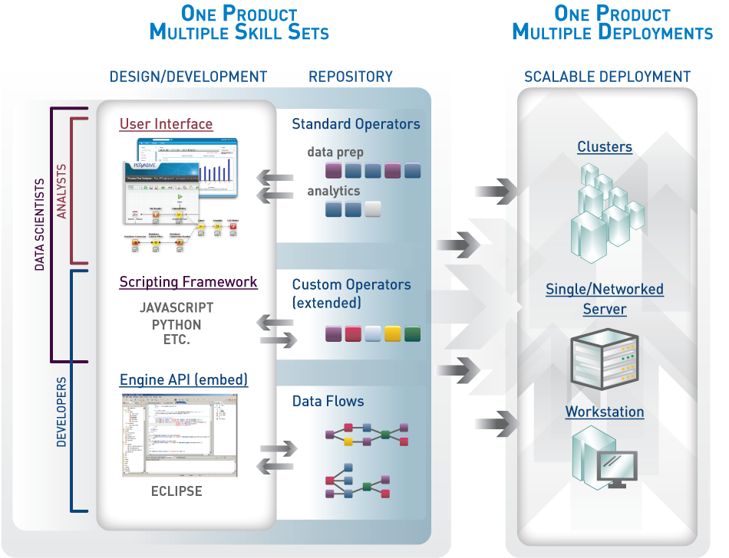
RushAnalytics: Big Data for Analytic Teams
MapReduce
Code

Slide 31
Resources
Software download links
Pervasive
Project repository
Pervasive Big Data & Analytics
www.pervasivebigdata.com
Design and Runtime Performance (3 minute demo)
http://youtu.be/ZQaROlWFXh4
Performance Metrics
http://bigdata.pervasive.com/Resources/Performance-Metrics.aspx

Slide 32
Resources
Software download links
Actuate
www.BIRT-Exchange.com
Download BIRT Designer Pro
Download BIRT 360 +
Download BIRT iServer
Download sample code and designs from DevShare

Slide 33
Questions?

