Slide 1
Innovative Marketing Techniques in the Digital Age
Harnessing New Technologies to Transform Engagement

Slide 2

Introduction
Brief introduction to the current digital marketing landscape
Importance of innovation in staying ahead of the competition
Overview of the presentation structure

Slide 3

The Shift in Consumer Behavior
Statistics and trends showing changes in consumer digital behavior (e.g., increased mobile usage, video consumption)
Impact of these changes on marketing strategies

Slide 4
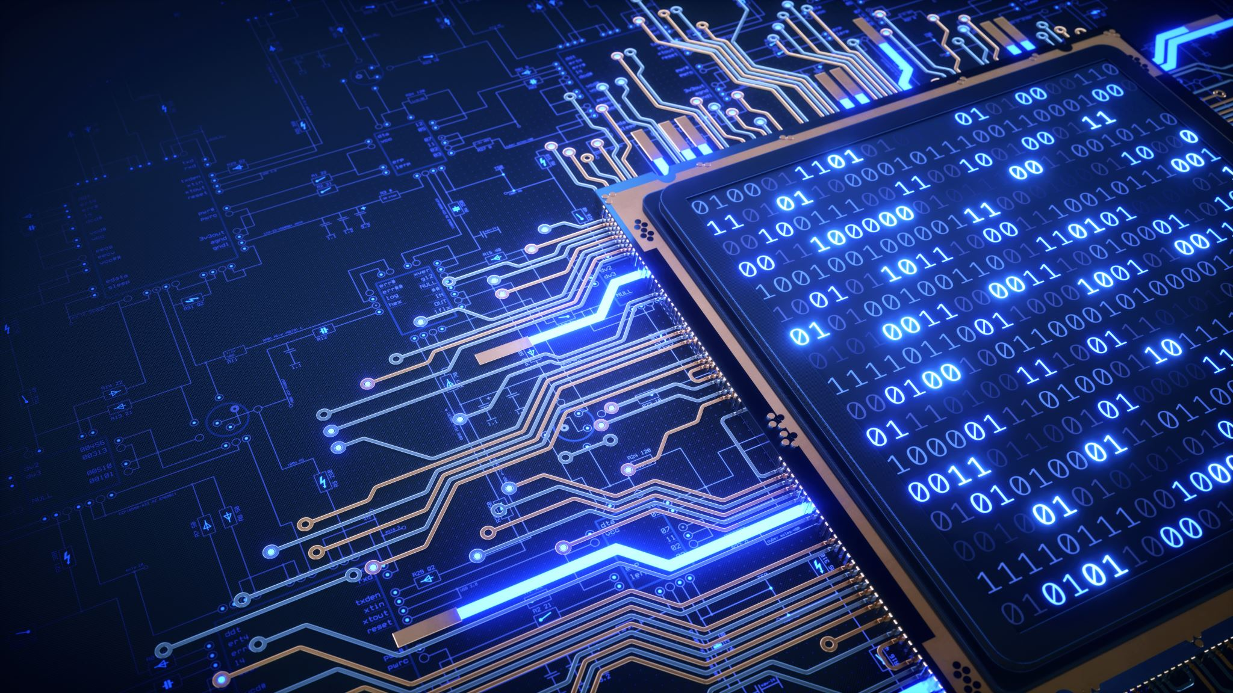
Overview of Emerging Marketing Technologies
Brief introduction to new technologies reshaping marketing:
Artificial Intelligence (AI)
Augmented Reality (AR) and Virtual Reality (VR)
Internet of Things (IoT)
Blockchain for transparency and security

Slide 5

Artificial Intelligence in Marketing
How AI is used for personalized marketing campaigns
Case studies of AI-driven results (e.g., chatbots, predictive analytics)

Slide 6

Leveraging Augmented and Virtual Reality
Examples of AR/VR in immersive marketing experiences
Case study of a successful AR campaign

Slide 7
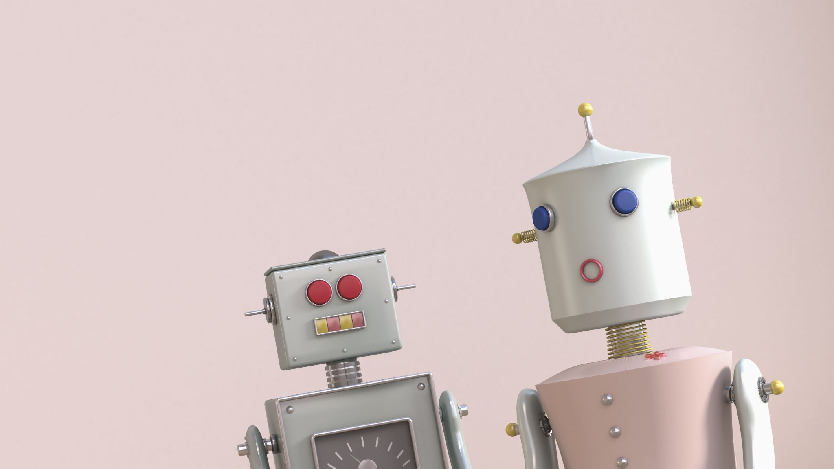
The Role of IoT in Marketing
Explaining IoT’s role in enhancing customer experiences through smart devices
Example of IoT-driven personalized advertising

Slide 8

Blockchain for Marketing
How blockchain enhances transparency in marketing campaigns
Benefits of blockchain for customer trust and data security

Slide 9

Conclusion
Recap of the key points covered
The future of marketing in the digital era

