Slide 1

TC2008B Modelación de Sistemas Multiagentes con Gráficos
Alan Flores Saldivar
Escuela de Ingeniería y Ciencias Departamento de Ciencias de la Computación
alan.flores_s@tec.mx
MODELADO DE AGENTES

Slide 2
AgentPy Framework
AgentPy es una biblioteca de código abierto para el desarrollo y análisis de modelos basados en agentes en Python. Este framework integra las tareas de
diseño de modelos, simulaciones interactivas, experimentos numéricos, y análisis de datos dentro de un único entorno.

Slide 3
AgentPy Framework
AgentPy es una biblioteca de código abierto para el desarrollo y análisis de modelos basados en agentes en Python. Este framework integra las tareas de
diseño de modelos, simulaciones interactivas, experimentos numéricos, y análisis de datos dentro de un único entorno.
El paquete está optimizado para la computación interactiva con:
IPython
IPySimulate
y Jupyter.

Slide 4
Agent-based models: class Model
class Model(parameters=None, _run_id=None, **kwargs)
parameters: Dictionary of the model’s parameters. Automatically defined:
steps (int, optional): Defines the maximum number of time-steps. If none is passed, there will be no step limit.
seed (int, optional): Used to initiate the model’s random number generators. If none is passed, a random seed will be generated.
**kwargs – Will be forwarded to Model.setup().

Slide 5
Agent-based models: class Model
class Model(parameters=None, _run_id=None, **kwargs)
parameters: Dictionary of the model’s parameters. Automatically defined:
steps (int, optional): Defines the maximum number of time-steps. If none is passed, there will be no step limit.
seed (int, optional): Used to initiate the model’s random number generators. If none is passed, a random seed will be generated.
**kwargs – Will be forwarded to Model.setup().
Attributes:
p – The model’s parameters.
t – Current time-step of the model.
random, nprandom – Random number generators (Numpy).
reporters – The model’s documented reporters.

Slide 6
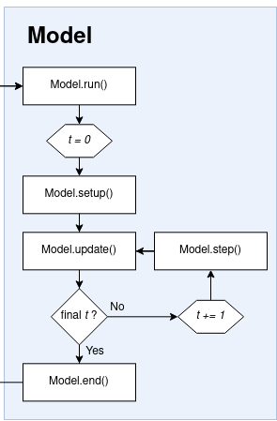
Agent-based models: class Model
Methods:
run(): Executes simulation
setup(): Initialize values and attributes
step(): Called to execute each simulation step (excluding t==0).
update(): Called after each simulation step (including t==0).
end(): Defines the model’s actions after the last simulation step.
stop(): Stops Model.run() during an active simulation.

Slide 7
Agent-based models: class Agent
class Agent(model, *args, **kwargs)
model – The model instance.
**kwargs – Will be forwarded to Agent.setup().

Slide 8
Agent-based models: class Agent
class Agent(model, *args, **kwargs)
model – The model instance.
**kwargs – Will be forwarded to Agent.setup().
Variables
model – The model instance.
p (AttrDict) – The model parameters.
vars – Names of the agent’s custom variables.

Slide 9
Agent-based models: class Agent
class Agent(model, *args, **kwargs)
model – The model instance.
**kwargs – Will be forwarded to Agent.setup().
Variables
model – The model instance.
p (AttrDict) – The model parameters.
vars – Names of the agent’s custom variables.
Methods:
setup(): Initialize values and attributes
Custom methods.

Slide 10
Agent-based models: Environments
class Grid(model, shape, torus=False, track_empty=False,
check_border=True, **kwargs)
model – The model instance.
shape – Size of the grid
track_empty (bool, optional) – Whether to keep track of empty cells (default False). If true, empty cells can be accessed via Grid.empty
**kwargs – Will be forwarded to Grid.setup().

Slide 11
Agent-based models: Environments
class Grid(model, shape, torus=False, track_empty=False,
check_border=True, **kwargs)
model – The model instance.
shape – Size of the grid
track_empty (bool, optional) – Whether to keep track of empty cells (default False). If true, empty cells can be accessed via Grid.empty
**kwargs – Will be forwarded to Grid.setup().
Variables
agents– Iterator over all agents in the grid..
positions (dict) – Dictionary linking each agent instance to its position.

Slide 12
Agent-based models: Environments
class Grid(model, shape, torus=False, track_empty=False,
check_border=True, **kwargs)
model – The model instance.
shape – Size of the grid
track_empty (bool, optional) – Whether to keep track of empty cells (default False). If true, empty cells can be accessed via Grid.empty
**kwargs – Will be forwarded to Grid.setup().
Variables
agents– Iterator over all agents in the grid..
positions (dict) – Dictionary linking each agent instance to its position.
Methods:
setup: Initialize values and attributes
add_agents, remove_agents: adds/removes agents to/from the environment.
move_by, move_to: Moves agents within the grid
neighbors returns an agent’s neighbors within a given distance.

Slide 13
Agent-based models: Environments
class Space(model, shape, torus=False, track_empty=False,
check_border=True, **kwargs)
model – The model instance.
shape – Size of the grid
**kwargs – Will be forwarded to Grid.setup().
Variables
agents– Iterator over all agents in the grid..
positions (dict) – Dictionary linking each agent instance to its position.
Methods:
setup: Initialize values and attributes
add_agents, remove_agents: adds/removes agents to/from the environment.
move_by, move_to: Moves agents within the grid
neighbors returns an agent’s neighbors within a given distance.

Slide 14
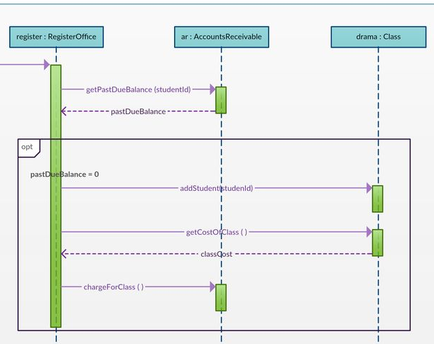
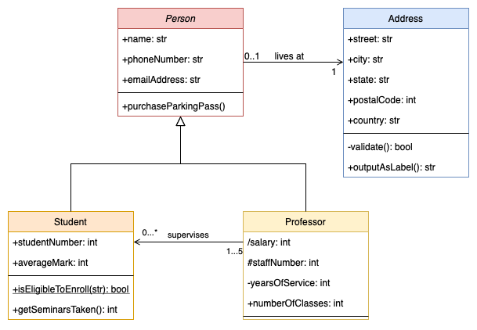
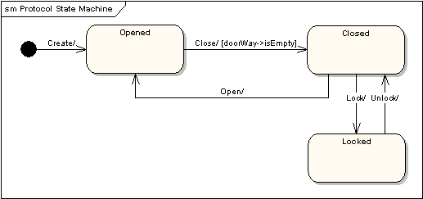
Diagramas
UML Sequence
State Machine Flow

