Slide 1

TC2008B Modelación de Sistemas Multiagentes con Gráficos
Alan Flores Saldivar
Escuela de Ingeniería y Ciencias Departamento de Ciencias de la Computación
alan.flores_s@tec.mx
INTERACCIÓN MULTIAGENTE

Slide 2
Agendas sugeridas
Agenda 1:
Martes 26 de noviembre: presentación final de solución de reto (ejecución y modelos con avance hasta ese momento).
Miércoles 27 de noviembre: Examen final (MAS). Se presenta en el horario de clase de maner no presencial (sujeto a presentación en martes)
Viernes 29 de noviembre: Entrega de versión final de reto: Documentación + video de ejecución.
Agenda 2:
Martes 26 de noviembre: Examen final (MAS). Se presenta en el horario de clase de manera presencial.
Jueves 28 de noviembre: Presentaciń final de reto.
Viernes 29 de noviembre: Entrega de versión final de reto: Documentación + video de ejecución.

Slide 3
Agent Interaction
Bibliography for this section:
Chapter of Artficial Intelligence: A Modern Approach (Russel and Norvig)
Chapters 6-7 of An Introduction to MultiAgent Systems (Wooldridge)

Slide 4
Agent Interaction
Utilities and preferences
Encounters
Game theory
Strategies (Dominant, Nash Equilibrium)
The Prisoner’s Dilemma

Slide 5
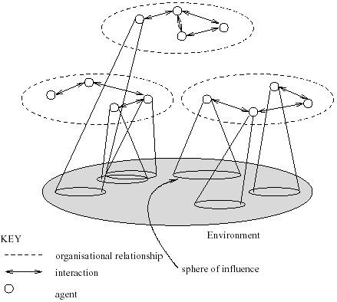
MultiAgent Systems
A multiagent system contains a number of agents
which interact through communication
are able to act in an environment
have different “spheres of influence” (which may coincide)
will be linked by other (organizational) relationships

Slide 6
Decision Theory
Examines how individuals and groups make choices. Decision theory aims to provide a framework for making rational decisions by evaluating different options and their potential outcomes.
Decision Maker (Agent): Entity making the choice.
Alternatives (Options): Possible actions or strategies to choose from.
Outcomes: Results of choosing a particular alternative.
Preferences: Ranking of outcomes based on agent’s desirability.
Utility: A numerical representation of the agent's preferences for outcome comparison.
Risk and Uncertainty:
Risk: When the probabilities of different outcomes are known.
Uncertainty: When the probabilities of outcomes are unknown.
Expected Utility:
Decisions under risk, where the decision-maker chooses the alternative with the highest expected utility.

Slide 7
Utilities and Preferences
Assume we have just two agents: Ag = {i, j}
Agents are self-interested: they have preferences over how the environment is
Ω = {ω₁, ω₂, …}is the set of “outcomes” that agents have preferences over
We capture preferences by utility functions: u_{i} = Ω → ℝ u_{j} = Ω → ℝ
Utility functions lead to preference orderings over outcomes: ω ≥_{i} ω’ means u_{i}(ω) ≥ u_{i}(ω’) ω >_{i} ω’ means u_{i}(ω) > u_{i}(ω’)

Slide 8
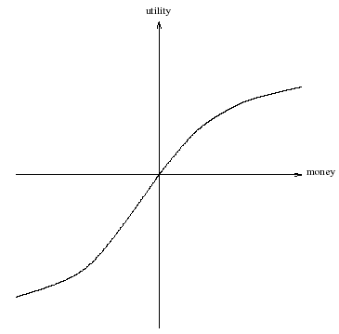
What is Utility?
Utility is not money (but it is a useful analogy)
Typical relationship between utility & money:

Slide 9

What is Utility?
Utility is not money (but it is a useful analogy)
Typical relationship between utility & money:
 | 1 | 2 | 3 | 4 | 5 | 6 | 7
1 |  |  |  |  |  |  | 100
2
3
4 | 150

Slide 10
What is Utility?
U((1, 7)) = 100, u((4,1)) = 150
Preference: (4, 1) > (1, 7)
 | 1 | 2 | 3 | 4 | 5 | 6 | 7
1 |  |  |  |  |  |  | 100
2
3
4 | 150

Slide 11
What is Utility?
Walking a cell: -10. Then:
U((1, 7)) = 100 - 20 = 80
U((4,1)) = 150 - 70 = 80
(1, 7) = (4, 1)
 | 1 | 2 | 3 | 4 | 5 | 6 | 7
1 |  |  |  |  |  |  | 100
2
3
4 | 150

Slide 12

Multiagent Encounters
Model of the environment in which agents will act:
agents simultaneously choose an action to perform, and in consequence an outcome in Ω will result
the actual outcome depends on the combination of actions
assume each agent has two possible actions: C (“cooperate”=silent) and D (“defect”=betray)
Environment behavior given by state transformer function:

Slide 13

Multiagent Encounters
Model of the environment in which agents will act:
agents simultaneously choose an action to perform, and in consequence an outcome in Ω will result
the actual outcome depends on the combination of actions
assume each agent has two possible actions: C (“cooperate”=silent) and D (“defect”=betray)
Environment behavior given by state transformer function:
A state transformer function represents behavior of the environment:

Slide 14
Multiagent Encounters
Here is a state transformer function: (This environment is sensitive to actions of both agents.)
Here is another: (Neither agent has any influence in this environment.)
And here is another: (This environment is controlled by j.)

Slide 15
Multiagent Encounters
j
i
Sensitive to both No influence Controlled by j
 | D | C
D | ω₁ | ω₂
C | ω₃ | ω₄
 | D | C
D | ω₁ | ω₁
C | ω₁ | ω₁
 | D | C
D | ω₁ | ω₂
C | ω₁ | ω₂

Slide 16


Rational Action
Suppose both agents can influence the outcome, and they have utility functions as follows:
With a bit of abuse of notation:
Then agent i’s preferences are:
“C” is the rational choice for i. (Because i prefers all outcomes that arise through C over all outcomes that arise through D.)

Slide 17
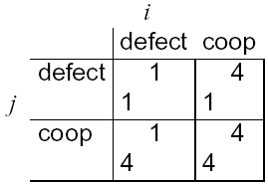
Payoff Matrices
We can characterize the previous scenario in a payoff matrix:
Agent i is the column player
Agent j is the row player

Slide 18
Dominant Strategies
Given any particular strategy (either C or D) of agent i, there will be a number of possible outcomes
We say s₁ dominates s₂ if every outcome possible by i playing s₁ is preferred over every outcome possible by i playing s₂
A rational agent will never play a dominated strategy
So in deciding what to do, we can delete dominated strategies
Unfortunately, there isn’t always a unique undominated strategy

Slide 19
Example
We say that Ω strongly dominates Ω’ (written Ω >_{i} Ω’ ) if every outcome of Ω is preferred over every outcome of Ω’. This is:
ω >_{i} ω’ for any ω ∈ Ω, ω’ ∈ Ω’
1. Consider the following set of outcomes and preferences
Ω = {ω₁, ω₂, ω₃, ω₄}
ω₁ >_{i} ω₂ >_{i} ω₃ >_{i} ω₄
Ω₁ = {ω₁, ω₂}
Ω₂ = {ω₃, ω₄}
Then Ω₁ >_{i} Ω₂.

Slide 20
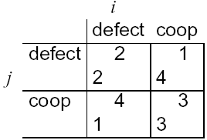
The Prisoner’s Dilemma
Payoff matrix for prisoner’s dilemma:
Top left: If both defect, then both get punishment for mutual defection
Top right: If i cooperates and j defects, i gets sucker’s payoff of 1, while j gets 4
Bottom left: If j cooperates and i defects, j gets sucker’s payoff of 1, while i gets 4
Bottom right: Reward for mutual cooperation

Slide 21
Nash Equilibrium
In general, two strategies s₁ and s₂ are in Nash equilibrium if:
if agent i plays s₁, agent j can do no better than play s₂; and
if agent j plays s₂, agent i can do no better than play s₁.

Slide 22
Nash Equilibrium
In general, two strategies s₁ and s₂ are in Nash equilibrium if:
if agent i plays s₁, agent j can do no better than play s₂; and
if agent j plays s₂, agent i can do no better than play s₁.
Considering the aforementioned probabilities, is there a dominant strategy? a Nash equilibrium?

Slide 23
The Prisoner’s Dilemma
The individual rational action is defect This guarantees a payoff of no worse than 2, whereas cooperating guarantees a payoff of at most 1
So defection is the best response to all possible strategies: both agents defect, and get payoff = 2
But intuition says this is not the best outcome: Surely they should both cooperate and each get payoff of 3!

Slide 24
Nash Equilibrium
In general, two strategies s₁ and s₂ are in Nash equilibrium if:
if agent i plays s₁, agent j can do no better than play s₂; and
if agent j plays s₂, agent i can do no better than play s₁.
Neither agent has any incentive to deviate from a Nash equilibrium
Unfortunately:
Not every interaction scenario has a Nash equilibrium
Some interaction scenarios have more than one Nash equilibrium

Slide 25
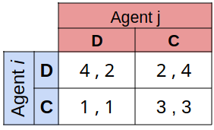
The Prisoner’s Dilemma

Slide 26
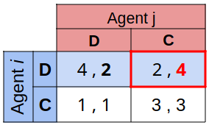
The Prisoner’s Dilemma
If agent i decides D, the best option for agent j is C.

Slide 27
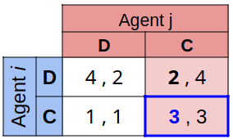
The Prisoner’s Dilemma
If agent i decides D, the best option for agent j is C.
If agent j decides C, the best option for agent i is C.

Slide 28
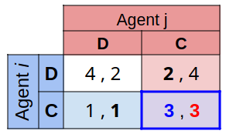
The Prisoner’s Dilemma
If agent i decides D, the best option for agent j is C.
If agent j decides C, the best option for agent i is C.
In this point none of them have an incentive to change its strategy.

Slide 29
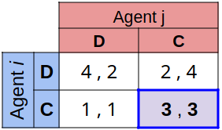
The Prisoner’s Dilemma
If agent i decides D, the best option for agent j is C.
If agent j decides C, the best option for agent i is C.
In this point none of them have an incentive to change its strategy.
Then, strategy (C, C) reaches a Nash equilibrium.

Slide 30
The Prisoner’s Dilemma
If agent i decides D, the best option for agent j is C.
If agent j decides C, the best option for agent i is C.
In this point none of them have an incentive to change its strategy.
Then, strategy (C, C) reaches a Nash equilibrium.

Slide 31
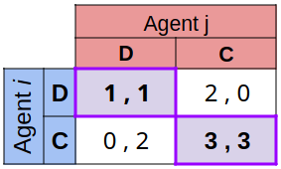
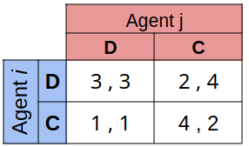
The Prisoner’s Dilemma

Slide 32
Competitive and Zero-Sum Interactions
Where preferences of agents are diametrically opposed we have strictly competitive scenarios
Zero-sum encounters are those where utilities sum to zero: u_{i}(ω) + u_{j}(ω) = 0 for all ω ∈ Ω
Zero sum implies strictly competitive
Zero sum encounters in real life are very rare … but people tend to act in many scenarios as if they were zero sum

Slide 33
Competitive and Zero-Sum Interactions
Consider this situation:
You can buy a ticket for a lottery. 1000 tickets are sold $100 each. Only 1 ticket wins.
If your ticket is winner, you earn, $200,000, otherwise $0.
Would you buy the ticket?

Slide 34
Competitive and Zero-Sum Interactions
Consider this situation:
You can buy a ticket for a lottery. 1000 tickets are sold $100 each. Only 1 ticket wins.
If your ticket is winner, you earn, $200,000, otherwise $0.
Would you buy the ticket?
Before purchasing the ticket, you find that only 1 person owns the remaining 999 tickets, would you still buy the ticket?

Slide 35
The Prisoner’s Dilemma
This apparent paradox is the fundamental problem of multi-agent interactions. It appears to imply that cooperation will not occur in societies of self-interested agents.
Real world examples:
nuclear arms reduction (“why don’t I keep mine. . . ”)
free rider systems — public transport;
in the UK — television licenses.
The prisoner’s dilemma is ubiquitous.
Can we recover cooperation?

Slide 36
The Iterated Prisoner’s Dilemma
One answer: play the game more than once
If you know you will be meeting your opponent again, then the incentive to defect appears to evaporate
Cooperation is the rational choice in the infinititely repeated prisoner’s dilemma (Hurrah!)

Slide 37
Backwards Induction
But…suppose you both know that you will play the game exactly n times On round n - 1, you have an incentive to defect, to gain that extra bit of payoff… But this makes round n – 2 the last “real”, and so you have an incentive to defect there, too. This is the backwards induction problem.
Playing the prisoner’s dilemma with a fixed, finite, pre-determined, commonly known number of rounds, defection is the best strategy

Slide 38
Axelrod’s Tournament
Suppose you play iterated prisoner’s dilemma against a range of opponents… What strategy should you choose, so as to maximize your overall payoff?
Axelrod (1984) investigated this problem, with a computer tournament for programs playing the prisoner’s dilemma

Slide 39
Strategies in Axelrod’s Tournament
ALLD:
“Always defect” — the hawk strategy;
TIT-FOR-TAT:
On round u = 0, cooperate
On round u > 0, do what your opponent did on round u – 1
TESTER:
On 1st round, defect. If the opponent retaliated, then play TIT-FOR-TAT. Otherwise intersperse cooperation and defection.
JOSS:
As TIT-FOR-TAT, except periodically defect

Slide 40
Recipes for Success in Axelrod’s Tournament
Axelrod suggests the following rules for succeeding in his tournament:
Don’t be envious: Don’t play as if it were zero sum!
Be nice: Start by cooperating, and reciprocate cooperation
Retaliate appropriately: Always punish defection immediately, but use “measured” force — don’t overdo it
Don’t hold grudges: Always reciprocate cooperation immediately

Slide 41
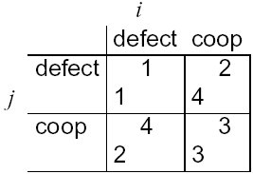
Game of Chicken
Consider another type of encounter — the game of chicken:
Difference to prisoner’s dilemma: Mutual defection is most feared outcome. (Whereas sucker’s payoff is most feared in prisoner’s dilemma.)
Strategies (c,d) and (d,c) are in Nash equilibrium

Slide 42
Exercises
1. Consider the set of outcomes and preferences
Ω = {ω₁, ω₂, ω₃, ω₄, ω₅, ω₆}
ω₆ >_{i} ω₂ >_{i} ω₃ >_{i} ω₁ >_{i} ω₅, >_{i} ω₄
Which of the following subsets (if any) dominates the others?
Ω₁ = {ω₁, ω₃}
Ω₂ = {ω₃, ω₄}
Ω₃ = {ω₃}
Ω₄ = {ω₂, ω₆}
Ω >_{i} Ω’ if ω >_{i} ω’ for any ω ∈ Ω, ω’ ∈ Ω’

Slide 43
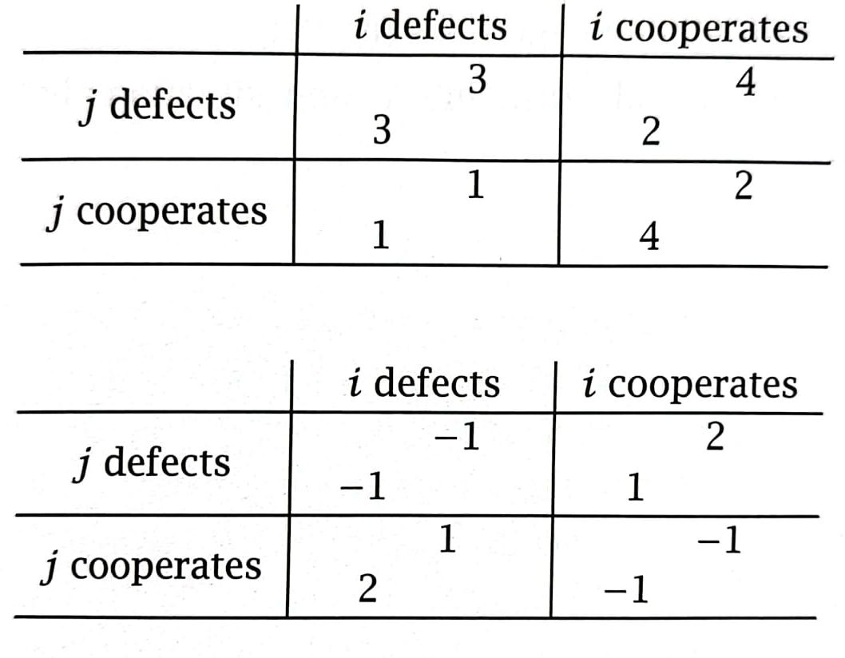
Exercises
Considering the interaction scenarios:
Informally analyze to determine what the agents should do.
Classify the preferences that agents have with respect of outcomes.
Determine which strategies are strongly dominated.
Identify any Nash equilibrium.

