Slide 1
EmporiUM East region Sales analysis By: Demy Melgar

Slide 2
agenda
Project Overview:
Sales Trends Over Time
Sales by Category
State Breakdown
Top-Selling Books
Recommendations

Slide 3
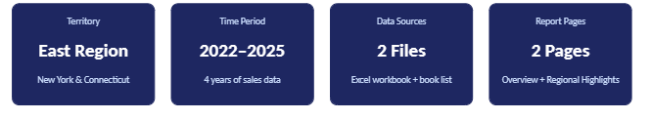
PROJECT OVERVIEW
I was asked to analyze the East Region, specifically the sale performance for the years 2022-2025. I built a Power BI report that shows key trends, top performing categories etc. This analysis will support ultimate business decisions.

Slide 4
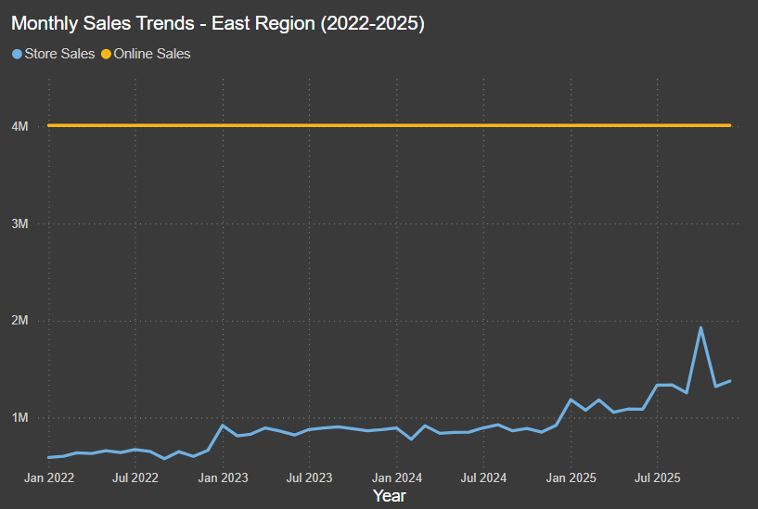
Sales trends over time
Online sales stayed consistently flat at $380,000 per month, during this time frame.
Store sales show growth in 2022, starting at $620k to up to $1.8M heading into 2025
In-store sales show clear growth trend

Slide 5
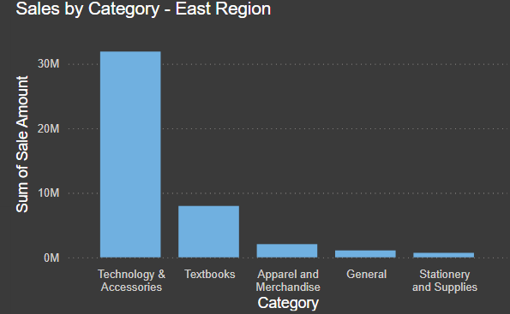
Sales by category
Key Takeaways:
Technology & Accessories shows the most sales at $30M almost quadruple the other categories
Stationery and General are the lowest performers (possible promotions to boost sales is an option)

Slide 6
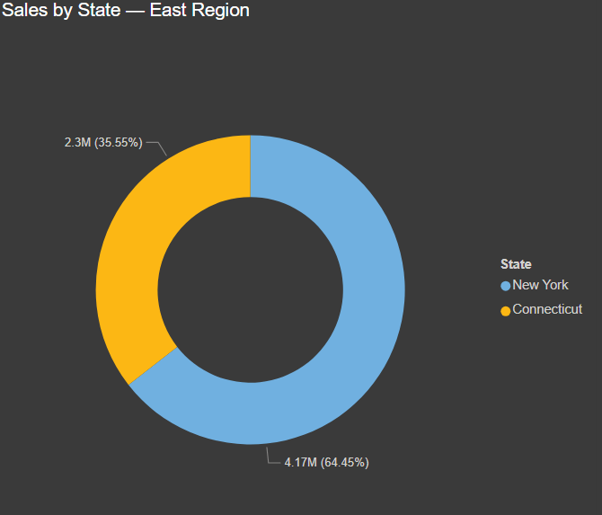
STATE: NY VS. CT
New York shows 64.45% of regional sales = $4.17M
Connecticut shows 35.55% of regional sales= $2.3M
It’s recommended to investigate why Connecticut is underperforming and see where there is room for improvement.

Slide 7
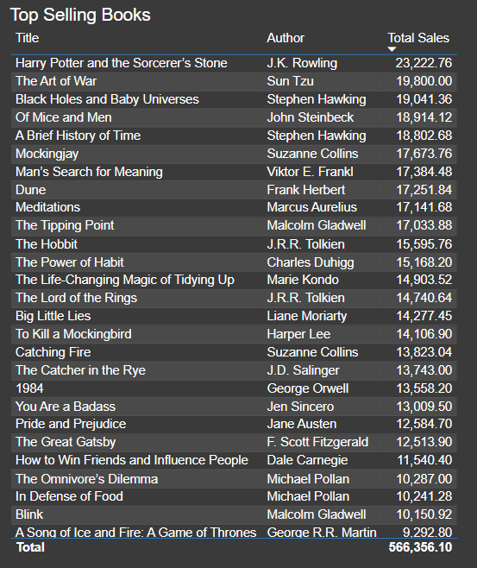
Top selling books: east region
Insight: The East region in terms of readers have a diverse interested in category.

Slide 8
RECOMMENDATIONS:
New York generates over 64% of the East Region in terms of revenue. Investment should be focused here. Also watch for growth potential in Connecticut.
There is a growth trend in stores in the East Region, shows promising pattern.
Technology & Accessories has the most sales and overall revenue, making sure the focus stays here for maximum sales.
There is room for growth in Books & Stationery and General, promotions and marketing could really help drive sales here and close the gap.

Slide 9
Thank you
Demy Melgar
Github repo: https://github.com/dmelgar333/Capstone_3.git

