Slide 1
Classifying Formula 1 Pole-to-Win Conversions
Dakota Mellish
1

Slide 2


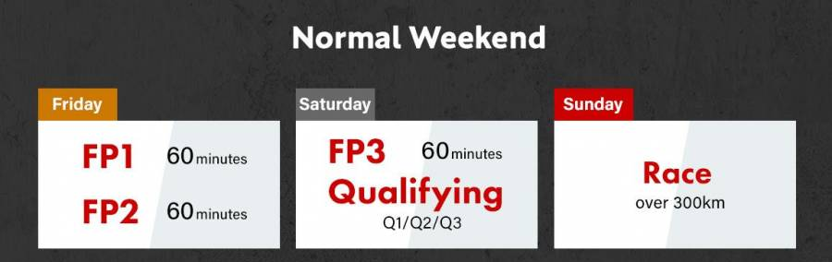
Background
Formula 1 Racing has grown to be quite popular worldwide, and now features 24 races throughout the season
20 racers, 10 teams
Despite this, generally only 3-4 teams are competitive and capable of winning a race
In the past 15 years, the seasons have been dominated by Lewis Hamilton (7x WC) and Max Verstappen (3x WC)
Typical race weekend includes practice sessions, qualifying and a race.
Pole leader often considered to have a strong advantage when starting
2
2

Slide 3
Defining the Problem and Dataset
Question is if a pole winner can be classified as ‘winning the race’ or not
Binary classification
Rich Formula 1 dataset exists within Kaggle surrounding Formula 1 season data
Features extracted using Python
293 observations from January 2009-September 2024
Only the qualification winner is considered for each race
Weather data also provided using Visual Crossing API
Balanced dataset (52/48% in favor of pole-to-win conversions)
3
2

Slide 4
Defining the methodology
5 non-probabilistic classifiers and 8 probabilistic classifiers are considered separately and together using four different feature subset selection methods
Grid search is performed to tune hyperparameters
5-fold leave one out cross validation strategy is conducted using the best hyper parameters selected and metrics are tabulated using the mean.
Results are then compared
Numerical variables are scaled using standard z scaling
4
2

Slide 5
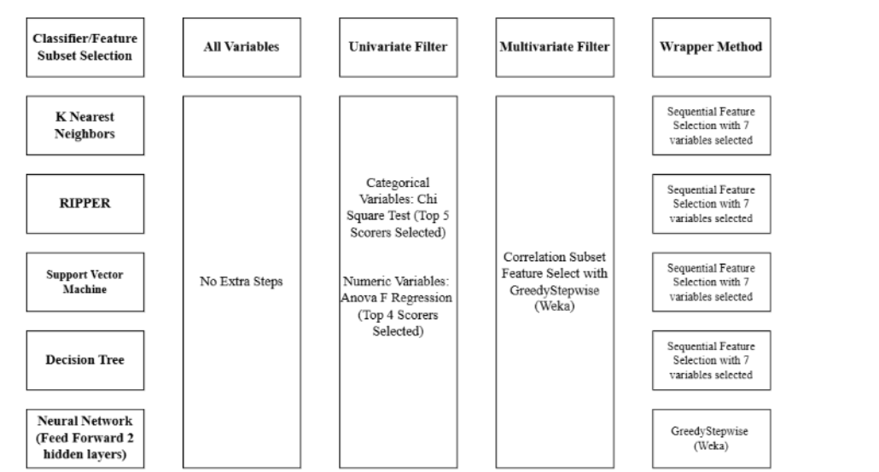
Defining the methodology (Con’t)
5
2

Slide 6
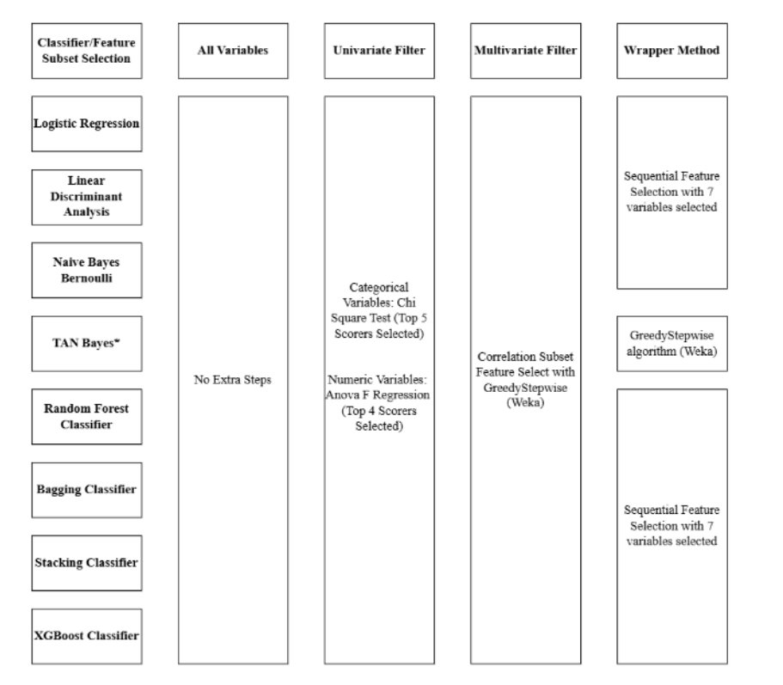
Defining the methodology (Con’t)
6
2

Slide 7
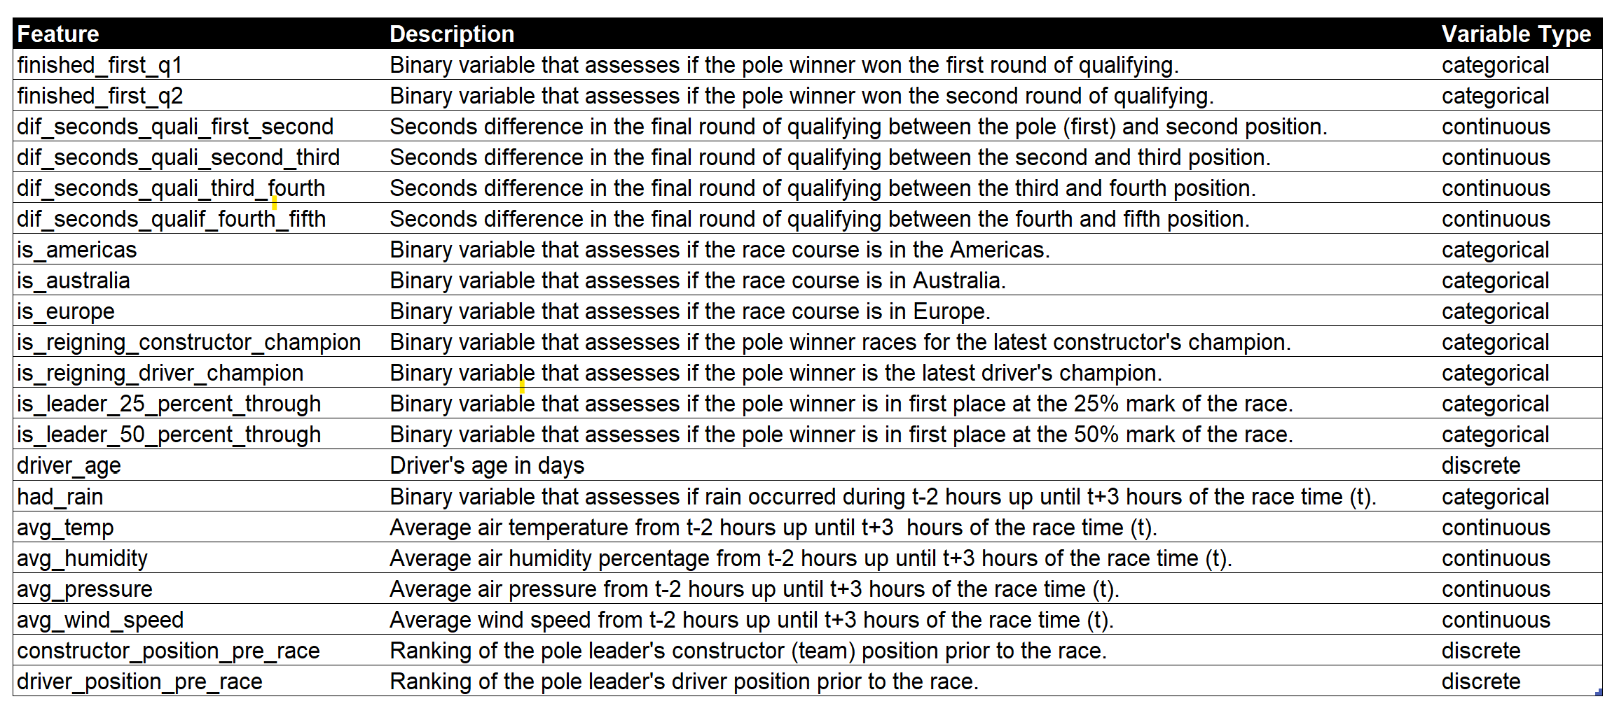
Variables Used
Primarily formed from driver and car constructor attributes, weather, in-season metrics as well as qualifying results and two in-race metrics
12 categorical, 9 numeric
7
2

Slide 8
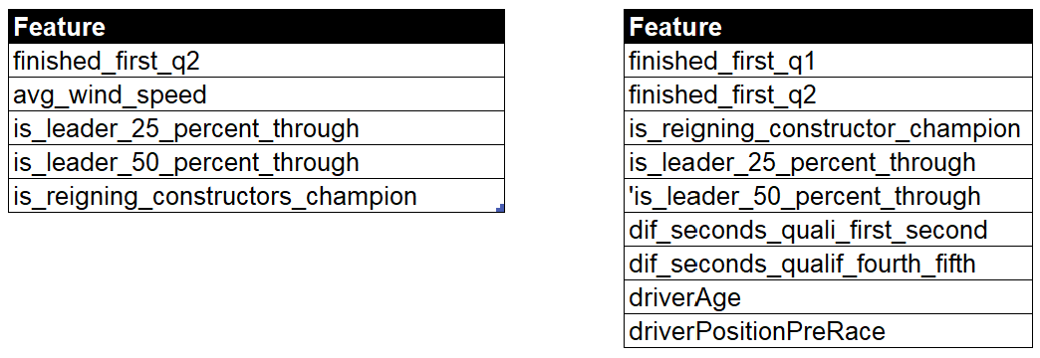
Variables Used in Feature Subset Selection
Univariate and multivariate filter results showed below
Wrapper method features vary with each model and there are too many to show
8
2

Slide 9
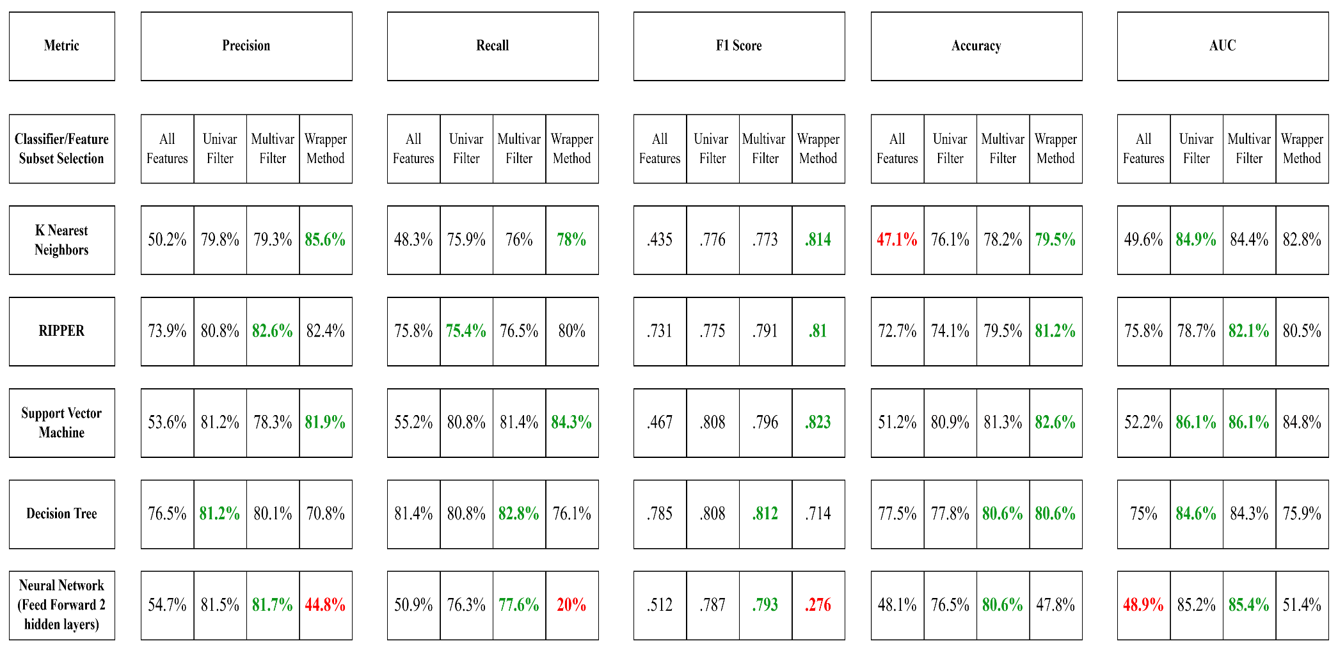
Results of Non-Probabilistic Classifiers
9
2

Slide 10
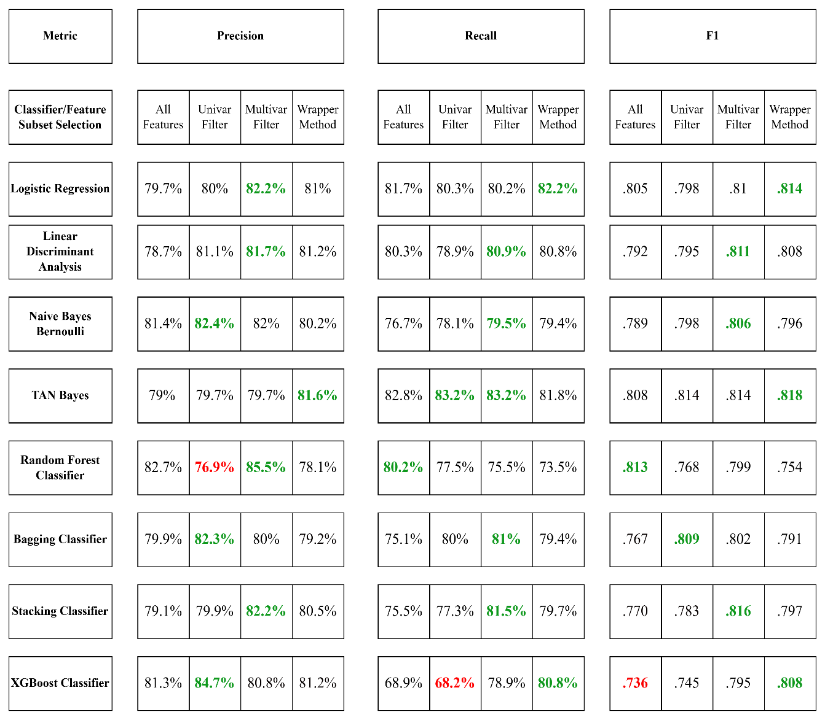
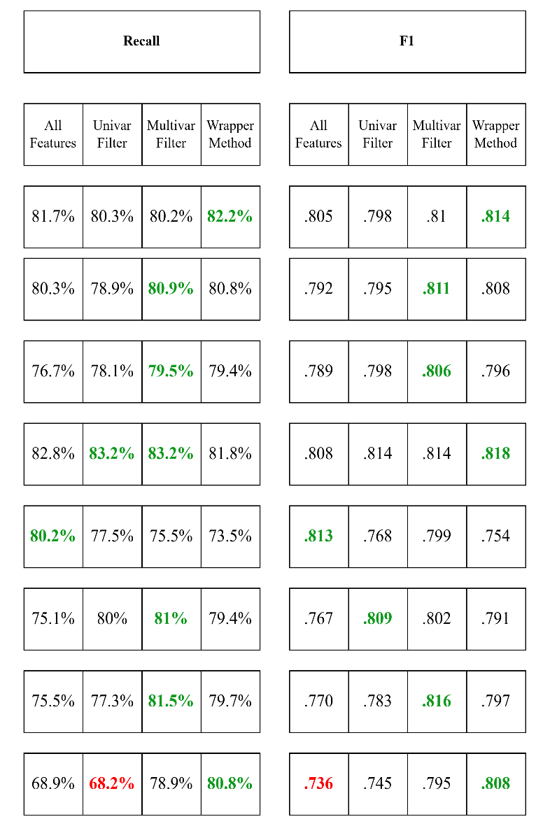
Results of Probabilistic Classifiers
10
2

Slide 11
Results Continued
Best overall model for non-probabilistic classifiers: Support Vector Machine
Best overall model for probabilistic classifier: Logistic Regression
Wrapper method provides the best overall performance in the majority of models, as well as multivariate for probabilistic classifiers
Bottom Line: Support Vector Machine slightly outperforms, but Logistic Regression retains higher degree of interpretability
Metric | Support Vector Machine | Logistic Regression
Accuracy | 82.6% | 82.6%
F1 Score | .823 | .819
AUC | .861 | .843
Precision | 81.9% | 81%
Recall | 84.3% | 82.2%
11
2

Slide 12
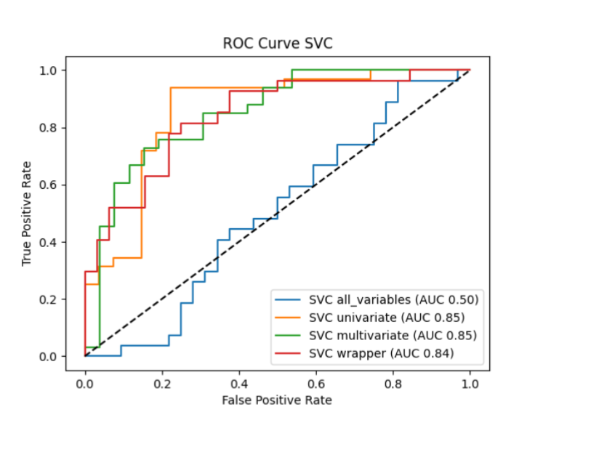
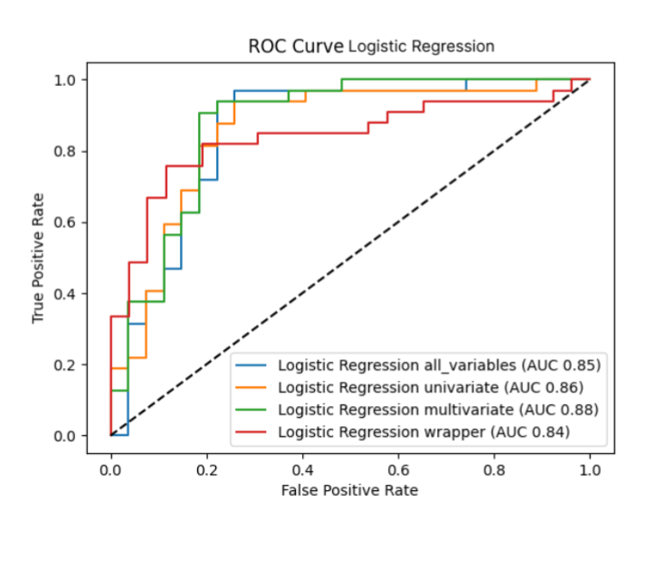
ROC Curves
Support Vector Machine is more sensitive with variable selection than Logistic Regression
Both score better than random guessing, though there is room for improvement
12
2

Slide 13
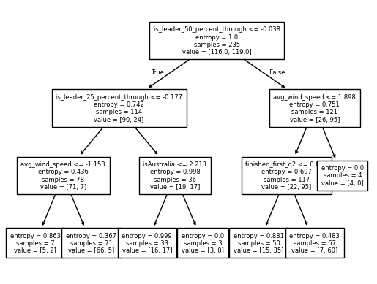
Interpretation of Model Outputs
Decision Tree (univariate filter)
RIPPER (repeated incremental pruning to producer error reduction) (univariate filter)
13
2

Slide 14
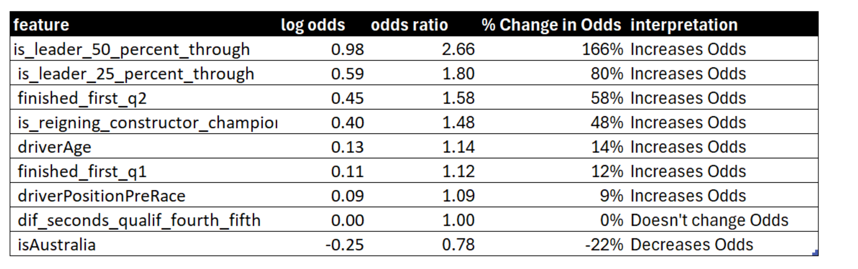
Interpretation of Model Outputs
Logistic Regression Coefficients (Intercept at 0)
14
2

Slide 15
Additional Considerations
Simpler models outperform more complicated models due to small dataset (n=293)
Probabilistic Classifiers don’t tend to fluctuate as much in performance with variable selection as Non-Probabilistic Classifiers
A handful of features in the given dataset largely explain if a pole winner will win the race or not
Feature subset selection is beneficial, as some large models can only achieve what amounts to random guessing
Potential for adding other features in the future
Additional tweaking of hyperparameters for regularization (L1) of Logistic Regression and C parameter for Support Vector Machine could eke out higher performance
15
2

