Slide 1
Visual Cryptography
Prepared By:
Ansley Rodrigues
Selwyn Dmello
Nevin Dabre

Slide 2
Agenda
Introduction
Literature Survey
Future Work
Conclusion
References

Slide 3
Introduction
Visual cryptography (VC) was introduced by Moni Naor and Adi Shamir at EUROCRYPT 1994.
Visual cryptography is a cryptographic technique which allows visual information (pictures, text, etc.) to be encrypted in such a way that decryption becomes a mechanical operation that may or may not require a computer.
It is used to encrypt written material (printed text, handwritten notes, pictures, etc) in a perfectly secure way.
The decoding is done by the human visual system directly, without any computation cost.

Slide 4

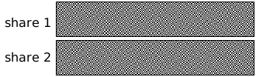
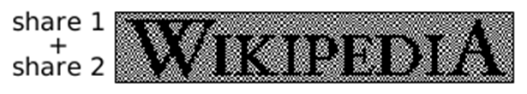
OR- Visual Cryptography
Divide image into two parts
Separately, they are random noise
Combination reveals an image
Simple example

Slide 5
k out of n sharing problem
k out of n sharing problem
For a set P of n participants, a secret image S is encoded into n shadow images called shares (shadows), where each participant in P receives one share.
The original message is visible if any k or more of them are stacked together, but totally invisible if fewer than k transparencies are stacked together.

Slide 6








k out of n example (k=3,n=4)
Original
Share 1
Share 2
Share 3
Share 4
Share 1+2+3
Share 1+2
Share 2+3
Share 4+ 3
Share 1+ 4

Slide 7
General k out of k Scheme
In k out of k, the image is visible only if all the shares are stacked together.
If any share in k is lost, and remaining shares are stacked together, it will not form the image.
Thus, in k out of k, all the shares are important
to construct the image.

Slide 8
k out of k example (k=n,n=3)
Original
Share #1
Share #2
Share #3
Share #1+#2+#3
Share #1+#2
Share #2+#3
Share #1+ #3

Slide 9
Model
m
Pixels are split:
Pixel
Subpixels
n shares per pixel:
m
si,j
Share 1
Share 2
n
Share n

Slide 10
2 out of 2 Scheme (2 subpixels)
Black and white image: each pixel divided in 2 sub-pixels
Randomly choose between black and white.

Slide 11
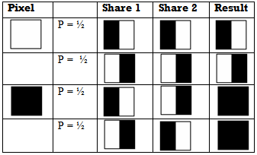
2 out of 2 Scheme (2 subpixels)

Slide 12

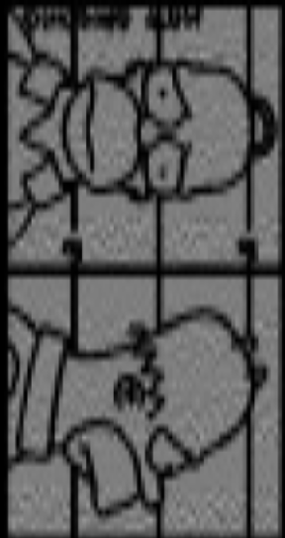
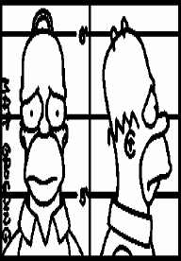

2 out of 2 Scheme (2 subpixels)
The two subpixels per pixel variant can distort the aspect ratio of the original image
+

Slide 13


2 out of 2 Scheme (4 subpixels)
Each pixel encoded as
  a 2x2 cell
  in two shares (key and cipher)
Each share has 2 black, 2 transparent subpixels
When stacked, shares combine to
  Solid black
  Half black (seen as gray)

Slide 14
2 out of 2 Scheme (4 subpixels)
Horizontal shares
Vertical shares
Diagonal shares

Slide 15
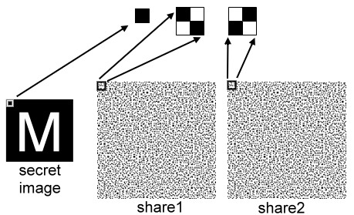
2 out of 2 Scheme (4 subpixels)

Slide 16
pixel
0
1
2
3
4
5
0
1
2
3
4
5
share1
share2
stack
4
0
1
5
random

Slide 17
X-OR Visual Cryptography
X-OR Visual cryptography is a cryptographic technique which allows image to be encrypted in such a way that after decryption we get the original image which was not possible with normal visual cryptography.
The decoding is done by the human visual system directly or with the help of computer.

Slide 18
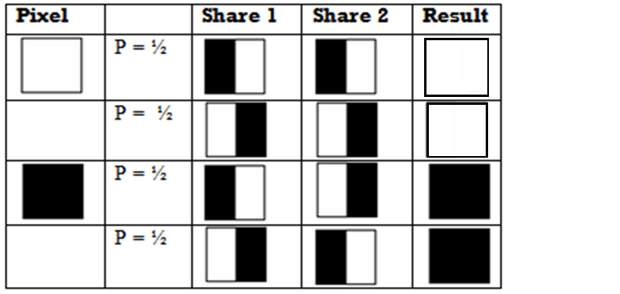
X-OR Visual Cryptography
2 out of 2 Scheme (2 subpixels)

Slide 19
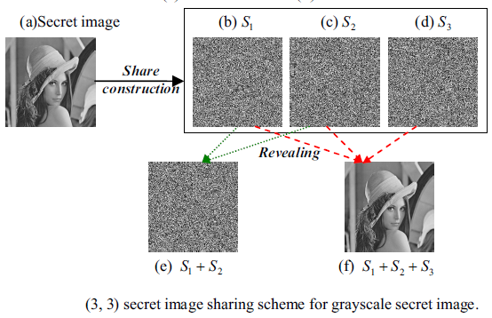
3 out of 3 Scheme Example
Original image

Slide 20
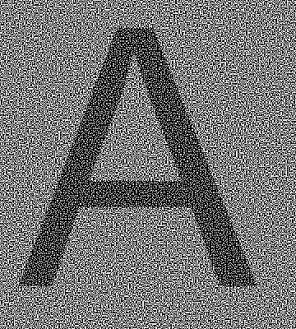
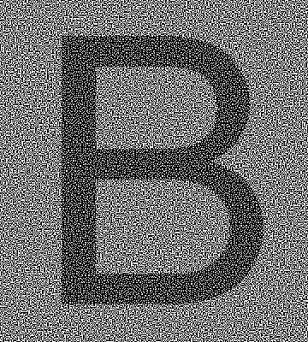

Extensions - Extended VC
Ateniese et al., 2001
Send innocent looking transparencies, e.g. Send images a dog, a house, and get a spy message with no trace.

⇨

Slide 21
Future Use and Applications
Remote Electronic Voting
Anti-Spam Bot Safeguard
Banking Customer Identification
Message Concealment
Key Management

Slide 22
Conclusion
Shares can be difficult to align (it helps to have fat pixels, but that reduces quality),
Contrasts declines rapidly with the number of shares.

Slide 23
References
Naor and Shamir, Visual Cryptography, in Advances in Cryptology - Eurocrypt ‘94
www.cacr.math.uwaterloo.ca/~dstinson/visual.html
http://homes.esat.kuleuven.be/~fvercaut/talks/visual.pdf
http://www.cse.psu.edu/~rsharris/visualcryptography/viscrypt.ppt

Slide 24
References
http://netlab.mgt.ncu.edu.tw/computersecurity/2002/ppt/%E5%BD%A9%E8%89%B2%E8%A6%96%E8%A6%BA%E5%AF%86%E7%A2%BC%E5%8F%8A%E5%85%B6%E6%87%89%E7%94%A8.ppt
http://163.17.135.4/imgra/PPT/200500022.ppt

