Slide 1
Spring 2026 Capstone Presentation
Using Flood Risk and Property Data to Assess Public Asset Vulnerability in Pinellas County, Florida
Presenter: Donald D. Melone, Jr.

Slide 2

Research Question
How can spatial analysis of flood risk data help identify vulnerable public assets in Pinellas County, Florida?

Slide 3

Why This Matters
I have lived in and currently work in the study area
Highly urbanized coastal region
High exposure to storm surge
Coastal development pressure (reaching build-out)
Increasing hurricane risk
Financial exposure to flooding
Asset management and strategic initiatives – we need to know what we have and don’t have

Slide 4
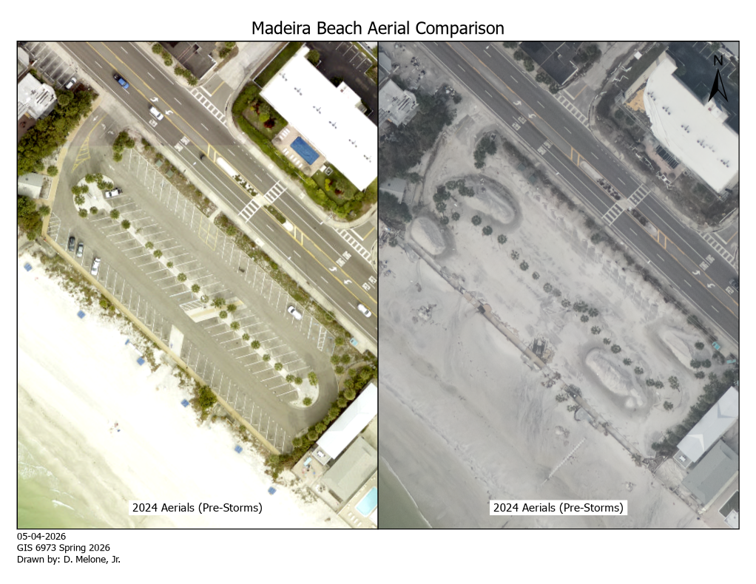

Slide 5
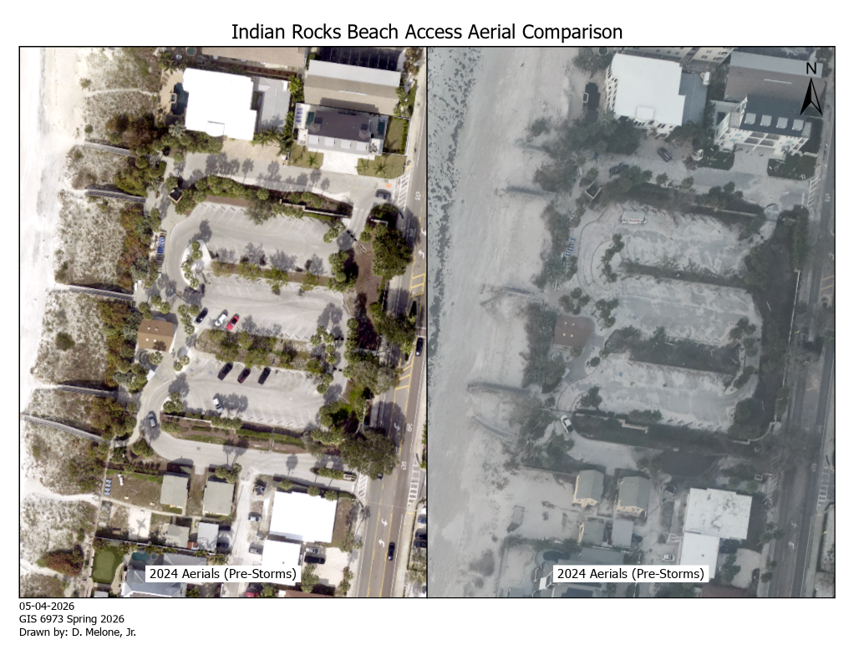

Slide 6
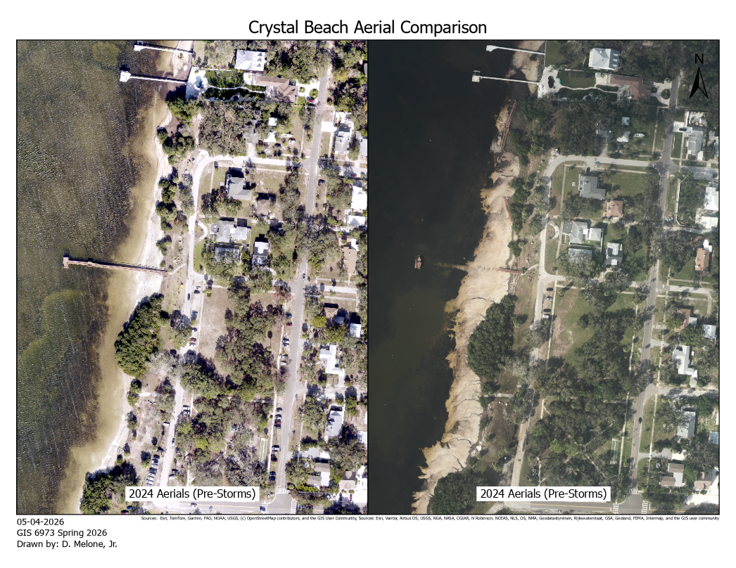

Slide 7
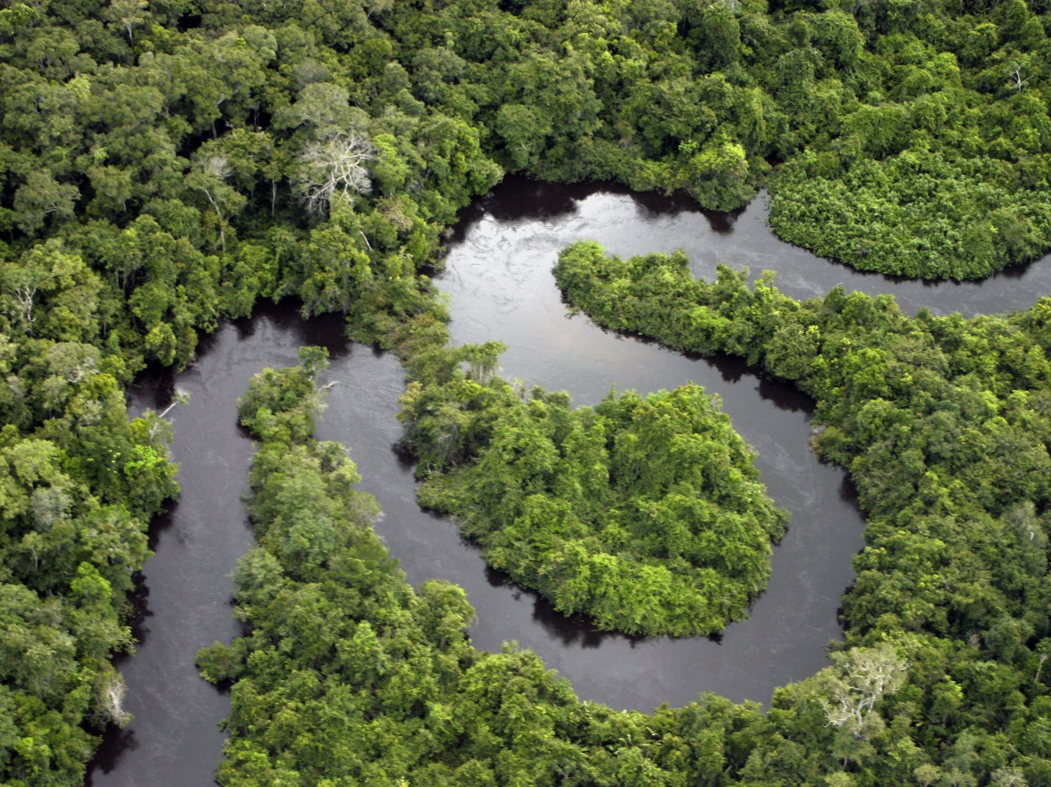
Overview
This study uses spatial analysis of FEMA flood hazard data and local asset datasets to quantify the exposure of public infrastructure to flood risk in Pinellas County, Florida, highlighting implications for more informed asset management and investment decisions.

Slide 8

Literature Review
Three main themes:
Data-driven
Observable, quantifiable increase in disaster risk and exposure
Disaster and formerly normal gray-sky events are increasing in frequency and cost
Despite the previous two points, development continues in high-risk areas
Analysis-driven
GIS, remote sensing, and spatial analysis tools are frequently utilized for risk assessment and identification of infrastructure vulnerabilities
Future-planning
The research emphasizes the importance of asset management in reducing the impacts of disasters.
Various studies expound upon these themes to quantify public asset exposure to flood hazard risks.

Slide 9

Data Sources
FEMA Flood Map Service Center
Hazard Layer
Pinellas County GIS (Open Data)
Parcels
County Boundary
Emergency Management Shelters
Pre- and Post-storm Aerial Imagery
Land Use Data
Land Use Planning
Unincorporated Zoning

Slide 10
Methods
Live service
Utilize live services when local hosting/processing not necessary (i.e., aerial imagery for mini-maps)
Spatial Intersect (Parcels + Flood Zones)
Unique symbology, filter out zones “X” and “Open Water”
Added field(s)
Added a "Risk_Level" field to symbolize data within the flood zones by “High” or “Moderate” (easy visualization)
Summary Statistics by risk
Total property value in hazard zones
Total public (County) property identified in hazard zones
Processing
Projected imported data as-needed to ensure proper analysis
Spatial Intersect (Park Boundaries + Flood Zones)
Unique symbology, filter out Zones “X” and “Open Water”

Slide 11
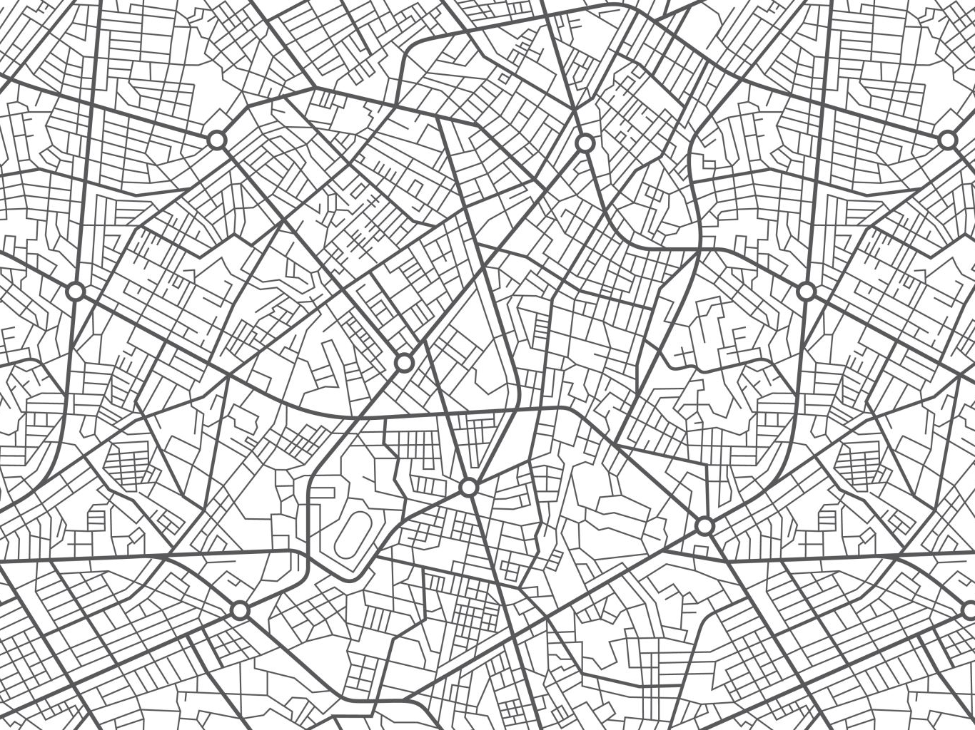
Example Damage Locations

Slide 12
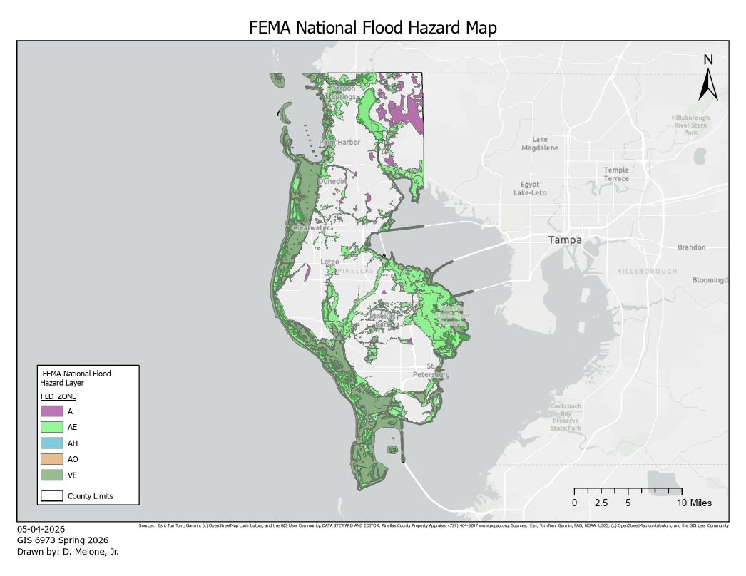

Slide 13
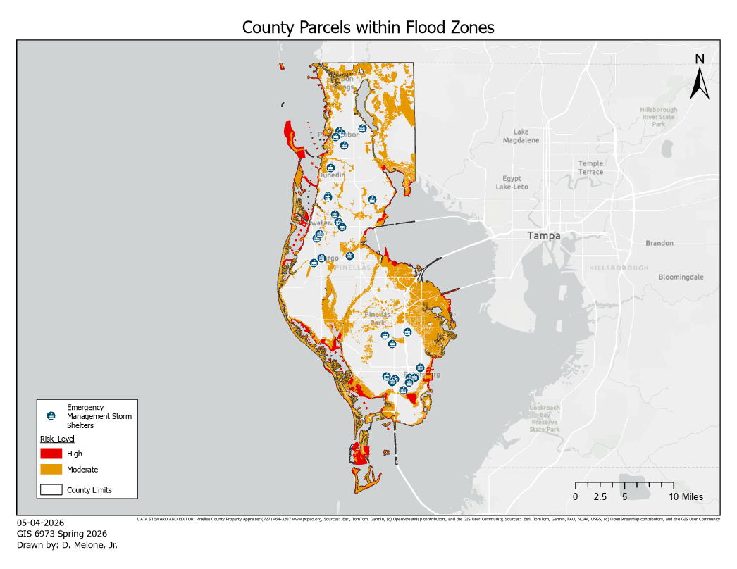

Slide 14
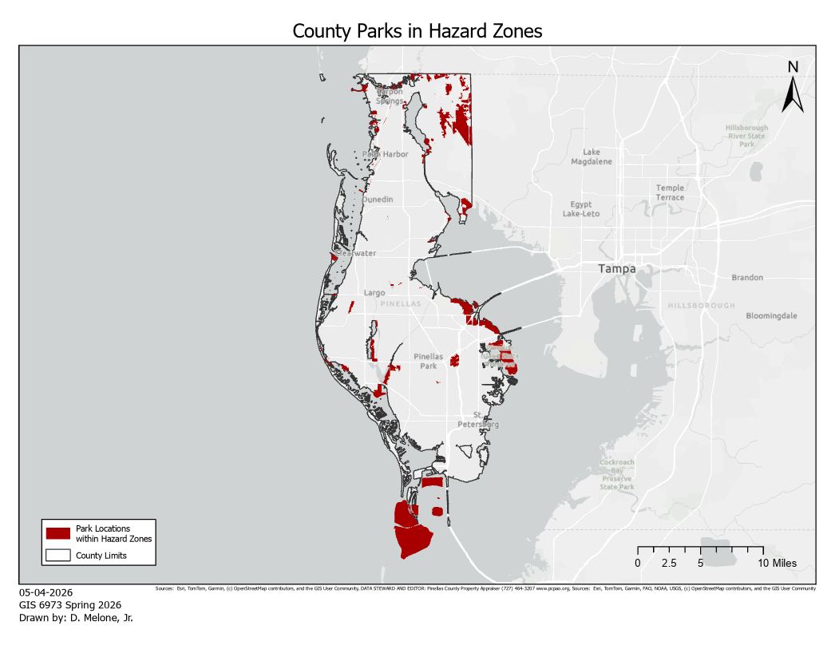

Slide 15
Analysis: Exposed Parcel Count
Characteristic | Count | Percentage
Parcels in Flood Zones | 166,970 | 38.24%
Private parcels | 166,116 | 38.04%
County-owned parcels | 854 | 0.19%
Total of unique Parcels in Flood Hazard Zones: 436,650

Slide 16
Analysis: Property Value at Risk
Flood Zone | Count | Value
A | 8,694 | $ 2,369,591,050.00
AE | 235,360 | $ 102,195,849,440.00
AH | 66 | $ 10,454,900.00
AO | 381 | $ 413,859,709.00
VE | 31,091 | $ 19,196,889,087.00
Total property value at risk: $124,186,644,186

Slide 17
Conclusion
Analysis Overview:
Significant % of parcels in flood zones
High-value properties concentrated in risk areas
Implications:
Continued development in risky areas
Long-term financial vulnerability
Planning challenges
Flood risk and development overlap significantly
Public Sector Asset Management:
Better planning needed to reduce vulnerability
Lack of cohesive data to count, assess, and manage damaged public assets

Slide 18
Future Work
Add social vulnerability data
This is available from the CDC but was eliminated from this analysis for the Asset Management discussion
Asset Management Plans
Extract data from County Strategic Initiatives when completed
Policy recommendations
Analyze hurricane response and record keeping

Slide 19
Questions or Condemnations?
Thank you!
Donald D. Melone, Jr.
(727) 423-5663
d.melonejr@outlook.com

