Slide 1
Sensors
Input samples
Microcontroller
Test case (from file)
Input requests,
Interval observations,
Output observations
Laptop
MicroGrader client
MicroGrader server
USB connection
Student code
Input samples
Test results (to file)
Output signals
Actuators

Slide 2
Sensors
Test case (from file)
Input samples
Input requests,
Interval observations,
Output observations
Laptop
Microcontroller
MicroGrader Server
MicroGrader
Client
Student
Code
USB connection
Input samples
Test results (to file)
Output signals
Actuators

Slide 3
Sensors
Test case (from file)
No data
Input requests,
Interval observations,
Output observations
Laptop
Microcontroller
MicroGrader Server
MicroGrader
Client
Student
Code
USB connection
Input samples
Test results (to file)
Output signals
Actuators

Slide 4
Sensors
Input samples
Input observations,
Interval observations,
Output observations
Laptop
Microcontroller
MicroGrader Server
MicroGrader
Client
Student
Code
USB connection
Observation Log
Output signals
Actuators

Slide 5
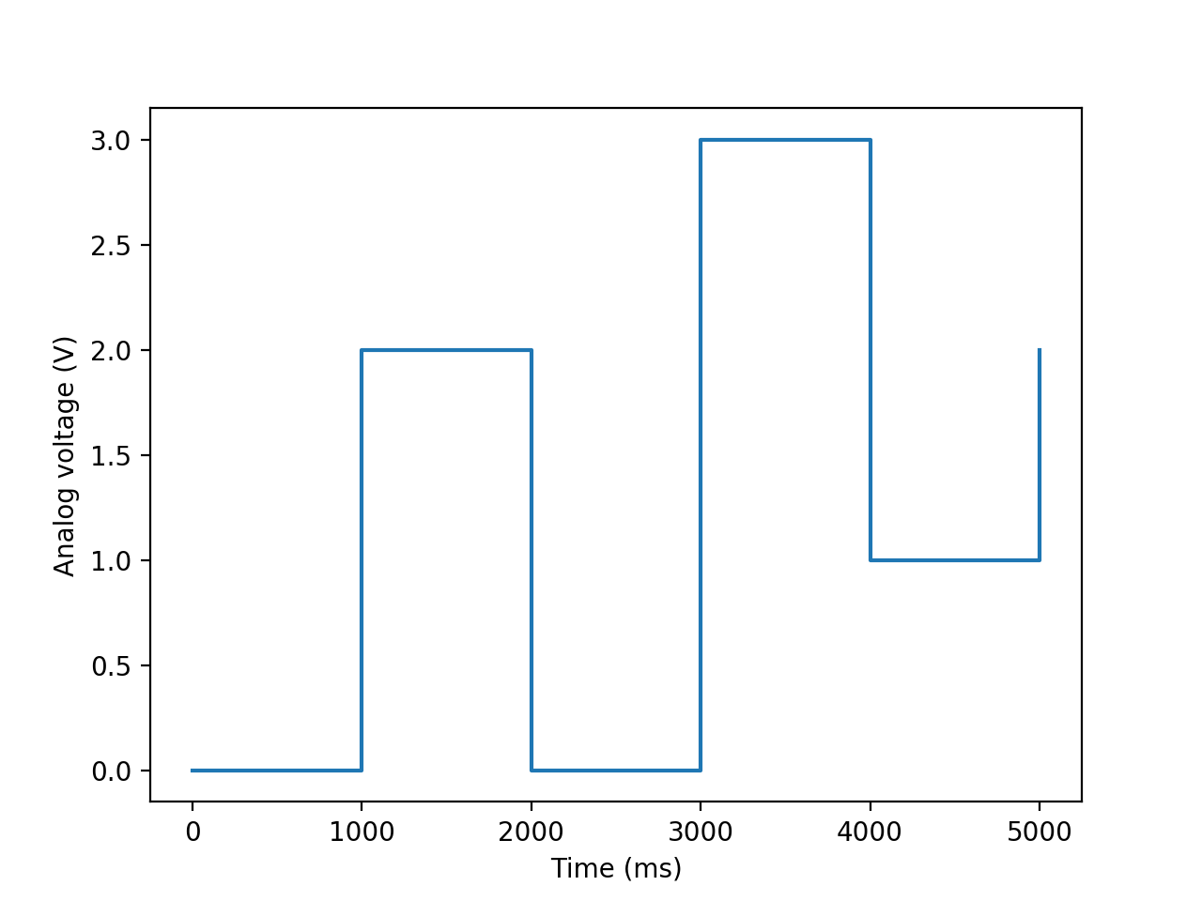
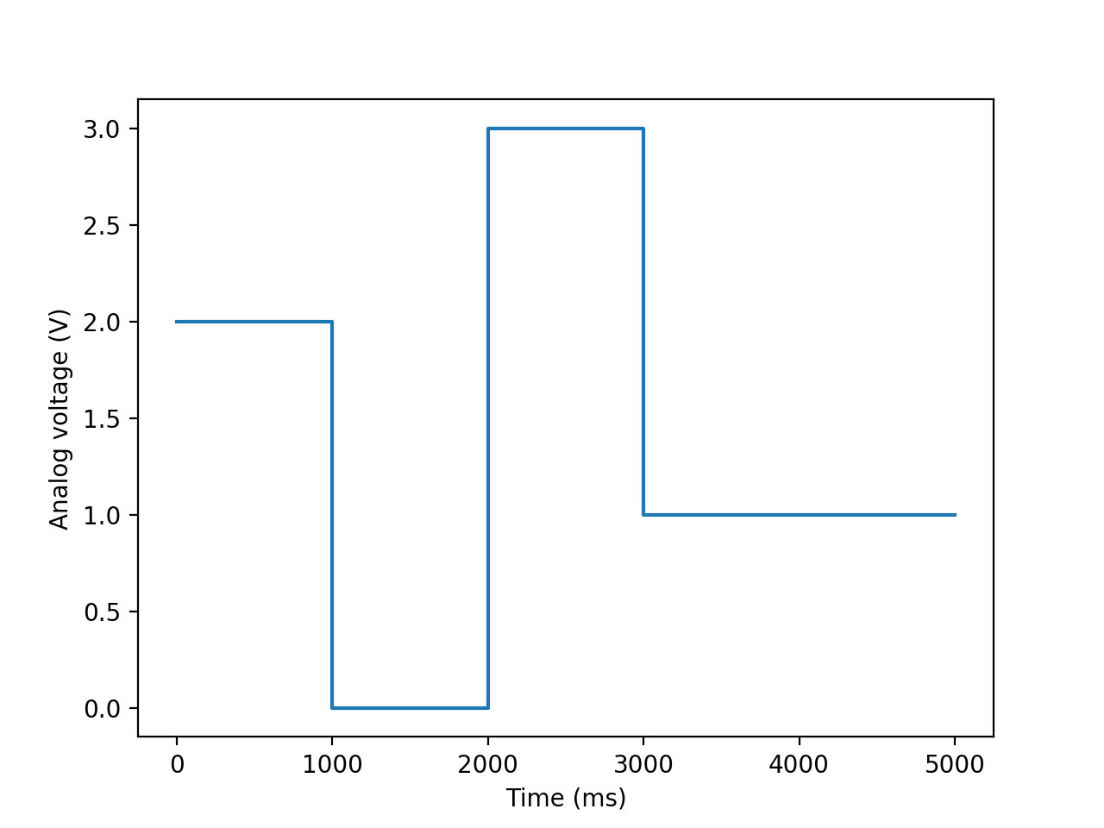
Original input signal
Value generating function
for input frame with
t_{start} = 1000ms and
t_{end} = 4000ms and

Slide 6
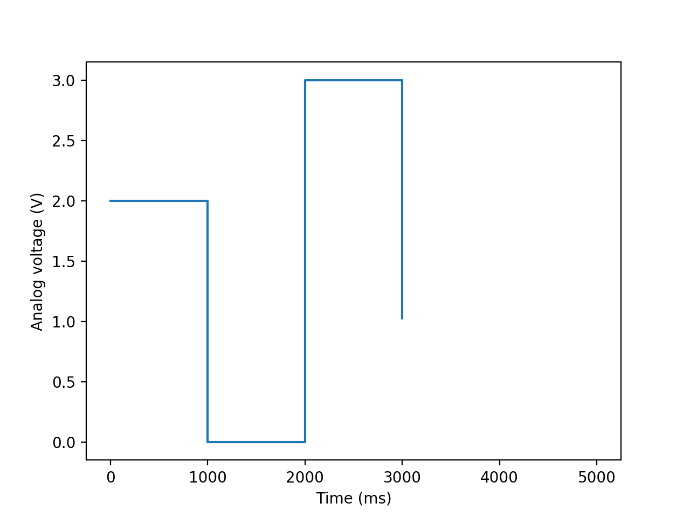
Original output signal
Reference signal,
if frame has
t_{start} = 1000ms and
t_{end} = 4000ms

