Slide 1
Huawei HackatHon
Team FB
Diego Menin (MSc TCD)
Joao Santos (PhD TCD)
(undergrad UCD)

Slide 2
Motivation
Have you ever felt bored looking for something to spend time on?
Or maybe overwhelmed by having too many option?
How to decide depending on your mood?

Slide 3
solution
Use Machine Learning Method
Capture the user’s emotion;
Refine Suggest Activities based on the person’s feeling + other variables (day of the week, time, age, location, etc…)

Slide 4
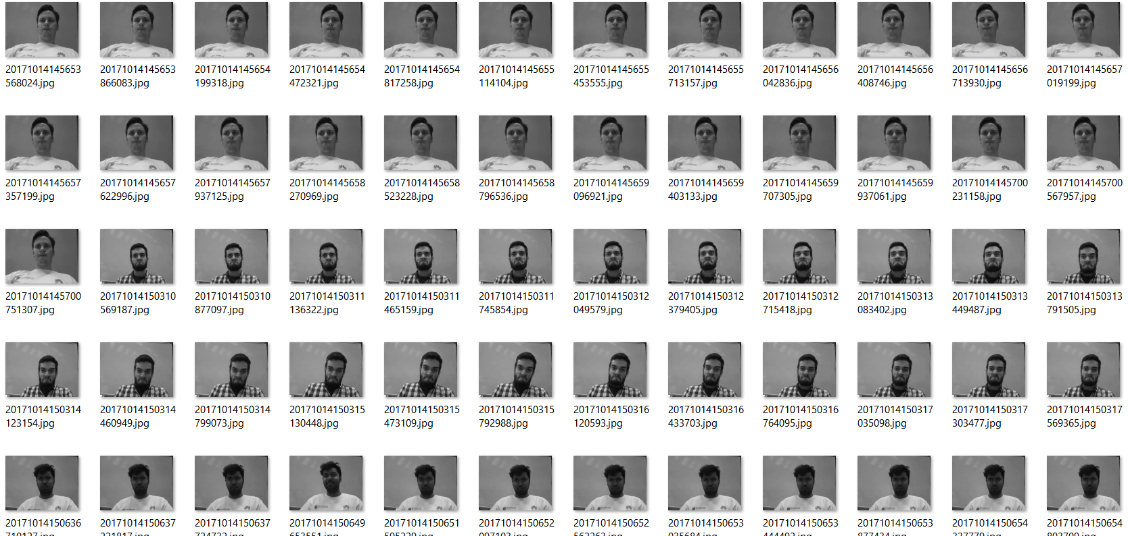


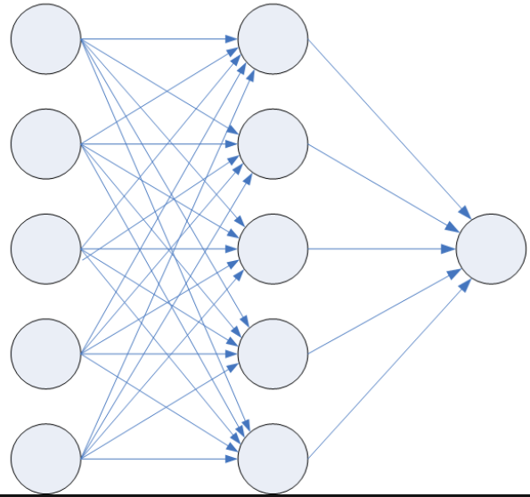
MODEL – part1

Slide 5
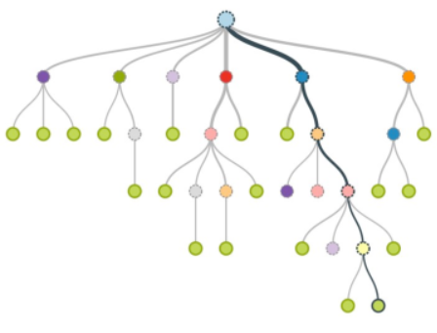



MODEL – part 2

Slide 6
DEMO

Slide 7
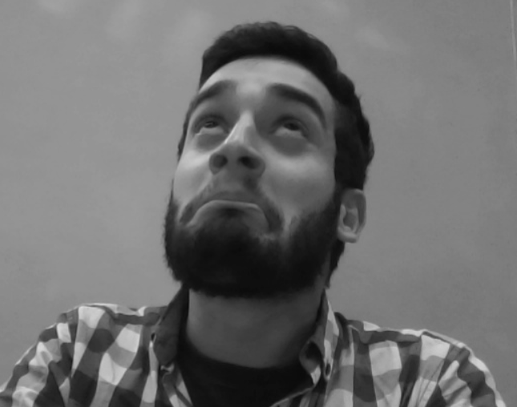

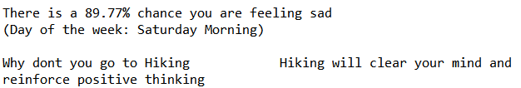

Slide 8
FUTURE?
Link with Facebook\Instagram account and suggest group activities

Slide 9
