Slide 1
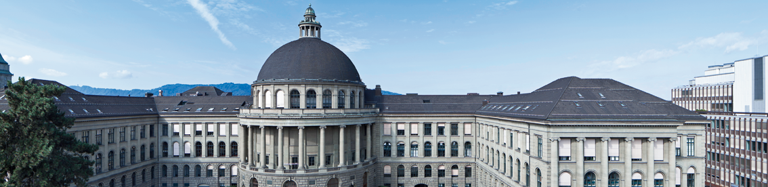
Lightweight Face Detection on Wearable Microcontroller
Edoardo Mello Rella, Davide Menini

Slide 2
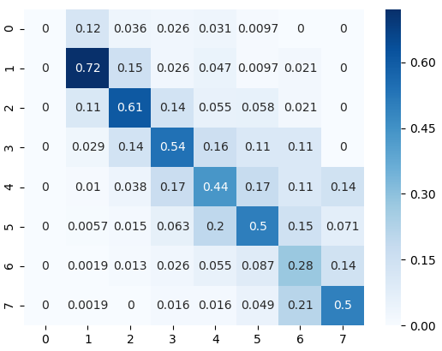
Ideal Algorithm
Multi-Task CNN
3 cascaded CNNs, for a total of 500k parameters
Works with RGB images of any shape
Various iterations at different scale
Needs a quite high resolution to work properly
Detects also face details (out of scope)
Accuracy
86.55% with IoU-F1 metric
Great results, but definitely a dream for a MCU

Slide 3
Real Implementation
Image Preprocessing on Host Device
Gaussian smoothing to spread information over neighboring pixels accuracy
Downscaling the max dimension to size 90 memory, accuracy
Padding to size 90x60x3 using boundary values MCU constraint
Normalization of intensities accuracy
Original CNN lightened and flashed on ARM Cortex-M7 memory, accuracy
Postprocessing on Host Device
CNN’s outputs transformed from predictions to boxes
Clean-up to reduce false positives accuracy

Slide 4
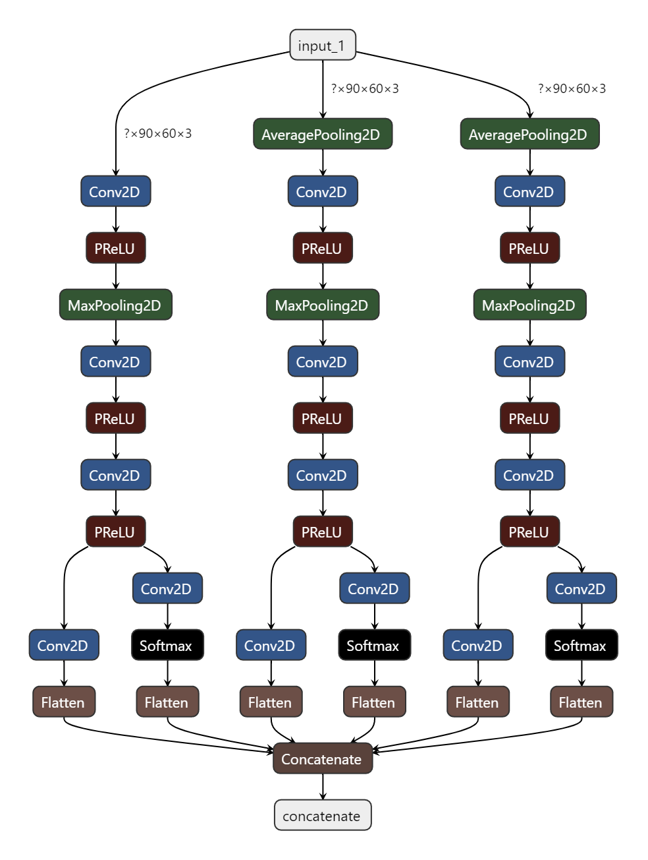
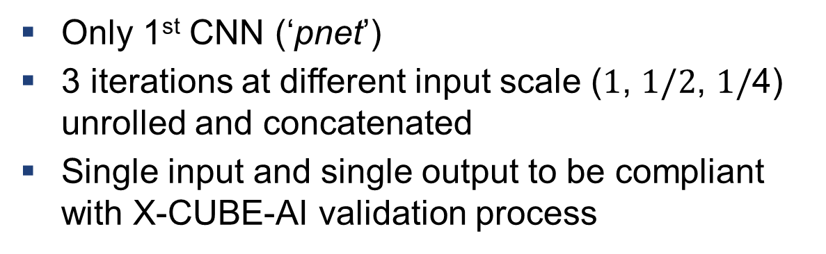


Real Implementation - CNN
Only 1st CNN (‘pnet’)
3 iterations at different input scale ($1$, $1/2$, $1/$4) unrolled and concatenated
Single input and single output to be compliant with X-CUBE-AI validation process
$$1/2$$
$1/$4
Parameters | 19’896
RAM | 301 kB (205 kB + 96 kB)
ROM | 81 kB
MACs | 9’974’344

Slide 5
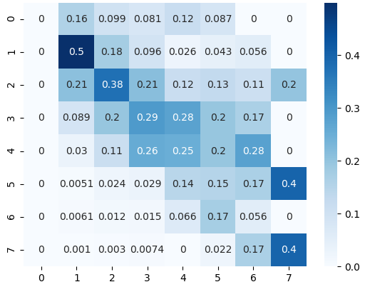
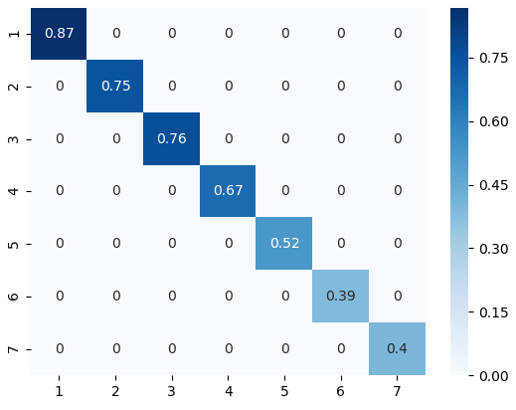
Results - Accuracy
Accuracy: 76.62% with IoU-F1 metric (tolerance ±1)

Slide 6
Results - Profiling
Profiling on STM32F756 @192MHz
Results from X-CUBE-AI (‘validate on target’), double checked by using the DWT_CYCCNT register to count cycles at runtime.
Duration (on average) | 363.6 ms
CPU cycles | 69’811’225
MACs | 9’974’344
Efficiency | 7 cycles/MAC (float32)
Bottleneck | 159 ms for 3rd conv2D

Slide 7
Notes & Future Work
7 cycle/MAC is not optimal. We could accelerate it using some advanced DSP extensions of Cortex-M7 (e.g. CMSIS-DSP library)
Training the network by ourselves would allow some improvements:
Higher accuracy
Using grayscale images to reduce memory occupation and computation time
Using float16 instead of float32
Postprocessing in C was complicate and would have required more time

Slide 8
Thank you for your attention!

