Slide 1

GPU Acceleration of Inverted Index Search
Luca Colagrande
Davide Menini
Supervisors: Lukas Cavigelli, Michael Hersche

Slide 2
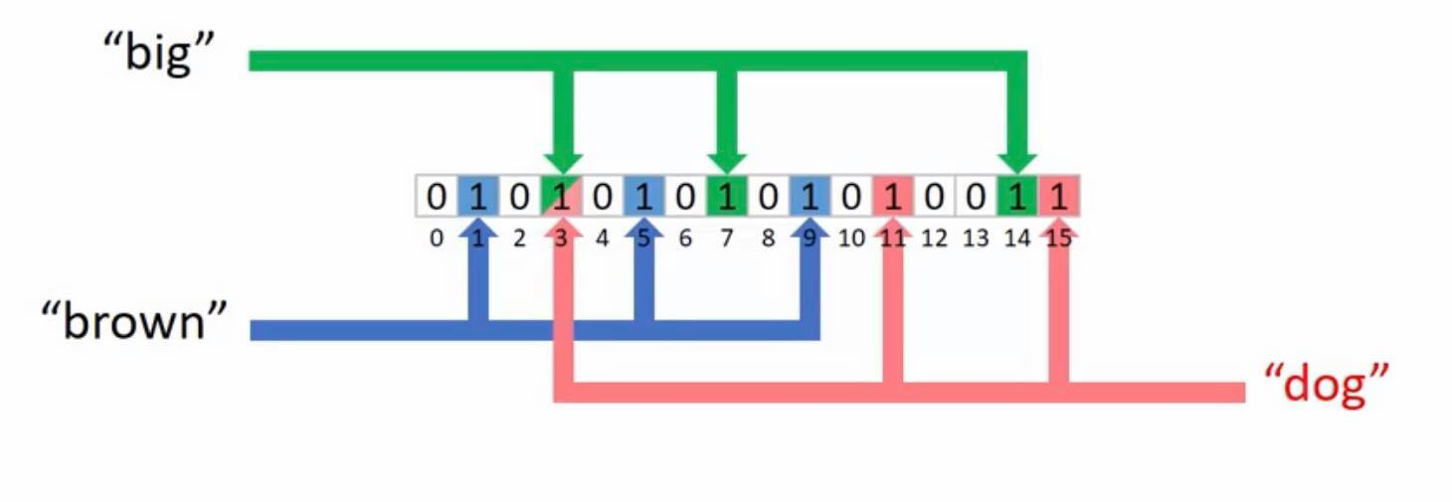
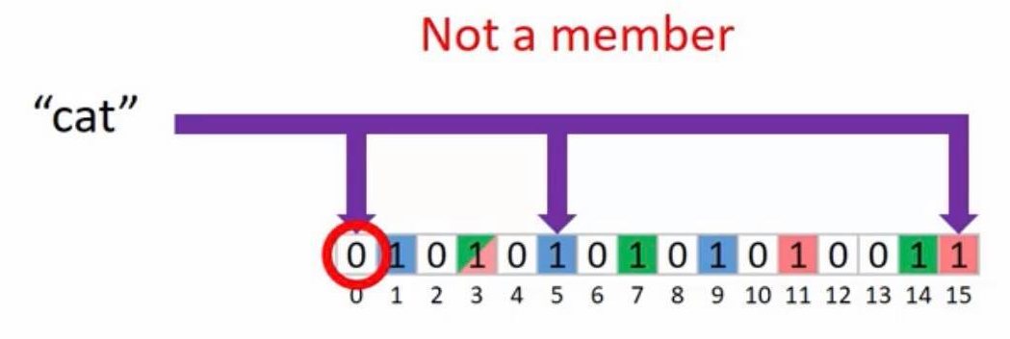
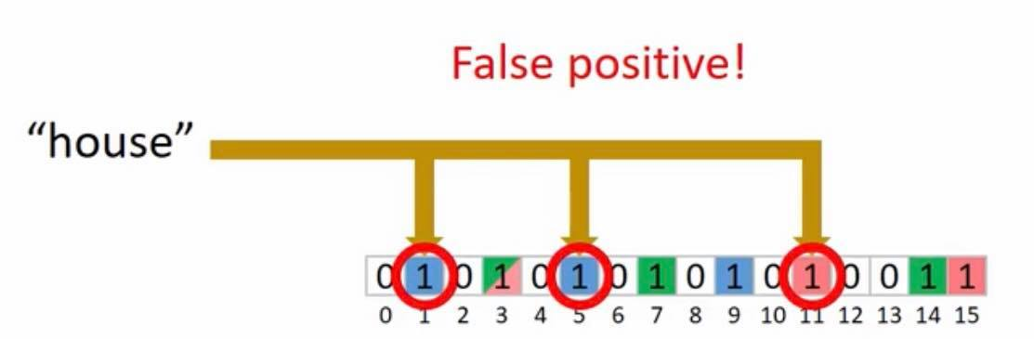
Bloom Filters
D=16
S=3
Generate D-bit array encoding for each text
S hash functions map word to 1s in array
Text encoded by OR-ing words
Same encoding applies to query
Search: compare text and query 1s
Zero false negatives
Possible false positives
Filter sparsity is a desired property

Slide 3
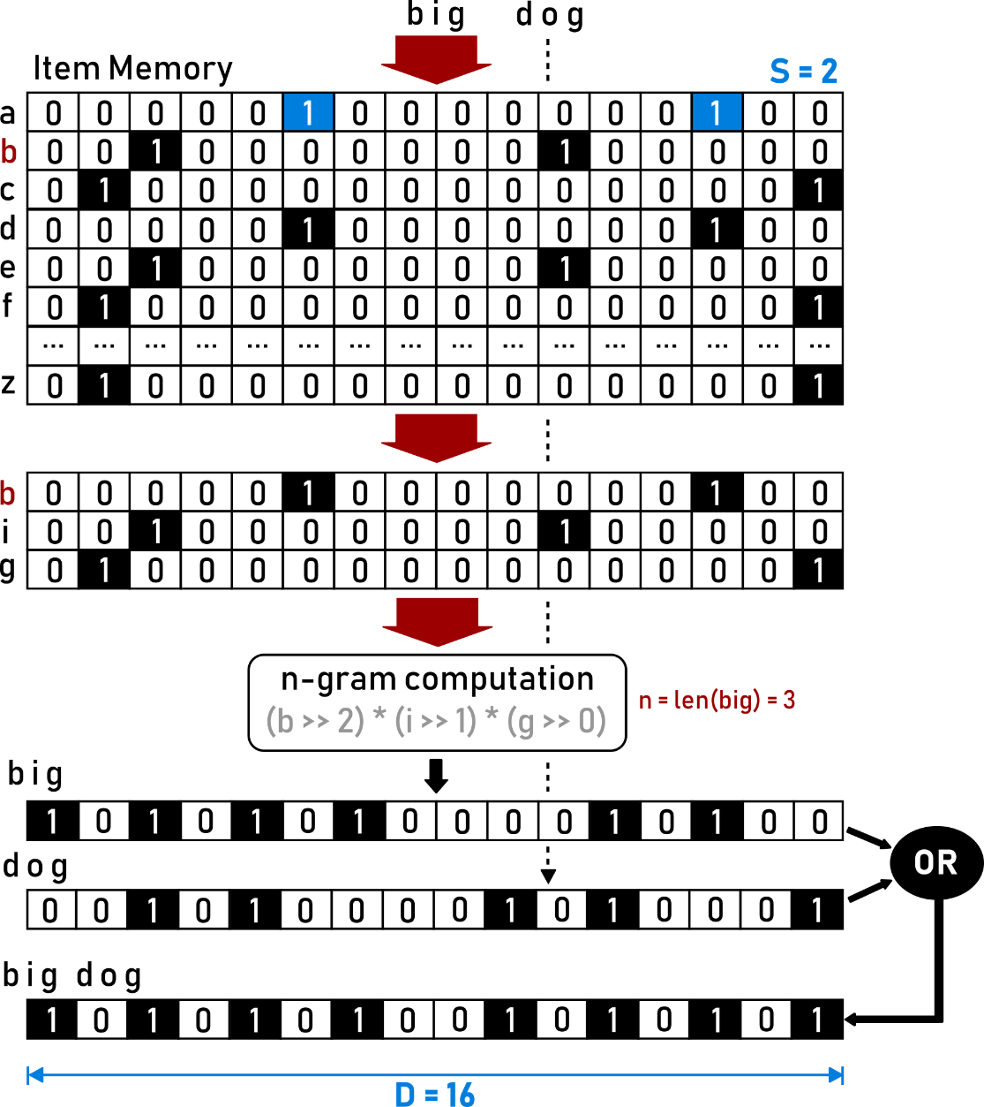

Hyperdimensional Computing
To generate “Bloom” filters
Alphabet encoded to hypervectors
Pseudo-random orthonormal hypervectors
Length D, sparsity
Combine letter hypervectors into word n-grams
Circular shift, multiply (XOR)
Use hypervectors as Bloom filters
OR words together to encode text
$$\frac{D−S}{D}$$

Slide 4
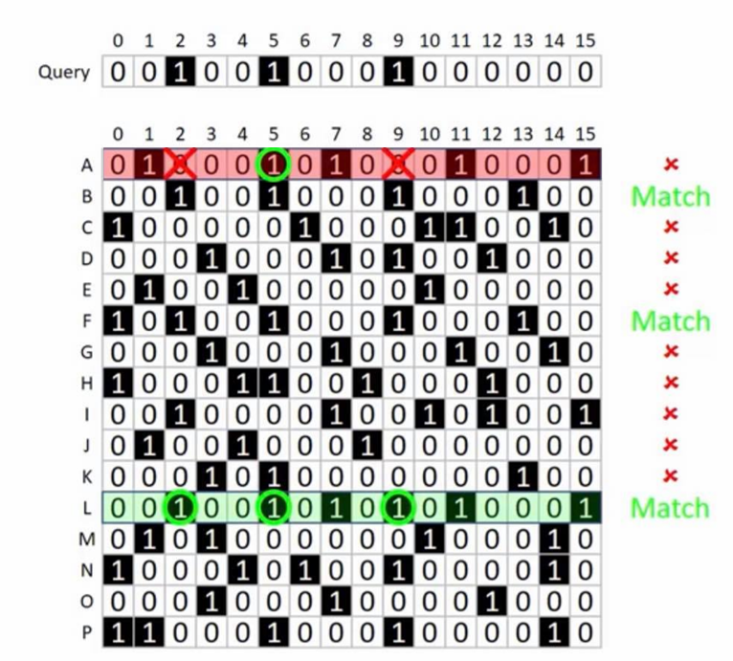
Forward Index Search
Starting from dictionary of all text encodings
Example: documents A-P, 16-dimensional vectors
Compare query to each entry
Match if all 1s are present (exhaustive search)
Overhead to access bits
Memory: bandwidth to load whole word
Processing: bit twiddling

Slide 5
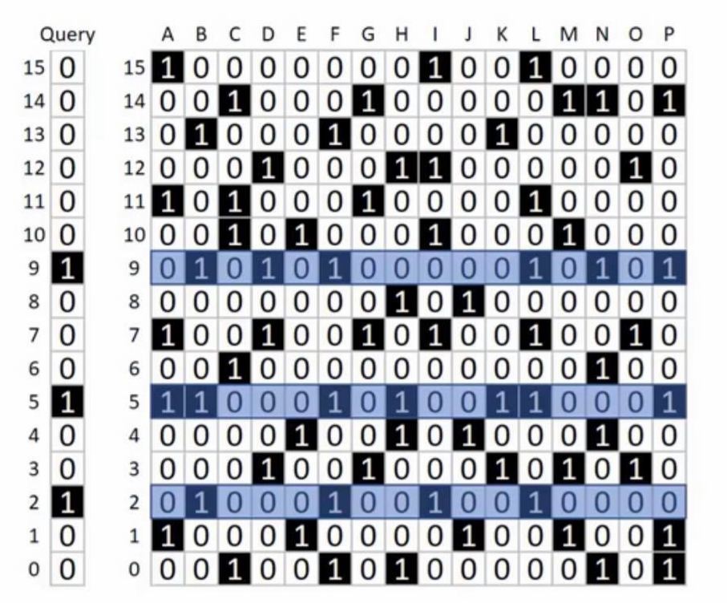
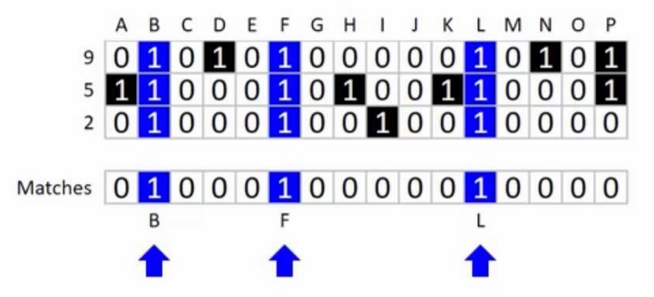
Inverted Index Search
Index all inverted dictionary rows (part 1)
Perform AND of rows to obtain match vector (part 1)
Find matches as 1s in match vector (part 2)
Select query encoding which eases finding 1s
Char for each bit, no bit-twiddling
Select inverted dictionary encoding
Integer-packed 32 bits per row

Slide 6
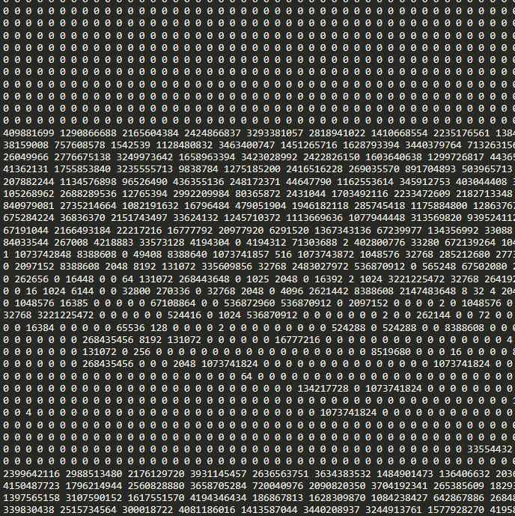
Setup
HDC-Language-Recognition set: 21000 texts
We extend Python hdlib module
Configurable hypervector length and sparsity
Python to generate dictionary and query
Python forward index search golden model
C inverted index search implementation
CPU: Intel Core i7-4790 @3.60GHz
CUDA acceleration
GPU: NVDIA GeForce GTX 1080-Ti @1.734Ghz

Slide 7
False Positives Rate on Varying Sparsity and Dimensionality
spar
Simple query: optimal sparsity is 1.5%
Greater sparsity can’t capture diversity
Lower sparsity leads to word overlaps
More complex query yields less false positives
Higher dimensionality allows to better capture texts’ diversity
Sparsity fixed accordingly

Slide 8
CPU Implementation
1. Basic forward index algorithm
Inverted index
for j in range(N_FILES):
for i in range(D):
if query[i]==1:
match_v = match_v & dict[j][i]
for j in range(INV_DICT_WIDTH):
for i in range(D):
if query[i]==1:
match_v = match_v & inv_dict[i][j]
2. Forward index with loop interchange
4. Inverted index with loop interchange
for i in range(D):
if query[i]==1:
for j in range(N_FILES):
match_v = match_v & dict[j][i]
for i in range(D):
if query[i]==1:
for j in range(INV_DICT_WIDTH):
match_v = match_v & inv_dict[i][j]
C Implementation | Query search
Basic | 394ms
Basic (loop interchange) | 3.6ms
C Implementation | Query search
Inverted index | 12.3ms
Inverted index (loop interchange) | 70us

Slide 9
GPU Implementation
CUDA code (part 1)
Threads execute across columns
Query pre-processing to find ones
Lower host-to-device communication
Lower sequential processing overhead
Dictionary padded in GMEM
CUDA implementation | Query search | Global load efficiency | Host to Device
Basic | 6.59ms | N.A. | 1.5us
Pre-process query | 43.84us | 70.6% | 0.8us
G-mem padding | 42.26us | 81.5% | 0.8us
if(th_index < INV_DICT_WIDTH) {
match = 0xFFFFFFFF;
for(i=0; i<D; i++) {
if(query[i]==‘1’) { //line removed with pre-processing
match_v = match_v & *(inv_dict + i*INV_DICT_WIDTH_PAD + th_index);
}
}
}
ones_cnt
query_ones[i]

Slide 10
CPU and GPU performance with increasing database size
#txt
#txt
Compute match vector
Find matches in match vector
Compute match vector
Find matches in match vector
MemCpy DeviceToHost

Slide 11
CPU vs GPU vs Heterogeneous Solutions
#txt
#txt
Compute match vector on GPU
Find matches in match vector on GPU
MemCpy DeviceToHost
Compute match vector on CPU
Find matches in match vector on CPU

