Slide 1
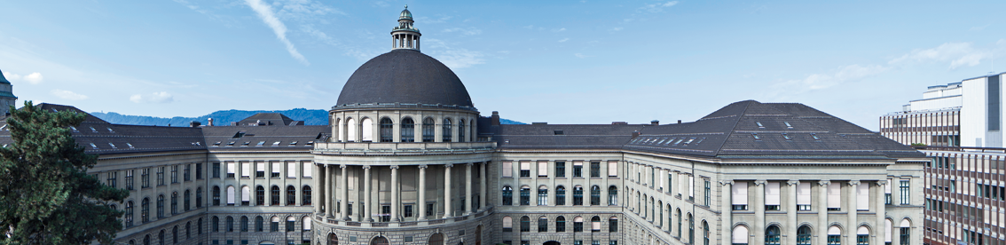
NVDLA Meets PULP
Semester Thesis – Davide Menini
Professor: Luca Benini
Supervisors: Fabian Schuiki, Florian Zaruba

Slide 2
NVDLA Meets PULP: Goals
NVDIA Deep Learning Accelerator (NVDLA) is an open source project released as Verilog source code.
Getting familiar with NVDLA environment and run a convolution test on it.
Synthesize NVDLA in UMC 65nm.
Extract figures about area, power and overall efficiency.
Area is accurate (Synopsys DC)
Power analysis has to be finished, thus it is not included yet (due date is 17.06)
Make a comparison against NTX accelerator.

Slide 3
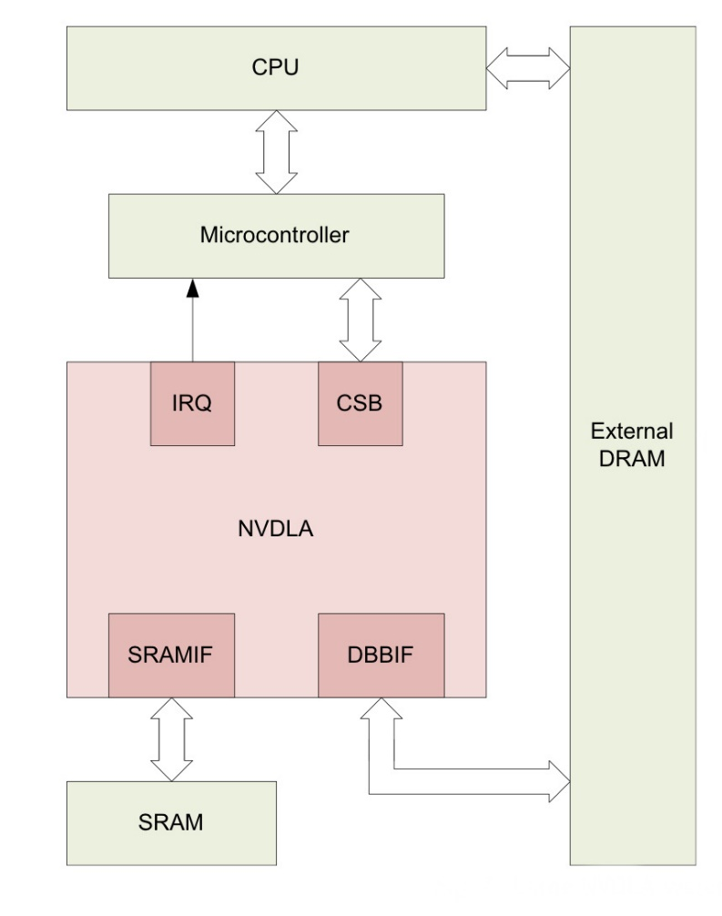
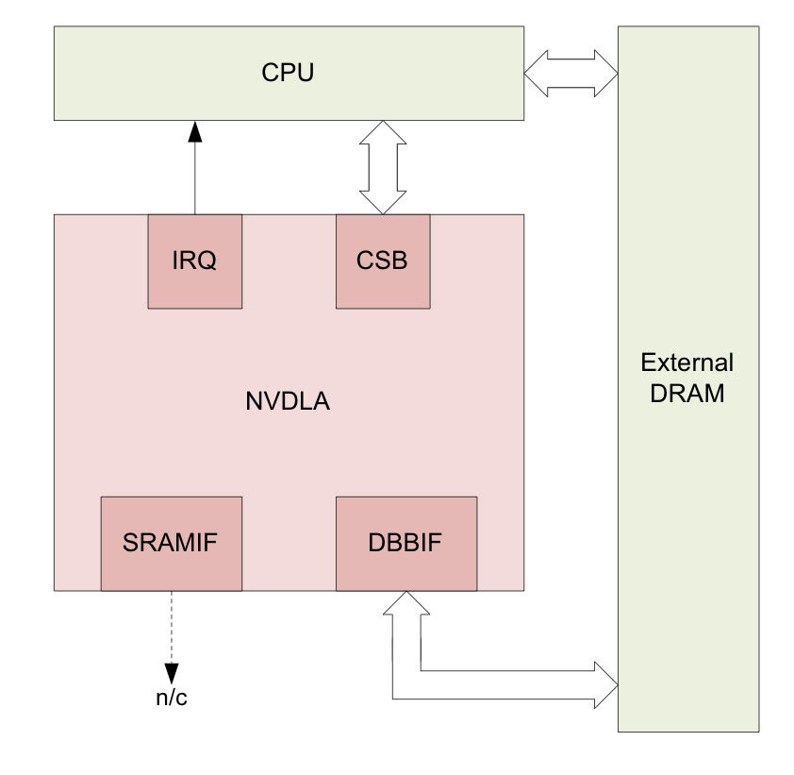
NVDIA Deep Learning Accelerator
A configurable hardware accelerator targeting inference operations in deep learning applications.
Large | NVDLA | Small
int16, fp16 | Precision | int8
500MHz | Frequency | 500MHz
advanced | Features | basic
27 mm² | Area | 7 mm²
1 Tflop/s | Performances | 64 Gop/s
µC | Host | CPU
yes | Extra SRAM | no
Large: 16 MAC cells with 64 fp16 multipliers each.
Small:. 4 MAC cells with 16 int8 multipliers each.

Slide 4
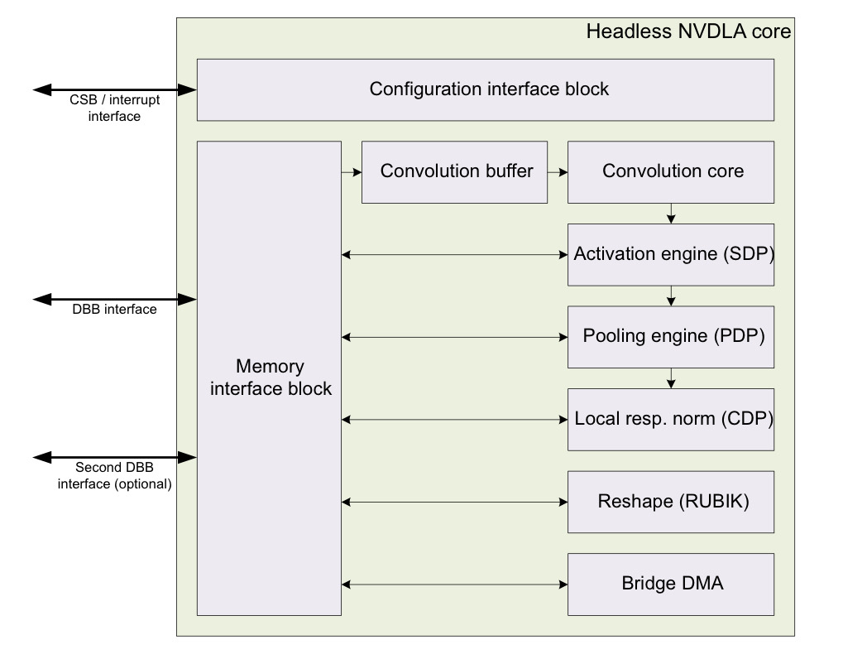
External Interface
Independent mode or fused mode.
Simple Configuration Bus used by the host to configure sub-unit registers
different clock domain
3 channels: request, read data, write response
Interrupt channel to notify events to the host.
Two AXI-compliant interfaces to access memories:
DBBIF to access main DRAM memory
NVDLA core clock (500 MHz)
SRAMIF to access on-chip SRAM:
Lower latency, higher throughput

Slide 5
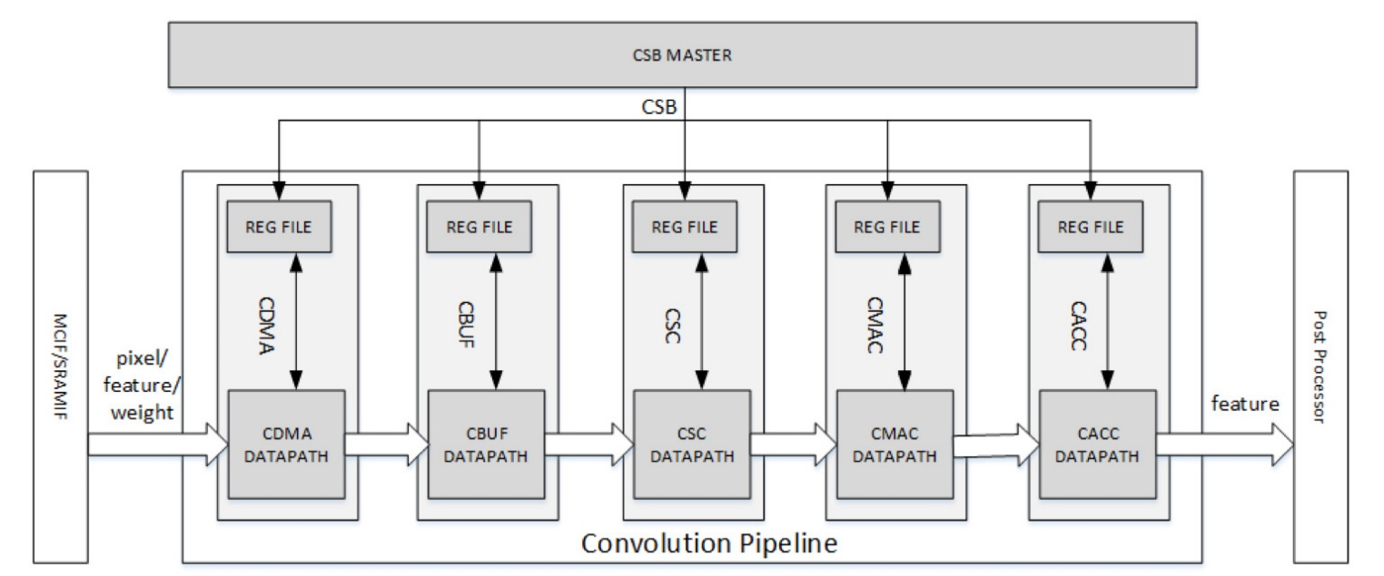
Where are we?
Convolution Pipeline: Convolution DMA (CDMA)

Slide 6
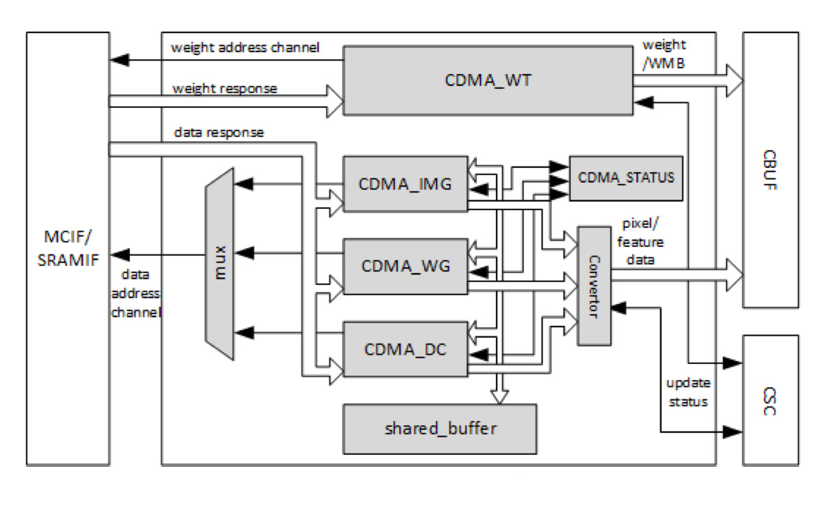
Convolution Pipeline: Convolution DMA (CDMA)
CDMA fetches data and weights from memory and stores them into CBUF in the order needed by the current convolution mode.
Several convolution modes to increase MAC cell utilization and reduce memory traffic:
Direct Convolution
Winograd
Input Image

Slide 7
Where are we?
Convolution Pipeline: Convolution Buffer (CBUF)

Slide 8
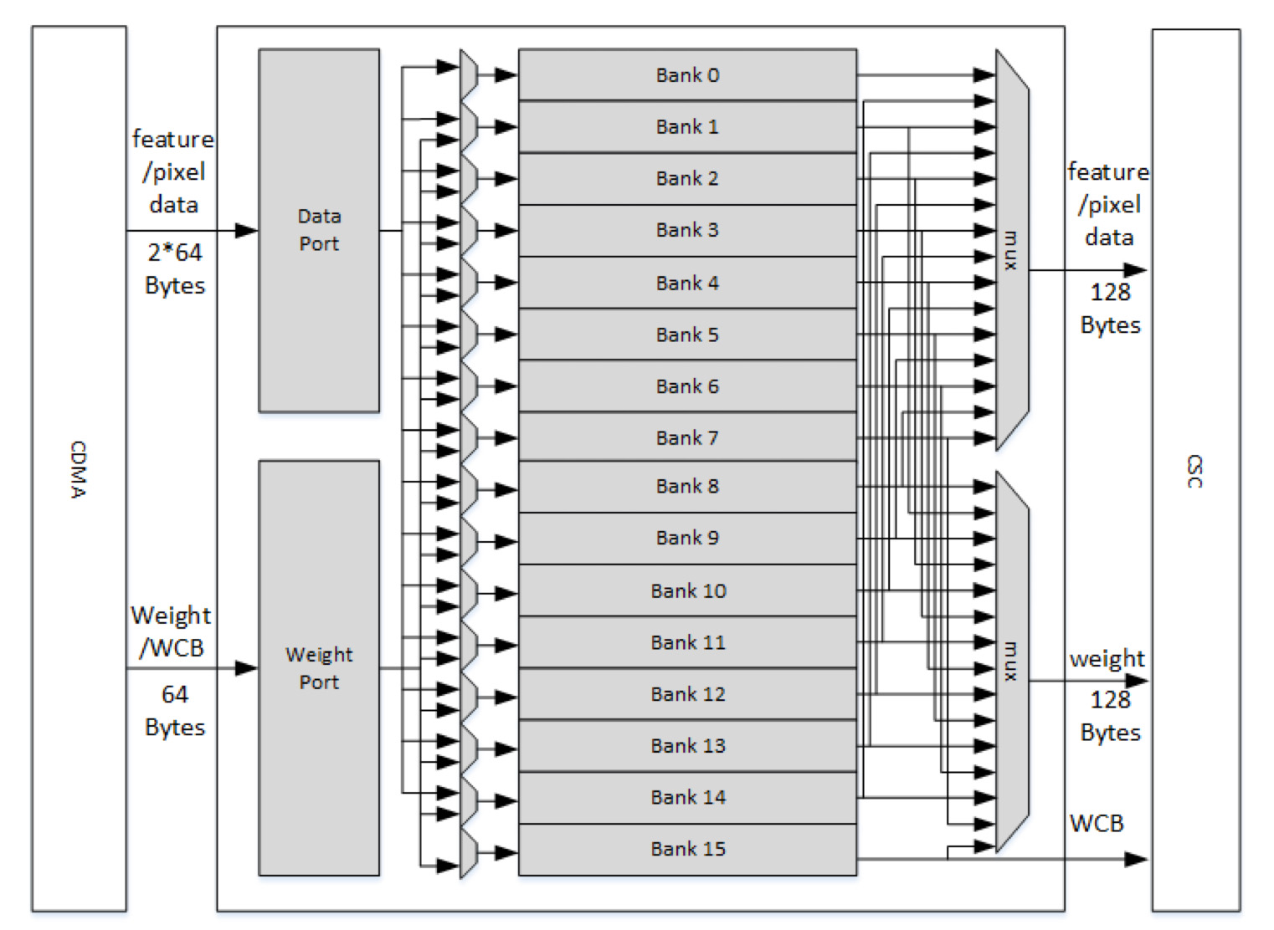
Convolution Pipeline: Convolution Buffer (CBUF)
CBUF caches input pixel data, feature data and weights.
16x 32KB banks, for a total of 512KB.
A bank consists of two two-port SRAMs.
Three 64B read ports, two 128B write ports.
Bandwidth: 256B/cycle →128 GB/s
Estimated memory area: 8.91 mm² (25%)

Slide 9
Where are we?
Convolution Pipeline: Convolution Sequence Controller (CSC)

Slide 10
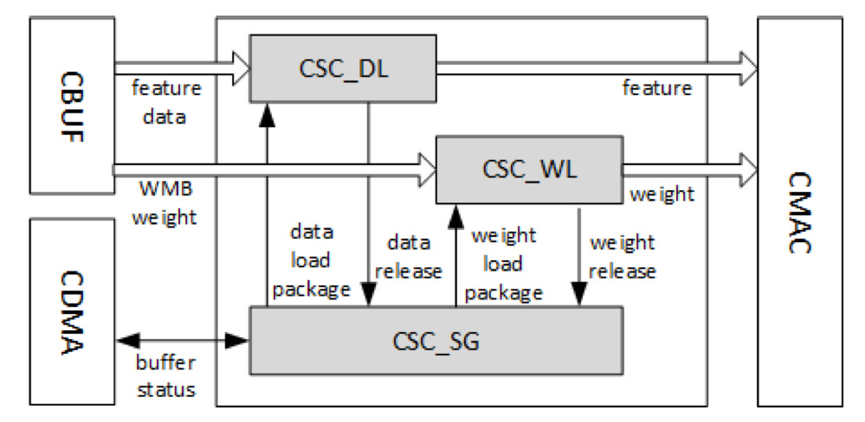
Convolution Pipeline: Convolution Sequence Controller (CSC)
Responsible for loading data and weights and sending them to the MAC units.
Sequence Generator is a FSM which generates the sequence of weights/features.
16 clock cycles to send weights to MAC units.

Slide 11
Estimation: CDMA + CBUF + CSC (Pre-processing)
Area = 12.732 mm² = 8.48 MGE (42%)
Logic = 3.396 mm² = 2.36 MGE
Memory = 9.336 mm² = 6.12 MGE
Largest partition of the accelerator

Slide 12
Where are we?
Convolution Pipeline: Convolution MAC (CMAC)

Slide 13
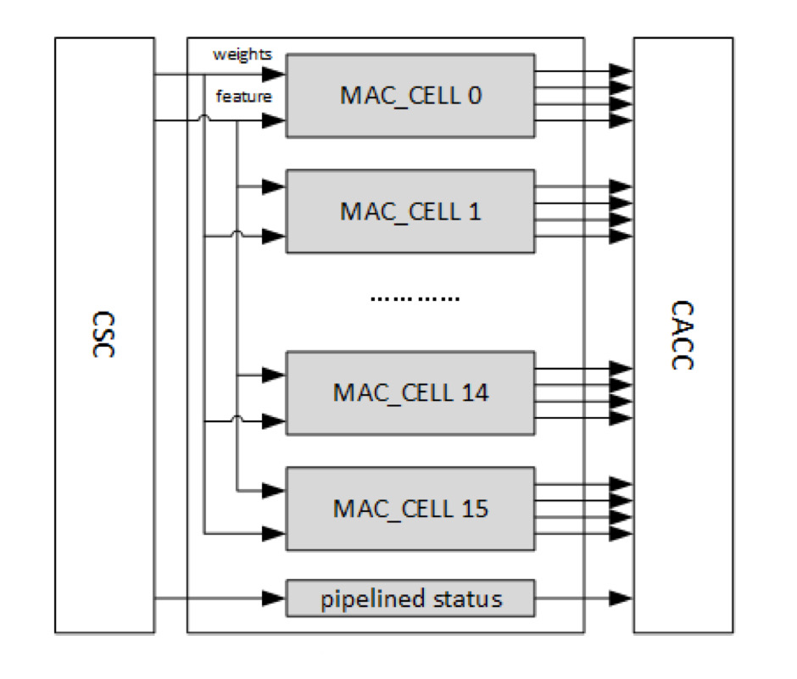
Convolution Pipeline: Convolution MAC (CMAC)
16 MAC Cells → MAC Array
Each cell has hardware for 64 int16/fp16 MACs or for 128 int8 MACs.

Slide 14
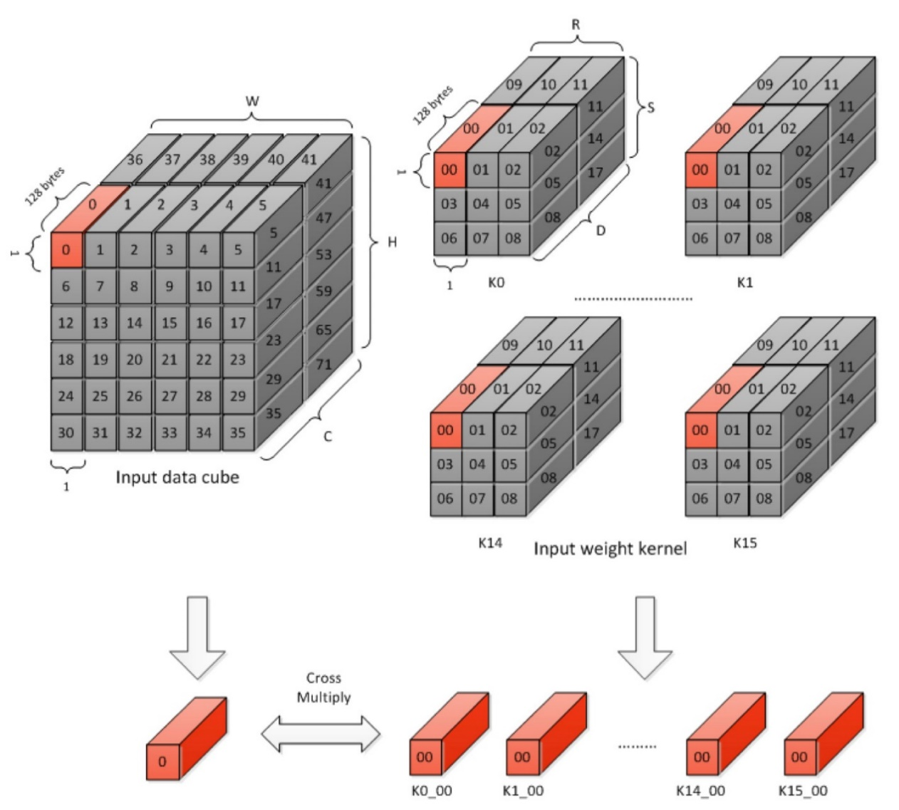
Convolution Pipeline: Convolution MAC (CMAC)
16 MAC Cells → MAC Array
Each cell has hardware for 64 int16/fp16 MACs or for 128 int8 MACs.
They cache weight cubes (1x1x64) from 16 different weight kernels.
Each cycle an atomic operation is performed, resulting in 16 partial sums per cycle.
Partial sums are sent to CACC for further processing.

Slide 15
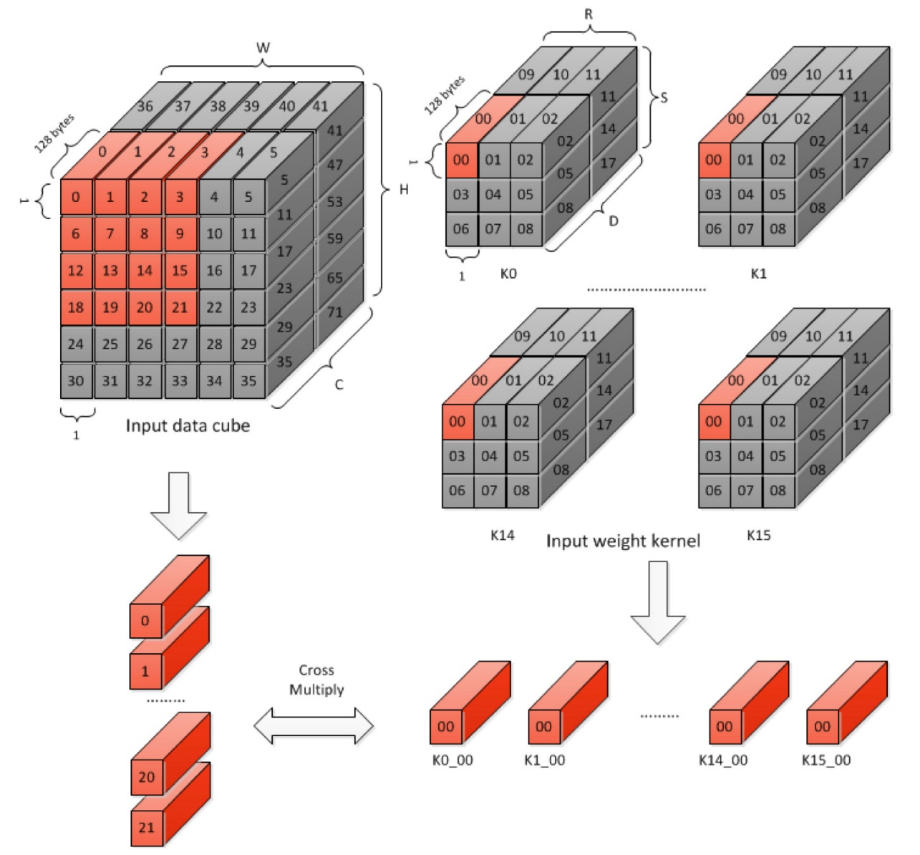
Convolution Pipeline: Convolution MAC (CMAC)
16 MAC Cells → MAC Array
Each cell has hardware for 64 int16/fp16 MACs or for 128 int8 MACs.
They cache weight cubes (1x1x64) from 16 different weight kernels.
Each cycle an atomic operation is performed, resulting in 16 partial sums per cycle.
Partial sums are sent to CACC for further processing.
For 16 cycles weights are kept unchanged, while data slide along input data cube (stride operation).

Slide 16
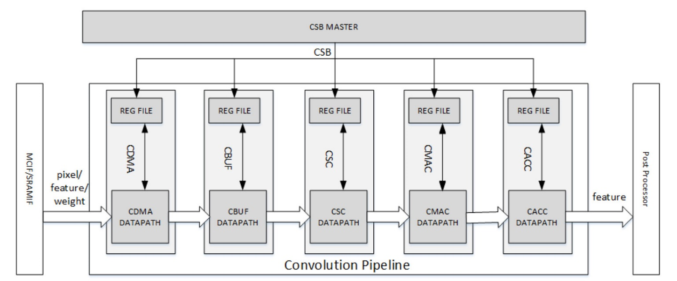
Estimation: CMAC
Area = 6.017 mm² = 4.18 MGE (2%)
Format | MAC/cycle | Peak performances | Area efficiency
int16 / fp16 | 1024 | 1 Tflop/s | 166 Gflop/mm²s
Int8 | 2048 | 2 Top/s | 332 Gop/mm²s

Slide 17
Where are we?
Convolution Pipeline: Convolution Accumulator (CACC)

Slide 18
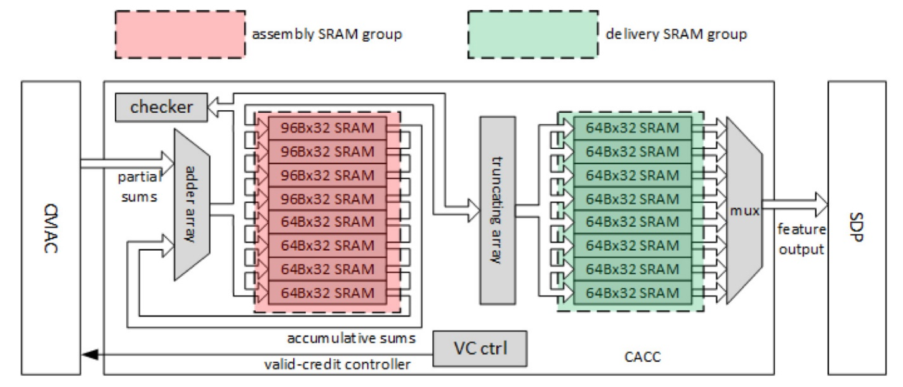
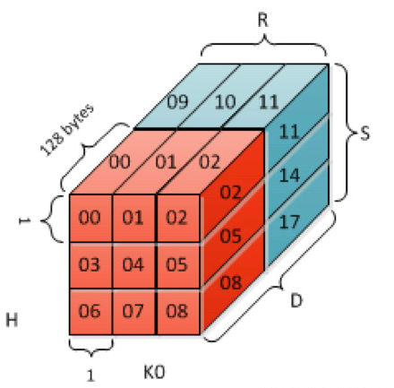
Convolution Pipeline: Convolution Accumulator (CACC)
CACC accumulates partial sums and rounds the result before SDP (fp48 → fp32).
Assembly group to cache accumulative sums.
Delivery group to cache rounded results.
Partial sums are accumulated in terms of stripe operation until a channel operation is done.
This takes RxSxC iterations and at least 11 cycles per iteration.

Slide 19
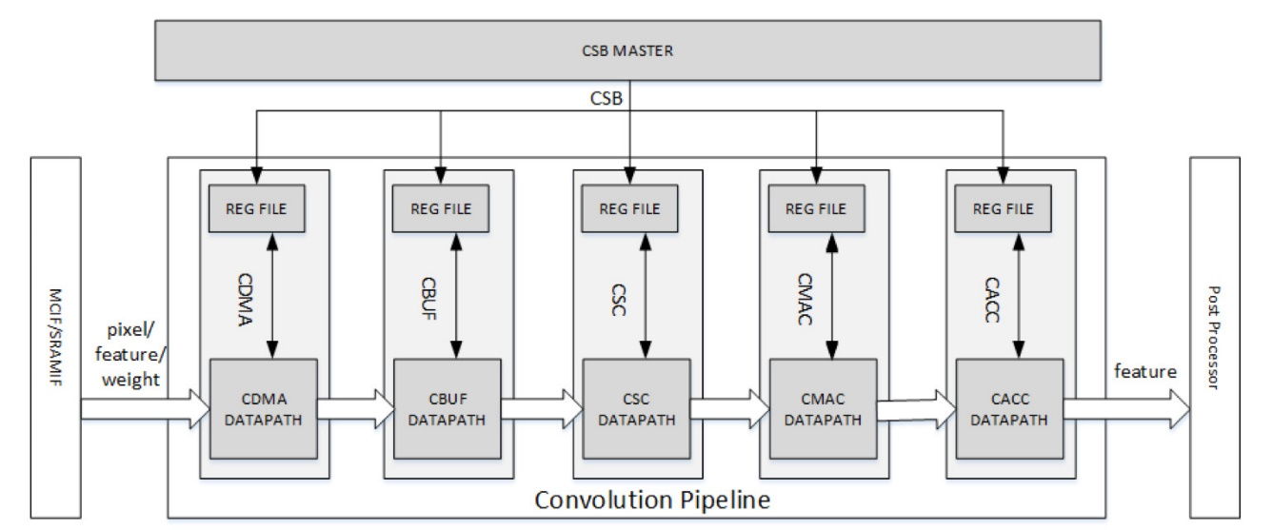
Estimation: CACC
Throughput: 16 fp32/cycle → 32 GB/s
Area = 3.683 mm² = 2.57 MGE (13%)
Logic = 1.814 mm² = 1.26 MGE
Memory = 1.869 mm² = 1.31 MGE

Slide 20
Where are we?
Single Data Point Processor (SDP)

Slide 21
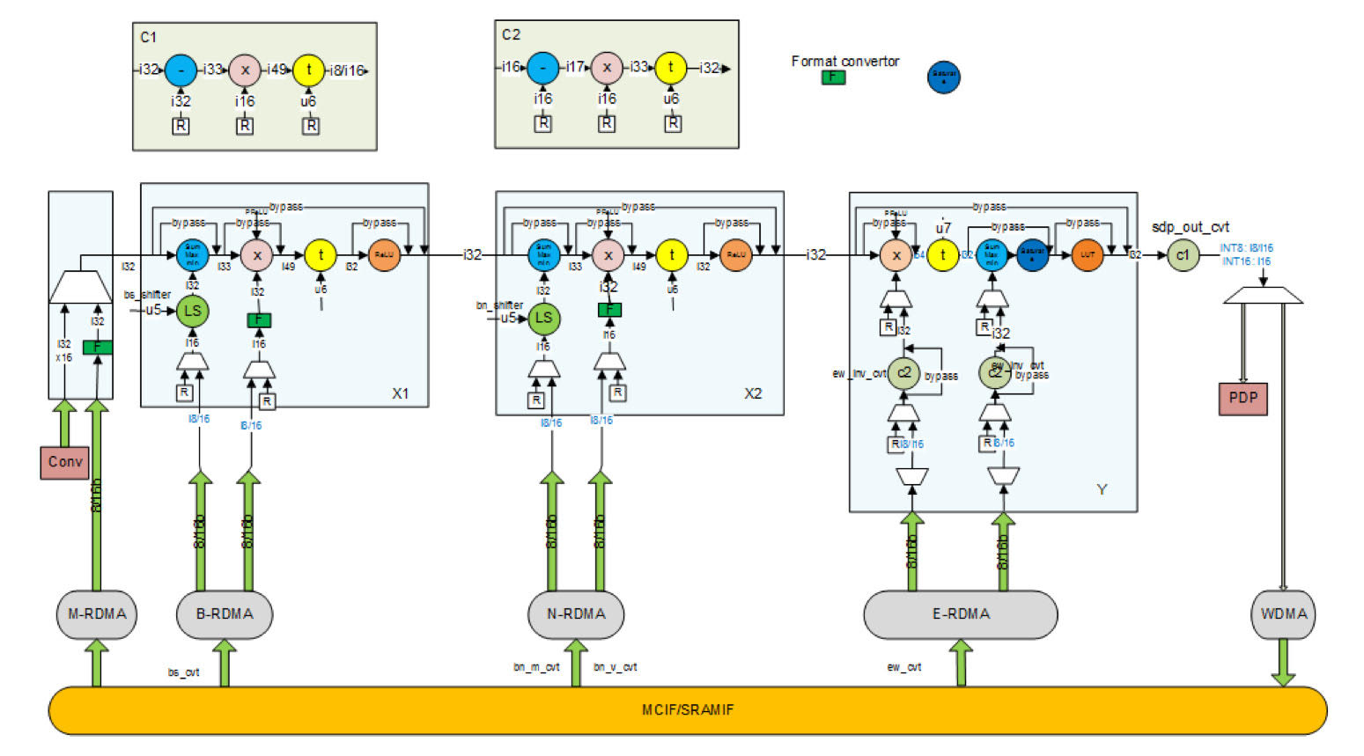
Single Point Data Processor (SDP): Activation
Operations:
Bias Addition
Non-linear Function (look-up table)
Batch Normalization
Format conversion
Load parameters from memory/register.
LUT buffer, read DMA buffer and write DMA buffer used to hide memory latency and to provide necessary access bandwidth.

Slide 22
Estimation: SDP
Throughput: 16 fp16/cycle → 16 GB/s
Area = 4.472 mm² = 3.19 MGE (16%)
Logic = 3.709 mm² = 2.58 MGE
Memory = 0.763 mm² = 0.61 MGE

Slide 23
Post Processing Operations
Planar Data Processor (PDP) → Pooling (max, min, average)
Cross Channel Data Processor (CDP) → Local response normalization
RUBIK → Reshape data cubes in memory
Bridge DMA → Move data between memories (DRAM SRAM)

Slide 24
Post Processing Operations
Planar Data Processor (PDP) → Pooling (max, min, average)
Cross Channel Data Processor (CDP) → Local response normalization
RUBIK → Reshape data cubes in memory
Bridge DMA → Move data between memories (DRAM SRAM)
Estimation
Area = 7.866 mm² = 5.48 MGE (27%)
Logic = 6.509 mm² = 4.52 MGE
Memory = 1.357 mm² = 0.96 MGE

Slide 25
NVDLA vs NTX
Figure of Merit | NVDLA ‘full’ | NVDIA stated | NTX ‘big’
Technology | UMC 65nm | 28nm | 28nm FD-SOI
Note | 16 MAC Cells 512KB CBUF | 16 MAC Cells 512KB CBUF | 64 clusters 8MB TCDM
Frequency [GHz] | 0.5 | 1 | 1.5
Precision | fp16 | int8 | fp32
Peak Performance [Gop/s] | 1024 | 4096 | 1536
Area Efficiency [Gop/mm²s] | 29.5 | 744.7 | 37.5
Area [mm²]
Logic | 21.5 | - | 21.5
Memory | 13.3 ¹ | - | 19.5
Total | 34.8 | 5.5 ² | 41.0
No secondary SRAM.
No secondary SRAM, results vary based on foundry and libraries.

Slide 26
Conclusion: My Contribution
Run different tests in trace form on NVDLA through the provided verification suite (Verilator, VCS with Verdi wave viewer).
The main difficulty was understanding the environment and the dependencies between modules (417 in total) and scripts.
Exported the convolution trace test to umcL65 cockpit to run it with Modelsim.
Synthesized NVDLA in UMC 65nm technology with Synopsys DC.
NVDLA requirements for synthesizable memories are unusual (e.g. 64x236), thus realizing them with the RAMs provided by Faraday while keeping the overhead small was not easy.
Area estimation (via Synopsys DC + manual optimizations).
Power estimation (available in the final report).

Slide 27


