Slide 1
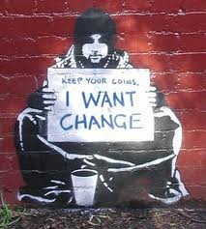
Change
How to program with it in mind

Slide 2
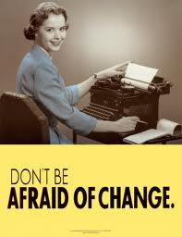
What we are going to do
Golden Rules
Talk about conventional ideas of change
Look at the deeper nature of change
Give some examples on how to program to gracefully to accept change
Start some preferences
Have everyone give some examples

Slide 3
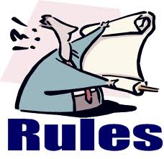
Remember the rules….
Good software design is making good decisions so your user can’t make bad decisions
You are an user
So are all the people who read your code in the future
Tackle a difficult program by redefining it as a series of solved problems
We will do this today by defining our solved problems to use in the future
Only test the scenarios you want to work in production
Test things that can go wrong in a truthful way

Slide 4

But let’s add one more
Always write code that shows your intent
The intent is the wording of the spec
So the new golden rule is:
Always write code that tells the intent of the specification

Slide 5
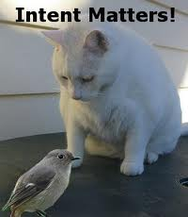
Examples of Intent
GetCustomerPreferences()
SetCustomerPreferences()
IsACustomer
HasAdminPriviledges
DoesCustomerDataExist
InitialSetupWizard.Start()
InitialSetupWizard.CurrentStep
InitialSetupWizard.GoToNextStep()

Slide 6

When good specs go bad
If you look at the intent and see it has problems…
You need to act
You are the doctor of code and the customer is the patient
You have experience to know the consequences of programming decisions

Slide 7
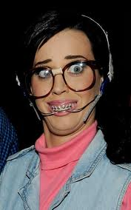
Conventional ideas
Change is basis of all of the Agile movements
Software WILL change over time
Software upgrades
New versions
Bugs
Fact of life
But why?

Slide 8
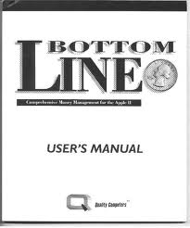
Bottom Line
We want to build software that is easy to change
Because it will change
We want to allow people to change their mind
We want to have the least work when they do
We want to verify we haven’t blown anything up that was working
So how does code change?

Slide 9
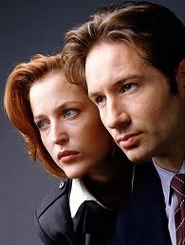
The truth is out there
Code changes mainly happens because your code moves
When the code moves, does it still act the same
We will spend a lot of time of this topic in particular
Code changes because the spec changes
Add new code
Modify existing code
Remove existing code
Code changes because unforeseen issues arise
Bugs
Poorly thought out spec

Slide 10

The first movement
Your code moves
Different machines
Versions
OS
Processors
Links to different machines depending on context
DBServers
WebServices
Inside your project
Refactoring
Client/ Server
Different files/pages
Thought -> Silicon

Slide 11
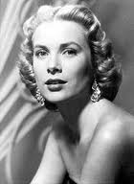
Does it move gracefully?
Graceful movement is …
Needing to recompile as little as possible if at all
Just changing settings
Agnostic or configurable
OS, Web Server, .NET version, Processors(#), Farm or not
Testable for verification
Examples
Config files
Database configurations
Unit Tests

Slide 12

Lifecycle changes
Lifecycle changes are the basic predictable patterns of moving to different machines
Can be solved by configuration files
Most important example is Database
Local->Development->Testing->(Staging)->Production
References to databases should never be in code!
Use Visual Studio to tie your configuration file to a build

Slide 13
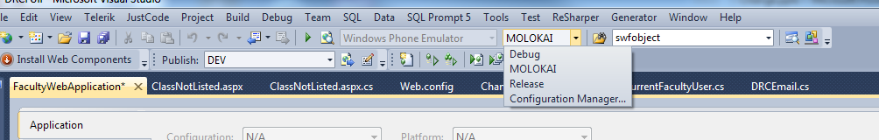
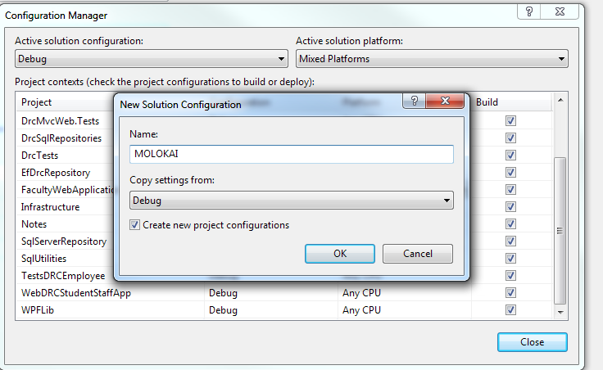
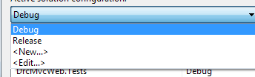
Building for change
Can create “Named” builds
Go to Build->Configuration Manager

Slide 14

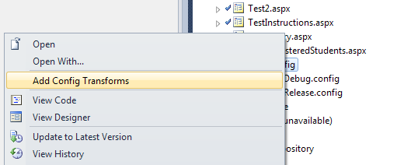
Configuration Transforms
Right click on web.config

Slide 15

Change on Publish
Find correct section of web.config
Match(name)
Means to match this with the name parameter
SetAttributes means set the attributes from this to the web.config for the next place

Slide 16
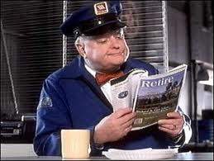
Services
WebAuth
Always use CB’s component
Allow settings of return url in config
WebServices
Usually use config for url
Can you use dynamically with database
Allows user to configure which service
OLA is example
These are called boundaries

Slide 17
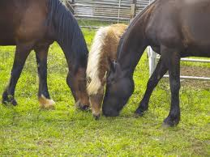
Boundaries
Encapsulate boundaries
Many advantages
Can mock the new object and test your app
Can code your app before boundary exists
Can do learning test for new components
Write tests that verify that you understand what the component does
Allows you to upgrade without fear

Slide 18
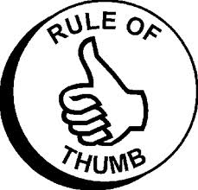
Rule of thumb
If a program will change a value when it moves to a different server, the web.config is the first choice
Use Visual Studio to set up changing automatically
NEVER have information for a changing server hard coded in an application
You can change the config file to a database table if the customer would like to change it even further
This idea lets us best test as if in production

Slide 19

The other important change
Code changes because of who is accessing the application
The most important morphing of this the user access portion of your application

Slide 20

Changes by User Rights
Abilities change depending on which user is used
User can claim something you can’t duplicate
Strategies
Allow config override for local verification
Allow admins to impersonate users

Slide 21
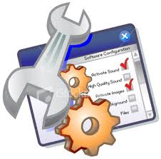
Override in config example
Add Debug and Debug User in Web.Config
Check on local if Debug is Y
If debug is Y then user Debug User
If not use webauth

Slide 22
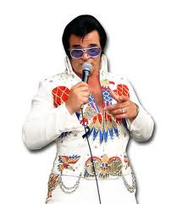
Impersonation Example
Create CurrentUserClass
Create GetCurrentUser()
Checks for current user in session
If doesn’t exist, calls setuser
Create override of SetUser()
No parameters uses User.Identity.Name
One parameter can setup new user
Sets user as session variable

Slide 23
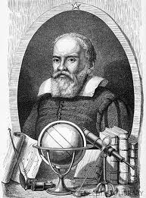
My heresy
Why I hate roles vs. columns
(my) Rule of Thumb
Program against schema not data if possible
Might need to allow user to configure data
Only programmer can change schema
Reason is anticipation of changes

Slide 24

Anticipation of user changes
Most basic-Add a new “role”
When new roles appear, the application need to be setup anyways unless Page rights are set in database
Adding a new bool column is easy and can be an easy expansion of your user class
Page rights become bool-easy to understand
Deployment becomes more transparent via SQL Compare

Slide 25
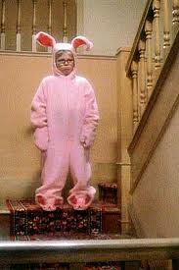
Why I don’t like roles
You have to hard code a number or value for test
This is very fragile
Creates 3 tables vs 1
Have to hard code data to work
Get multiple rows
Need to loop

Slide 26
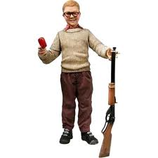
Other user interests
Make a user class separate from User.Identity
Allows for easy impersonation abilities
Always make an admin user
Eventually someone will need to configure some values
Always allow admins to create users

Slide 27

Design Star
Prefer DesignTime controls to user created code
Examples
SubSonic
Telerik Components
LINQ
SQL Datasources
Anytime you can change something with a click
This is another reason for User Columns, just rerun wizard and voila, you are done

Slide 28

Preferences
I will now open it to more discussion as loop through my preferences (note-not best practices)
Feel free to jump in on each concept

Slide 29

Preference ideas
Prefer showing intent vs. raw code
Prefer once concept per line
Encapsulate concept
Prefer writing code so that the end user would understand
Domain Languages
Prefer design-time controls over raw code
Prefer tests for classes or methods that might change or have hard to test logic
Prefer no more than 1 NEW technology per project

Slide 30

Preference wording
Prefer good names to comments
Prefer enums to magic words
Actually an database called function that gets the magic values is even better
Class preferences need a sidebar first
Prefer schema to data

Slide 31

Data vs. Code
Even with ORM there still is difference
Objects hide their data behind abstractions and expose functions that operate on that data.
Data structure expose their data and have no meaningful functions.
Procedural code (code using data structures) makes it easy to add new functions without changing the existing data structures.
OO code, on the other hand, makes it easy to add new classes without changing existing functions.
Procedural code makes it hard to add new data structures because all the functions must change.
OO code makes it hard to add new functions because all the classes must change.
Separate Data from Logic

Slide 32
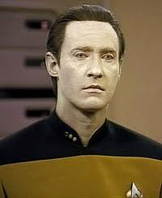
Preferences of data
Prefer Stored Procedures to direct table access
Allows the tables to change
Prefer Views to Tables
Allows the tables to change
Allows you to mask normalization
Prefer lookup tables to hard coding
Users will change their mind

Slide 33
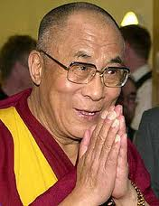
Preferences of DAL results
Prefer surrogate keys to multi-key tables
Prefer strong types to datasets
Prefer data design types to user created
Prefer public vs. private data
Prefer no logic vs. logic

Slide 34
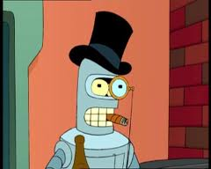
Preferences of classes(non DAL)
Prefer short classes
Prefer classes that are one abstraction
Prefer tests for classes or methods that might change or have hard to test logic
Prefer configuration(encapsulation) to subclasses
Prefer private variables with setters to properties
Prefer private vs. public data

Slide 35
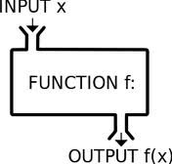
Preferences of function
Prefer short methods to long ones
Prefer spacing to compact information
Prefer methods with lower numbers of parameters
Prefer methods that do one thing
One level of abstraction

Slide 36
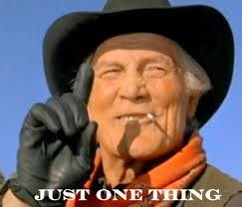
Most important concept
Anticipate what might change
Make sure you have a plan if that does happen
Think through your projects in the last year
What changed from spec to end product
What stays the same

Slide 37

My findings on most common changes:
Added new columns
Added more pages
Adding more steps to process
Combo of rights and pages
More control over the data
Ability to notate the processes
Don’t believe users will understand

Slide 38
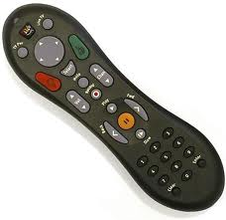
Remote control example
A remote control is an interface to control the data flow on a TV, DVR, etc.
You want to be able to pick your device only if it makes sense
Volume is the TV->not the DVR->Shouldn’t need to set to TV mode
TV button could change with new TV
Should be able to configure and forget
You should be able to pick a device
You should have as few buttons as possible
The remote should understand context
Depending on data, buttons would understand context

Slide 39

Let’s draw it out
Let’s create the API for the ultimate remote

