Slide 1
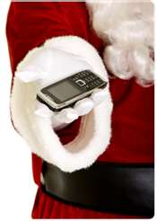
It’s the end of world as We know it
How SANTA is GOING TO ROCK OUR WORLD AFTER WE COME BACK FROM BREAK

Slide 2

Overview
Why Mobile Devices are starting to matter
What is the difference between mobile, web, process and standalone
What are mobile devices good at and bad at
Round table of how you use a mobile device

Slide 3
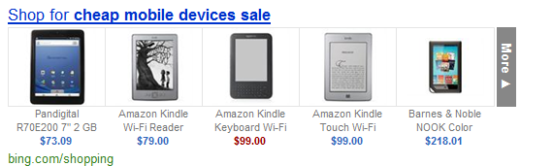
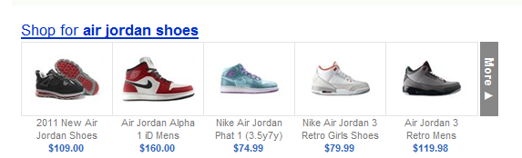
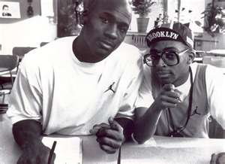
Santa Clause is coming to town
Device price has dropped to “disposable” level
Less than text books
Lots of devices less than a pair of Air Jordan shoes
It’s got to be the shoes!

Slide 4

It’s my mobile
Mobile makes computing more personal
Phone is a personal computing device
Smart phones more common than non-smart
More cheap tablets out in the world
Kindle Fire is a real browser
Customer expects mobile app

Slide 5
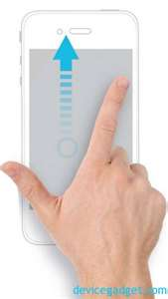
What you don’t know you know
As mentioned last week, experience changes what knowledge is “acquired”
iOS changes computing
Gestures
Pinching and …?
Etch a sketch
Multi touch
Not a mouse
Only one button

Slide 6
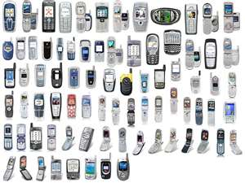
It is not just smaller
It does certain things better
And other things worse
So let’s examine these in more detail

Slide 7
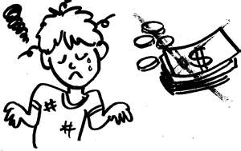
What does mobile do poorly?
An app is not an application
No splash screen
Not Multi-purpose
Customer expects quick response
Price is low or free
App is disposable
Data Entry is hard
Editing is just impossible
Any app where need to view lots of data at same time
Any app that relies on uninterruptable procedures
Any app that needs detailed instructions or exploration
Delete on iPad mail
Multitask on iPad

Slide 8

What does mobile do well?
Personal data
It knows who I am
It knows where I am
It knows my friends
It know what I like
Social apps
Single purpose application
Quick apps
Person integration
Interruptible application
News
Multimedia
Create new intuitive gestures

Slide 9

What new possibilities?
Clay Shirky
Ubiquitous computing
Meet you at the movies
Picture me at the riot
Personal applications
New client server model
Lilliputian computing
Farm out small tasks to mobile

Slide 10

What new problems?
Andriod OS/Phone number is immense
All handle css differently
Even though based on WebKitUI
Apple
Only answers to Apple
Kindle vs. Nook
Android readers
App can end at any time –phone call!
Computing power is small

Slide 11

What is the right solution?
Where does this task work best?
OLA
Basic app =Yes
Essay =No
SU
Updates
Personal Information-calc on device
CatQ =Yes
NextSteps-built for mobile

Slide 12

Other mindful items
Reading is tricky
Article mode
Updates on task/process
Server up
Email to device
What is the right amount of design?
And therefore branding/marketing become important

Slide 13

We have the tools
Monodeveloper tool
Can use C# for all of our code
Let’s make C# standard for all new code
No more VB
Can do iPhone
Can do Andriod
Still needs to understand the model

Slide 14
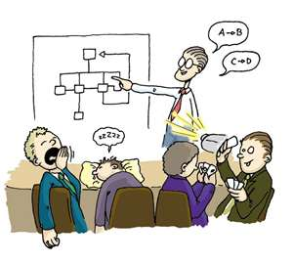

Data, Logic and Presentation
Separate logic of app to dll
Can use dll on each platform
Web Services get data-allows migration into each platform
But….
Only need to do this if part of app as mobile makes sense

Slide 15


Information vs. Data
Data
Describes person, place or thing
Used for logic
Make it easy to gather
But have security
Information
Meant for reading
Make it is easy to read
Sometimes security
Sometimes actionable

Slide 16
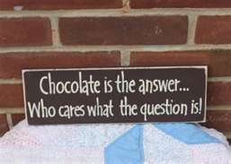
What is the answer?
Let’s talk about it….

Slide 17
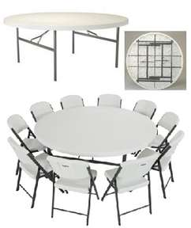
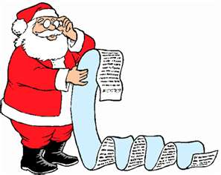
What mobile devices do you use?
Name all you own
Which ones do you use?
How do you use them?
Is Santa bring you a new one?
What do you expect in interface?

Slide 18

Let’s talk about apps
What apps do you create?
Are they a good fit for mobile?
Are parts of them good for mobile?

Slide 19
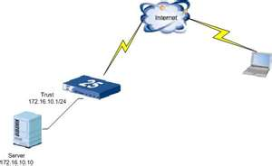
What about WebAuth?
Is WebAuth experience something we would expect from mobile? In each app?
Is size an issue?
Login each time, is this an issue?
Apps remember where they were
Is security an issue for us in mobile market?

Slide 20
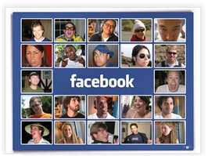
Social Status
Intergration?
Does mobile make it easier?
Does it open up a new can of worms?
How well will the user expect us to know them?
How well should we expose them? Pictures, info, etc.

Slide 21

Any other topics?

Slide 22

Summary
Mobile market is exploding and set to really explode
Mobile apps are not just smaller versions of apps
New war78u of standards
We don’t know what to expect
But we need to think about it

Slide 23

Santa Clause has left the building
The End!

