Slide 1
sudN
Semi understandable data notation

Slide 2
What’s wrong with old stuff?
No really good format
Better ones are extremely verbose
Many blow up

Slide 3
Old Schools
Character formats
XML
SQL

Slide 4
CSV and other character deliminators
Advantages
Quick to create
Light weight
Lots of support
Disadvantages
Characters can be in fields
Need escape characters
Can’t define data

Slide 5
XML
Advantages
Very flexible
Very definable
Disadvantages
Way too verbose
Very complicated
Need escape characters
Blows up if incorrect

Slide 6
SQL
Advantages
Normalization
Indexing
Typing
Disadvantages
More complex
Not ad hoc
Joins can cause locks

Slide 7
So what’s the answer?
Why do people like excel?
Can intuitively understand
Quickly create data
Modify rows and columns easily
Excel figures out data types
But you can change data types

Slide 8
sudN
Pronounced Sudden
Semi understandable data Notation
Readable (kind of)
Very slim
Easy to write

Slide 9
Principle 1
Don’t use markers that people can type
But make it so people can type it!
Solution-use first 8 ASCII symbols
ASCII character 1(\x01) is record marker

Slide 10
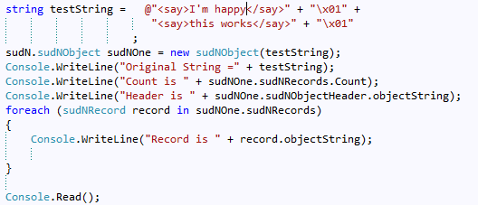
You can type this

Slide 11

And get this!

Slide 12
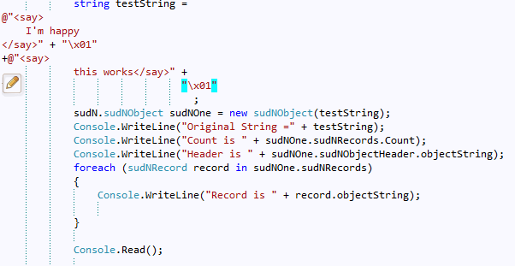
You can even do this

Slide 13
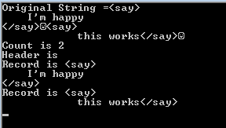
And get returns preserved

Slide 14
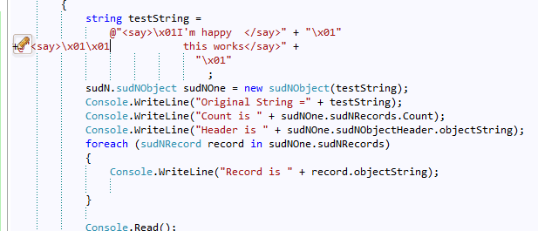
It’s hard to break

Slide 15

You still get

Slide 16
You can break it
“\x01” + “\x01”
But characters before and after will fix
ACSII escape sequences are rarer than comma, space , tab or even pipe
But doesn’t blow up
This is principle 2- doesn’t blow up
You can still see data with objectString property

Slide 17
Principle 3
You can create data set with no type information
You can label data with type and name information
Types are anything you want
To explain this let’s look at the markers

Slide 18
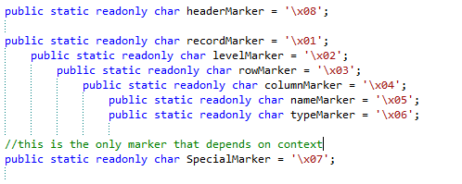
Markers
Note that we didn’t create levels, rows or column markers in our earlier examples
Allows for the most lightweight information

Slide 19
Simple to complex
“one” + “\0x1” + “two”
2 Records
Each record has 1 level
Each level has 1 row
Each row has 1 field
The field names are “”
The field types are “Text”

Slide 20


Headers

Slide 21
Column Format
Name-Type-value
“MyName” + “\0x5” + “myType” + “\x06” + “This is my value”
Name=MyName, type=MyType,value=This is my value
“MyName” +”\0x5” +”hello”
Name=MyName,type=text, value=hello
Note the above are complete sudN datasets

Slide 22
Principle 4
Format can make odd shapes
“base” + “\x02” + “indent” + “\x01” + “two” + “\x02” + “secondindent” + “\x02” + “\x07” + “backalevel”
Base
Indent
Two
Secondindent
Backalevel
Note use of special character 7

Slide 23
Corollaries
Only 1 double duty characters that depends on context (For rule 2)
Special character can be uses for back level and list item breaks
“gradtype” + “\x05” + “ugrad” + “\x07” + “grad” + “\x01” + “grad”
A listype of grad/ugrad named gradtype with the value of grad
Allows user defined types

Slide 24
Principal 5-Type definition
User can custom type anything but will do basic duck typing
Type is just string
The type abilities are logic-not in data format
Built in types for duck typing
Text
Number
Date
Lists with ASCII 7
Modeled after EXCEL

Slide 25
Corollary Headers and Types
One record with a header beginning can be thought of as a custom type
Way to preserve class like type in string format

Slide 26
Principle 6
Any language can implement it
Basic Idea in C# but could do in Javascript

Slide 27
Principle 7
As lightweight as possible
Can be streamed across web

Slide 28
C# Implementation
sudN
sudNObject
sudNHeader
sudNLevel (alias to rows if no levels)
sudNRows
sudNColumns
sudNName
sudNType
sudNValue
sudN.Utility
CommonFunctions
Markers
Convert

Slide 29
Convert
Convert.Data
Convert.HTMLControls
Convert.WebControls
Convert.TelerikUI

Slide 30
sudN principles
Don’t use markers users can type but still allow easy entry of data
Doesn’t blow up
Can create data with or without type information
Formats can have odd shapes
User can custom type anything with basic duck typing
Any language can implement it
Lightweight as possible

