Slide 1
Multi class Text Classification with Differential Privacy using TensorFlow 2.0
Debsankar Mukhopadhyay
CSEE 5590
UMKC

Slide 2
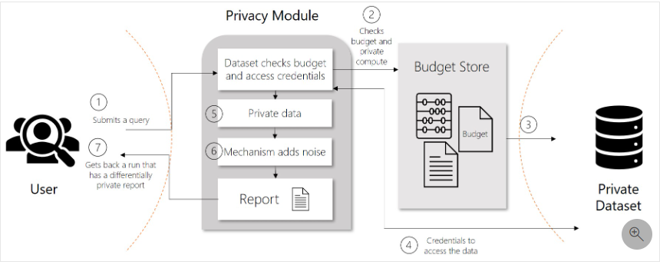
Differential Privacy
Differential privacy is a set of systems and practices that help keep the data of individuals safe and private.

Slide 3
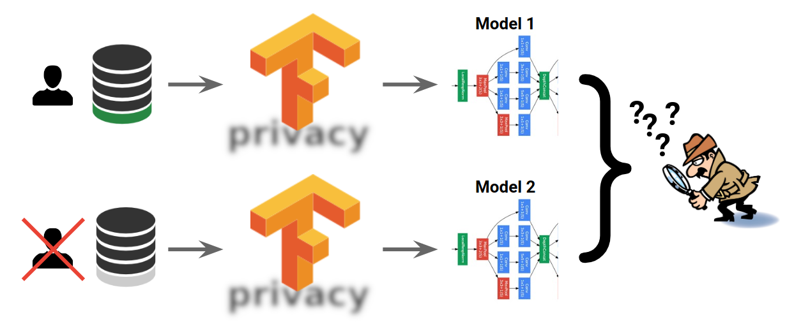
Technical Overview
The differential privacy framework introduced by Google is known Tensorflow Privacy, and it is equipped with a Differential Private Stochastic Gradient Descent algorithm to provide strong privacy guarantees.

Slide 4
TensorFlow 2.0 - contd
Mitigates the risk of exposing sensitive training data (heterogeneous datasets) in machine learning.
Can be integrated into any tensorflow system without any change in model architectures, training procedures, or processes.
Compares two machine learning models in terms of a single user data
Modified Stochastic Gradient Descent , that averages the model updates, clips each of these updates, and adds noise to the final average.
Helps in model generalization by encoding generic data
Supports federated learning and training where updates are received from several participants
Protects from differencing attack, linkage attacks, and reconstruction attacks

Slide 5
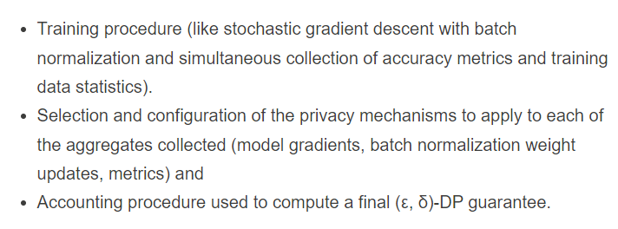
TensorFlow 2.0 contd.

Slide 6
Hackathon Data
Sample Multi-text classification of product reviews and complains with TF Privacy
Source:
www.kaggle.com/selener/multi-class-text-classification-tfidf/data

Slide 7
Goal
Multi-text classification of product reviews and complains with TensorFlow Privacy.

Slide 8
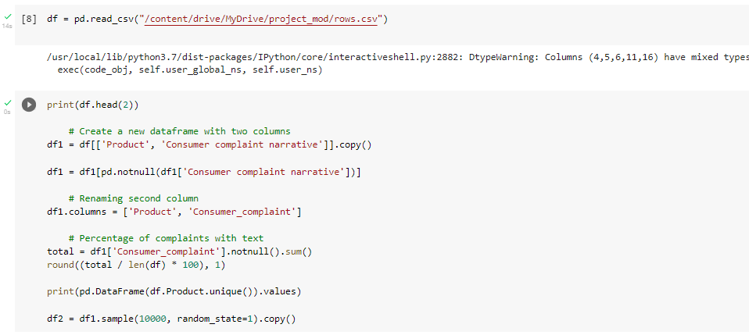
Data preprocessing

Slide 9
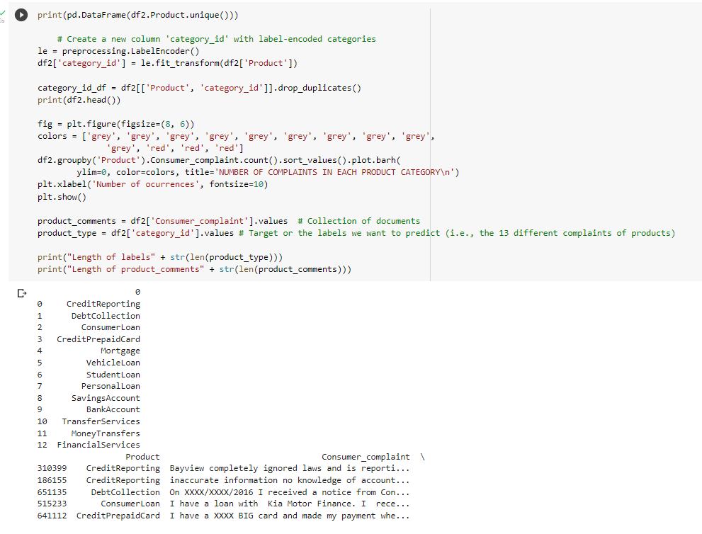
Data preprocessing II

Slide 10
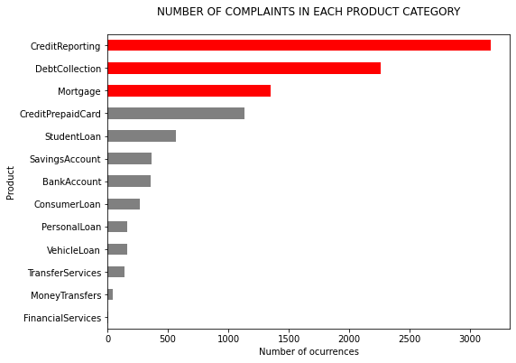
Data Preprocessing III

Slide 11
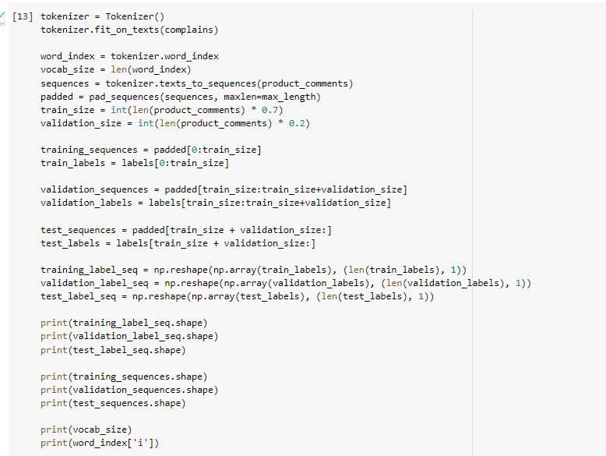
Data preprocessing IV - Tokenization

Slide 12
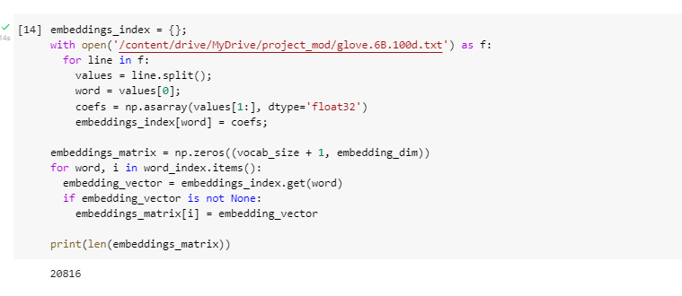
Data Preprocessing V - Embedding

Slide 13
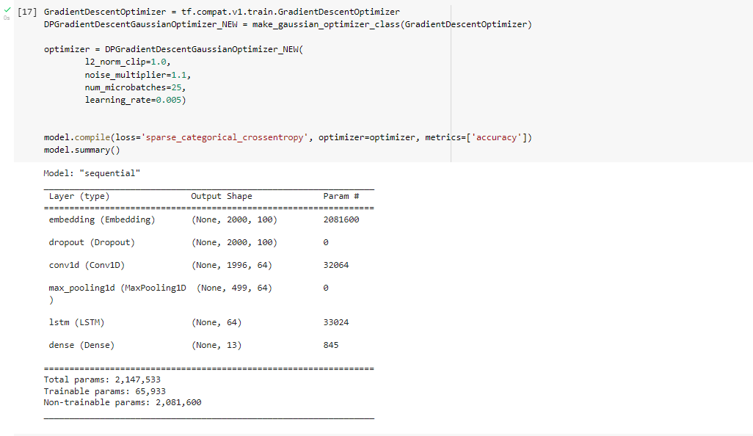
The Model

Slide 14
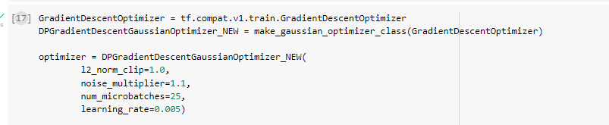
An anomaly between TF 2.0 and TFP
“AssertionError: compute_gradients() on the differentially private optimizer was not called. Which means that the training is not differentially private. It happens for example in Keras training in TensorFlow 2.0+.”
Solution – redefined optimizer class making sure that compute_gradients is always called.:

Slide 15
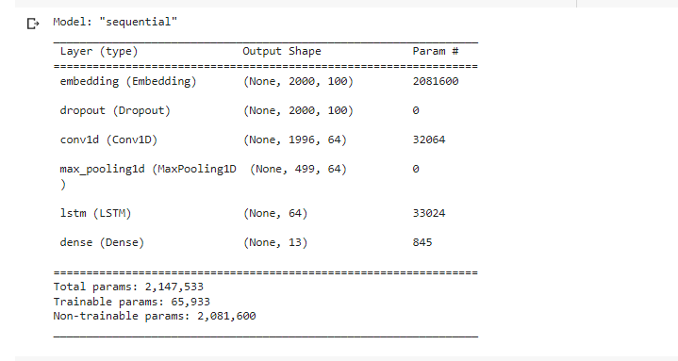
Model

Slide 16
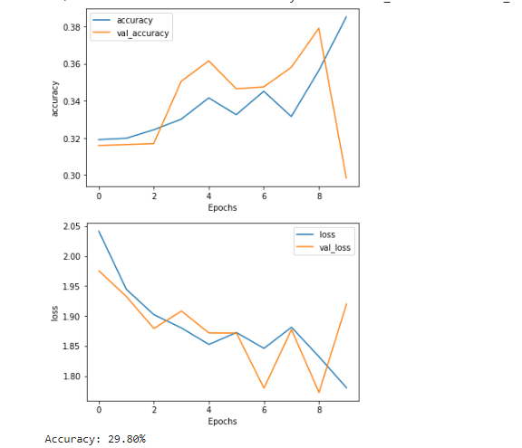
Model Fitting
Need to tune hyper parameters

Slide 17
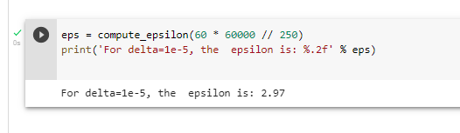
Estimation of ε
ε measures the strength of privacy guarantee

Slide 18
Outlook
We added DP using TensorFlow Privacy for the multi text classification problem.
Extend this approach to stock price sentiment classification.
The current model requires tuning of its hyper parameters.

