Slide 1
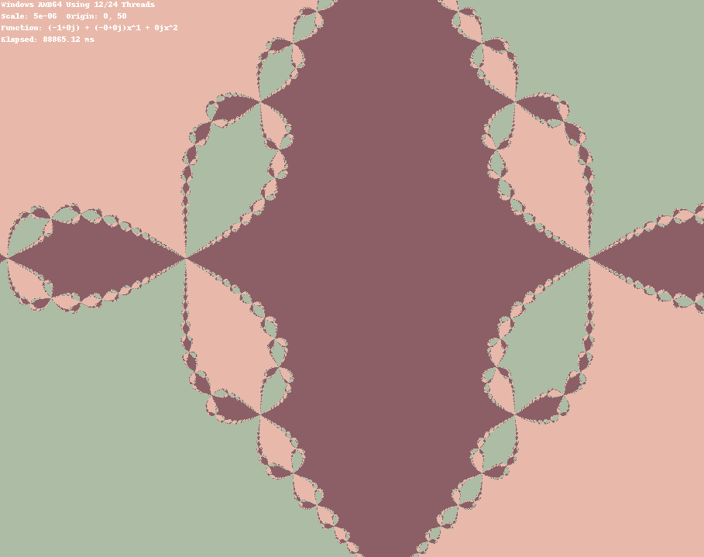
Newton’s Fractal (In Parallel)
Daniel Foreacre

Slide 2
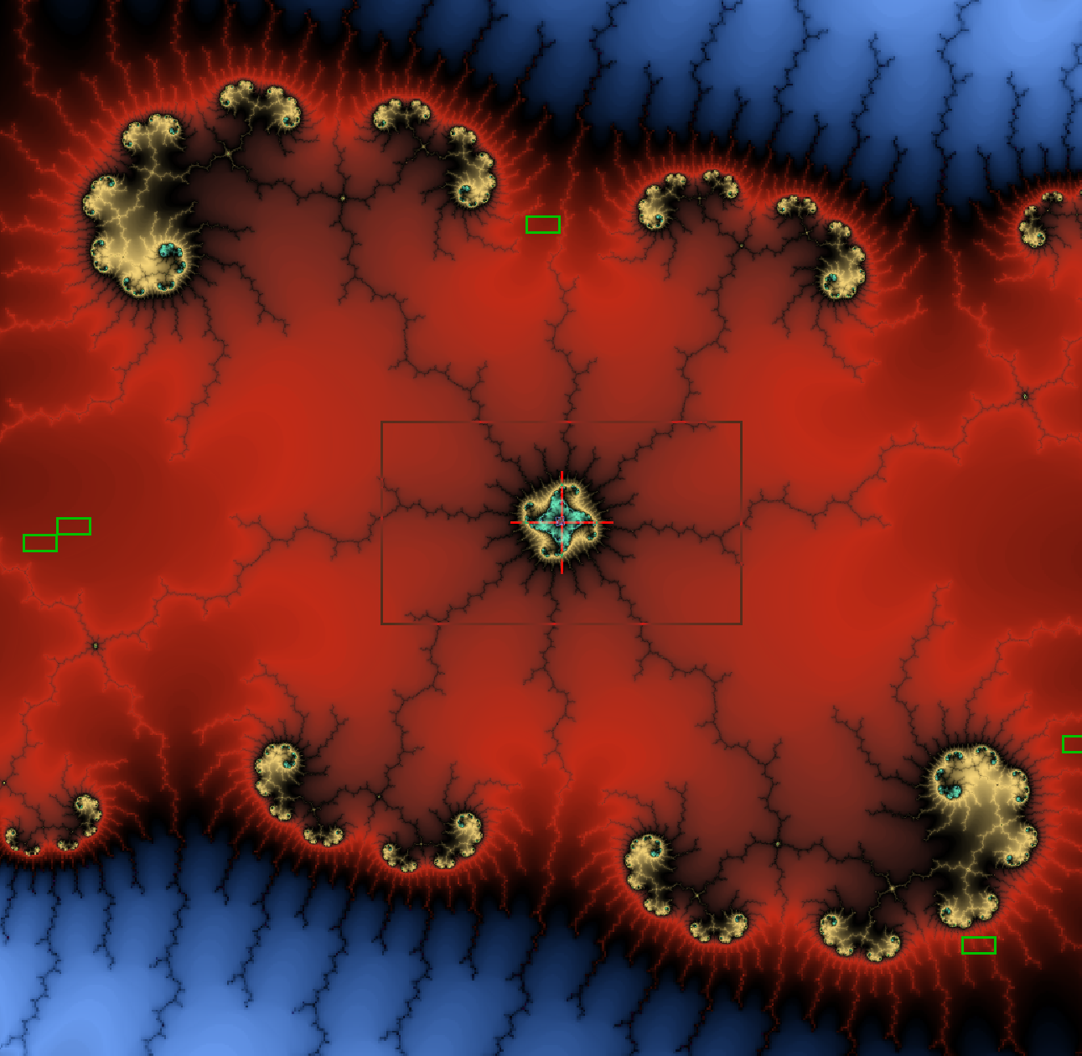

Why Fractals?
Pretty pictures!
Interesting math
Easy to parallelize
So, what is a fractal?
Technically – A figure with a non-integer dimension. Fractal dimension larger than topological dimension.
Square area increases by $l^{2}$
Newton’s fractal increases by $l^{1.213}$
Generally - Infinite complexity. Self-Similarity.

Slide 3
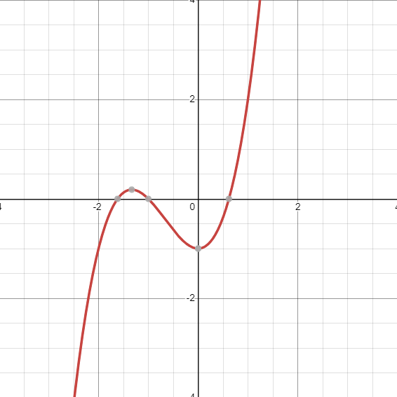

Newton’s Method
Used to approximate the roots of a polynomial.
$x^{′}=x− \frac{f(x)}{f′(x)}$

Slide 4
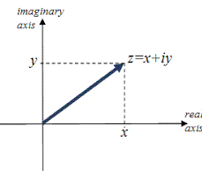

How to interpret in 2 dimensions?
Complex plane!
X = real component
Y = imaginary component
$y= x^{3}$- 1
At $x=1+1i$
$y=−3+2i$

Slide 5
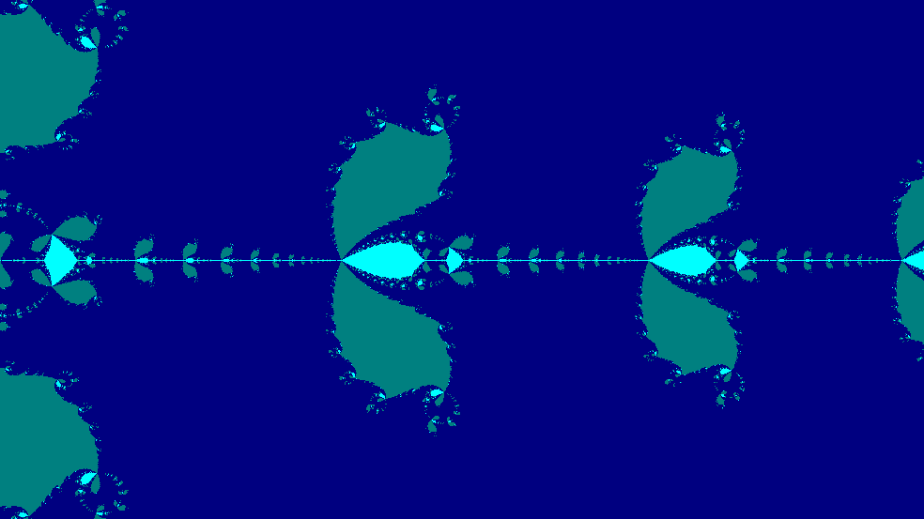
Early results in C#

Slide 6
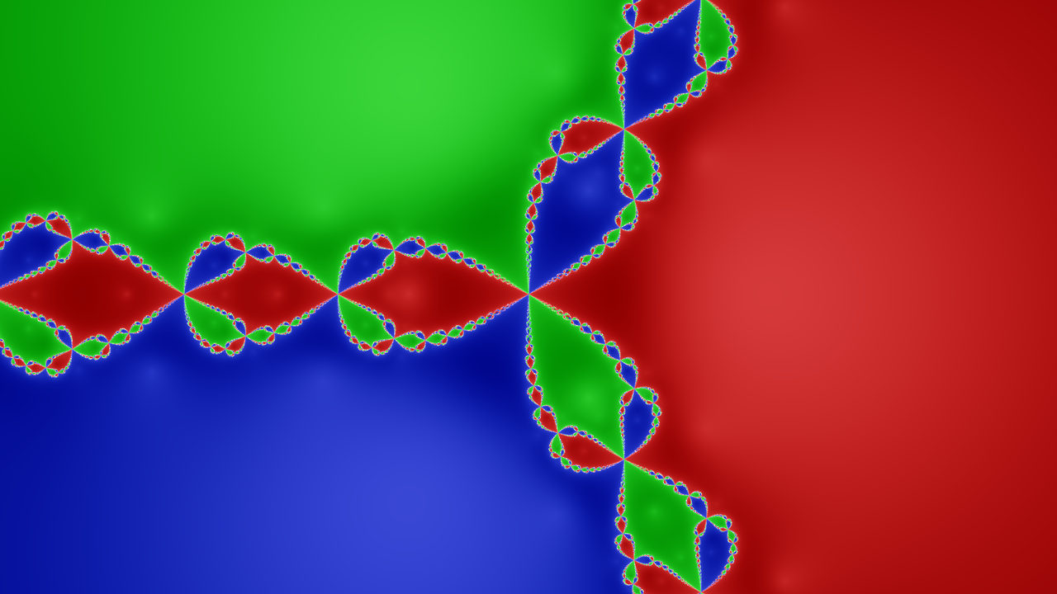
Example of Newton’s Fractal

Slide 7
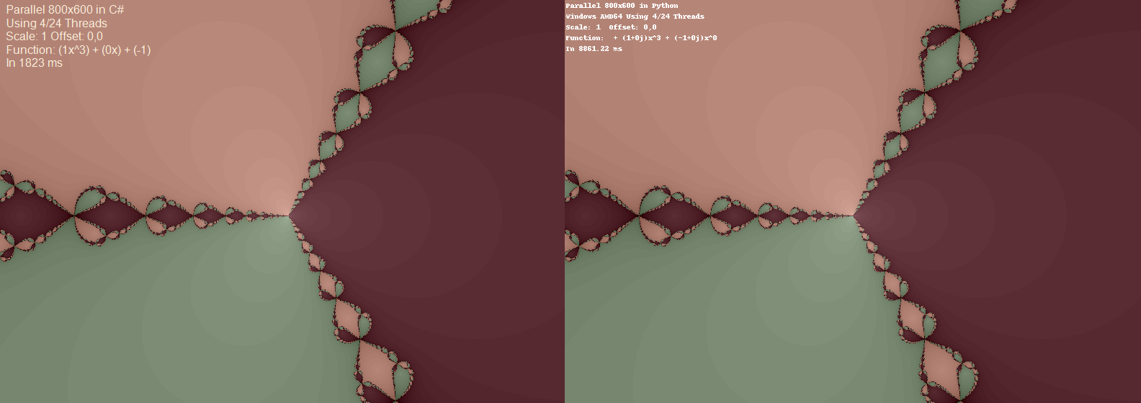
Comparison of C# (left) and Python (right)

Slide 8
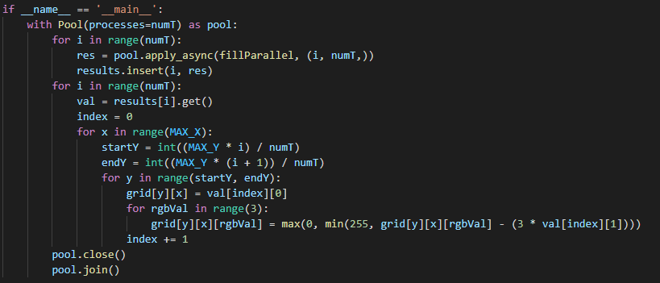
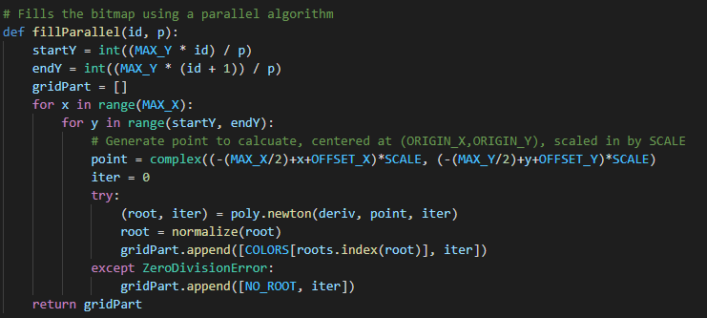
Python

Slide 9
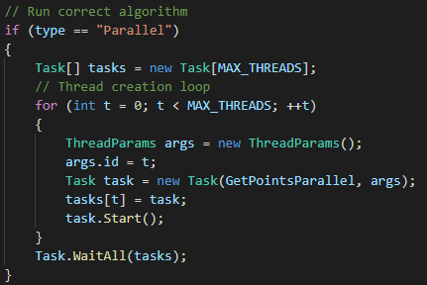
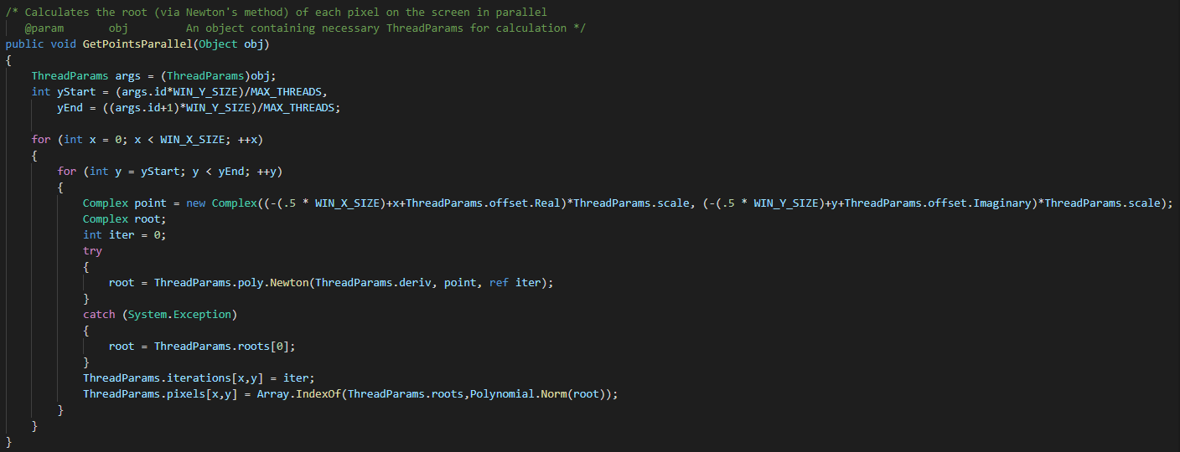
C#

Slide 10
Timings by Language (in ms)
 | Serial | 800x600 |  | Parallel 8 Threads | 800x600
 | C# | Python |  | C# | Python
1 | 3443 | 17530 |  | 516 | 7259
2 | 3514 | 17443 |  | 529 | 7267
3 | 3450 | 17650 |  | 532 | 7186
4 | 3456 | 17498 |  | 547 | 7207
5 | 3480 | 17511 |  | 561 | 7358
6 | 3447 | 17423 |  | 518 | 7186
7 | 3543 | 17331 |  | 559 | 7244
8 | 3524 | 17343 |  | 497 | 7182
9 | 3442 | 17464 |  | 480 | 7166
10 | 3435 | 17389 |  | 583 | 7266
 | 3473.40 | 17458.20 |  | 532.20 | 7232.10
 | Difference: | -13984.80 | 402.63% | Difference: | -6699.90 | 1258.91%
 |  | C# Wins! |  |  | C# Wins!

Slide 11
Conclusions
Fractals are cool!
Problems where each pixel must be calculated are a great opportunity to parallelize.
Using this implementation, Python is much slower than C# However, other libraries may be faster!

