Slide 1
✓
TOP-Feedback
The student and instructor feedback cycle,
owned entirely by your detachment.
An introduction — what it is, what it does, and how it is used
Notes:
A primer, not a training session. Three things to land: there is no vendor and no server; the detachment owns the data; and it turns feedback into something an instructor can act on rather than a stack of paper.

Slide 2
WHAT IT IS
A feedback app that stores nothing on anyone else's computer
Cadets answer a short form on their phone. Instructors see the results analysed, not just listed. Every record is written to a Google Drive folder your detachment already owns.
Your Google account
No vendor holds your data, because no vendor is involved. If you stop using the app, every response is still sitting in your Drive.
Any device
Runs in a browser and installs to a phone home screen. Works with no signal and sends when the connection returns.
Nothing to buy
No licences, no subscription, no server to maintain. Setup is a Drive folder and about 45 minutes, once.
2
Notes:
These three answer the questions always asked first: where does the data go, what do I need to run it, and what does it cost.

Slide 3
WHY IT EXISTS
Feedback nobody can act on
Paper forms get collected, stacked, and never counted.
Survey tools put cadet feedback on a company's servers.
An average hides the very thing you needed to see.
A disclosure of hazing can sit unread in a pile for weeks.
What it replaces
One app that issues the form, collects the responses, runs the statistics, reads the written answers, and flags anything a person needs to see today.
On a phone. Offline. At no cost.
3
Notes:
Frame the problem before the product. The last bullet is the one a commander cares about most.

Slide 4
WHERE THE DATA LIVES
Your folder is the database
Each record is a plain file you can open in Drive — nothing is locked in a format only this app can read.
TOP-Feedback/
config/ detachment profile and settings
users/ the roster: who may sign in, and as what
forms/ feedback form definitions
requests/ feedback issued, each with an ID
responses/ submitted feedback
receipts/ who submitted, kept apart from
what they said
reports/ exported reports
Stop using the app and you still have every response.
Readable in Drive, backed up by Google, recoverable from the trash for 30 days.
Who can read the feedback is a Drive sharing setting.
Not a setting inside this app. That is the access control that actually matters.
4
Notes:
This is the procurement answer: no lock-in, no data processor, no contract. Stress that folder sharing is the real access control.

Slide 5
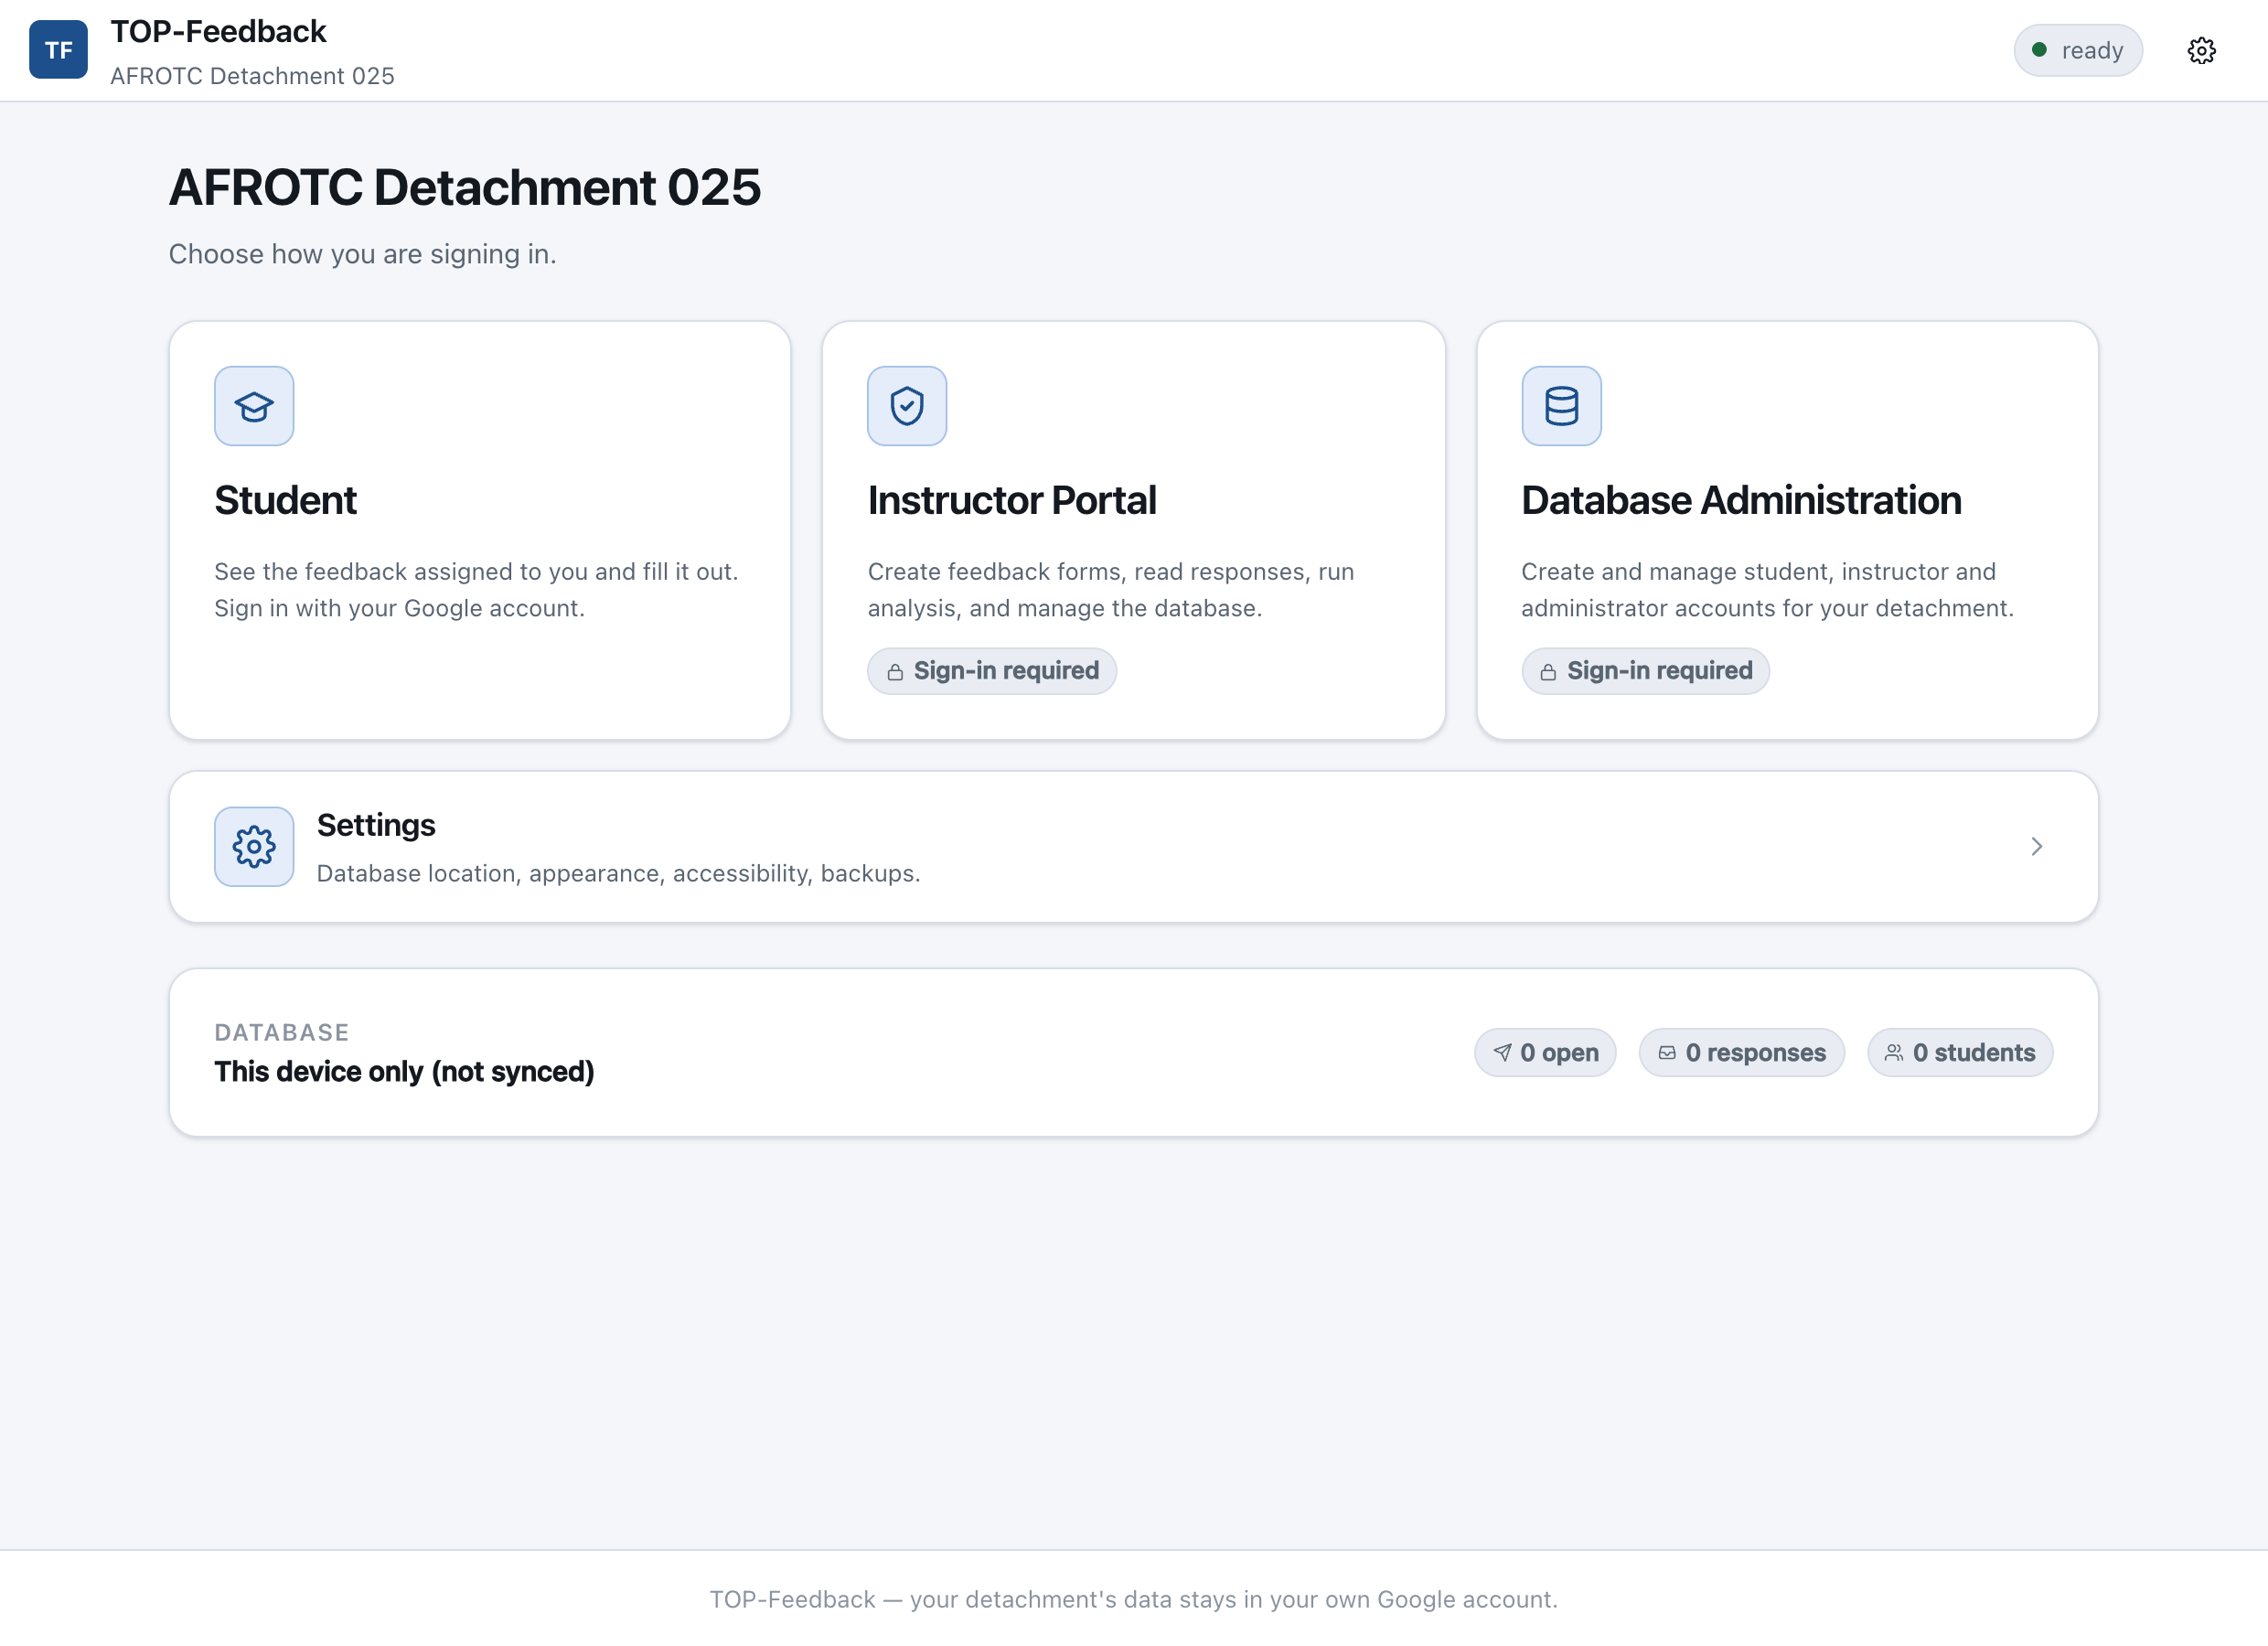
WHO USES IT
Built around the chain of command
Cadet
Sees only what is assigned to them. Submits once.
Instructor
Creates feedback, reads responses, runs the analysis.
Cadre
All of that, plus an area instructors cannot see.
Commander
Sees every area, including one only they can read.
Database admin
Keeps the roster. A separate job, often held alongside.
5
Notes:
The point of this slide is that access follows rank, and that it is enforced rather than assumed. Cadre and commander areas are separate folders on the detachment's Drive, not hidden screens — an instructor cannot reach commander feedback by opening Drive directly, because the server will not open that folder for them. At most two commanders at a time, so a change of command overlaps.

Slide 6
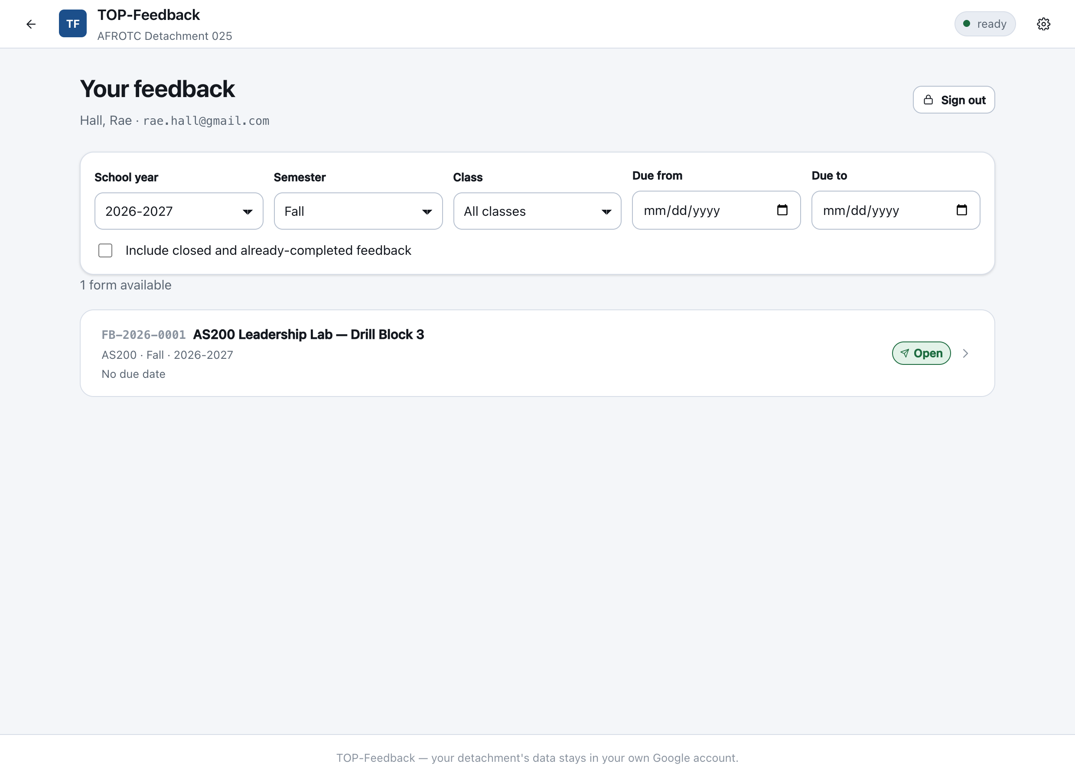
FOR CADETS
Only what is assigned to you
Filtered by school year, semester, class and due date. Anything already submitted drops off the list.
6
Notes:
A cadet sees their own list, not everything the detachment ever issued. Scheduled forms stay hidden until they open; overdue ones close on their own.

Slide 7
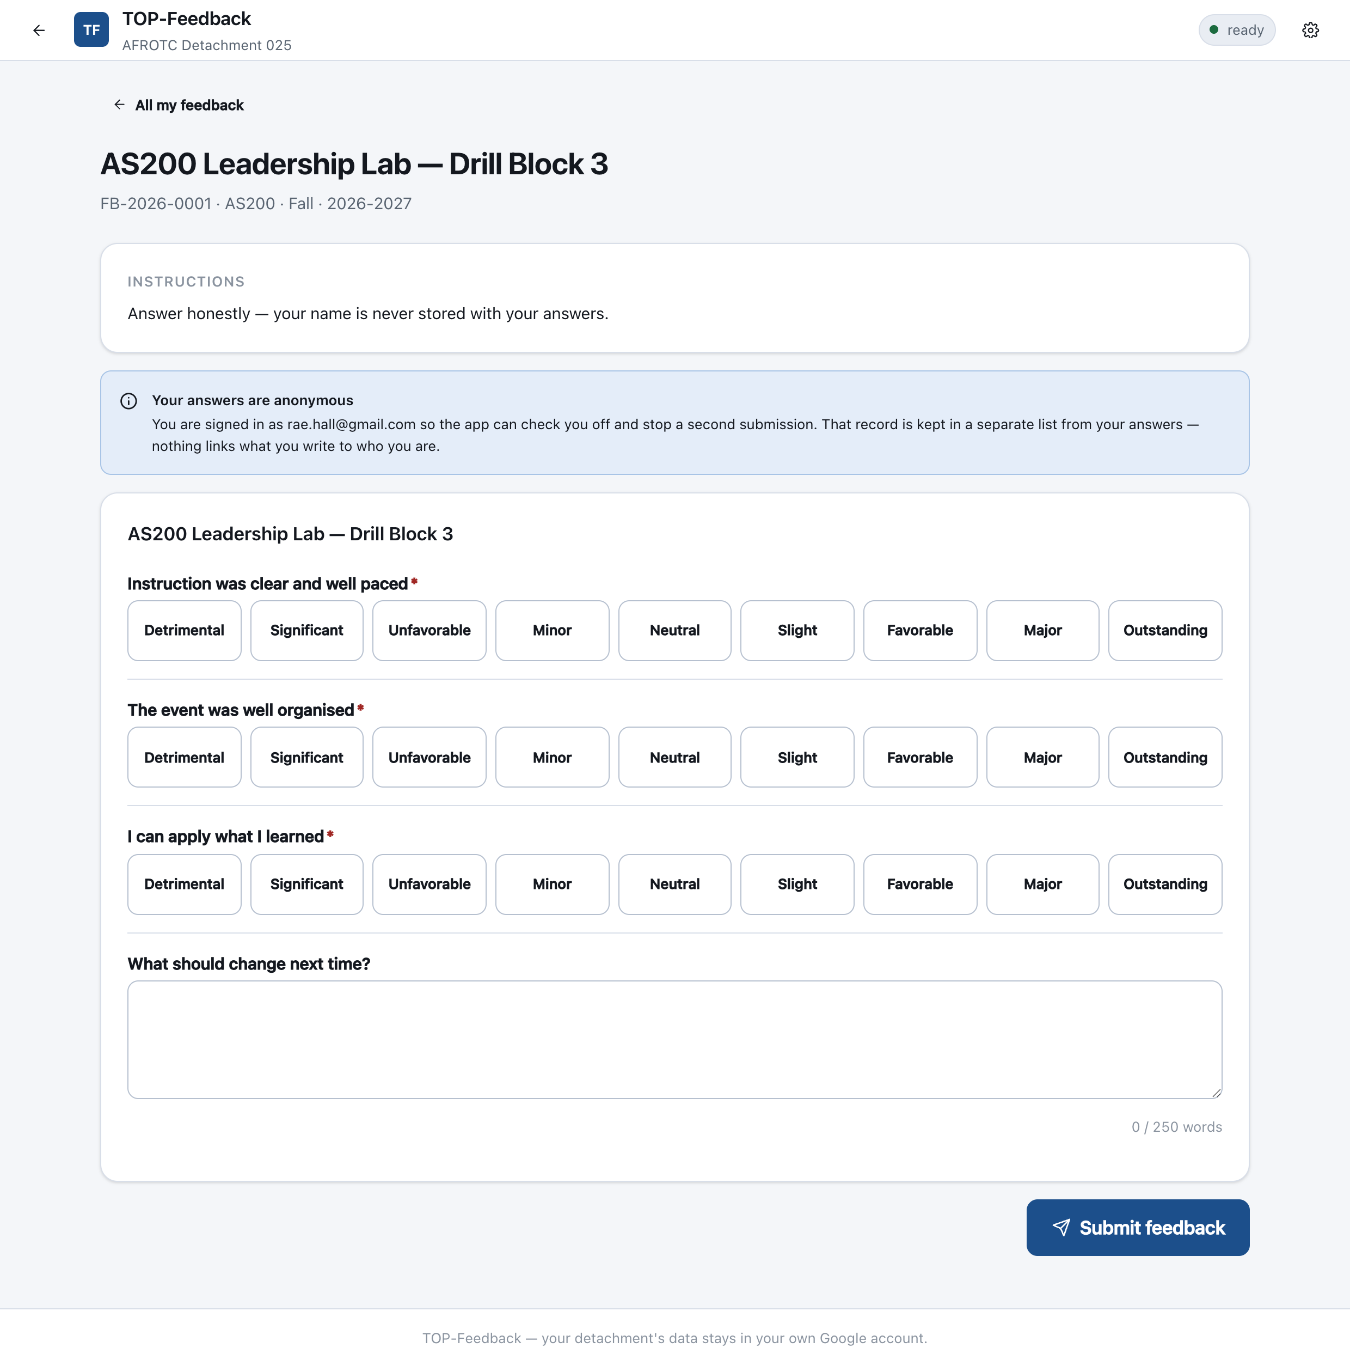
ANSWERING
Cadets choose a word. The maths runs on the number.
Nine ratings, every one named
Detrimental, Significant, Unfavorable, Minor, Neutral, Slight, Favorable, Major, Outstanding.
No numbers on screen
A visible number invites people to average it in their head while answering.
Written answers capped at 250 words
With a live counter as they type.
7
Notes:
Neutral sits at 5, the true centre of a 1-9 scale. Instructors see the word and the number together; cadets only ever see the word.

Slide 8
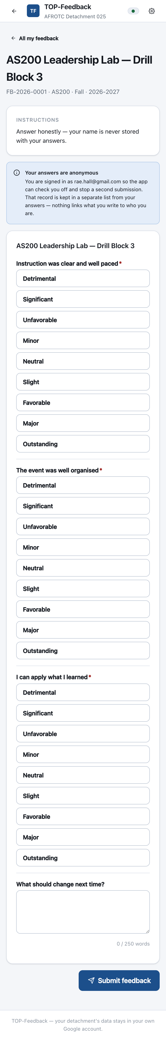
ON A PHONE
Built for the walk out of the classroom
Installs to the home screen
Opens like an ordinary app. No address for anyone to remember.
Works with no signal
A submission made offline is saved on the device, shown as pending, and sent automatically when the connection returns.
Nothing is lost to a dropped connection
8
Notes:
Classroom wifi is unreliable — that is the whole reason for the offline queue. Reading existing feedback still needs a connection.

Slide 9
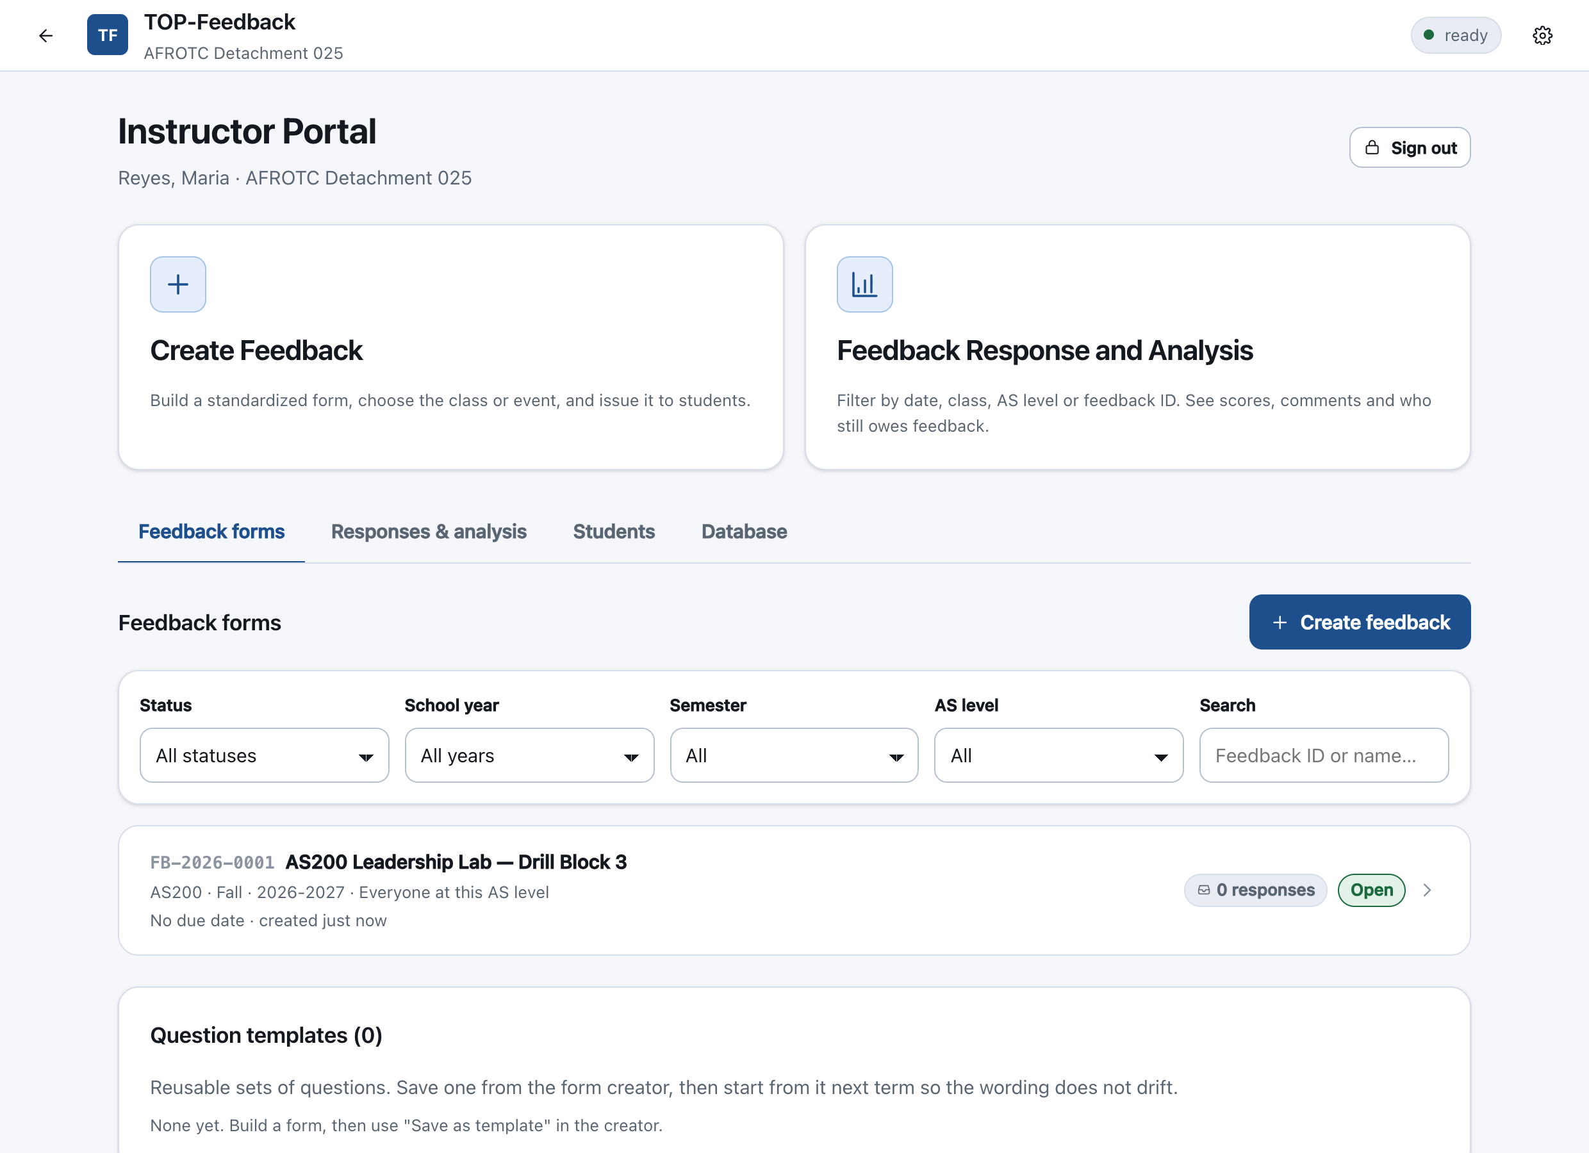
FOR INSTRUCTORS
Two things to do, both one click away
9
Notes:
Create Feedback and Feedback Response and Analysis are the headline actions. The tabs underneath hold forms, students and database tools.

Slide 10
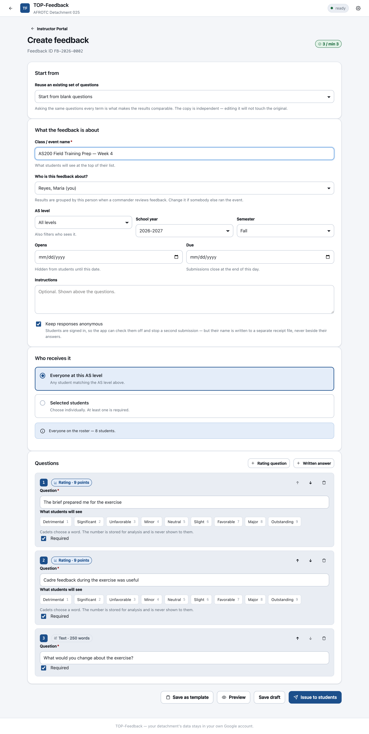
CREATING FEEDBACK
A standardized form, in about two minutes
Name the class or event
Set the AS level, term and dates
Scheduled forms stay hidden until they open.
Choose who receives it
Everyone at that level, or named cadets.
Add questions — three minimum
A rating or a written answer. No maximum.
Every form gets an ID
Such as FB-2026-0001, to quote in conversation.
10
Notes:
The form is deliberately narrow. That constraint is exactly what makes results comparable between events, cohorts and terms.

Slide 11
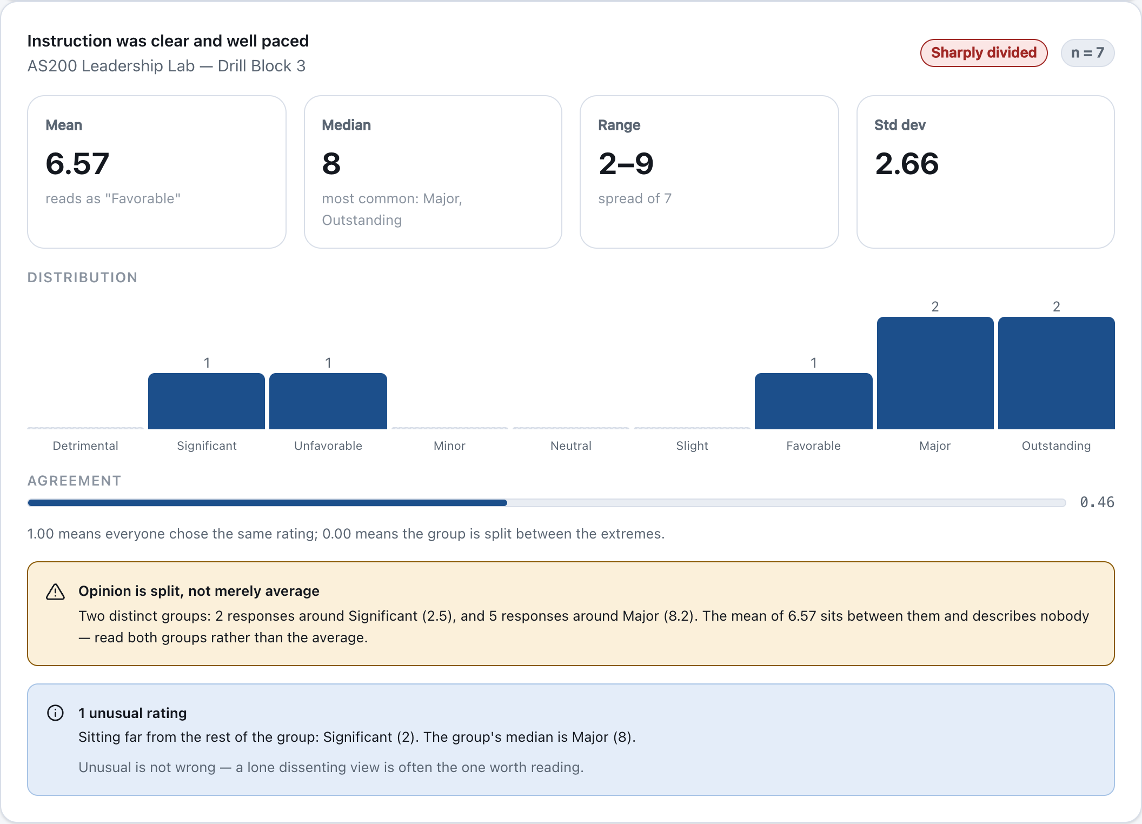
ANALYSIS — RATINGS
Everything an average on its own would hide
Mean, median, range and spread
The distribution across every rating
Shape you can see rather than infer.
An agreement score from 0 to 1
Did they actually agree, or just average out?
Outliers, found robustly
Measured against the median, so one extreme rating cannot hide itself.
11
Notes:
Point at the distribution in the screenshot. It is bimodal — the mean of 5.75 describes nobody who was actually in the room.

Slide 12
An average of 5 can mean everyone shrugged —
or that half the flight thought it outstanding
and half thought it harmful.
Same number. Opposite situations. Only one of them needs acting on.
TOP-Feedback finds the split, says so plainly, and tells you the average describes nobody — so you read both groups instead of the middle.
Notes:
This is the strongest single argument for the analysis over a spreadsheet. A spreadsheet gives you the mean and stops there.

Slide 13
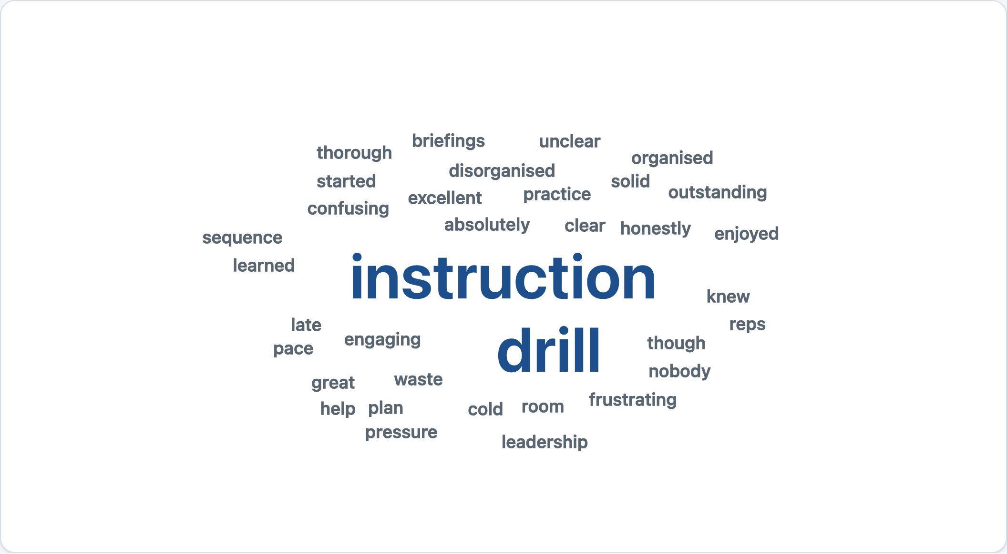
ANALYSIS — WRITTEN ANSWERS
Read the ones that matter first
Sentiment, ranked most negative first
Handles negation and emphasis, so 'not helpful' and 'extremely helpful' both score correctly.
Every answer is shown
Answers the word list cannot read are labelled, never hidden.
It runs on the device
No cloud service sees your cadets' words. That is why it is a word list and not a model, and the accuracy limits are stated on screen.
Word cloud sized by how many people used a word, not how often it appears.
13
Notes:
Be straight about the limits in the room: it reads words, not meaning. It decides what you read first; it does not read for you.

Slide 14
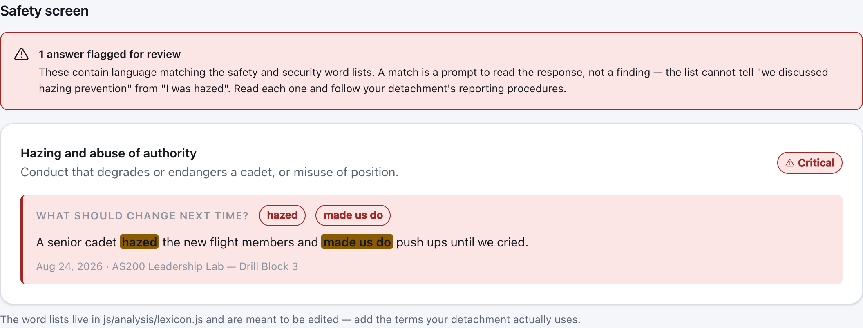
SAFETY SCREEN
Nothing important sits unread
Every written answer is screened
Hazing, sexual harassment, discrimination, violence, self-harm, substances, integrity.
Matches are highlighted in context
A prompt, never a finding
It cannot tell 'we discussed hazing prevention' from 'I was hazed'. A person reads it and decides.
14
Notes:
Say the limits out loud: it matches words, not meaning, and a clear screen is not proof that nothing was reported. Follow detachment reporting procedures either way.

Slide 15
ANONYMITY
Anonymous, and still able to chase people
How it works
The cadet signs in, so the app knows who they are. It writes a receipt in a separate folder, then drops the name. The response itself carries no identity.
What that buys
You can say 'two cadets still owe feedback' about responses nobody can attribute — and nobody can submit twice.
The honest limit
With very few responses a single answer can be identified by elimination. So anonymous results stay hidden until three people have responded.
Safety flags are the deliberate exception: a disclosure cannot wait for a third response, so the app tells you one exists and warns that opening it may identify the author.
15
Notes:
Expect this question. The receipt-versus-response separation is the whole design, and the three-response threshold is the honest limit of the maths.

Slide 16
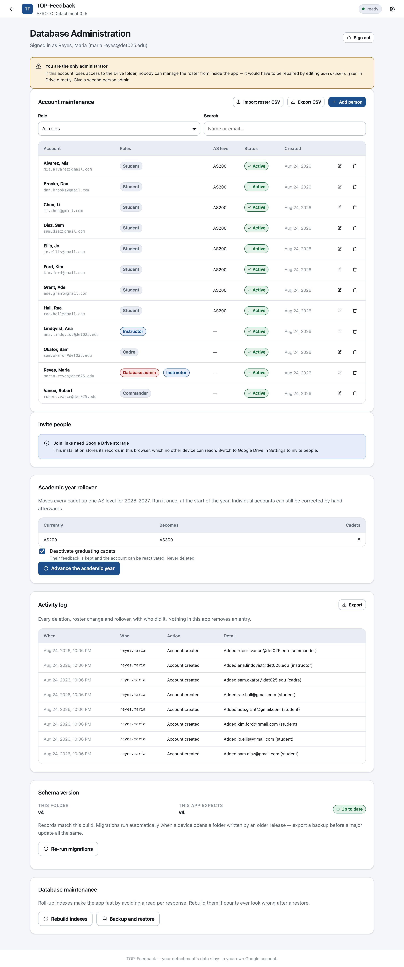
RUNNING IT
A roster, not a password list
Everyone signs in with the Google account you already mail them at. Add people by email, one at a time or a whole class by CSV.
16
Notes:
Worth dwelling on for a cadre audience: there is nothing to distribute and nothing to reset. Cadets travel in from several schools, so there is no one campus login to key on, but they all already have a Google account because that is where we mail them. Being on this list is what grants access, and that is your decision.

Slide 17
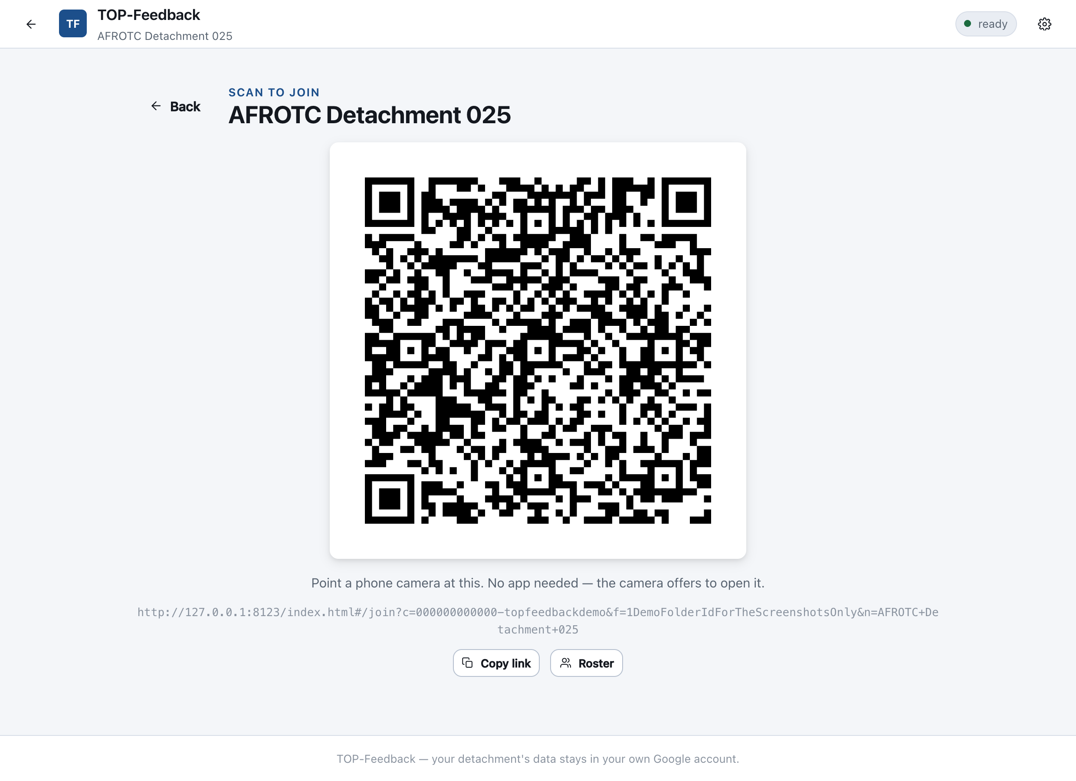
GETTING A DETACHMENT ONTO IT
One link. Or point a room at a screen.
Cadets do not install anything, configure anything, or type anything.
Send a join link
Chat, email, however you already reach them. It carries the whole setup.
Or show the QR code
On a projector at the start of a meeting. Thirty phones in a minute.
They sign in with Google
The account you already mail them at. That is the whole enrolment.
17
Notes:
This slide answers the objection that kills tools like this: 'my cadets will never set that up'. They do not have to. The link carries the configuration, so there is no Client ID or folder address in anybody's hands but yours. Worth demonstrating live if there is a screen in the room — it takes about ten seconds and it lands better than any slide.

Slide 18
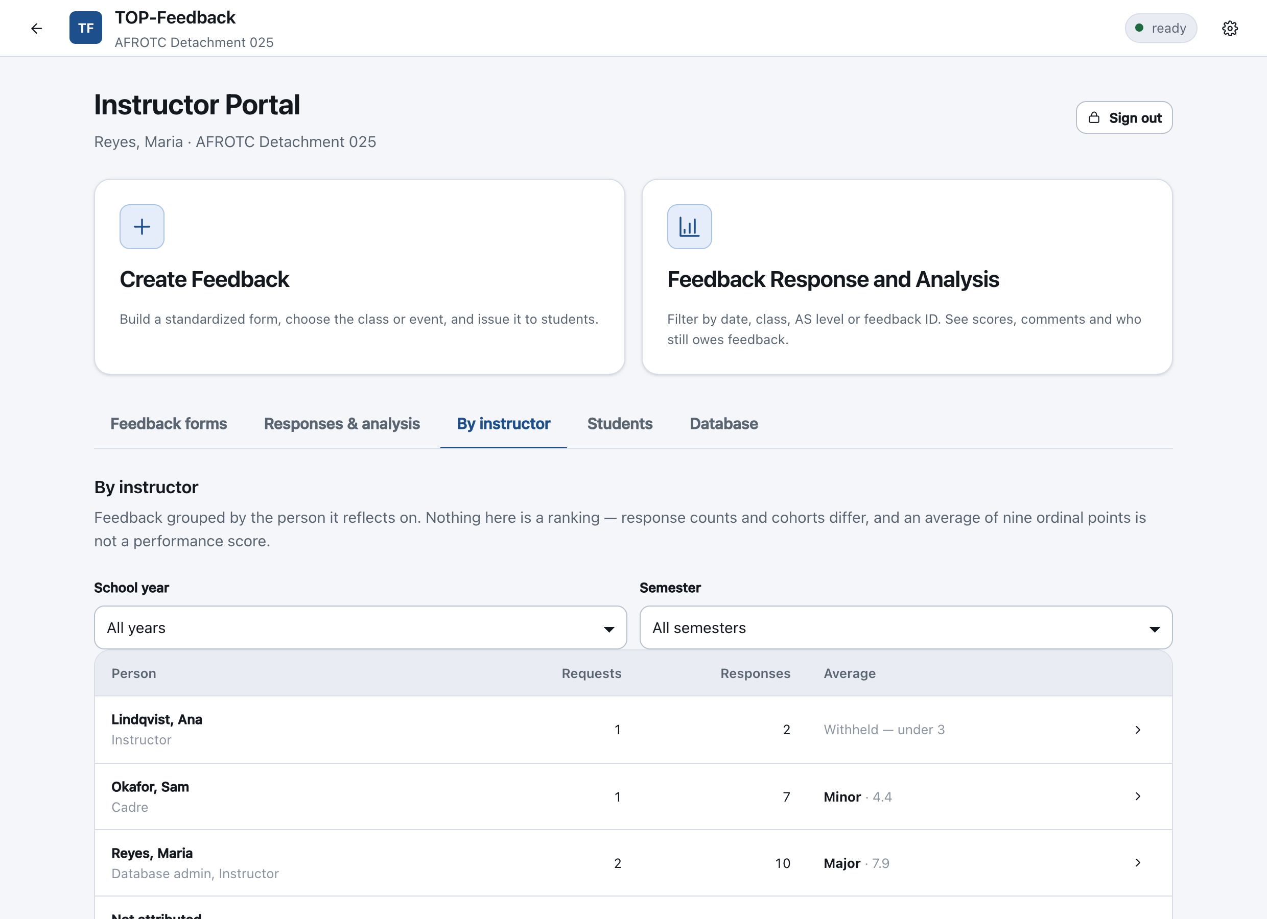
FOR THE COMMANDER
How is this instructor doing?
The same feedback, grouped by the person it reflects on.
18
Notes:
This is the capability a commander will care about most, and the one no general purpose survey tool offers. Every other screen answers 'how did the event go'. This answers 'how is this person doing', across a term, without anyone compiling a spreadsheet. Say plainly that it is not a ranking, and that the app says so on the screen — response counts and cohorts differ, and an average of nine ordinal points is not a performance score. It also withholds anyone under three responses, counting their total rather than each form, because two responses across two forms is still two identifiable cadets.

Slide 19
Your detachment owns its data. Nobody else can reach it.
It lives in your Google Drive, in your account
No vendor database, no copy anywhere else. Delete the folder and it is gone.
Only the folder's owner needs access to it
Cadets and cadre reach their feedback through your own server, not the folder.
Removing somebody removes them permanently
Their feedback stays; their name is stripped out of it and does not come back.
There is an export built for sharing
No roster, no names, timestamps rounded to the month. Safe to keep off-site.
Notes:
Expect the data question early from anyone senior. The answer is that there is no vendor holding anything: the records sit in the detachment's own Drive, and the maintainer's role is the source code. The strongest single fact here is that after setup, nobody but the folder owner has access to the folder at all — cadets and cadre both go through the detachment's own server. That is unusual, and it is worth saying slowly.

Slide 20
Getting started
1
Create the folder
A Google account the detachment owns, and a folder named TOP-Feedback.
2
Register the app
One free Google Cloud project, so the app can reach that Drive. About ten minutes.
3
Deploy the server
A short script in the same account. Fifteen minutes, and nobody else needs the folder.
4
Send the link
Add people by email, then send one join link. Cadets configure nothing.
Step by step, with screenshots: TOP-Feedback Setup Guide (PDF).
Notes:
Close here. Anyone who will actually perform the install should be given the setup guide PDF rather than this deck.

