Slide 1
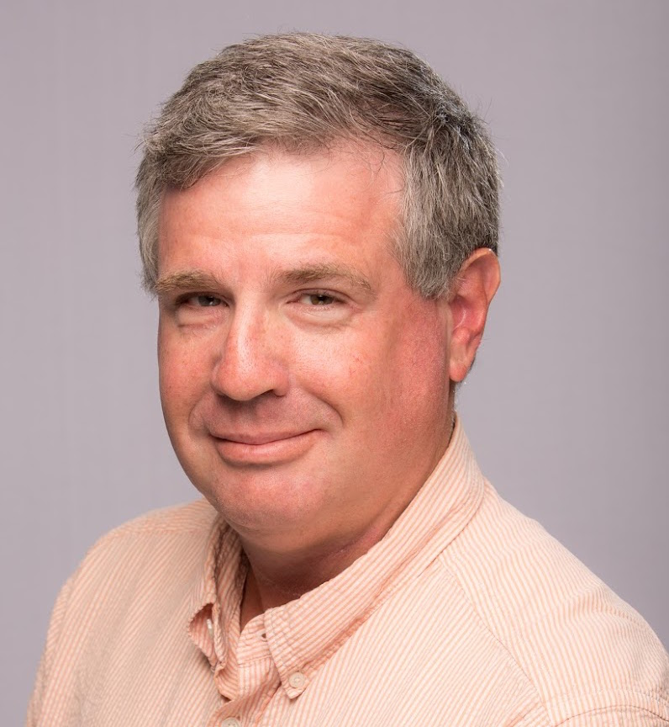


Mike Godfrey
Email: migod@uwaterloo.ca @migod
Professor, Cheriton School of CS, UWaterloo
Founding member of SWAG (Software Architecture Group)
Research interests:
Software reverse engineering, sw architecture modelling
Empirical studies of sw dev (e.g., Linux evolution, code review)
Software artifact repository mining, sw analytics
Code duplication analysis ("code cloning")
Analytics

Slide 2
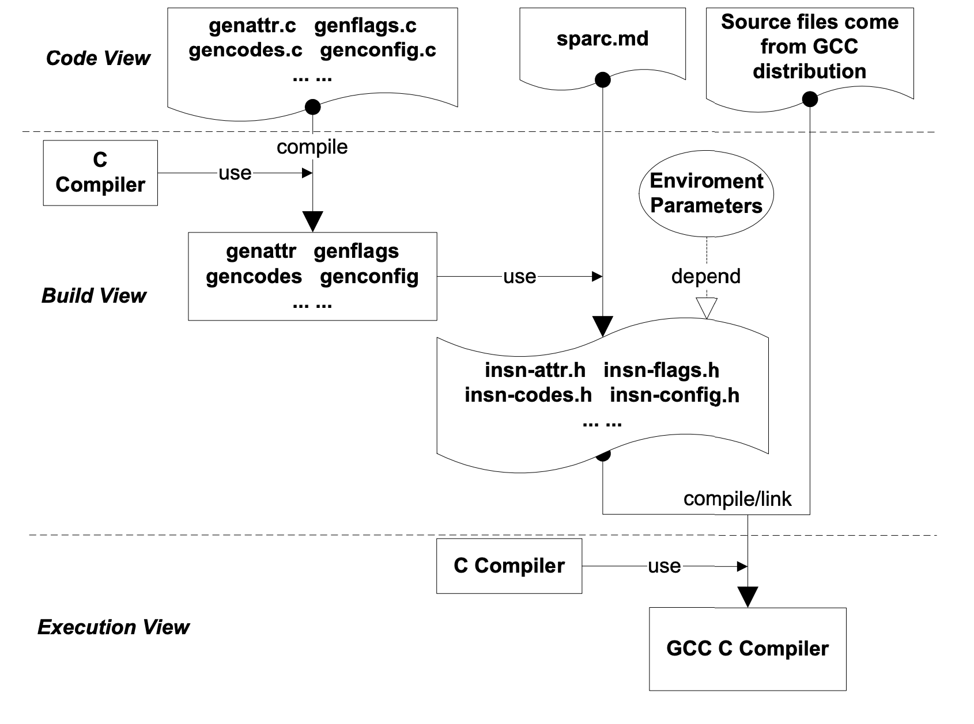
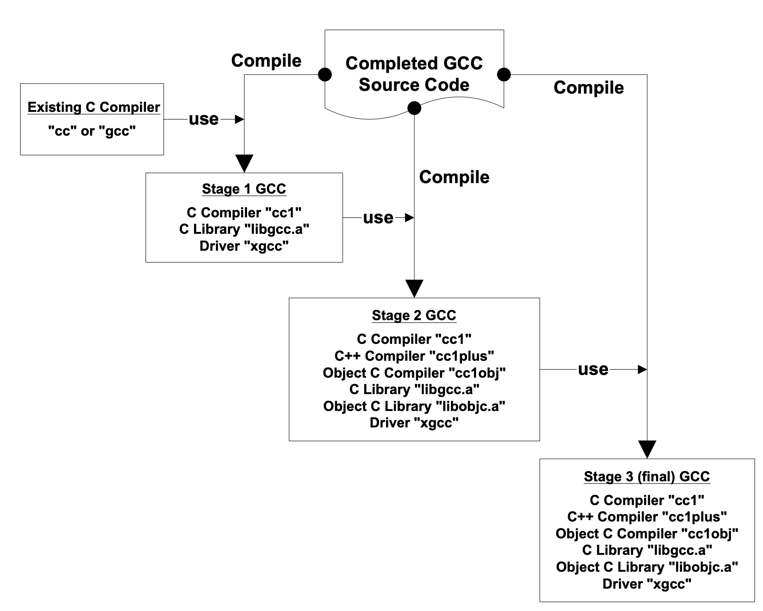
Studying build-time architectures
Build-time source code generation
Compiler bootstrapping
[Tu & Godfrey, ICSM 2001; Godfrey et al., MSR 2004]]
Notes:
GCC bootstrappg:

Slide 3
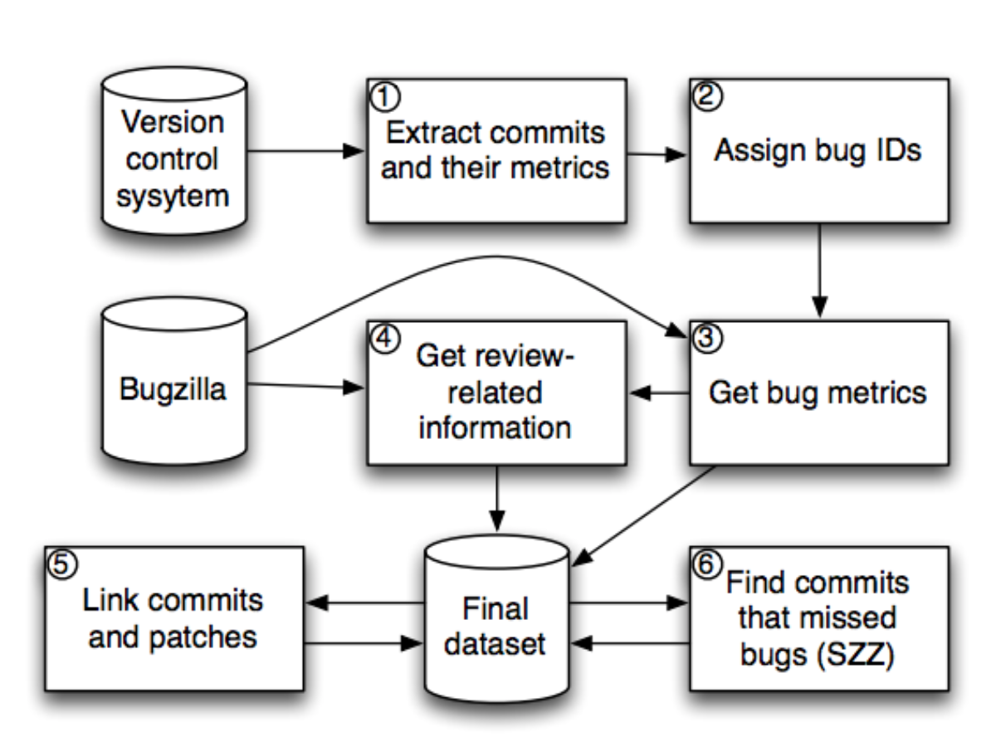
"Investigating Code Review Quality: Do People and Participation Matter?"
Do Mozilla reviewers miss a lot of bugs?
Yes, about 54% of patches contained uncaught bugs
Do reviewer "personal factors" affect code review quality?
Yes, long review queues and inexperience lead to more bugs
Does "participation" affect code review quality?
Yes, more developers involved in commenting leads to fewer bugs
Challenges — Better modelling & assessment of:
Costs & risks for developers
"Soft"/qualitative data, esp. about developers
Process models and instrumentation opportunities for model app development
[Kononenko et al., ICSME 2015, ICSE 2016]

