Slide 1



Mike Godfrey
Email: migod@uwaterloo.ca @migod
Professor, Cheriton School of CS, UWaterloo
Founding member of SWAG (Software Architecture Group)
Research interests:
Software reverse engineering, sw architecture modelling
Empirical studies of sw dev (e.g., code review, sw evolution)
Software artifact repository mining, sw analytics
Code duplication analysis ("code cloning")
Analytics

Slide 2
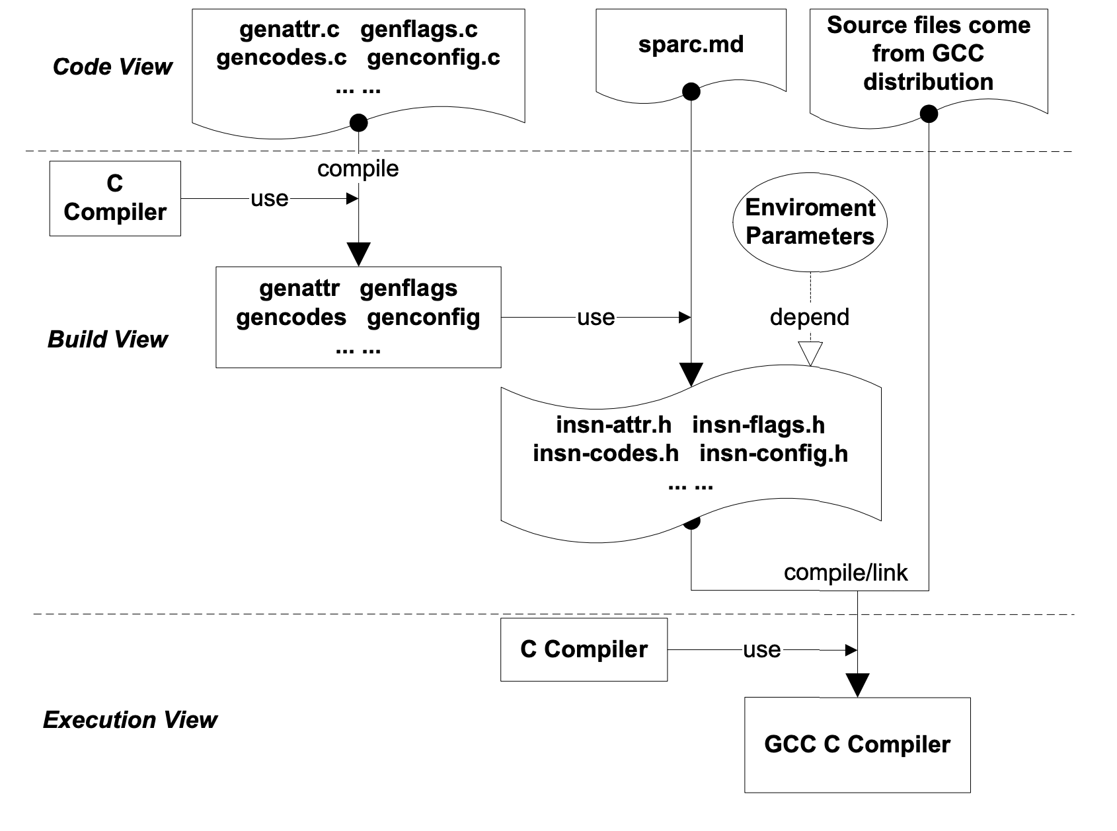
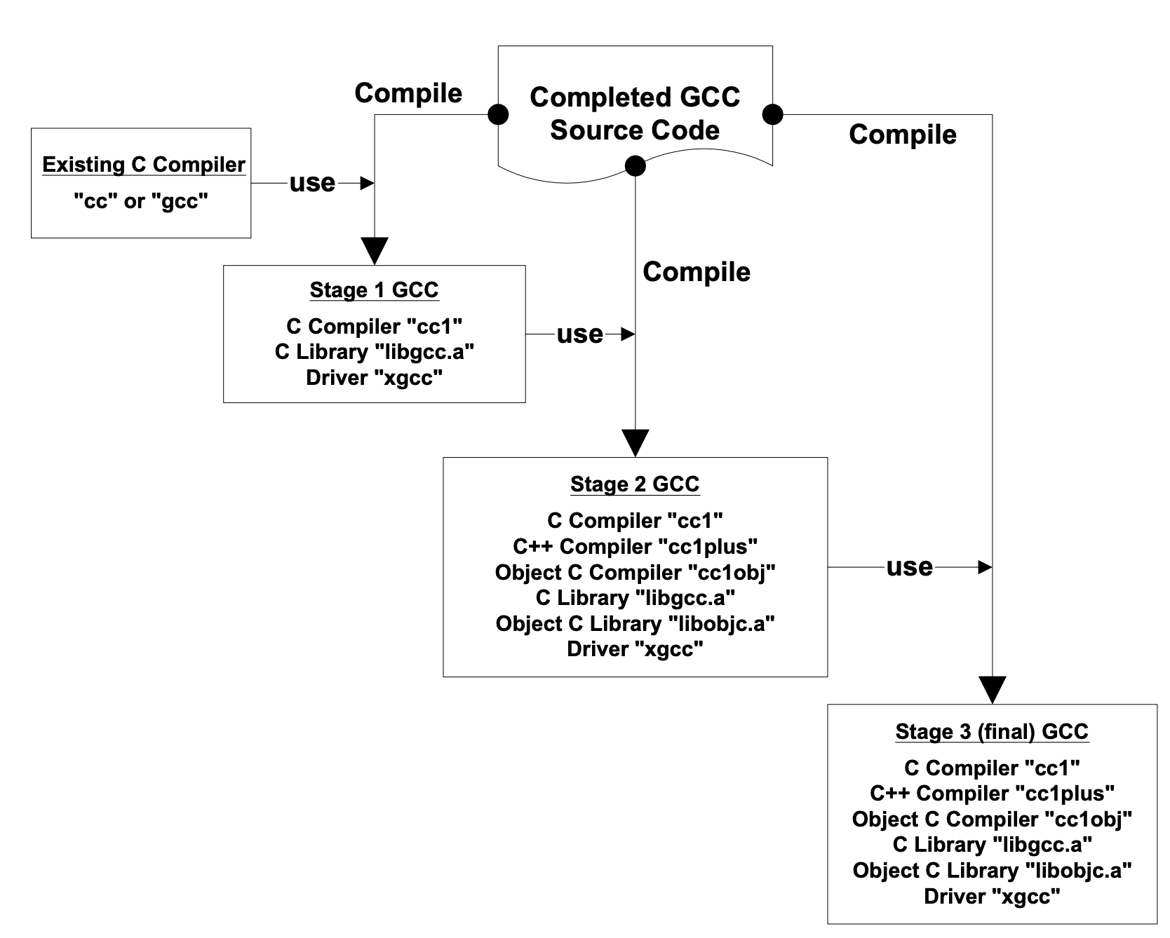
Studying build-time architectures
Build-time source code generation
Compiler bootstrapping
[Tu & Godfrey, ICSM 2001; Godfrey et al., MSR 2004]]
Notes:
GCC bootstrappg:

Slide 3
Studying build-time properties
How can we model and understand how build / deploy processes work?
"Infrastructure as code"
How hard is system building?
How can we measure its costs / risks?
How many devs edit the process / artifacts?
What is a "build bug"?

Slide 4
Build-time source code generation
In GCC, the common intermediate representation language is called the Register Transfer Language (RTL)
The RTL is hardware dependent!
Therefore, the code that generates and transforms RTL is also hardware dependent
RTL related code is generated at build-time
Information about the target environment is input as build parameters

Slide 5
GCC Bootstrapping
"Same" source code base is compiled multiple times
Each time by a different compiler!
Usually, the one built during the previous iteration.
Different source modules are included and configured differently for some iterations
Static analysis (reading) of the Makefiles doesn't help much in understanding what's going on.
Makefiles are templated, control flow depends on complex interactions with environment.
Need to instrument and trace executions of build process, build visual models for comprehension

Slide 6
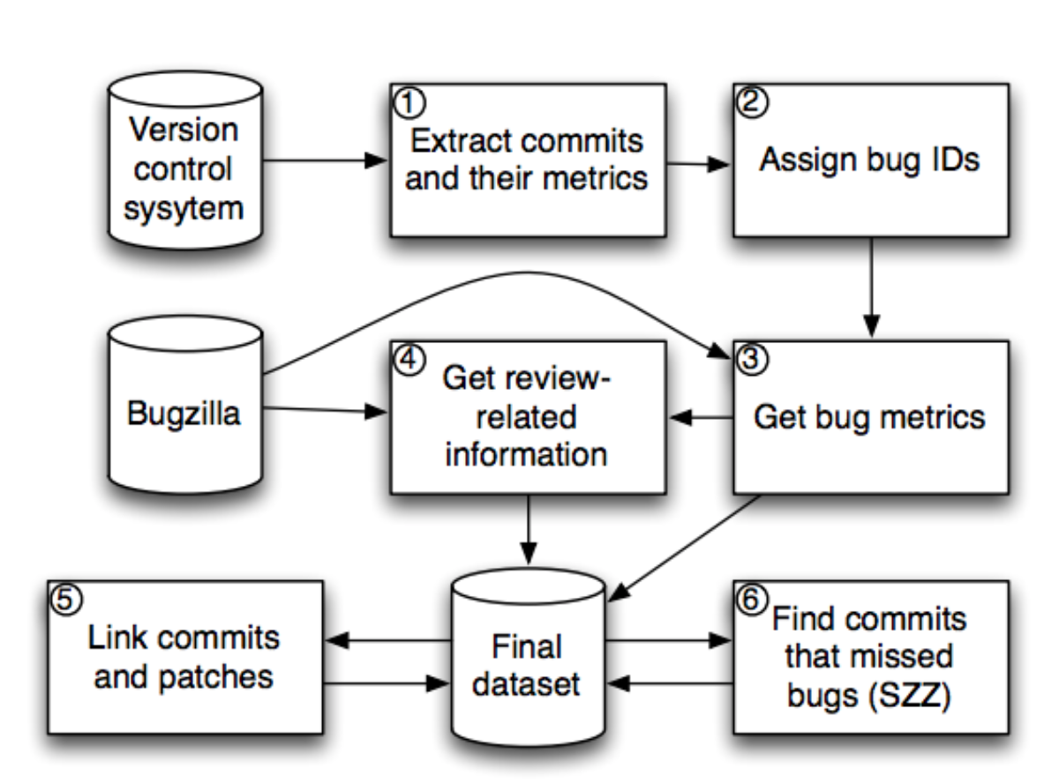
"Investigating Code Review Quality: Do People and Participation Matter?"
Do reviewers miss a lot of bugs?
Yes, about 54% of patches contained uncaught bugs
Do reviewer "personal factors" affect code review quality?
Yes, long review queues and inexperience lead to more bugs
Does "participation" affect code review quality?
Yes, more developers involved in commenting leads to fewer bugs
[Kononenko et al., ICSME 2015]

Slide 7
We can measure a rich landscape

