Slide 1
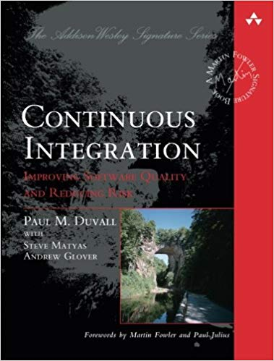
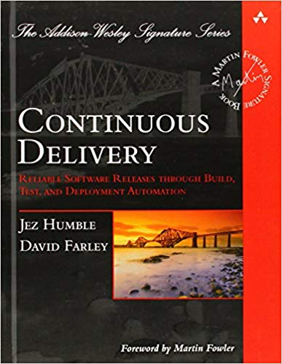

Sebastian Proksch
University of Zurich, Switzerland
TU Delft, The Netherlands

Slide 2

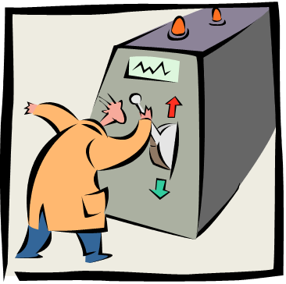

Context-Aware CI/CD Maturity Model
DevOps Cook Book
Context-Aware
Configurator
Teaching /
Onboarding

Slide 3
Seminar Expectations
Feedback on Research Ideas
Finding New Collaborations
Improve Ping-Pong Skills

