Slide 1
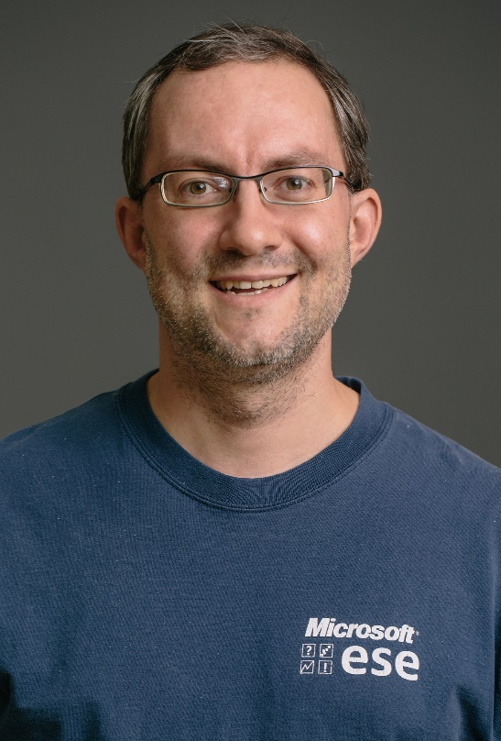
Thomas Zimmermann Sr. Principal Researcher, Microsoft Research
“Doing” Data Science since 2002.
Core Research Areas
Software Productivity
Data Science in Software Teams
Software Engineering and Machine Leaning

Slide 2
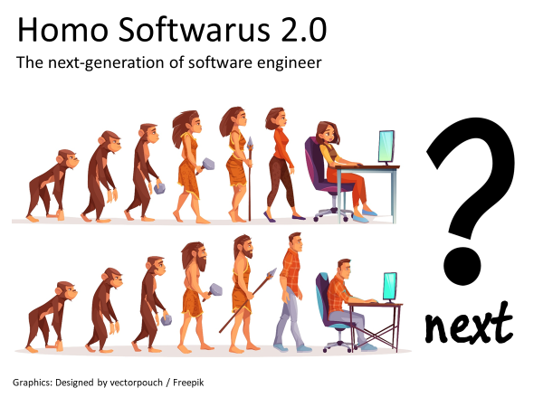
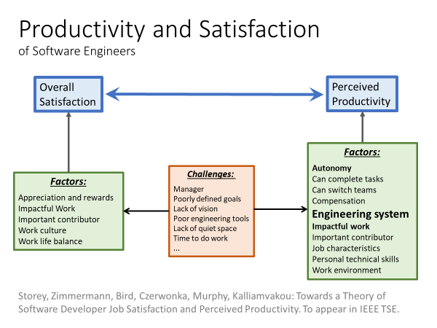
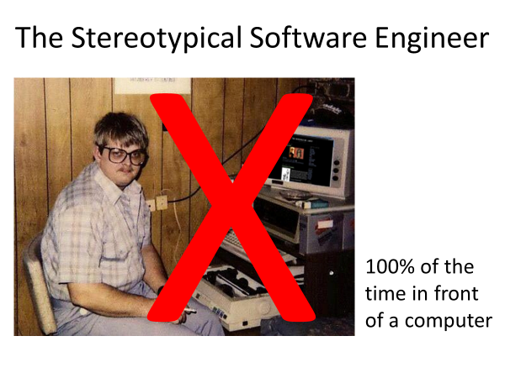
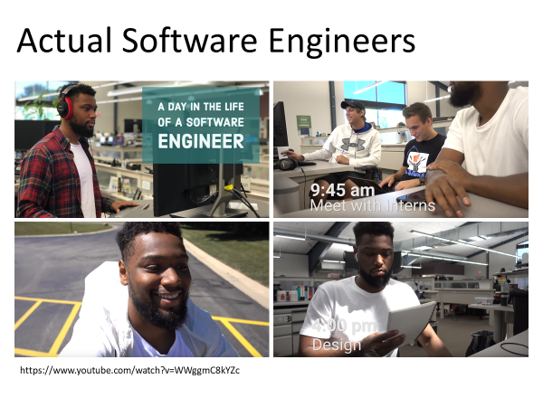


Good/bad workdays
Office

Slide 3

Goals for the meeting
Make connections
Relation between release engineering and productivity
Impact of AI on release engineering and mobile apps

