Slide 1
Internet of Things
What is IOT?
Deploying a system of smart devices (one to a million or more)
Connected over the internet
Monitor them remotely
Control them remotely
Access them securely
IOT is not just about programming embedded systems
It’s a system and an infrastructure
That’s where the opportunities are
Notes:
Just what it says
At first IOT might look to a developer as requiring embedded systems programming skills. Maybe, but that’s just a small part of it. Its about a system where the embedded devices are just one part.
I expect that a company developing an IOT solution would need a couple of embedded system nerds (I was one for 35 years). Maybe an EE or two. But these days many embedded boards run Linux and that increases all the time. Some use an RTOS but that’s just software too.
That’s not the focus here. Assume you have an embedded device with the right hardware hookups that’s running Linux.

Slide 2
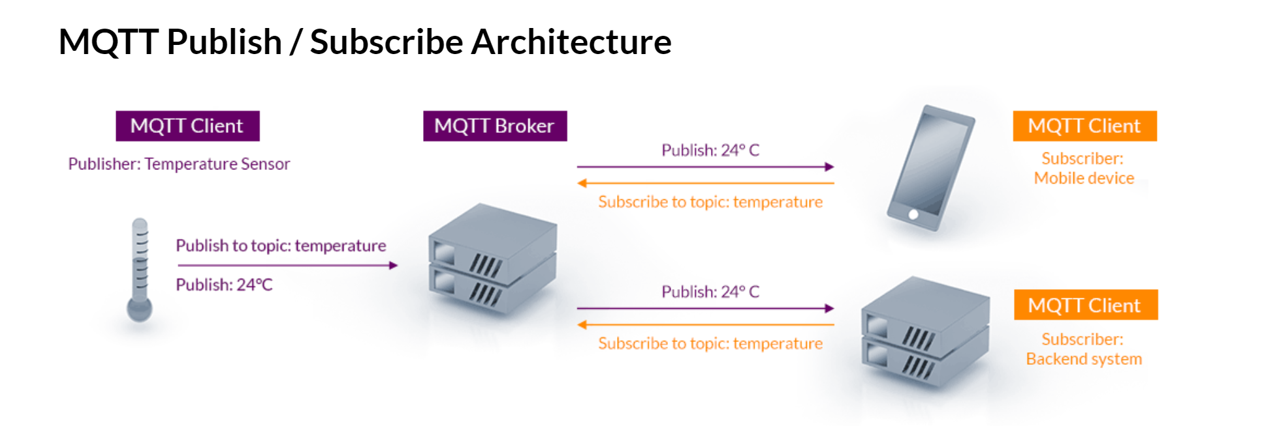
IOT System
Subscribe to a command
Publish a command
Notes:
An IOT system has just 2 components
A Broker
A set of clients
All clients work the same way and use the same interface to the broker.
Some clients are the remote nodes that everyone things of as IOT.
The ‘front end’
Other clients are workstations, servers, mobile
The ‘back end’
But to the system and broker they are all the same
Clients can do two things:
publish data to the Broker
subscribe to data from the Broker
There is no direct interface between clients, such as workstation to remote node

Slide 3
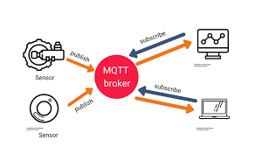
Broker
An IOT Broker is:
Server software, visible on the interwebs
A middleman to decouple Clients
Receives and Sends Messages
Speaks MQTT – MQ Telemetry Transport
Publish/Subscribe
MQ Telemetry Transport
Lightweight protocol over TCP
Somewhere in the cloud
Lots of vendors
Notes:
There are many implementations of Broker’s available, open source

Slide 4
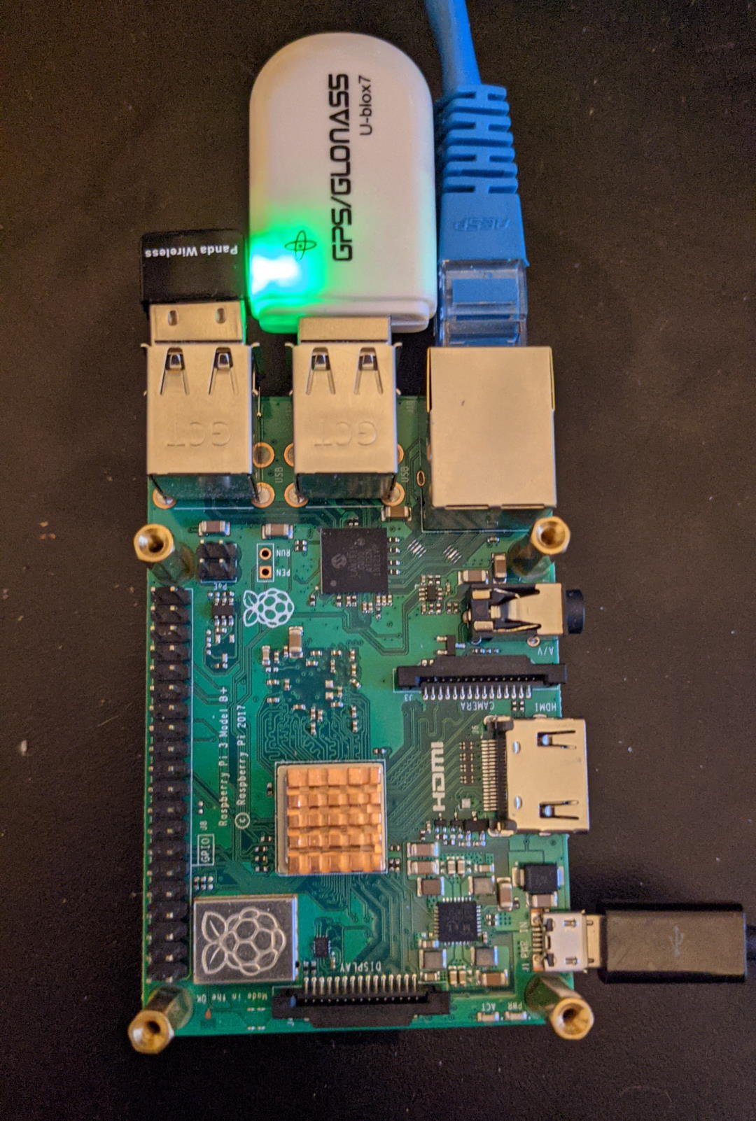
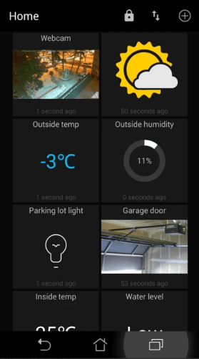
Clients
IOT calls all the devices and computers ‘Clients’ of the Broker
Remote Devices
Workstations, Mobile, Back-end
Clients contact the Broker
Clients are usually behind a firewall of some kind
Typically, don’t expose a static address and port on the internet (at least not the port)
Clients reach out to the broker and establish a connection
The Broker never goes out to the Clients
Clients Publish and Subscribe their data as ‘Topics’ (in MQTT)
Software
Broker Software usually has associated Client SDKs for most languages and runtimes
usually Linux or RTOS, not so much Windows
You need basic Linux skills

Slide 5

They Talk MQTT Protocol
MQ Telemetry Transport – not a message queue ☺
Machine-to-machine communication
invented at IBM in 1999 by Andy Stanford-Clark and Arlen Nipper
Open-source spec released 2010
Simple
TCP/IP (clients initiate the connections)
QOS
Lightweight
Data agnostic (binary)
Publish/Subscribe vs Client Server
Version 3.x, Version 5 coming soon
Standards based SDK’s are available for mainstream programming languages
Notes:
The communication protocol, MQTT is simple enough that you could write your own, but there are MQTT sdk’s available for most languages and platforms.
Some SDKs support embedded systems , others anything with Linux, Windows on the back end side.
There is a javascript package that works in browsers (MQTT over Websocket) or node back-ends. That’s what I’m using right now.

Slide 6
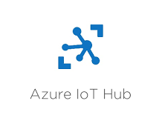
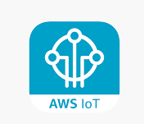
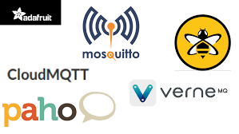
Some Solutions
Major Cloud Providers
Google, Azure, AWS, IBM
All provide an end-to-end IOT infrastructure including broker, node and client support
Tie into all their other cloud services such as storage, database, analytics
Of course, large distributed data center infrastructure
Hosted MQTT Brokers
These focus more on the core Client ⬄ Broker infrastructure
hivemq.com *
cloudmqtt.com
emqx.io *
Open Source
mosquitto.org*
eclispse.org/paho*
* has open source edition
Notes:
The big cloud providers tie you into their entire offerings. In the long run they are probably the way to go even if you host the basic MQTT broker in their cloud.
Their IOT support is very vendor specific.
The hosted MQTT brokers focus on MQTT itself and seem much more standards based. You can use their hosting or a cloud of your choice. As competition grows, they are adding more features similar to the big cloud providers, or just tie their offering into one or the other of big providers.
You can do it all yourself with one of the open source solutions.

Slide 7
Developer Opportunities In IOT
Cloud Experts
The most important for a system designer and administrator
Back End Devs : API’s, Databases, Analytics, Servers
Subscribe to data
Publish commands
Front End Devs : Web, Mobile, Dashboards, Analytics, Apps
Embedded Systems : Linux, RTOS, Devices

Slide 8
References
mqtt.org/
standards
www.hivemq.com/mqtt-essentials/
https://youtu.be/jTeJxQFD8Ak (their mqtt-essentials YouTube series)
https://www.hivemq.com/mqtt-client-library-encyclopedia/
www.steves-internet-guide.com/
azure.microsoft.com/en-us/overview/iot/
amazon.com/iot/
My IOT REPO
https://github.com/dmh2000/iot.git
Includes quickstarts for HiveMQ and Azure IOT
Slides from this presentation
But you don’t really need those ☺

Slide 9
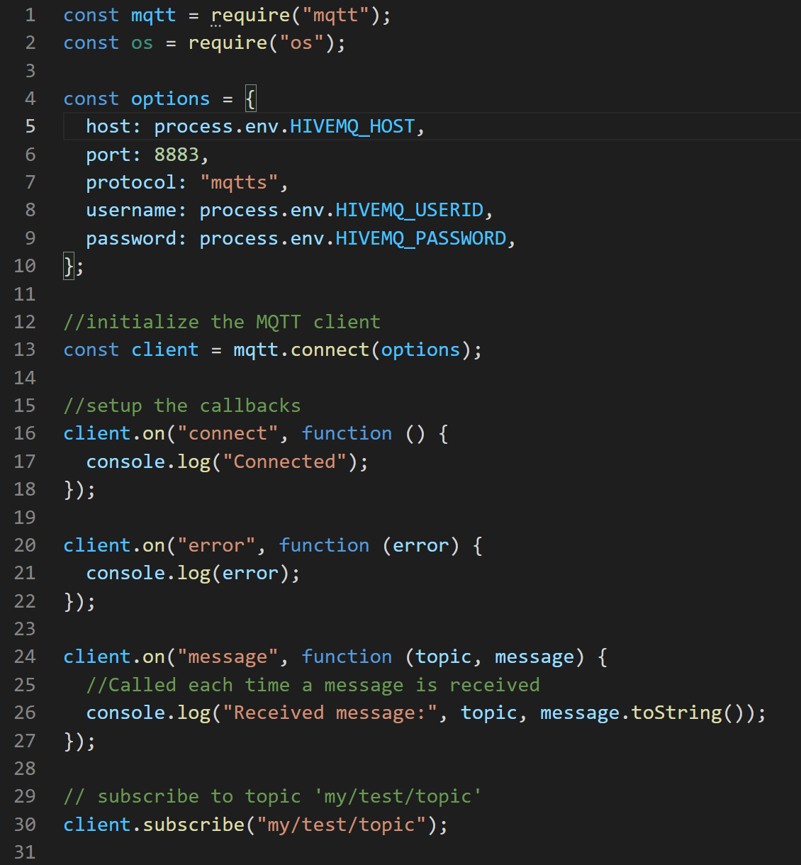
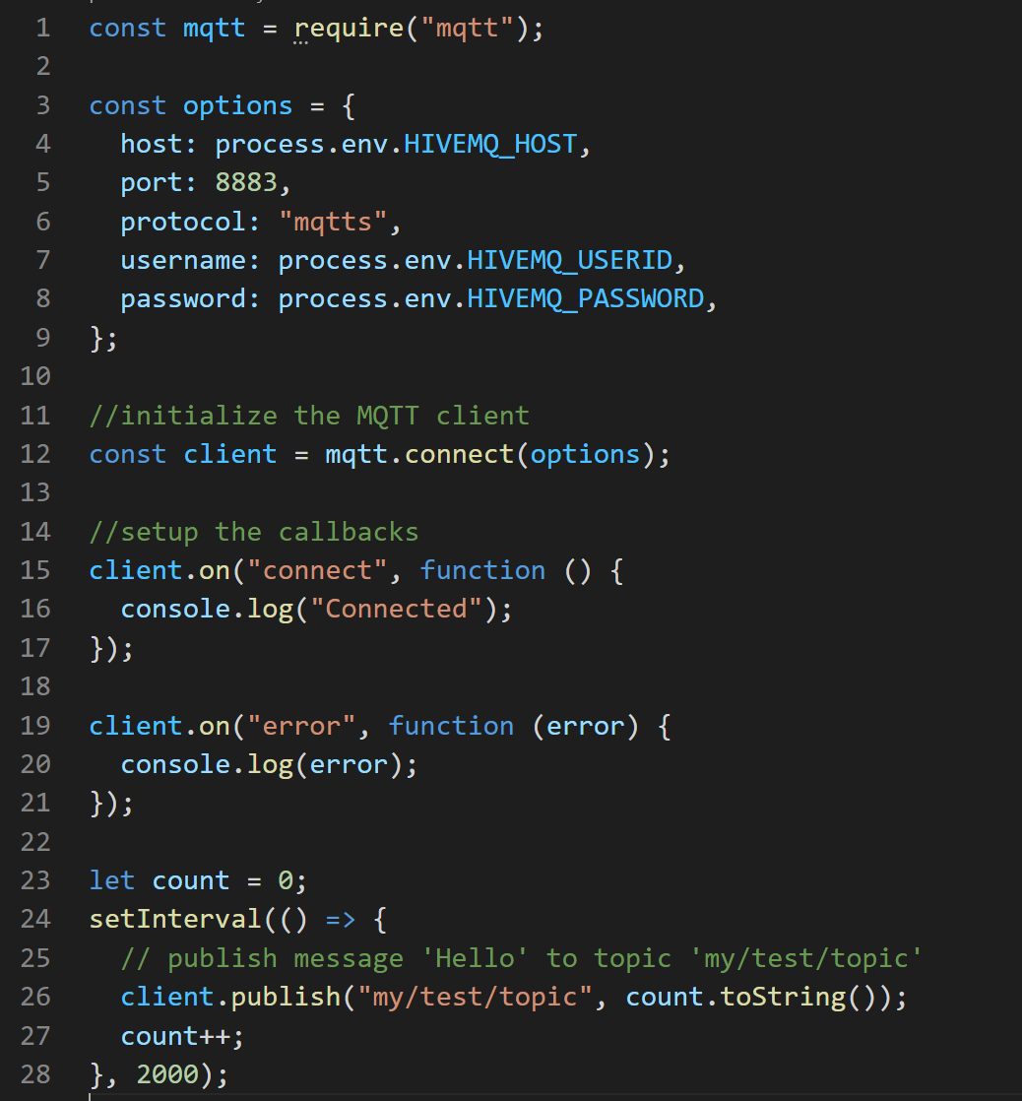
HiveMQ Quickstart at https://github.com/dmh2000/iot.git
https://www.hivemq.com/docs/hivemq/4.7/user-guide/getting-started.html
subscriber
You get these when you signup
publisher

