Slide 1
IOT : Brief Overview

Slide 2
Internet of Things
What is IOT?
Deploying smart devices (one to a million or more)
Connected over the internet
Monitor them remotely
Control them remotely
Access them securely
IOT is not really about programming embedded systems
That’s just a part of it
It’s a system and an infrastructure

Slide 3
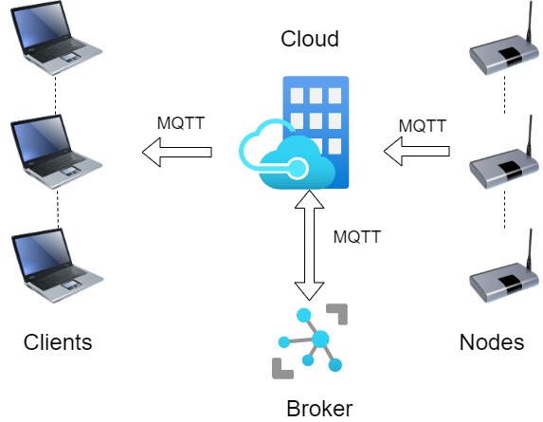
Components Of AN IOT SYSTEM Think Big!
Nodes
Device
Millions/billlions
Clients
servers
workstations
Broker
cloud
MQTT
Transport
others

Slide 4
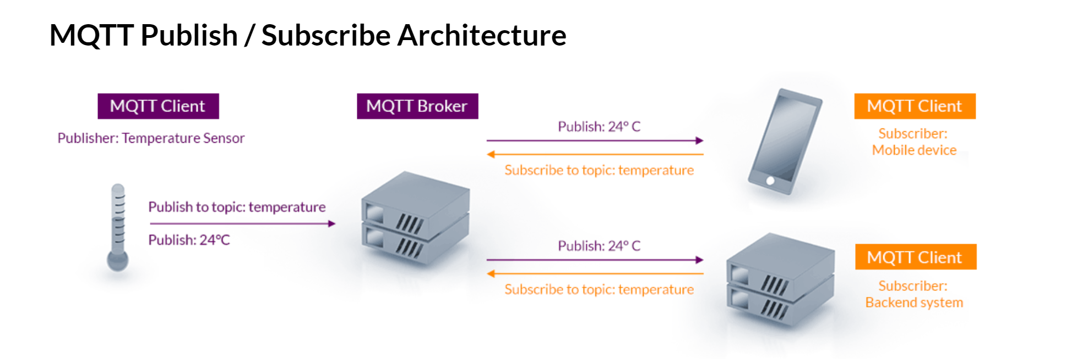
The Broker
An IOT Broker is:
Software, usually running in the cloud
A middleman to decouple Nodes from Clients
Sort of Like a Post Office
Nodes Publish Data to the Broker : Sending Mail
Clients Subscribe to Data from the Broker : Receiving Mail
The Broker Routes The Mail
MQTT
MQ Telemetry Transport (not ‘message queue’)
Lightweight protocol over TCP

Slide 5
Nodes
Aka Clients
Devices
Typically, remote
Embedded system or regular computer
Think of them as being behind a NAT firewall
Not directly on the internet with a static IP
Nodes publish to the Broker
Nodes reach out to the broker
The Broker doesn’t go out to the Nodes
Publish their data as ‘Topics’
Software
Broker Software usually has associated Device SDKs
For most languages and runtimes
Assume Linux or RTOS, not so much Windows

Slide 6
Clients
Workstations, Servers whatever
Software
Depends on the Broker
Broker software usually comes with Client-side SDKs
Most ‘popular’ languages
Oriented towards web-ish back-end
Supports the various subscribe modes
Client can request data or have it sent automatically

Slide 7
How To Get Started
Cloud Providers
Google, Azure, AWS
All provide an end-to-end IOT infrastructure including broker, node and client support
MQTT Packages (not from cloud provider)
https://mqtt.org/software/
I found the Azure package easiest to get going
https://docs.microsoft.com/en-us/azure/iot-develop/quickstart-send-telemetry-central
You can get a client-broker-node example going with a workstation only
Navigating their dashboards and such can be confusing
https://docs.aws.amazon.com/iot/latest/developerguide
As expected, AWS is very full featured
Its Complicated and can be confusing

