Slide 1

LLM DEEP DIVE
How Large Language Models Perform Inference
A technical walkthrough of the transformer inference pipeline — from raw text in to generated tokens out.
10
1B+
1 token
Concepts
ops per token
per forward pass
Notes:
Welcome everyone. Today we're going to open the black box — walk through exactly what happens inside a large language model from the moment you send a prompt to the moment tokens start streaming back. We'll go step by step, and I'll try to give you a strong mental model for each stage of the pipeline.

Slide 2
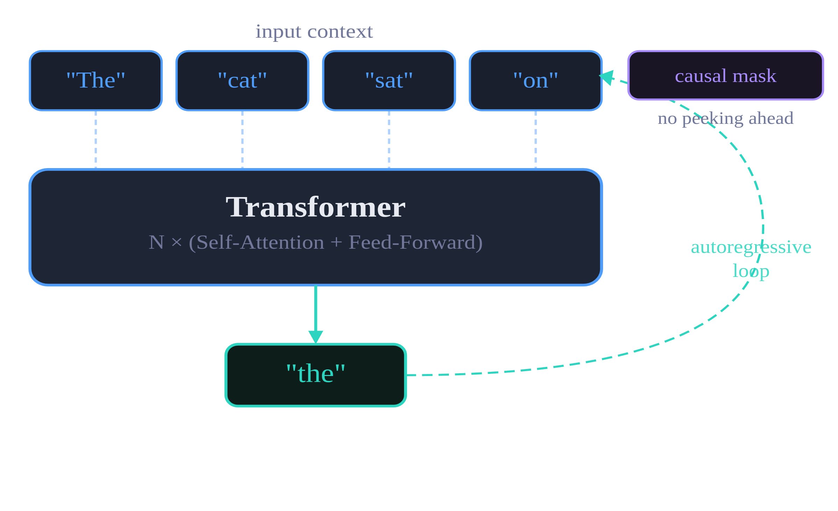
01 — ARCHITECTURE
Decode-Only Transformers
One job: predict the next token given all previous tokens
Each output token is appended and becomes the next input
A deep stack of transformer blocks, each refining what token comes next
Causal masking: tokens can only attend to what came before
Notes:
Modern LLMs like GPT and Llama are decode-only transformers — they generate text one token at a time, left to right, like finishing someone's sentence. Think of it like a very sophisticated autocomplete engine — one that's read a significant fraction of the internet. The key insight is that the model has just one job: predict the next token given everything that came before. And it does this in a loop.

Slide 3
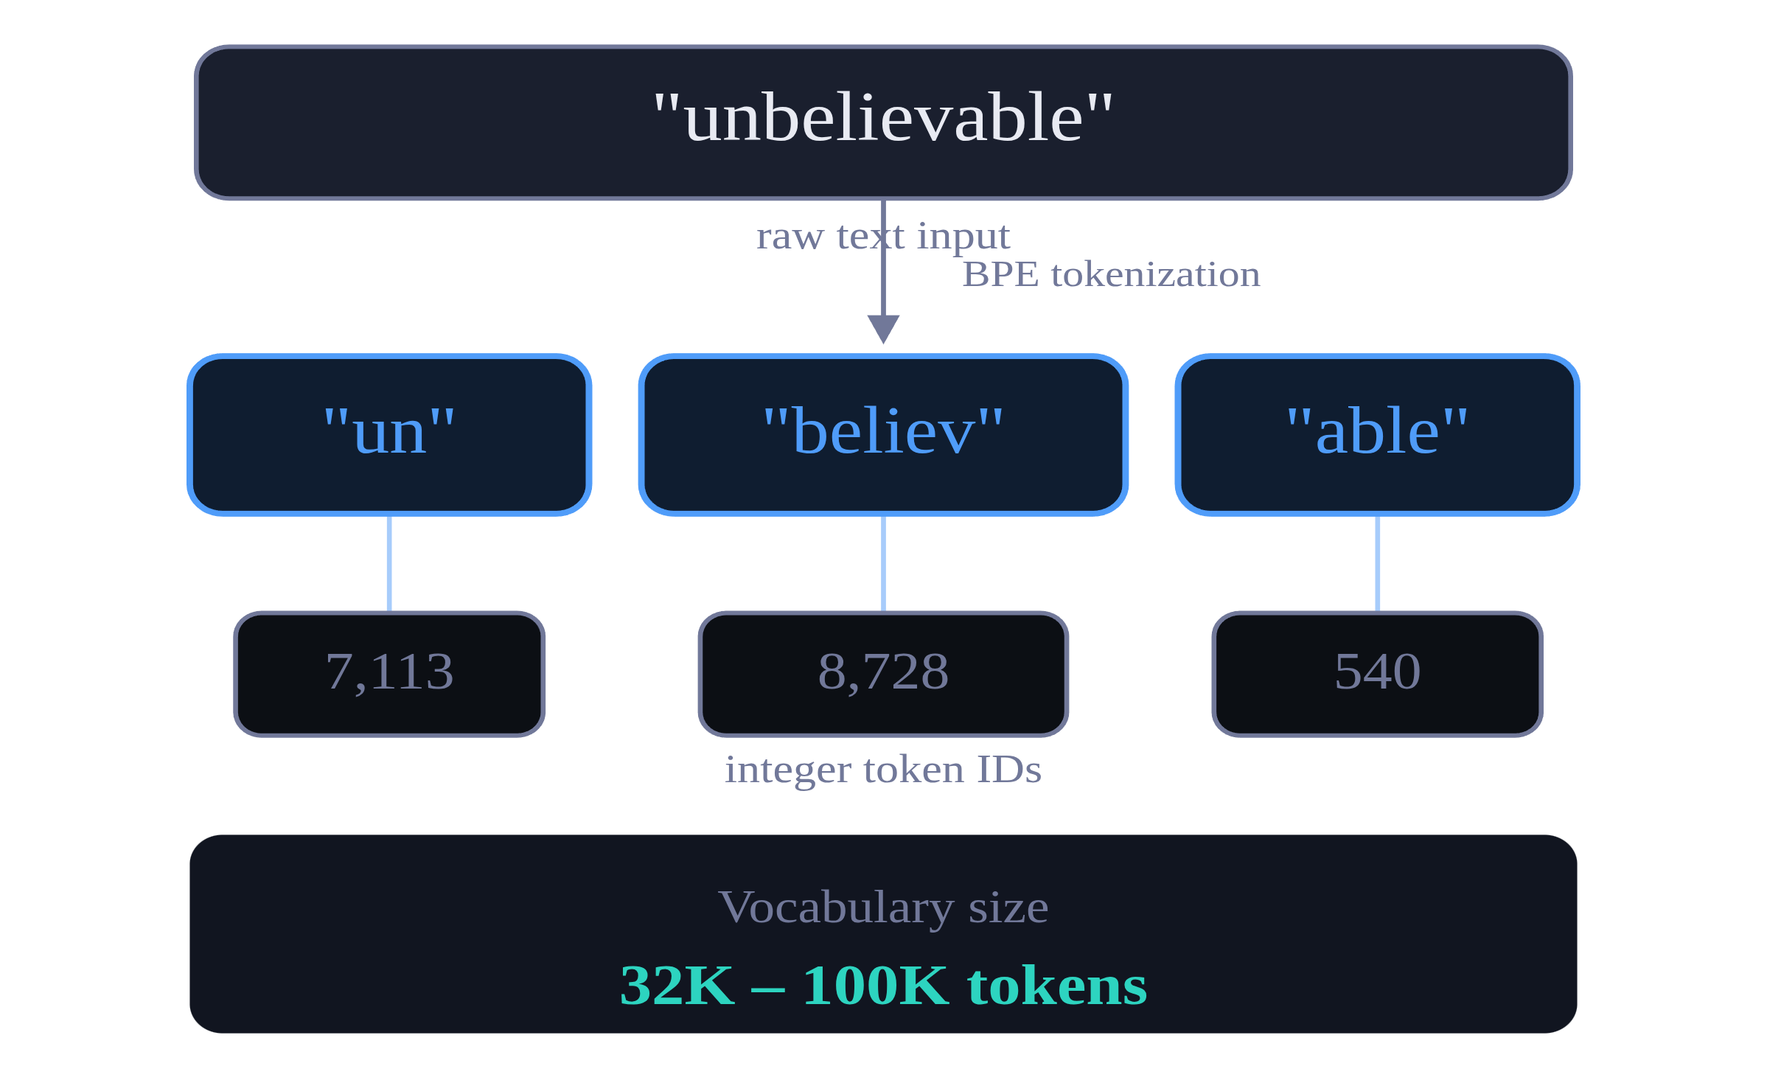
02 — INPUT
Tokenization
Text split into subword chunks — words, pieces, or punctuation
Each chunk maps to an integer ID in a fixed vocabulary
Rare words split into pieces; common words stay whole — "the" = 1 token
Pre-built BPE dictionary — not learned during model training
Notes:
Before the model can do anything, raw text must be converted into tokens — small chunks that are usually words, subwords, or punctuation. The model works with a fixed vocabulary of around 32K to 100K token IDs. Common words like 'the' are a single token; rare words get split into pieces — 'unbelievable' becomes 'un', 'believ', 'able'. This is a pre-built dictionary, not something the model learned. Think of it as translating human language into the model's native language of integers.

Slide 4
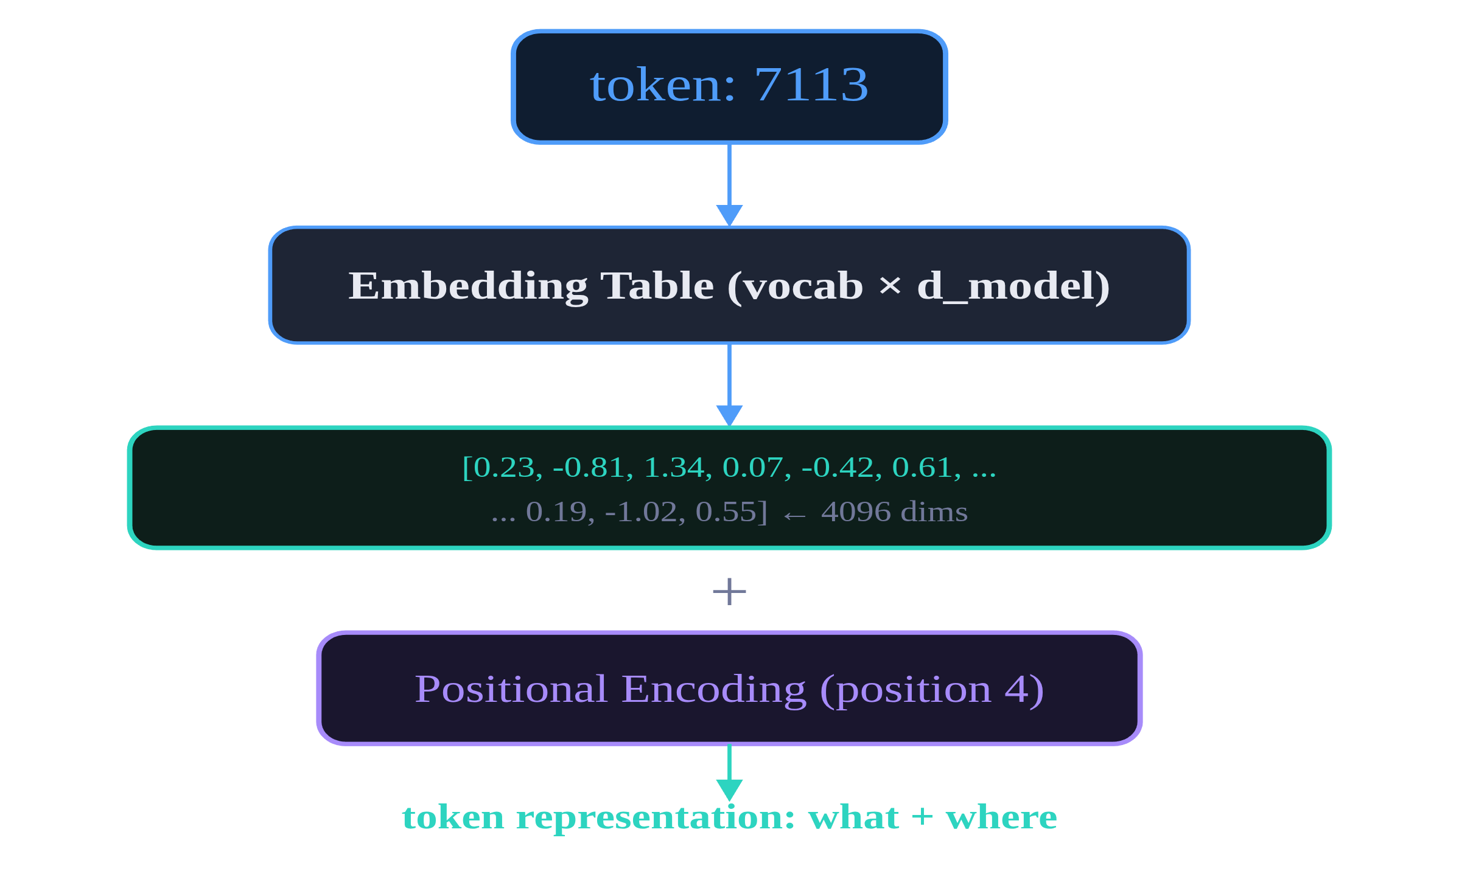
03 — REPRESENTATION
Embeddings & Positional Encoding
Token ID → lookup in table → dense vector of ~4096 numbers
Similar tokens cluster nearby: "king" ≈ "queen" , "cat" ≈ "dog"
Positional encodings add token order — order changes meaning
Result encodes both what the token is and where it sits
Notes:
Each token ID is looked up in an embedding table, producing a dense vector — typically 4096 numbers — that represents the token's meaning. These vectors live in a high-dimensional space where similar concepts cluster together. But the model also needs to know where each token sits in the sequence — 'dog bites man' vs 'man bites dog' mean very different things. So positional encodings are added to each embedding to encode order. The result is a rich numerical representation of both what the token is and where it sits.

Slide 5
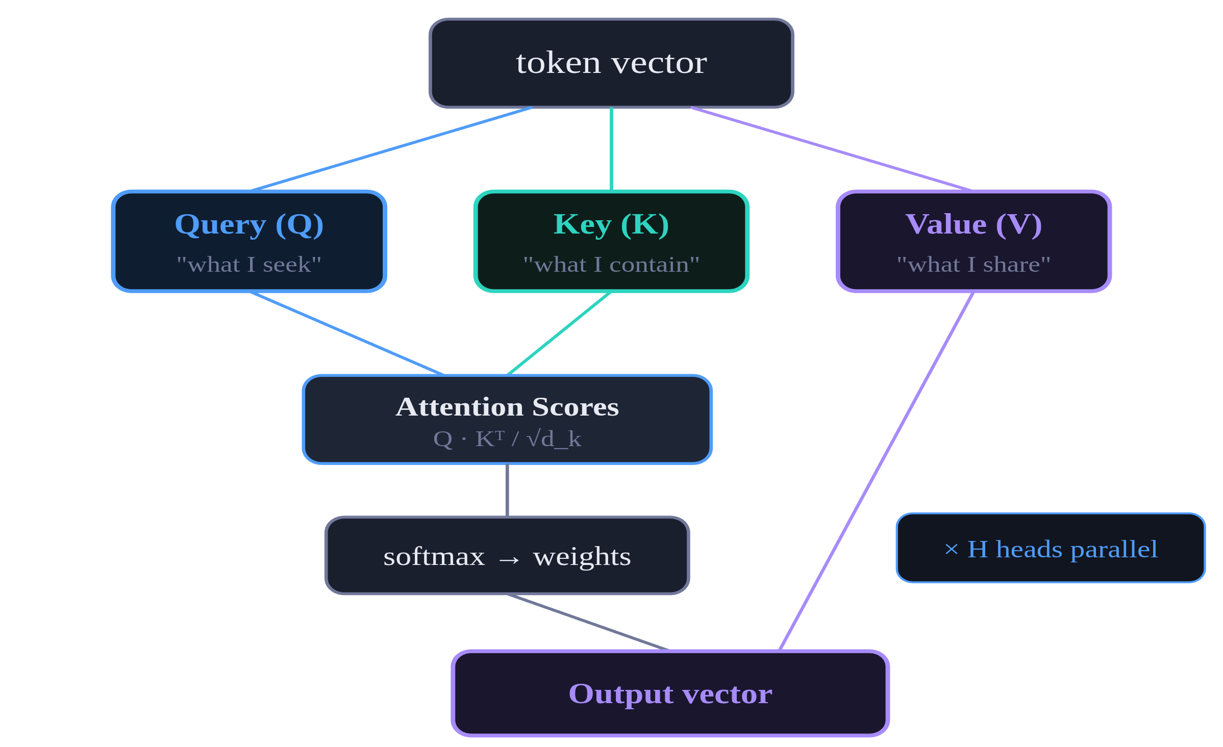
04 — CORE MECHANISM
Self-Attention
Each token asks: which previous tokens matter most?
Q · Kᵀ computes relevance scores; softmax converts to attention weights
Multi-head attention runs H copies in parallel — grammar, semantics, context
Causal masking: only attend to prior tokens , never ahead
Notes:
Self-attention is the core mechanism that lets each token look at every previous token and decide which ones are relevant. Think of reading a sentence and highlighting the words that help you understand the current word — that's what attention does, mathematically. Each token produces three vectors: a Query — what am I looking for? A Key — what do I contain? And a Value — what information do I share? Attention scores come from comparing each Query against all previous Keys. Multi-head attention runs this process in parallel, letting the model attend to grammar, meaning, and context simultaneously.

Slide 6
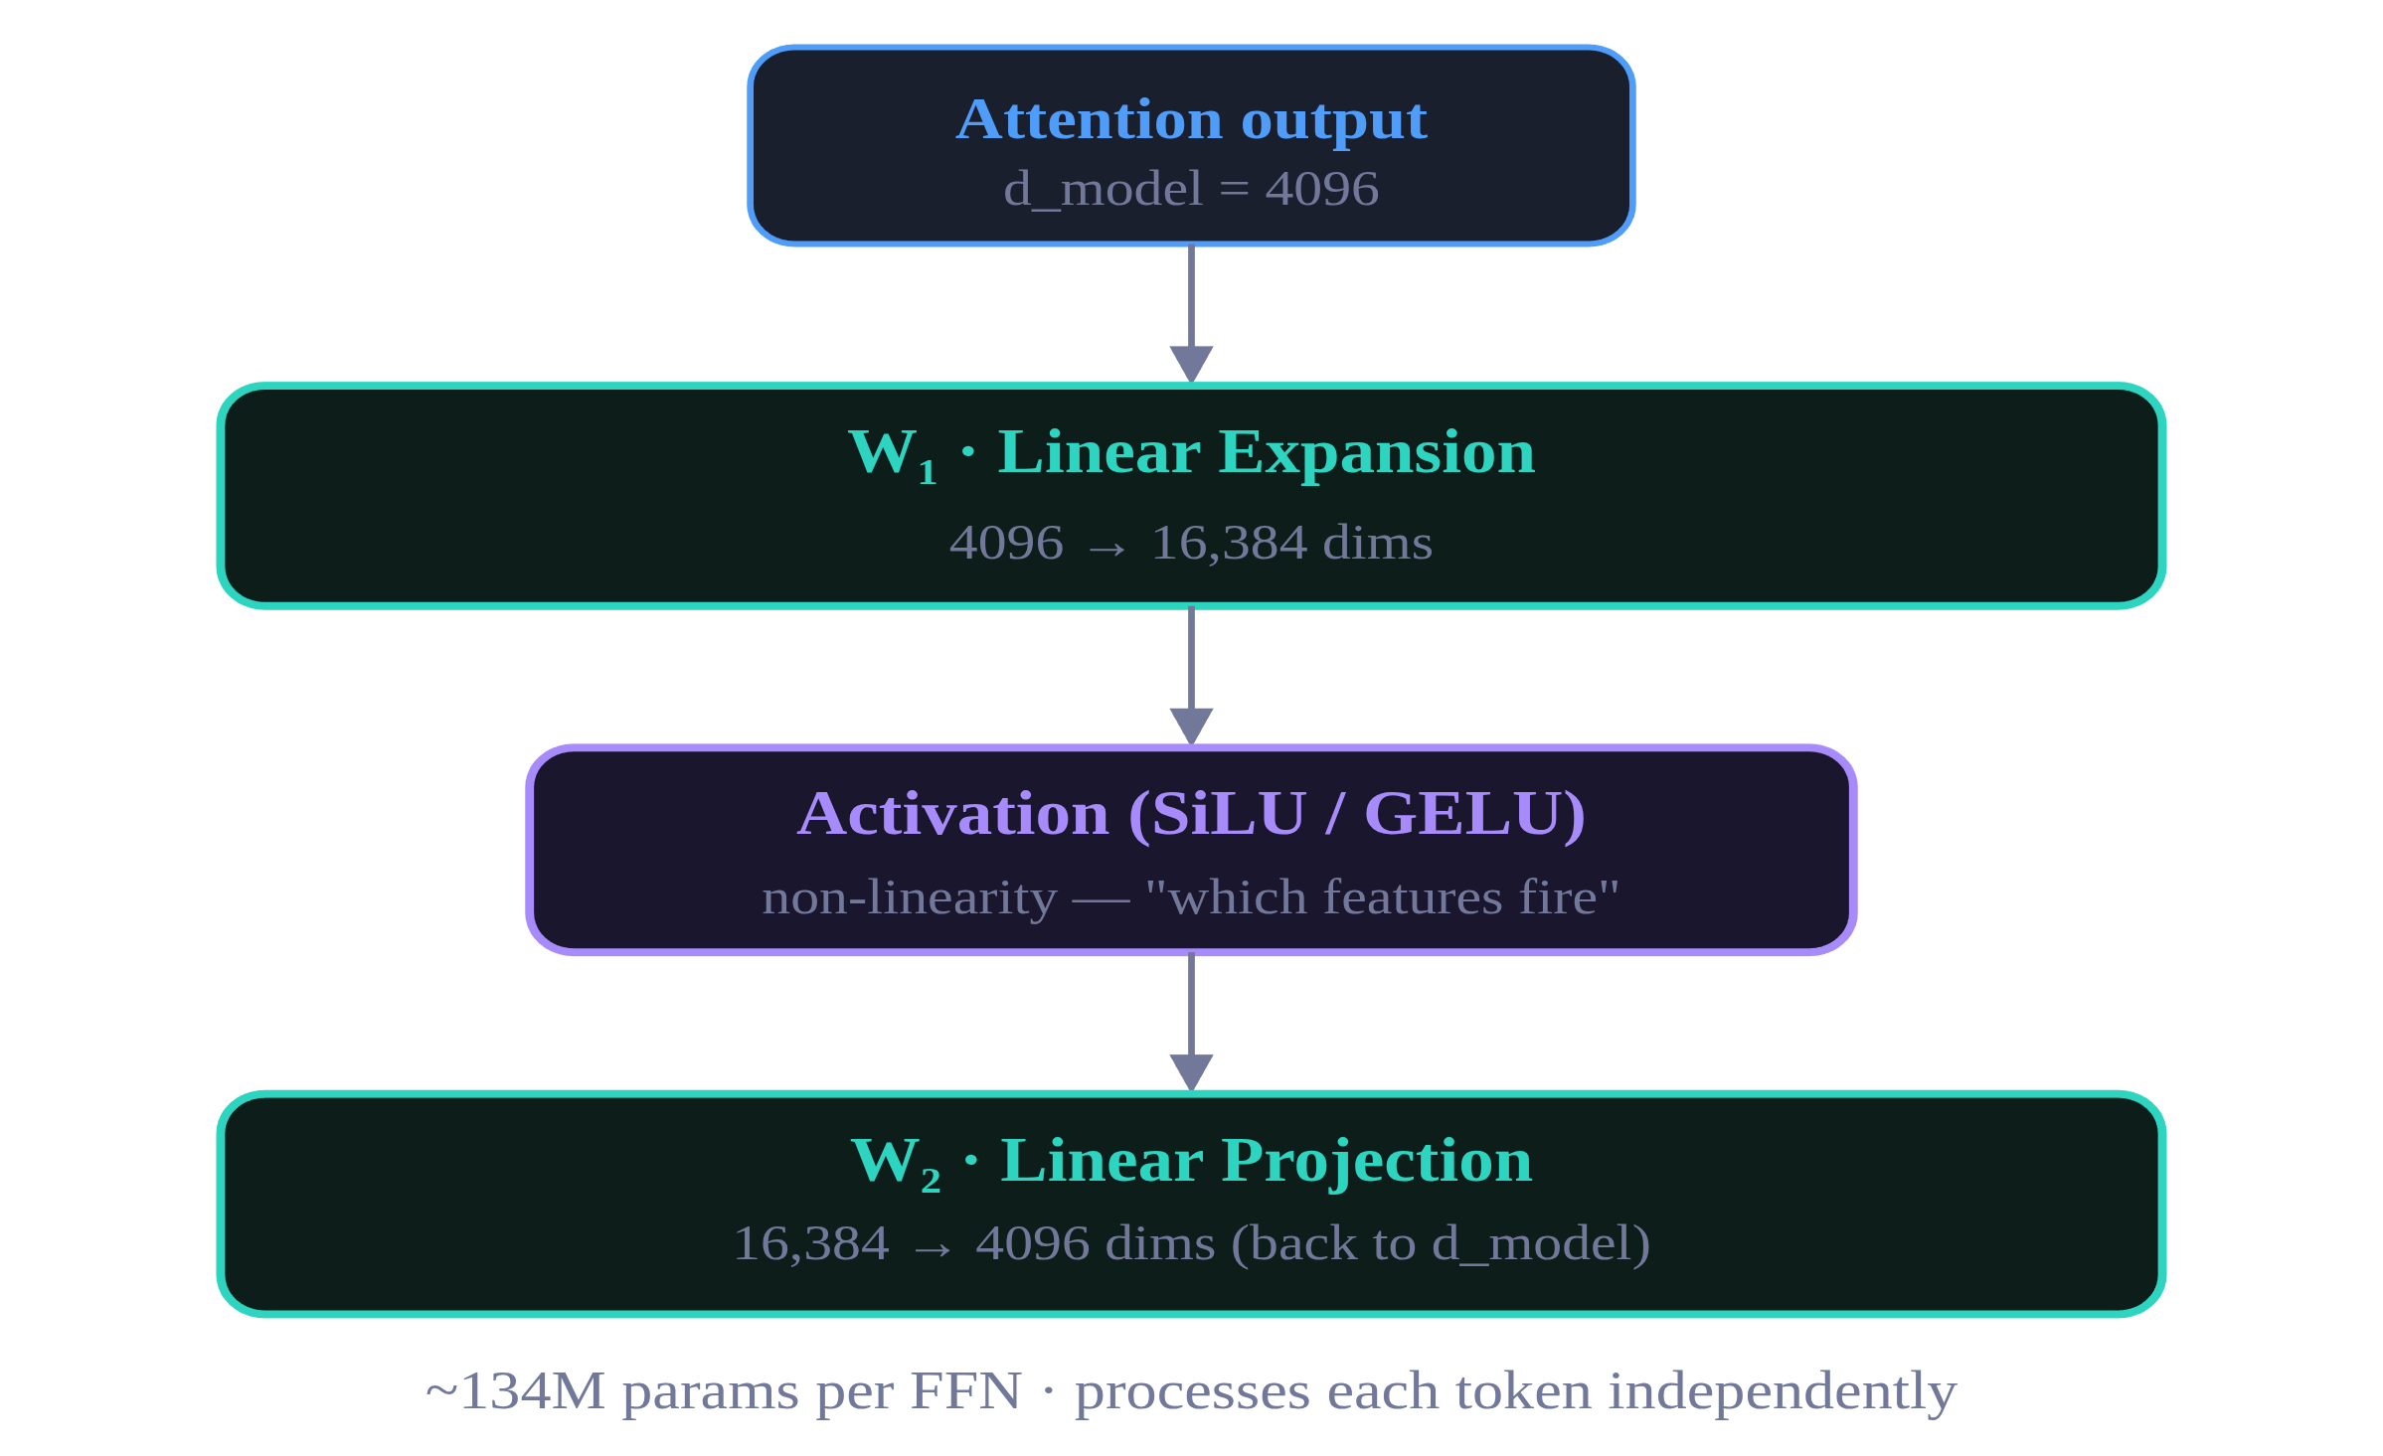
05 — KNOWLEDGE STORE
Feed-Forward Layers
Two matrix multiplies with activation — most parameters live here
Attention finds relevant context; FFN applies stored knowledge
Acts like a vast compressed database of learned facts and patterns
One attention + one FFN = one block; stacked 32–80× deep
Notes:
After attention gathers context, each token passes through a feed-forward network — two large matrix multiplications with an activation function in between. If attention is about relationships between words, the FFN is about applying stored knowledge. These layers are where most of the model's parameters live — they act like a vast compressed database of learned information. Each transformer block pairs one attention layer with one FFN. A typical model stacks 32 to 80 of these blocks.

Slide 7
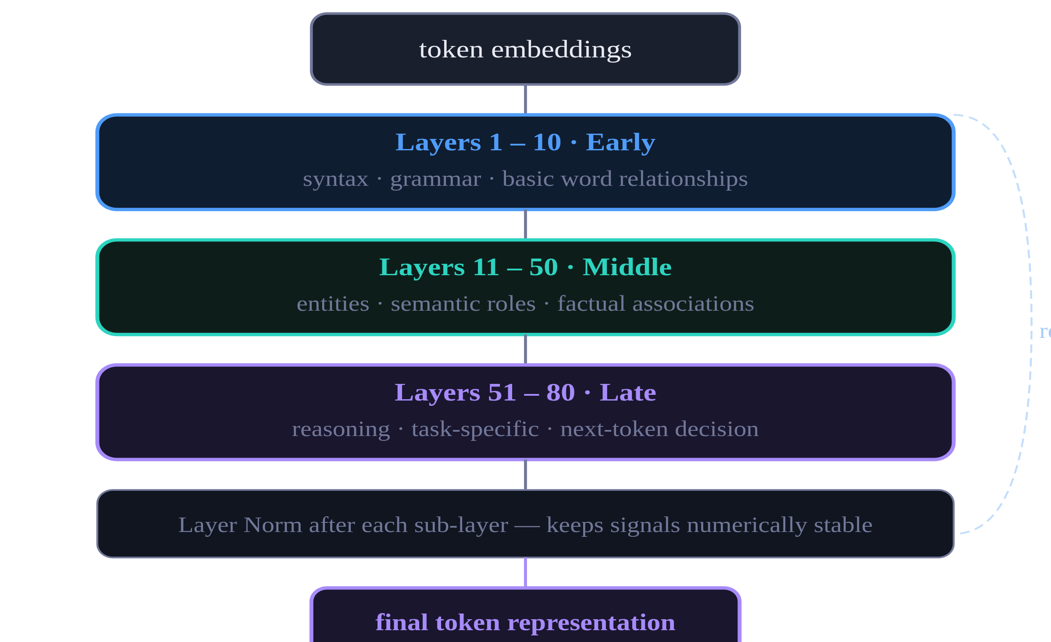
06 — DEPTH
Layer Stacking
Early layers : syntax, grammar, surface-level features
Middle layers : entities, semantic roles, factual associations
Late layers : task-specific reasoning, next-token prediction
Residual connections pass early information forward — nothing lost
Notes:
The model processes tokens through dozens of transformer blocks in sequence — each one refining the representation further. Early layers capture surface-level features: syntax, grammar. Middle layers build more abstract understanding: entities, semantic roles, factual associations. Later layers focus on task-specific reasoning — deciding what the actual next word should be. Residual connections mean information can skip ahead, and layer normalization keeps everything numerically stable across depth.

Slide 8
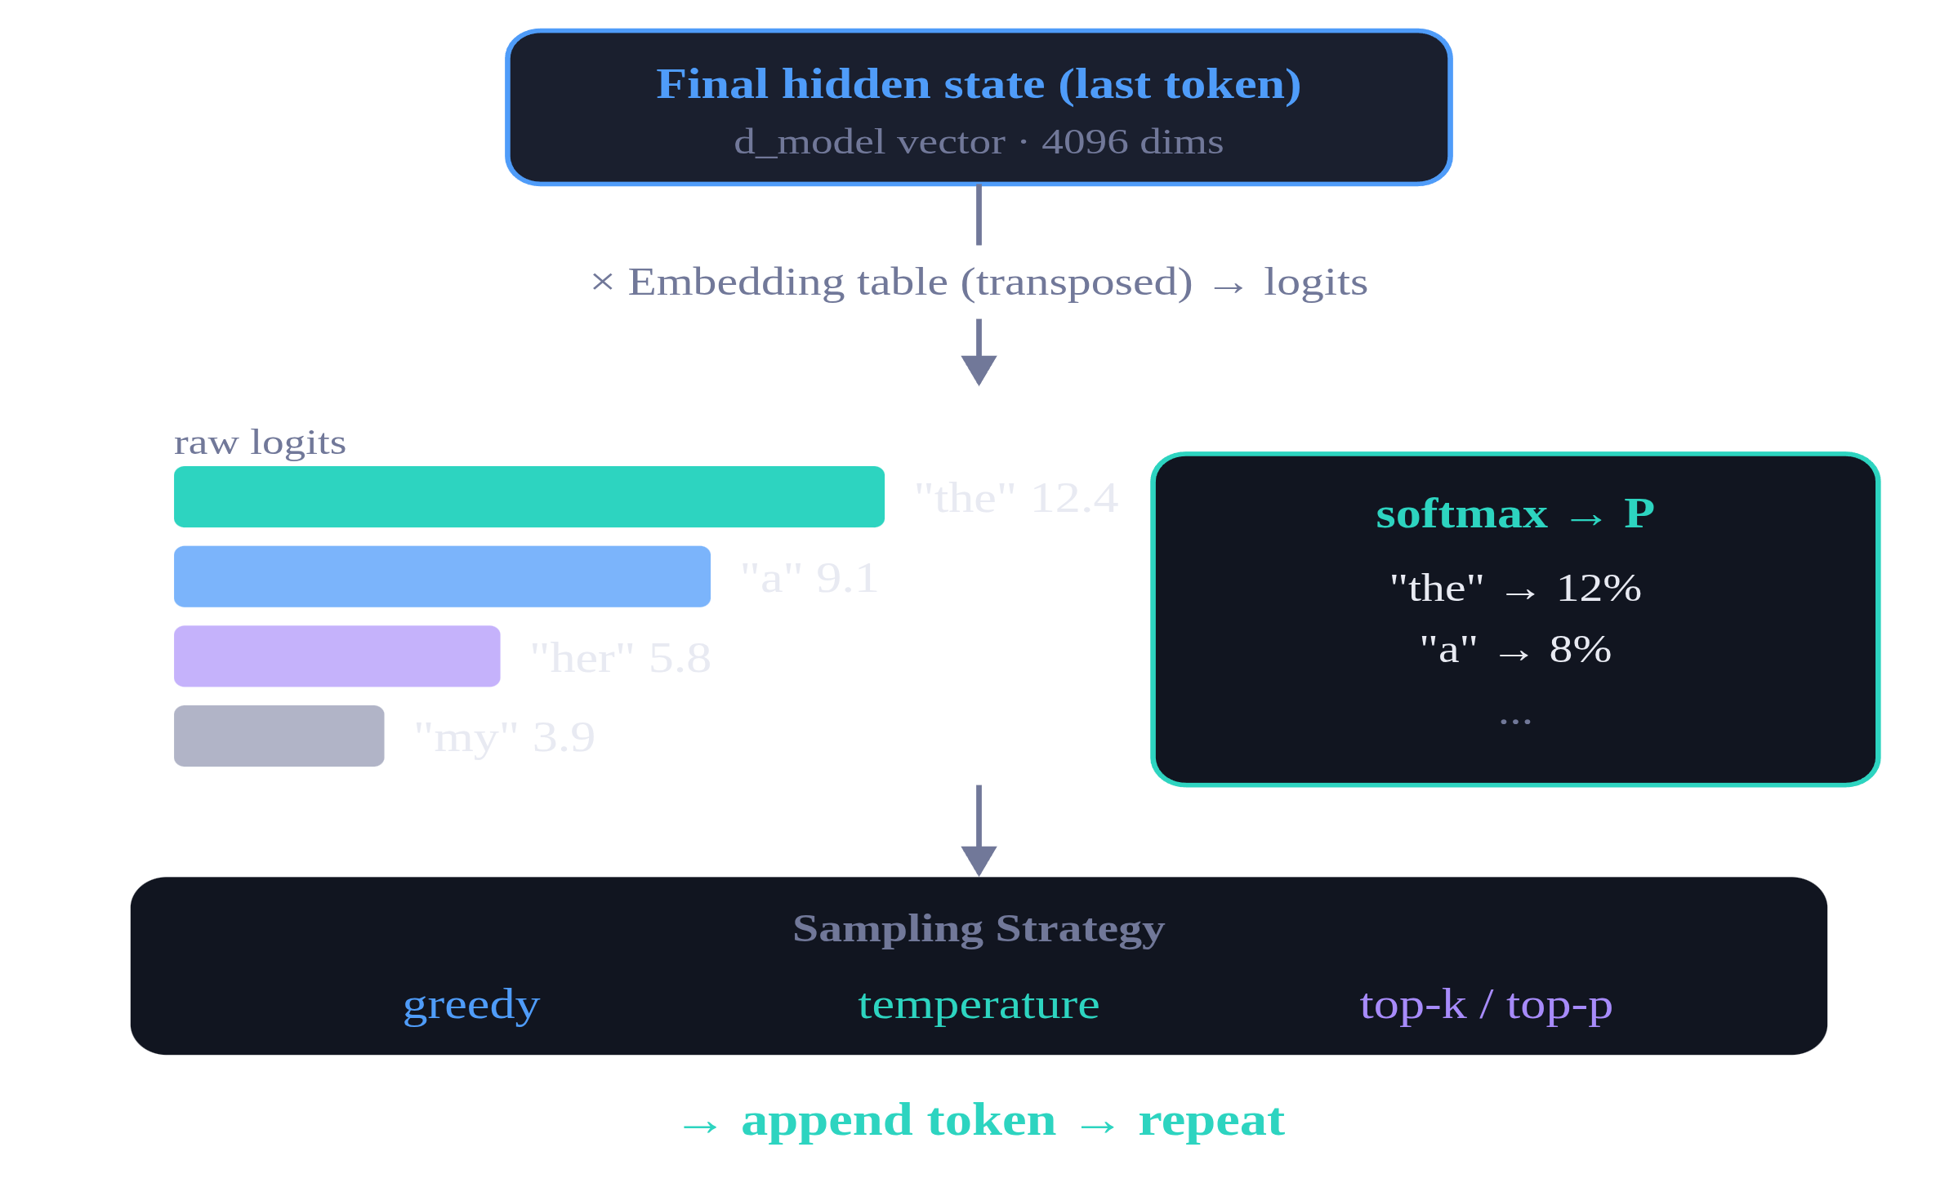
07 — OUTPUT
From Vectors to Words
Only the last token's vector matters — it predicts what comes next
Logits are raw scores for every vocabulary token
Softmax converts logits to probabilities; sampling picks the next token
Token appended → sequence grows → loop repeats until done
Notes:
After the final transformer block, we only care about the last token's vector — that's the one predicting what comes next. This vector is multiplied by the embedding table to produce a score, called a logit, for every token in the vocabulary. A softmax function converts these into probabilities. A sampling strategy then picks the actual next token: greedy takes the highest, temperature sampling adds randomness, top-k and top-p choose from the most likely candidates. The chosen token is appended to the sequence, and the whole process repeats.

Slide 9
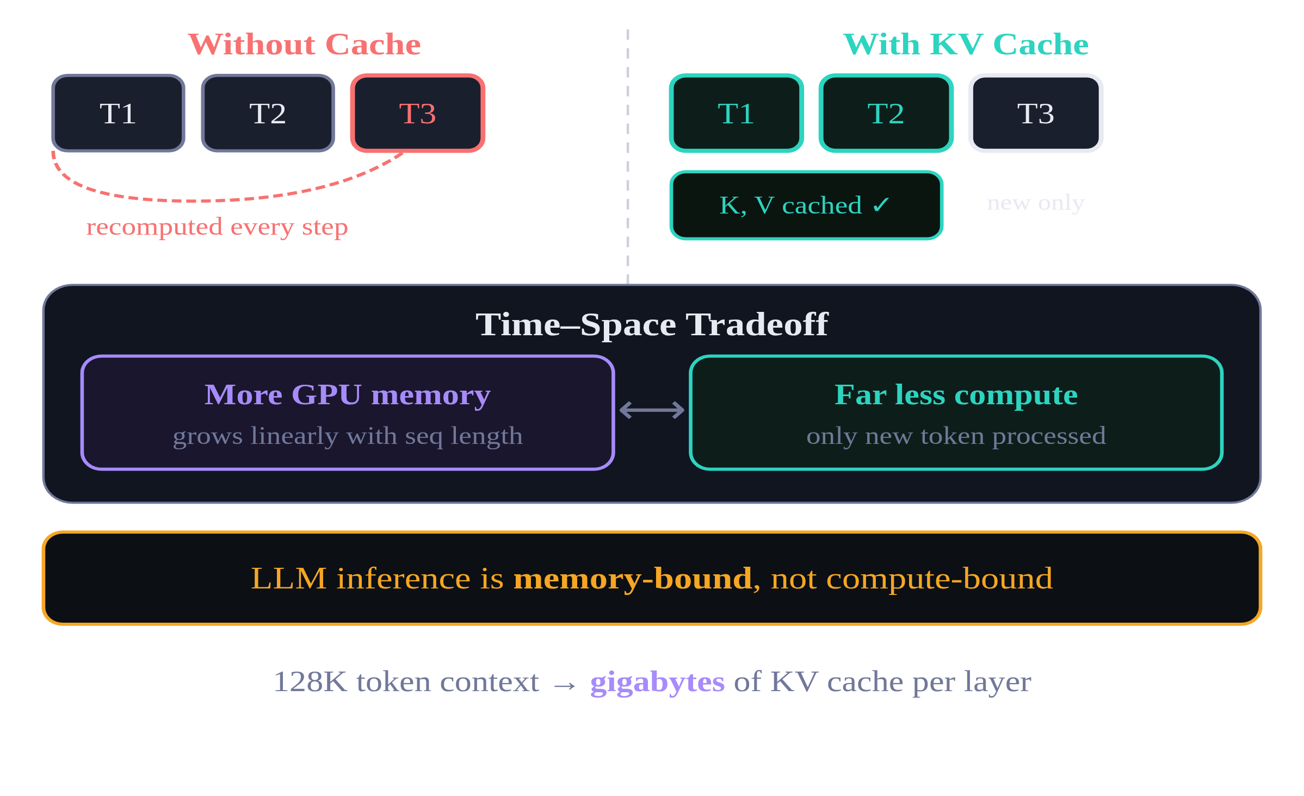
08 — OPTIMIZATION
The KV Cache
Without cache: reprocess entire sequence per token — O(n²) cost
KV cache stores K and V; only the new token is computed fresh
Inference becomes memory-bound , not compute-bound
Long contexts are hard: cache grows linearly with sequence length
Notes:
Naively, generating each new token would require reprocessing the entire sequence from scratch — this gets very expensive as the output grows. The KV cache solves this by storing the Key and Value vectors from all previous tokens, so they don't need to be recomputed. When generating token 100, only the new token needs to go through the full computation. This is a classic time-space tradeoff: more memory in exchange for dramatically less computation. The KV cache is a major reason LLM inference is memory-bound rather than compute-bound.

Slide 10
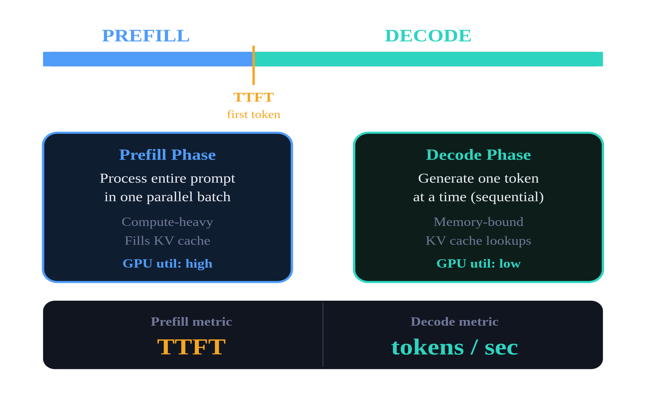
09 — INFERENCE PHASES
Prefill vs. Decode
Prefill : entire prompt processed in one parallel batch
Decode : tokens generated one-at-a-time in a sequential loop
TTFT is prefill speed; tokens/sec is decode throughput
Different hardware and batching strategies target each phase separately
Notes:
Inference has two distinct phases. In the prefill phase, the model processes your entire input prompt in one parallel batch — compute-heavy but fast because all tokens are handled simultaneously. In the decode phase, the model generates output tokens one at a time in a sequential loop. Prefill is like reading a whole page at once; decode is like writing one word at a time. Time-to-first-token is dominated by prefill; tokens-per-second after that is determined by decode speed. Understanding this split is key to optimizing inference.

Slide 11
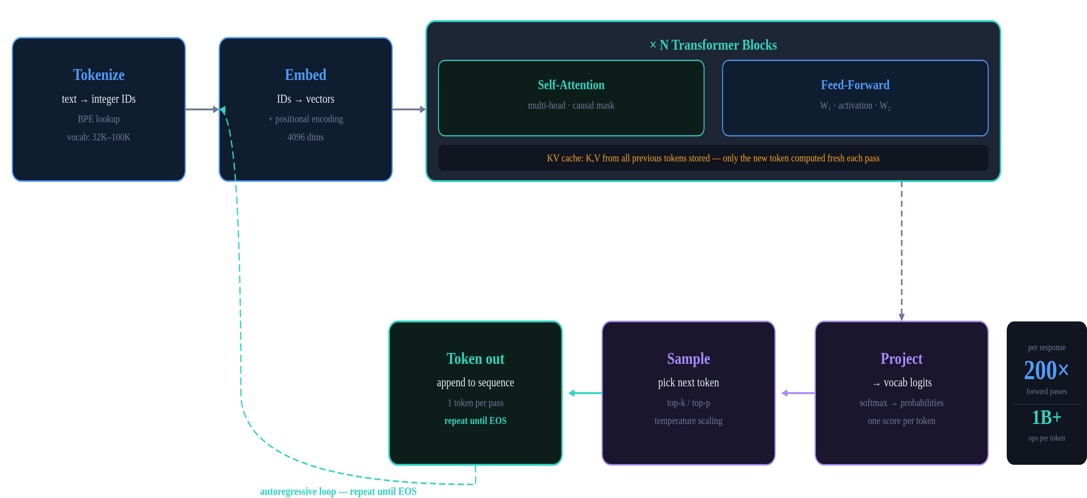
10 — FULL PIPELINE
Putting It All Together
Notes:
The full pipeline: tokenize, embed, pass through N transformer blocks — attention plus FFN each — project to vocabulary, sample, repeat. A single forward pass through a large model involves billions of multiply-add operations, yet produces just one token. A typical response of 200 tokens means 200 sequential forward passes through the entire model. The magic isn't in any single component — it's in scale: enough parameters, enough training data, enough layers to capture the patterns of language. Current research focuses on making this faster through speculative decoding, quantization, and better architectures.

