Slide 1
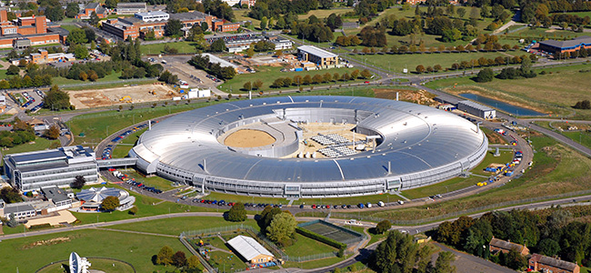
BURT at DLS
Will Rogers
Controls Group

Slide 2
Background
One big accelerator
Plus linac and booster synchrotron
Fixed lattice – changes every year or so
Different ‘optics’ – operation modes

Slide 3
BURT
Back-up and restore tool
Just snapshots of PV values
Restores the machine to a known state
Switches the machine between operational modes
After ‘burting’, AP use the LOCO algorithm to fine-tune the configuration

Slide 4

Burt implementation
Old-school EPICS extension
Written in C
22 files, 8000 lines of code
Not (really) updated since 2008

Slide 5
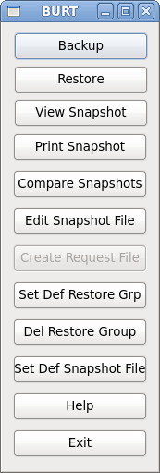
Burt implementation
Extension developed at DLS (circa 2010?) to group multiple snapshot files
Python-Qt gui developed to manage the files
Post to elog when saving and restoring

Slide 6
Burt at DLS
Current usage defined by experience
250 ‘request’ files
60k ‘snapshot’ files (!)
Not well versioned

Slide 7
Possible improvements
‘Check’ files:
Raise a warning if a PV value does not match its expected value
‘Write-only’ values:
The value at the time of the snapshot is less important than the ‘correct’ value

Slide 8
Overall
Pros:
Simple
Stable
Reliable
Cons:
File management is a little tricky
Further development would be tricky

Slide 9
Beamlines
Burt is not widely used
Defaults are set at IOC build time
Autosave restore:
Reset PVs to sensible values on IOC restart

Slide 10
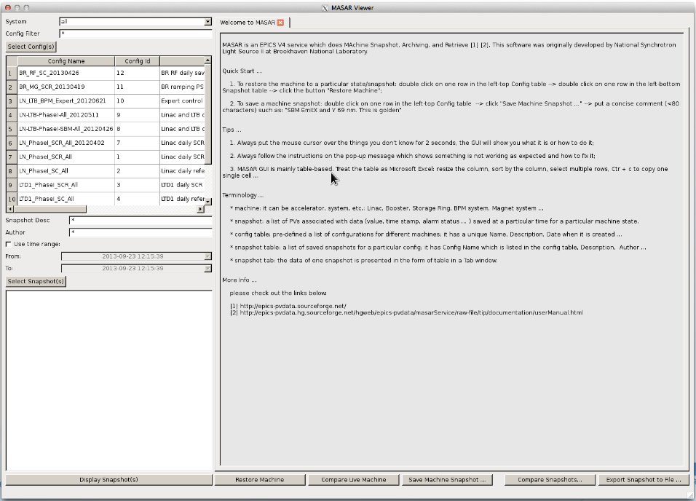
Masar
Machine Snapshot, Archiving and Retrieval
Very much like Burt in principle

Slide 11
Masar
Developed by Guobao Shen at NSLS-II
Relational database storage
?C++ implementation?
?Java application server (Wildfly)?
Plotting, compare tools
EPICS v4 API
Scriptable with Python

Slide 12
Score?
Save compare restore
Associated with OpenXAL project
Details are difficult to come by

Slide 13
Discussion…

