Slide 1
Recurrent Neural Network,
LSTM, and GRU

Slide 2
Vanila RNN
LSTM
GRU

Slide 3







Vanila RNN
LSTM
GRU
1. Sequence Learning
Auto regressive models
Predict the next term in a sequence from a fixed number of previous terms
Feed-forward neural nets
Generalization of autoregressive models by using one or more layers of non-linear hidden units
$$hidden$$
$$input(t−2)$$
$$input(t−1)$$
$$input(t)$$
$$input(t−2)$$
$$input(t−1)$$
$$input(t)$$
Memoryless models :
Limited memory window
Hidden state cannot be used efficiently

Slide 4
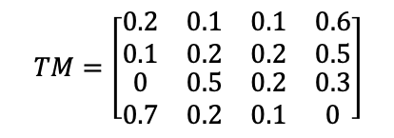
Vanila RNN
LSTM
GRU
1. Sequence Learning
3) Hidden Markov Model (HMM)
Have a discrete one-of-N hidden state
Transitions between states are stochastic and controlled by a transition matrix
Have to infer hidden state distribution (transition matrix)
Output
Output
Output
$$TM=\left[\begin{matrix}\begin{matrix}0.2 & 0.1 \\ 0.1 & 0.2\end{matrix} & \begin{matrix}0.1 & 0.6 \\ 0.2 & 0.5\end{matrix} \\ \begin{matrix}0 & 0.5 \\ 0.7 & 0.2\end{matrix} & \begin{matrix}0.2 & 0.3 \\ 0.1 & 0\end{matrix}\end{matrix}\right]$$
Memoryful models :
Time-cost to infer the hidden state distribution

Slide 5
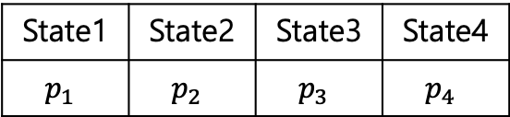
Vanila RNN
LSTM
GRU
1. Sequence Learning
4) Recurrent Neural Network (RNN, 1986)
Update the hidden state in a deterministic nonlinear way
No need to infer hidden state, pure deterministic
Weight sharing
Ex) We have 4 states
HMM
RNN
Now
State 1
Now
State 1
TM
W
State1 | State2 | State3 | State4
$$p_{1}$$ | $$p_{2}$$ | $$p_{3}$$ | $$p_{4}$$
State 4

Slide 6







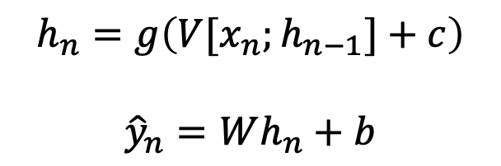
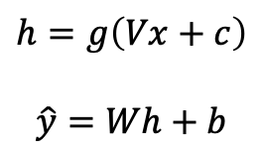



Vanila RNN
LSTM
GRU
2. Recurrent Neural Network (RNN)
$$\hat{y}$$
$$W$$
$$h=g\left(Vx+c\right)$$
$$\hat{y}=Wh+b$$
$$h$$
$$V$$
$$x$$
$${\hat{y}}_{n}$$
Input vector at some time step
New state
Old state
$$W$$
$$h_{n}=g\left(V[x_{n};h_{n−1}]+c\right)$$
$${\hat{y}}_{n}=Wh_{n}+b$$
$$h_{n}$$
$$V$$
$$x_{n}$$

Slide 7





Vanila RNN
LSTM
GRU
2. Recurrent Neural Network (RNN)
Computational Graph
$$h_{1}=g\left(V[x_{1};h_{0}]+c\right)$$
$$h_{0}$$
$$f_{w}$$
$$h_{1}$$
$$x_{1}$$

Slide 8




Vanila RNN
LSTM
GRU
2. Recurrent Neural Network (RNN)
Computational Graph
$$h_{1}=g\left(V[x_{1};h_{0}]+c\right)$$
$$h_{2}=g\left(V[x_{2};h_{1}]+c\right)$$
$$h_{0}$$
$$f_{w}$$
$$h_{1}$$
$$f_{w}$$
$$h_{2}$$
$$x_{1}$$
$$x_{2}$$

Slide 9
Vanila RNN
LSTM
GRU
2. Recurrent Neural Network (RNN)
Computational Graph
$$h_{1}=g\left(V[x_{1};h_{0}]+c\right)$$
$$h_{2}=g\left(V[x_{2};h_{1}]+c\right)$$
$$h_{0}$$
$$f_{w}$$
$$h_{1}$$
$$f_{w}$$
$$h_{2}$$
$$x_{1}$$
$$x_{2}$$

Slide 10







Vanila RNN
LSTM
GRU
2. Recurrent Neural Network (RNN)
Computational Graph
$$h_{1}=g\left(V[x_{1};h_{0}]+c\right)$$
$$h_{2}=g\left(V[x_{2};h_{1}]+c\right)$$
$$h_{3}=g\left(V[x_{3};h_{2}]+c\right)$$
$$h_{0}$$
$$f_{w}$$
$$h_{1}$$
$$f_{w}$$
$$h_{2}$$
$$f_{w}$$
$$h_{3}$$
$$…$$
$$h_{T}$$
$$x_{1}$$
$$x_{2}$$
$$x_{3}$$

Slide 11



Vanila RNN
LSTM
GRU
2. Recurrent Neural Network (RNN)
Computational Graph
Parameters are shared for all time-step
$$h_{1}=g\left(V[x_{1};h_{0}]+c\right)$$
$$h_{2}=g\left(V[x_{2};h_{1}]+c\right)$$
$$h_{3}=g\left(V[x_{3};h_{2}]+c\right)$$
$$h_{0}$$
$$f_{w}$$
$$h_{1}$$
$$f_{w}$$
$$h_{2}$$
$$f_{w}$$
$$h_{3}$$
$$…$$
$$h_{T}$$
$$x_{1}$$
$$x_{2}$$
$$x_{3}$$

Slide 12




Vanila RNN
LSTM
GRU
2. Recurrent Neural Network (RNN)
Computational Graph : Many to one
$$L_{T}$$
$${\hat{y}}_{T}$$
$$W$$
$$h_{0}$$
$$f_{w}$$
$$h_{1}$$
$$f_{w}$$
$$h_{2}$$
$$f_{w}$$
$$h_{3}$$
$$…$$
$$h_{T}$$
$$x_{1}$$
$$x_{2}$$
$$x_{3}$$
$${\hat{y}}_{n}=Wh_{n}+b$$

Slide 13

























Vanila RNN
LSTM
GRU
2. Recurrent Neural Network (RNN)
Computational Graph : Many to Many
$$L$$
$$L_{1}$$
$$L_{2}$$
$$L_{3}$$
$$L_{T}$$
$${\hat{y}}_{1}$$
$${\hat{y}}_{2}$$
$${\hat{y}}_{3}$$
$${\hat{y}}_{T}$$
$$W$$
$$W$$
$$W$$
$$W$$
$$h_{0}$$
$$f_{w}$$
$$h_{1}$$
$$f_{w}$$
$$h_{2}$$
$$f_{w}$$
$$h_{3}$$
$$…$$
$$h_{T}$$
$$x_{1}$$
$$x_{2}$$
$$x_{3}$$
$${\hat{y}}_{n}=Wh_{n}+b$$

Slide 14
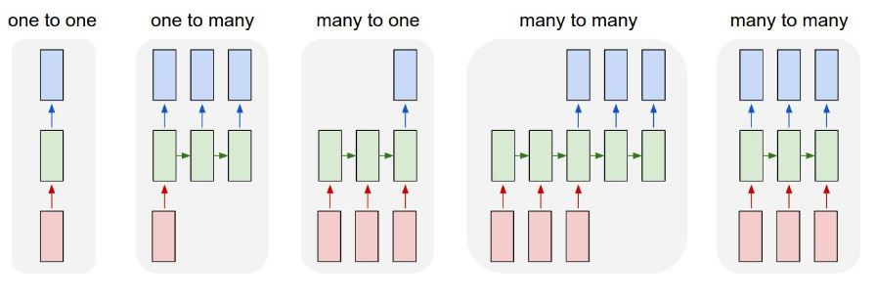
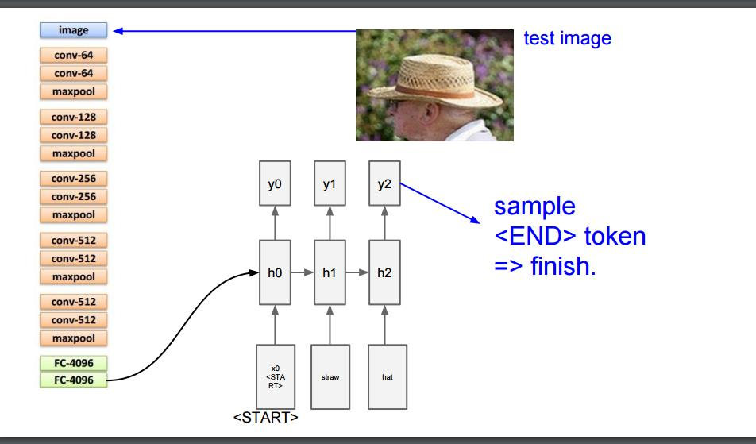
Vanila RNN
LSTM
GRU
2. Recurrent Neural Network (RNN)
RNN Structure
Ex) Image captioning

Slide 15
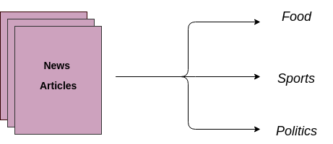
Vanila RNN
LSTM
GRU
2. Recurrent Neural Network (RNN)
RNN Structure
Ex) Document classification
Sequence of words

Slide 16
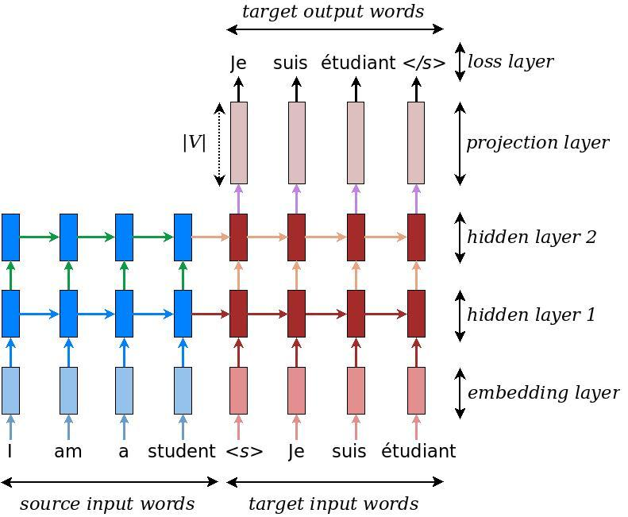
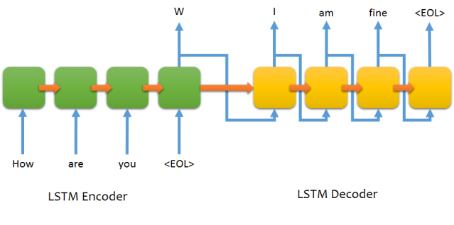
Vanila RNN
LSTM
GRU
2. Recurrent Neural Network (RNN)
RNN Structure
Ex) Machine translation
Chat bot

Slide 17



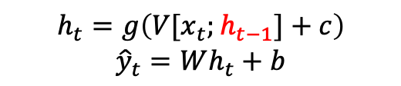





Vanila RNN
LSTM
GRU
2. Recurrent Neural Network (RNN)
Vanila RNN cell
$$h_{t−1}$$
$$h_{t}$$
$$h_{t+1}$$
$$h_{t−1}$$
$$h_{t}$$
tanh
$$x_{t−1}$$
$$x_{t}$$
$$x_{t+1}$$
$$h_{t}=g\left(V[x_{t};h_{t−1}]+c\right)$$
$${\hat{y}}_{t}=Wh_{t}+b$$

Slide 18
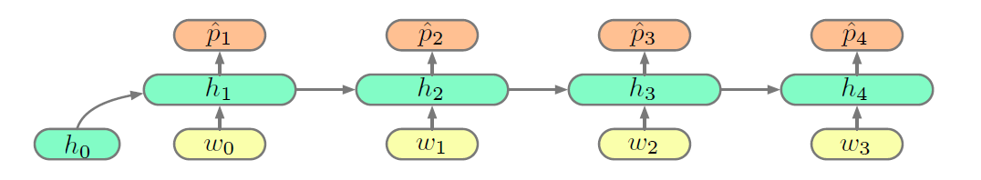
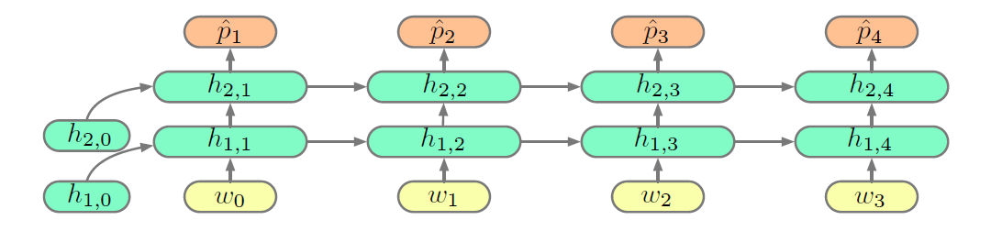
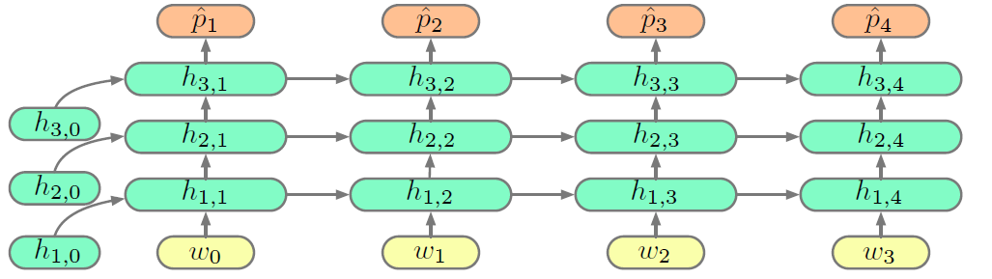
Vanila RNN
LSTM
GRU
2. Recurrent Neural Network (RNN)
Deep RNN
One Layer
Two Layer

Slide 19
























Vanila RNN
LSTM
GRU
2. Recurrent Neural Network (RNN)
다른 Neural Network 구조와 마찬가지로 backpropagation을 통해 학습
Back Propagation Through Time (BPTT)
$$L=L_{1}+L_{2}+L_{3}+ …+L_{T}$$
$$\frac{∂L}{∂h_{2}}=\frac{∂L_{1}}{∂h_{2}}+\frac{∂L_{2}}{∂h_{2}}+\frac{∂L_{3}}{∂h_{2}}+…+\frac{∂L_{T}}{∂h_{2}}$$
$$\frac{∂L}{∂h_{2}}=\frac{∂L_{2}}{∂{\hat{y}}_{2}}\frac{∂{\hat{y}}_{2}}{∂h_{2}}+\frac{∂L_{3}}{∂{\hat{y}}_{3}}\frac{∂{\hat{y}}_{3}}{∂h_{3}}\frac{∂h_{3}}{∂h_{2}}+…+\frac{∂L_{T}}{∂{\hat{y}}_{T}}…\frac{∂h_{3}}{∂h_{2}}$$
$$L$$
$$L_{1}$$
$$L_{2}$$
$$L_{3}$$
$$L_{T}$$
$${\hat{y}}_{1}$$
$${\hat{y}}_{2}$$
$${\hat{y}}_{3}$$
$${\hat{y}}_{T}$$
$$W$$
$$W$$
$$W$$
$$W$$
$$h_{0}$$
$$f_{w}$$
$$h_{1}$$
$$f_{w}$$
$$h_{2}$$
$$f_{w}$$
$$h_{3}$$
$$…$$
$$h_{T}$$
$$x_{1}$$
$$x_{2}$$
$$x_{3}$$
시점 n의 derivative 는 n시점 이후의 derivative 에 dependent

Slide 20
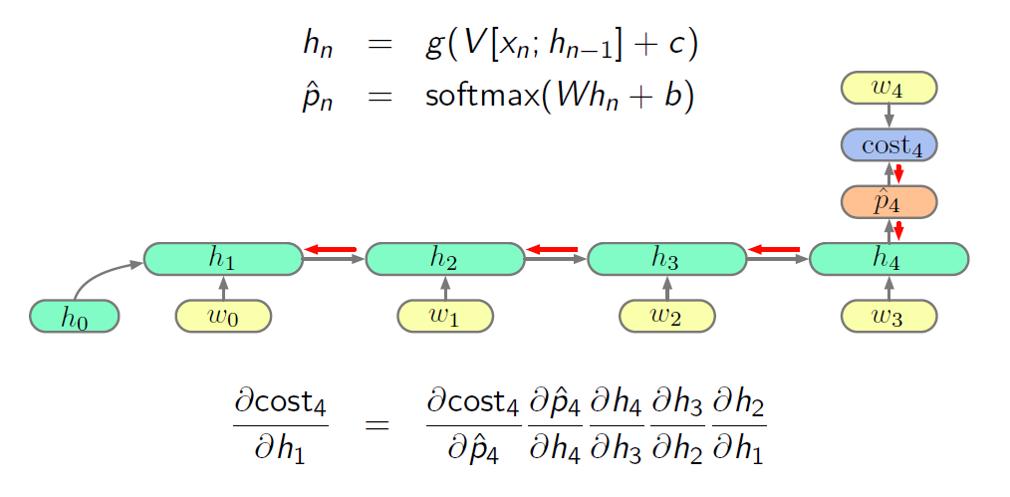
Vanila RNN
LSTM
GRU
3. Vanishing/Exploding Gradients Problem
Gradient 가 매우 작아지거나 커져서 Gradient based learning 이 불가능해지는 문제

Slide 21
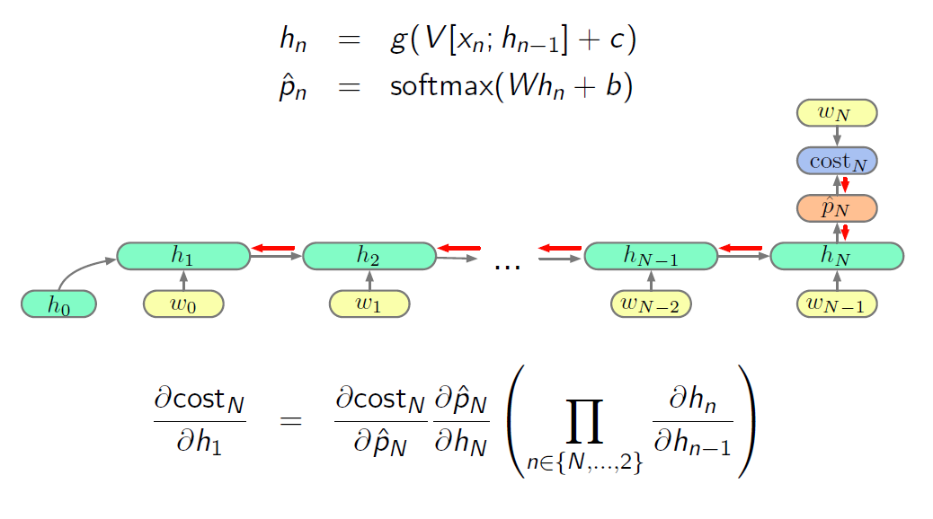
Vanila RNN
LSTM
GRU
2. Recurrent Neural Network (RNN)
Gradient 가 매우 작아지거나 커져서 Gradient based learning 이 불가능해지는 문제

Slide 22
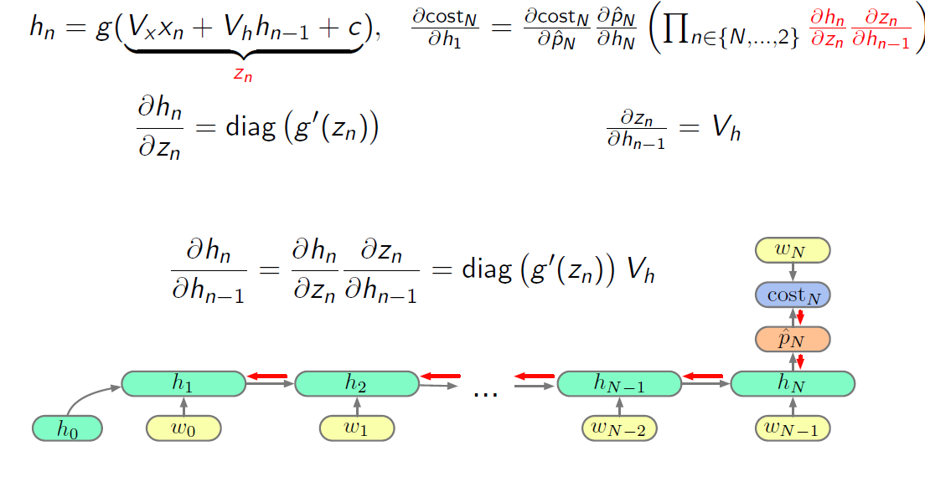
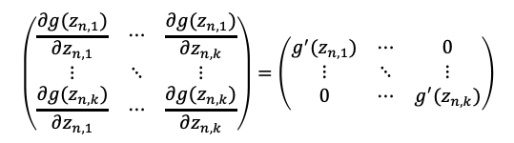


Vanila RNN
LSTM
GRU
2. Recurrent Neural Network (RNN)
Gradient 가 매우 작아지거나 커져서 Gradient based learning 이 불가능해지는 문제
$$(k×1)$$
$$(k×k)$$
$$\left(\begin{matrix}\frac{∂g(z_{n,1})}{∂z_{n,1}} & ⋯ & \frac{∂g(z_{n,1})}{∂z_{n,k}} \\ ⋮ & ⋱ & ⋮ \\ \frac{∂g(z_{n,k})}{∂z_{n,1}} & ⋯ & \frac{∂g(z_{n,k})}{∂z_{n,k}}\end{matrix}\right)=\left(\begin{matrix}g^{′}(z_{n,1}) & ⋯ & 0 \\ ⋮ & ⋱ & ⋮ \\ 0 & ⋯ & g^{′}(z_{n,k})\end{matrix}\right)$$

Slide 23
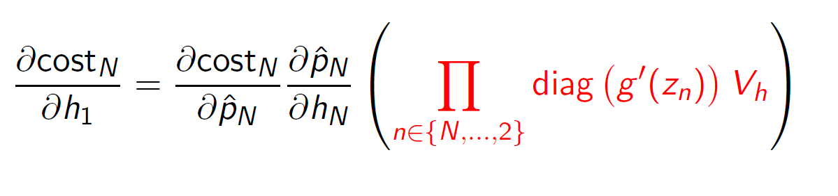

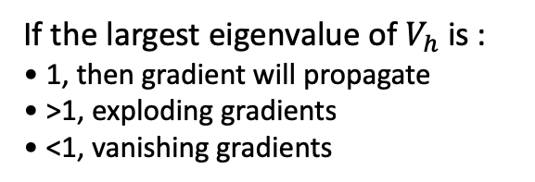

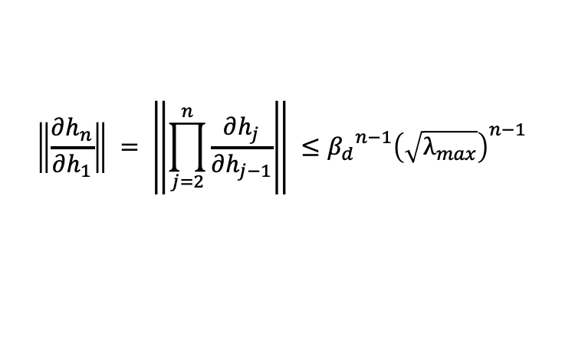
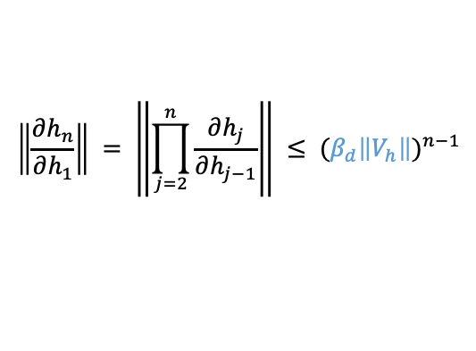
Vanila RNN
LSTM
GRU
2. Recurrent Neural Network (RNN)
Gradient 가 매우 작아지거나 커져서 Gradient based learning 이 불가능해지는 문제
$$\left\|\frac{∂h_{n}}{∂h_{n−1}}\right\| ≤ \left\|diag\left(g^{′}\left(z_{n}\right)\right)\right\|\left\|V_{h}\right\|$$
$$\left\|\frac{∂h_{n}}{∂h_{1}}\right\| = \left\|\prod_{j=2}^{n}{\frac{∂h_{j}}{∂h_{j−1}}}\right\| ≤ {(β_{d}\left\|V_{h}\right\|)}^{n−1}$$
If we use L2 norm
$$\left\|\frac{∂h_{n}}{∂h_{1}}\right\| = \left\|\prod_{j=2}^{n}{\frac{∂h_{j}}{∂h_{j−1}}}\right\| ≤{β_{d}}^{n−1}{\left(\sqrt{λ_{max}}\right)}^{n−1}$$
$∵ {\left\|A\right\|}_{2}=\max_{{\left\|x\right\|}_{2}=1}{{\left\|Ax\right\|}_{2}}=\sqrt{λ_{max}}$
If the largest eigenvalue of $V_{h}$ is :
• 1, then gradient will propagate
• >1, exploding gradients
• <1, vanishing gradients

Slide 24
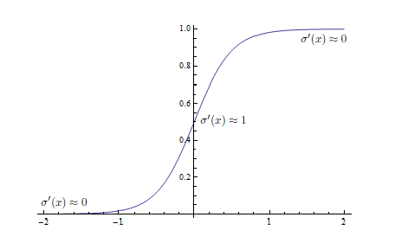
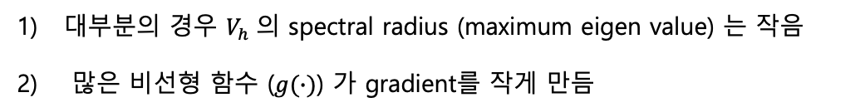
Vanila RNN
LSTM
GRU
2. Recurrent Neural Network (RNN)
Gradient 가 매우 작아지거나 커져서 Gradient based learning 이 불가능해지는 문제
대부분의 경우 $V_{h}$의 spectral radius (maximum eigen value) 는 작음
많은 비선형 함수 ($g(∙)$) 가 gradient를 작게 만듬
해결책:
Second order optimizers
Careful initialization
Changing the network architecture

Slide 25
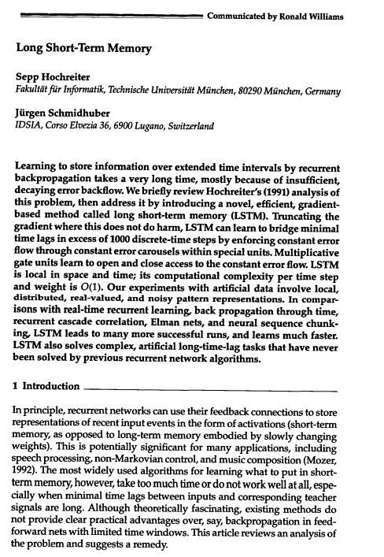
Vanila RNN
LSTM
GRU
1. Long Short Term Memory (Sepp Hochreiter, 1997)

Slide 26
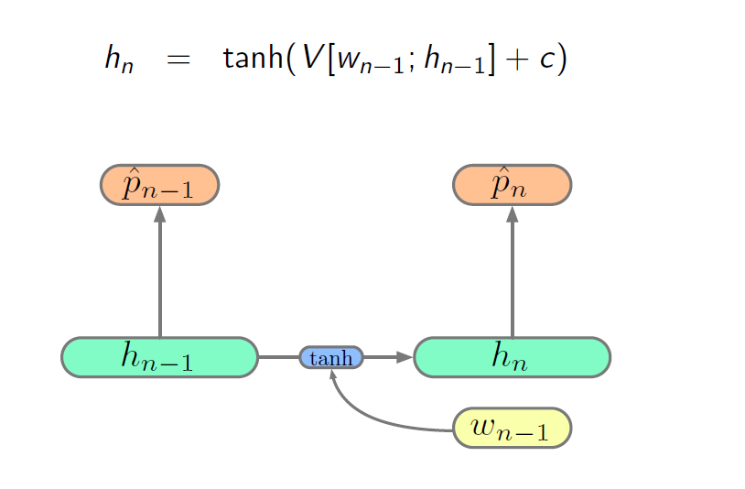
Vanila RNN
LSTM
GRU
1. Long Short Term Memory (Sepp Hochreiter, 1997)
Simple Recurrent Neural Network
Update by multiplying

Slide 27
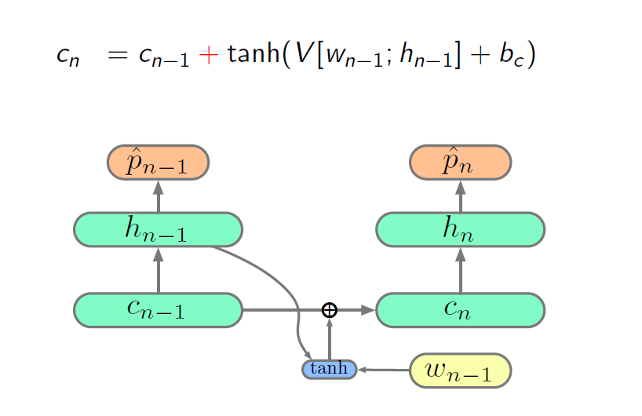

Vanila RNN
LSTM
GRU
1. Long Short Term Memory (Sepp Hochreiter, 1997)
LSTM
- Cell state 도입 : memory 로 생각할 수 있음
$${\tilde{c}}_{n}$$
Update by additive : gradient flow nicely
Balance 를 조절할 필요: summation 으로 인해 explode 할 수 있음

Slide 28
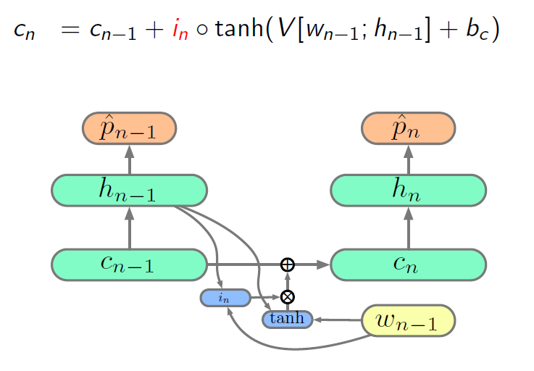


Vanila RNN
LSTM
GRU
1. Long Short Term Memory (Sepp Hochreiter, 1997)
LSTM
- Balance 조정을 위해 gate 도입 : input gate
$${\tilde{c}}_{n}$$
$$i_{n}=σ(W_{i}\left[w_{n};h_{n−1} \right]+b_{i})$$

Slide 29
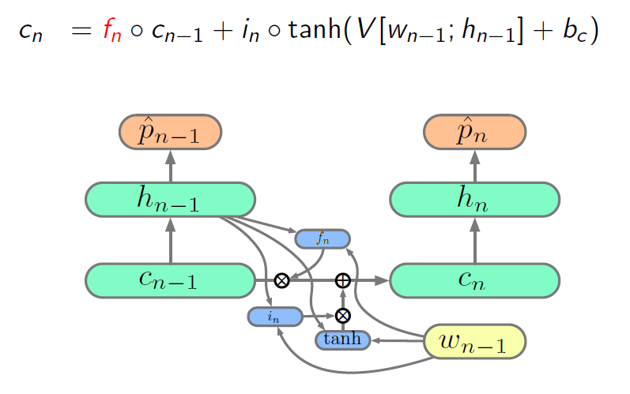
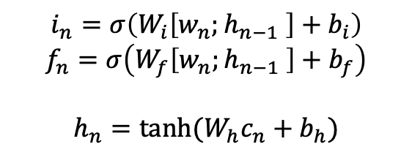
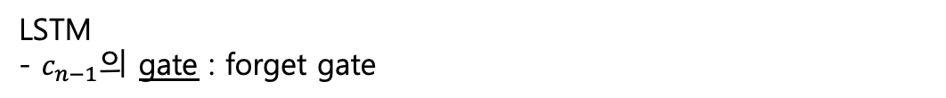

Vanila RNN
LSTM
GRU
1. Long Short Term Memory (Sepp Hochreiter, 1997)
LSTM
- $c_{n−1}$의 gate : forget gate
$${\tilde{c}}_{n}$$
$$i_{n}=σ\left(W_{i}\left[w_{n};h_{n−1} \right]+b_{i}\right)$$
$$f_{n}=σ\left(W_{f}\left[w_{n};h_{n−1} \right]+b_{f}\right)$$
$$h_{n}=tanh(W_{h}c_{n}+b_{h})$$

Slide 30
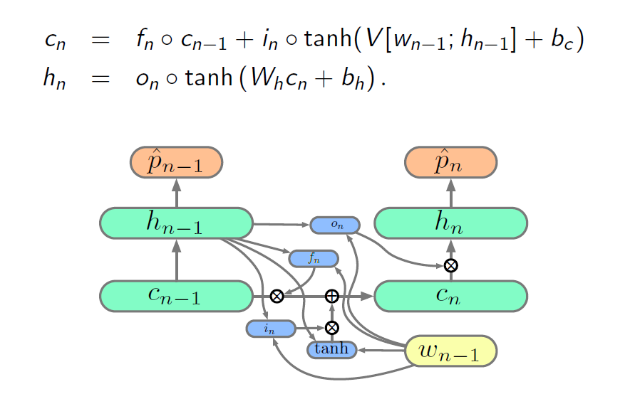
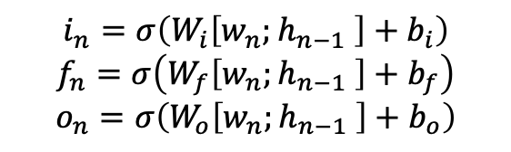

Vanila RNN
LSTM
GRU
1. Long Short Term Memory (Sepp Hochreiter, 1997)
LSTM
- output에도 gate 를 설치하면?? : output gate
$${\tilde{c}}_{n}$$
Sigmoid : gate로 사용하기 적합 (0 ~ 1)
tanh : 다른 non-linearity 함수로 대체 가능
$$i_{n}=σ\left(W_{i}\left[w_{n};h_{n−1} \right]+b_{i}\right)$$
$$f_{n}=σ\left(W_{f}\left[w_{n};h_{n−1} \right]+b_{f}\right)$$
$$o_{n}=σ\left(W_{o}\left[w_{n};h_{n−1} \right]+b_{o}\right)$$

Slide 31



















Vanila RNN
LSTM
GRU
1. Long Short Term Memory (Sepp Hochreiter, 1997)
$$h_{t−1}$$
$$h_{t}$$
$$h_{t+1}$$
$$C_{t−1}$$
$$C_{t}$$
$$×$$
+
tanh
$$f_{t}$$
$$i_{t}$$
$$o_{t}$$
$$×$$
$${\tilde{C}}_{t}$$
$$×$$
$$h_{t−1}$$
$$σ$$
$$σ$$
tanh
$$σ$$
$$h_{t}$$
$$w_{t−1}$$
$$w_{t}$$
$$w_{t+1}$$

Slide 32
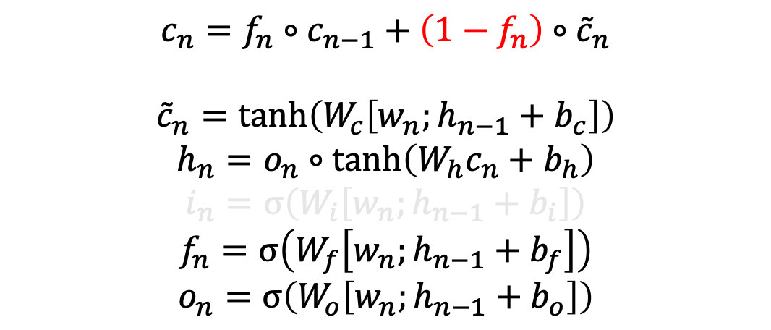
Vanila RNN
LSTM
GRU
1. Long Short Term Memory (Sepp Hochreiter, 1997)
LSTM
$$c_{n}=f_{n}∘c_{n−1}+\left(1−f_{n}\right)∘{\tilde{c}}_{n}$$
$${\tilde{c}}_{n}=\tanh\left(W_{c}\left[w_{n};h_{n−1}+b_{c}\right]\right)$$
$$h_{n}=o_{n}∘\tanh\left(W_{h}c_{n}+b_{h}\right)$$
$$i_{n}=σ\left(W_{i}\left[w_{n};h_{n−1}+b_{i}\right]\right)$$
$$f_{n}=σ\left(W_{f}\left[w_{n};h_{n−1}+b_{f}\right]\right)$$
$$o_{n}=σ\left(W_{o}\left[w_{n};h_{n−1}+b_{o}\right]\right)$$

Slide 33
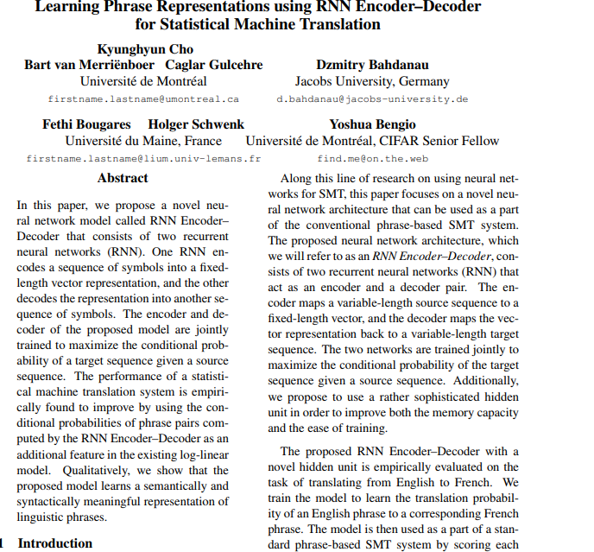
Vanila RNN
LSTM
GRU
1. Gated Recurrent Unit (Cho et al., 2014)

Slide 34
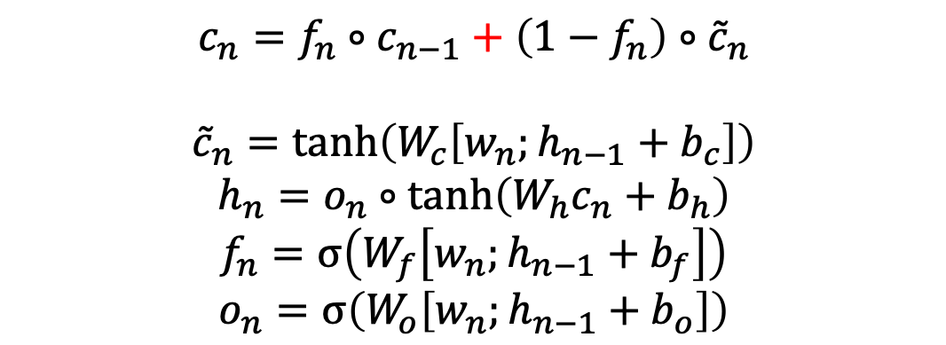
Vanila RNN
LSTM
GRU
1. Gated Recurrent Unit (Cho et al., 2014)
GRU
- LSTM의 parameter 를 줄여보자!
$$c_{n}=f_{n}∘c_{n−1}+\left(1−f_{n}\right)∘{\tilde{c}}_{n}$$
$${\tilde{c}}_{n}=\tanh\left(W_{c}\left[w_{n};h_{n−1}+b_{c}\right]\right)$$
$$h_{n}=o_{n}∘\tanh\left(W_{h}c_{n}+b_{h}\right)$$
$$f_{n}=σ\left(W_{f}\left[w_{n};h_{n−1}+b_{f}\right]\right)$$
$$o_{n}=σ\left(W_{o}\left[w_{n};h_{n−1}+b_{o}\right]\right)$$
$$h_{n}=z_{n}∘h_{n−1}+\left(1−z_{n}\right)∘{\tilde{h}}_{n}$$

Slide 35
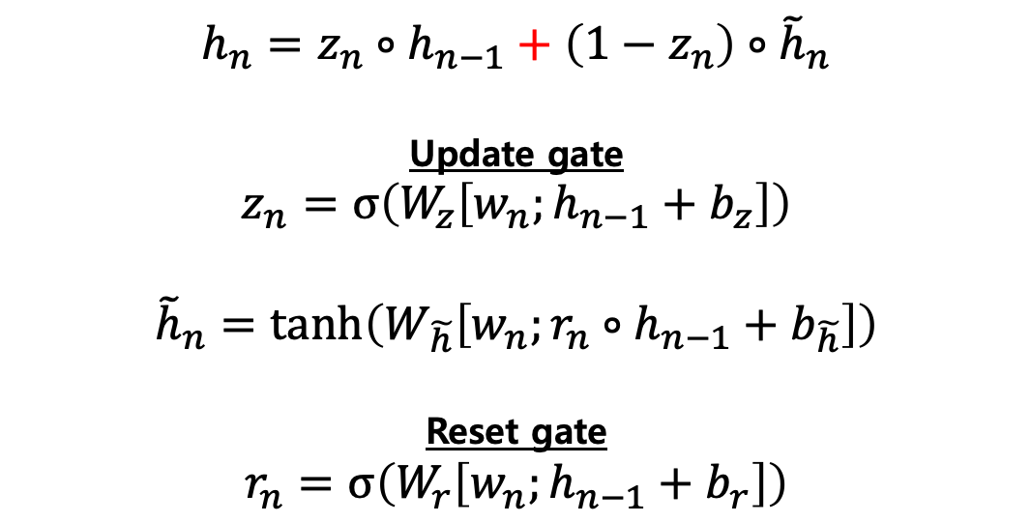
Vanila RNN
LSTM
GRU
1. Gated Recurrent Unit (Cho et al., 2014)
GRU
- LSTM의 parameter 를 줄여보자!
$$h_{n}=z_{n}∘h_{n−1}+\left(1−z_{n}\right)∘{\tilde{h}}_{n}$$
Update gate
$$z_{n}=σ\left(W_{z}\left[w_{n};h_{n−1}+b_{z}\right]\right)$$
$${\tilde{h}}_{n}=\tanh\left(W_{\tilde{h}}\left[w_{n};r_{n}∘h_{n−1}+b_{\tilde{h}}\right]\right)$$
Reset gate
$$r_{n}=σ\left(W_{r}\left[w_{n};h_{n−1}+b_{r}\right]\right)$$

Slide 36











Vanila RNN
LSTM
GRU
1. Gated Recurrent Unit (Cho et al., 2014)
$$h_{t−1}$$
$$h_{t}$$
$$h_{t+1}$$
$$h_{t−1}$$
$$h_{t}$$
$$×$$
+
$$×$$
$$r_{t}$$
1 -
$$×$$
$$σ$$
$$z_{t}$$
$$σ$$
$${\tilde{h}}_{t}$$
tanh
$$w_{t−1}$$
$$w_{t}$$
$$w_{t+1}$$

Slide 37
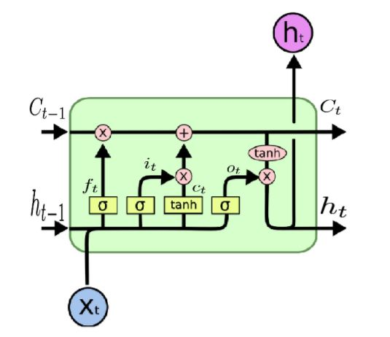
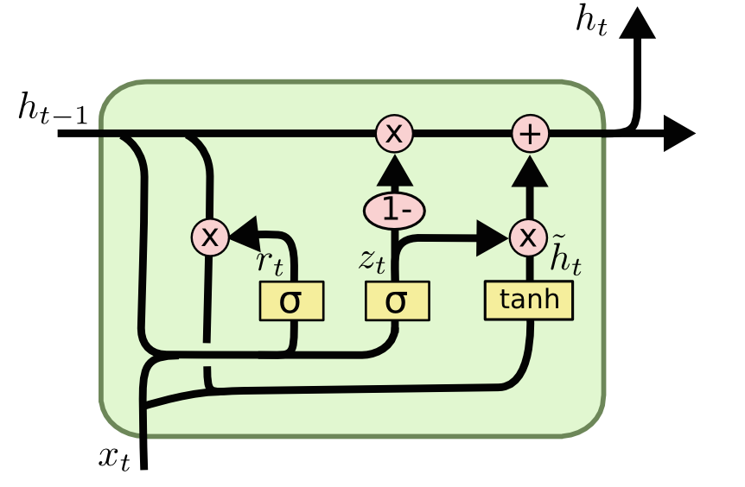
Vanila RNN
LSTM
GRU
1. Gated Recurrent Unit (Cho et al., 2014)
LSTM, GRU, Vanila RNN 비교
성능
LSTM > GRU >>> Vanila RNN
학습 시간
LSTM >> GRU >>> Vanila RNN

Slide 38
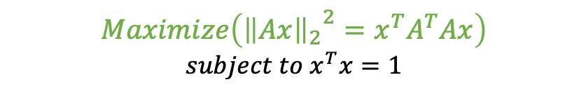
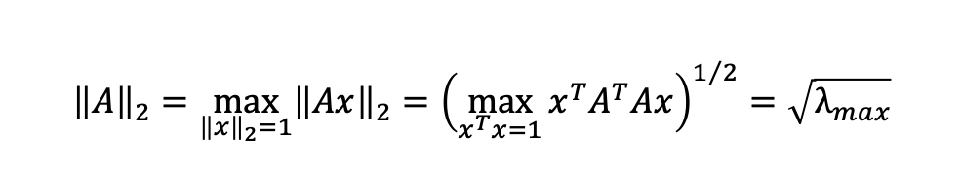



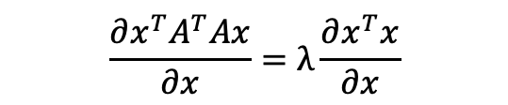
Appendix
* Proof)
$${\left\|A\right\|}_{2}=\max_{{\left\|x\right\|}_{2}=1}{{\left\|Ax\right\|}_{2}}=\sqrt{λ_{max}}$$
Let’s solve the problem below
$$Maximize\left({{\left\|Ax\right\|}_{2}}^{2}=x^{T}A^{T}Ax\right)$$
$$subject to x^{T}x=1$$
By using the Lagrange multiplier method
$$\frac{∂x^{T}A^{T}Ax}{∂x}=λ\frac{∂x^{T}x}{∂x}$$
$$2A^{T}Ax=2λx$$
$$∴x^{T}A^{T}Ax=λx^{T}x=λ$$
It follows that
$${\left\|A\right\|}_{2}=\max_{{\left\|x\right\|}_{2}=1}{{\left\|Ax\right\|}_{2}={\left(\max_{x^{T}x=1}{x^{T}A^{T}Ax}\right)}^{1/2}=\sqrt{λ_{max}}}$$

Slide 39


