Slide 1
Illustrative enzyme response
Notes:
Illustrative data only. Explain the model before interpreting the fit.

Slide 2
Dose sponse — illustrative data
02

Slide 3
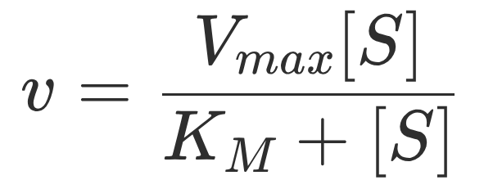
03

Slide 4
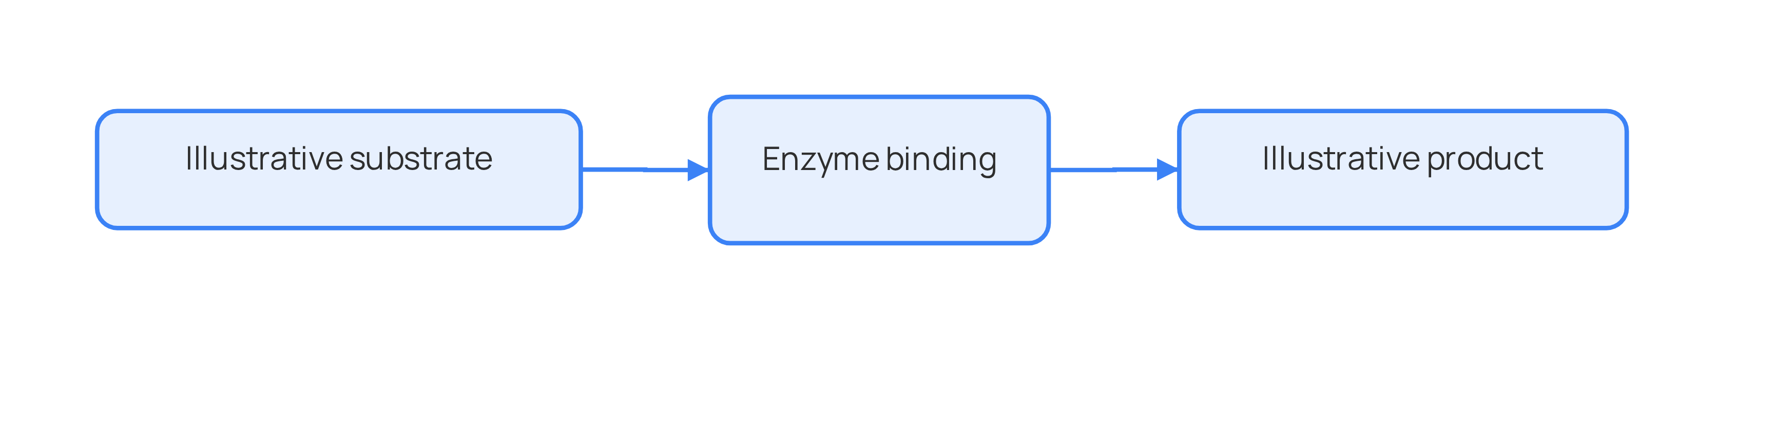
04

Slide 5
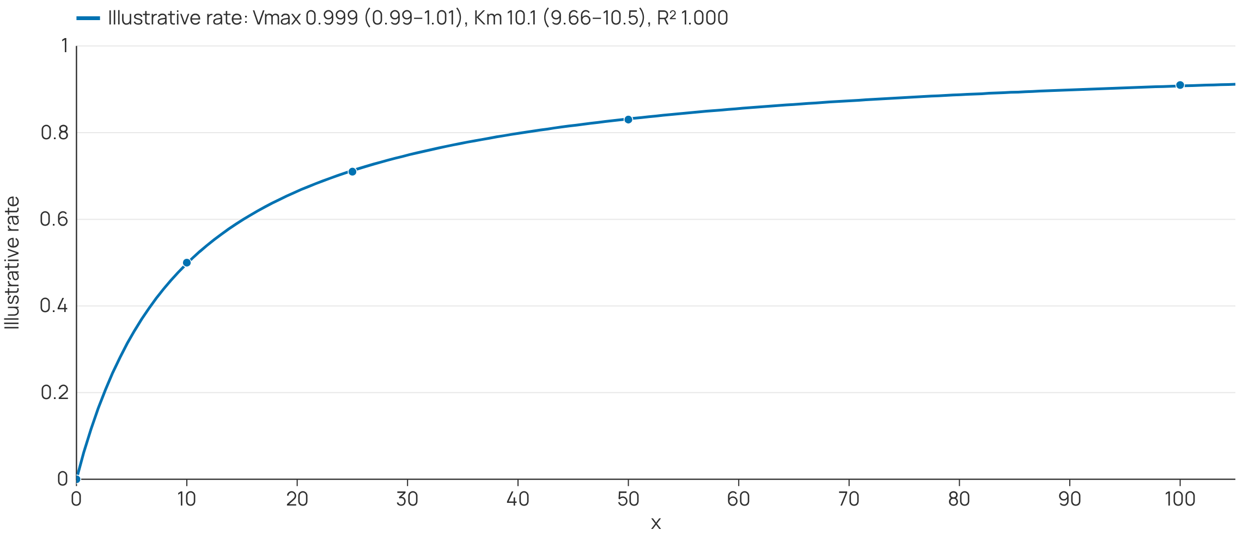
05

Slide 6
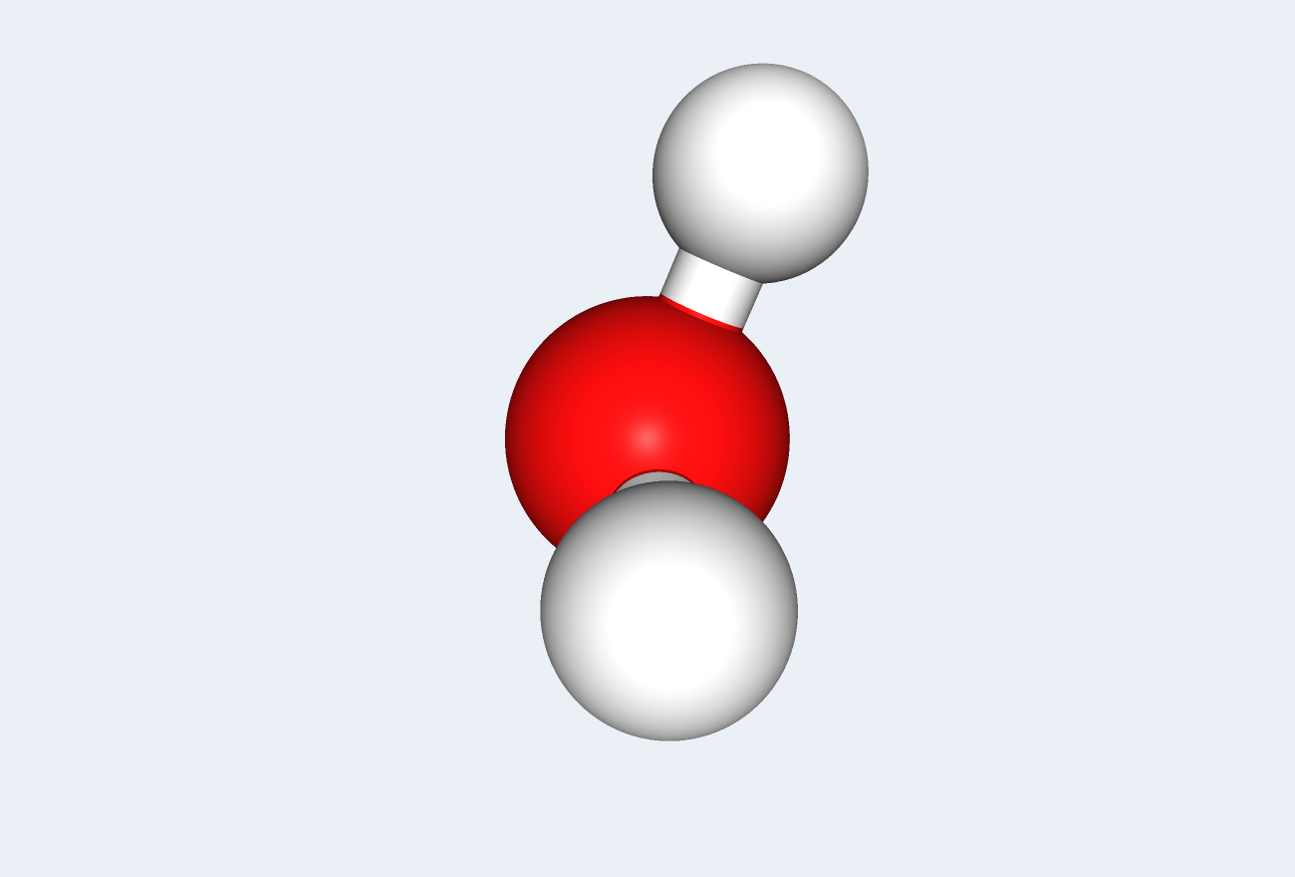
06

