Slide 1
Illustrative enzyme response
Notes:
Illustrative data only. Explain the model before interpreting the fit.

Slide 2
Dose response: illustrative data
02
Notes:
Illustrative notes: explain the response.

Slide 3
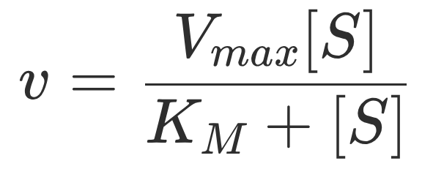
A model for the response
03

Slide 4
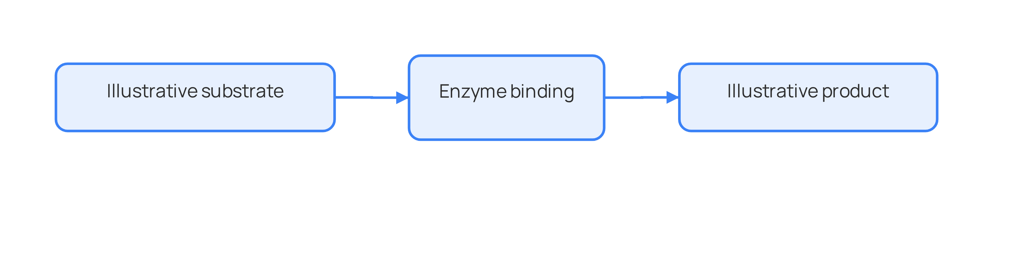
From substrate to product
04

Slide 5
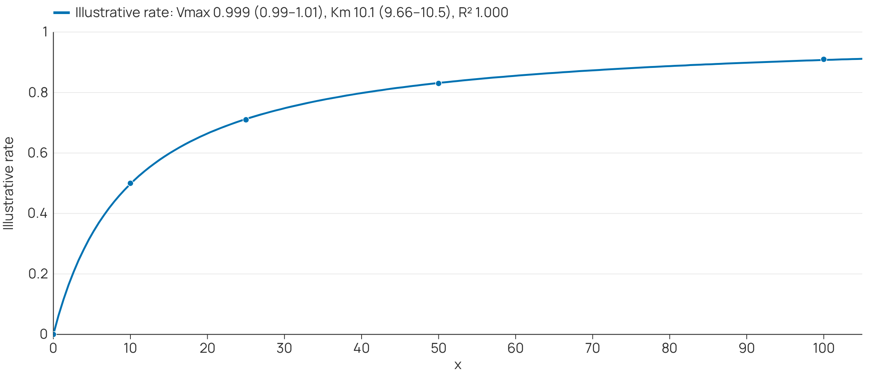
Fit the data on the slide
05

Slide 6
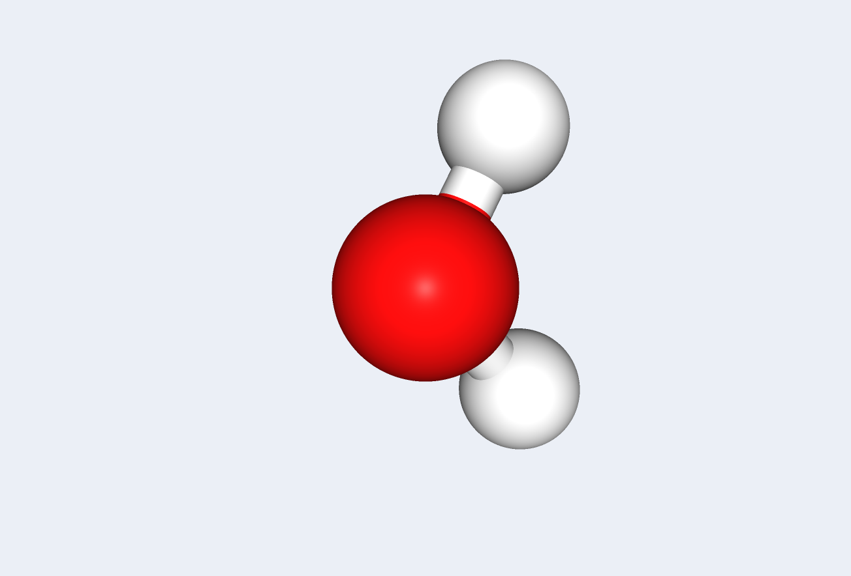
Explore the molecular view
06

