Slide 1
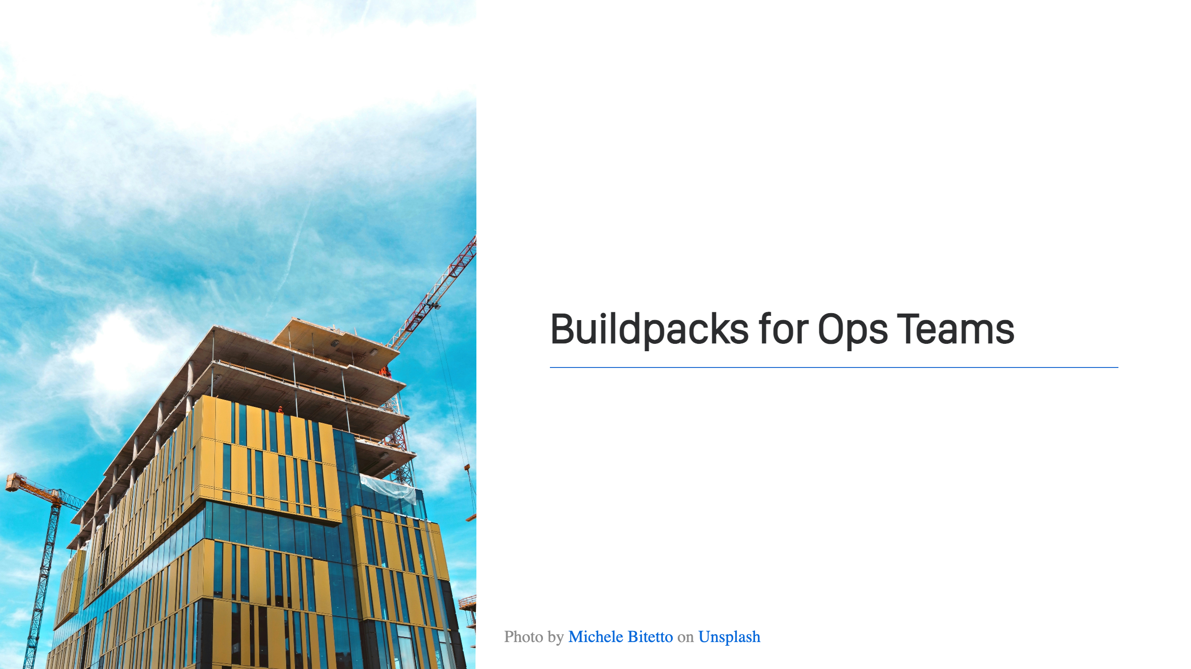
Notes:
Welcome! This is my session. Let's get started!

Slide 2
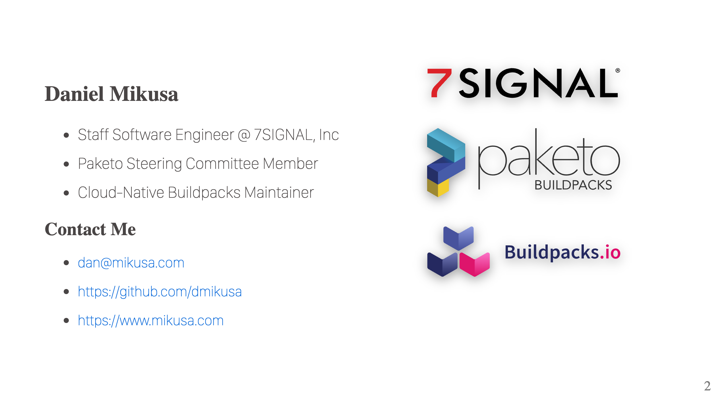
Notes:
Who am I? I work at 7SIGNAL, a leader in WiFi optimization. In a nutshell, we write performance monitoring software that helps make your WiFi awesome. I also help with a couple of OSS projects, Cloud-Native Buildpacks and Paketo Buildpacks. Both, great tools for building your container images and the subject of today's discussion. While I'm not covering WiFi in this talk, if you're curious feel free to come chat after the session.

Slide 3
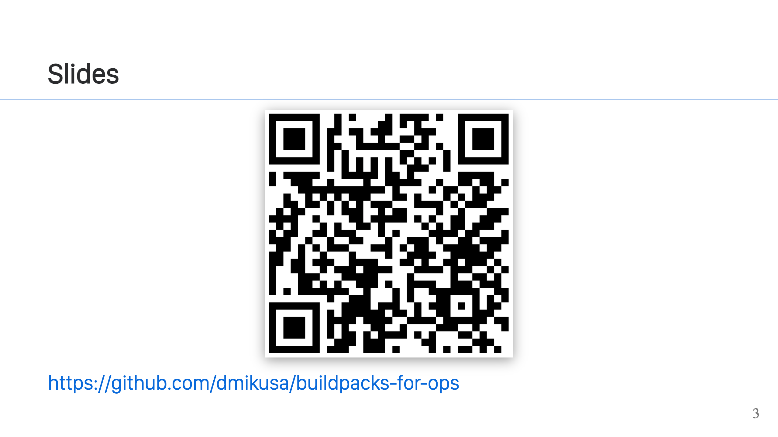
Notes:
Slides are available at the link above.

Slide 4
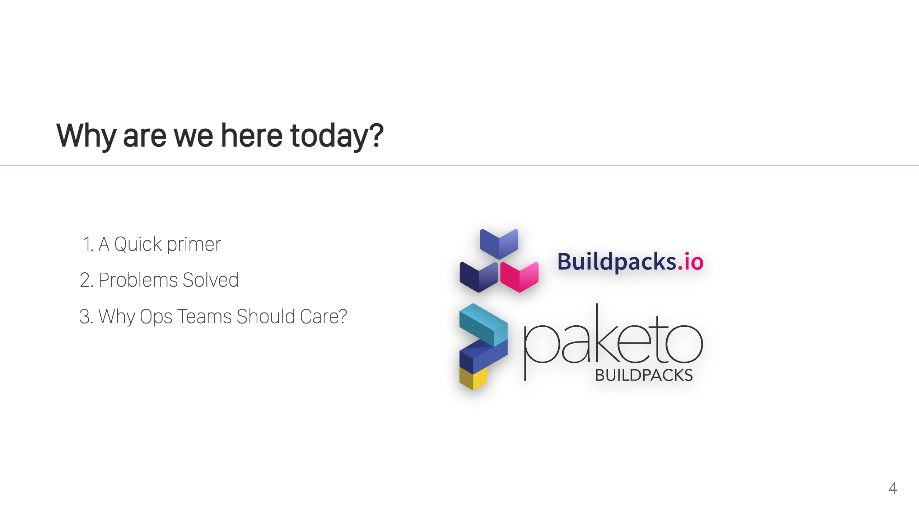

Slide 5
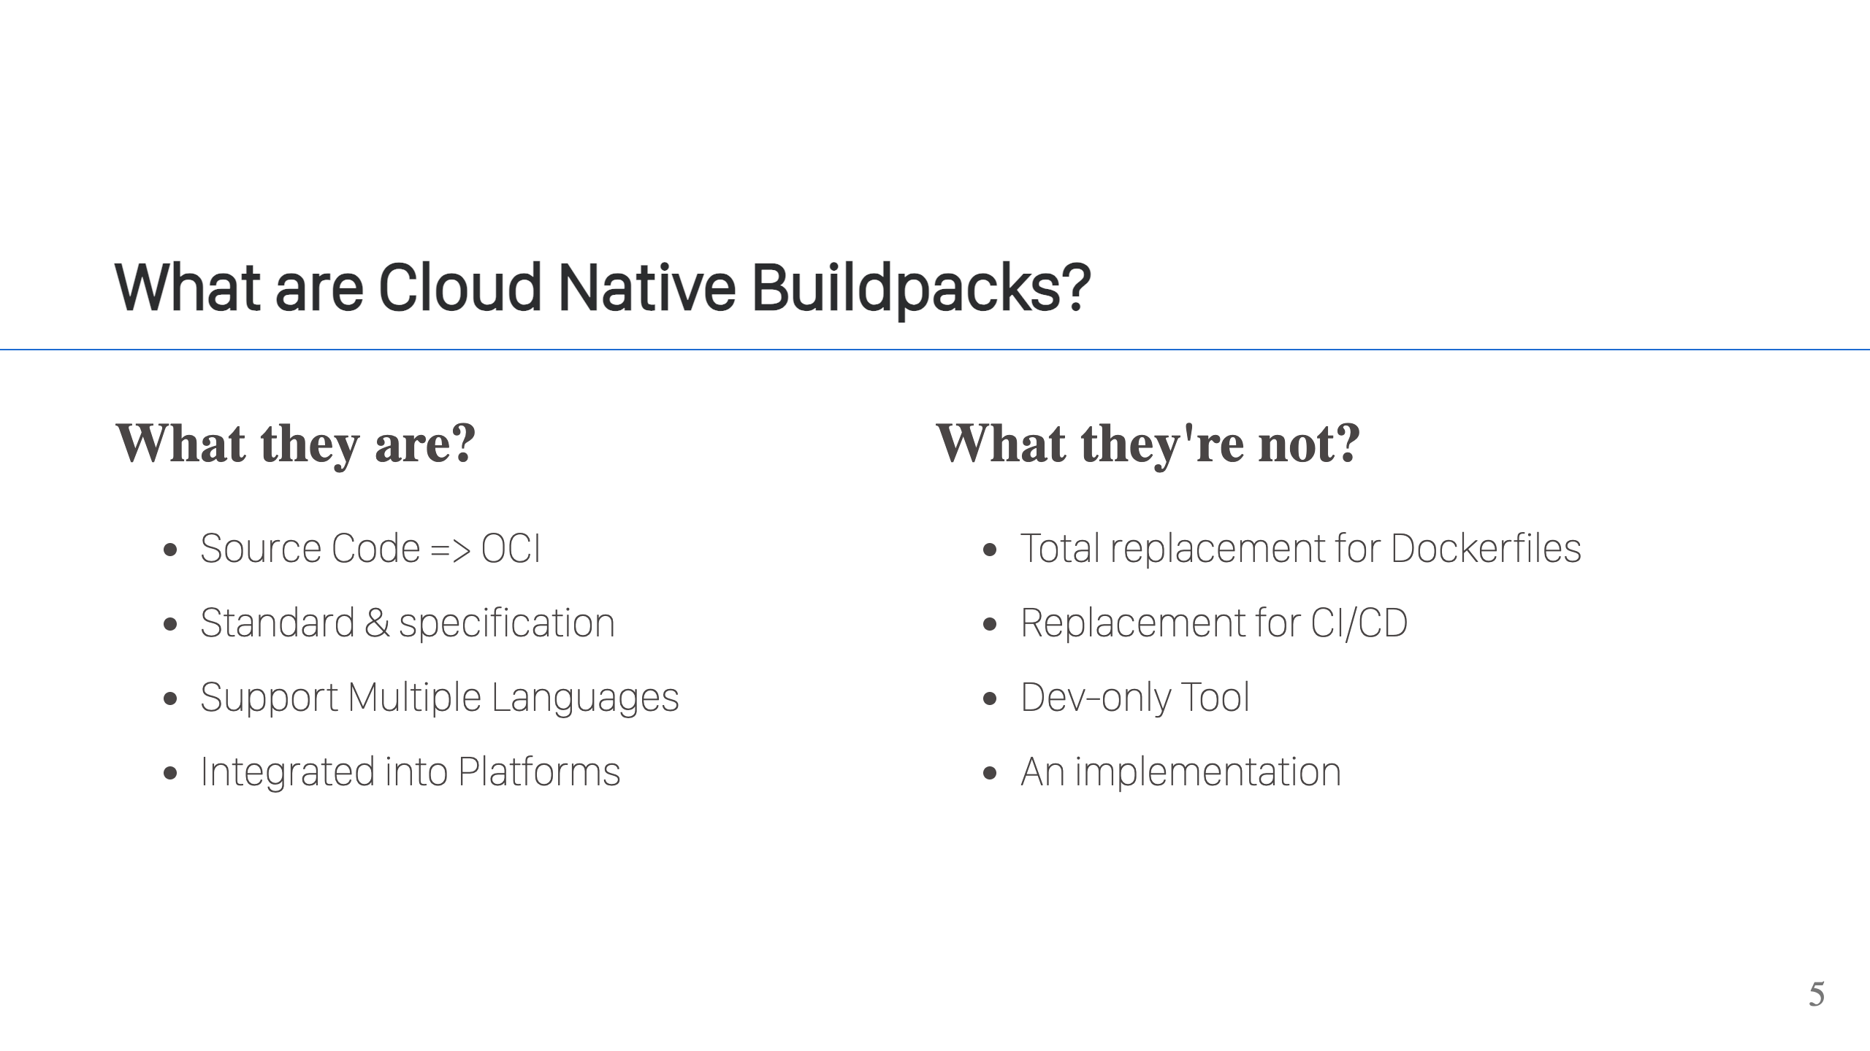
Notes:
What they are: - CNBs have a focused purpose, to turn source code into OCI images. - They are a general standard and support many different languages. - They are suited well for integration into platforms and are in many already (CF, Heroku, Fly.io, AWS AppRunner, Google Cloud Run) - They are a specification (platform + buildpacks). It defines how buildpacks work and how you integrate them into your platforms. What they are not: - They do not attempt to completely replace Dockerfiles. There are still some good use cases for Dockerfiles. They do replace Dockerfiles for use when it comes to building application containers. - They're not replacing CI/CD, although there are some common parts to both. Both build your app, both create artifacts. CNBs are usually integrated into your existing CI/CD pipelines some point after tests have run. - They're not a dev-only tool. They're great for Ops folks too, and that's what we're talking about today. - They're not an implementation. CNB does not provide a working set of buildpacks, which is where Paketo buildpacks come in. Paketo is an implementation of the CNB specification for most popular languages: Java, GraalVM, Scala, Kotlin, Clojure, Go, .NET, Node.js, Python, Ruby, Rust, PHP & web servers

Slide 6
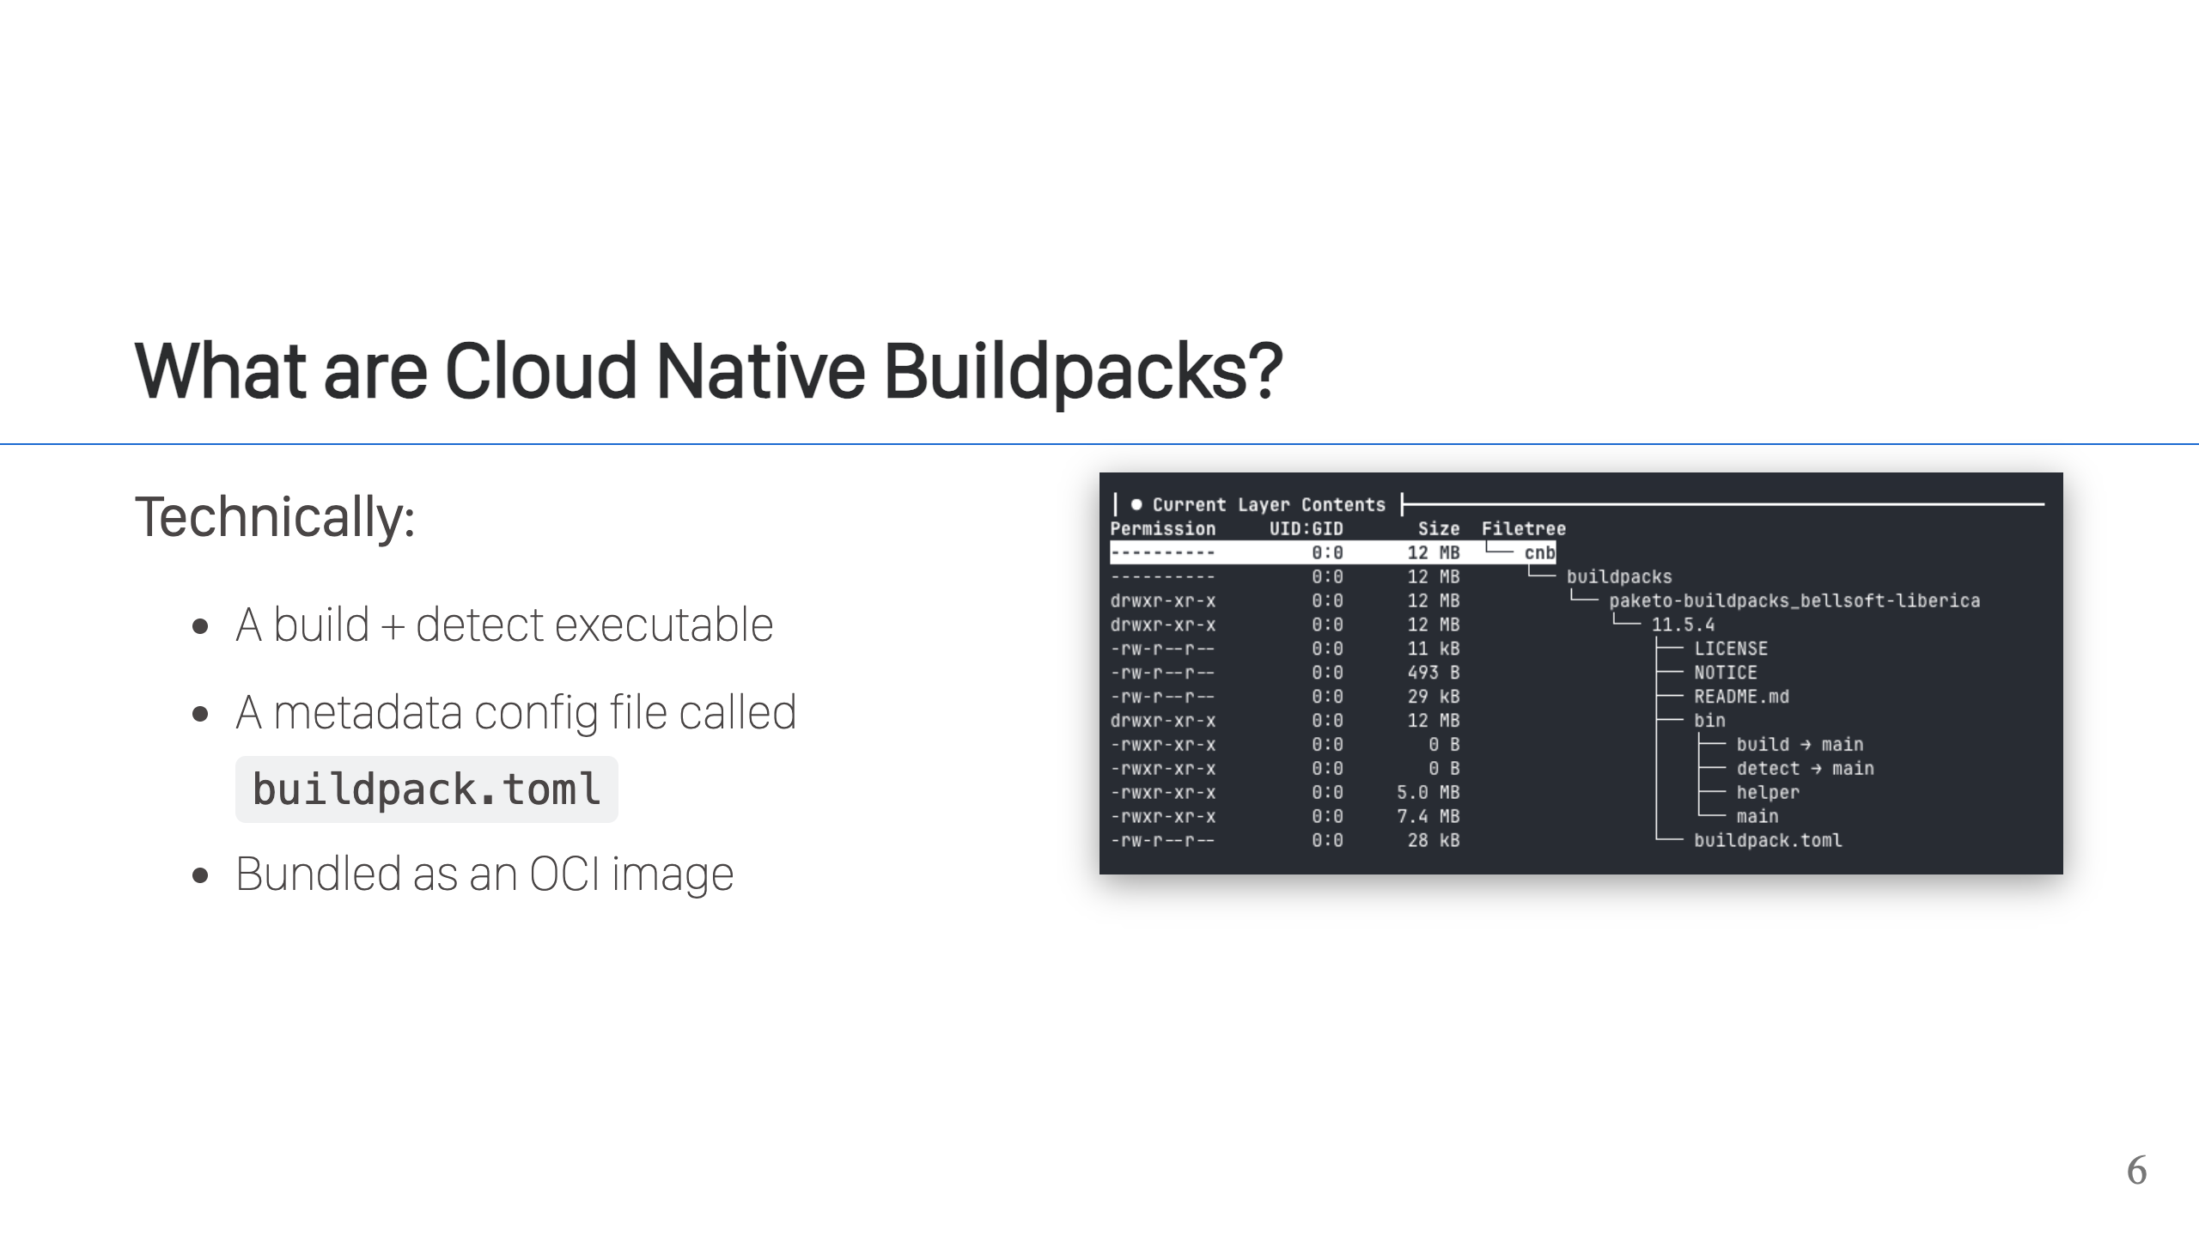

Slide 7
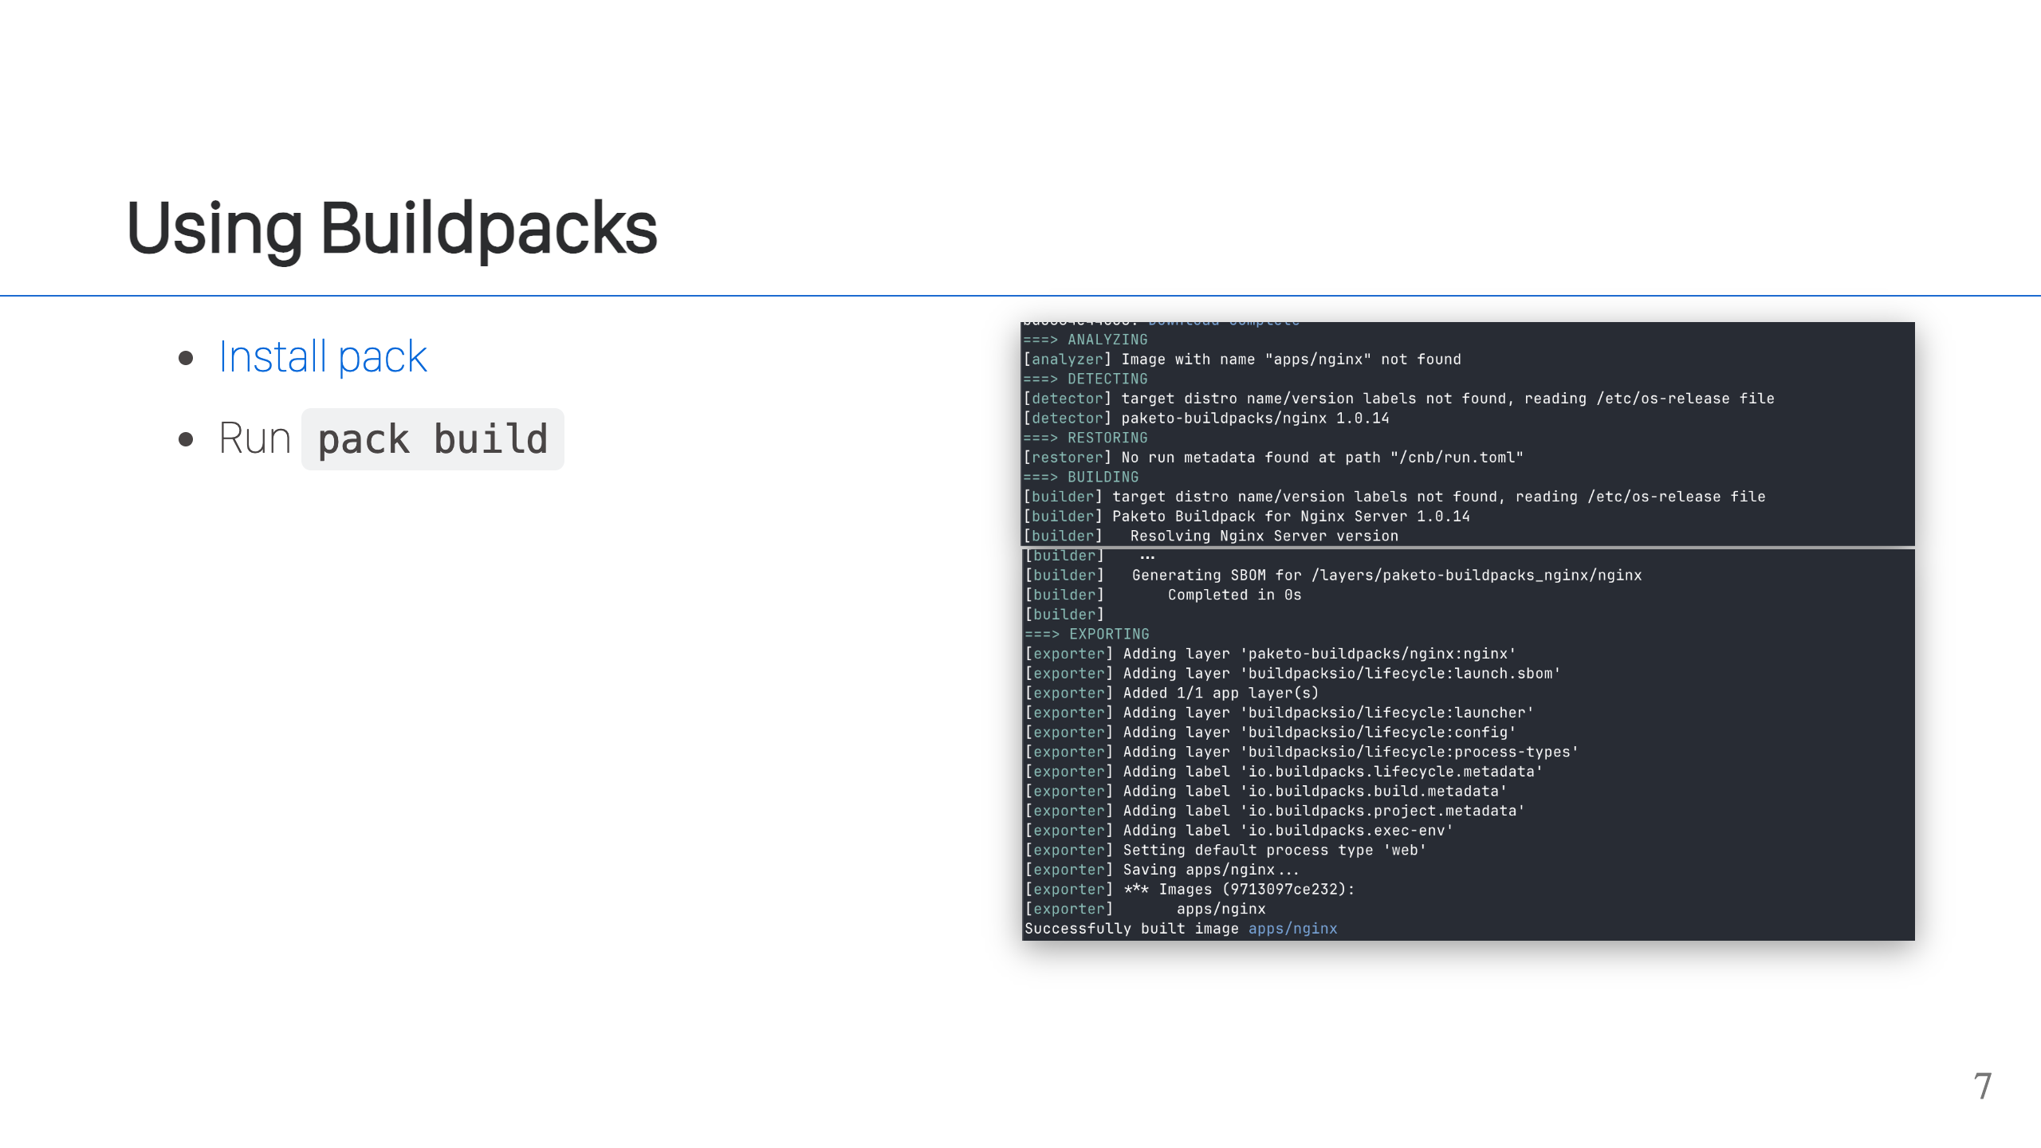

Slide 8
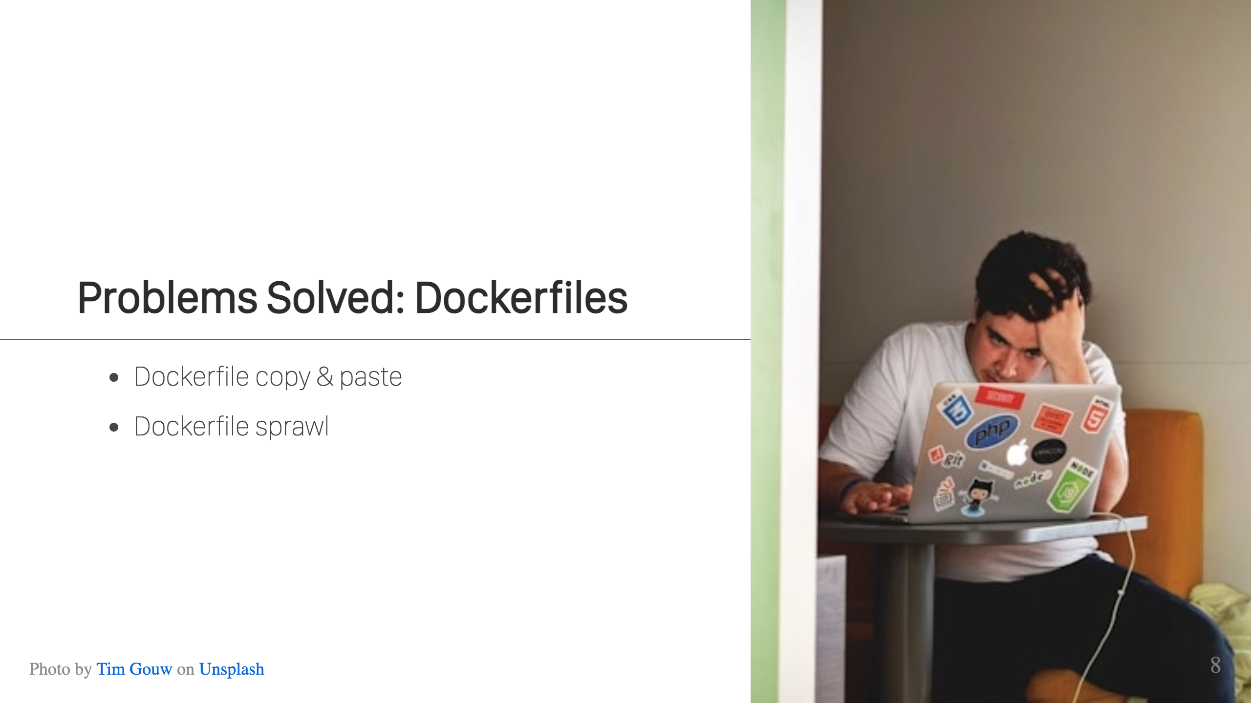
Notes:
You need to containerize an app. Where do you get the Dockerfile? a.) Copy & Paste from another repo b.) Copy & Paste from Stack Overflow or a blog post c.) Let AI tools generate it Most people don't have time to sit and generate one from scratch, check that it's following all the best practices (or even know of them), so any issues or problems get copied and pasted with the Dockerfile. If you have enough applications at your company, then you hit a new issue. What happens when you want to update all of these unique Dockerfiles? You need to analyze them, because there may be differences in the files, and then buckle in to submit a whole bunch of pull requests. It's not a fun process. Cloud Native buildpacks have no Dockerfiles, so this problem is gone. The knowledge and commands in the Dockerfiles are codified in the buildpacks & shared that way.

Slide 9
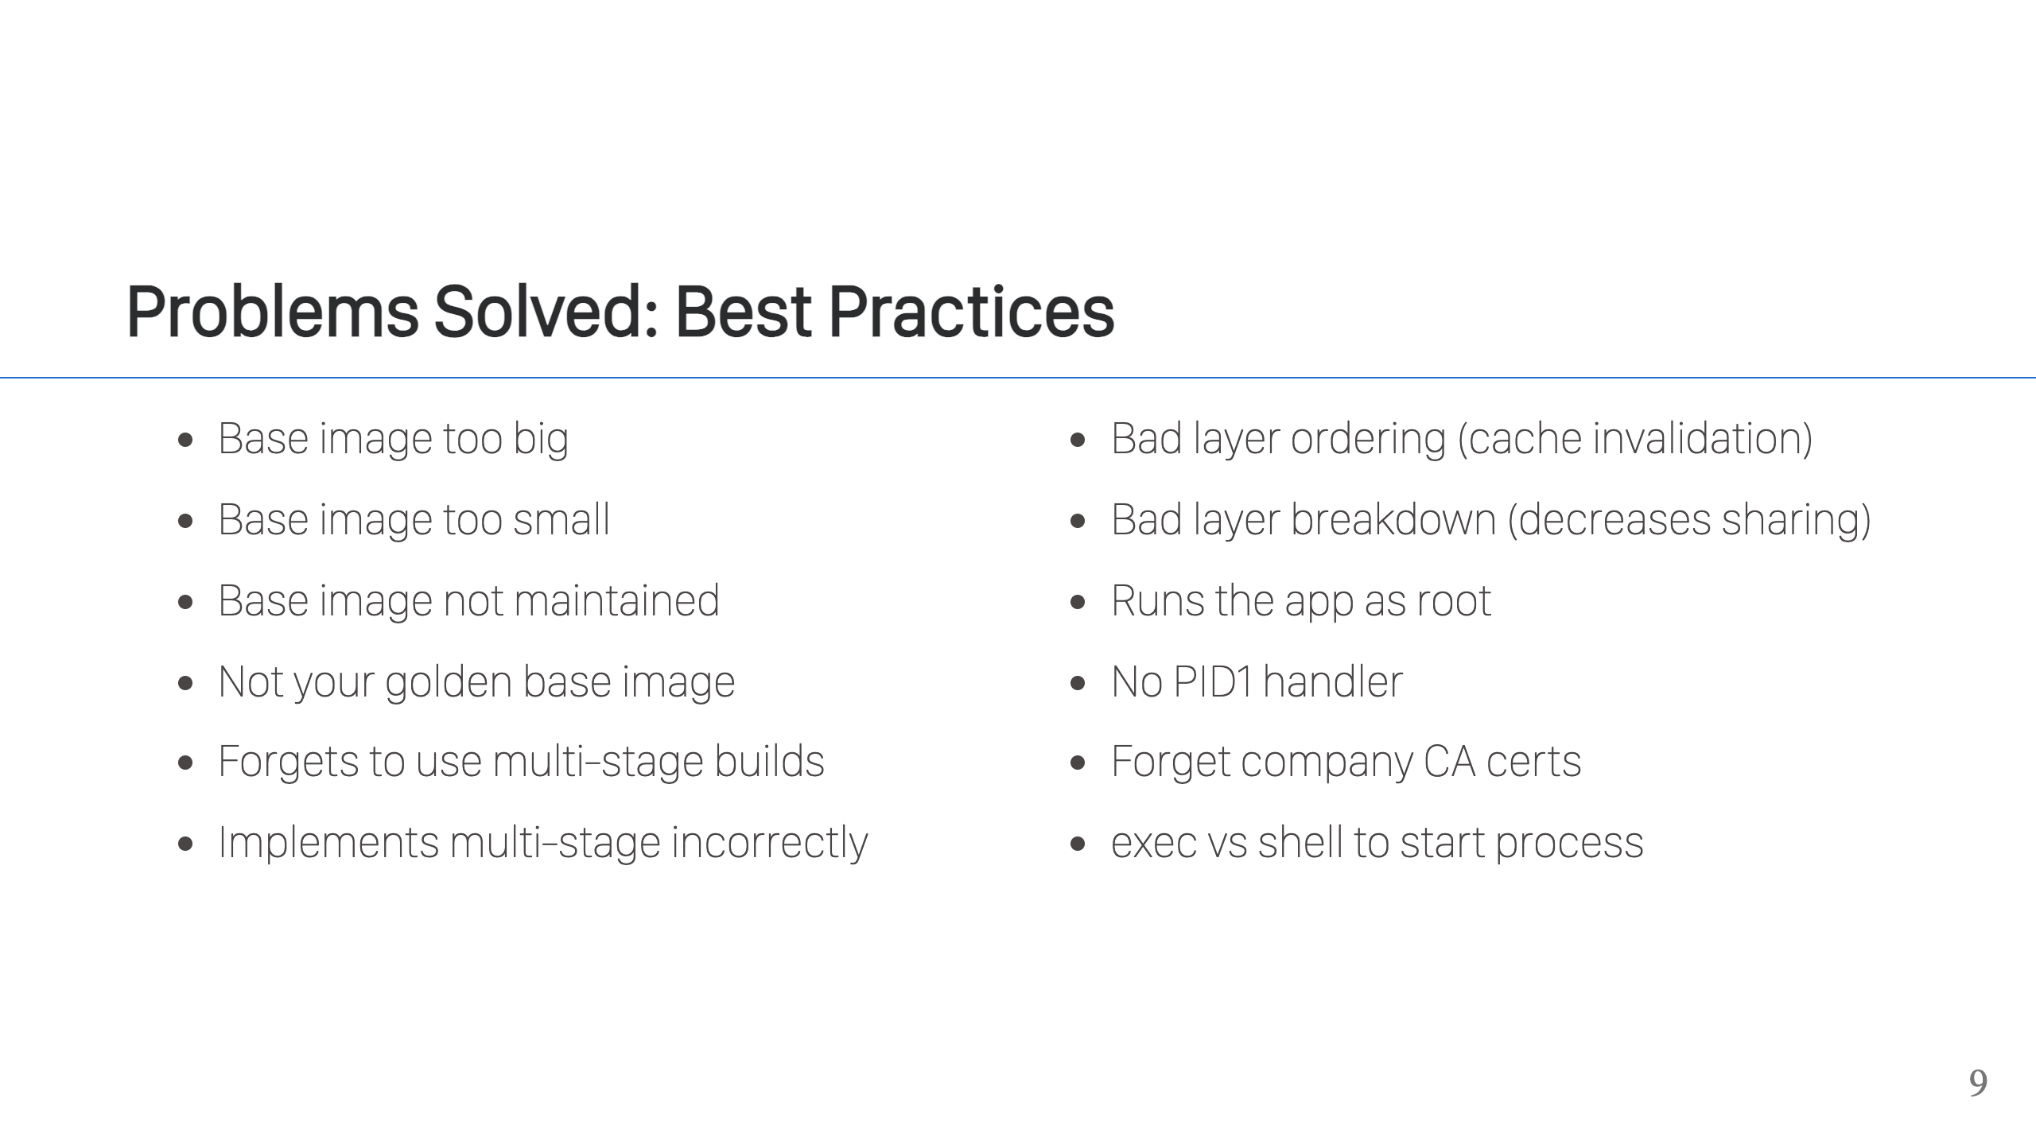
Notes:
Dockerfiles are easy to write, but hard to get correct. A quick search will show you tons of articles talking about the "best practices" you should follow when writing a Dockerfile. There are dozens of them, some are obvious and some can be pretty subtle. As a busy developer, you may be unaware of these best practices or you may not have the time to go through them all. As mentioned earlier, copy & paste is the most common way to create a Dockerfile, so you're just hoping someone else before you put in the time to do this right. The great thing about Buildpacks is that you don't have to hope. The buildpack authors put in the time to get it right, and codify that knowledge so every time you run the buildpack, things are done correctly and you get the best possible image.

Slide 10
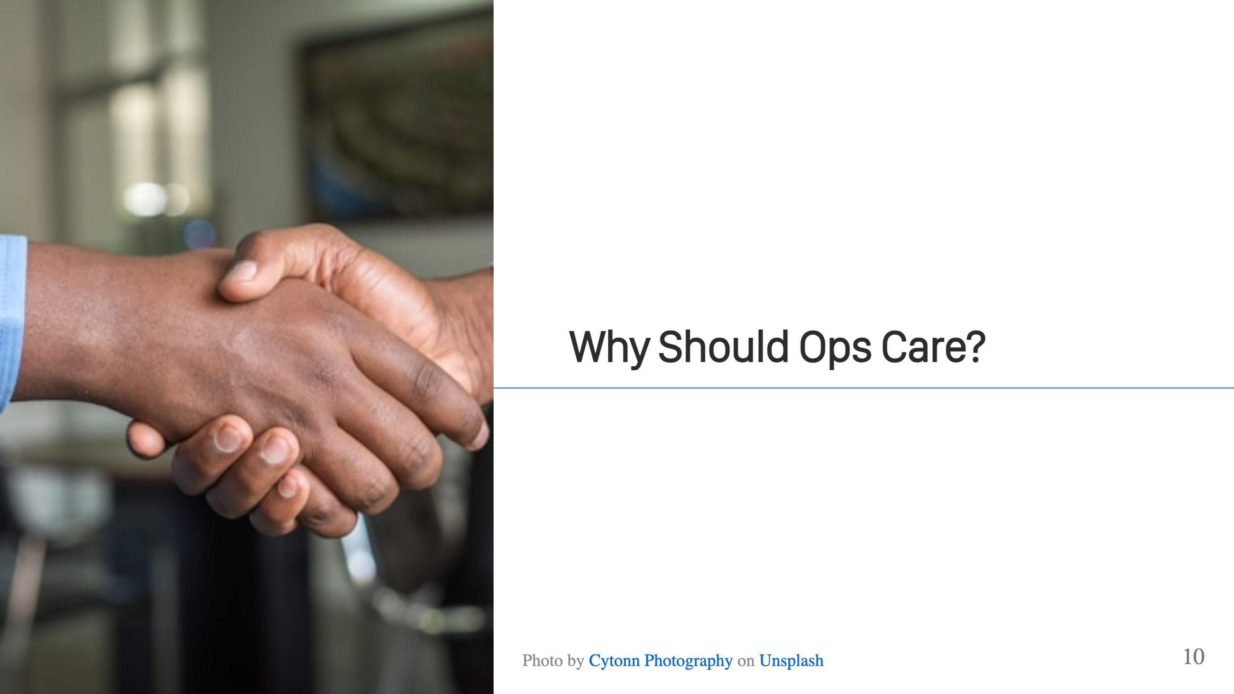
Notes:
Because these are not two separate problems. The term "DevOps" was coined for a reason. These tasks are intertwined. It might be that the app team might write the Dockerfile, but the Ops teams are running the platforms where these images or are running. It matters how those images are created. When there are vulnerabilities or problems with the app, everyone has to step in and help.

Slide 11
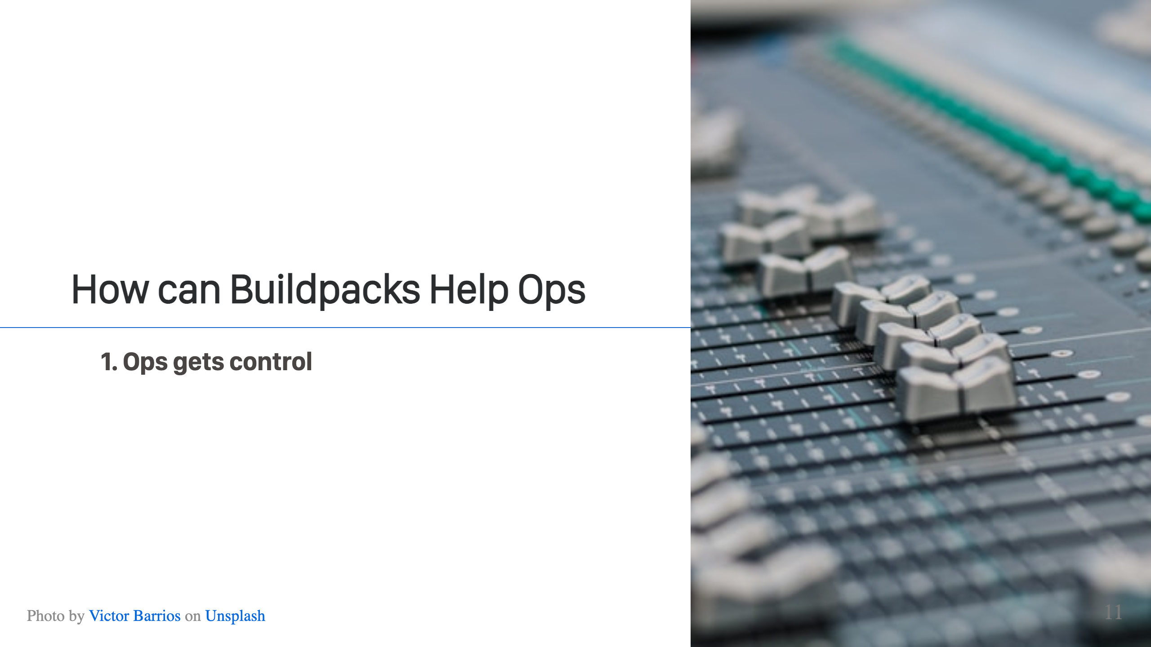
Notes:
There's no more Dockerfile, so no more mess. Builds are done in a unified way, according to your designs. You define the base images, you define the buildpacks, the tools run and produce safe, consistent images.

Slide 12
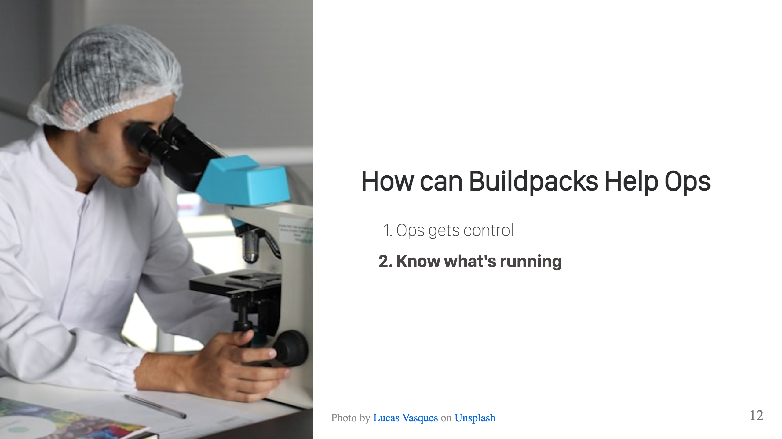
Notes:
Buildpack generated images automatically have SBOMs created for them by default, so you know what's in the image and what's running. In addition, buildpack builds are reproducible. If there's ever a question about the contents of an image, you can rebuild from source and assert down to the byte that nothing has changed.

Slide 13
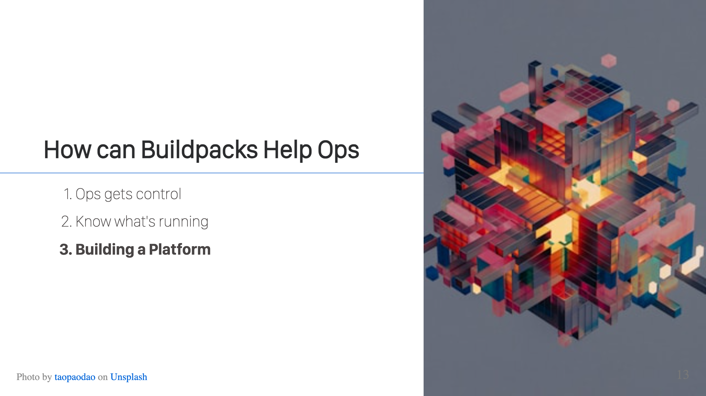
Notes:
Buildpacks are more than just a way to create images, they're a way to allow Ops teams to provide an almost PaaS-like platform to their Dev teams. This is a win-win and makes life easier for both teams.

Slide 14
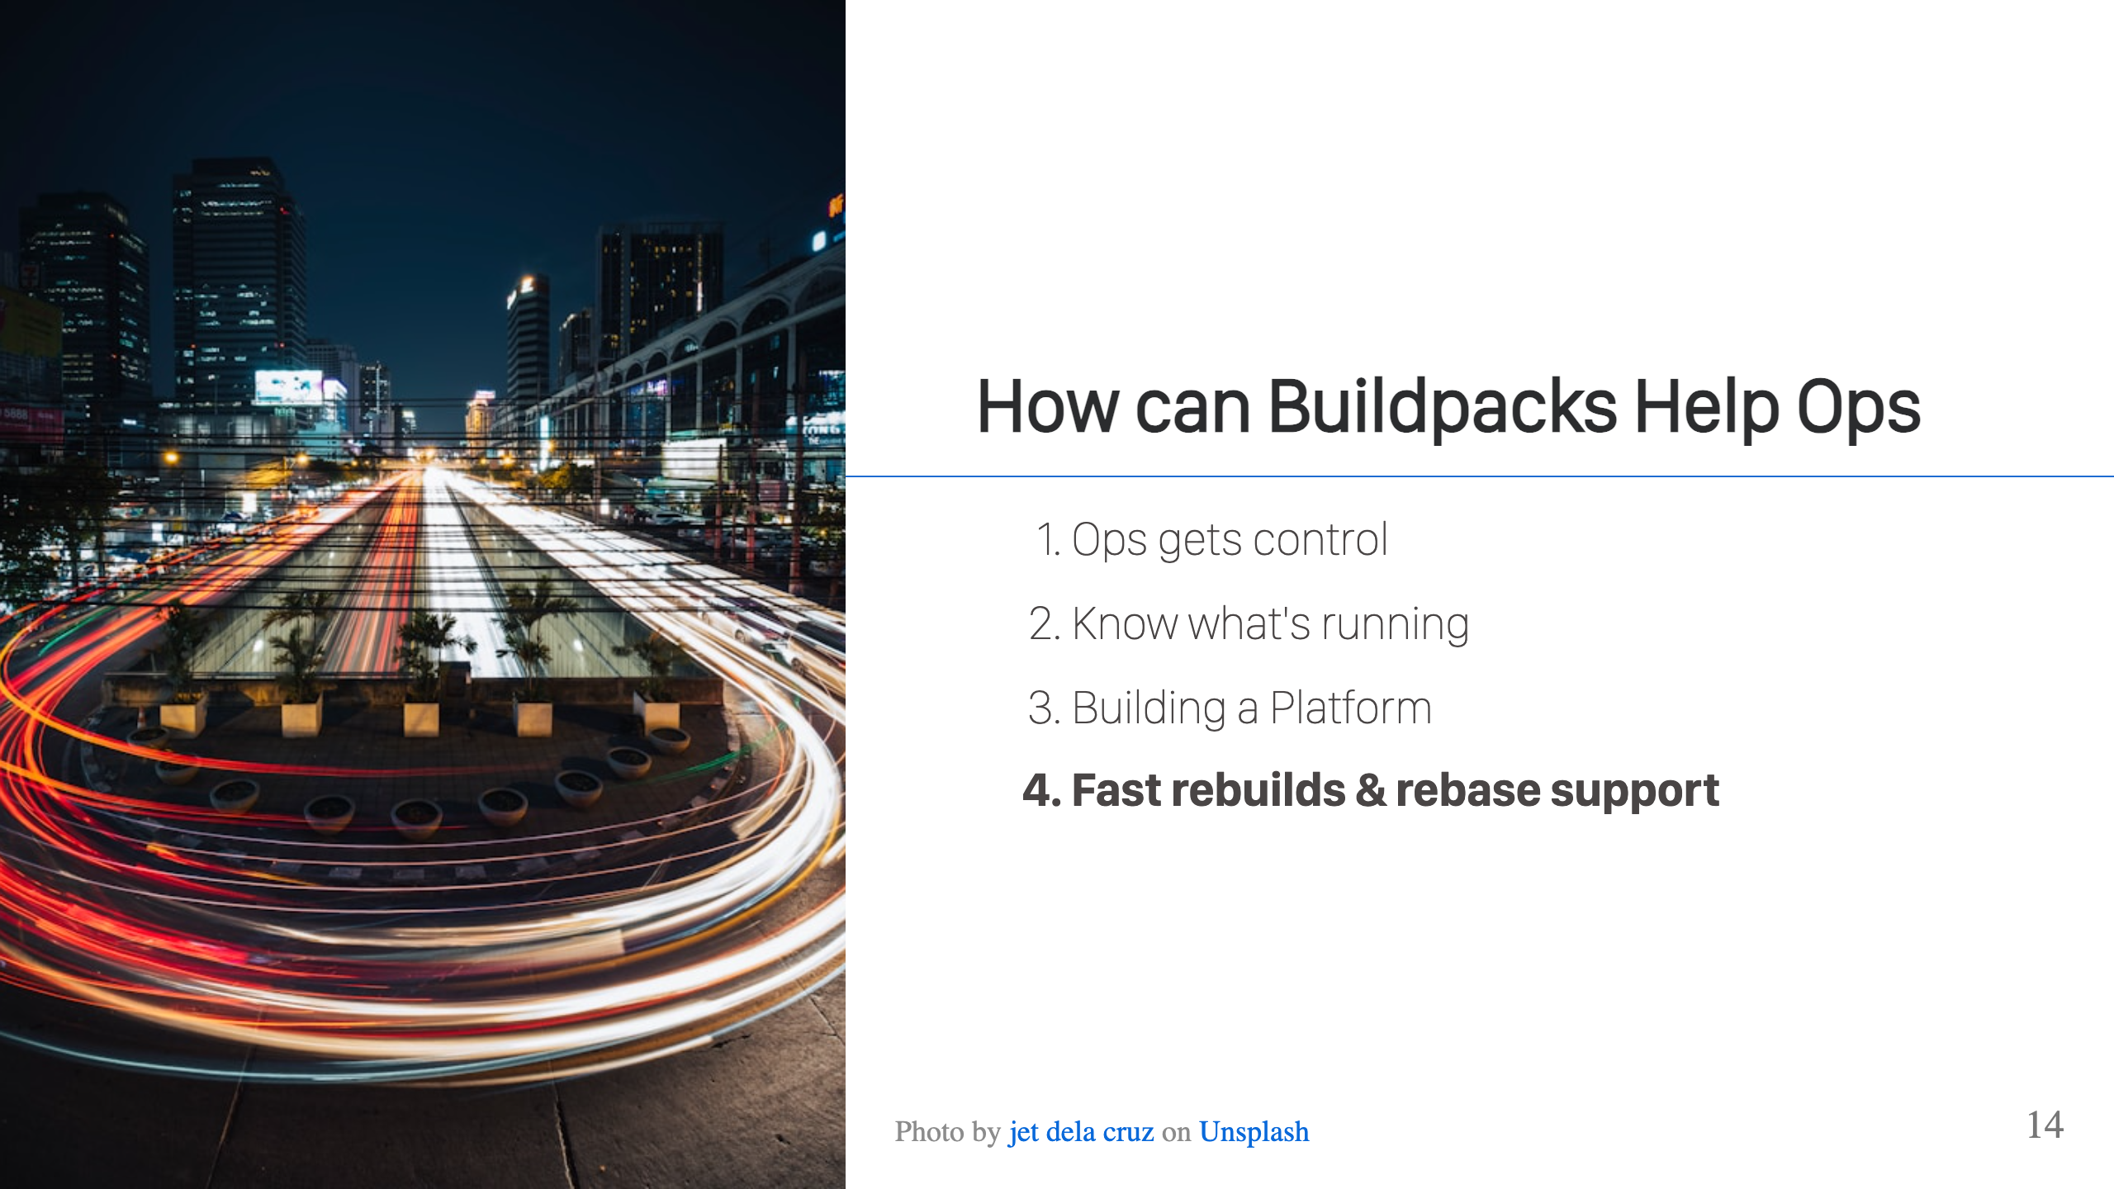
Notes:
Buildpacks efficiently cache build metadata, and allow for very quick rebuilds of applications. If that's not fast enough though, buildpacks support the ability to rebase images. When there are OS updates to your base image, this allows you to efficiently swap out the base layer of your application images with a new, updated base layer in a fraction of the time for a rebuild. If you're building a platform, rebase is huge because you can confidently patch applications en masse when that next CVE strikes.

Slide 15
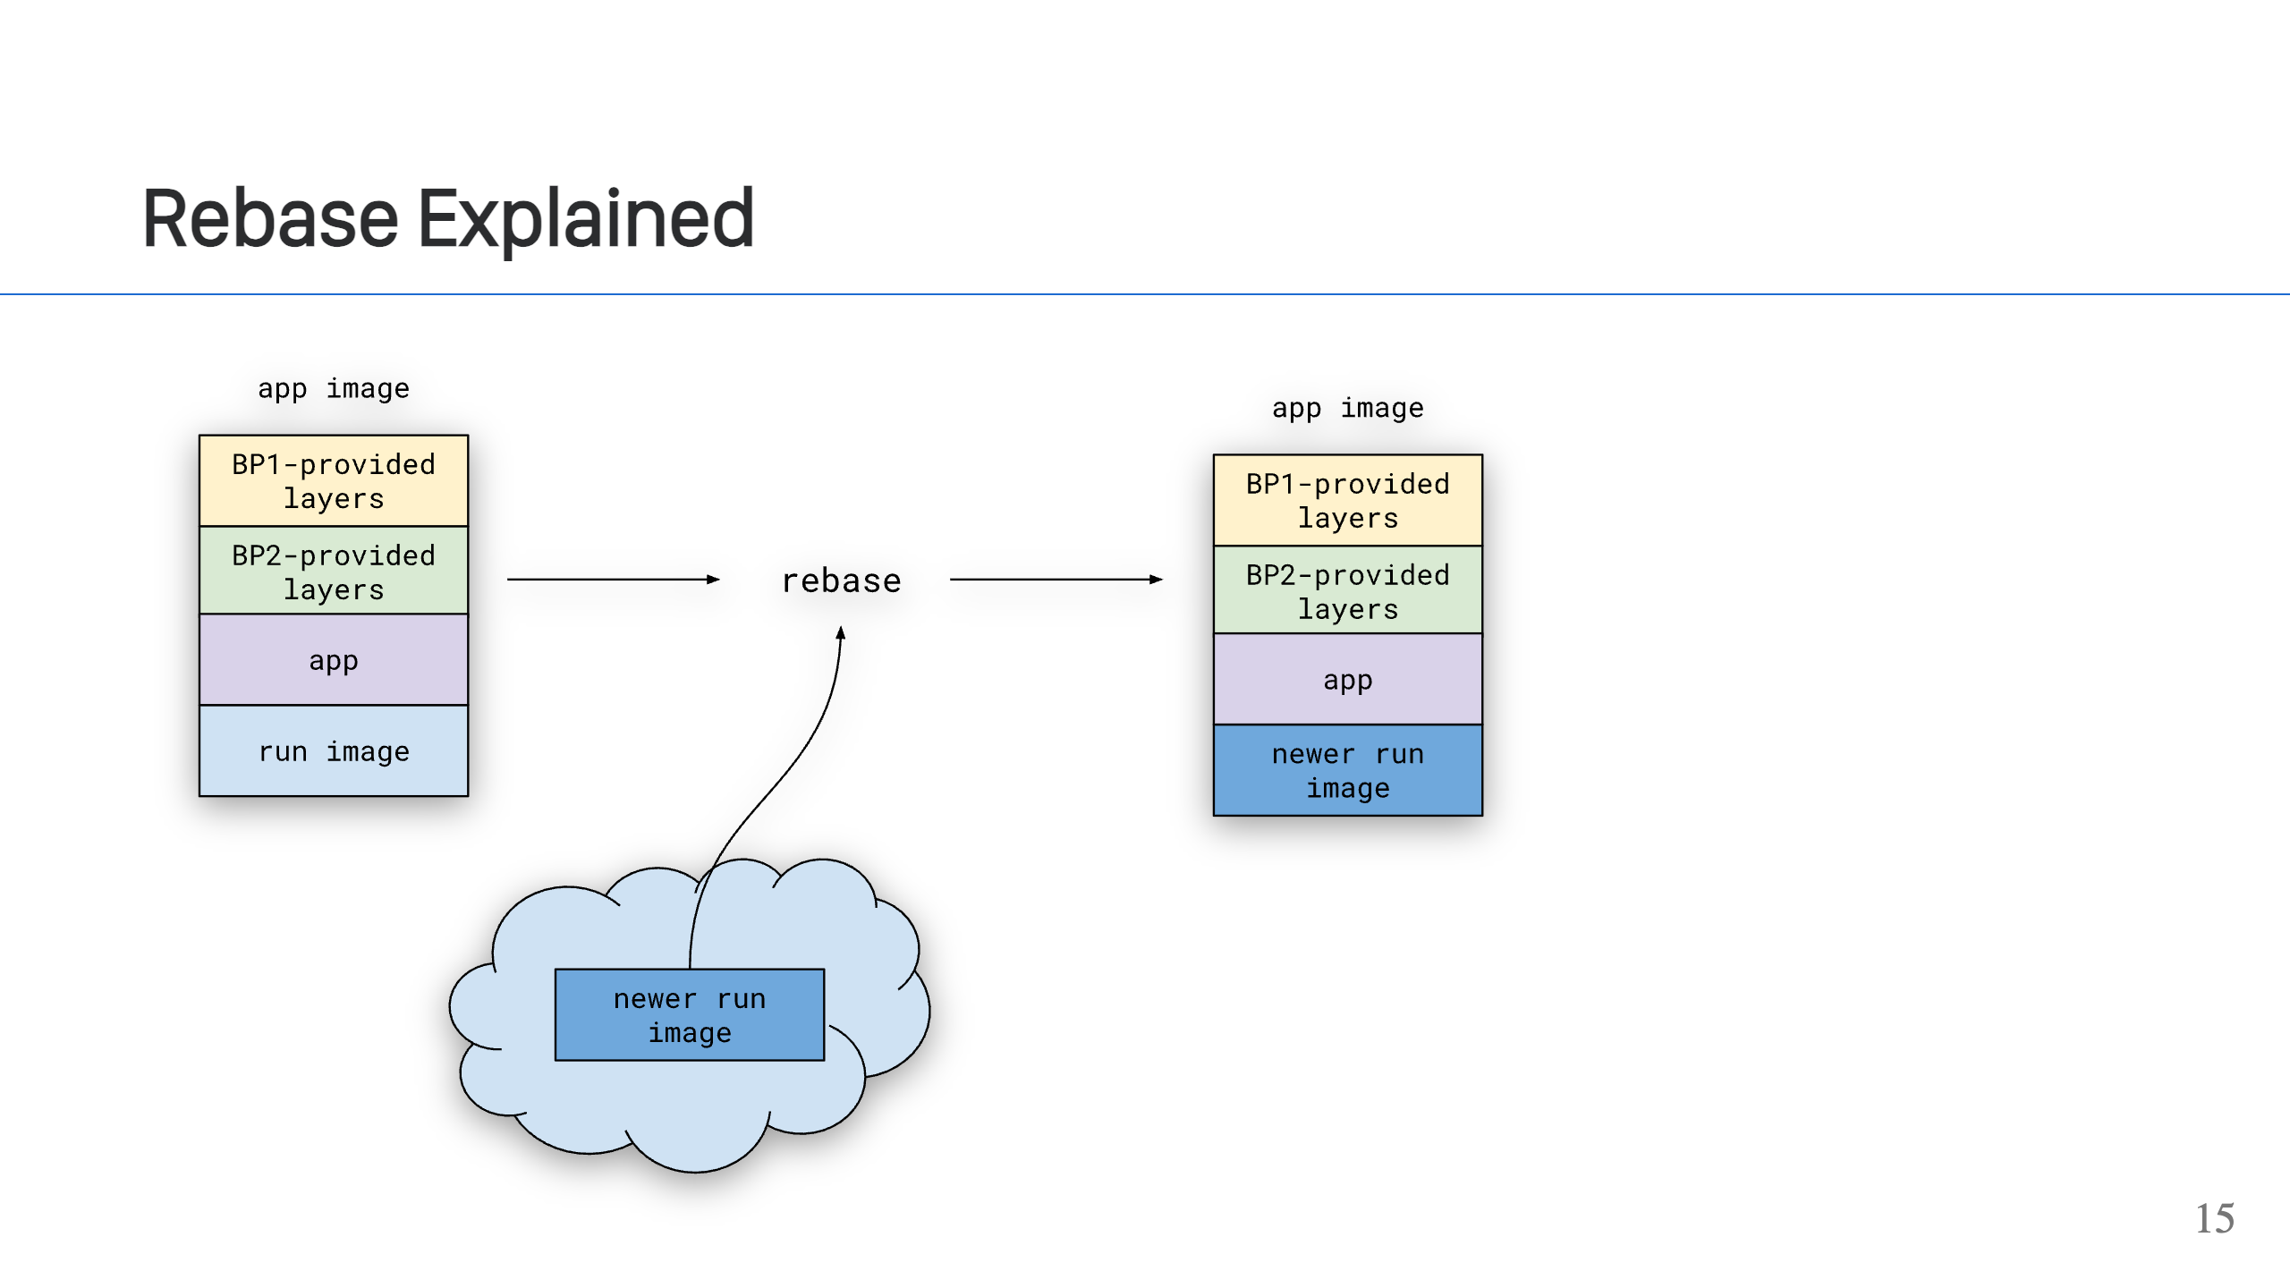
Notes:
A picture is worth a thousand words. This is how rebase works. The run image layer is the lowest layer in your app image. The `pack rebase` command looks for a newer run image layer, and upon finding one surgically swaps out just that lower layer, producing a new app image that is includes the new run image layer.

Slide 16
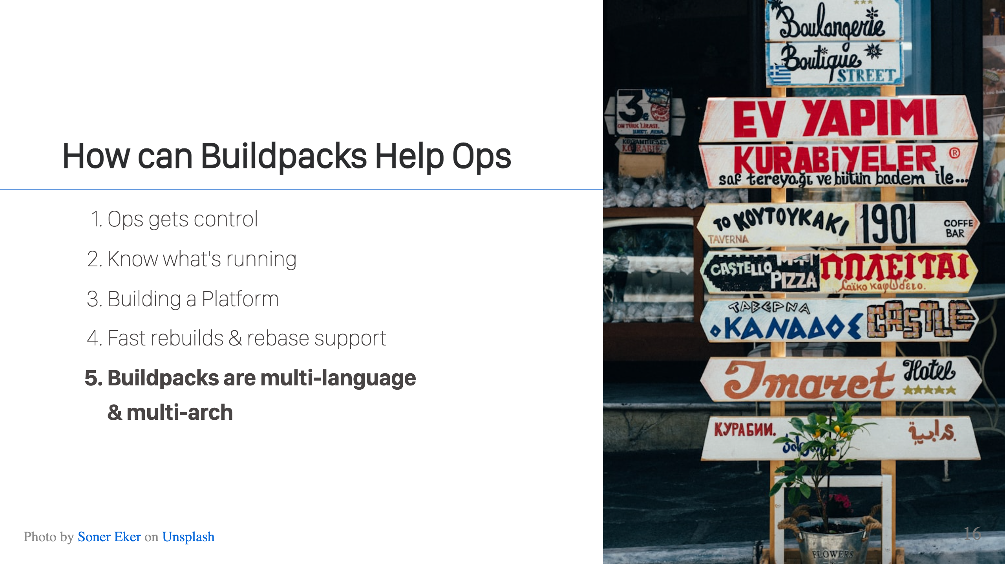
Notes:
Buildpacks are a language agnostic tool, so you can find buildpacks to support many different languages and even create your own. Dev teams don't need to worry, they just initiate a build and the buildpacks handle all the language specifics. In addition, buildpacks support multiple architectures, so you can build app images for AMD64 or ARM64 or whatever comes along next.

Slide 17
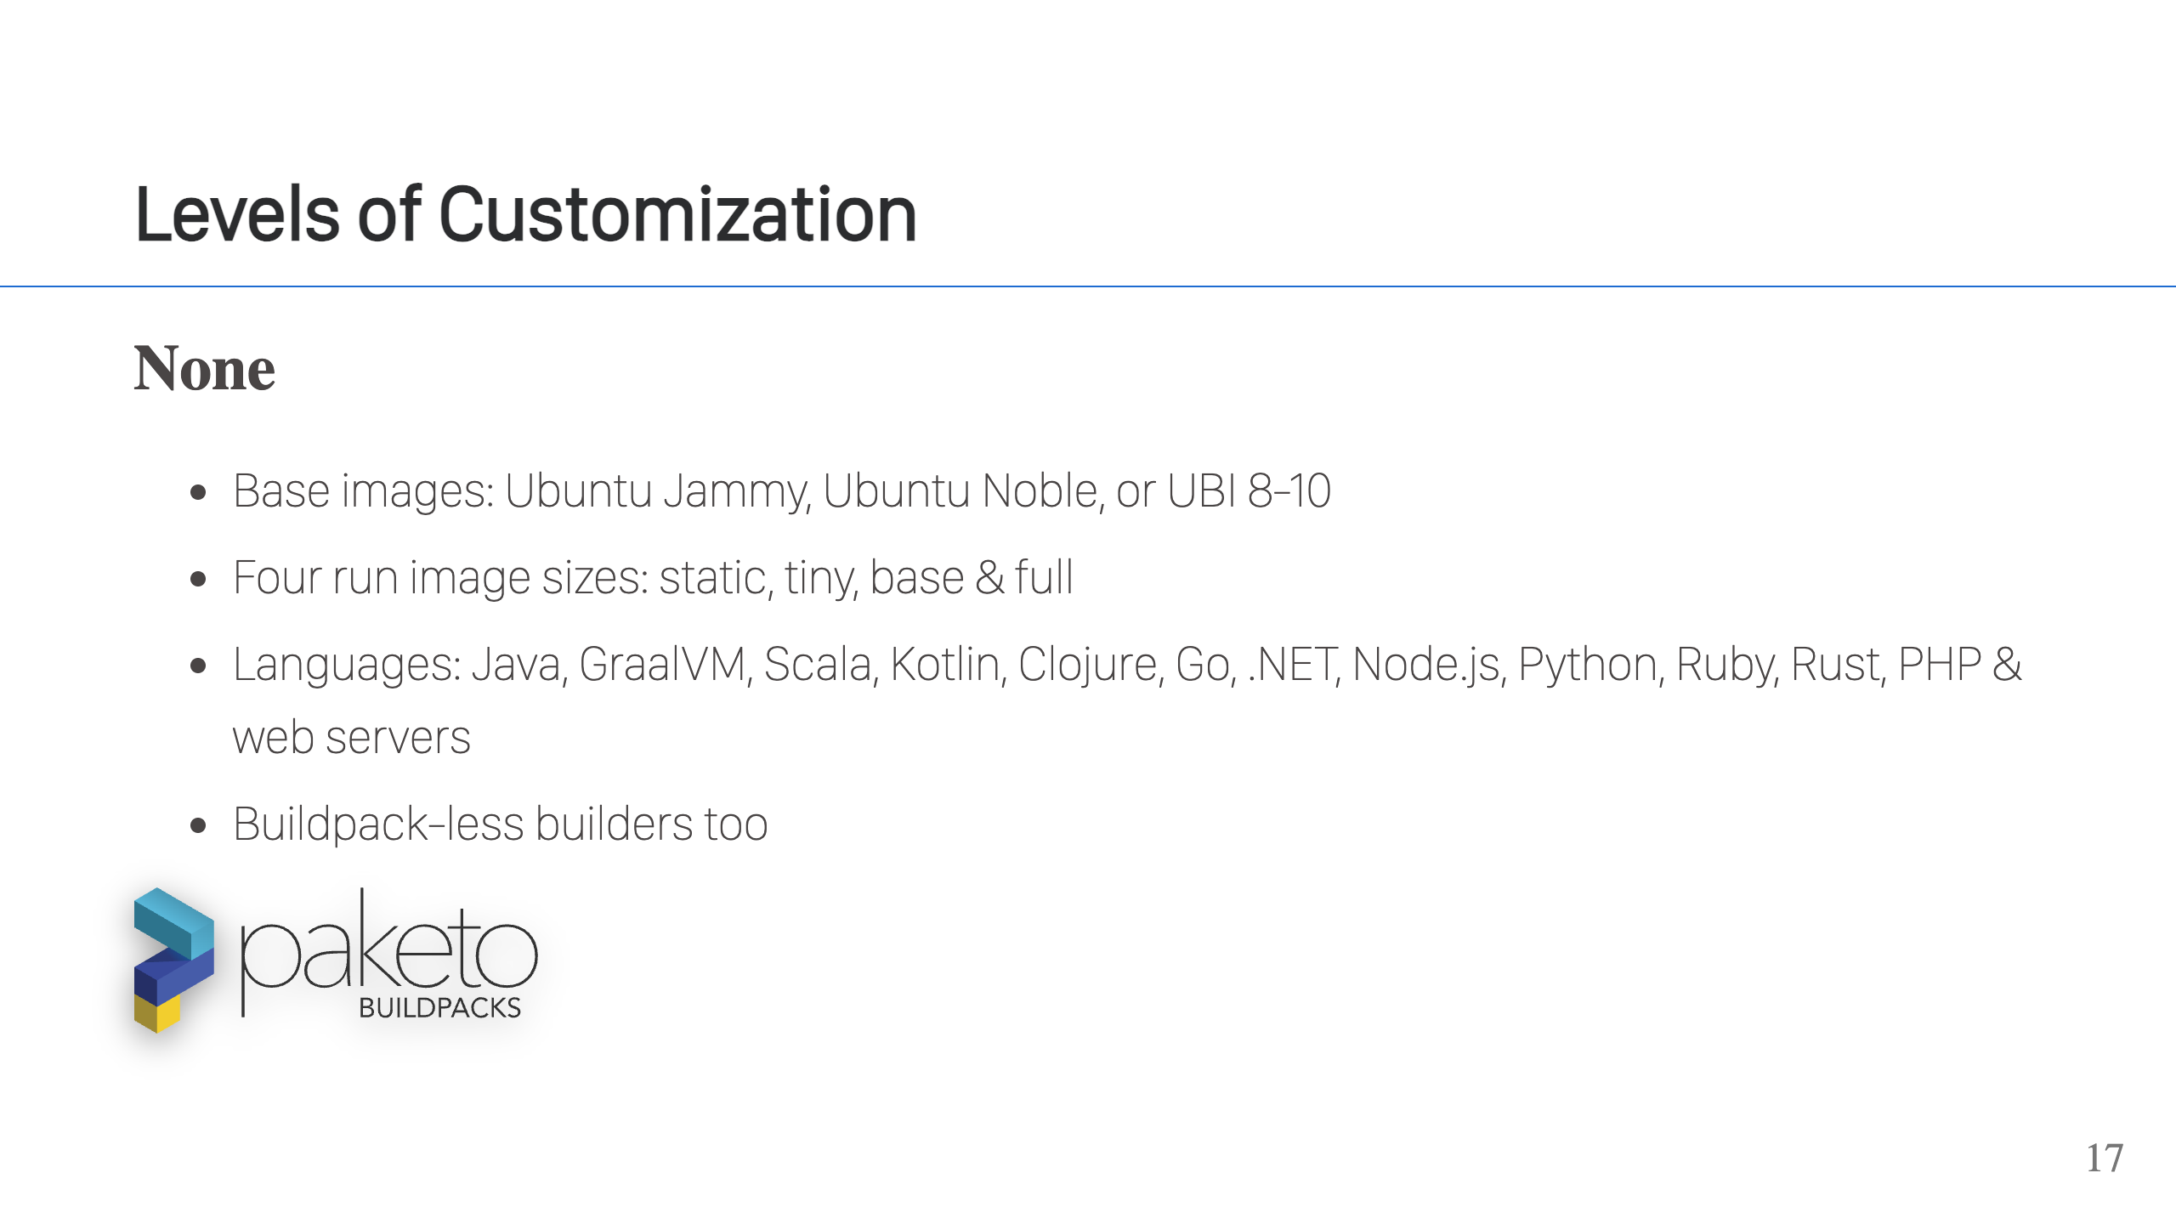
Notes:
Buildpacks can be customized in a number of ways to fit your needs, but let's start by covering what you get out-of-the-box without any customization, simply by using the Paketo Buildpacks implementation.

Slide 18
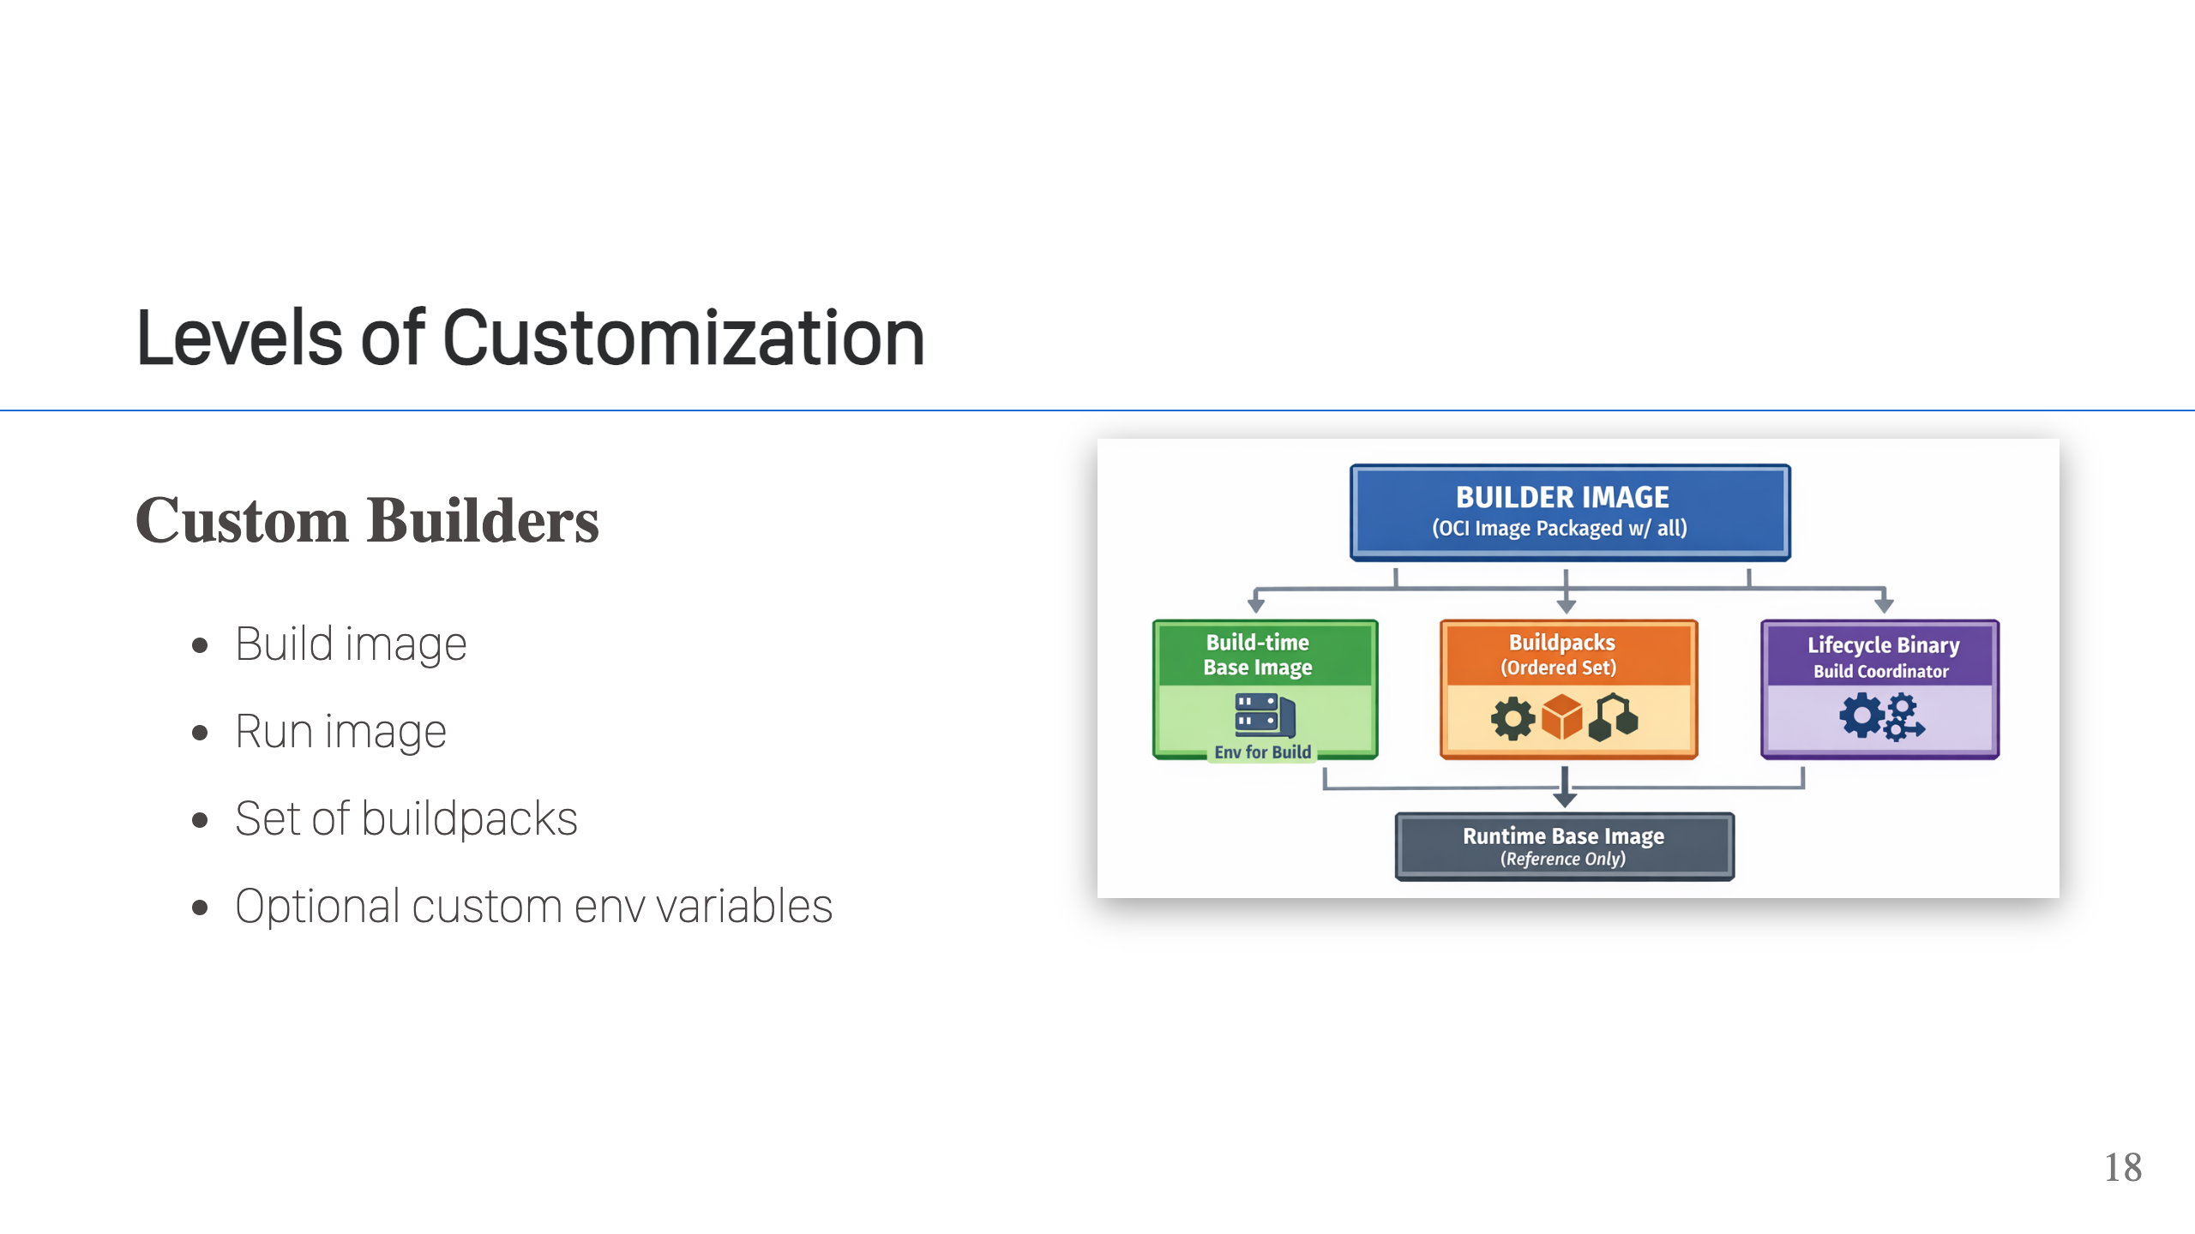
Notes:
This is the first level of customization. A builder is a base image + run image + buildpacks + metadata. This level of customization allow you to make your own collection for your company. For example, if you only do Java and you prefer a RedHat base, then you can make a builder with UBI9 build/run images and just two buildpacks, Java & Java Native Image.

Slide 19
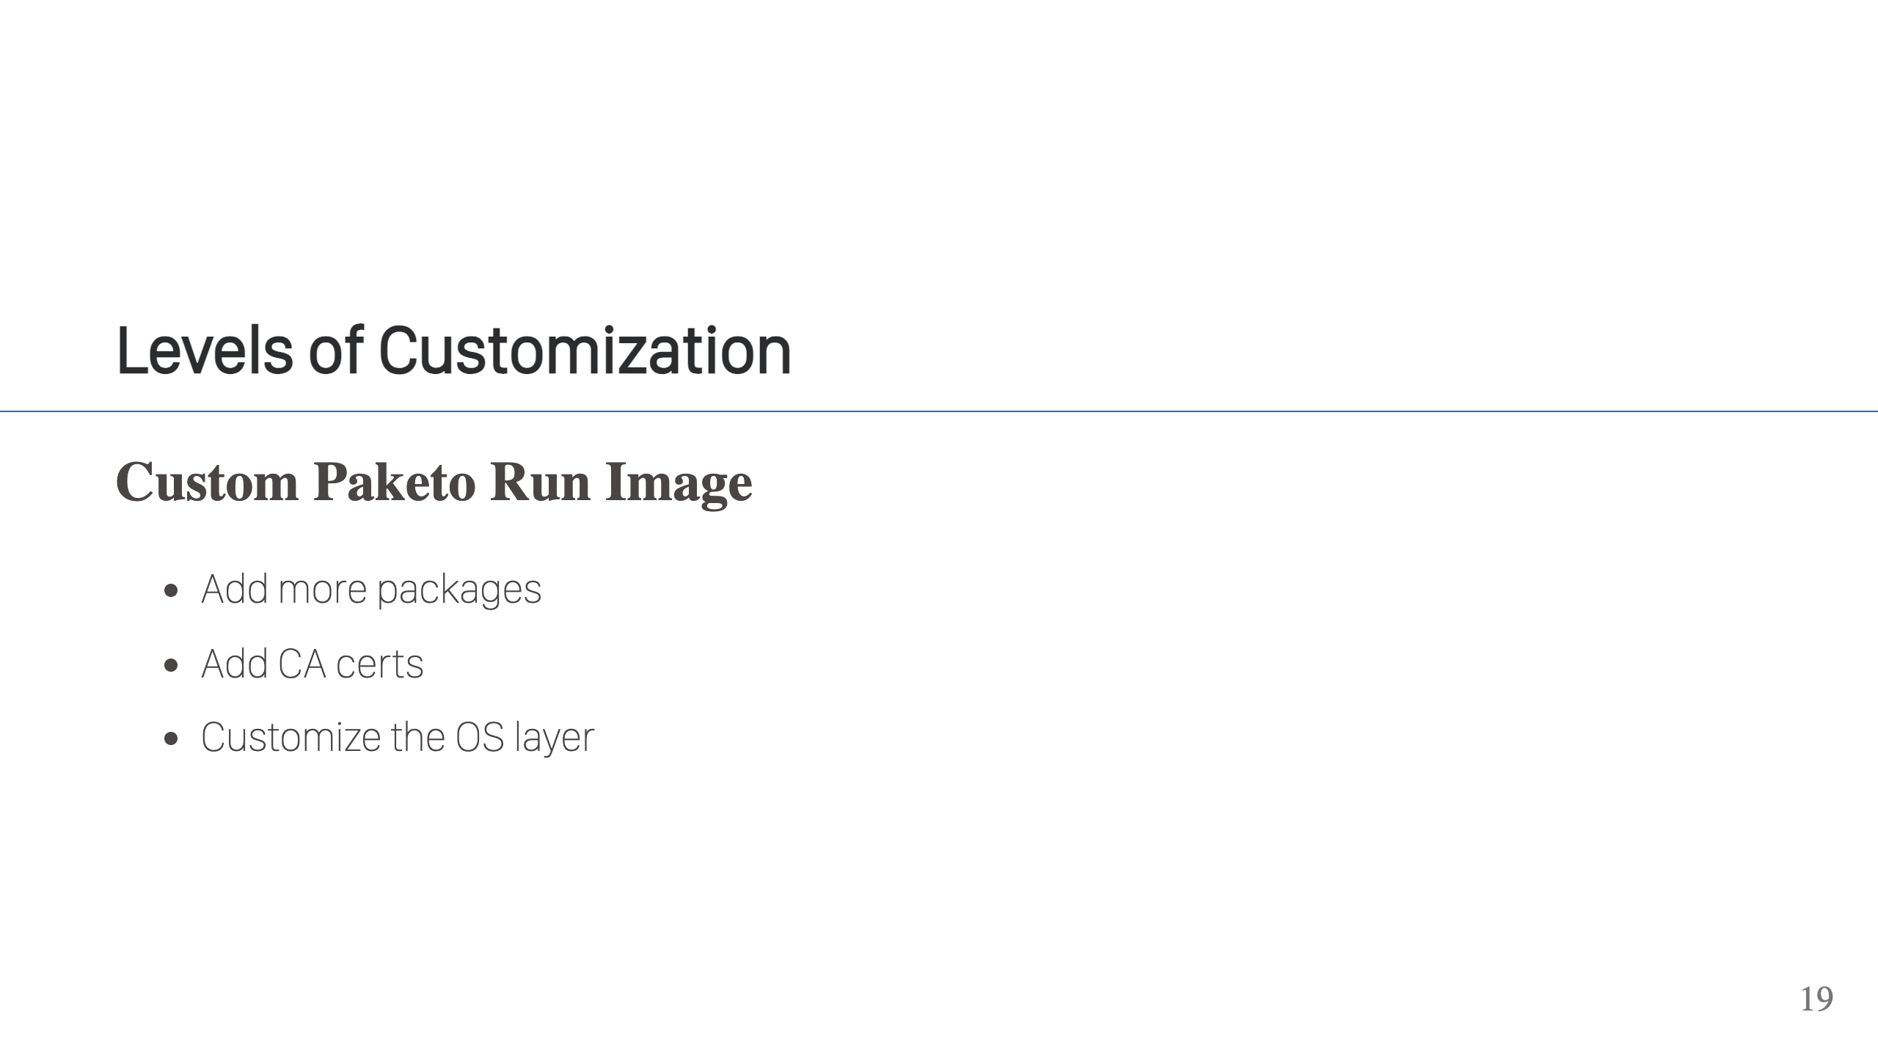
Notes:
The next level is a custom Paketo run image. Let's say you need some additional packages for your apps or you need to add some CA certs, so create a Dockerfile and base from your Paketo run image of choice. You can then customize it, build and publish to a registry. Your users can then use the custom run image directly with the `--run-image` flag when building or you can create a custom builder with the Paketo build image and your custom run image.

Slide 20
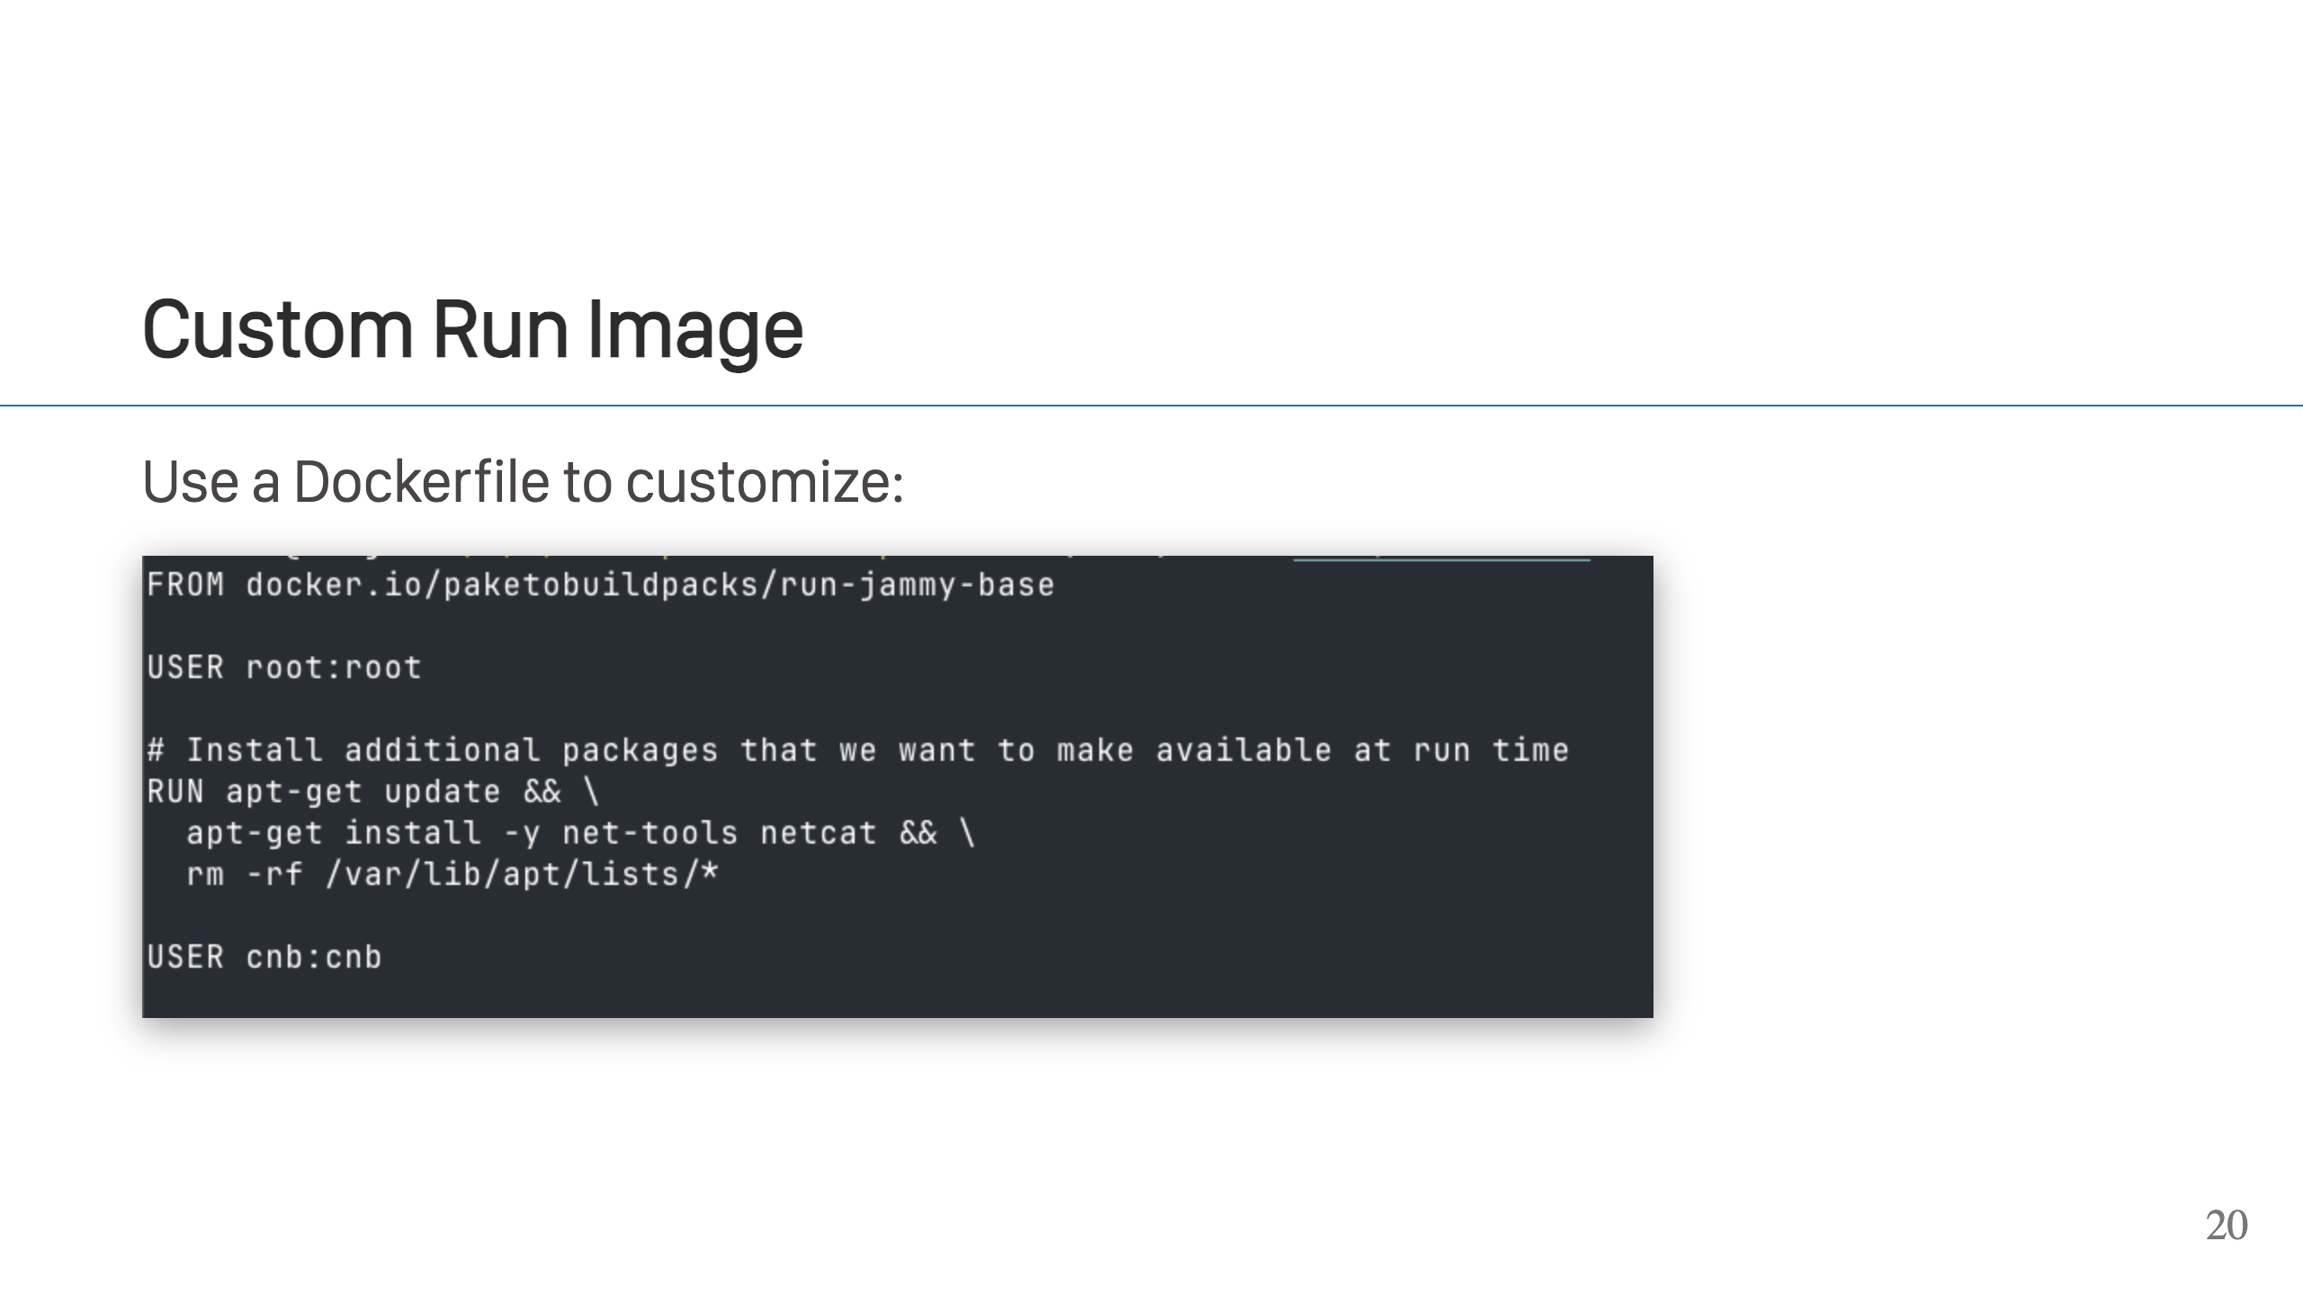
Notes:
This is a basic example, but it shows how you can start from the Paketo base image, make some customizations and produce a new image that can be used easily. Note how we're changing the user. That is required to do activities with elevated privileges because the Paketo base images change to the cnb user.

Slide 21
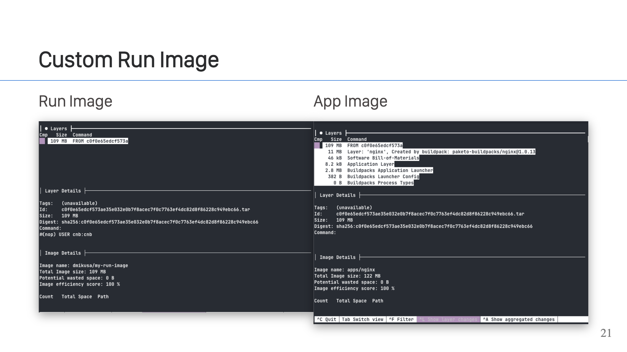
Notes:
After you perform a build, you'll see that your application image now uses the custom run image. Looking at the image on the left, we can see the single layer for our run image. Looking at the image on the right, we can see the layers of our application image, and the first layer, that's the run image. The hash matches in each window, which proves they are using the same layer. Our custom run image.

Slide 22
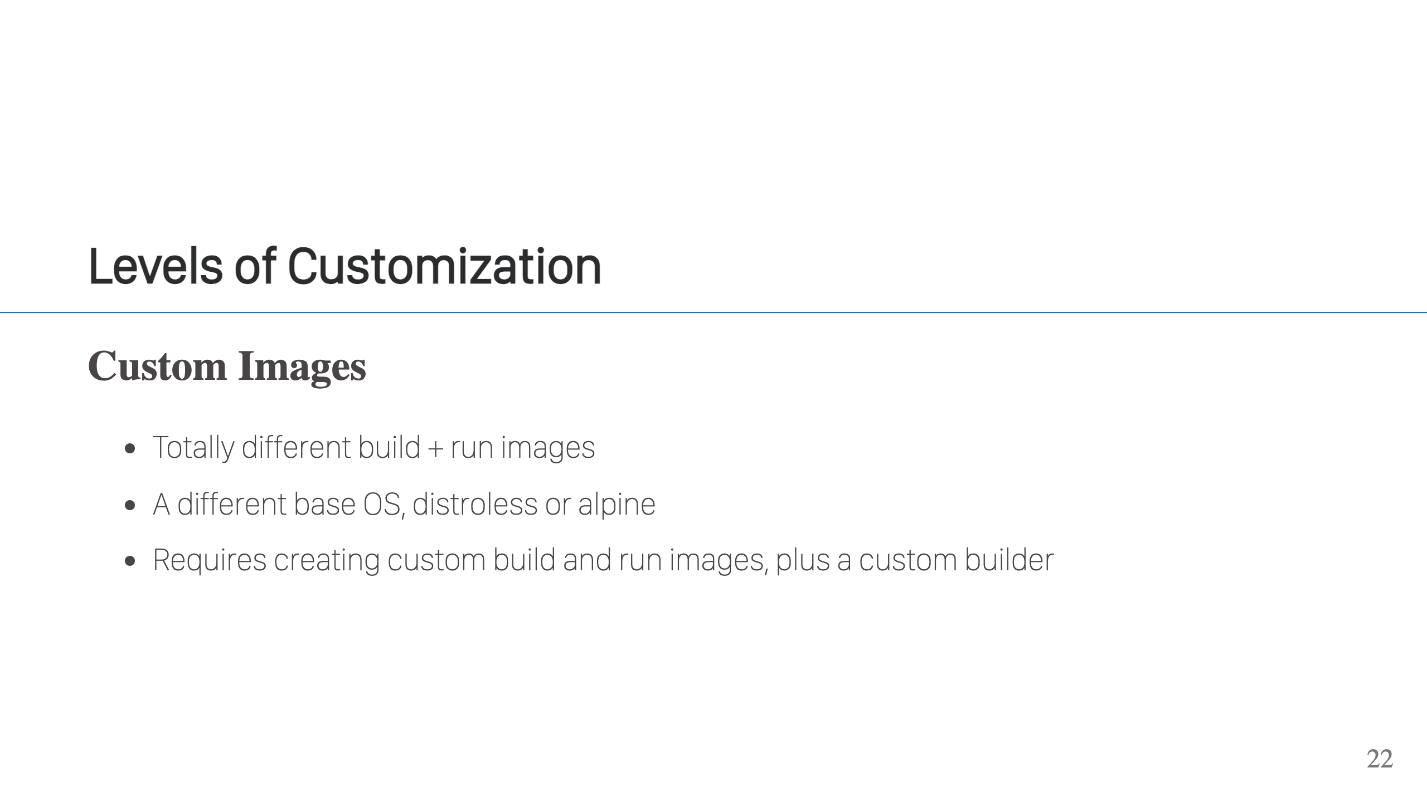
Notes:
Custom build images are a good bit of work. You need to create a custom build image, a custom run image, and a custom builder. Creating the build and run image can be done with Dockerfile, but there is a particular process to it as CNB requires some metadata to be set. Fortunately, there are instructions for creating a [build image](https://buildpacks.io/docs/for-platform-operators/how-to/build-inputs/create-builder/build-base/) and [run image](https://buildpacks.io/docs/for-platform-operators/how-to/build-inputs/create-builder/run-base/). Once you have those, you then create the [builder](https://buildpacks.io/docs/for-platform-operators/how-to/build-inputs/create-builder/builder/). You will also need CI pipelines to repeat the build process & keep up-to-date when there are changes in your upstream image.

Slide 23
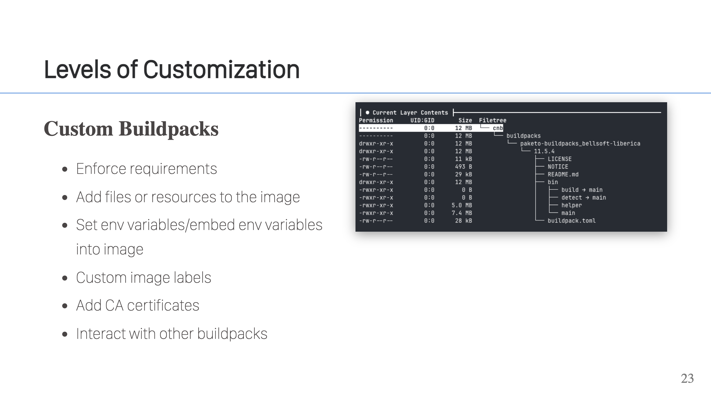
Notes:
Custom buildpacks let you tap into the build process. You can do virtually anything with them. They have the power to break a build, so you can use them to enforce requirements. They can add layers, set env variables, add CA certificates, and interact with other buildpacks through the build plan. A minimal buildpack is simple. You can write one with just a couple bash scripts and a `buildpack.toml` file. If you're doing basic things, that's where I would recommend you start. Buildpacks can do almost anything though, but as you do more the complexity goes up and you may not want to implement them in bash scripts. Bash scripts can't be tested easily, and the complexity of them grows fast. You can write buildpacks in other languages too, although it helps to have one with a buildpacks SDK. There are buildpacks SDKs in Python, Go and Rust. If you notice, these are mostly statically compiled languages. That is because it's easier to ship buildpacks that way. If you use Python, or another language that requires a runtime, then your buildpacks will only run on a base image that includes a runtime for that language. Static binaries don't need an external runtime, so they are more versatile. You don't absolutely need CI pipelines for publishing your buildpacks, but it's a good idea. Especially, if you're using a language the produces static binaries as those binaries need to be updated whenever the runtime embedded in them needs updating. at any rate, creating buildpacks is a presentation all on its own. If you would like to know more info, feel free to chat with me after.

Slide 24
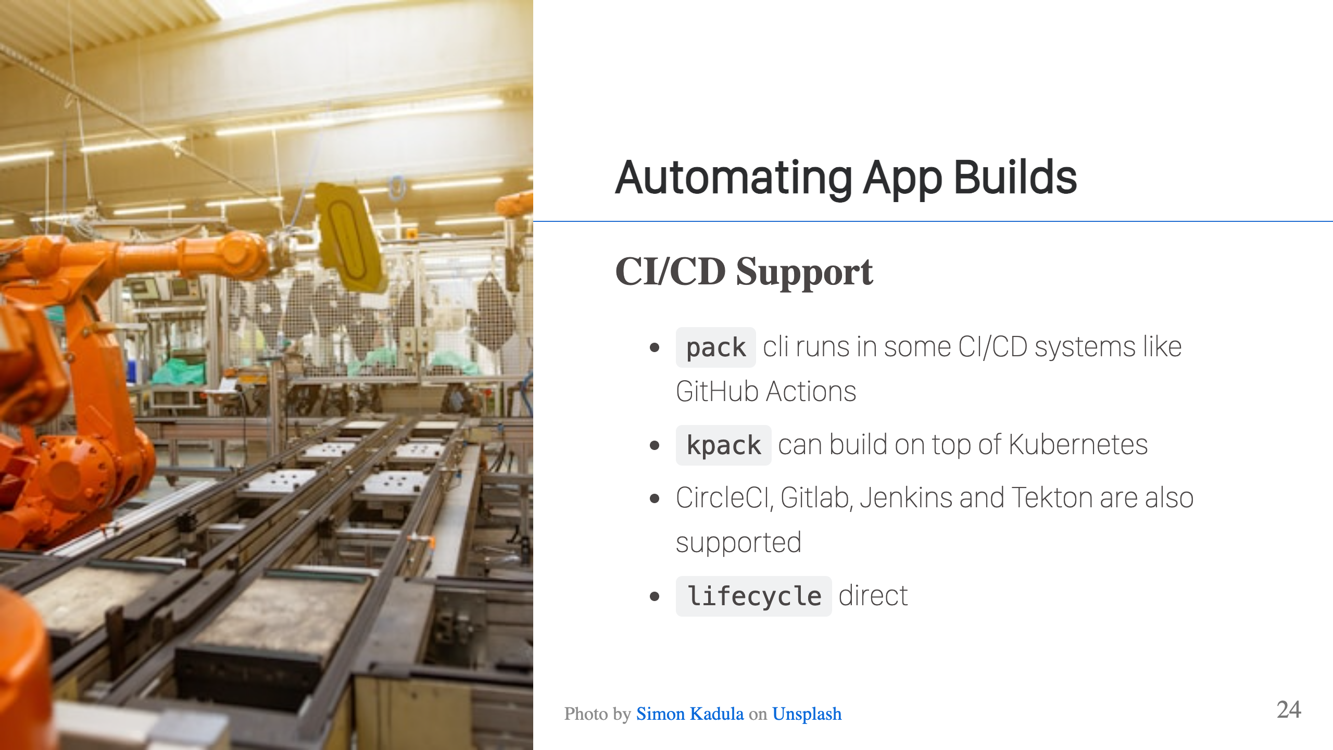
Notes:
For some CI/CD systems, you can just run `pack` directly. For example, GitHub actions have a Docker Daemon available, so you can use pack to do builds. There are some CI/CD systems that run in containers, so don't have a Docker daemon (don't mess with Docker in Docker). These have specific integrations provided by the CNB project, CircleCI, Gitlab, Jenkins, and Tekton fall in this category. Finally, there are some CI/CD systems where you can pick the image in which your job will run. Concourse is like this. In this case, you can set the image for the job to be your builder image. Then you can invoke the lifecycle directly and it will execute the build. This is essentially what pack is doing for you, it creates a container with the builder and runs the lifecycle. In this case, the CI/CD system is creating the container and we manually invoke lifecycle to run the build. The only note with this last approach is that you will need to publish directly to the OCI registry, since there is no daemon. This can actually be faster though, so it's not necessarily a bad thing.

Slide 25
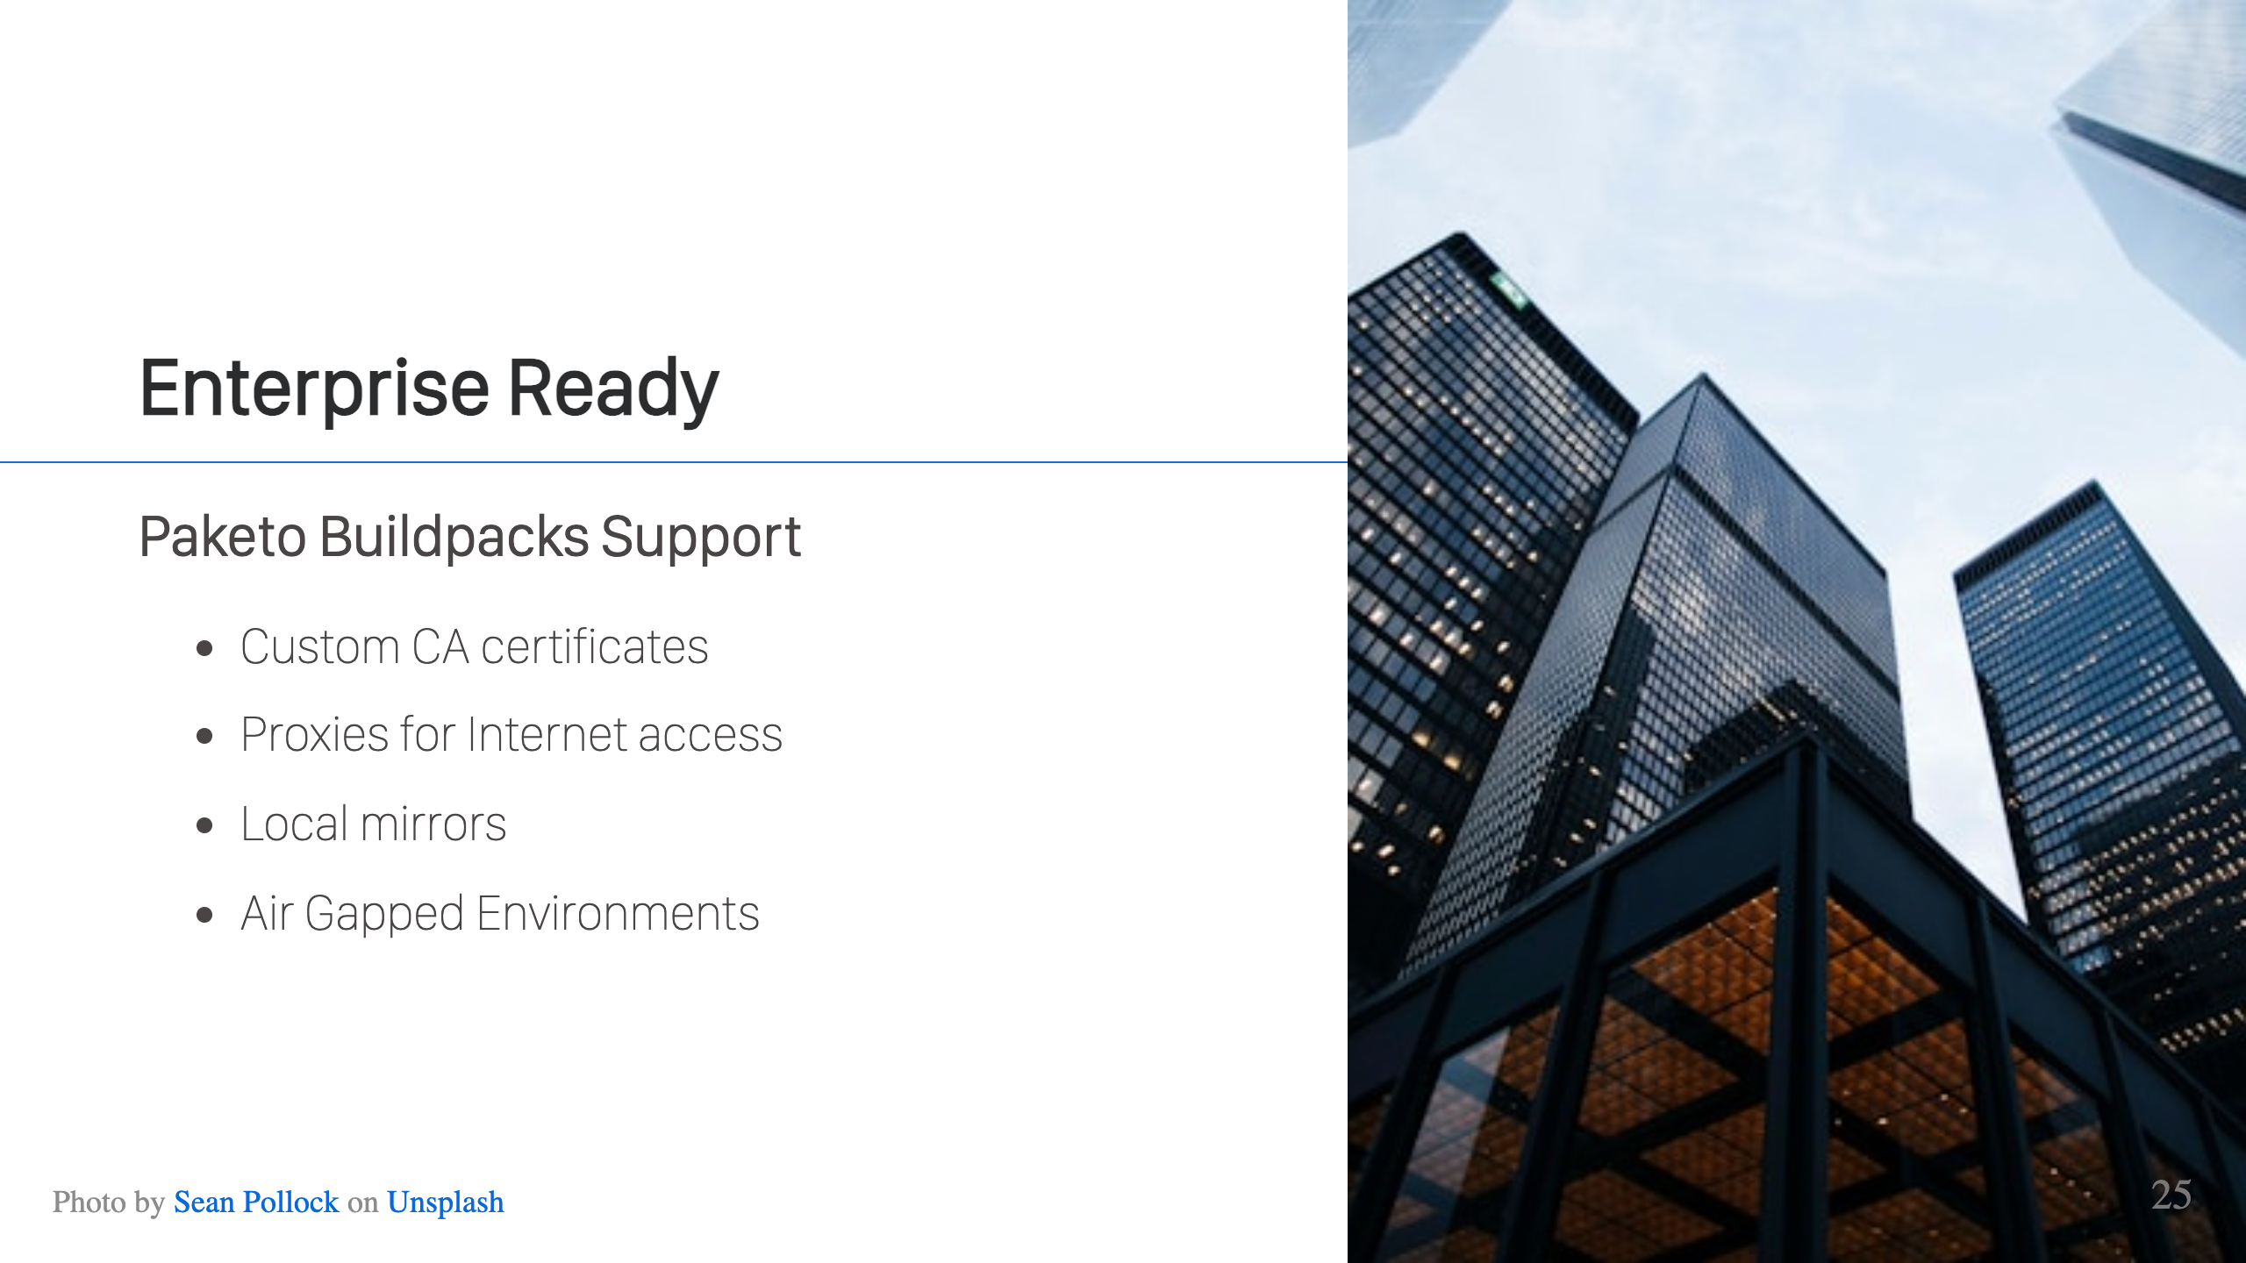
Notes:
Buildpacks are Enterprise ready. Many enterprises need things like proxy support for access to the Internet, or possibly to support a custom CA cert chain because their network intercepts TLS traffic to decrypt it. Paketo Buildpacks supports all of this. Some companies may not allow internet access at all, or certain parts of the company network may be air gapped. In these cases, Paketo has two options for you. You may run a local mirror for dependencies and a local registry for images. Another option that Paketo supports is to bundle dependencies into your buildpack images and use a local registry for images.

Slide 26
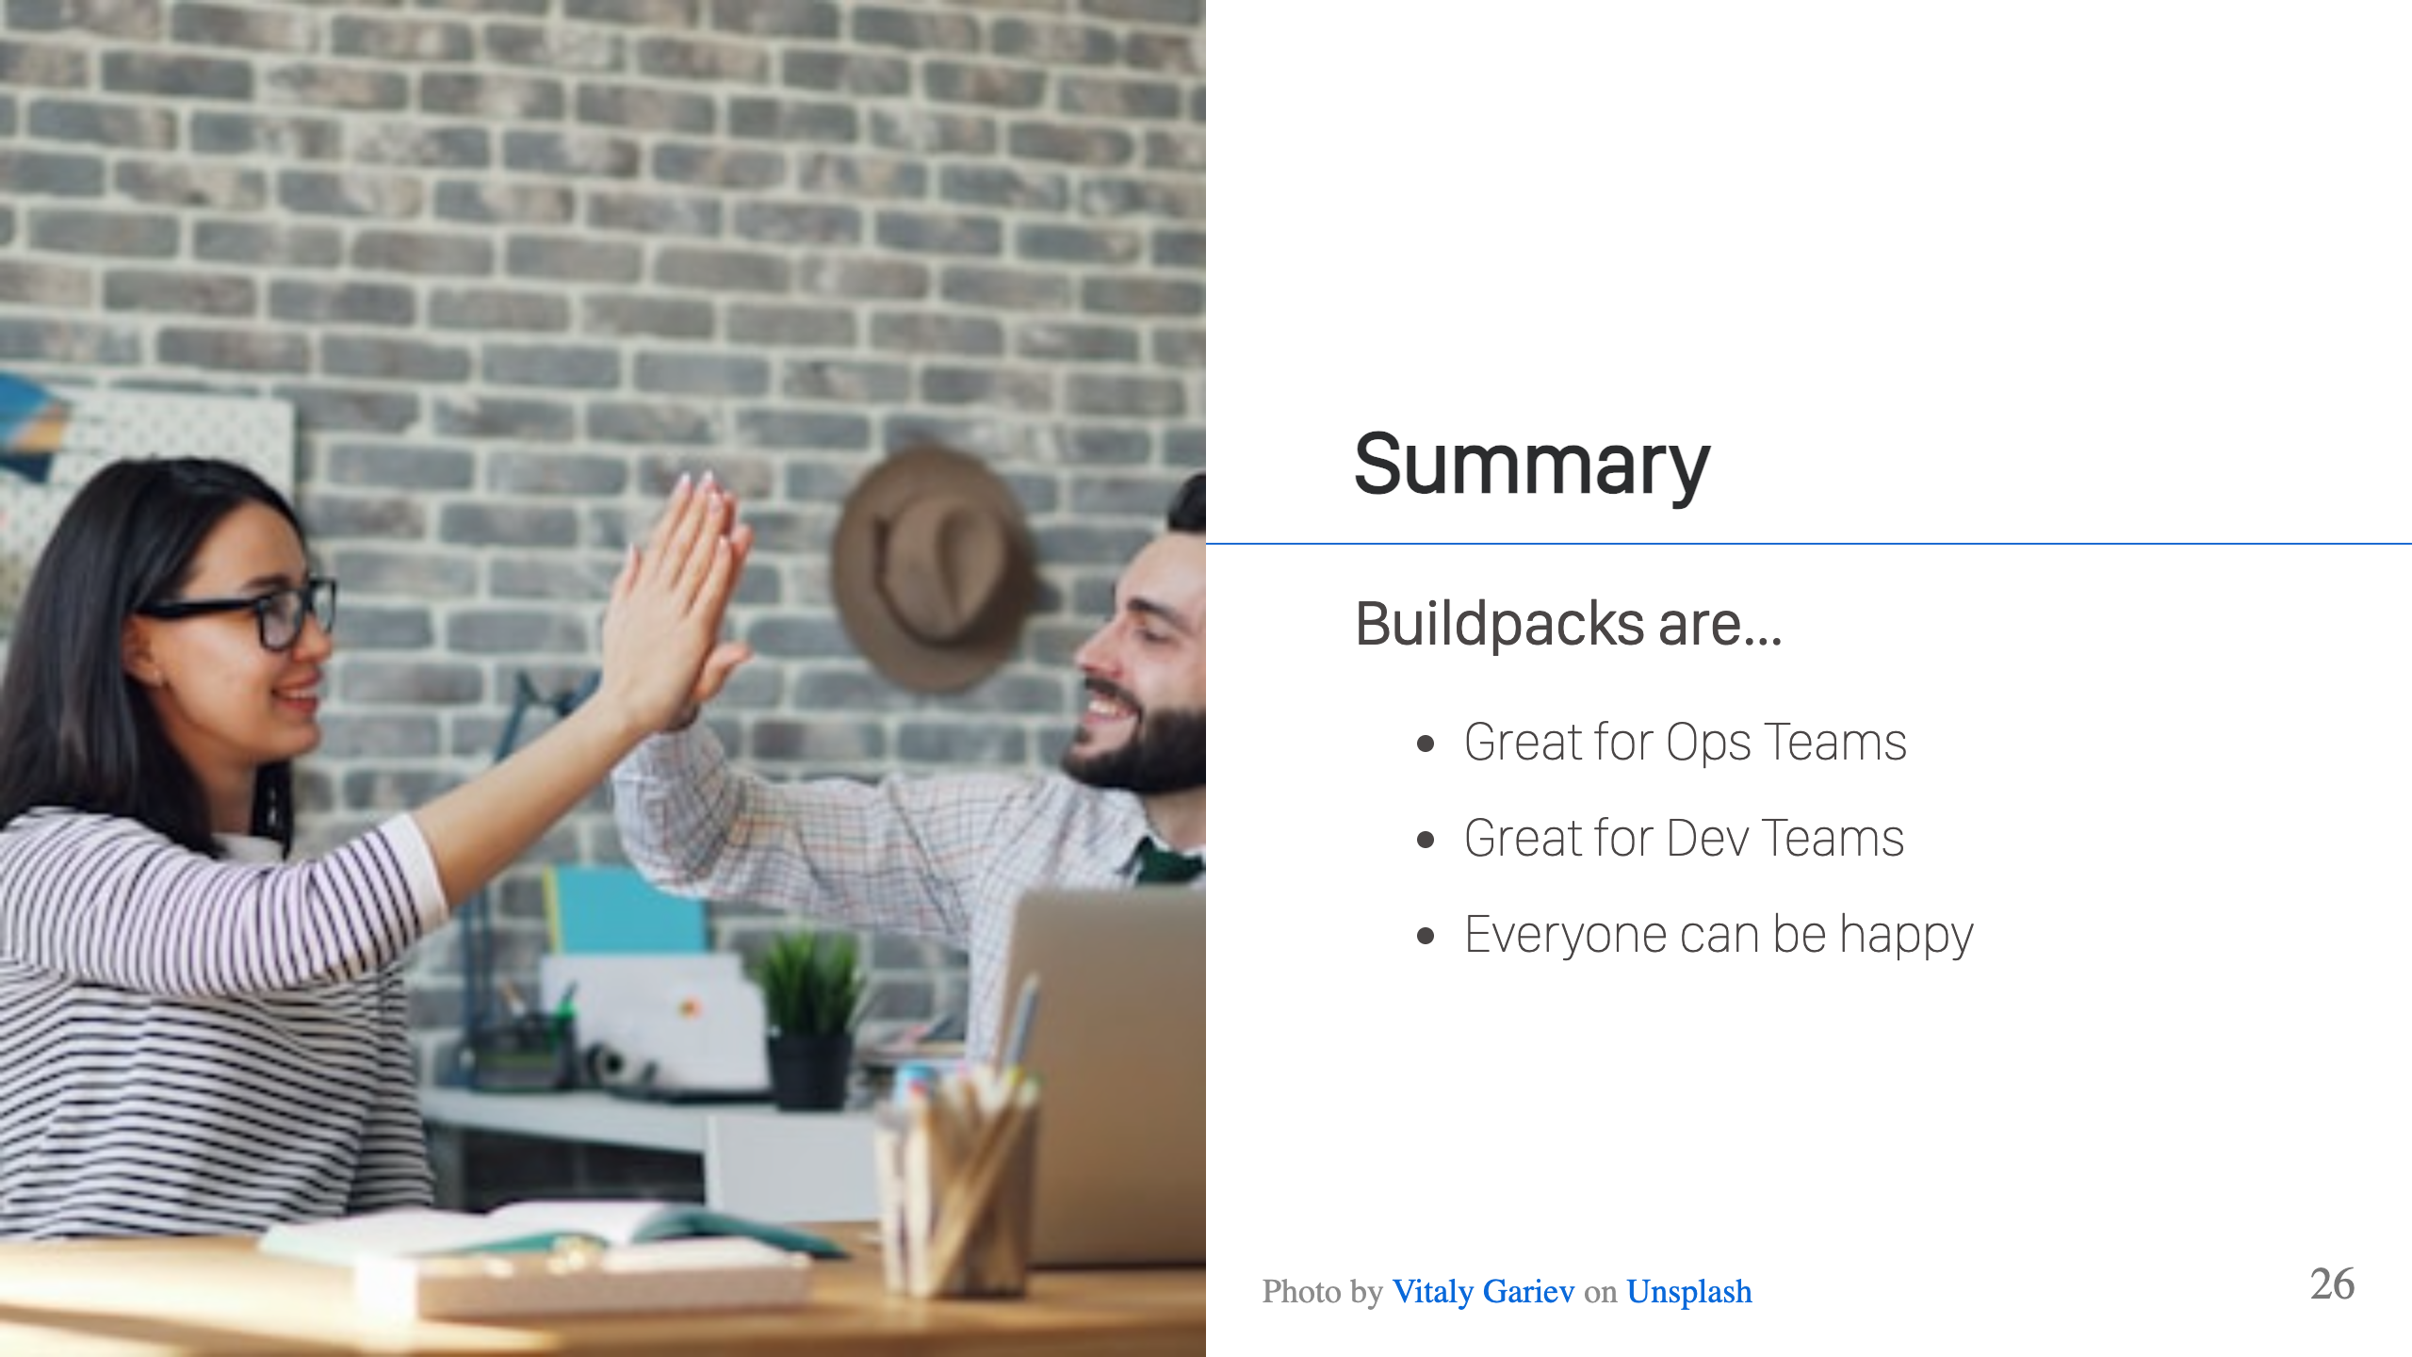
Notes:
Cloud Native Buildpacks offer a powerful solution to a persistent challenges in software organizations: the tension between developer productivity and operational security. Too often, Ops teams find themselves in the difficult position of locking down tools and restricting developer choices to maintain security standards. That causes developers to feel hampered and less productive because of those constraints. Buildpacks break this cycle by giving Ops teams the control they need, standardized builds, comprehensive SBOMs, reproducible images, and efficient patching through rebase, while simultaneously keeping the developer experience simple and friction-free. The result is a genuine win-win, both teams getting want they want. Everyone lives happily ever after.

Slide 27

Notes:
Slides are available at the link above.

Slide 28


