Slide 1
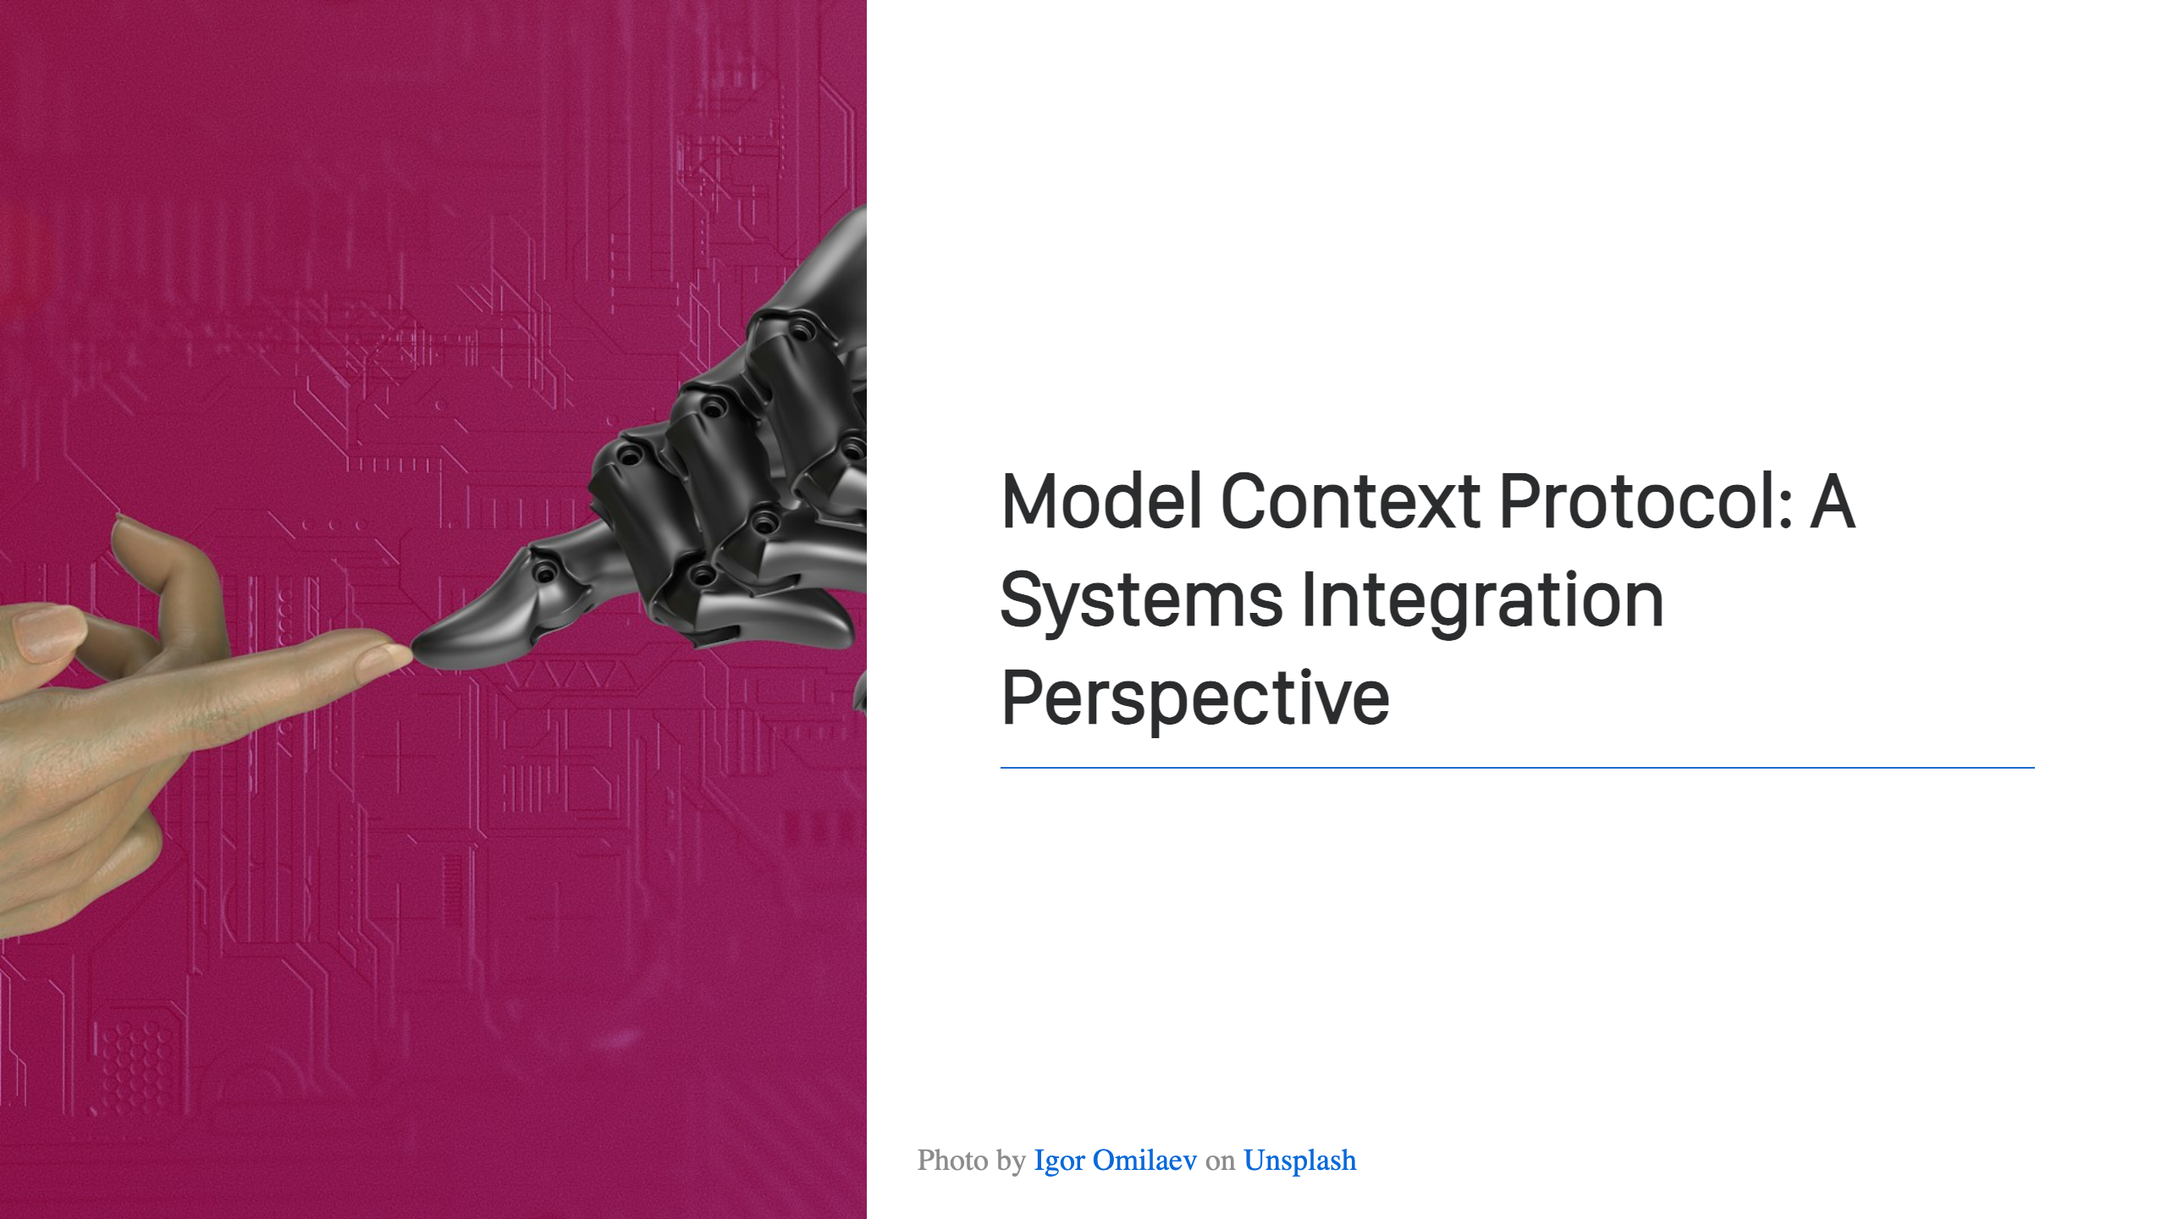
Notes:
Welcome! This is my session on MCP. Let's get started!

Slide 2
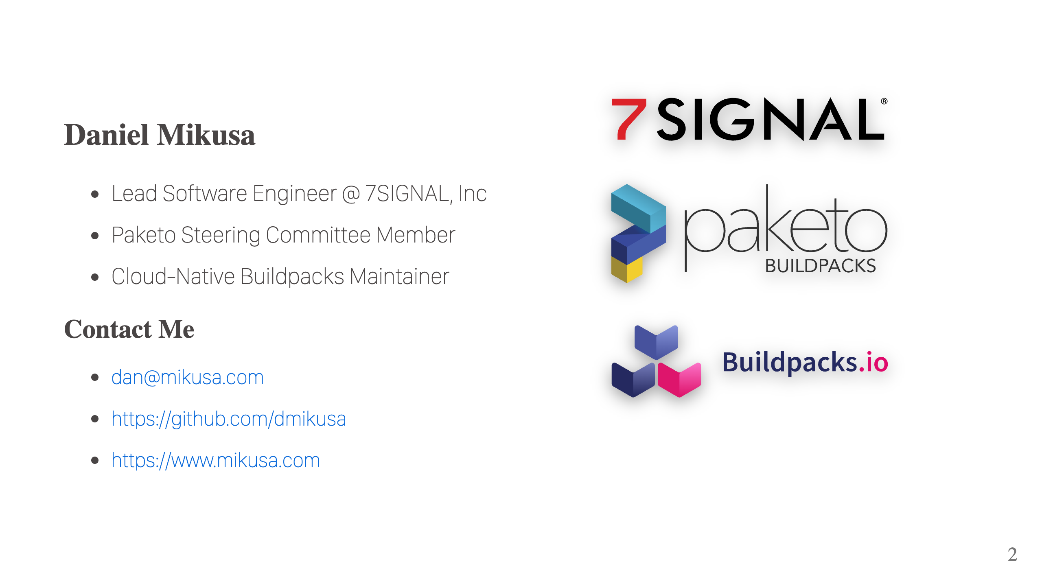
Notes:
Who am I? I work at 7SIGNAL, a leader in WiFi optimization. In a nutshell, we write performance monitoring software that helps make your WiFi awesome. I also help with a couple of OSS projects, Cloud-Native Buildpacks and Paketo Buildpacks. Both, great tools for building your container images. While I'm not covering WiFi or buildpacks in this talk, if you're curious feel free to come chat after the session.

Slide 3
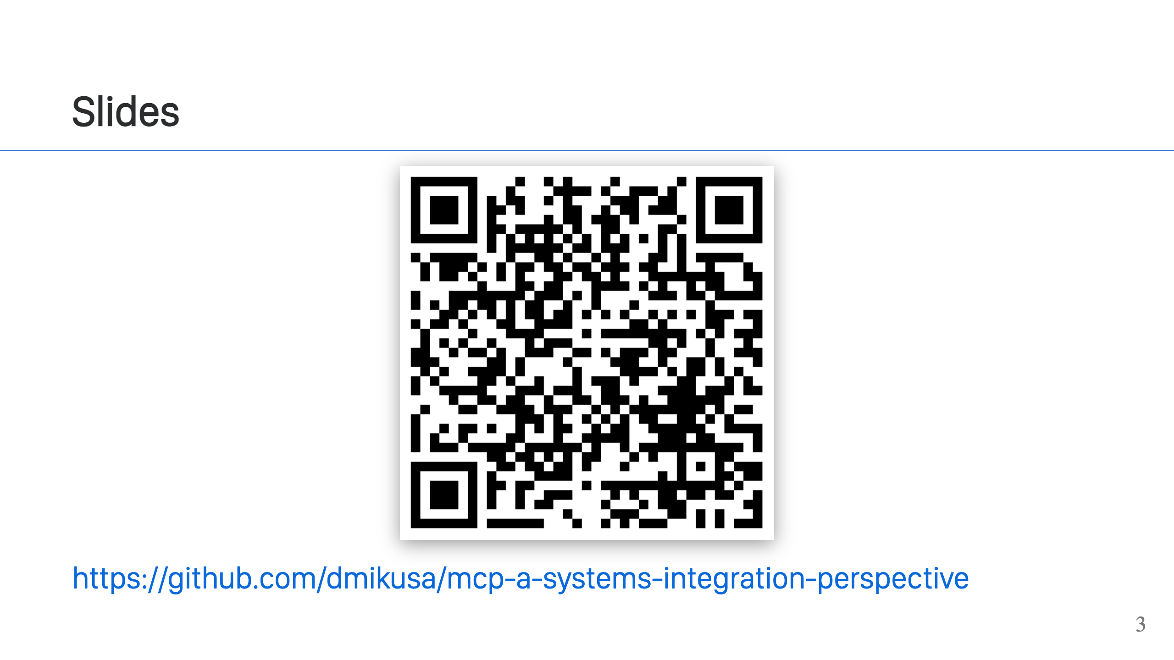
Notes:
So no one has to worry, all of the slides are available online. If you're interested, he's a link.

Slide 4
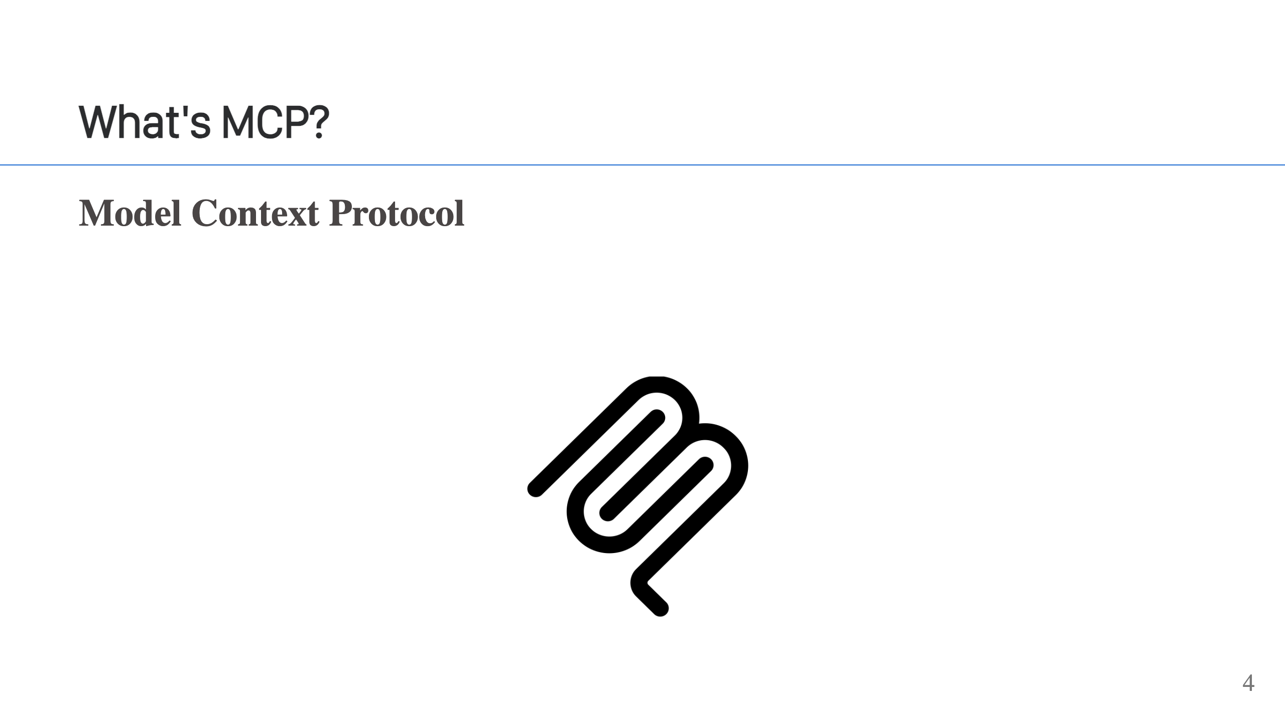
Notes:
Quick Survey: 1. Put your hands up if you've heard of MCP? 2. Keep them up if you've used an MCP server? 3. Keep them up if you've created an MCP server? 4. Keep them up if you're a contributor to the MCP spec? - A standard for connecting AI applications to a separate resource. - Two types of MCP servers, local and remote. - Local is great and has some compelling uses cases, in particular, around giving access to local resources. Like files, access to the shell or other development tools. There are different goals and concerns with a local MCP server and we’re not going to talk about that today. - Remote MCP servers are what you'll see at work. Business deploy things into data centers & runs services, and that's what remote MCP is all about. That’s the focus of today’s talk.

Slide 5
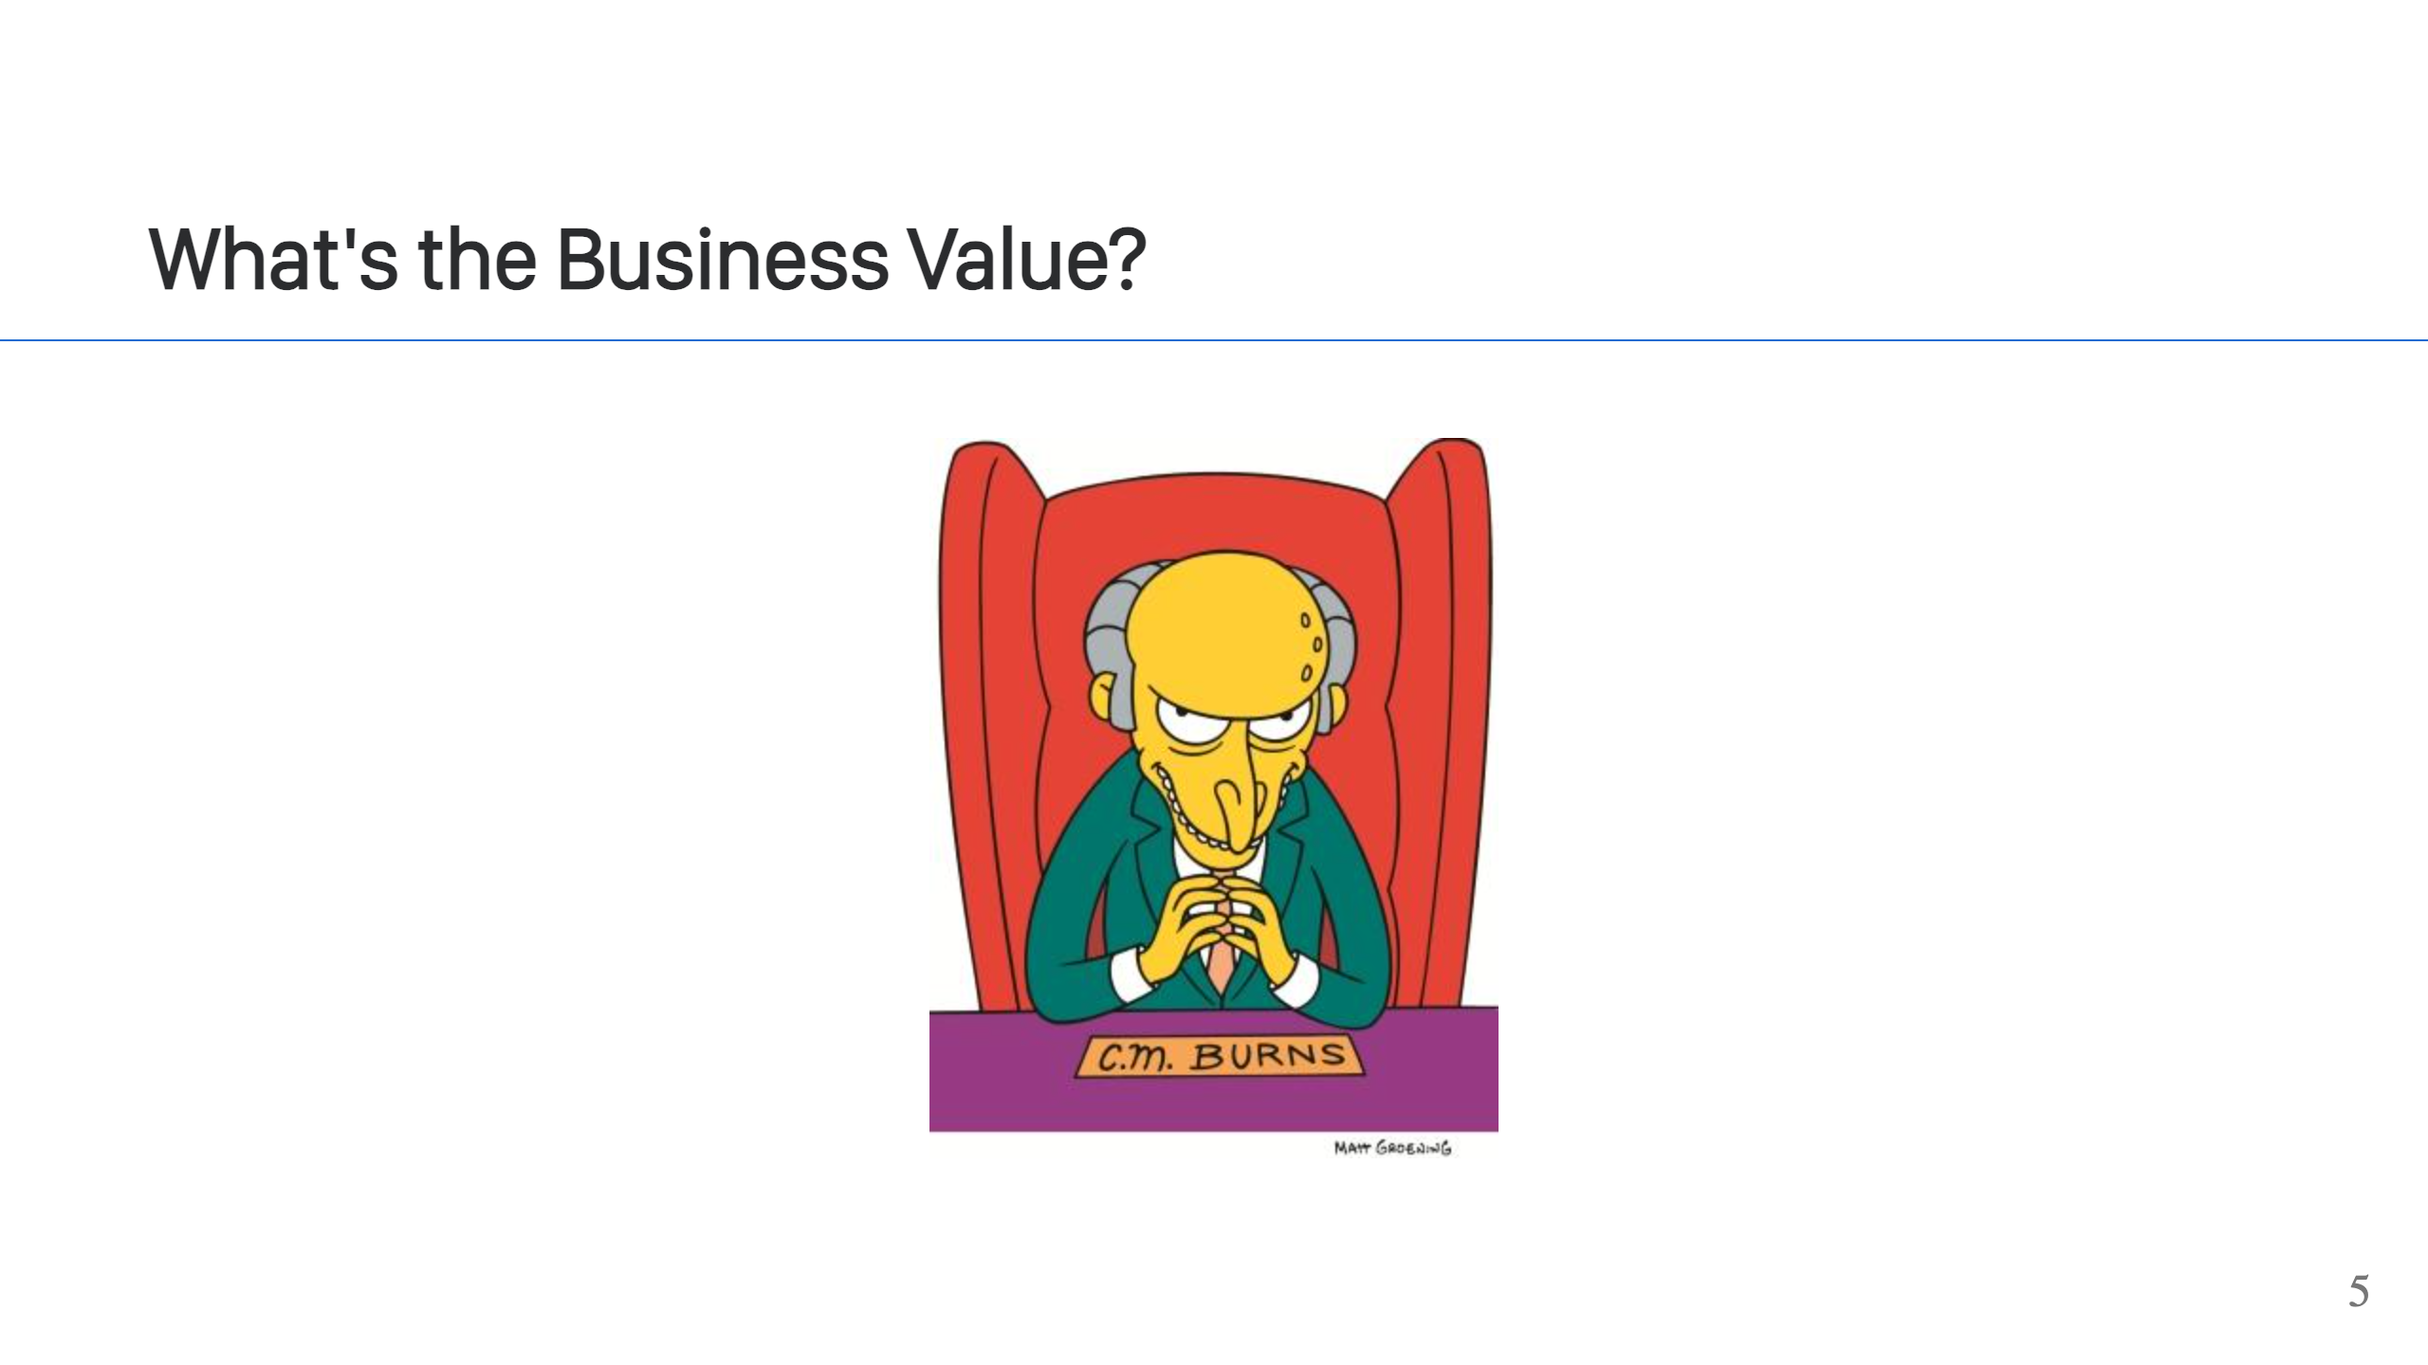
Notes:
- Similar to other APIs, it exposes your data to others, the difference is target. With MCP, our targets are agents & LLMs, like Claude & ChatGPT - The MCP server enables those agents to have access to data not baked into the models - For example, let's say we have a SaaS service that sells widgets. We can expose the widget sales data, and users can then dig through that data using Claude or ChatGPT. "Hey Claude, tell me about the sales for Q4.". - This is powerful because it enables you to move fast. All you need to build is the MCP server to expose the data. You're don't have to build chat bots or agents, and your users will still get all the benefits of having access to your data.

Slide 6
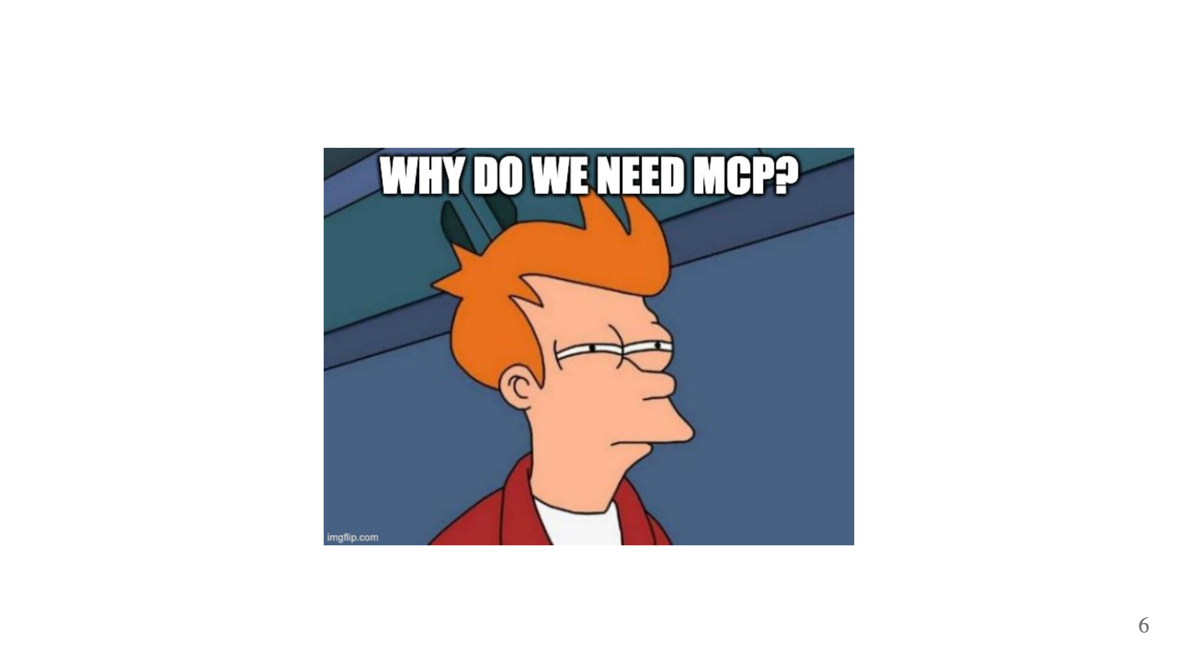
Notes:
Why do we need MCP? 1. Integration with Claude & ChatGPT. Claude & ChatGPT make some really great UIs. They provide a lot of value over and above their models. If you want to integrate with that offering, MCP is the way to do it. 2. Helps with context size. A couple early patterns that emerged for interacting with LLMs are context stuffing and RAG, retrieval augmented generation, where you fetch a bunch of stuff you think might be helpful and stuff that into the context with your question to the LLM. This has limits though because you don’t know what the LLM will want or need and the context has a finite size. With MCP, we can flip this around. We tell the LLM what’s available and it can tell us what would be helpful. Only sending what’s requested by the LLM reduces context size. This isn't a panacea though, if you return a huge chunk of JSON from an MCP tool call, you'll just as quickly blow up the context. 3. Discoverability. Again, we don't know what the LLMs going to want, so things need to be flexible. We need metadata that allows the LLM to discover what's available and to select what it wants. For example, we register the MCP server with an LLM, and when it connects the LLM is provided metadata that tells it there is information available about books, authors, and categories. We may then ask the LLM a question about those things, and the LLM will request the data it needs to answer your question. That could be fetching a specific book to give you a summary, or fetching all of the books in a specific category to help you find a new books you'd like. 4. MCP is a specification, so you get better interoperability than you otherwise would. Remember how I mentioned above that MCP is the way to integrate with Claude and ChatGPT and other services. This is because its a standard. Before MCP, you could integrate with these services but each had their own way of doing it. With MCP, you implement it one time and can connect to multiple services. I will say, take this with a grain of salt though, at least at this point in time, because while there is a specification not every server or client implements the full specification. The specification is also evolving rapidly! There's a [compatibility list available](https://modelcontextprotocol.info/docs/clients/).

Slide 7
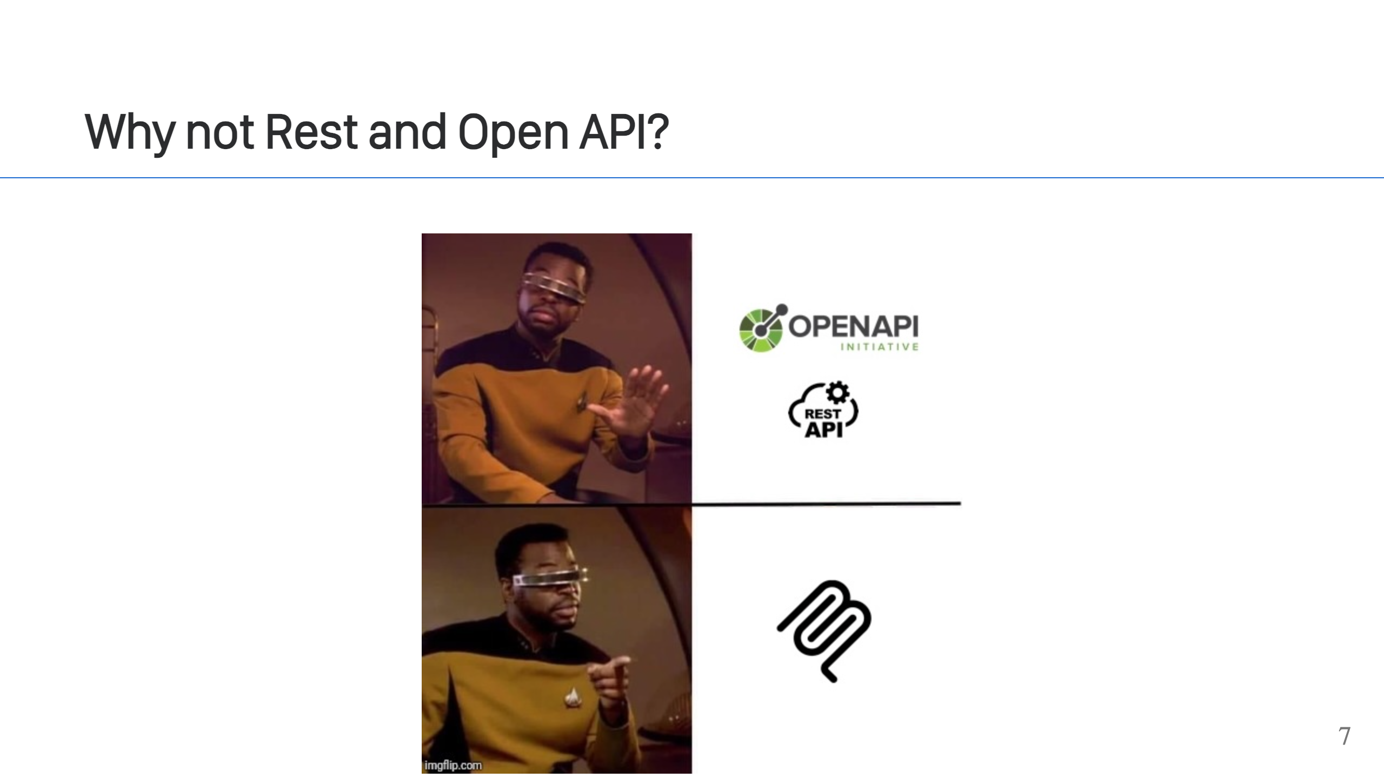
Notes:
Let's review the important properties of MCP & compare them. 1. Claude/ChatGPT support. No, not natively. 2. Reduce Context Size. Both. 3. Discoverability. Both. 4. A Specification. Both. 5. Different audiences. There are good reasons to have separate APIs. You've likely built your REST/OpenAPI endpoints with certain targets in mind (humans, UIs, apps, etc...), but since LLMs are new, it's possible they were not included in the design and exposing an MCP service allows you to adjust your API to perhaps fit better for the LLM target. Possible, but would require two Open API specs. At that point, you may as well just use MCP. As you can see, there is some overlap. The big win for MCP is compatibility with agents, especially if you're trying to integrate with Claude & ChatGPT. You are simply limited by the integrations they support. If you have a custom agent. You might be able to get away with using a REST api, since you're coding the agent. But if you're using an agent library, like AWS AgentCore for example, you again are limited to what's supported, which is very likely to be MCP.

Slide 8
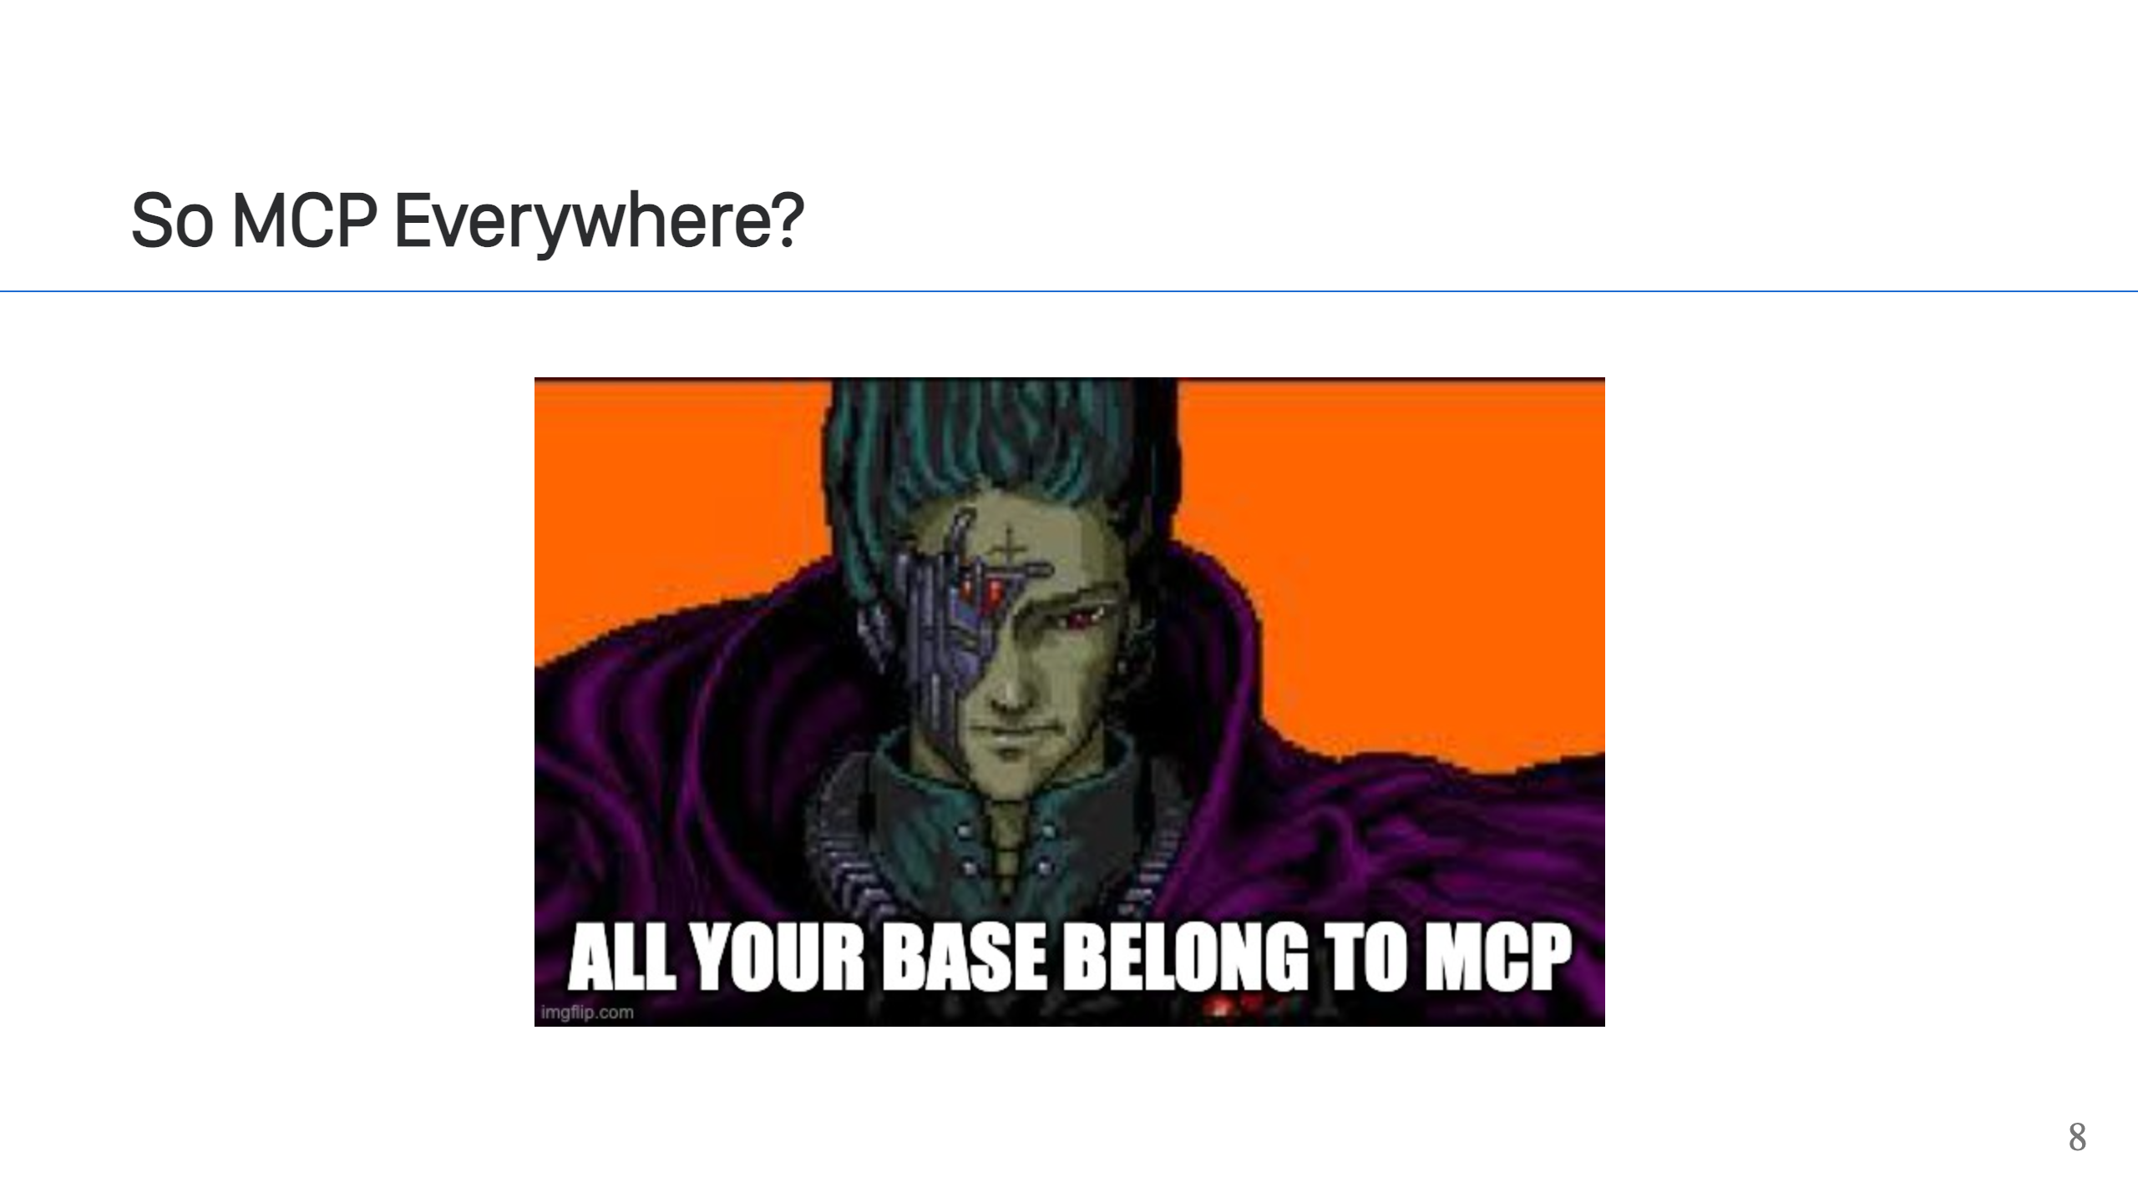
Notes:
Do you replace your REST/OpenAPI services with it? No! It’s not generally useful to say a web or mobile client, but is useful to expose your services to LLMs and Agents though. So, I'm sorry to say, but you need both.

Slide 9
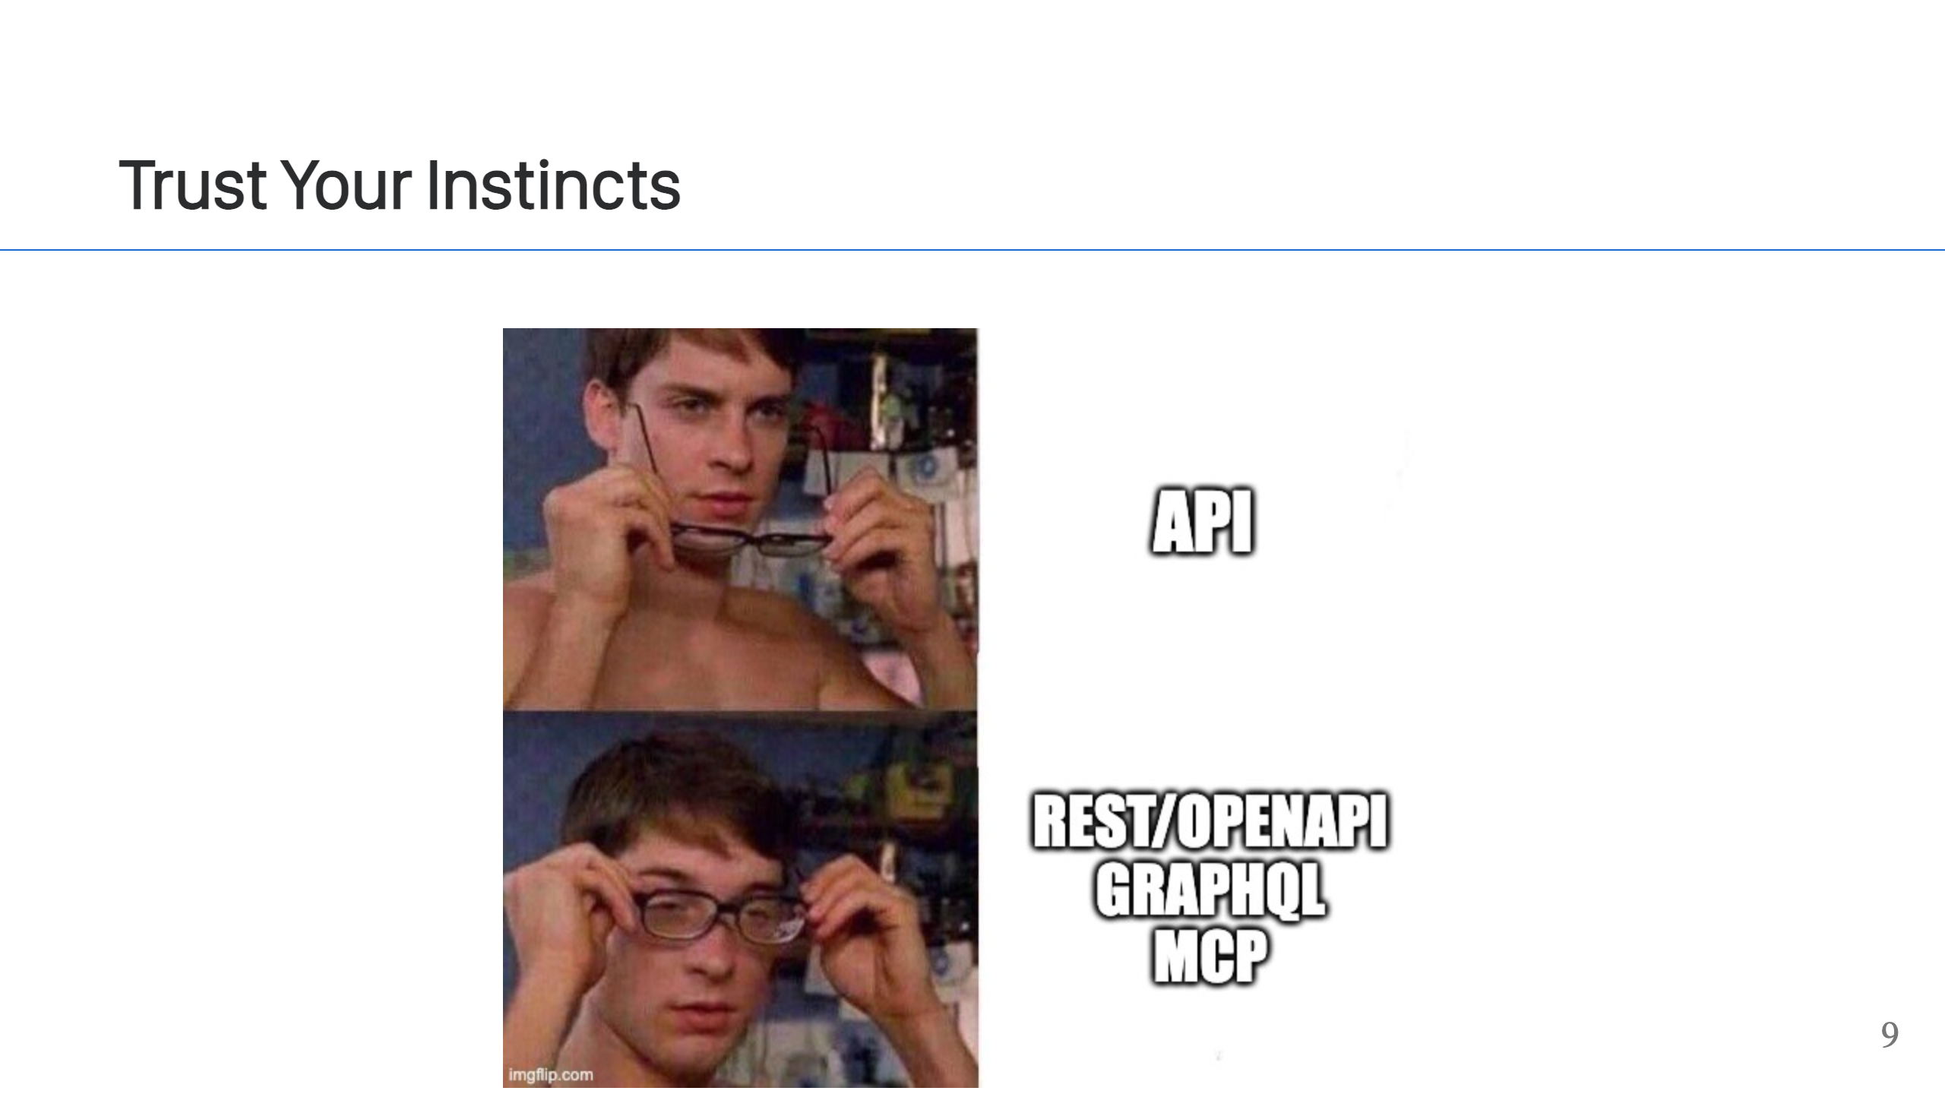
Notes:
This is not a new Problem! As API designers, we have to support may different clients, and MCP is no different. Every client has different capabilities and needs. Not one protocol or approach is going to be perfect for all of them. REST is great for a general purpose API, for browser or mobile clients, but other clients might work better with gRPC or GraphQL or MQTT. You're just building different interfaces for different clients, and MCP is the interface to use for integrating with LLMs and Agents.

Slide 10
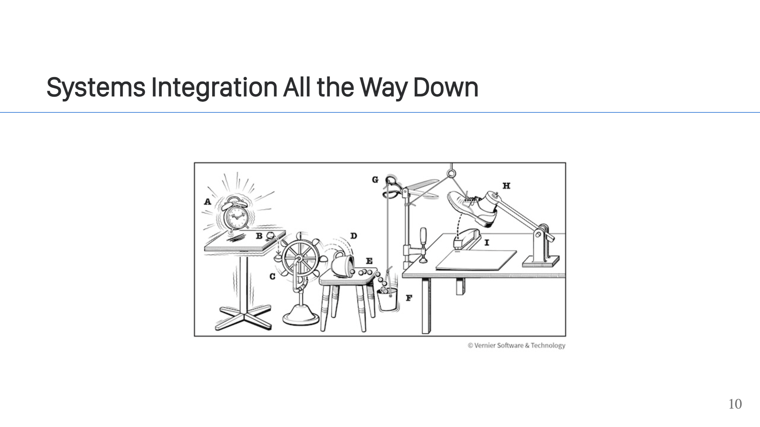
Notes:
This brings us to the title of this talk. These are just systems integration challenges. This is why I feel that, at it's core, remote MCP is really just a systems integration problem. It's just one more client to support, one more client to integrate with your existing systems.

Slide 11
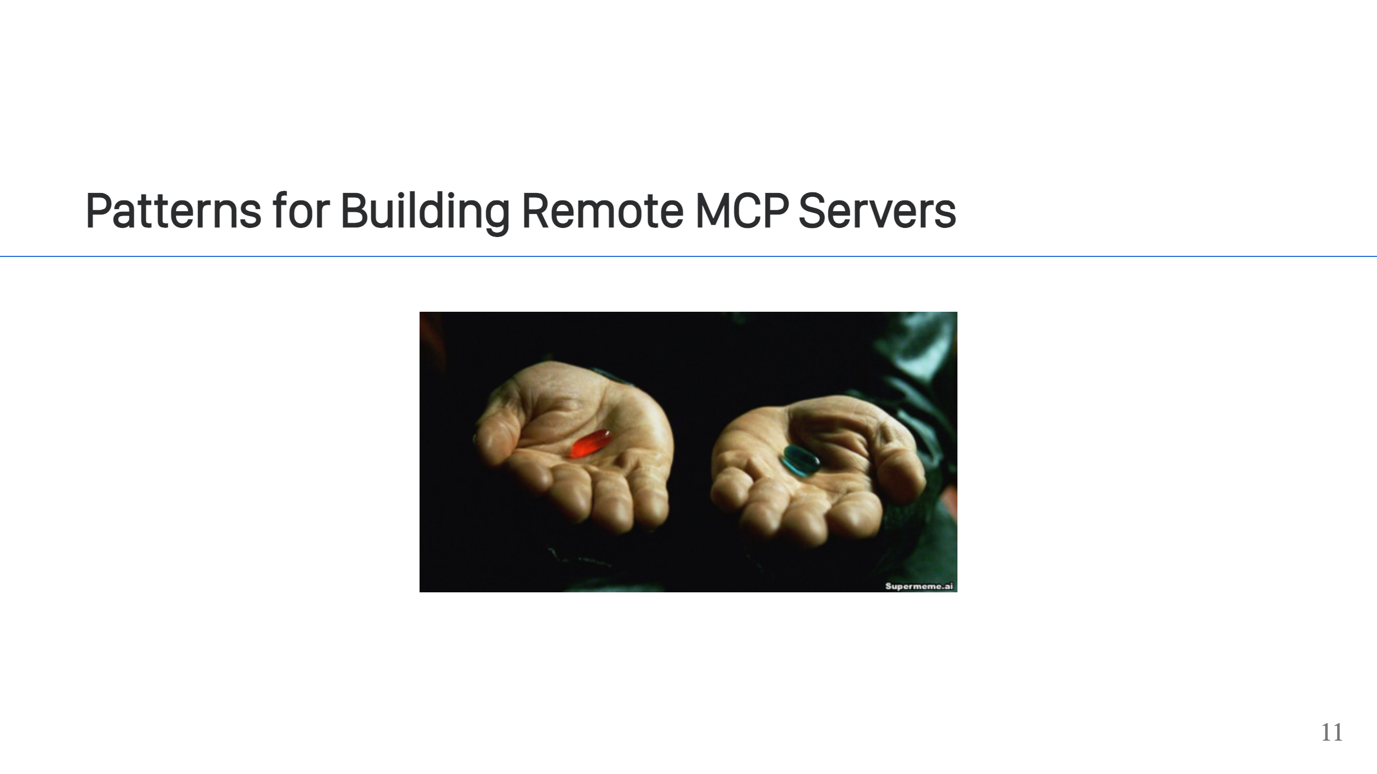
Notes:
When building your remote MCP server, there are two strategies. 1. Do you have an existing API? If so, then wrap it for MCP and create a facade. In other words, your MCP server becomes a gateway and it will expose a subset of your API as tool calls, resources, etc... This is such a common pattern, that there are tools to take an OpenAPI spec and turn that into an MCP server with almost no code (eg. FastMCP). This does require that your Open API spec have detail and documentation to work well though, since that is what will be exposed as your MCP metadata. 2. No API? Ok. You *can* have your remote MCP server make calls to a database (or read your Excel files), but think long and hard about doing that. What will you do if you need to support some other client that's not an Agent? MCP won't be a good choice and you'll be stuck. If instead you start by exposing a more general purpose API, like with Rest, JSON, and OpenAPI; then you'll be in a much better position when you eventually get a request to support more clients.

Slide 12
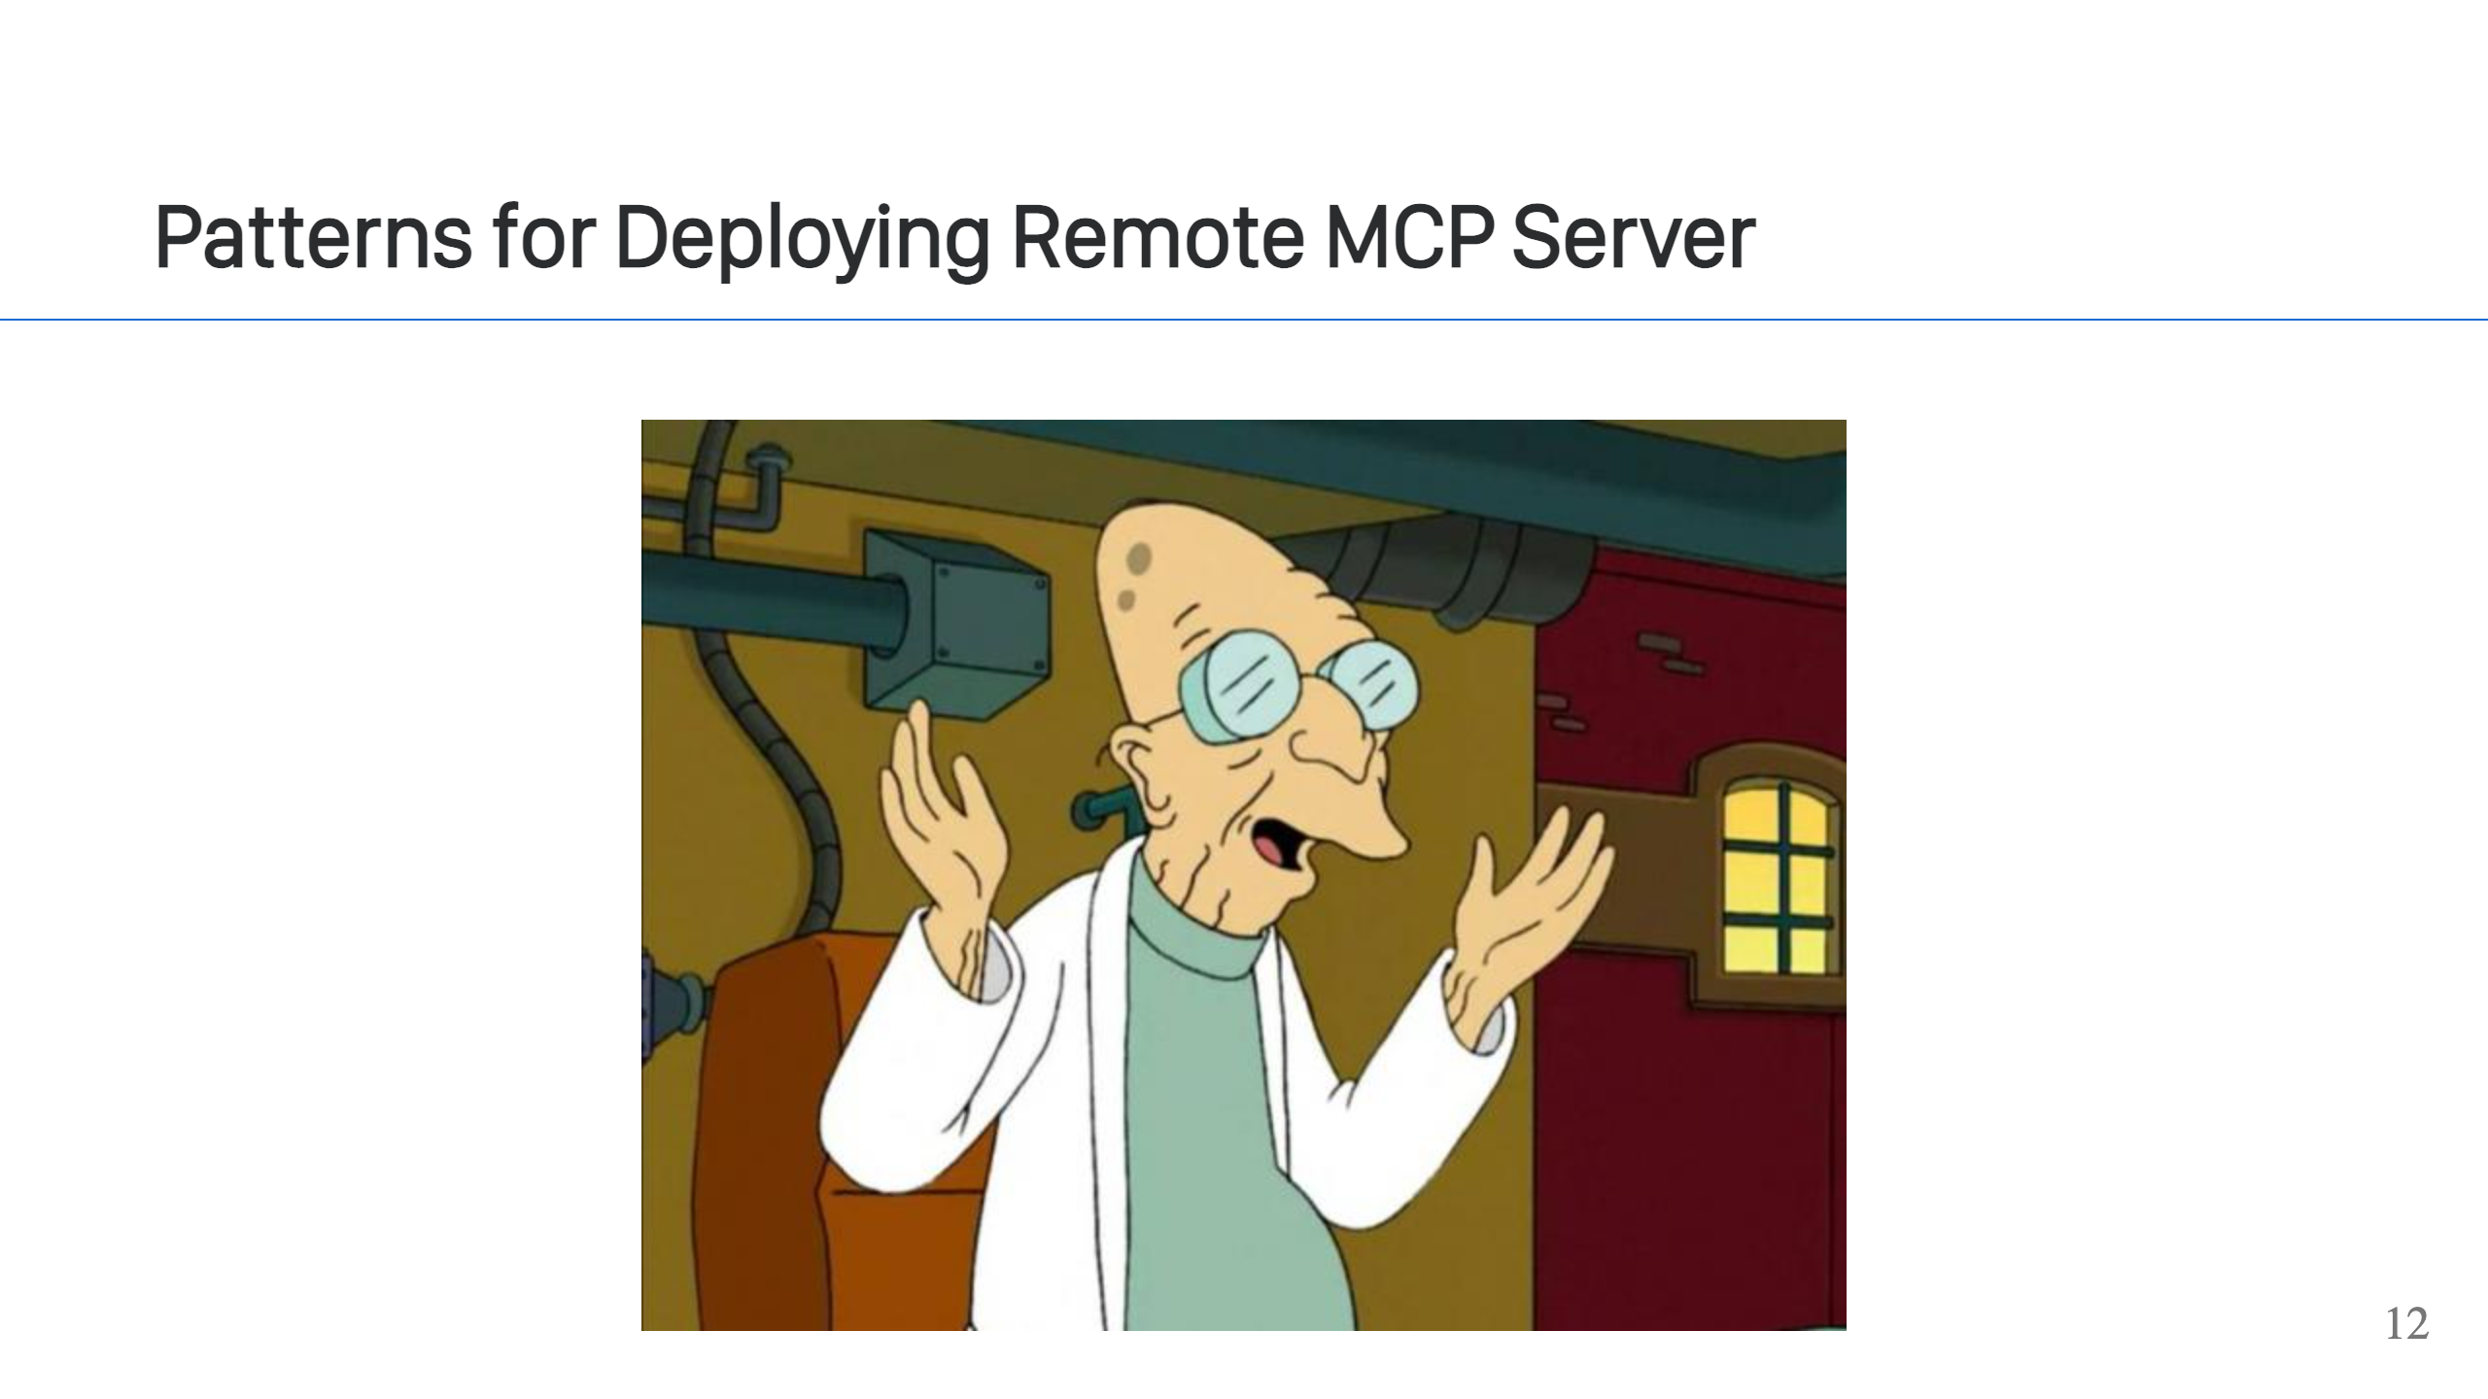
Notes:
Good news! All the deployment patterns you already use will work just fine for MCP. - How are you hosting services now? Kubernetes, AWS ECS, Google Cloud Run, Heroku, ... It's going to work just fine. - Ancillary products like load balancers and application firewalls, they should all work fine too. A remote MCP server is just an API using HTTPS for transport. Even if you use the SSE mode, which I don't recommended at this point in time, it's still just HTTPS. All the normal things you're doing to protect your services will likely work with MCP. - The cloud vendors do have offerings, like AWS AgentCore, where they wil run your MCP services. I don't see the value though. If you have an existing playbook for how you deploy HTTP-based services, stick with that. Using these MCP-specific services is just going to unnecessarily tie you to that vendor. Not to mention, at the time I write this, these are all new offerings. If you do decide to use these services, you will be subject the growing pains as the vendor evolves their offering (downtime, functionality limits, things changing in the UI, poor Terraform support, etc...).

Slide 13
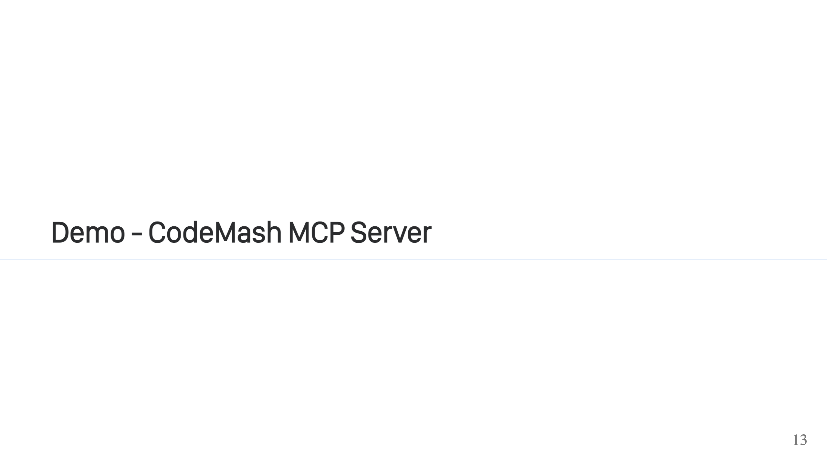
Notes:
- I wrote an MCP server for CodeMash. It has some tool calls which expose data about the conference like the speakers and sessions. The target of this MCP server is to be able to use it with Claude & ChatGPT (or other LLMs) to prepare for the conference. - Show demo code - Show integration with Claude Desktop

Slide 14
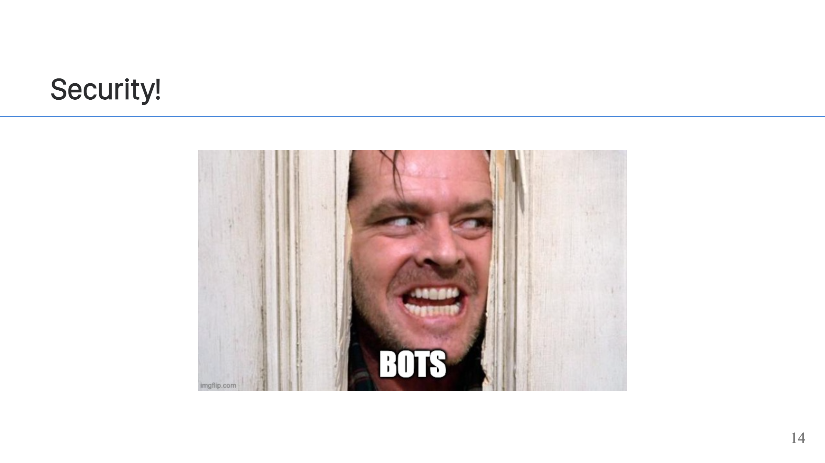
Notes:
You may have noticed what we did not have in the demo is any security. That's because I cheated and the demo doesn't really need it. The information is public info, so it doesn't need to be secured. What if we wanted to allow the MCP server to favorite sessions for the user though? That would require security. - Just like most APIs, most MCP services are going to require security too. - Just like when building an API, for MCP, we are going to reach for OAuth2 & OIDC to secure our service. - Technically, you do not need to use OAuth2. MCP allows for using an API key, but it is strongly recommended that you use OAuth2, just like with an API, it provides the most control for you and the best experience for user.

Slide 15
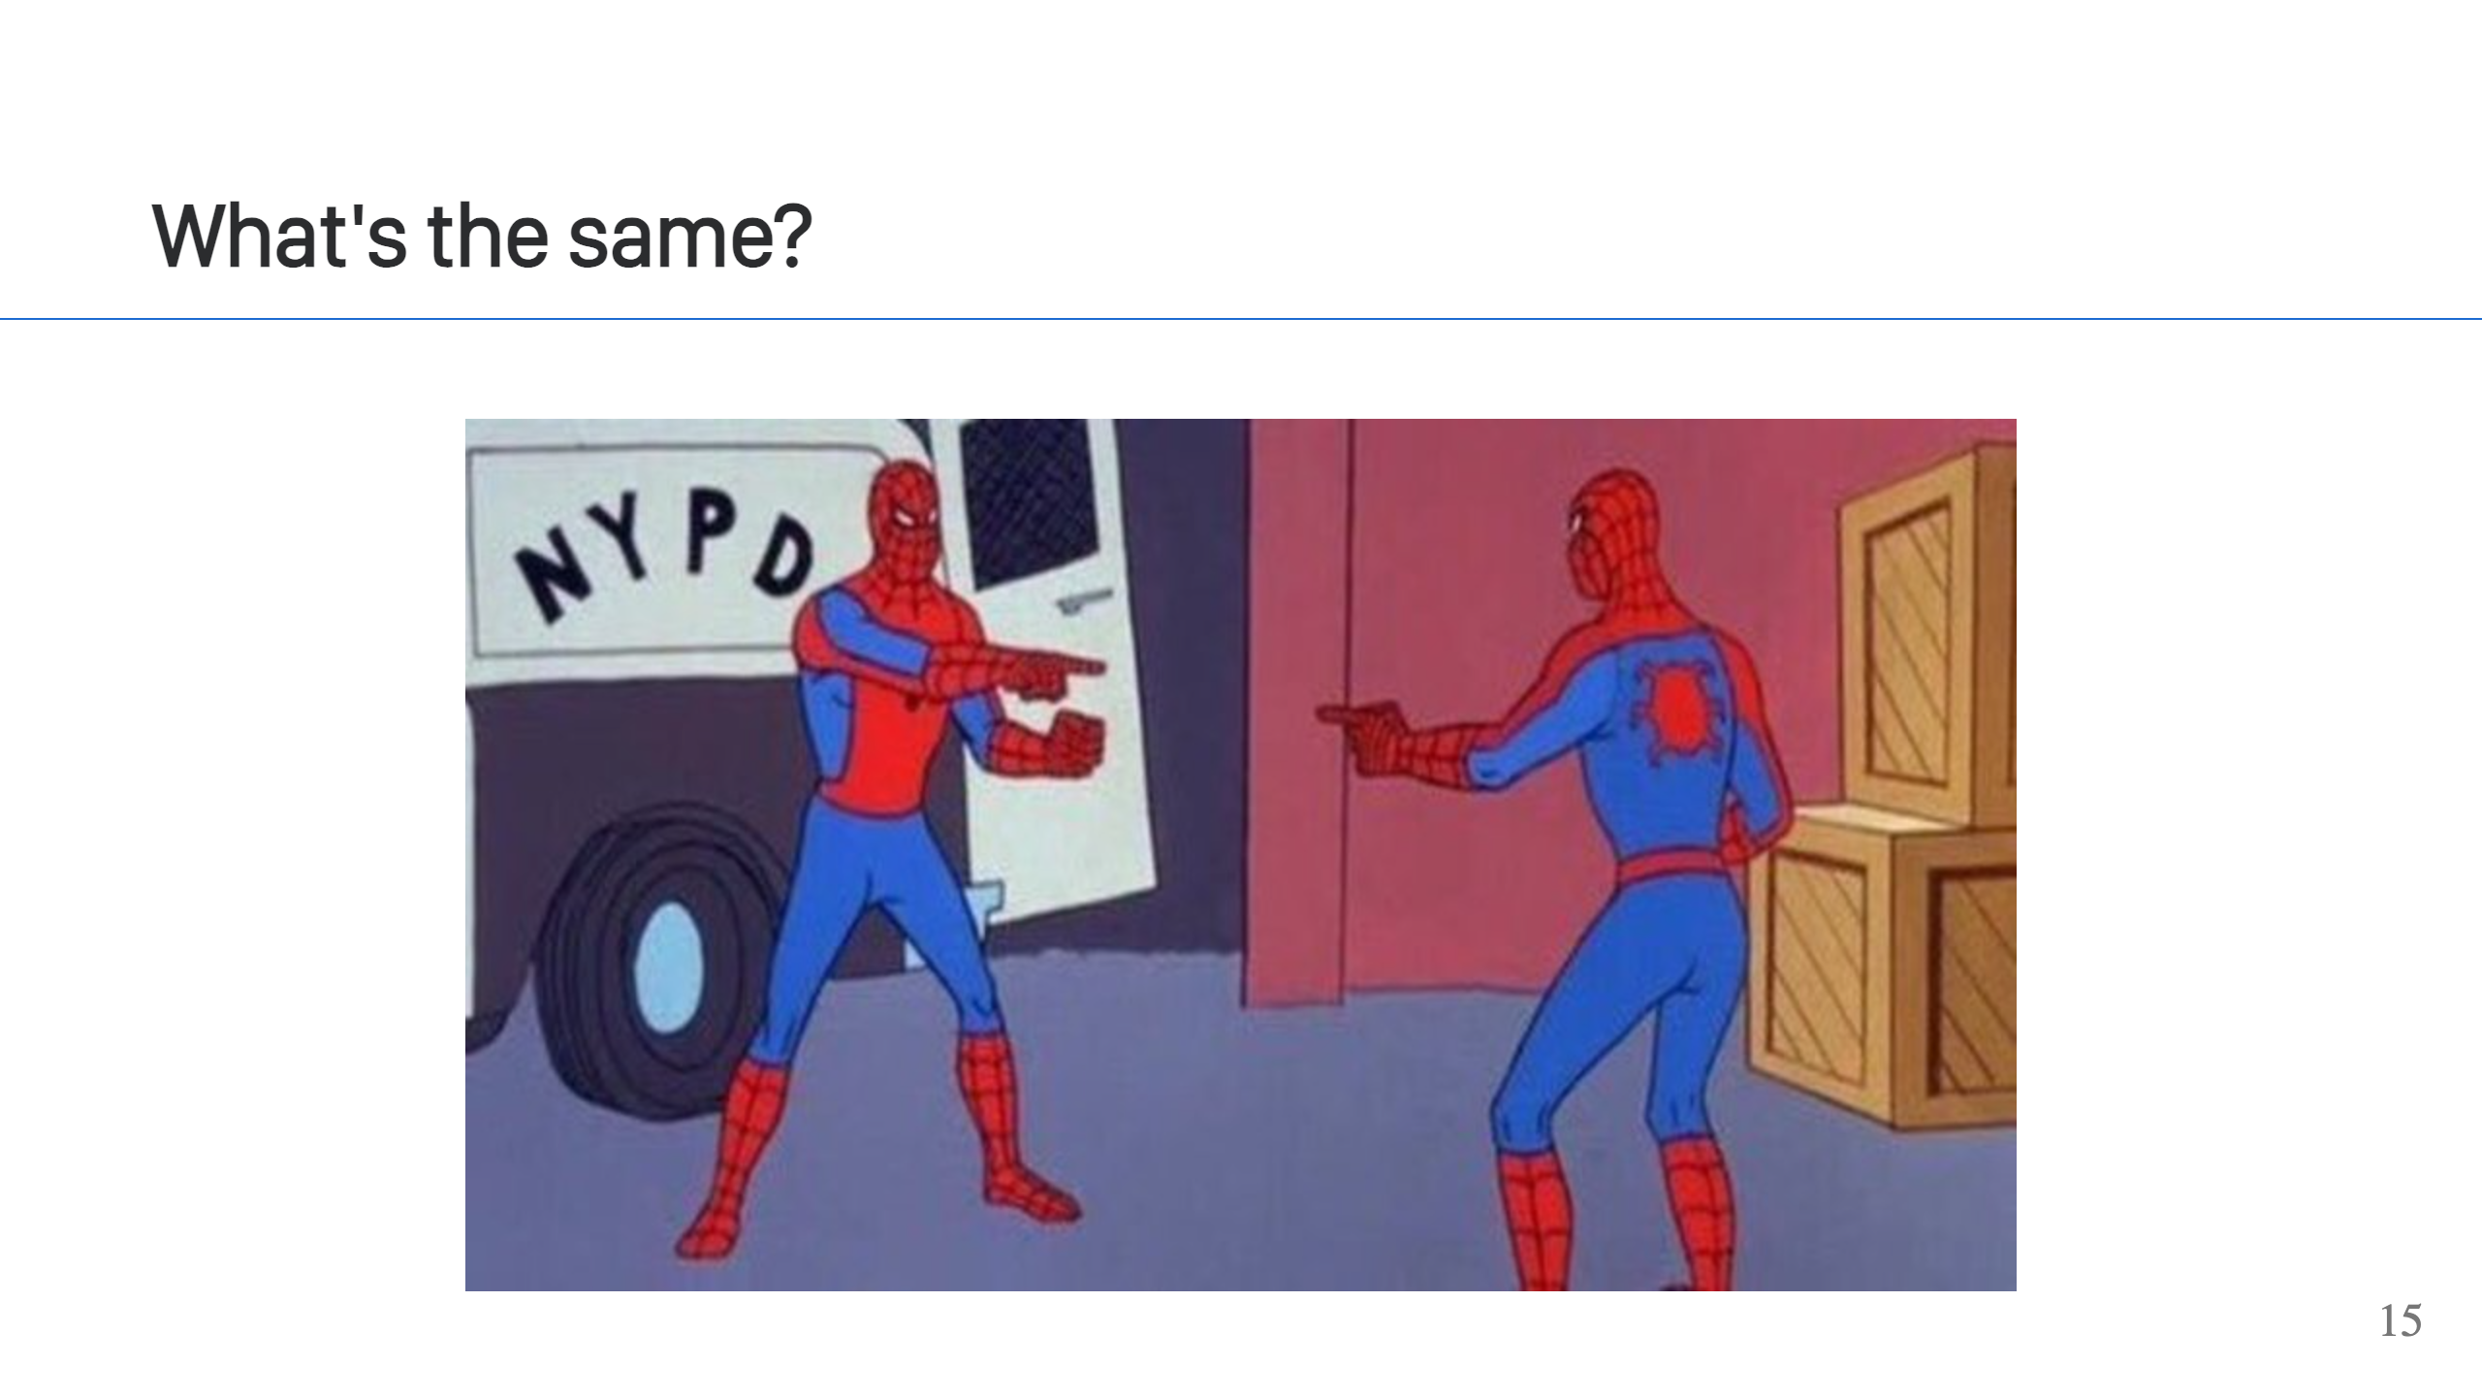
Notes:
- If you've secured other APIs with OAuth2, securing your MCP service will be very similar. 80% of what you do for your other APIs will be the same for MCP. - Just like your other APIs, your MCP service is considered a resource server. This means that it needs to take the user's token, probably a JWT token, and verify it. From there, your app can use the information in the token to identify the user and make decisions about what the user can access. - What's even better is that this will typically be handled by the framework you're using, automatically. FastMCP, which is based on FastAPI, will do this. So does Spring AI, through Spring Security. If for some reason your framework of choice doesn't handle this out-of-the-box, then you want to look for a library or extension to provides this functionality. The requirements of a resource server are not extremely difficult to implement, but friends don't let friends reimplement security critical code, so if there is a trusted option available, use it.

Slide 16
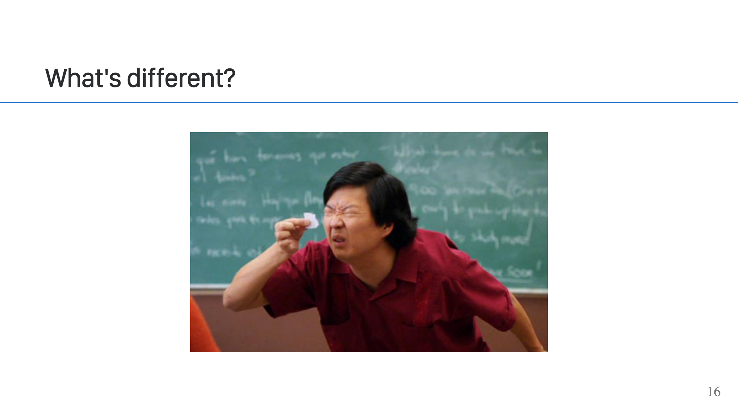
Notes:
- Primarily, the OAuth2 client. For a REST API, the client is going to be your SPA app or your Mobile App, or possibly some scripts running using a client credentials grant. These are all things you control, and you would typically define each of these clients for each of these services statically in your IDP. - With MCP, it's different. You won't know the clients in advance and you don't control them either. - To help with this, the MCP spec authors originally recommended the use of an OAuth2 extension called Dynamic Client Registration, which is [RFC-7591](https://www.rfc-editor.org/rfc/rfc7591).

Slide 17
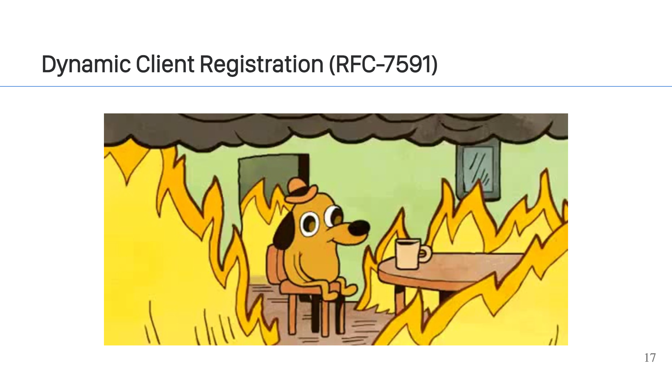
Notes:
- What is DCR? Well, in a nutshell it's simple. DCR requires your IDP to provide an additional endpoint for registering OAuth2 clients dynamically. A potential client app can send a request to this endpoint which creates a new OAuth2 client within your IDP. The client app can then uses the returned OAuth2 client information just like statically registered OAuth2 client in your IDP. - Dynamic Client Registration isn't new or specific to MCP. It existed before MCP, but wasn't very popular or used often. - Having DCR included with MCP has brought a lot of attention to DCR, and unfortunately, I think what has been found is that it doesn't work very well.

Slide 18
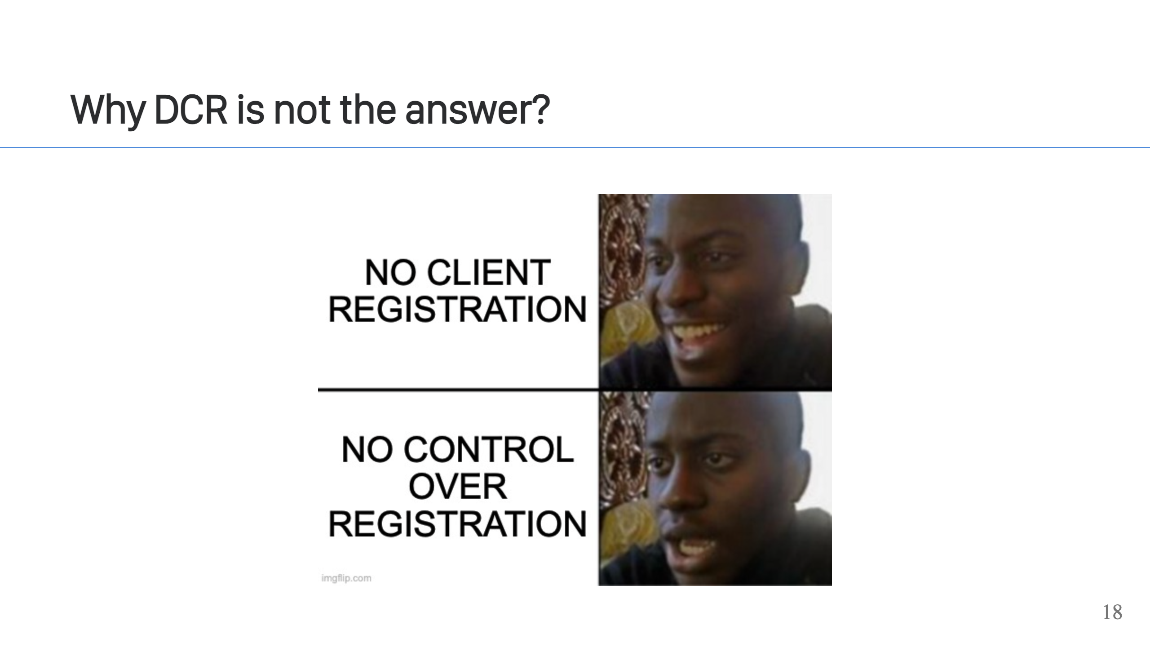
Notes:
There are a couple of challenges in supporting DCR: 1. Not all IDPs implement DCR. The ones that do, don't necessarily implement it well. 2. If your IDP doesn't implement it, there are workarounds but it's not a great situation. You basically end up running your own IDP or a IDP proxy (it will implement DCR and then proxy other OAuth2 requests to your actual IDP). Neither option is fun, and both are an avenue for [security problems](https://modelcontextprotocol.io/specification/2025-11-25/basic/security_best_practices#confused-deputy-problem). After all, you use OAuth2 an IDP because you don't want to have to implement this stuff. As for DCR itself, there are two main problems: 1. There are very few ways to restrict who can create clients. This is because you do not know who the person is that's creating the client. You can't trust any of the information they provide, so the only strategies are basic ones like rate limit by IP address, and using allow-lists for properties like scopes and the redirect_url that are requested for the client. This is if your IDP even supports applying limitations. 2. You need to store client state. If your IDP stores this information on the server side, you need to understand the cost for that. It's a small amount of data per client, but the number of clients can grow very large so this cost can add up. What's worse is if you combine these two drawbacks together, what you have is a DoS attack. Because there are no limitations on creating clients, a user could accidentally or maliciously create millions of users, which in turn runs up your costs. If that's not bad enough, once a client is created, there's virtually no want to clean them up. DoS attacks aside, you still need to eventually clean up legitimately created clients. There's just no good way to do this though. If your IDP supports it, you might be able to look at the last used date, but even then, it's a risk to delete clients. There's no way to know if someone might legitimately try using the client at some future point. This is compounded further by clients like Claude that do not handle their client being deleted well (at least this was the behavior the last time I checked in late 2025).

Slide 19
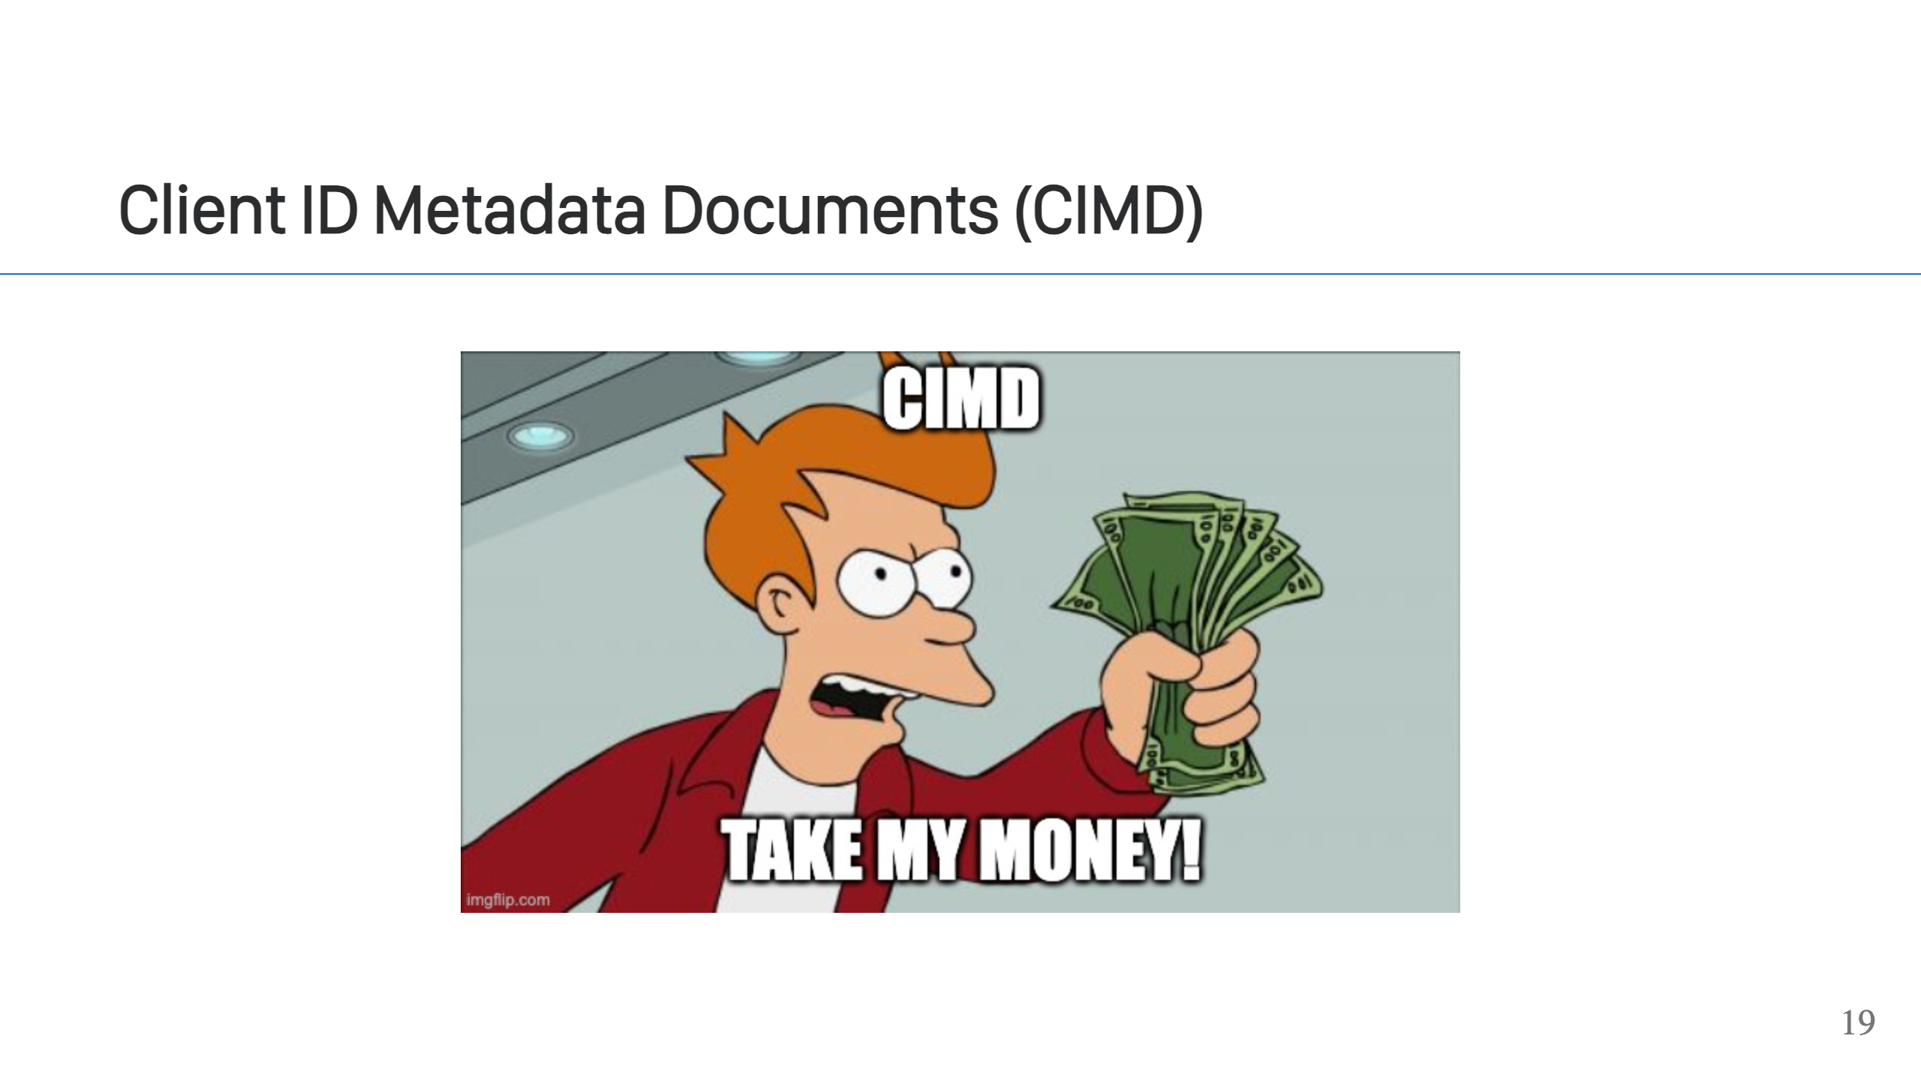
Notes:
- Fortunately, there is something better: [Client ID Metadata Documents (CIMD)](https://client.dev/). - This is very new, added to the 2025-11-25 version of the MCP specification. It is a better way to manage dynamic clients because it puts the burden on the client, not the server. - In a nutshell, the client must create a metadata document and host it somewhere accessible to the server via HTTPS. The document identifies the client. The client then uses a URL to the metadata document as its client_id when talking to the IDP. The IDP can then fetch the client's metadata and validate it (including the TLS information). If you notice, this resolves the two issues with DCR that we discussed. We know who is registering the client, so we can put limitations on them, and we do not have to store the client information on the server.

Slide 20
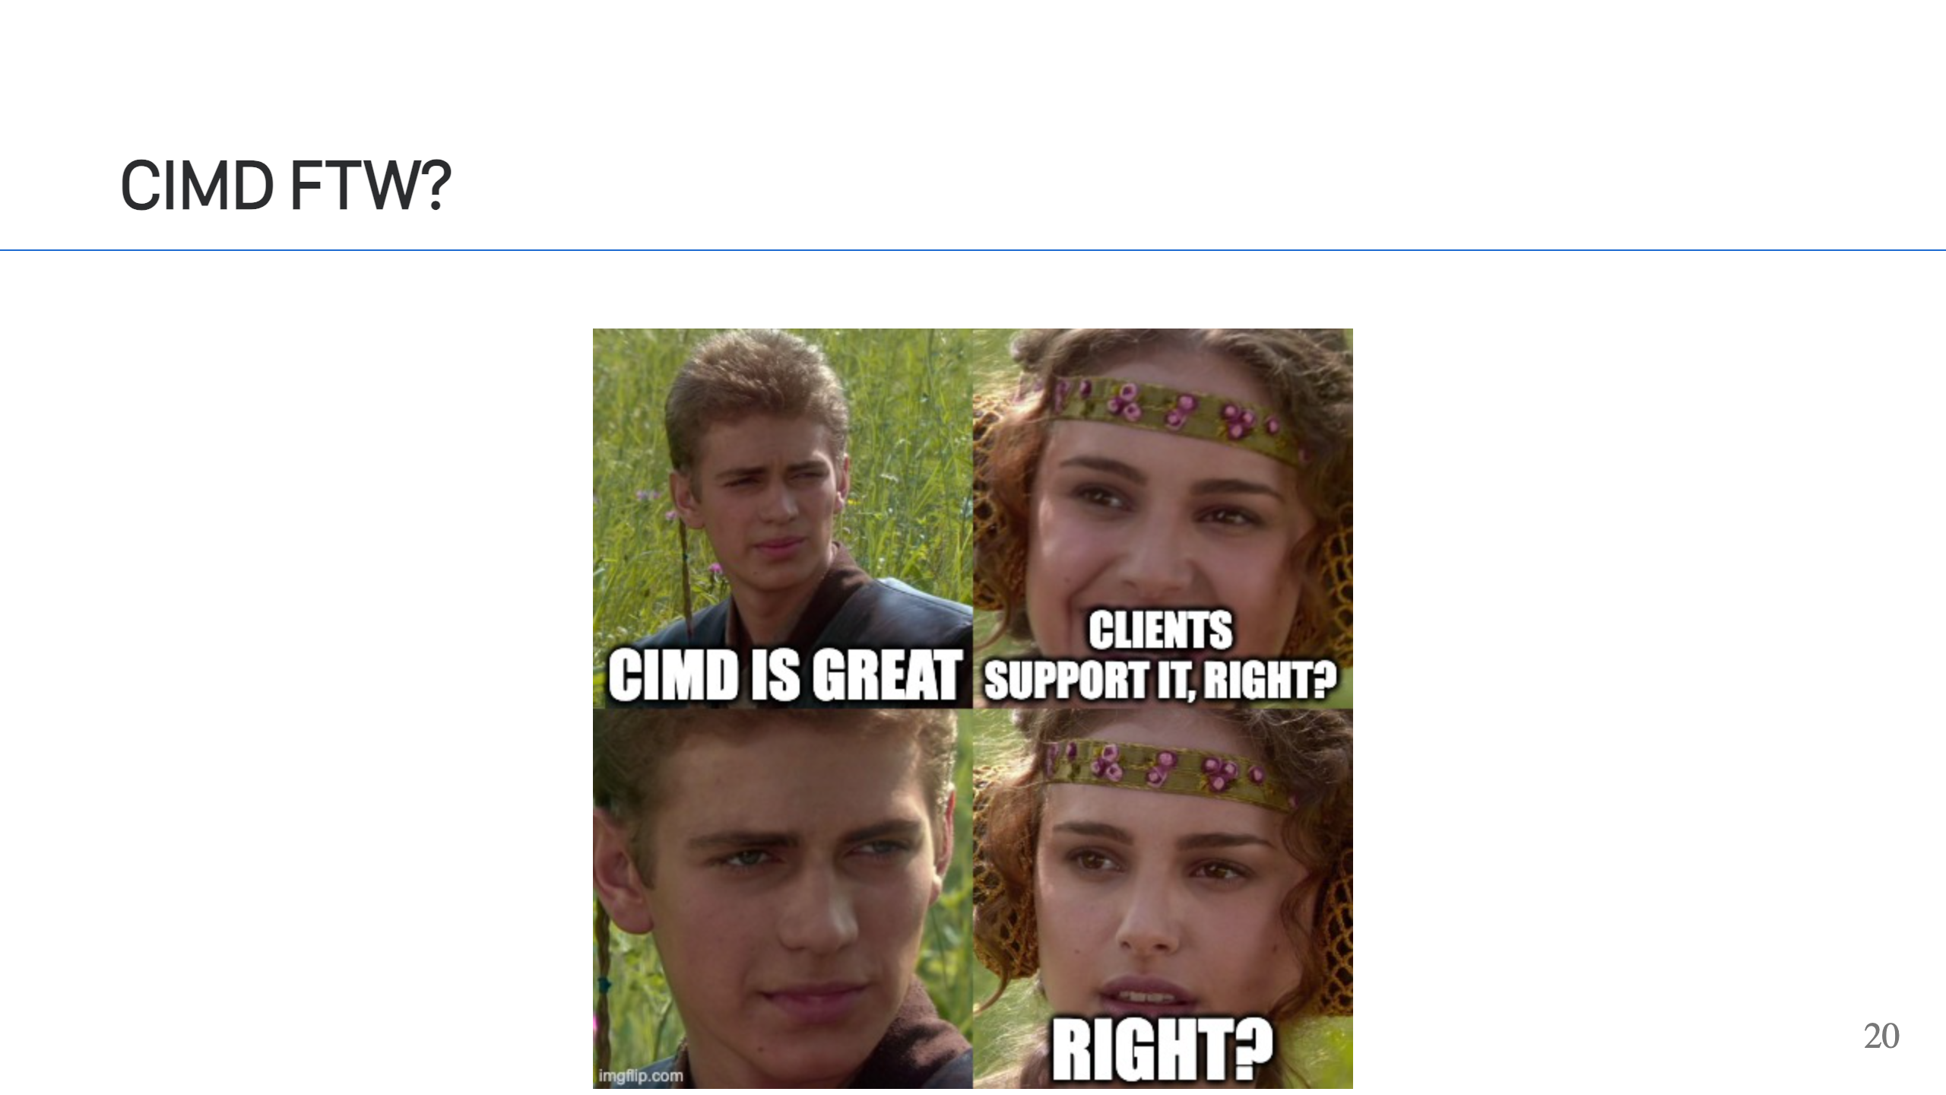
Notes:
I wish I had better news, but at this point in early Jan 2026, the major LLMs and Agents do not yet support CIMD. I wish I could sit here and tell you to just skip over DCR entirely, but since CIMD support isn't widely available, at least if you're targeting the major LLMs and Agents, [Claude](https://support.claude.com/en/articles/11503834-building-custom-connectors-via-remote-mcp-servers) and ChatGPT, it's tricky.

Slide 21
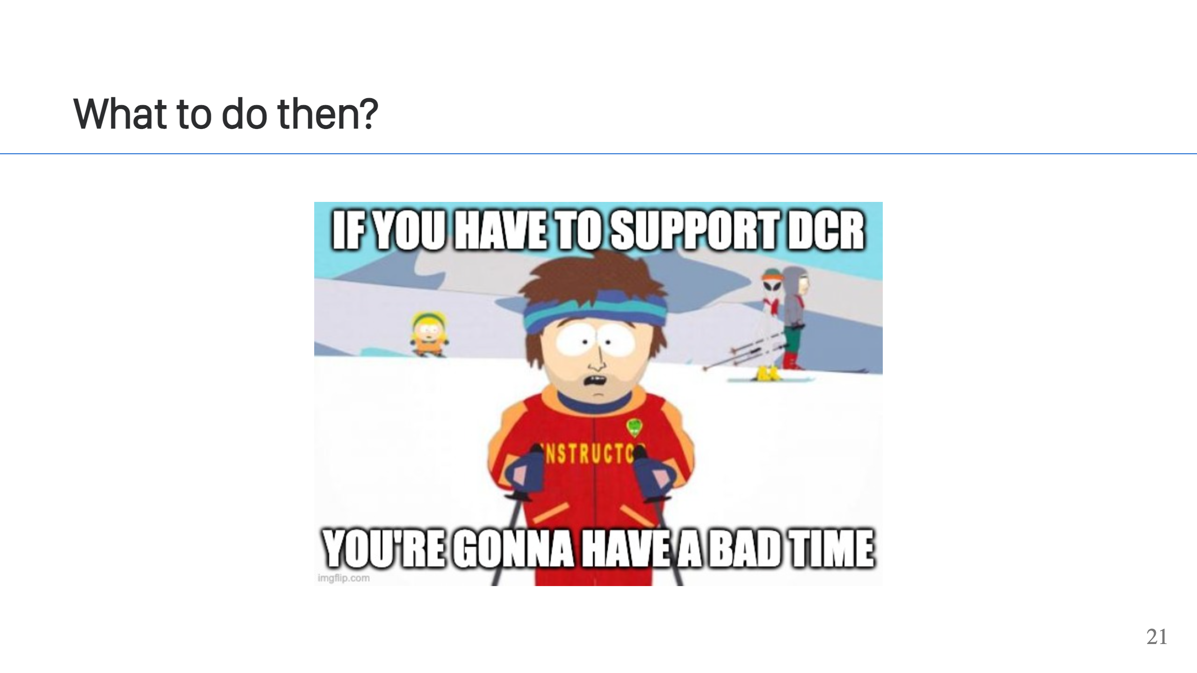
Notes:
Ok, so CIMD is out and we'd rather not support DCR, so that leaves us with one option. Support static client configuration. Both Claude & ChatGPT support using statically configured clients when registering an MCP server. Depending on your audience, this may be sufficient. For example, if you have an internal audience and you can work with them to set things up. This could get difficult if you are trying to allow customers or a wide audience to register as each person would need their own client (do not share clients). If that isn't viable then try to lean on your IDP. If you are lucky, and your IDP has a good implementation of DCR, then you're all set. Just remember... 1. Have a way to control what a user can dynamically register as a client 2. Have a way to clean up clients automatically. If a user can register a client with any scopes then they can potentially elevate their permissions. If a user can register a client with any redirect_uri, that allows them to impersonate your legitimate sites and try to steal tokens from your users. If you don't have a way to clean up clients, they will grow and eventually your IDP will send you a bill. You may be tempted to use a DCR Proxy. This is an option. You can use a proxy to add on DCR support, either in your MCP server or as a standalone service. I would not recommend this. I did this with FastMCP, and through no fault of theirs, it creates problems. FastMCP nails the client registration controls and provides ways to mitigate the client storage issue, but what you effectively end up with is a second IDP, complete with different tokens signed by a different set of keys and now everything in your infrastructure needs to trust tokens signed by those keys also. For my employer, this was too much effort and a deal breaker. The situation may seem grim, but the light at the end of the tunnel is that things are moving fast. Keep monitoring. Hopefully CIMD support will come soon and this transition period will be behind us. What we need to use CIMD are two things: 1. Claude & ChatGPT (or your target agents) need to support the "2025-11-25" version of the MCP spec and CIMD specifically. 2. Your IDP needs to support CIMD. If they don't, now is a great time to ask them where it's at on their roadmap.

Slide 22
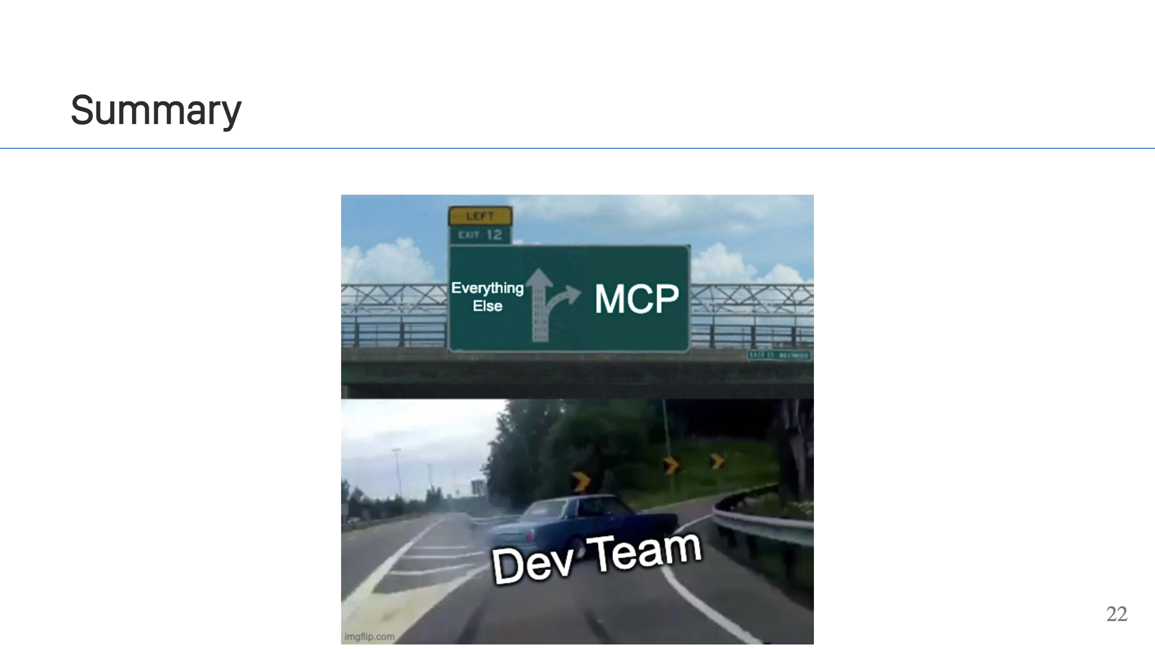
Notes:
In 2025, I wrote a remote MCP server for work. It was hard. It shouldn't have been though. Reflecting on the experience, it was hard for two main reasons: 1. MCP isn't a finished protocol. MCP had *three* spec releases in 2025 alone. It's a moving target. Projects and vendors are racing to keep up. Because of this, you encounter bugs, you file issues, you maybe submit PRs, and you wait for new releases. Hopefully, the pace of the spec changes slows down in 2026 and we get some stability. 2. Authentication with MCP is a challenge. OAuth2/OIDC can itself be a big hurdle, in fact, I've got a whole separate talk on that topic. When you layer on things like DCR, it gets worse. Fortunately, the spec improvements are addressing this. While you will always need to get over the OAuth2 hurdle, CIMD replacing DCR is a huge benefit to developers and operators of MCP servers. What is the future of MCP? - Hard to say. - It could be huge. I've heard speculation it could be as common as REST APIs. Why download web pages, parse HTML, and try to understand something designed to build a GUI, when you could interact directly with an MCP server and fetch structured data? - On the other hand, it could also be a flash in the pan, replaced by something else in a year or two. The rate things are changing with respect to AI is astounding. - Ultimately, we just don't know. If you implemented an MCP server today, I think you'd still be an early adopter. Given that, my advise is plan & architect accordingly.

Slide 23
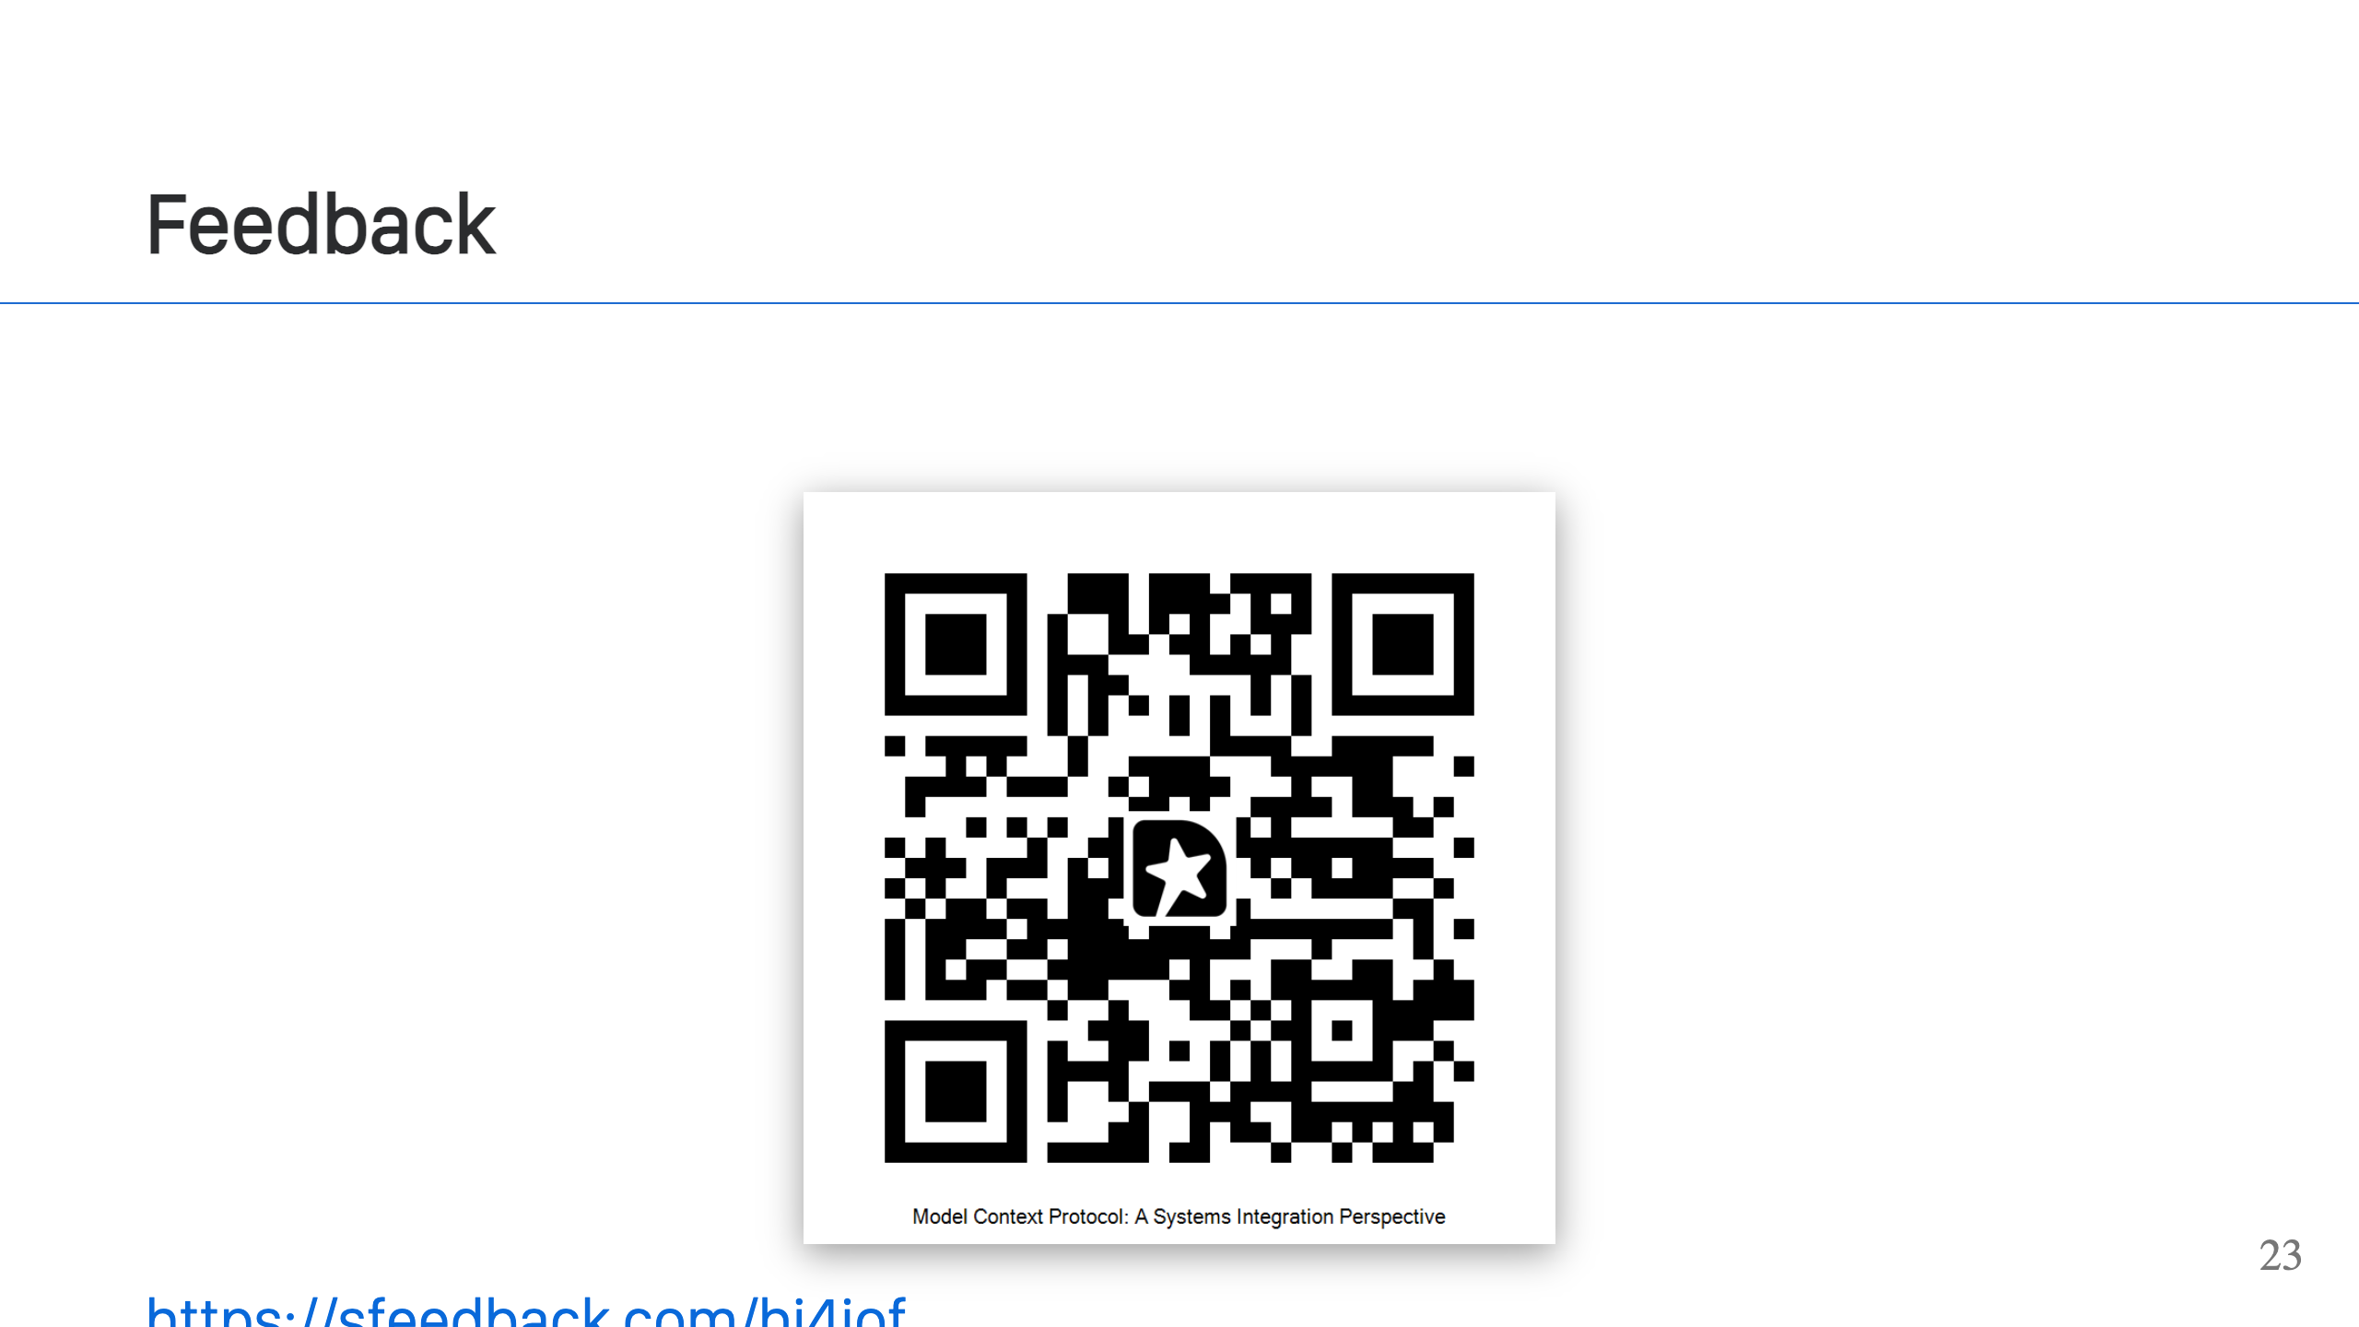

Slide 24
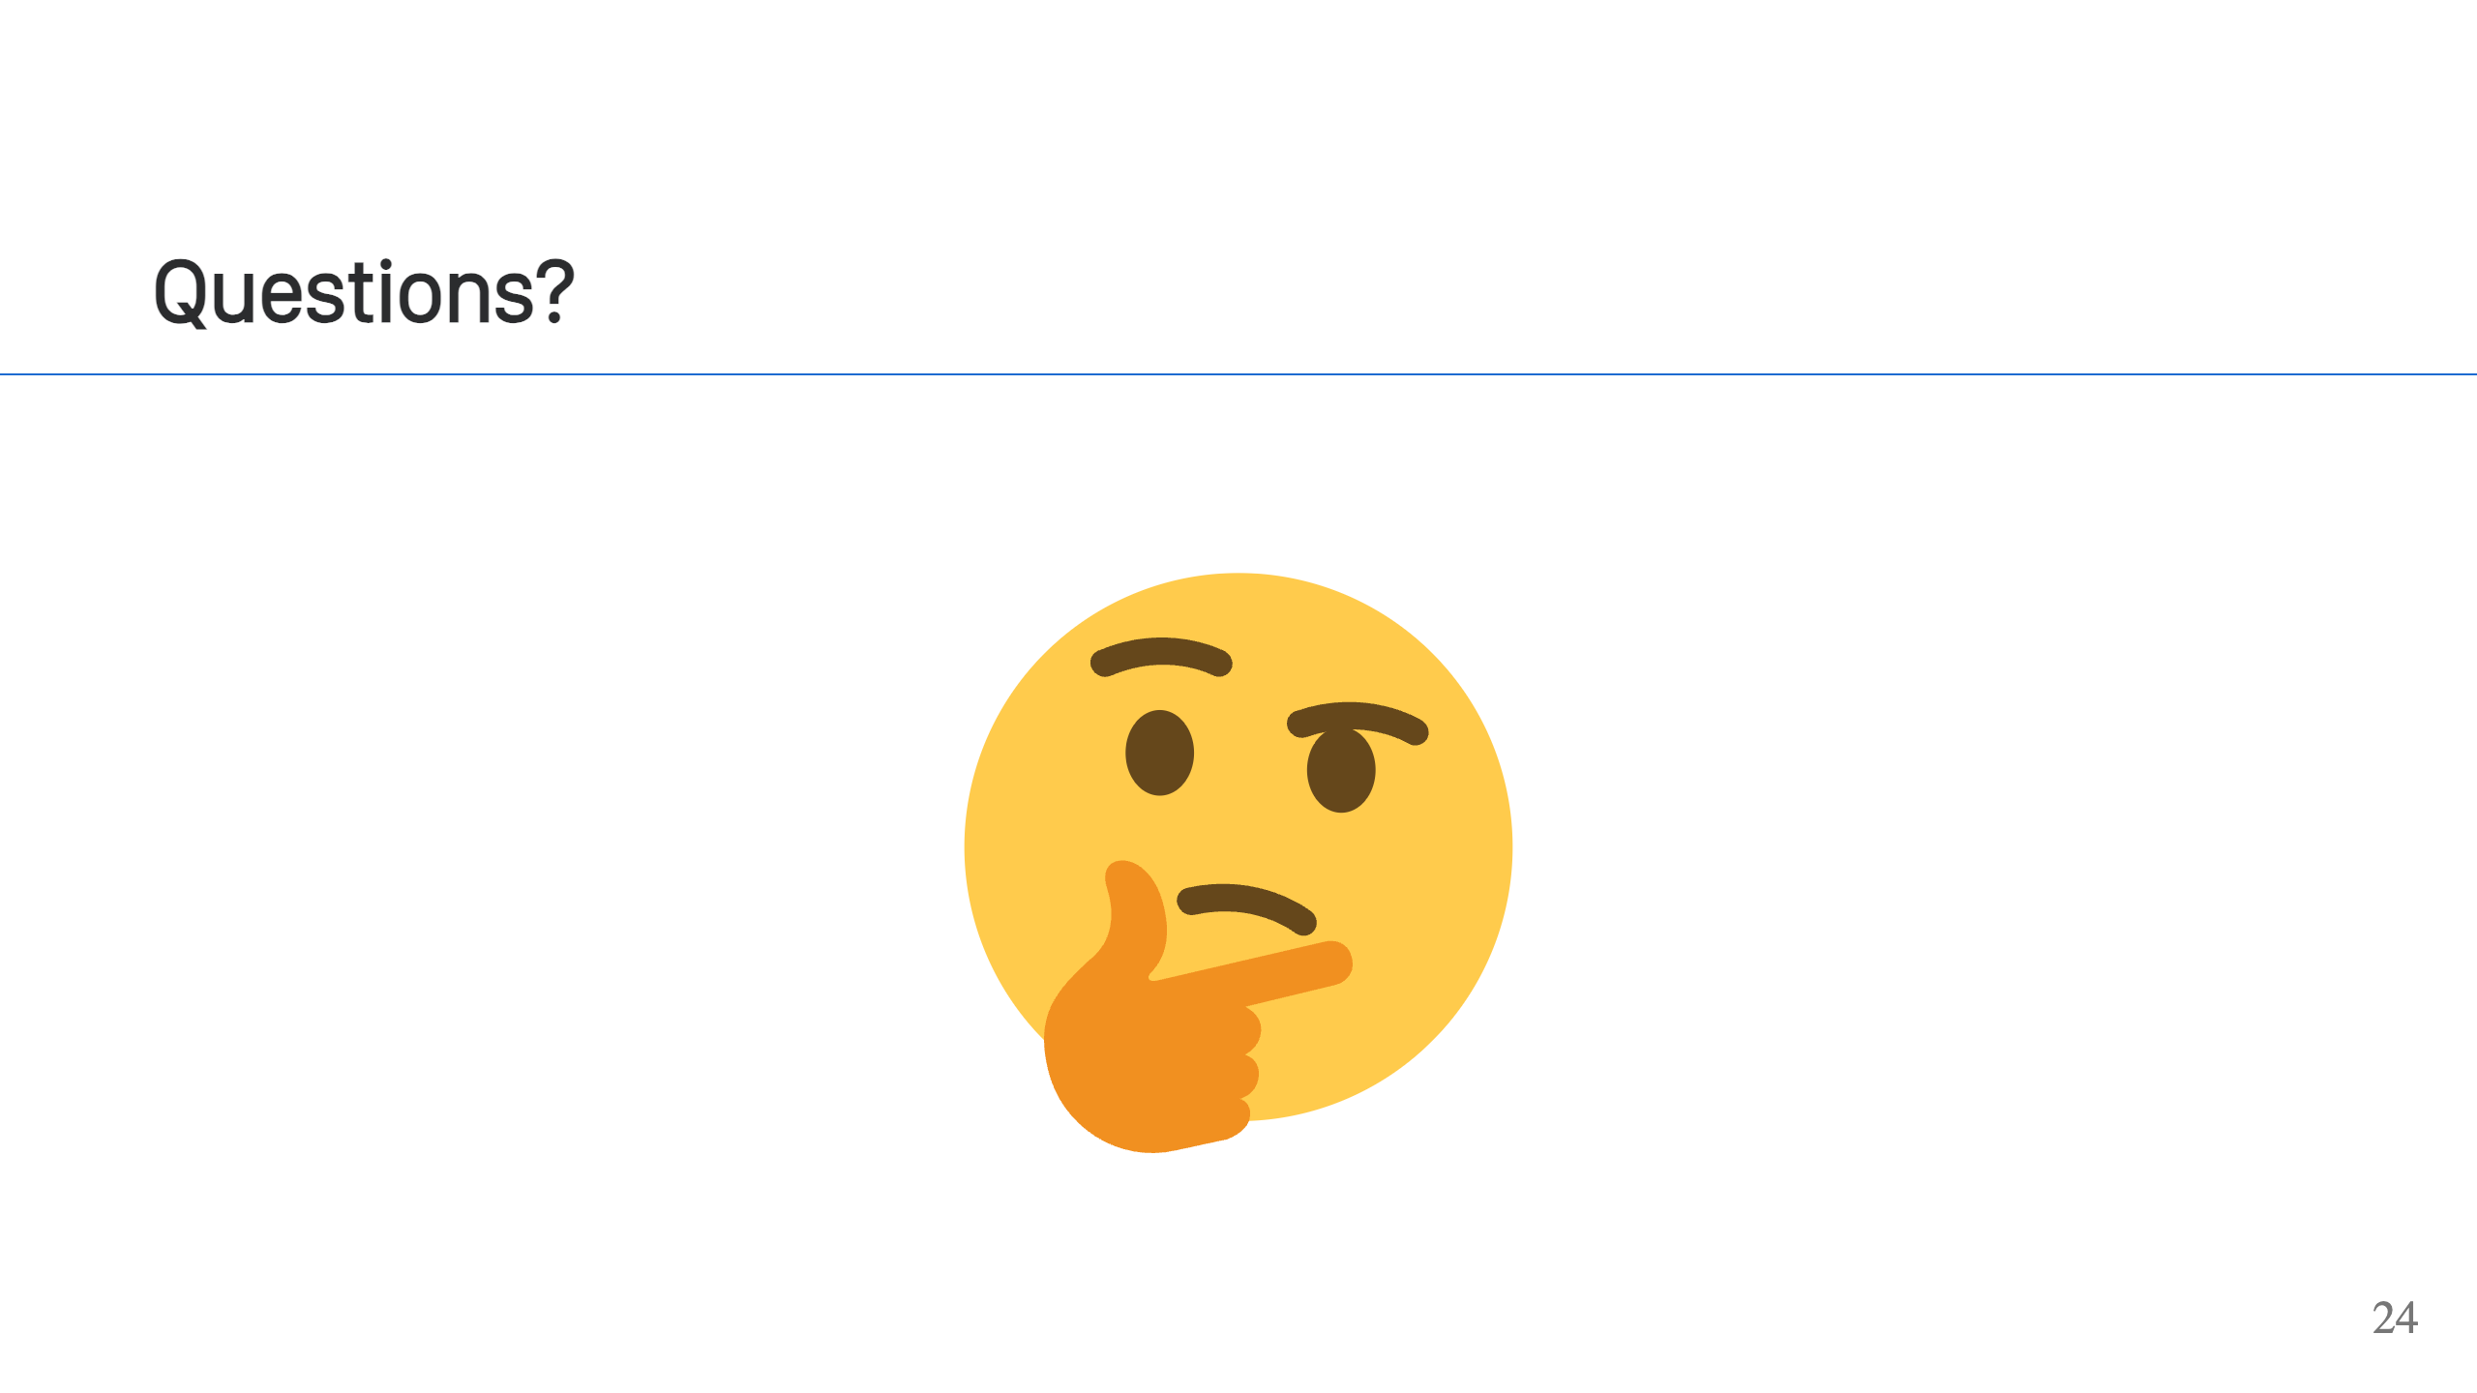

Slide 25
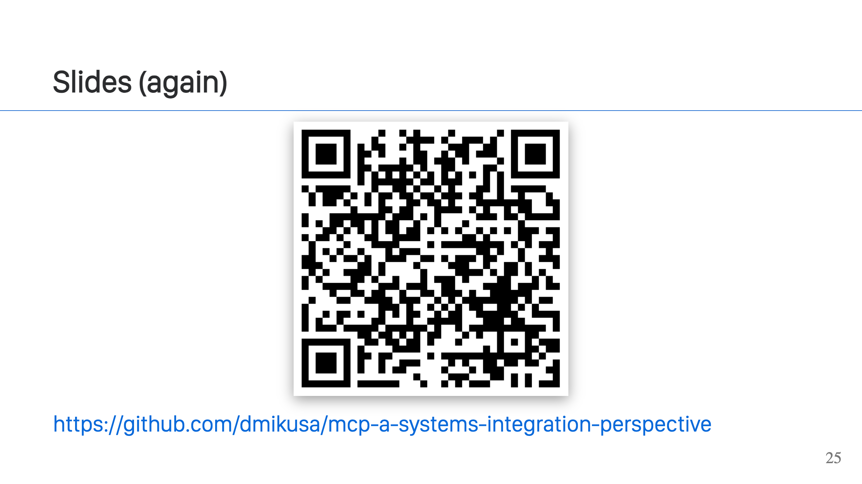
Notes:
Slides are available at the link above.

