Slide 1

KernelGen naïve GPU kernels generation
from Fortran source code
Dmitry Mikushin

Slide 2
Contents
Motivation, target, analysis
Assembling our own toolchain
Toolchain usecase: axpy example
Development schedule

Slide 3
1. Motivation, target, analysis

Slide 4
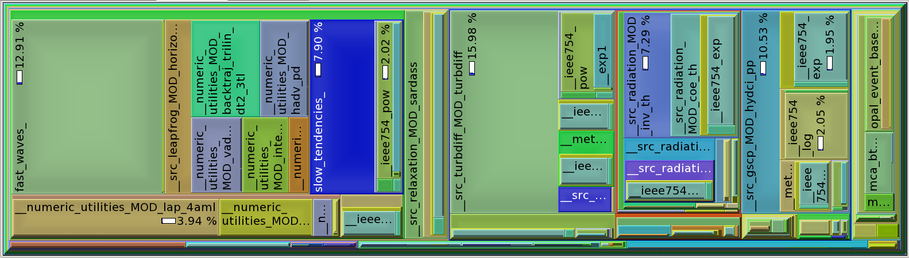
Why generation?
The need of huge numerical models porting onto GPUs:
  All individual model blocks have too small self perf impact (~10%), resulting into small speedups, if only one block is ported

Slide 5
Why generation?
The need of huge numerical models porting onto GPUs:
  A lot of code requiring lots of similar transformations
  A lot of code versions with minor differences, each requiring manual testing & support
  COSMO, Meteo-France: science teams are not ready to work with new paradigms (moreover, tied with propriety products), compute teams have no resources to support a lot of new code

Slide 6
Why generation?
So, in fact customers are ready to start GPU-based modeling, if three main requirements are met:
  Model works on GPUs, but conserves the original CPU source code
  Model works on GPUs and gives accurate enough results in comparison with control host version
  Model works on GPUs faster

Slide 7
Our target
Port already parallel models in Fortran onto GPUs:
  Conserving original Fortran source code (i.e. keeping all C/CUDA/OpenCL in intermediate files)
  Minimizing manual work on specific code (i.e. developed toolchain is expected to be reusable with other codes)
“Already parallel” means the model gives us some data decomposition grid to map 1 GPU onto 1 MPI process or thread.

Slide 8
Similar tools: PGI CUDA Fortran
Not really similar:
  Same manual coding as with CUDA C we want to minimize
  PGI's own Fortran language extensions

Slide 9
Similar tools: PGI Accelerator
Very similar, but:
  Still needs to set manual annotations on loops
  Is a propriety “black box” with limited info about implemented features

Slide 10
Similar tools: PathScale HMPP
Almost same as PGI Accelerator:
  Also has CAPS for automatic capable loops lookup
  Introduces some inapplicable constraints on accelerated loops, for instance, being a pure function (not really a problem with partial link-time kernels compilation)
  Tries to standardize OpenHMPP
  HMPP is a “black box”, but PathScale host compiler recently became open-source

Slide 11
Similar tools: f2c-acc
Actually, a work-in-progress equivalent for PGI Accelerator
  Still a lot of manual assistance needed

Slide 12
Conclusion
Clearly, it would be a right decision to use f2c-acc or PGI or HMPP, if they could support GPU kernels generation without directives/annotations
While they don't, adopting models is a complicated long-term task
Can we build our own toolchain with dependencies analysis instead of directives?

Slide 13
2. Assembling our own toolchain

Slide 14
Toolchain workflow
Original Fortran
source code
Modules
Modules
GForScale
LLVM IR
Optimized
LLVM IR
Modules
host-part of
Fortran code
device-part of
Fortran code
C-backend
Compiling host Fortran
code with target compiler
Compiling device
C++ code with nvcc
Extra
transformations
Assembling single object

Slide 15
Toolchain installation
/opt/kgen/
bin/
g95xml-refids
g95xml-tree
kgen
kgen-gforscale
kgen-gfortran
include/
gforscale.h
gforscale.mod
gforscale.dragonegg.mod
lib/
libgforscale.so
transforms/
split/
Source code XML-markup
Script performing steps 1-8
Source-to-source translator
Frontend (“compiler”)
Runtime-modules
Runtime-library
Tree of code transformation
rules performing host/device
code split

Slide 16
3. Toolchain usecase

Slide 17
8 basic steps in total
Original Fortran
source code
Modules
Modules
GForScale
2
3
LLVM IR
Optimized
LLVM IR
Modules
1
1
4
host-part of
Fortran code
device-part of
Fortran code
C-backend
7
6
5
Compiling host Fortran
code with target compiler
Compiling device
C++ code with nvcc
Extra
transformations
Assembling single object
8

Slide 18
Example: axpy
Consider toolchain steps in detail for the following simple test program:

Slide 19
Step 1
kgen-gforscale -Wk,--gforscale-scene-path=/opt/kgen/transforms/split/
-Wk,--gforscale-mode=tree axpy.f90
device-code
host-code

Slide 20
Step 2
dragonegg-gfortran -c axpy.axpy_loop_1_gforscale.F90
-D__CUDA_DEVICE_FUNC__ -ffree-line-length-none
-fplugin=/opt/llvm/dragonegg/lib64/dragonegg.so -O0 -S
-fplugin-arg-dragonegg-emit-ir -o axpy.axpy_loop_1_gforscale.F90.bc

Slide 21
Step 3
/opt/llvm/bin/opt -std-compile-opts axpy.axpy_loop_1_gforscale.F90.bc
-S -o axpy.axpy_loop_1_gforscale.F90.bc.opt

Slide 22
Step 4
/opt/llvm/bin/llc -march=c axpy.axpy_loop_1_gforscale.F90.bc.opt
-o axpy.axpy_loop_1_gforscale.F90.bc.cu

Slide 23
Step 5

Slide 24
Steps 6-8
Final compilation of host and device parts, assembling into single object file:
# 6
nvcc -g -c axpy.axpy_loop_1_gforscale.F90.bc.cu -D__CUDA_DEVICE_FUNC__ -G -o axpy.axpy_loop_1_gforscale.F90.o
# 7
gfortran -g -c axpy.host.F90 -D__CUDA_DEVICE_FUNC__ -ffree-line-length-none -I/opt/kgen/include -o axpy.host.F90.o
# 8
/usr/bin/ld --unresolved-symbols=ignore-all -r -o axpy.o_kgen axpy.host.F90.o axpy.axpy_loop_1_gforscale.F90.o

Slide 25
Testing axpy
# By default – execute on CPU
[marcusmae@T61p axpy]$ ./axpy
Usage: ./axpy <n> <eps>
[marcusmae@T61p axpy]$ ./axpy 10 0.001
Value of i after cycle = 11
Max abs diff = 0.000000
# Use GPU kernel if the corresponding environment variable set to 1
# (extra debug output showing how arguments are mapped into device memory)
[marcusmae@T61p axpy]$ axpy_1=1 ./axpy 1000 0.001
arg 0 maps memory segment [140735344500736 .. 140735344508928] to [1052672 .. 1060864]
arg 1 maps memory segment [28172288 .. 28184576] to [1060864 .. 1073152]
arg 2 reuses mapping created by arg 0
arg 3 reuses mapping created by arg 1
Value of i after cycle = 1001
Max abs diff = 0.000000

Slide 26
4. Testing

Slide 27
COSMO – coverage

Slide 28
COSMO – performance

Slide 29
WRF – coverage

Slide 30
WRF – performance

Slide 31
5. Team & resources

Slide 32




Team
Artem Petrov (testing, coordination)
Dr Yulia Martynova (WRF testing)
Alexander Myltsev (development, testing)
Dmitry Mikushin (development, planning)
Support from
communities:
LLVM
Polly/LLVM
gcc/gfortran

Slide 33
6. Development schedule

Slide 34
Stage 1 (April - June)
Put together all necessary toolchain parts, write the main script
Test C code generation, file bugs to llvm, patch C backend for CUDA support
Complete existing host-device code split transform (previously started in 2009 for CellBE)
Implement kernel invocation runtime
Implement kernel self-checking runtime
Compile COSMO with toolchain and present charts showing the percentage of successfully generated kernels with checked correct results

Slide 35
Stage 2 (July - October)
Improve support/coverage
Improve efficiency
Compare performance with other generation tools
Present the work and carefully listen to feedback

Slide 36
Stage 2 (July - October)
Improve support/coverage
  More testing on COSMO and other models, file bugs (+2 RHM fellows)
  Fix the most hot bugs in host-device code split transform
  Use Polly/Pluto for more accurate capable loops recognition
  Support link-time generation for kernels with external dependencies
Improve efficiency
  Use shared memory in stencils (+1 contractor)
  Implement both zero-copy and active data synchronization modes
  Kernel invocation configs caching
  [variant] Consider putting serial code into single GPU thread as well, to have the whole model instance running on GPU
  [variant] Consider selective/prioritized data synchronization support, using data dependencies lookup
  [variant, suggested by S.K.] CPU ↔ GPU work sharing inside MPI process
Compare performance with other generation tools
Present the work and carefully listen to feedback

