Slide 1
Frame-Analysis : Phase 1
Topic-Level Analysis:
Topic = Immigration

Slide 2
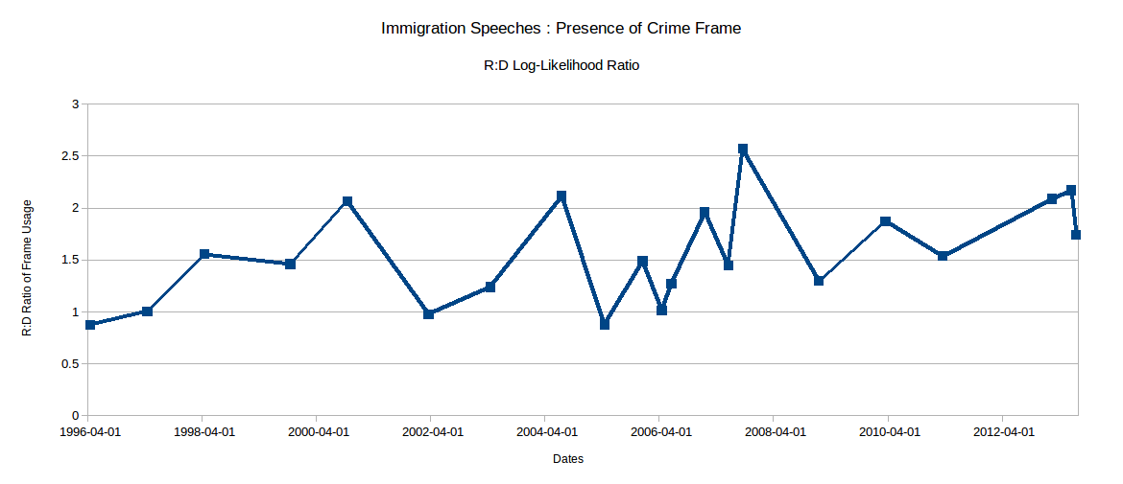
Frame = Crime

Slide 3
Frame =

