Slide 1
Plane Pursuit
“Plane Pursuit” is a game where a player engages in a wild pursuit of a combative smuggler plane. The player will have to maneuver through dangerous obstacles like flocks of birds to catch the enemy. Being hit by an obstacle decreases the integrity of the ship. Only once the player successfully negotiates these obstacles will he/she have the perfect shot. If the player can land three shots on the criminal’s vehicle, victory is assured.

Slide 2
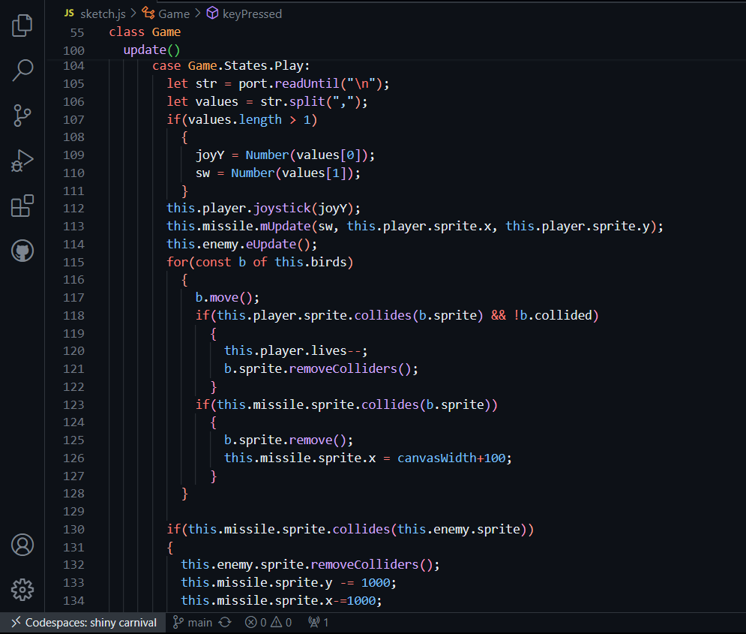
Game update method
This method is what allows the game to change during play and is where the most important logic lies. Given are expressions that determine whether objects have collided, spawn obstacles, and change individual objects’ states.

Slide 3
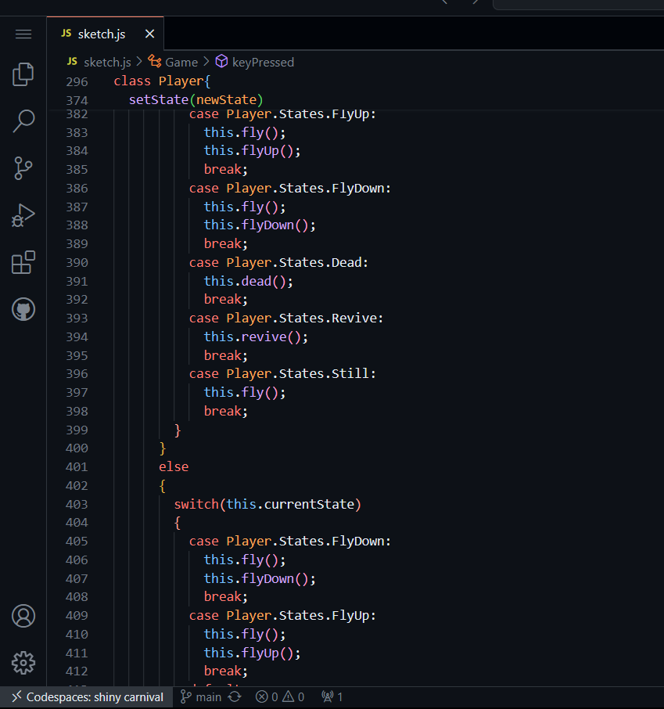
Player setState method
This method is the main meat that allows a finite state machine to work. It changes the state of the player object depending on certain conditions satisfied during gameplay and adjusts the player’s sprite and attributes accordingly.

Slide 4
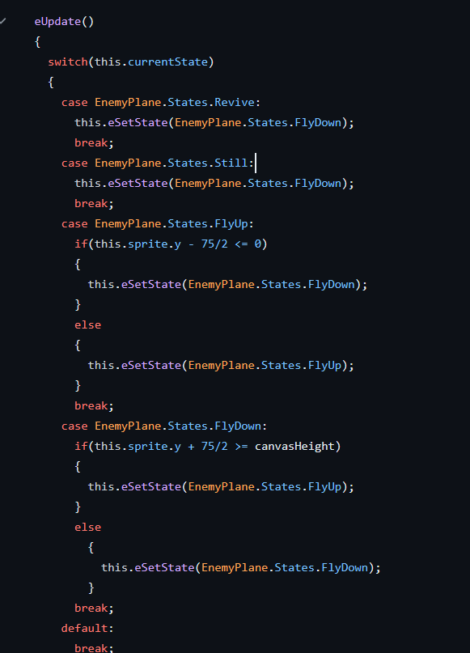
EnemyPlane Class
Most of the methods and attributes of the EnemyPlane class are derived from that of the Player. However, they allow for automatic movement.

Slide 5
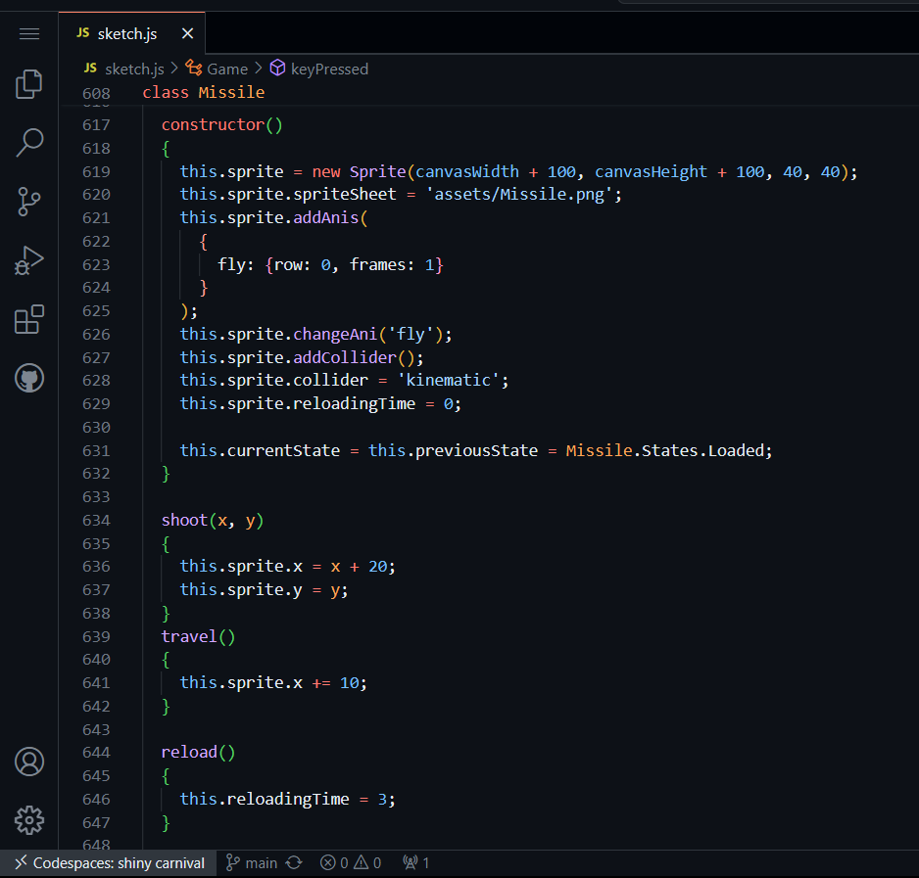
Missile class
This is a custom class that allows the player to “shoot” what looks like a missile toward the enemy. The class includes methods and attributes that allow a player to reload their weapon. The missile sprite has colliders that detect whether it touches another sprite with colliders.

Slide 6
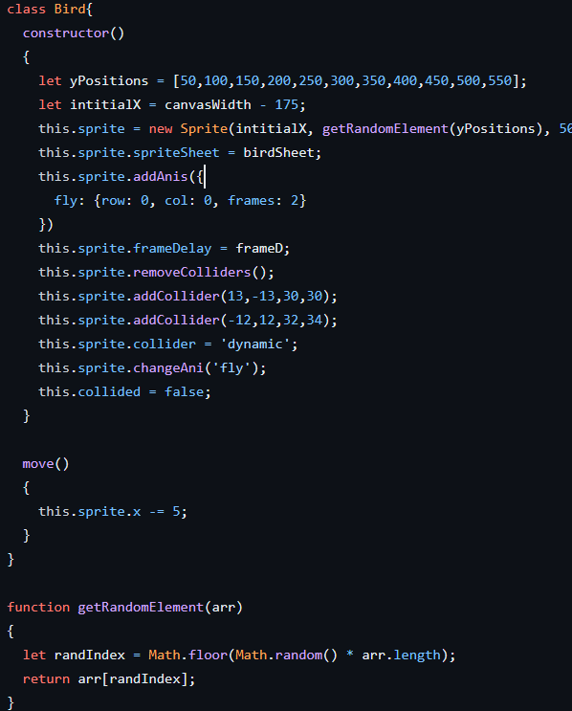
Bird Class
This is a simple class used to create bird obstacles during gameplay.

Slide 7
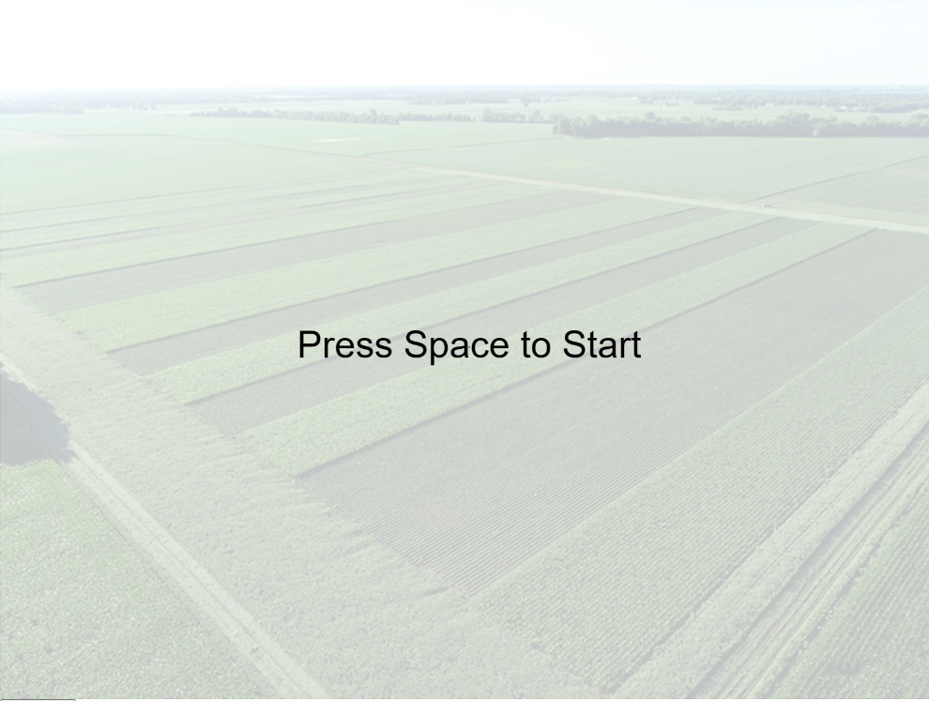
Game Start Screen

Slide 8
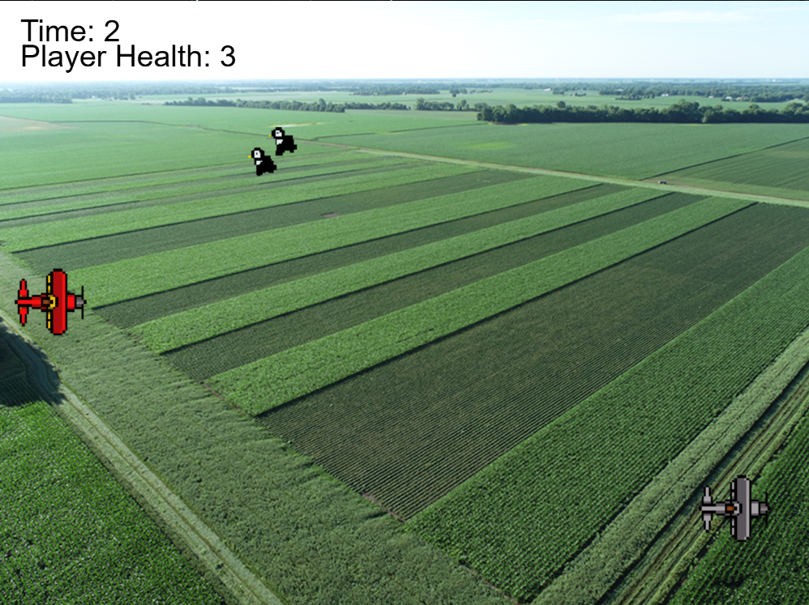
Game play

Slide 9
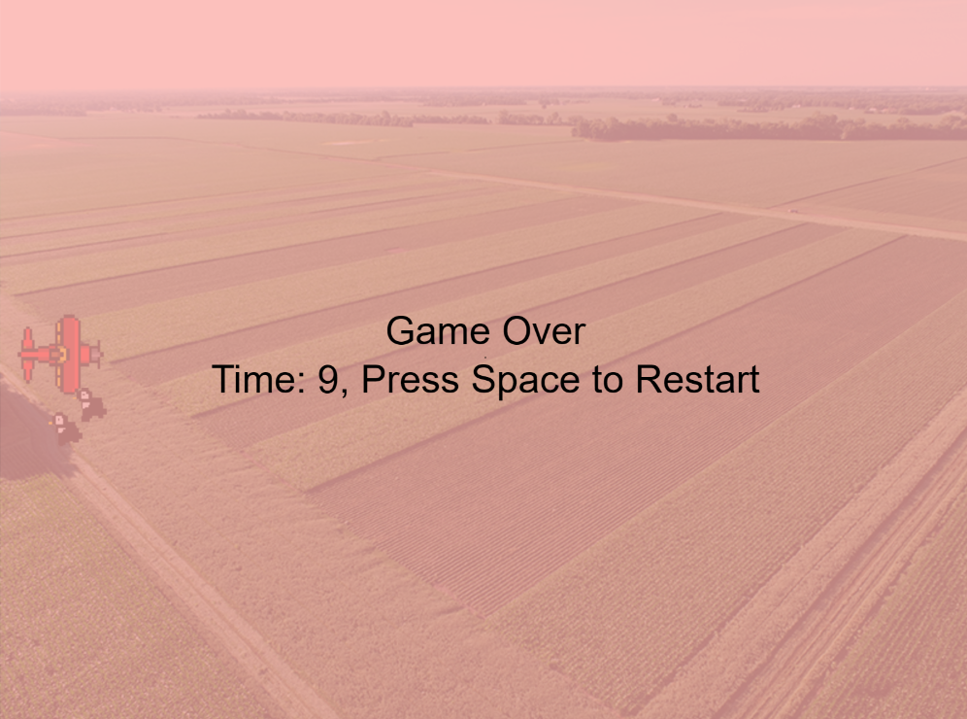
Game over

Slide 10
Problems
I could never get that Tone.js library to work. I did everything as I did in previous assignments, but Tone.js always gave me problems and would never work all the time. I scoured over the internet to find solutions to my problems; however, I could find no solutions. My personal opinions on the library itself may have also dissuaded me from doing what I could have.

Slide 11
Future Development
There is definitely room for improvement in this game. Sound is a must-have in any bestseller. Perhaps I can shorten the code by adding inheritance and polymorphism. Maybe I can add a method that allows the enemy to shoot back.

