Slide 1
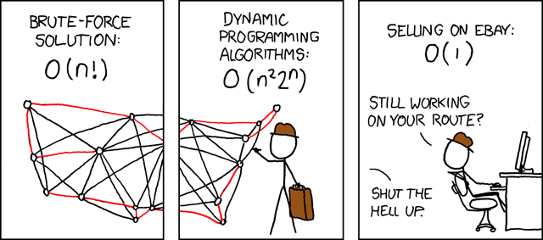
Computational complexity
xkcd joke

Slide 2
Computational complexity
- Analysis of the amount of resources required for an algorithm to perform a task
- It’s not about what or how, it’s about how much 💸
- How does an algorithm scale when given more input data?
- Time complexity: how much CPU
- Space complexity: how much RAM
- Different scenarii: best, average or worst

Slide 3
Time complexity
- How much time is an algorithm going to run?
- The exact duration is dependent of the computer (CPU)
- Instead, we define the duration as a function of the input size: f(n)
Input n | Duration f(n) = n³ | Duration f(n) = n³ + n² | Duration f(n) = n³ - 8n² + 20n
1 | 1 | 2 | 13
10 | 1000 | 1100 | 400
100 | 1.000E+06 | 1.010E+06 | 9.220E+05
1000 | 1.000E+09 | 1.001E+09 | 9.920E+08
10000 | 1.000E+12 | 1.000E+12 | 9.992E+11
100000 | 1.000E+15 | 1.000E+15 | 9.999E+14
1000000 | 1.000E+18 | 1.000E+18 | 1.000E+18
All three duration functions are equivalent when n increase

Slide 4
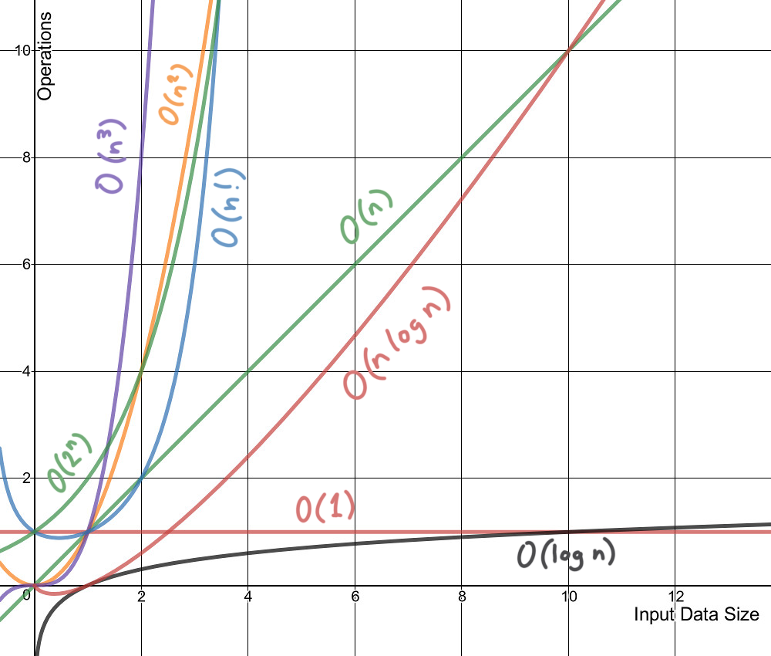
Big O notation
O(1) | Constant time
O(log n) | Logarithmic time
O(n) | Linear time
O(n log n) | Linearithmic time
O(n²) | Quadratic time
O(n^p) | Polynomial time
O(p^n) | Exponential time
O(n!) | Factorial time
Chart source

Slide 5
How to do the runtime analysis?
- Count every assignation, incrementation, comparison as taking one unit of time
- For every loop, count how many times the block is being executed
- Think about the best case scenario, the worst case scenario
- In case of submethod or recursive call, don’t forget to count the complexity of the called method

Slide 6
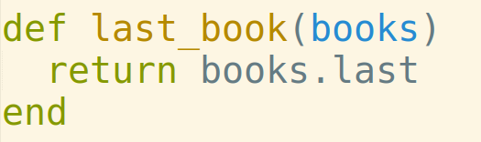
What is the time of complexity of this algorithm?
O(1)
This is a constant output

Slide 7
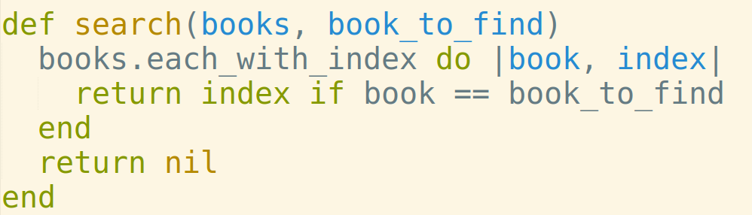
What is the time of complexity of this algorithm?
Best case scenario: the book is at the beginning of the array
O(1) Worst case scenario: the book is at the end of the array
O(n)
O(1)
O(1)
This is a linear search

Slide 8
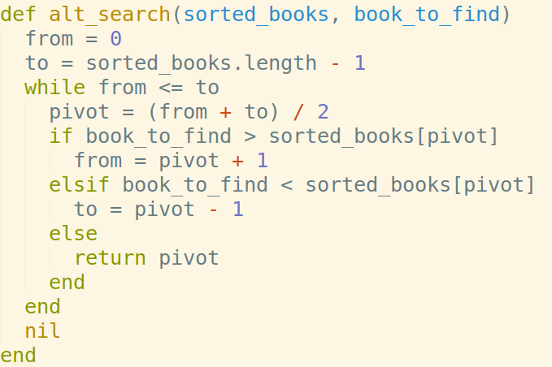
What is the time of complexity of this algorithm?
Best case scenario: the book is right in the middle, and the array is not going to be split
O(1)
Worst case scenario: the book is at the first or last position and the array is going to be split k times until the residual array length is 1
1 = n / 2^k ⇔ k = log n / log 2
O(log n)
O(1)
O(1)
O(1)
This is a binary search
Faster than linear search but input has to be sorted

Slide 9
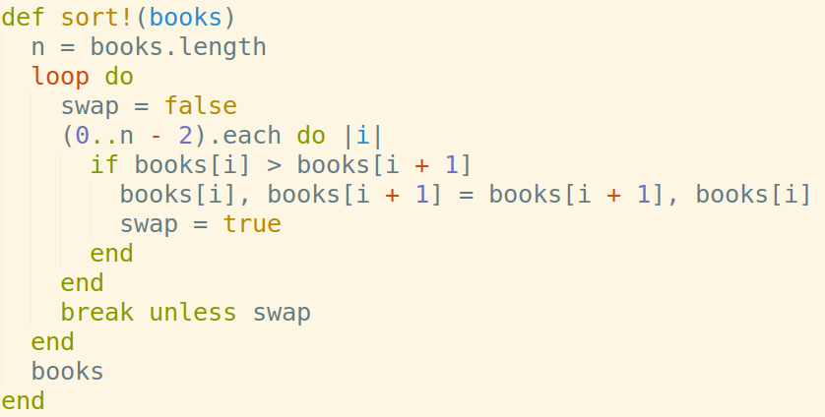
What is the time of complexity of this algorithm?
Best case scenario: the books are already sorted and swap is never going to be true
O(n)
Worst case scenario: the books are in sorted reversed order and loop is going to be executed n times
O(n²)
O(1)
O(1)
O(n)
O(1)
O(1)
O(1)
This is a bubble sort

Slide 10
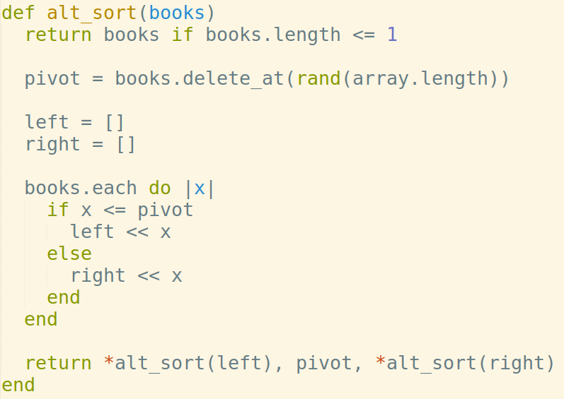
What is the time of complexity of this algorithm?
O(1)
Best case scenario: the books are already sorted and are going to be split log(n) times
O(n log n)
Worst case scenario: the pivot is the smallest or greatest element of the array, and one of the subarray length after split is n-1. If this happens at every split (really rare)
O(n²)
O(1)
O(1)
O(n)
O(1)
O(1)
This is a quick sort
It’s longer than bubble sort in the best case, but is quicker on average
This is the sort algorithm implemented by default in Ruby & Python

Slide 11
Conclusion
- Time complexity is about how much time algorithms take to perform a task
- Algorithm speed isn’t discussed in actual runtime but Big O Notation
- Depending of the data structure, best, worst or average scenario has to be considered
- For a given algorithm, its time complexity can be evaluate with a runtime analysis
- The same kind of analysis can be performed for space complexity (memory)

Slide 12
References
- 💻 Livecodes
- 🗒 Wikipedia - Computational Complexity
- 📺 CS50 - Computational Complexity
- 🗒 Michelle - Sorting algorithms in Ruby
- 🗒 Michelle - Search algorithms in Ruby
- 🌐 https://big-o.io/
- 🌐 Sorting Algorithms Animation

