Slide 1

RF Path Loss Tutorial
Dan Minear
Boeing Amateur Radio Club – HB
2006-02-07
Copyright 1996-98 © Dale Carnegie & Associates, Inc.
Notes:
Frequently, presenters must deliver material of a technical nature to an audience unfamiliar with the topic or vocabulary. The material may be complex or heavy with detail. To present technical material effectively, use the following guidelines from Dale Carnegie Training®.
Consider the amount of time available and prepare to organize your material. Narrow your topic. Divide your presentation into clear segments. Follow a logical progression. Maintain your focus throughout. Close the presentation with a summary, repetition of the key steps, or a logical conclusion.
Keep your audience in mind at all times. For example, be sure data is clear and information is relevant. Keep the level of detail and vocabulary appropriate for the audience. Use visuals to support key points or steps. Keep alert to the needs of your listeners, and you will have a more receptive audience.

Slide 2
Link Budgets and Planning
How much power do I need?
How much antenna gain do I need?
Will what I have do the job?
Is my system out of tune?
Notes:
In your opening, establish the relevancy of the topic to the audience. Give a brief preview of the presentation and establish value for the listeners. Take into account your audience’s interest and expertise in the topic when choosing your vocabulary, examples, and illustrations. Focus on the importance of the topic to your audience, and you will have more attentive listeners.

Slide 3
Of microvolts, dBm’s, & watts
Different ways of expressing quantitative levels
  Absolute
    Voltage (microvolt = 1 millionth of a volt)
    Power (watt, milliwatt = 1/1000 watt)
  As ratio in dB always referenced to some base value
    1 dBuV (dB referenced to 1 microvolt)
    1 dBm (dB referenced to 1 milliwatt)
    1 dBW (dB referenced to 1 watt)
Notes:
If you have several points, steps, or key ideas use multiple slides. Determine if your audience is to understand a new idea, learn a process, or receive greater depth to a familiar concept. Back up each point with adequate explanation. As appropriate, supplement your presentation with technical support data in hard copy or on disc, e-mail, or the Internet. Develop each point adequately to communicate with your audience.

Slide 4
More on dB whatever’s
dB voltages are calculated:
  dBuV = 20 * log[ v / 1 microvolt ]
  8 microvolts = 18 dBuV
dB powers are calculated:
  dBm = 10 * log[ p / 1 milliwatt ]
  1 watt = 30 dBm = 0 dBW
“I’m at the legal limit of 2500 watts!”
“Oh, I’m putting out 64 dBm.”
Same thing!
Notes:
If you have several points, steps, or key ideas use multiple slides. Determine if your audience is to understand a new idea, learn a process, or receive greater depth to a familiar concept. Back up each point with adequate explanation. As appropriate, supplement your presentation with technical support data in hard copy or on disc, e-mail, or the Internet. Develop each point adequately to communicate with your audience.

Slide 5
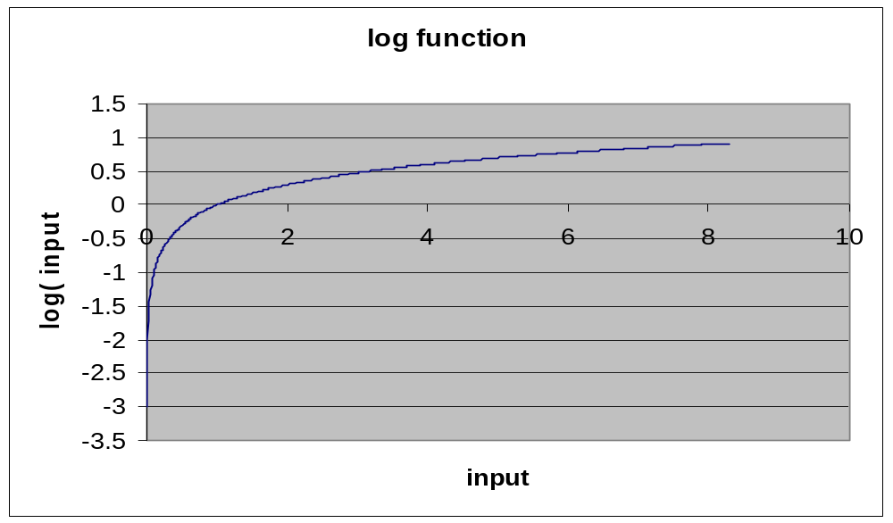
Log function graph
Flattens out quick!
log(3) is about 0.5
good to remember

Slide 6
How can we tie volts to power?
P = V * A, P = I² * R, P = V²/R ah, hah!
If you assume 50 ohm impedance (convenient for antenna work), then you can tie volts to power levels, and compare dBuV with dBm, etc.
Excel calculator download at http://rfsolutions.com/rfcalc1.htm
Comprehensive conversion table at http://www.microvolt.com/table.html

Slide 7
Some selected dBm – uV levels
dBm | W | uV
-107 |  | 1
30 | 1
37 | 5
40 | 10
Good signal level for 12 dB SINAD
Typical HT output

Slide 8
What’s good about dB’s?
With volts and watts you have to multiply and divide, conversions, – messy math!
dB’s just add or subtract!
  Gains add
  Losses subtract
So, lets check out a rf path link!

Slide 9


Common RF link items
Gains
  TX antenna gain & TX power
  RX antenna gain
Losses
  TX feedline losses
  RF free space path loss (next)
  RX feedline losses
  Connector losses
  Big building in front of you
  Air moisture
Add
Subtract

Slide 10
Free Space Path Loss
As the transmitted signal traverses the atmosphere its power level decreases at a rate inversely proportional to the distance traveled and proportional to the wavelength of the signal.
Loss = 20 * log₁₀[4*pi*d/L] {db}
  d = distance
  L = wavelength = c / freq
  Pi = 3.142…
Notes:
If you have several points, steps, or key ideas use multiple slides. Determine if your audience is to understand a new idea, learn a process, or receive greater depth to a familiar concept. Back up each point with adequate explanation. As appropriate, supplement your presentation with technical support data in hard copy or on disc, e-mail, or the Internet. Develop each point adequately to communicate with your audience.

Slide 11
Some selected path losses
Freq | Distance (mi) | Loss (dB)
2m | 50 | 114
2m | 20 | 106
2m | 5 | 94
440 | 20 | 116
1.2 GHz | 20 | 124
Notes:
If you have several points, steps, or key ideas use multiple slides. Determine if your audience is to understand a new idea, learn a process, or receive greater depth to a familiar concept. Back up each point with adequate explanation. As appropriate, supplement your presentation with technical support data in hard copy or on disc, e-mail, or the Internet. Develop each point adequately to communicate with your audience.

Slide 12
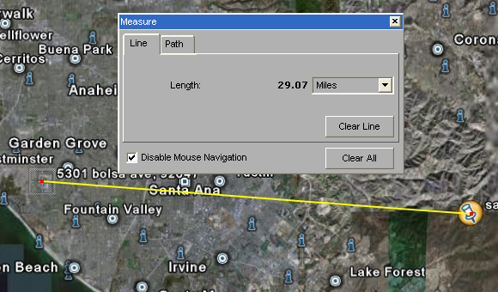
Distance from HB to Santiago
Google Earth

Slide 13
Can a 2m HT talk over 50 miles?
5 W – loss, then convert to uV
37 dBm – 114 dBm = -77 dBm
-77 dBm = 31.6 uV
YES WAY!
In reality, though, there’s other losses, not to mention the rubber ducky antenna.

Slide 14
Other losses
HT antenna (negative gain about –3 dB)
Ground interference (buildings, walls)
Air moisture (tends to absorb RF)
Phase noise (signal bouncing off something else – mountain, car, …)
Receive feedline and connectors

Slide 15
Reality check
Given a good path without too much obstruction
Antenna –3, feedline –3, moisture –6 = -12
Still at –77 – 12 = -89 dBm = 8 uV = OK!
Just watch out for something in the way.

Slide 16
How can you improve your signal?
Higher TX antenna gain
More TX power
Less feedline losses
Get that antenna UP out of the way.
Move to dry air
  Cold air is pretty dry, anyone for Denver?

Slide 17
Current example: SuitSat
Bob King, VE6BLD, in Alberta, who's managed to copy SuitSat fairly well on several passes, also noted that the signal's strength had declined from what it was during the previous two passes he'd heard. Located in DO32, King says he's using an FT-847 transceiver with the preamplifier on and a 22-element crossed Yagi with right and left circular polarization providing 19 dB of gain. A preamp at the antenna feeds into half-inch hardline to the shack. "The bird was almost overhead, so the signals were about S6 when clear," he reported over the weekend. "I also received the SSTV signal with some noise."

Slide 18
RF Path Loss Conclusion
Nice way to rough calculate if you have a good communication link.
Validate the performance of your system
  If things don’t work, probably something wrong – check cables, especially when working satellites (sadly, the voice of experience)!
Notes:
Determine the best close for your audience and your presentation. Close with a summary; offer options; recommend a strategy; suggest a plan; set a goal. Keep your focus throughout your presentation, and you will more likely achieve your purpose.

