Slide 1
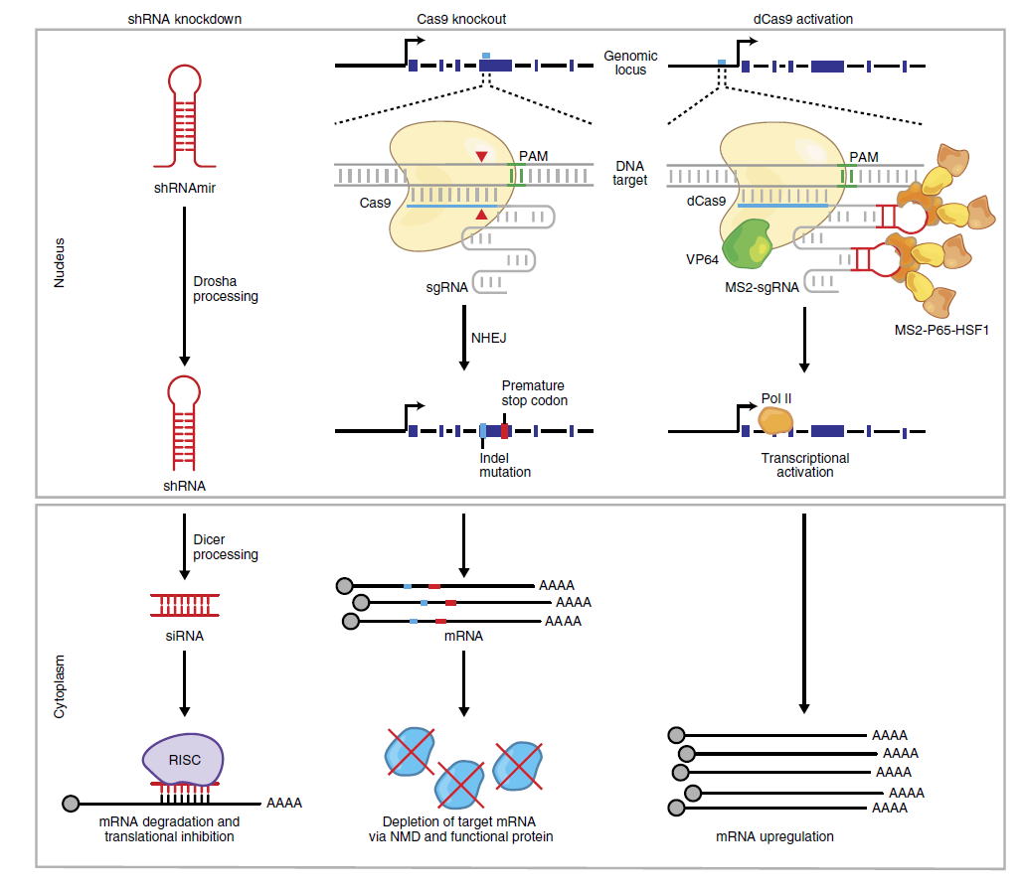
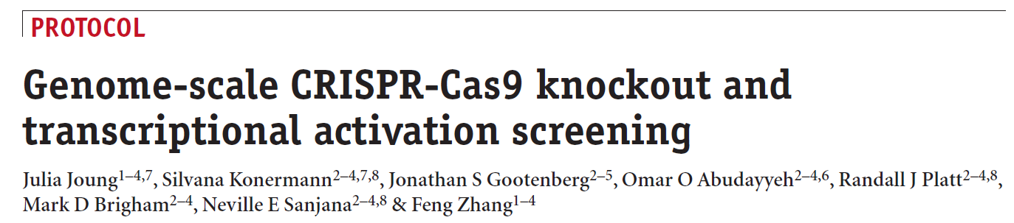
Notes:
Genome-scale CRISPR-Cas9 Knockout and Transcriptional Activation Screening

Slide 2
CRISPR/Cas9
CRISPRa cas9核酸酶活性缺失
VP64 domain
recruiting multiple activation domains to the dCas9 complex
CRISPRi cas9核酸酶活性缺失
KRAB
CRISPR-Cas9 + sgRNA pool
CRISPR-Cas9 screening：
GeCKO：CRISPR-Cas9 knockout
LOF
SAM: synergistic activation mediator
GOF
Array screens
Positive
Resistance to drug, toxin, pathogen
Negative
Essential genes, toxicity, synthetic lethal
Marker gene selection
Not enriched or depleted
Pooled screens

Slide 3
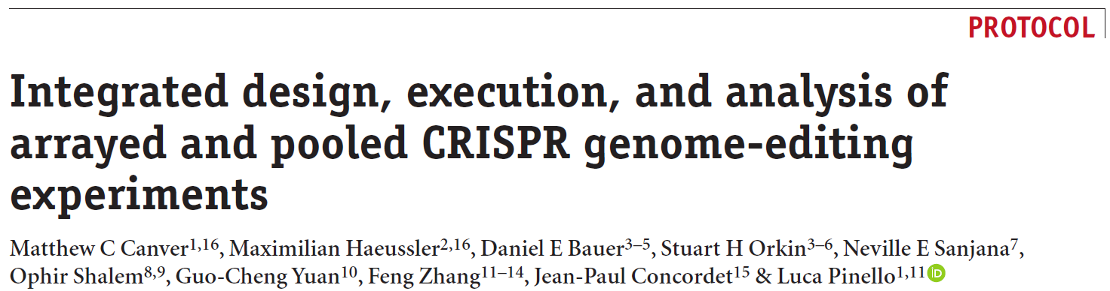

Slide 4
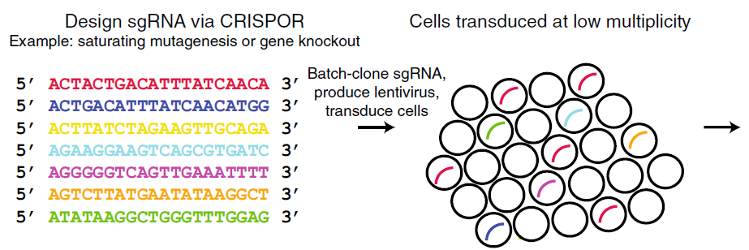
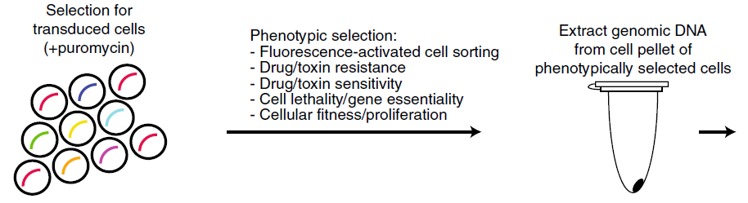
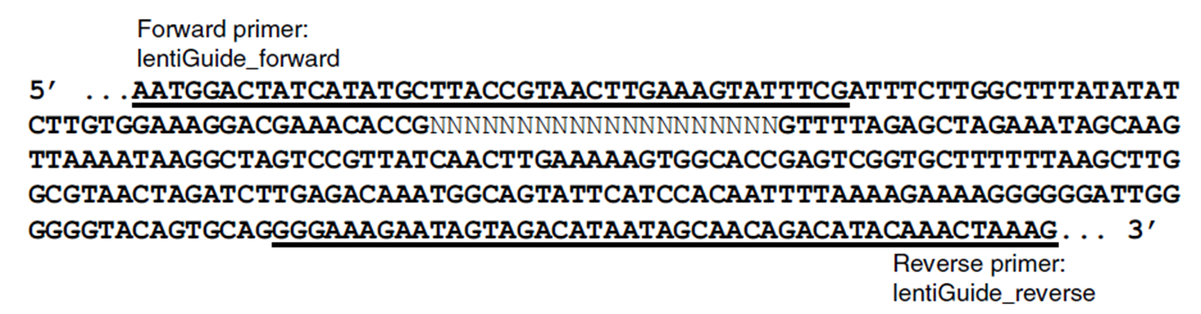
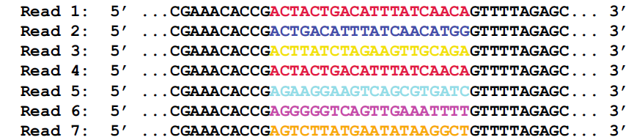
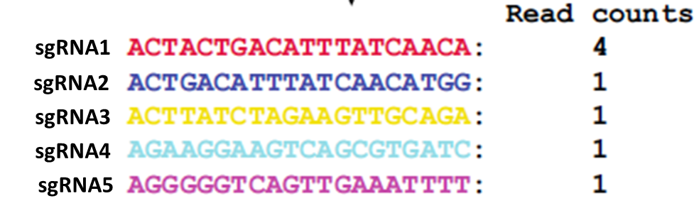
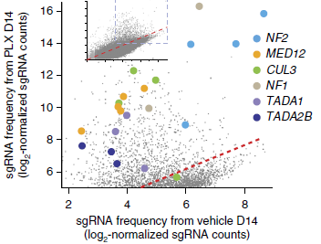
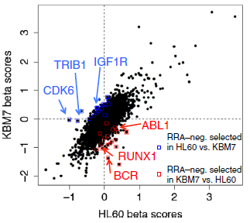
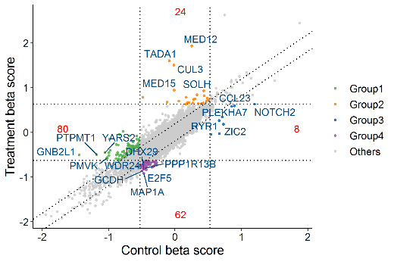
Pooled screens
PCR with primers from DNA
NGS
Data preprocess
Visualization
Analysis
Notes:
Integrated design, execution, and analysis of arrayed and pooled CRISPR genome-editing experiments

