Slide 1
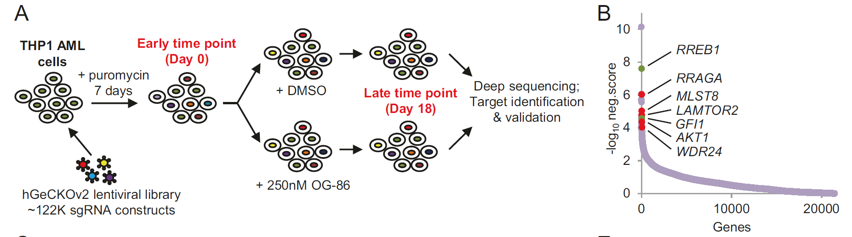
分析流程
参考文献：Pre-clinical activity of combined LSD1 and mTORC1 inhibition in MLL-translocated acute myeloid leukaemia
数据集：GSE126486
细胞系： THP1，Acute Myeloid Leukemia
LSD1 组氨酸 (赖氨酸特异的) 去甲基化酶1，是一个therapeutic target in AML。
研究目的： 为了identify gens/pathways that collaborate with LSD1 to maintain the leukemic phenotype, which could be targeted by combination therapies.
研究方法： genome-wide CRISRP screening

Slide 2
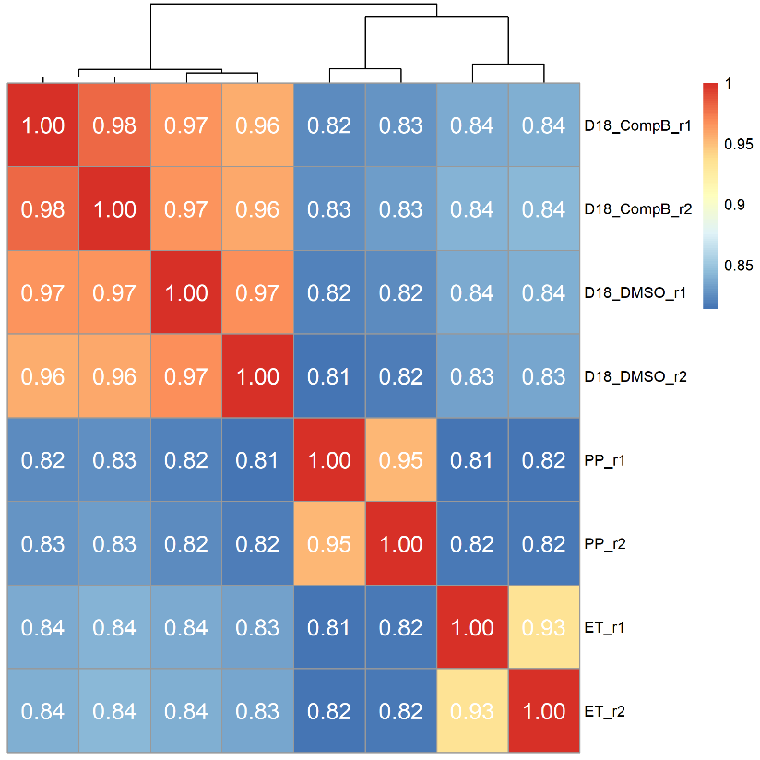
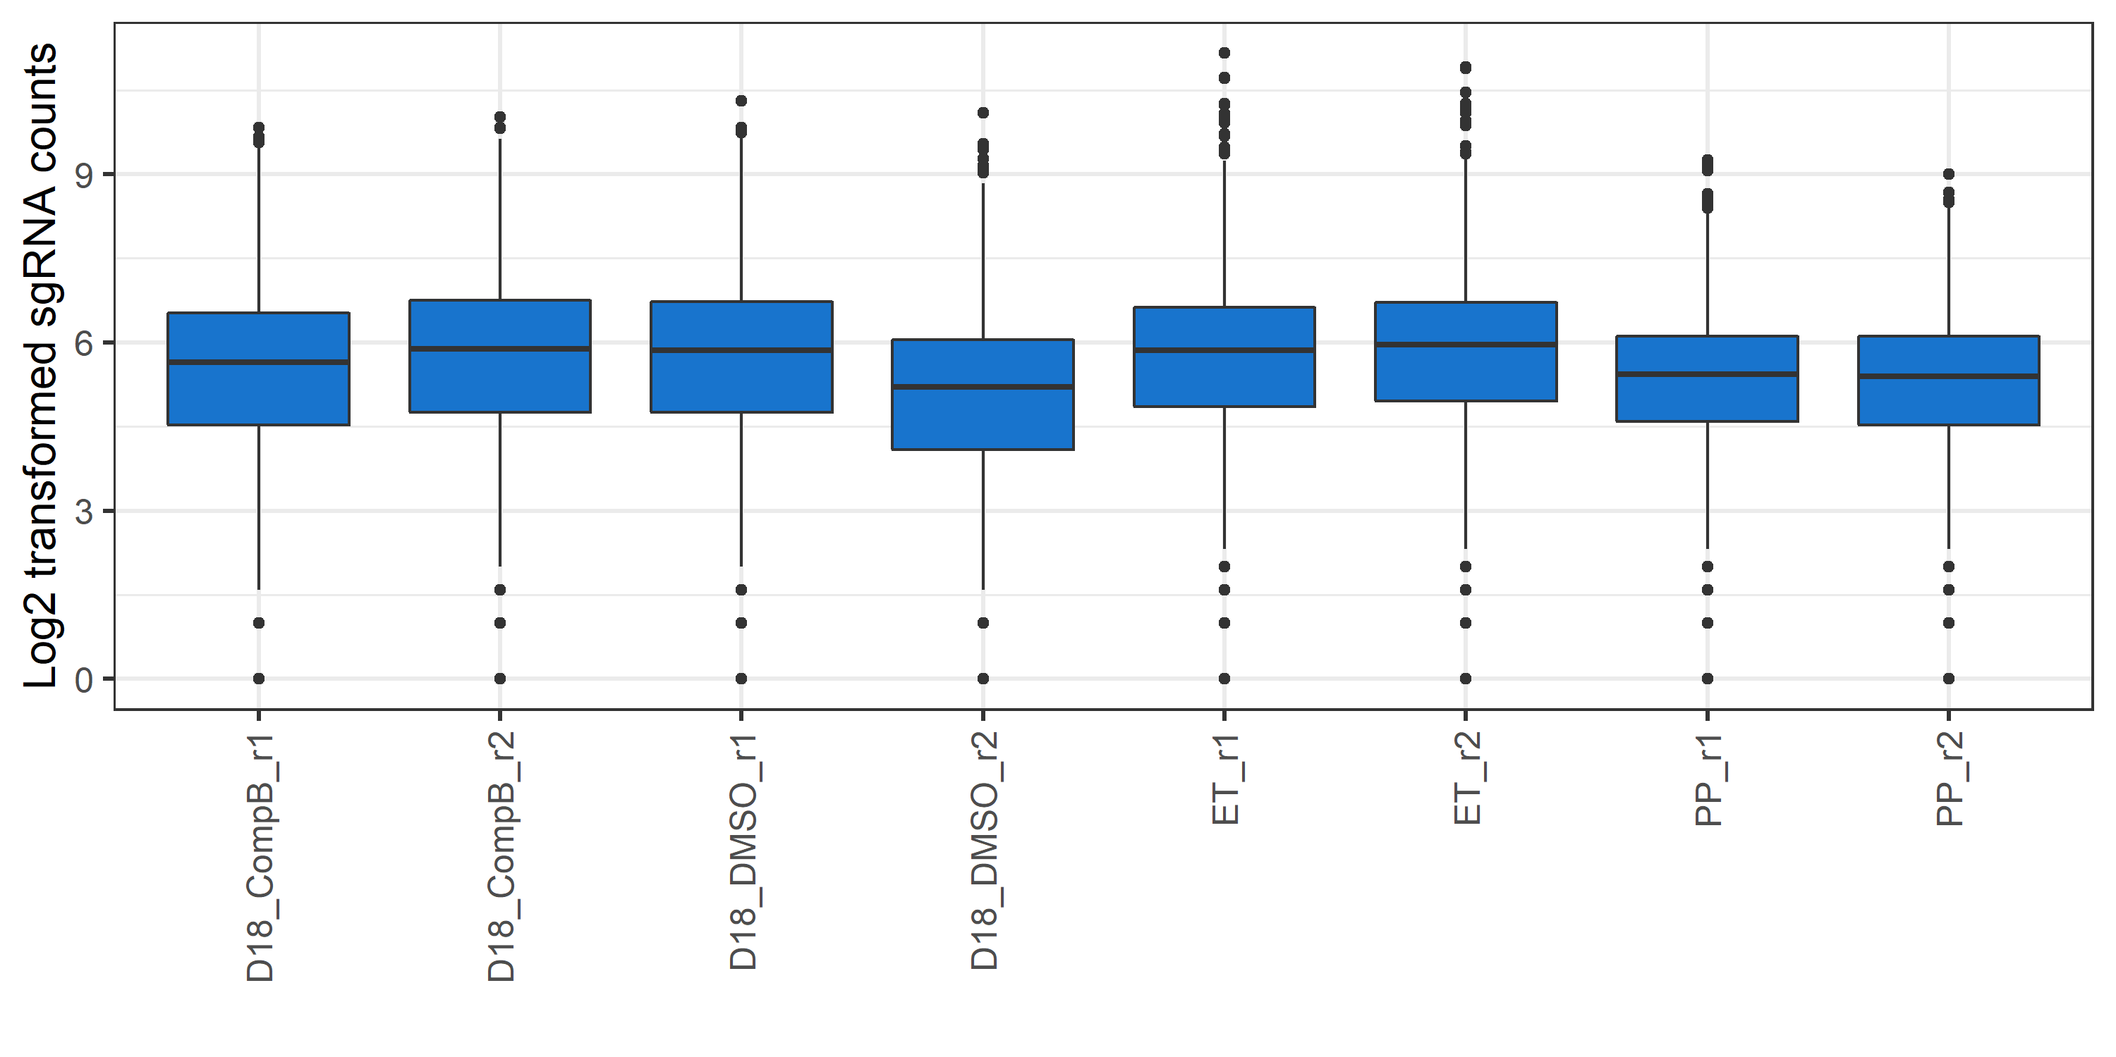
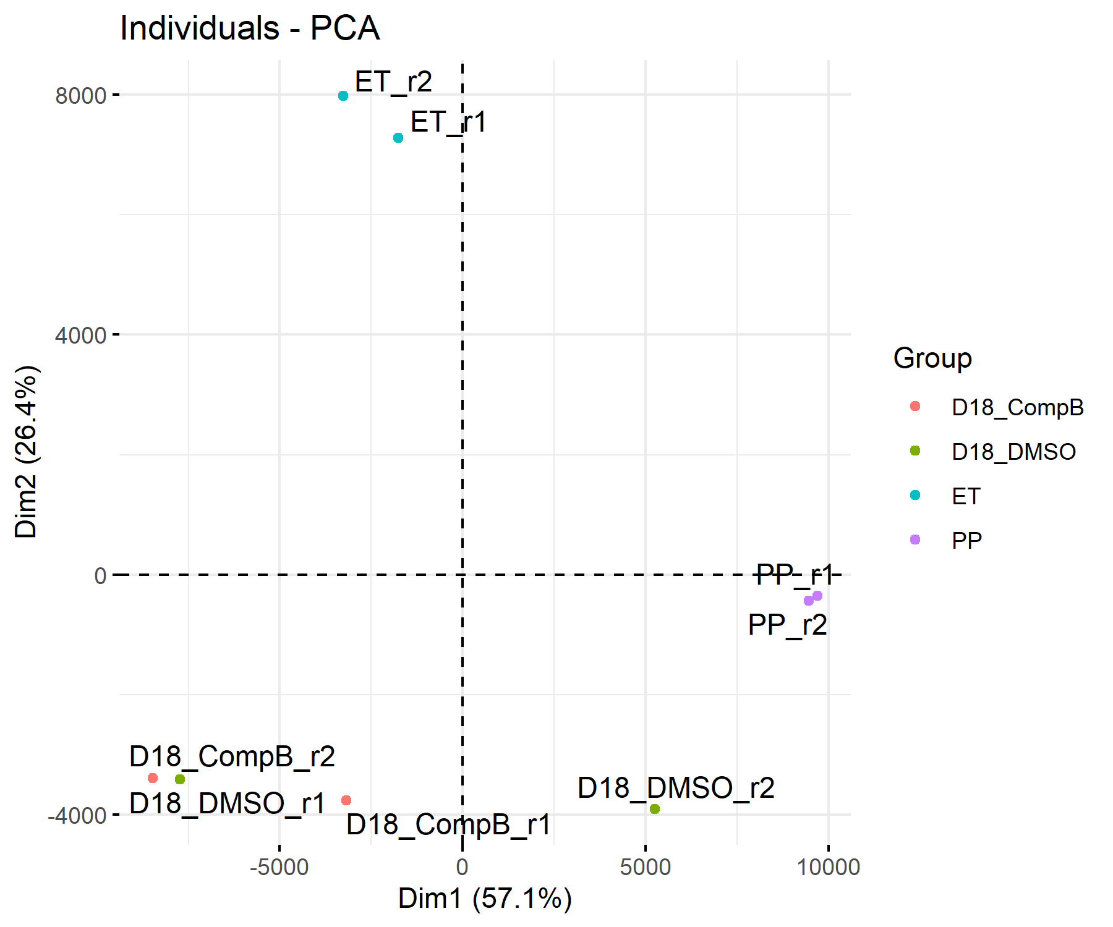
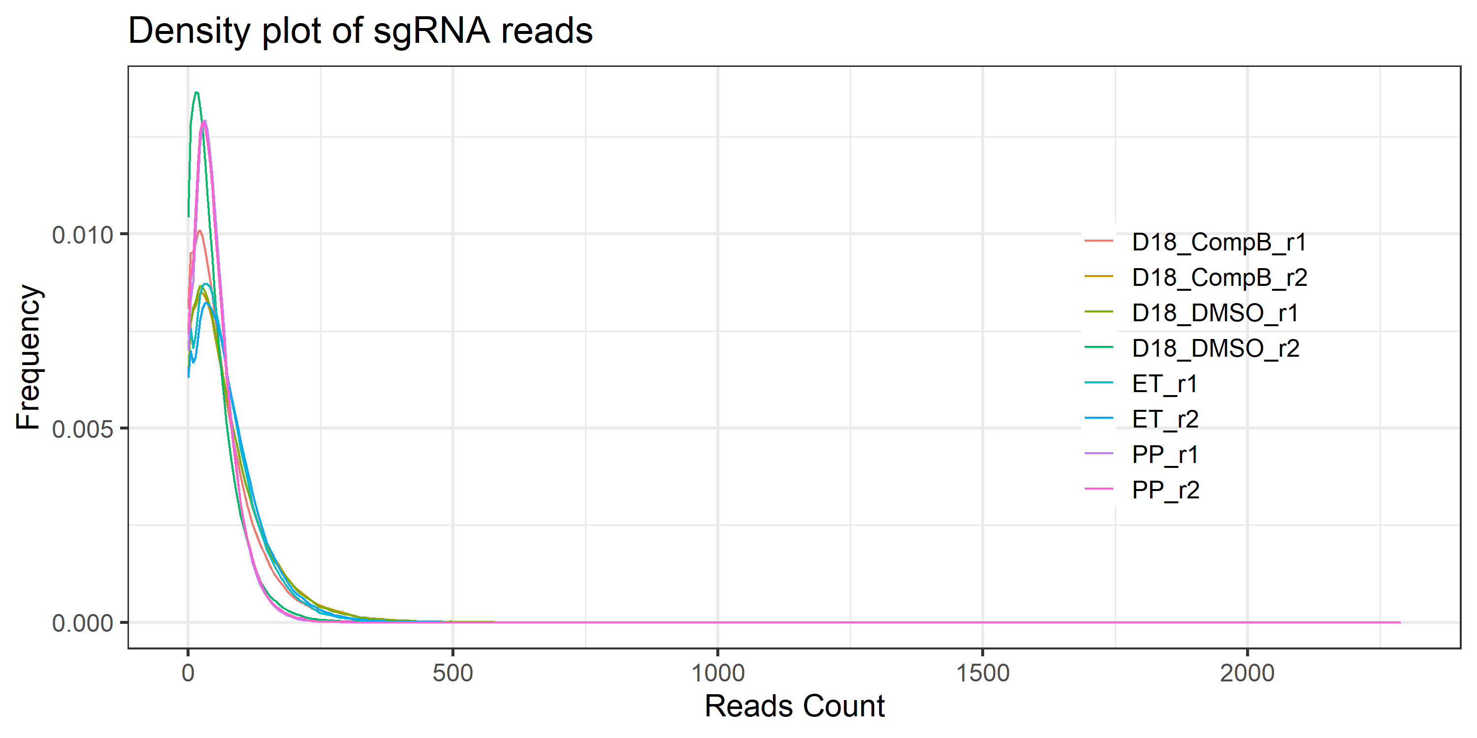
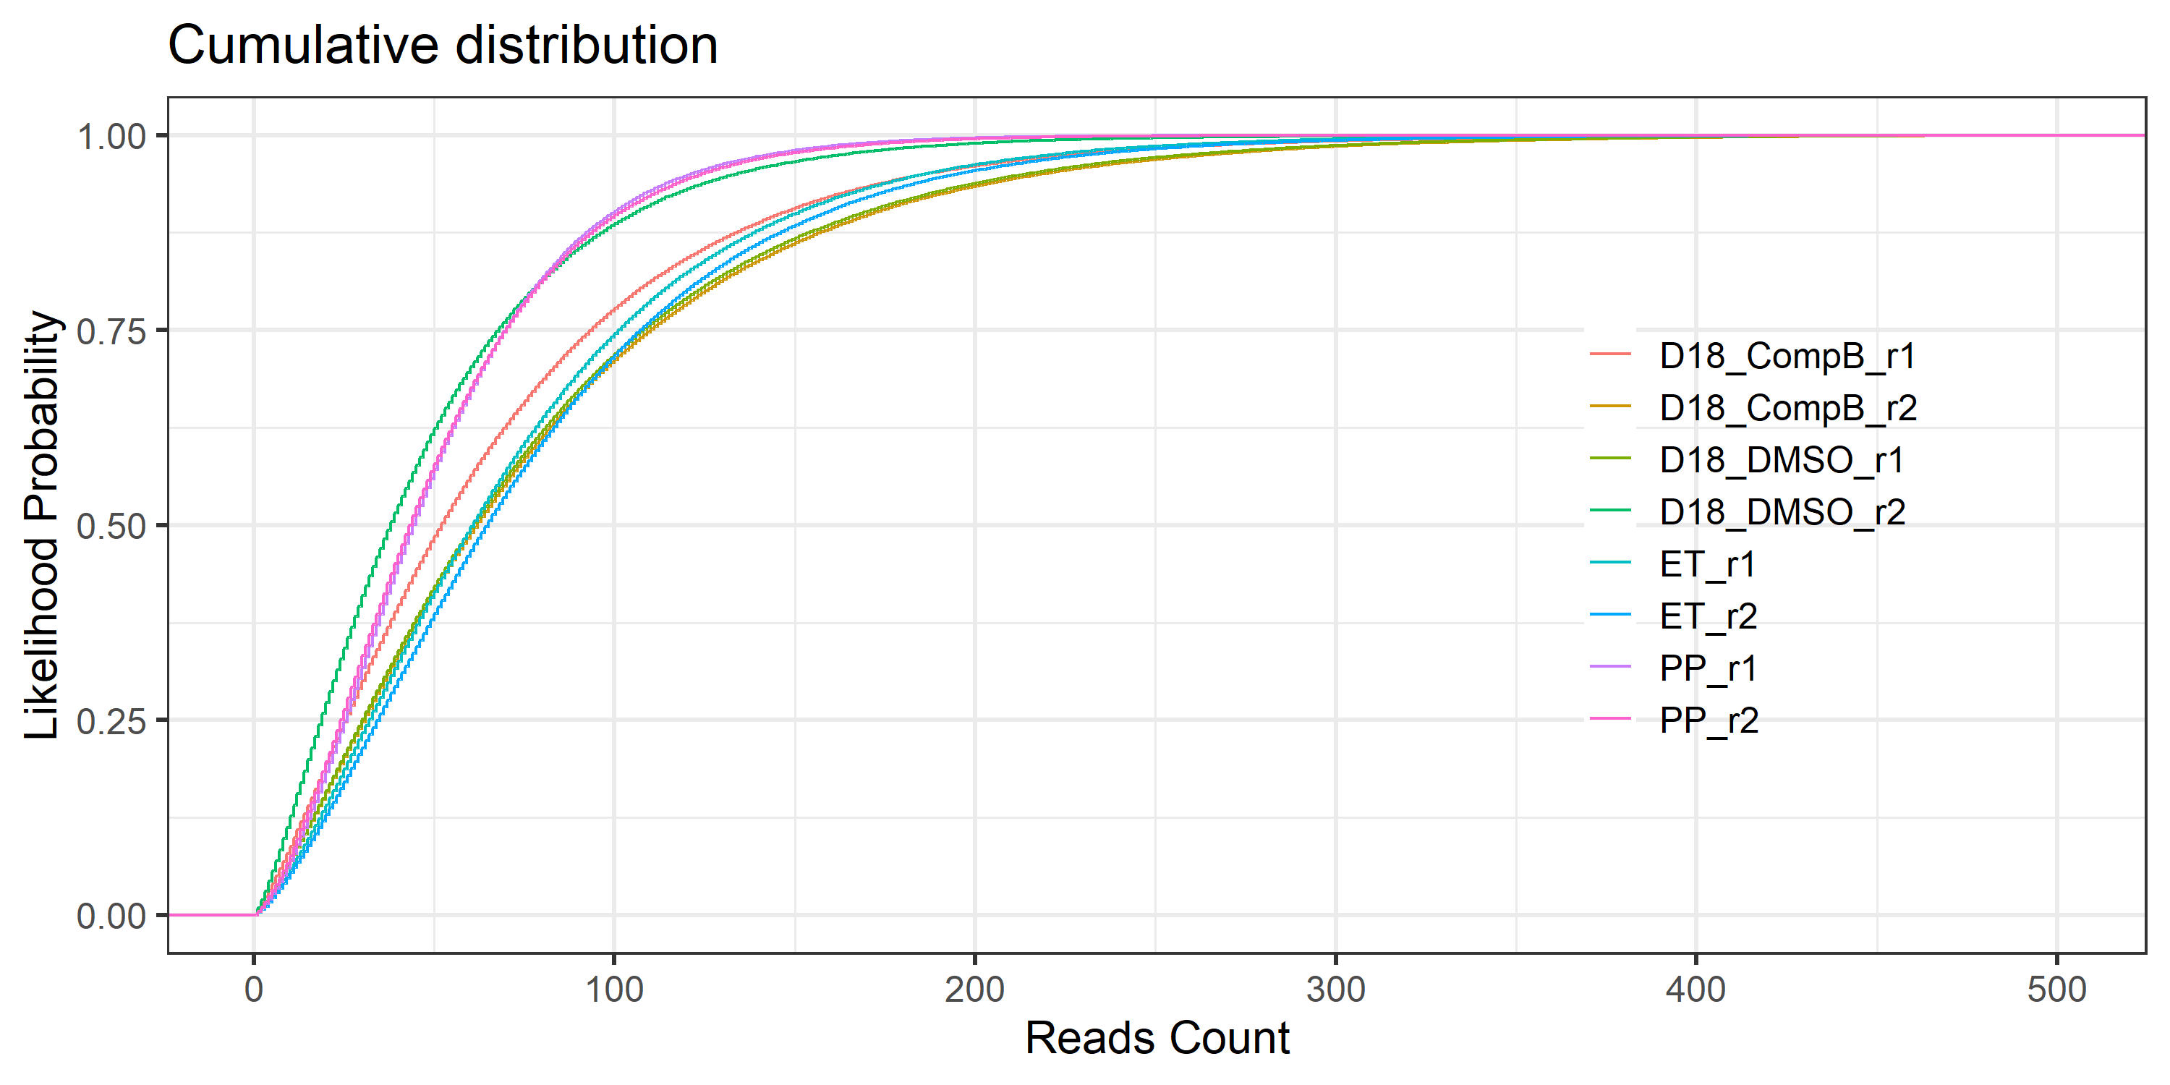
QC of sgRNA and samples
sgRNA counts 值相对较低<100，分布整体上是均匀
相关性和PCA分析，DMSO组和CompB组有些overlap，质控有些低

Slide 3
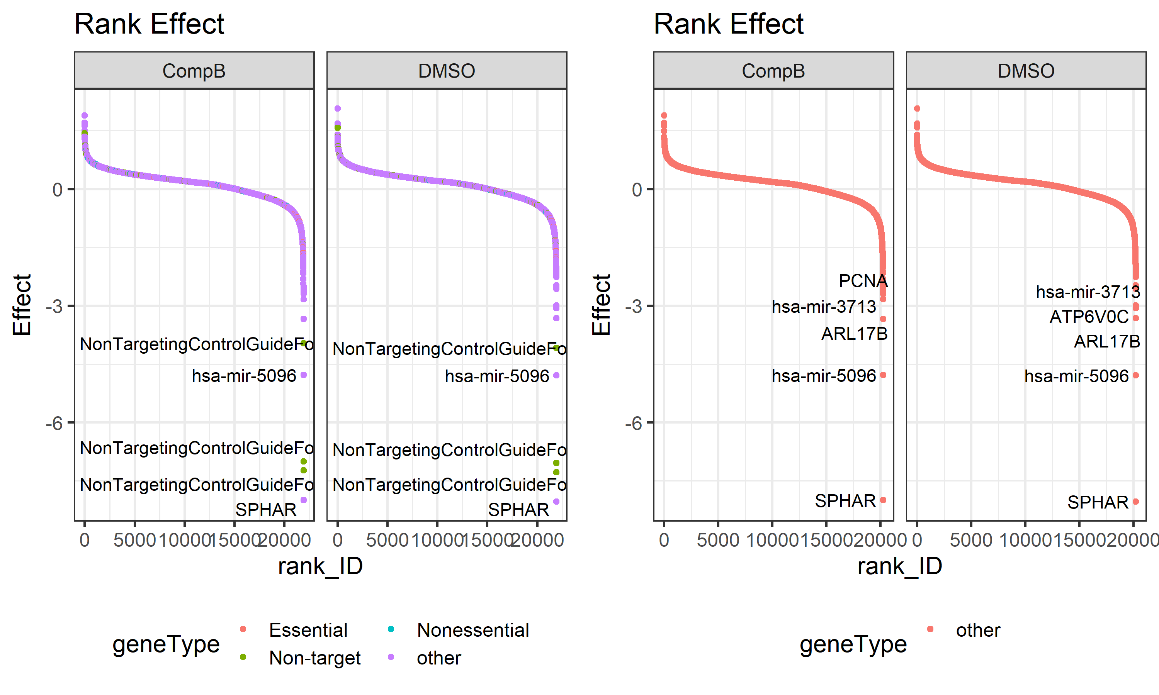
Rank of gene effect

Slide 4
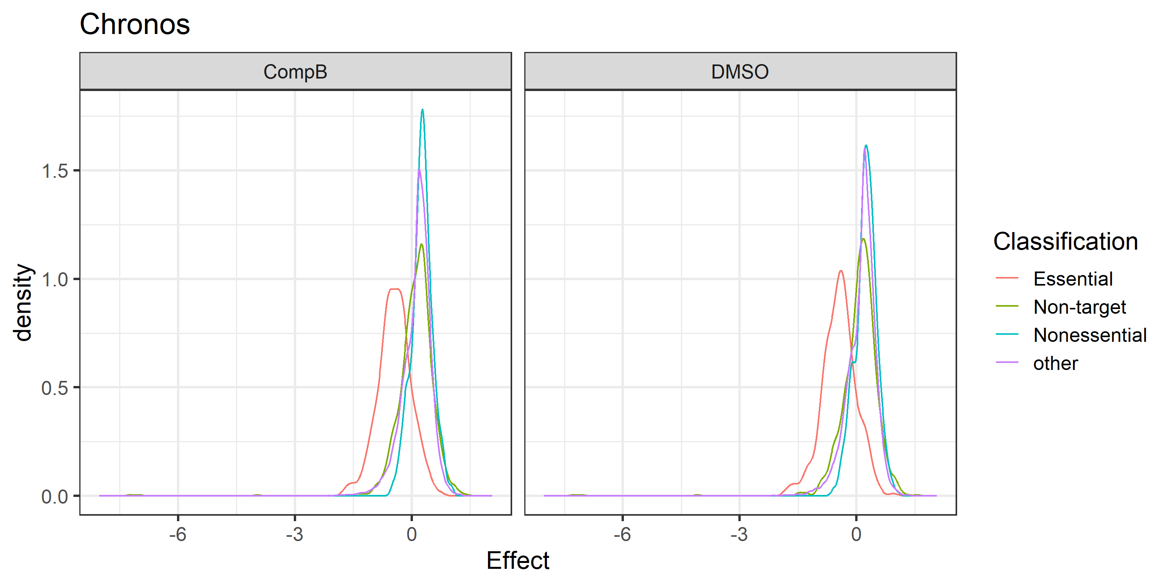
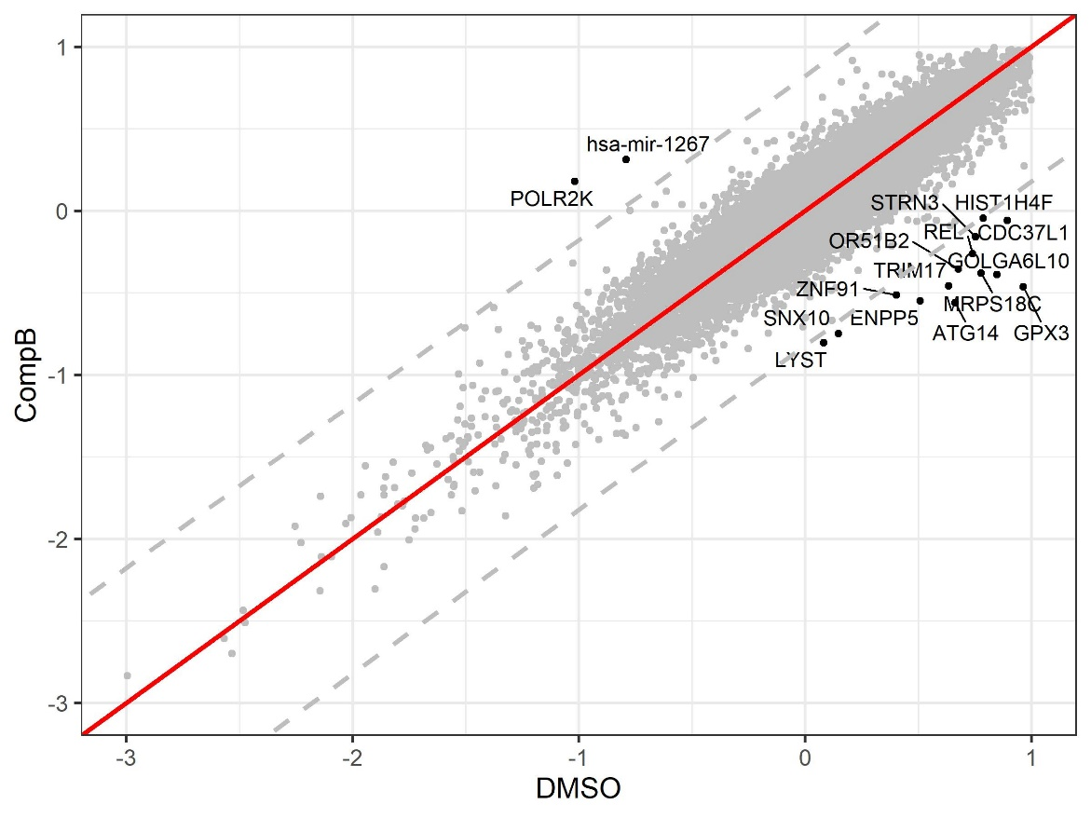
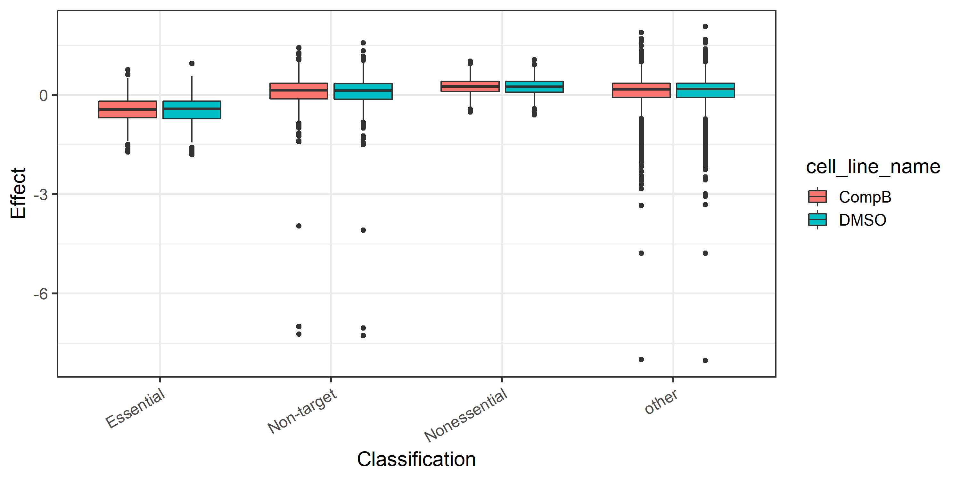
Results of Chronos analysis
Gene | y | x | y_dist
LYST | -0.80357 | 0.082439 | -0.62651
SNX10 | -0.74851 | 0.146749 | -0.63304
ATG14 | -0.55974 | 0.663675 | -0.86508
ENPP5 | -0.55021 | 0.508096 | -0.74833
ZNF91 | -0.51284 | 0.404411 | -0.6486
GPX3 | -0.46255 | 0.963883 | -1.00864
Overall, this CRISPR screen works well. Essential gene effect around -0.75, non-target and non-essential around 0. But there’re some outliers in non-target indicating low QC
CompB vs DMSO to screen candidate targets

Slide 5
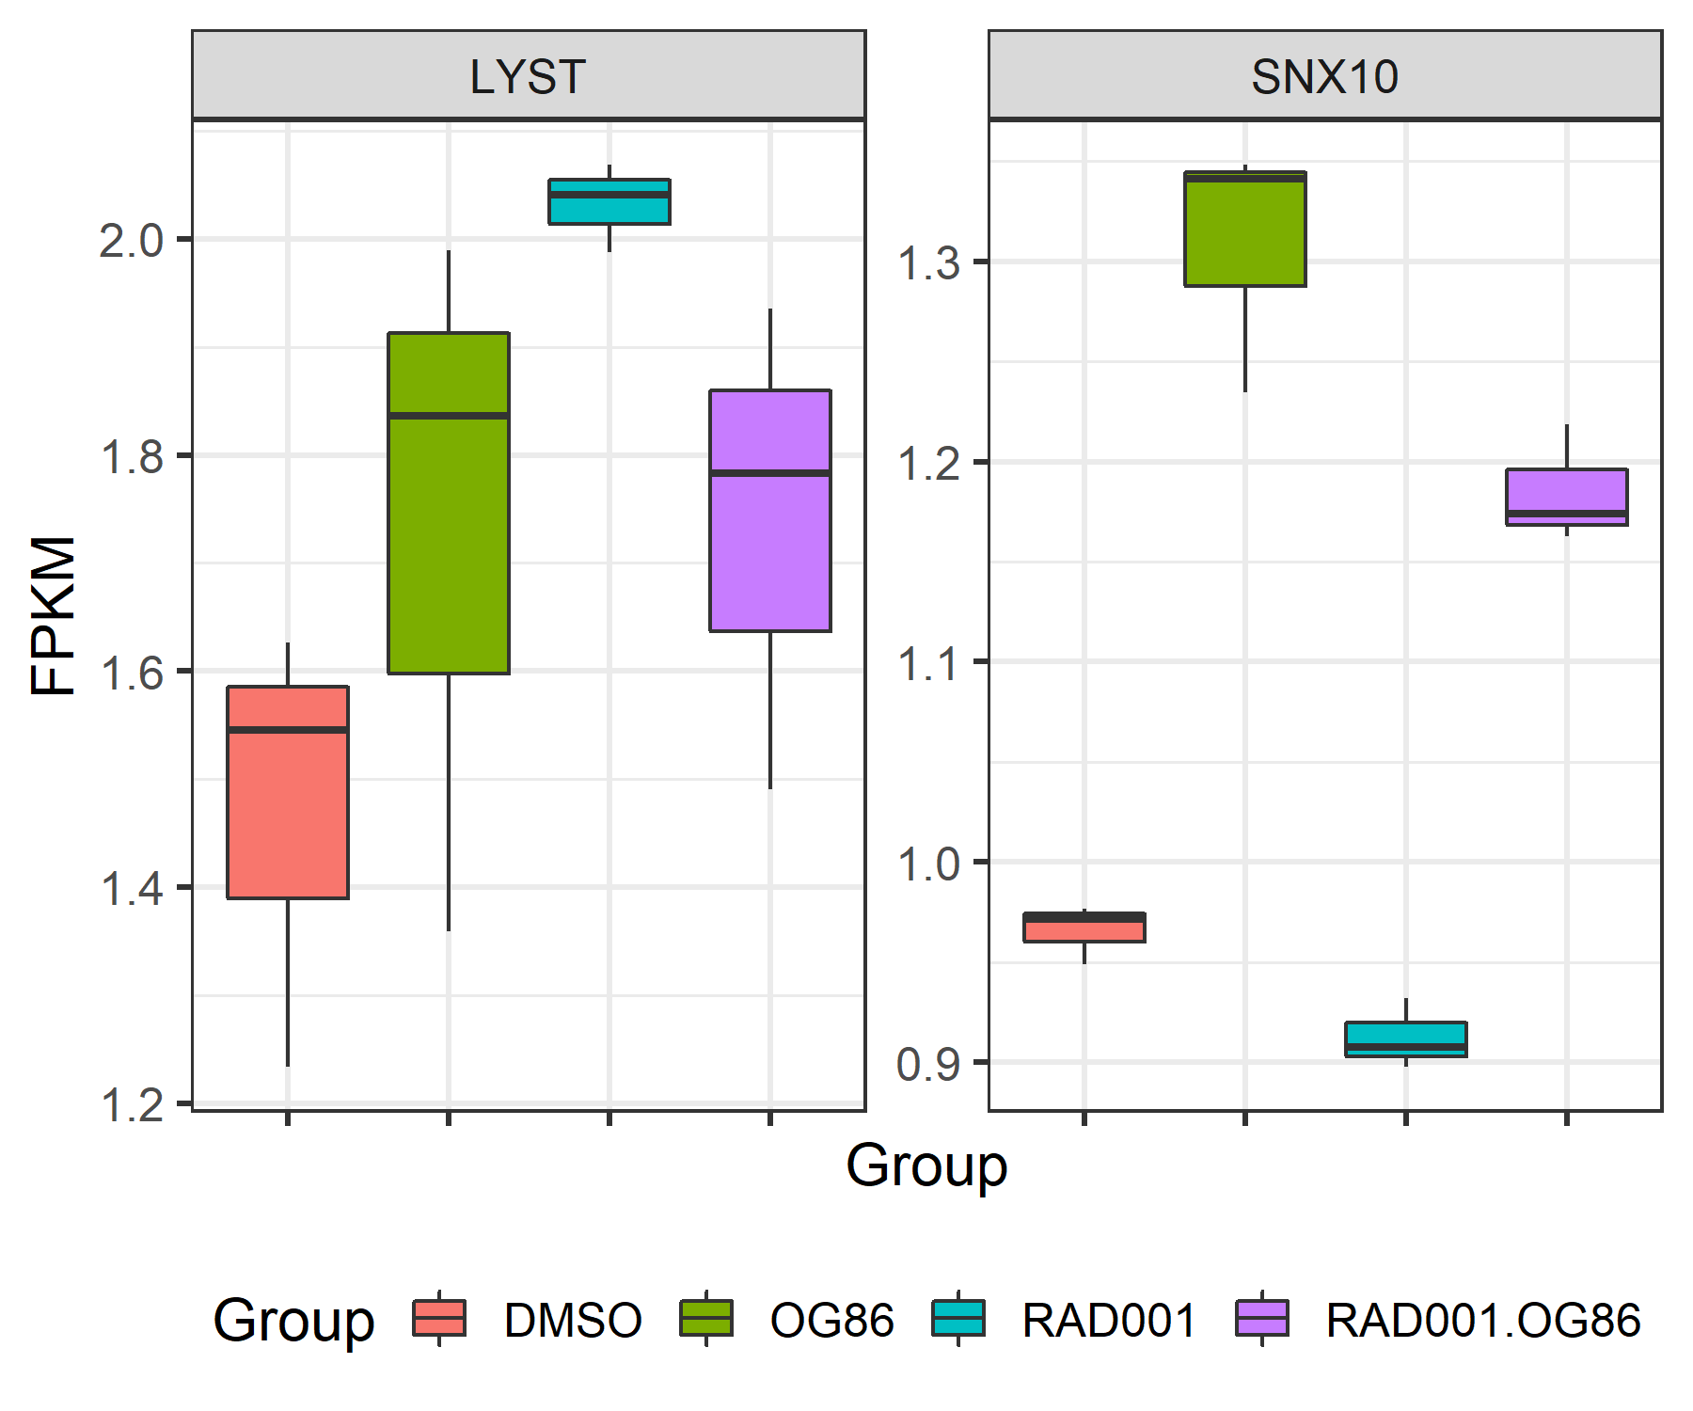
Validation of targets by RNA-Seq
LYST: lysosomal trafficking regulator, regulates intracellular protein trafficking in endosomes, and may be involved in pigmentation
SNX10: This gene may play a role in regulating endosome homeostasis, involved in intracellular trafficking
核内体异常（LYST, SNX10 knockout），可能与LSD1 inhibitor 有synergistic effect

Slide 6
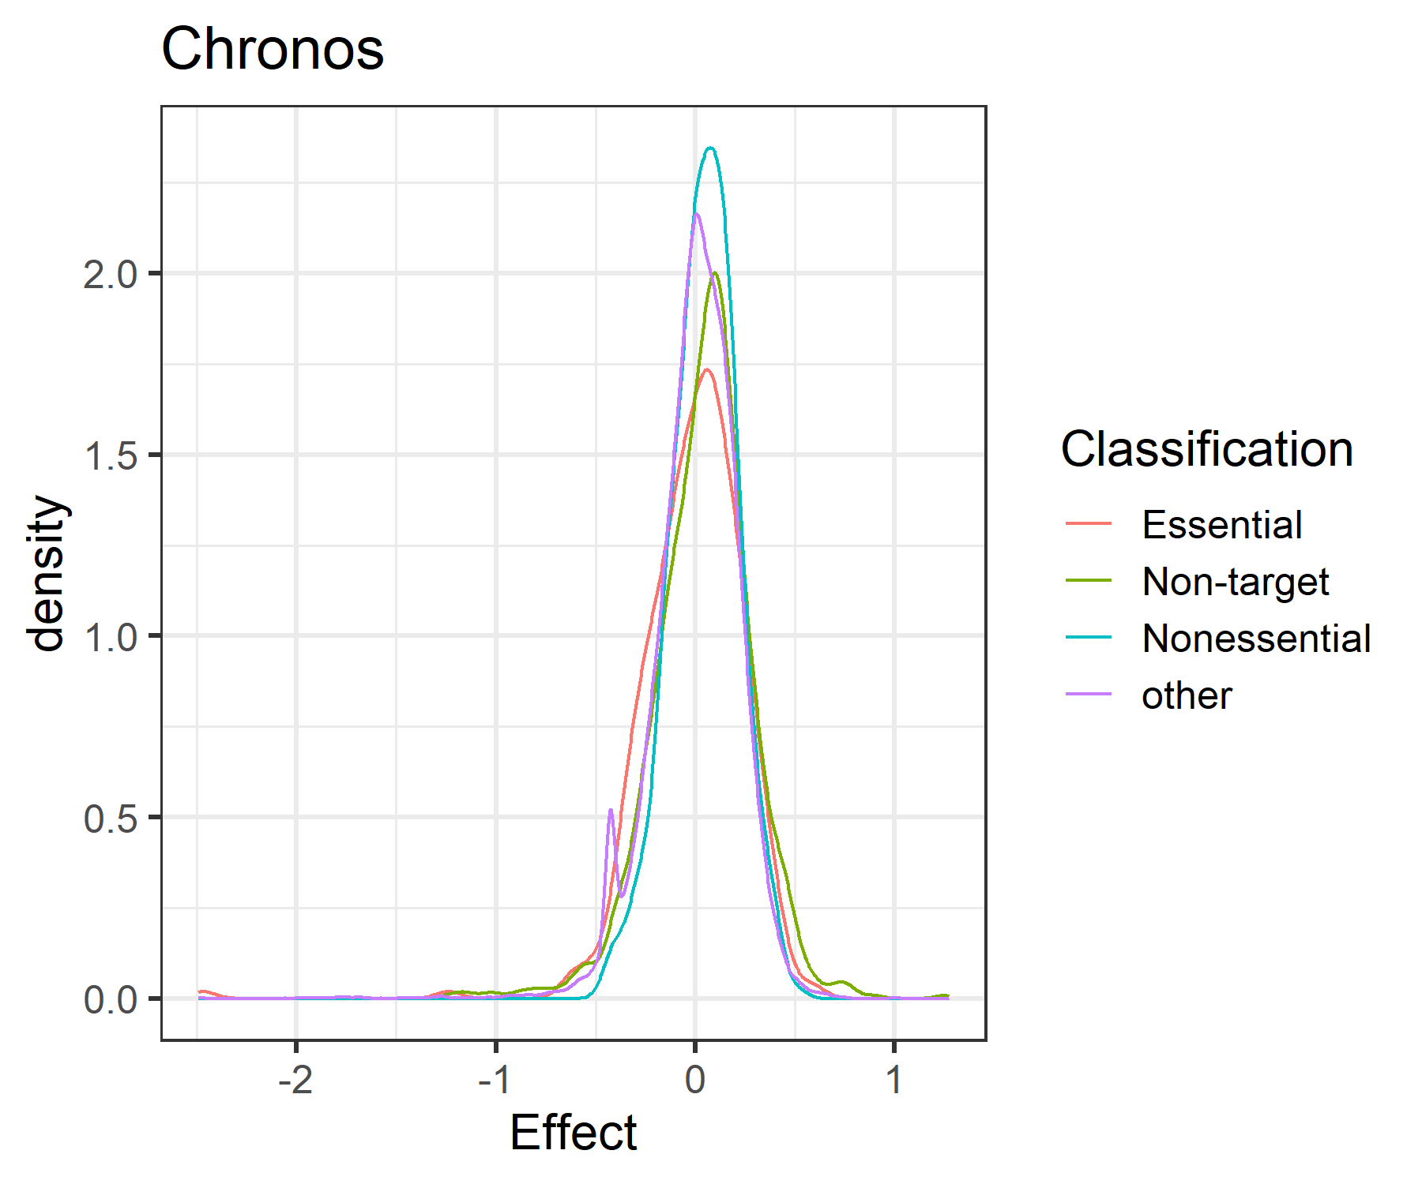
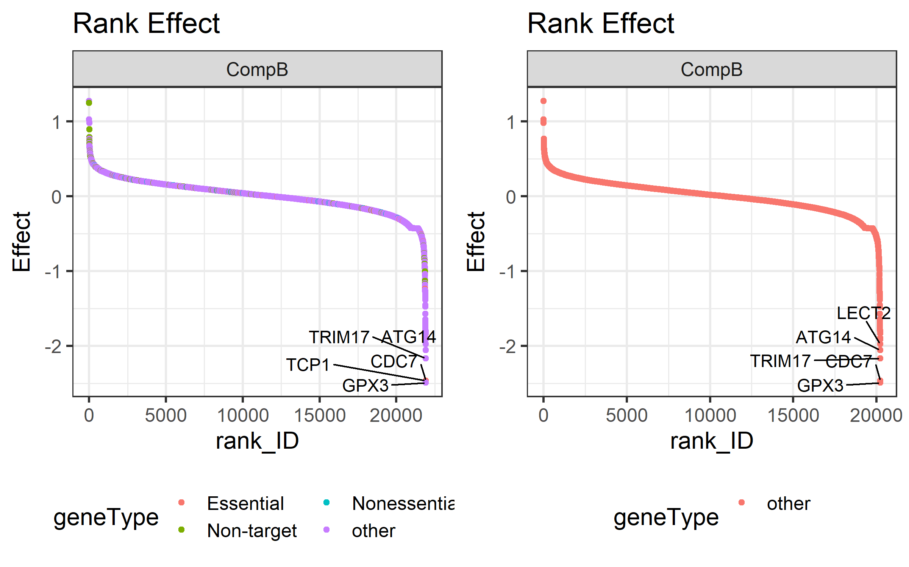
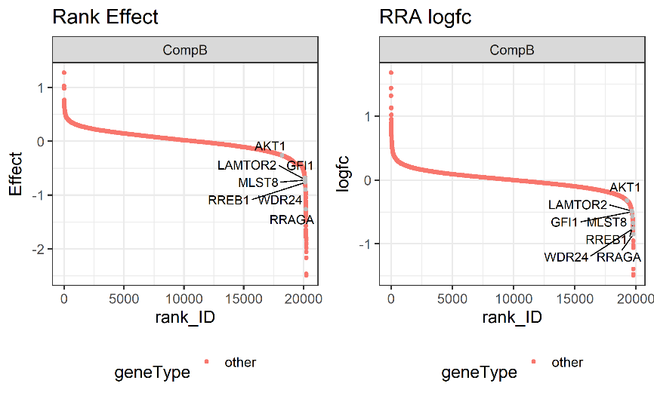
Strategy2: comparing Compoud vs DMSO directly with Chronos
能够找到一些新的targets： GPX3, TCP1, CDC7等
A 所有基因的Rank
B other基因的Rank
可以和文章中分析结果部分overlap
C paper reported genes in the ranking Effect derived from Chronos
D ranking logFC derived from RRA
和pDNA的比较，可以做质控，看到essential gene effect与non-essential直接分开；comp vs DMSO 则无法看出这种效果，

Slide 7
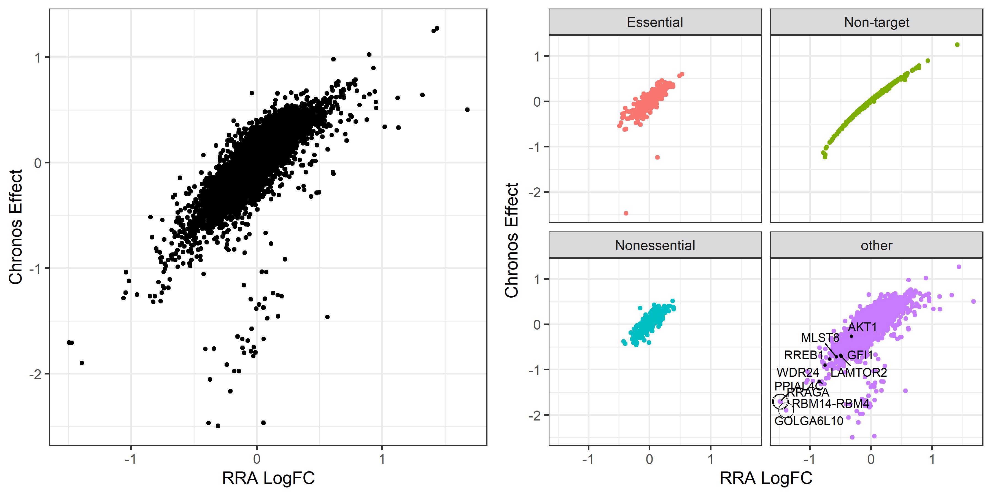
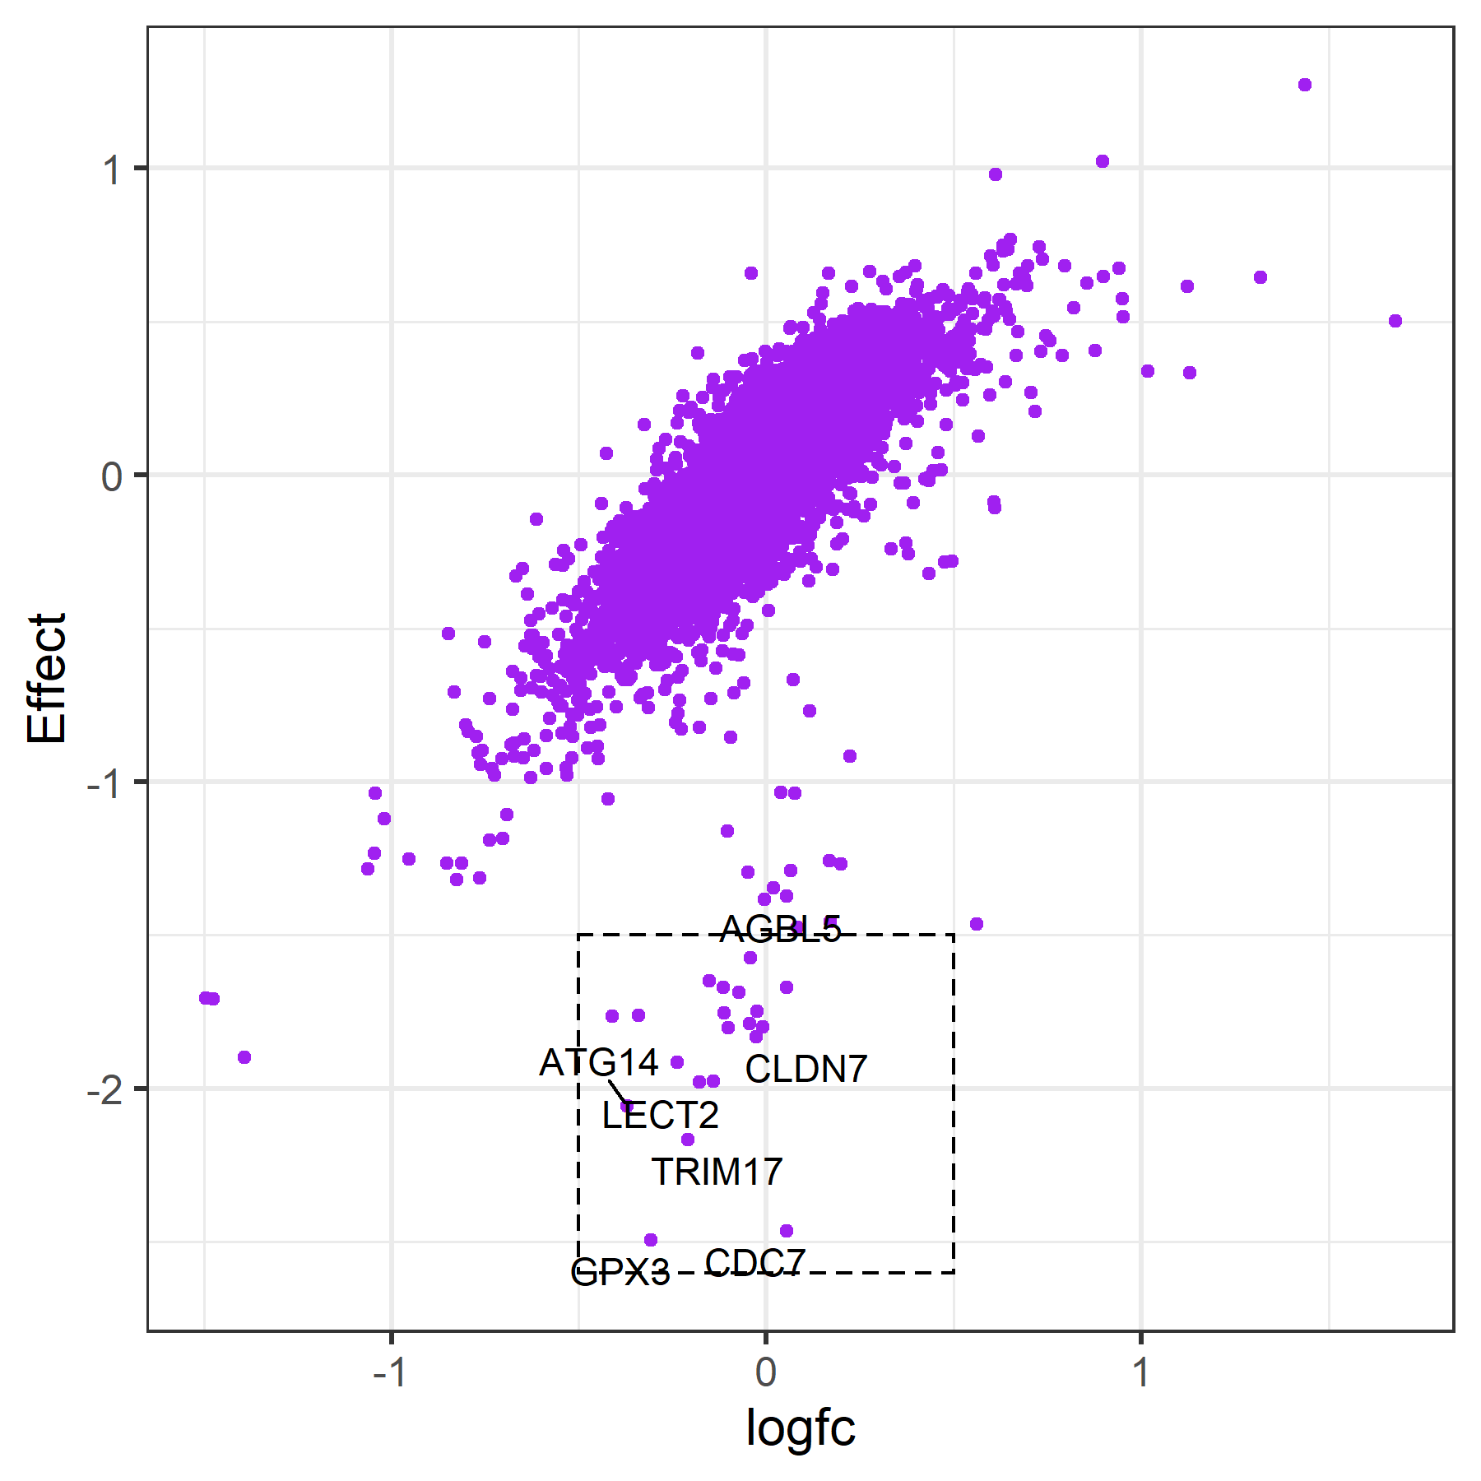
Strategy2: comparing Compoud vs DMSO directly with Chronos
RRA 和 Chronos分析结果一如既往的一致，尤其是Essential, non-target, Non-essential genes的结果。
即便在other也是有一定一致性，其中Chronos似乎检测更多essential genes，而RRA可能会漏掉一些essential genes: rra_chronos.csv

Slide 8
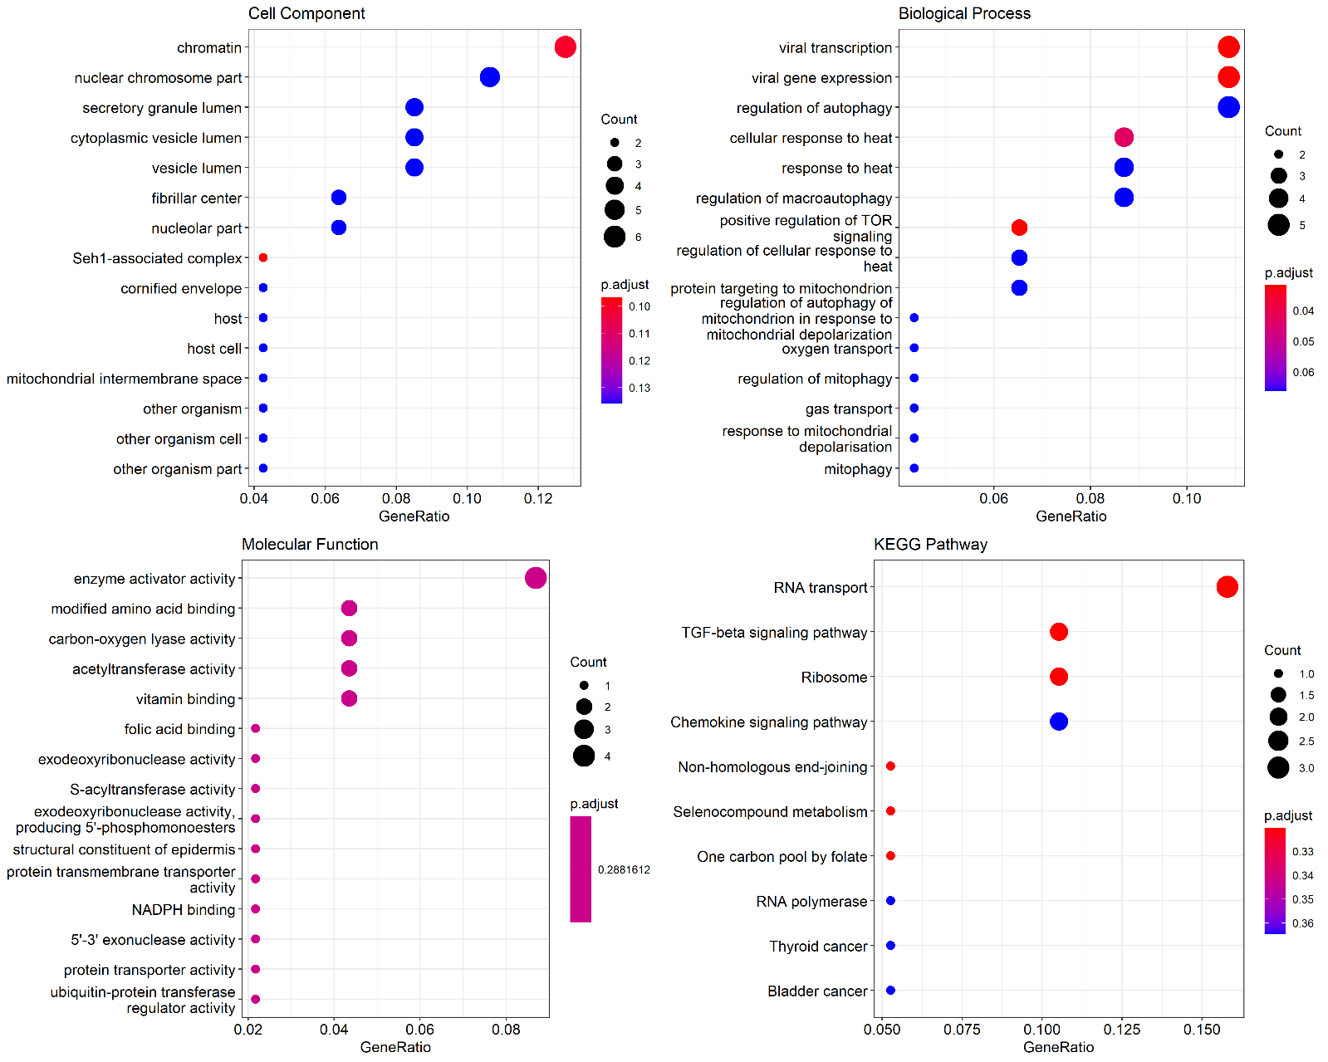
Functional enrichment analysis of essential genes
Effect < -1.5 的基因进行功能分析：novel_genes
一致性高，且Effect < -0.5 的基因: consistent_genes

Slide 9
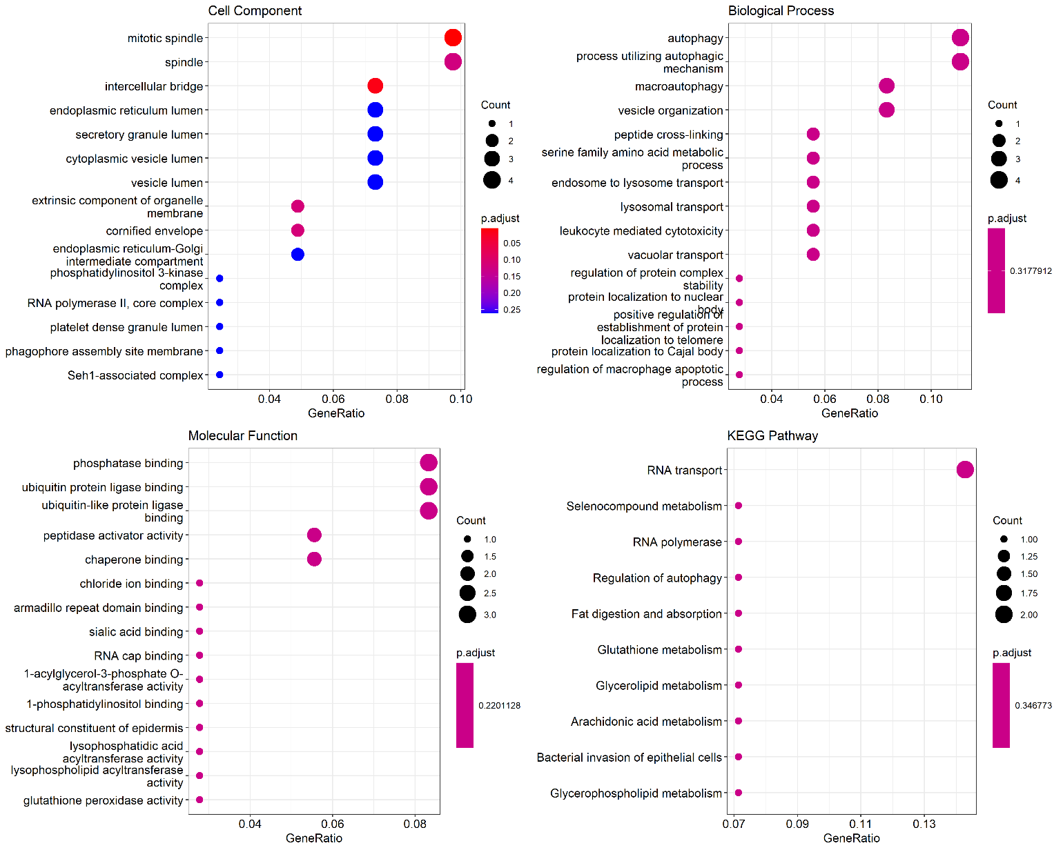
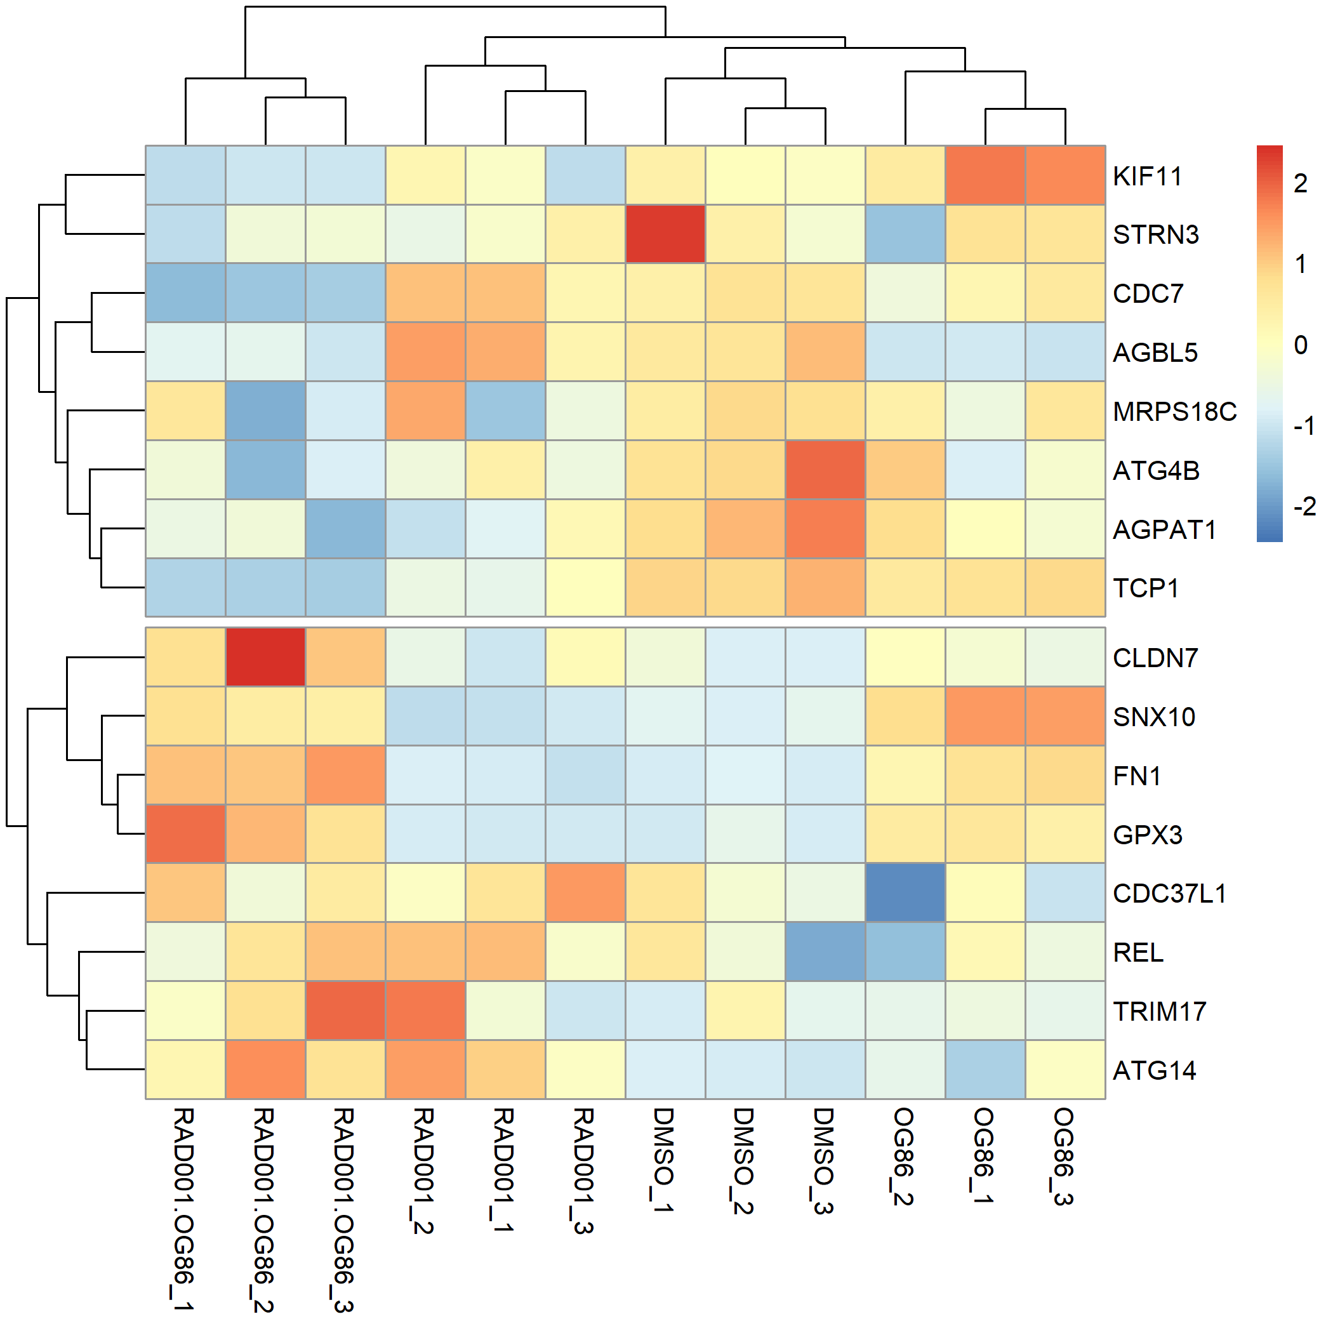
Effect < -1 的基因进行功能分析：novel_genes

