Slide 1
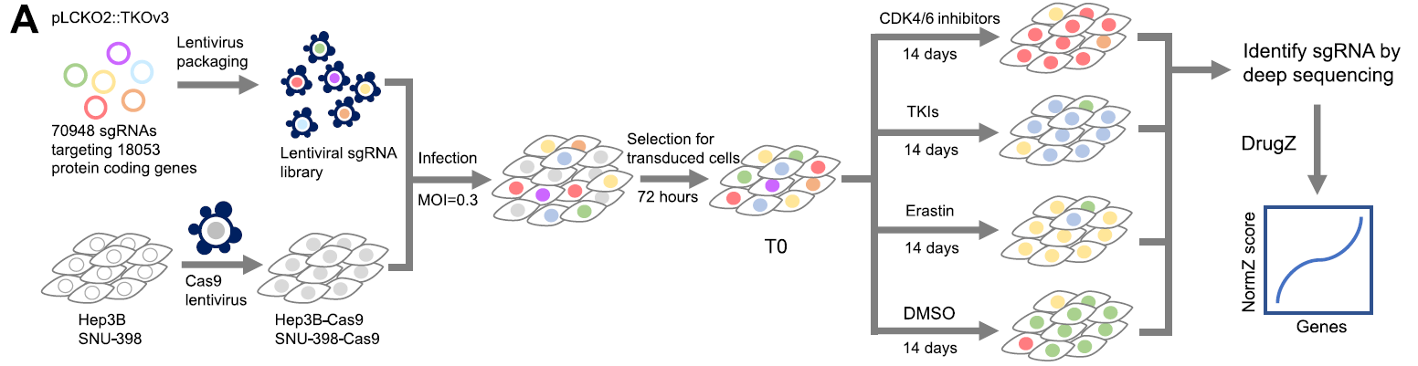
分析流程
参考文献：CRISPR screens uncover protective effect of PSTK as a regulator of chemotherapy-induced ferroptosis in hepatocellular carcinoma
数据集：GSE182185
细胞系： Hep3B, SNU-398
意义： 可以找到与多种化疗药物耐药相关的基因
实验设计
发现靶基因
验证靶基因
进行通路，功能分析
Conclusions:
Discovery: inhibition of phosphoseryl-tRNA kinase (PSTK) was found to increase HCC cell sensitivity to chemotherapeutic treatment
Mechanisms: PSTK was associated with the suppression of chemotherapy-induced ferroptosis in HCC cells, and the depletion of PSTK resulted in the inactivation of glutathione peroxidative 4 (GPX4) and the disruption of glutathione (GSH) metabolism owing to the inhibition of selenocysteine and cysteine synthesis, thus enhancing the induction of ferroptosis upon targeted chemotherapeutic treatment
Applications: punicalin, an agent used to treat hepatitis B virus (HBV), was identified as a possible PSTK inhibitor that exhibited synergistic efficacy when applied together with Sorafenib to treat HCC in vitro and in vivo

Slide 2
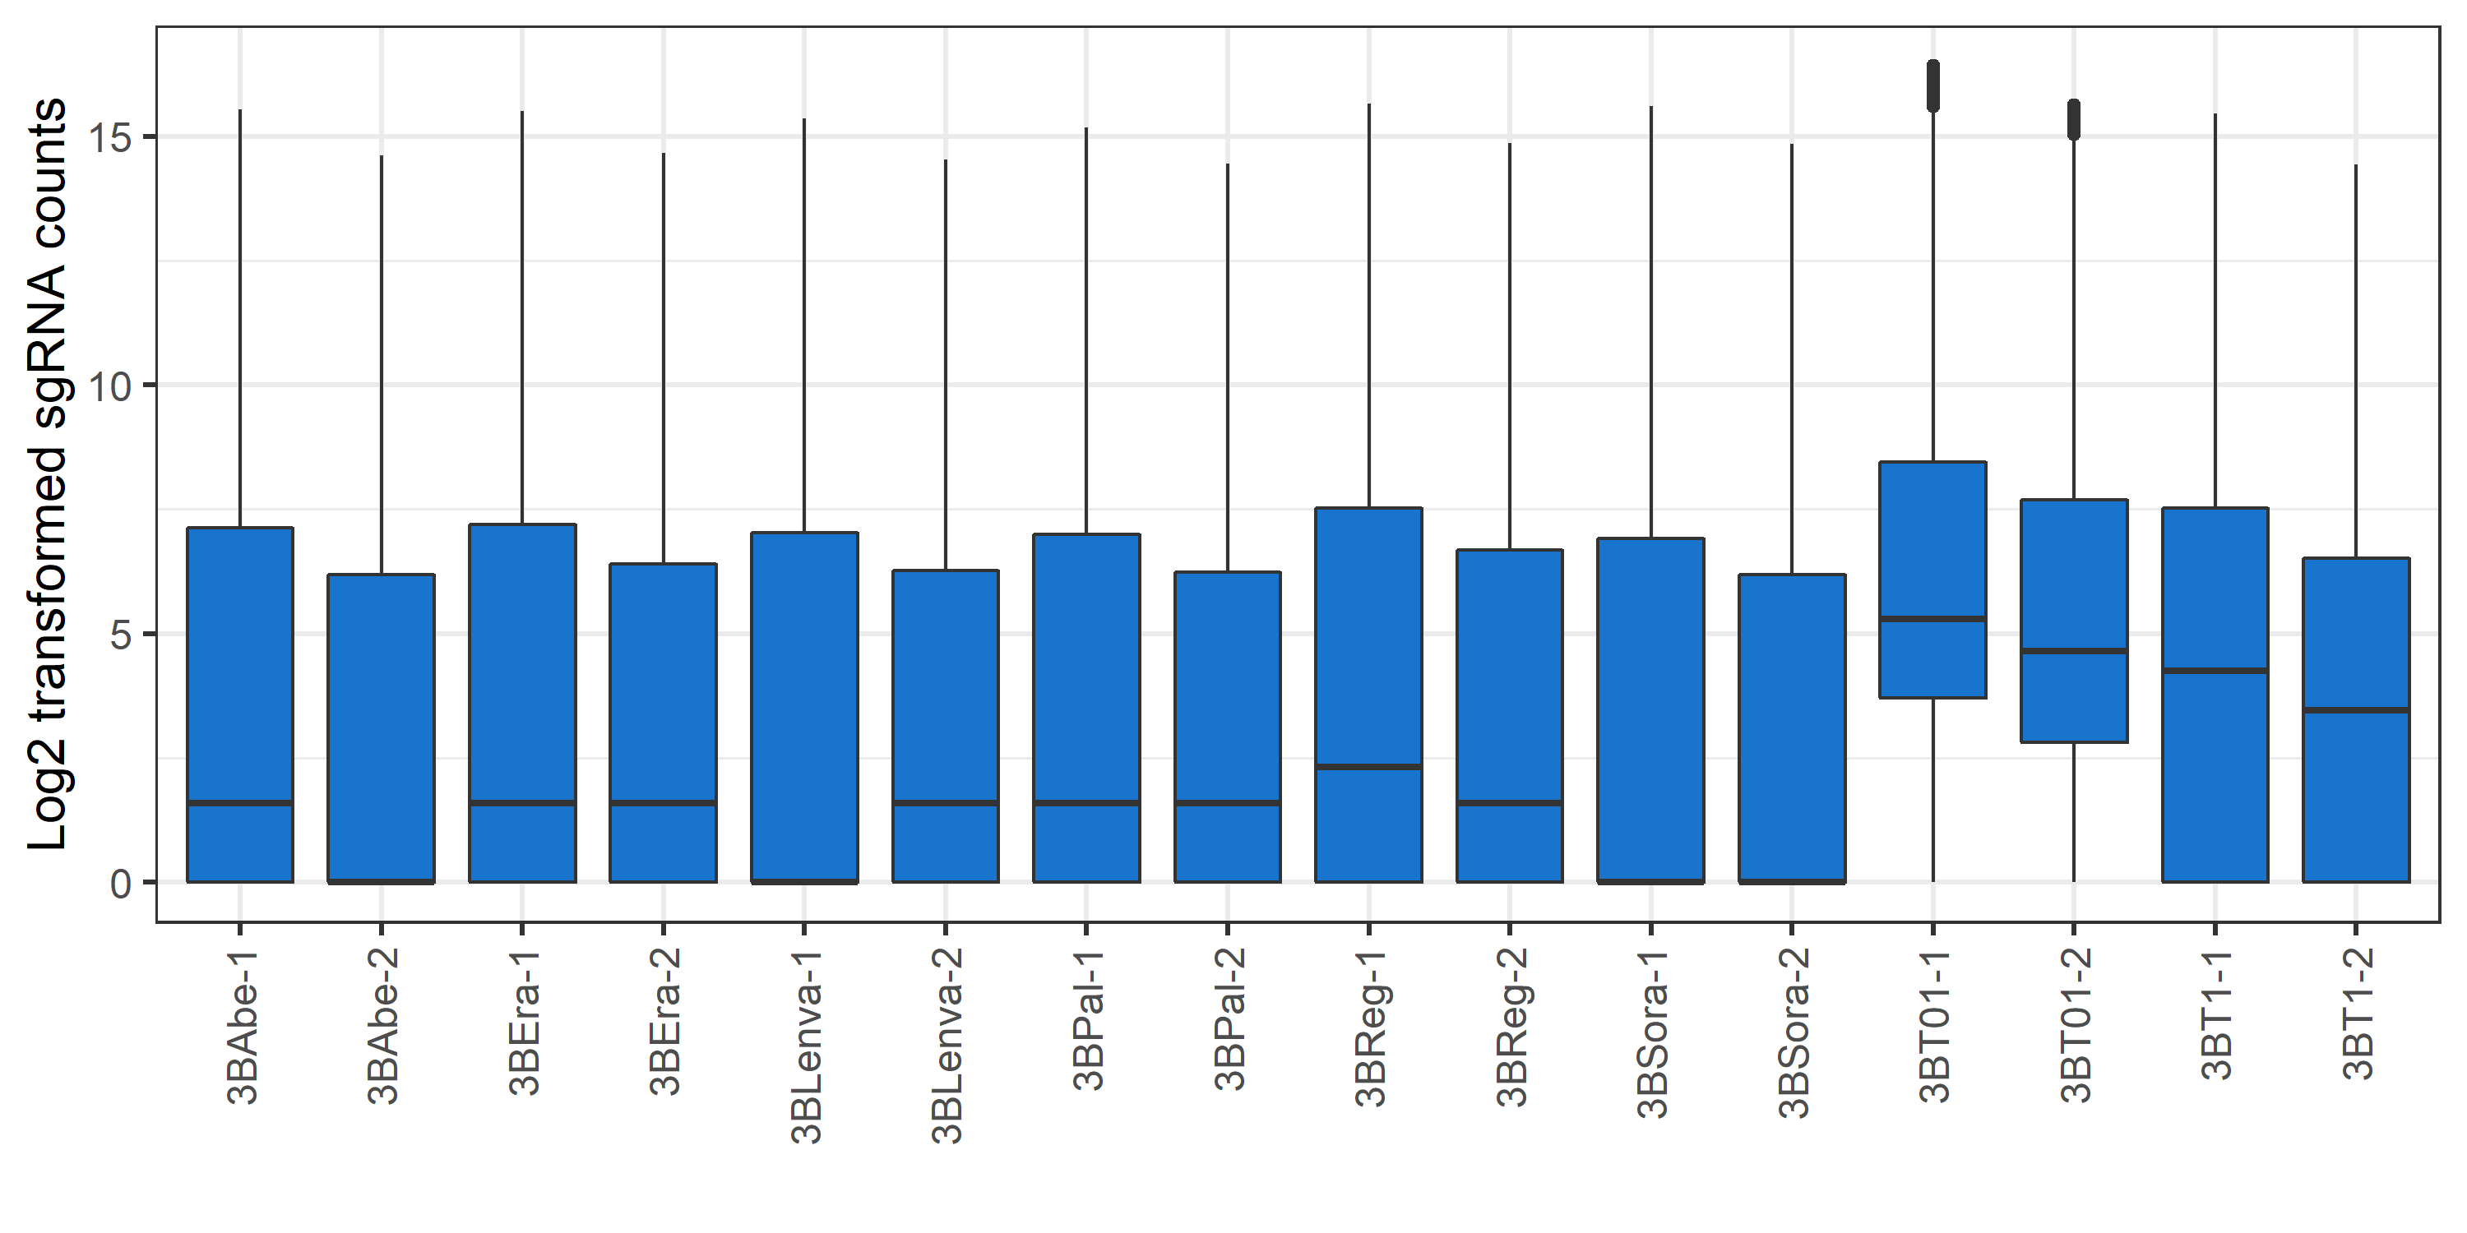
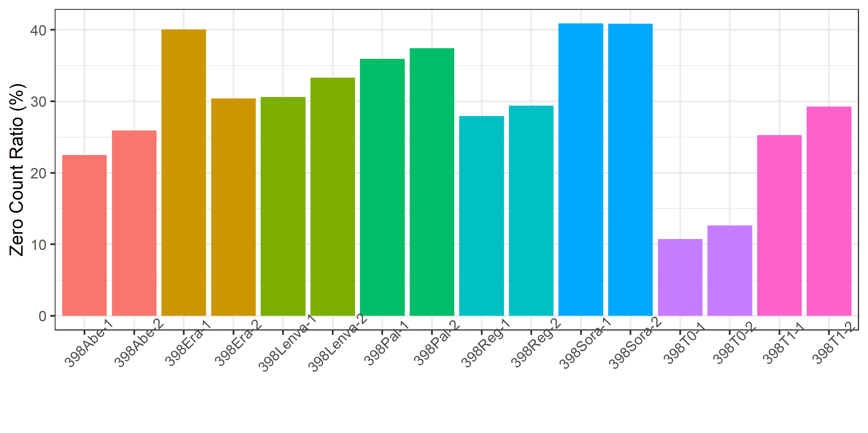
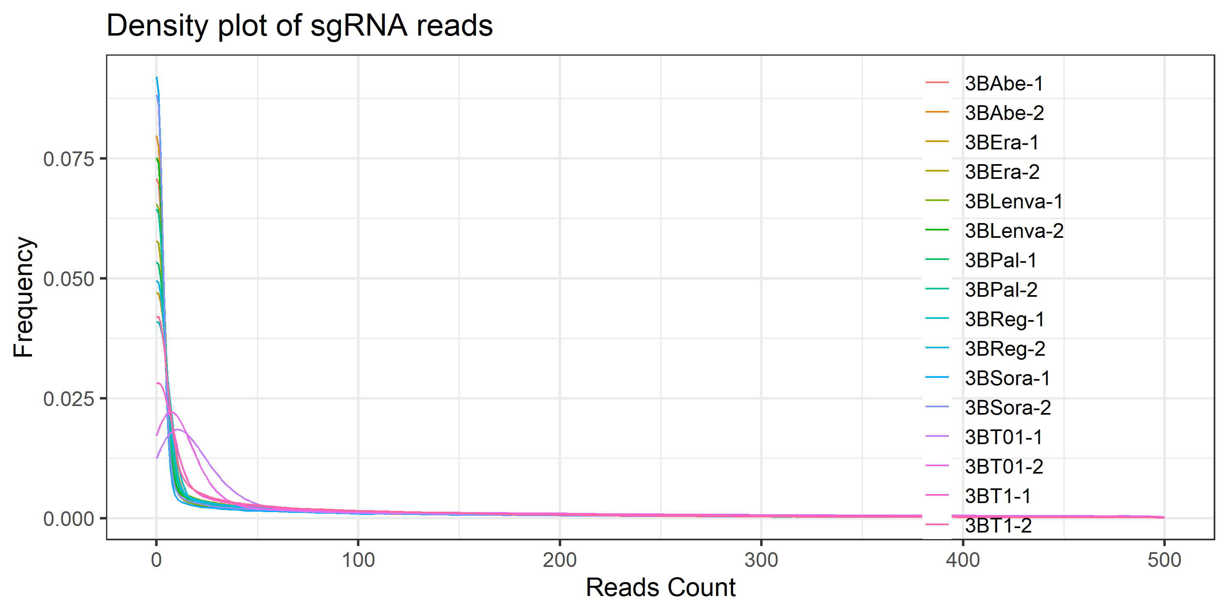
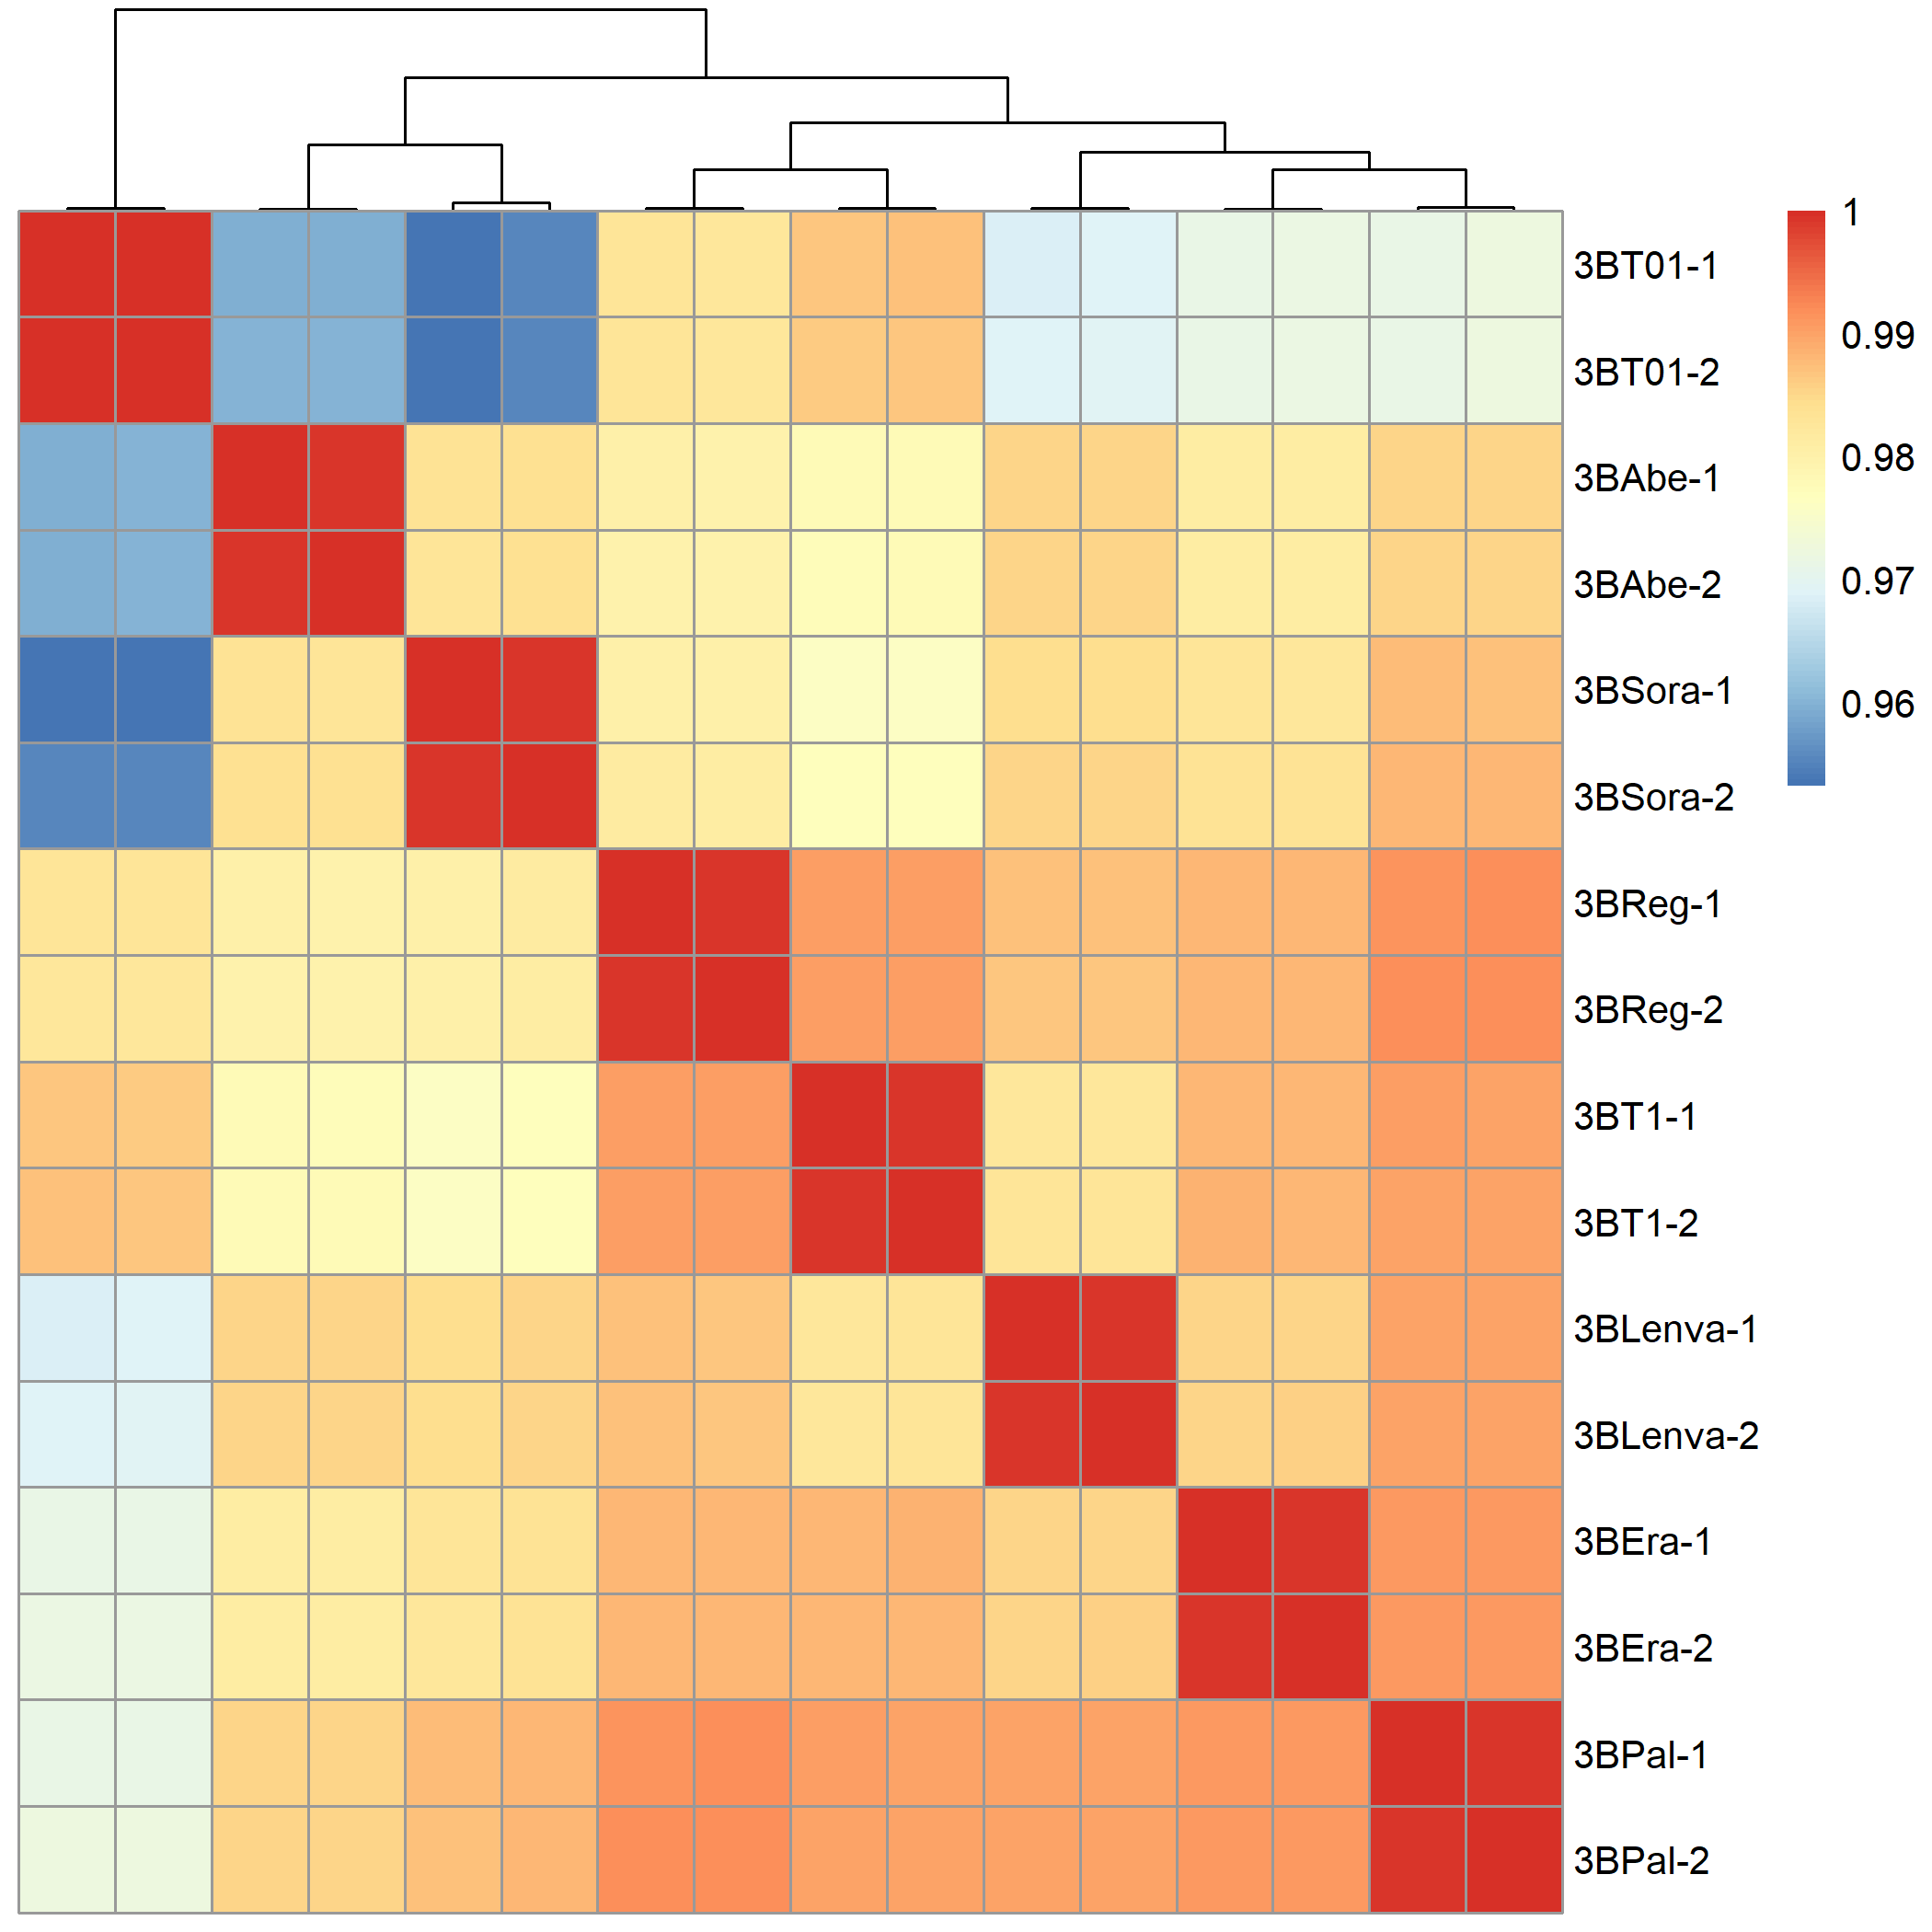
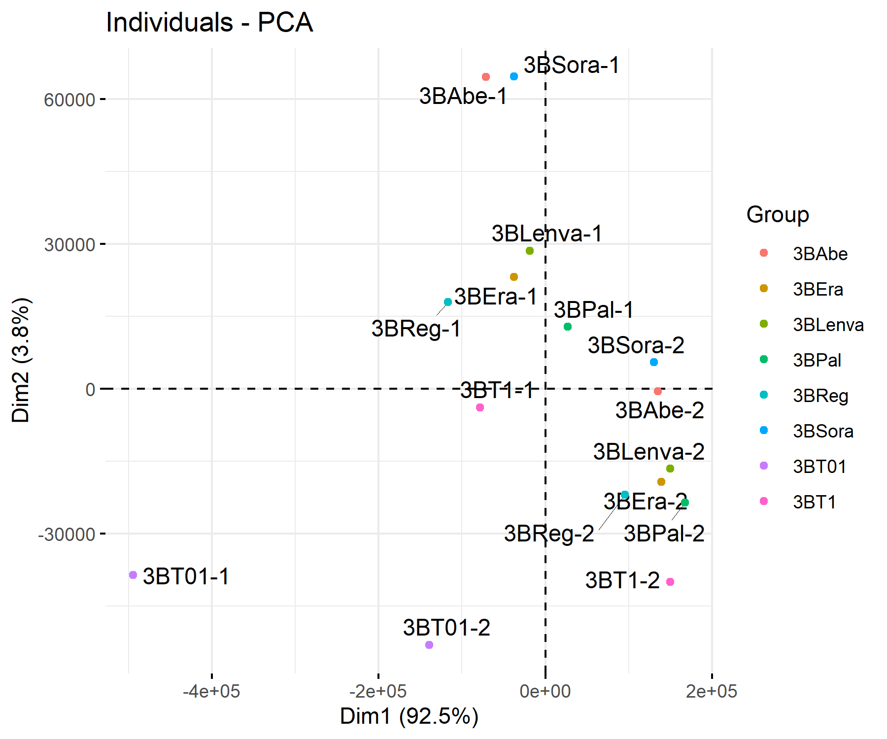
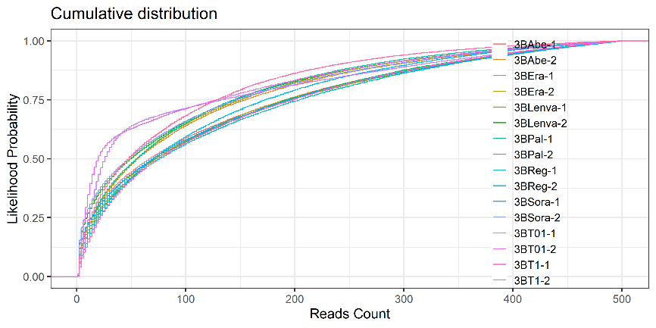
Hep3B QC of sgRNA counts
sgRNA counts 值相对较低<50，zero counts比例过多 (>20%)
相关性和PCA分析，相关性还行，PCA结果太差

Slide 3
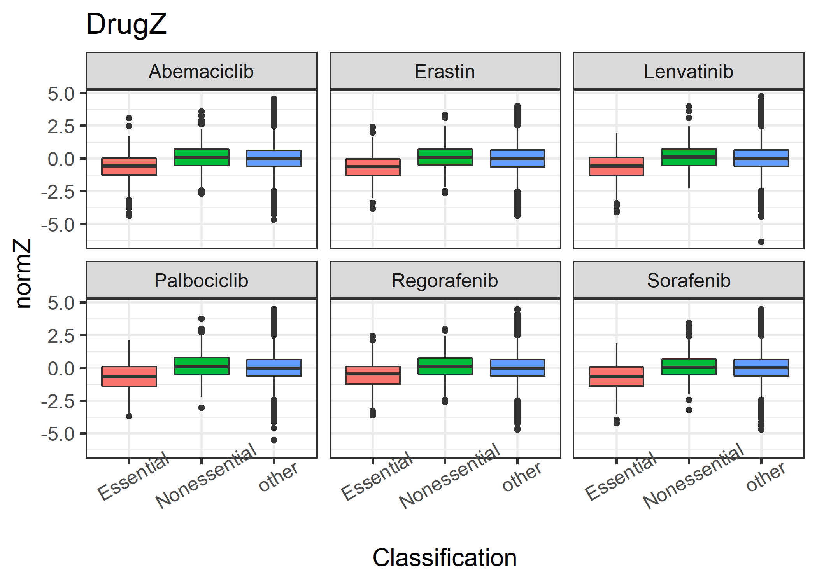
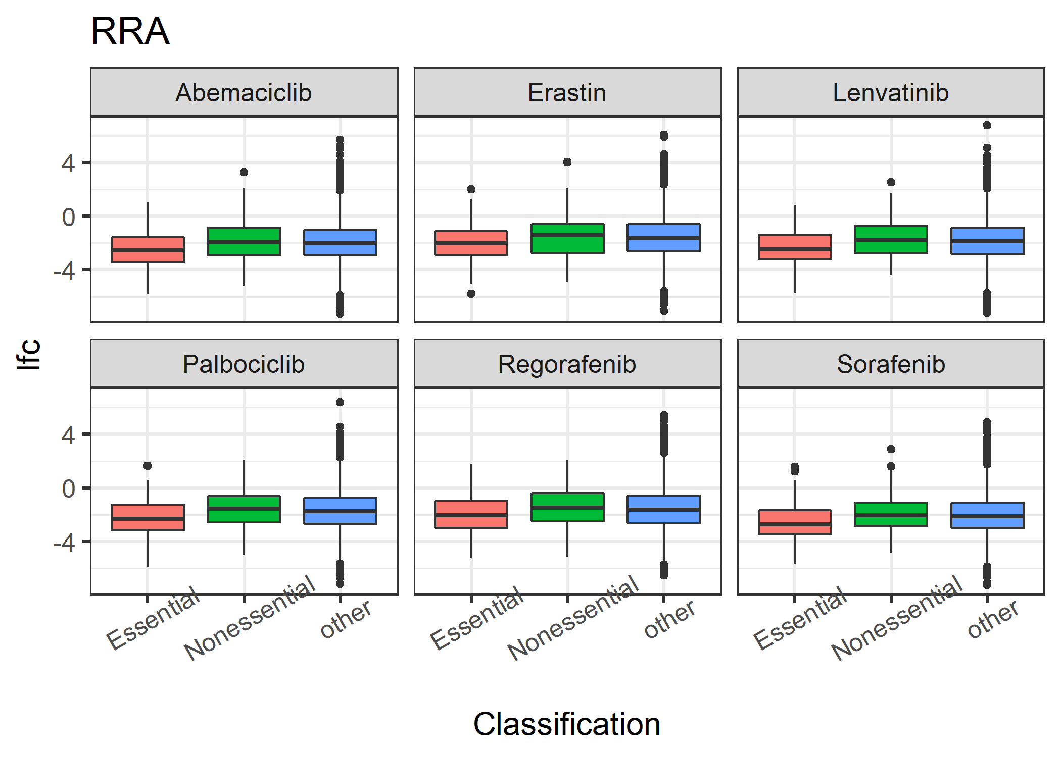
QC of essential genes
看一看不同分析方法，不同细胞中Essential genes，non-essential genes的 score分布
DrugZ的区分效果要优于RRA，RRA中整体lfc都比较低，可能与zero counts过多有关
Notes:
都和pcDNA，p0比较一下，然后再分类对基因score值进行可视化

Slide 4
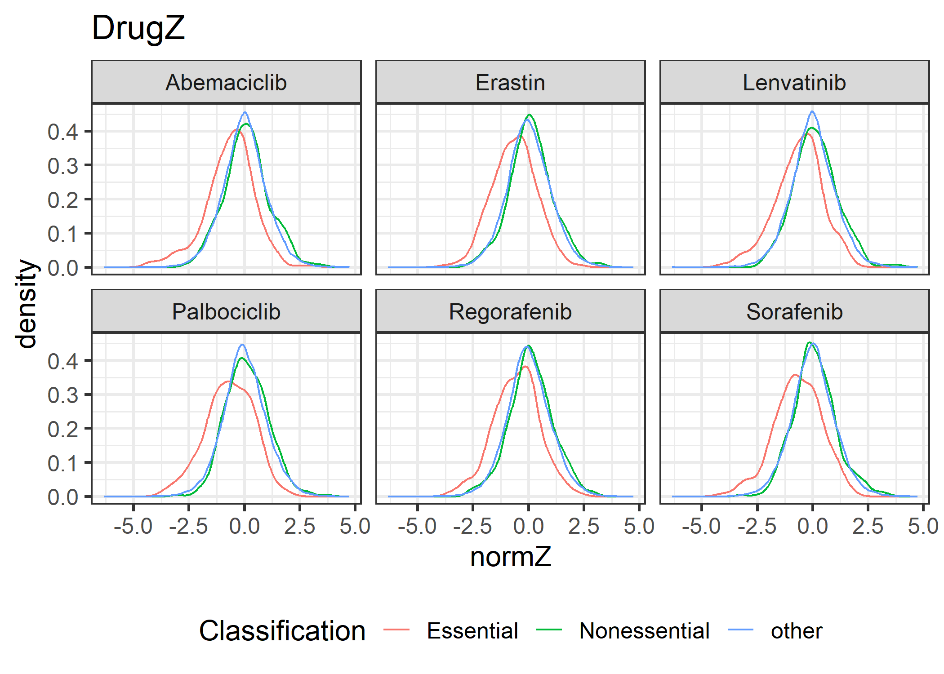
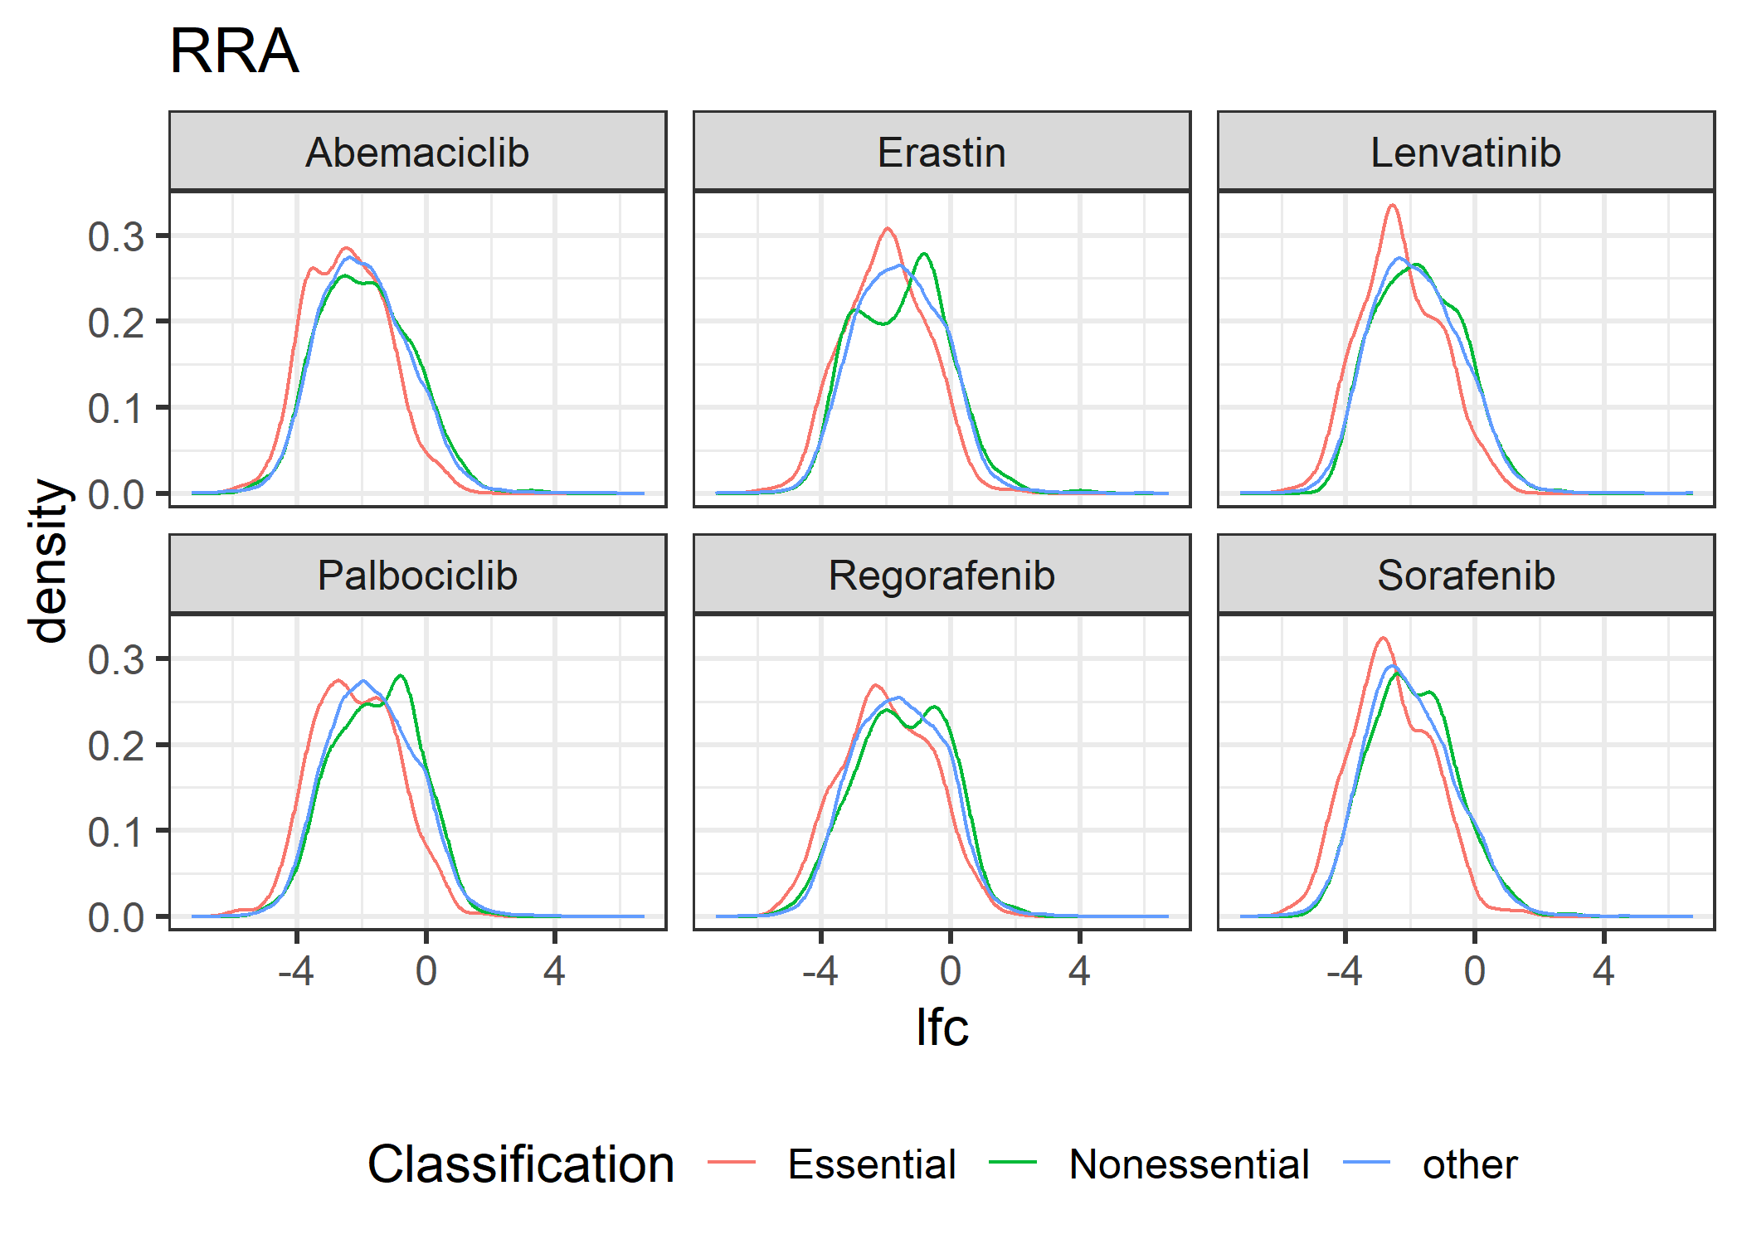
QC of essential genes
看起来区分效果都比较一般，不同类型的基因 score值或lfc 分布没有很大差异
DrugZ 相对较好一些
Notes:
都和pcDNA，p0比较一下，然后再分类对基因score值进行可视化

Slide 5
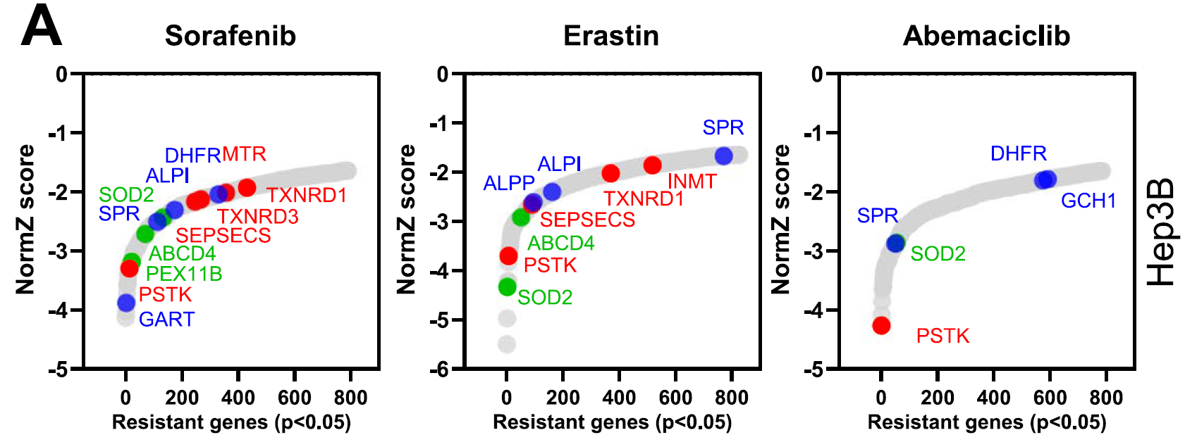
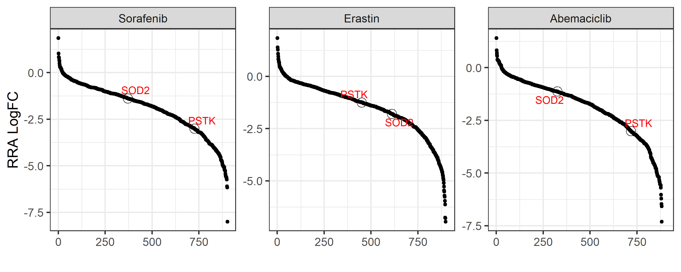
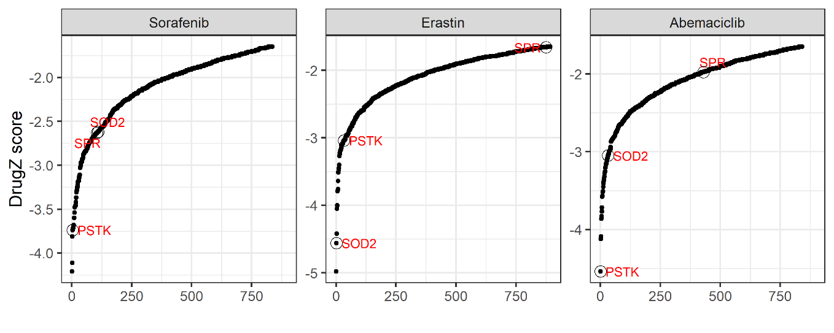
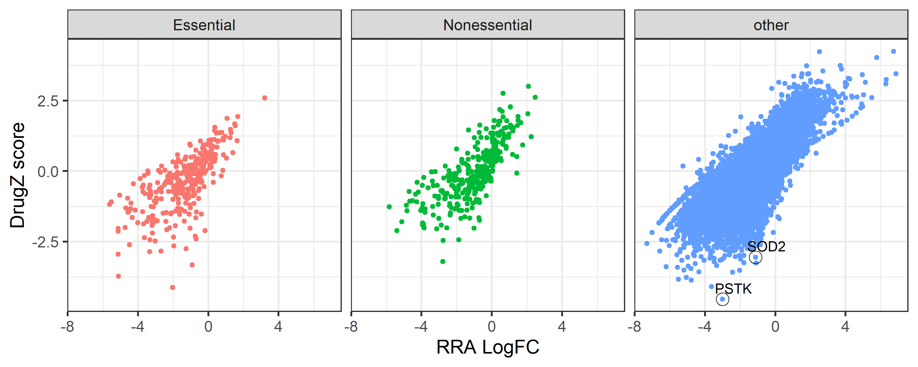
Hep3B Abemaciclib drugZ analysis
RRA Results
DrugZ Results
RRA vs DrugZ
使用DrugZ分析，基本上可以复现文章中的阳性结果 (filtered p<0.05)
RRA与DrugZ 结果一致性高，但是在筛选dependency genes时，还是会有不小的差别
或可使用RRA筛选一些有意思的candidate genes: hep3b_rra_drugz_results.csv

Slide 6
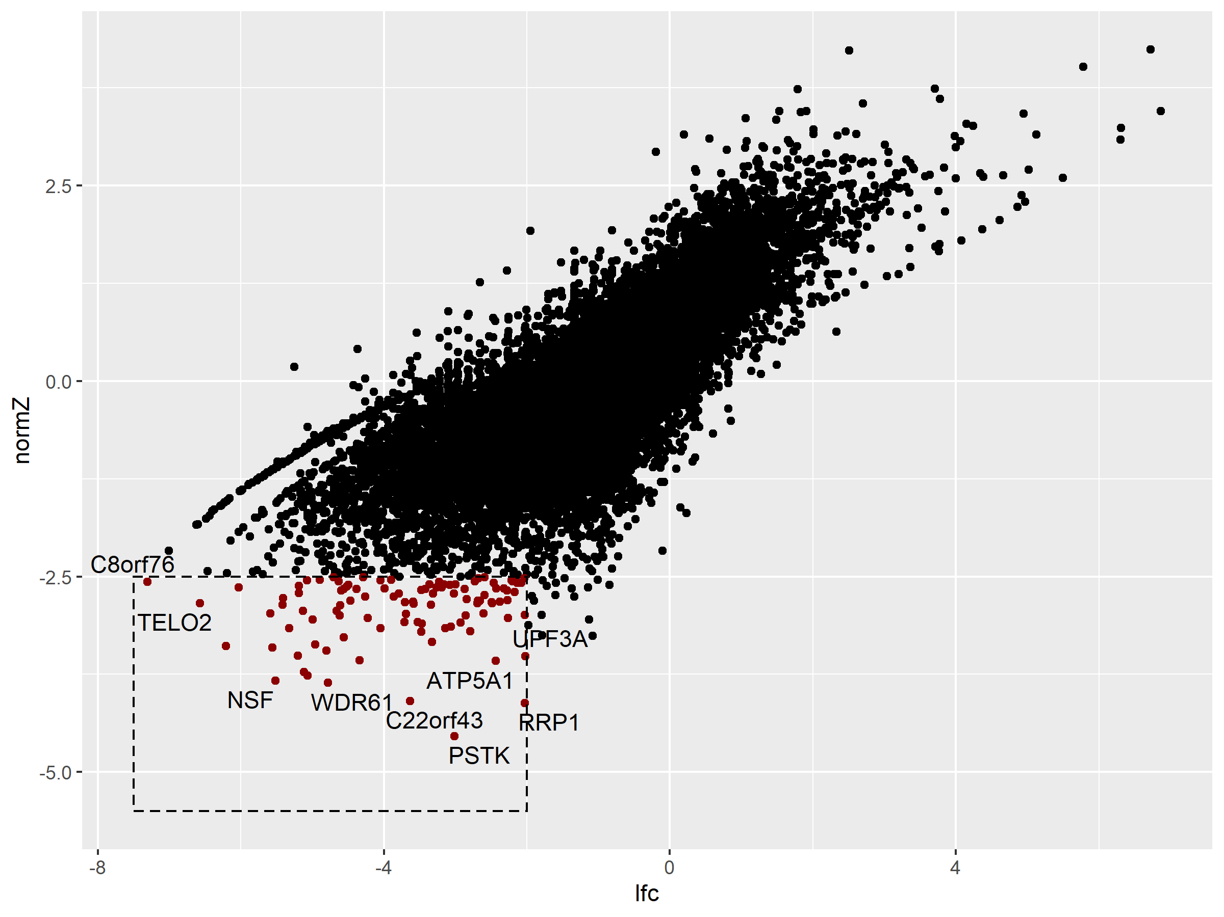
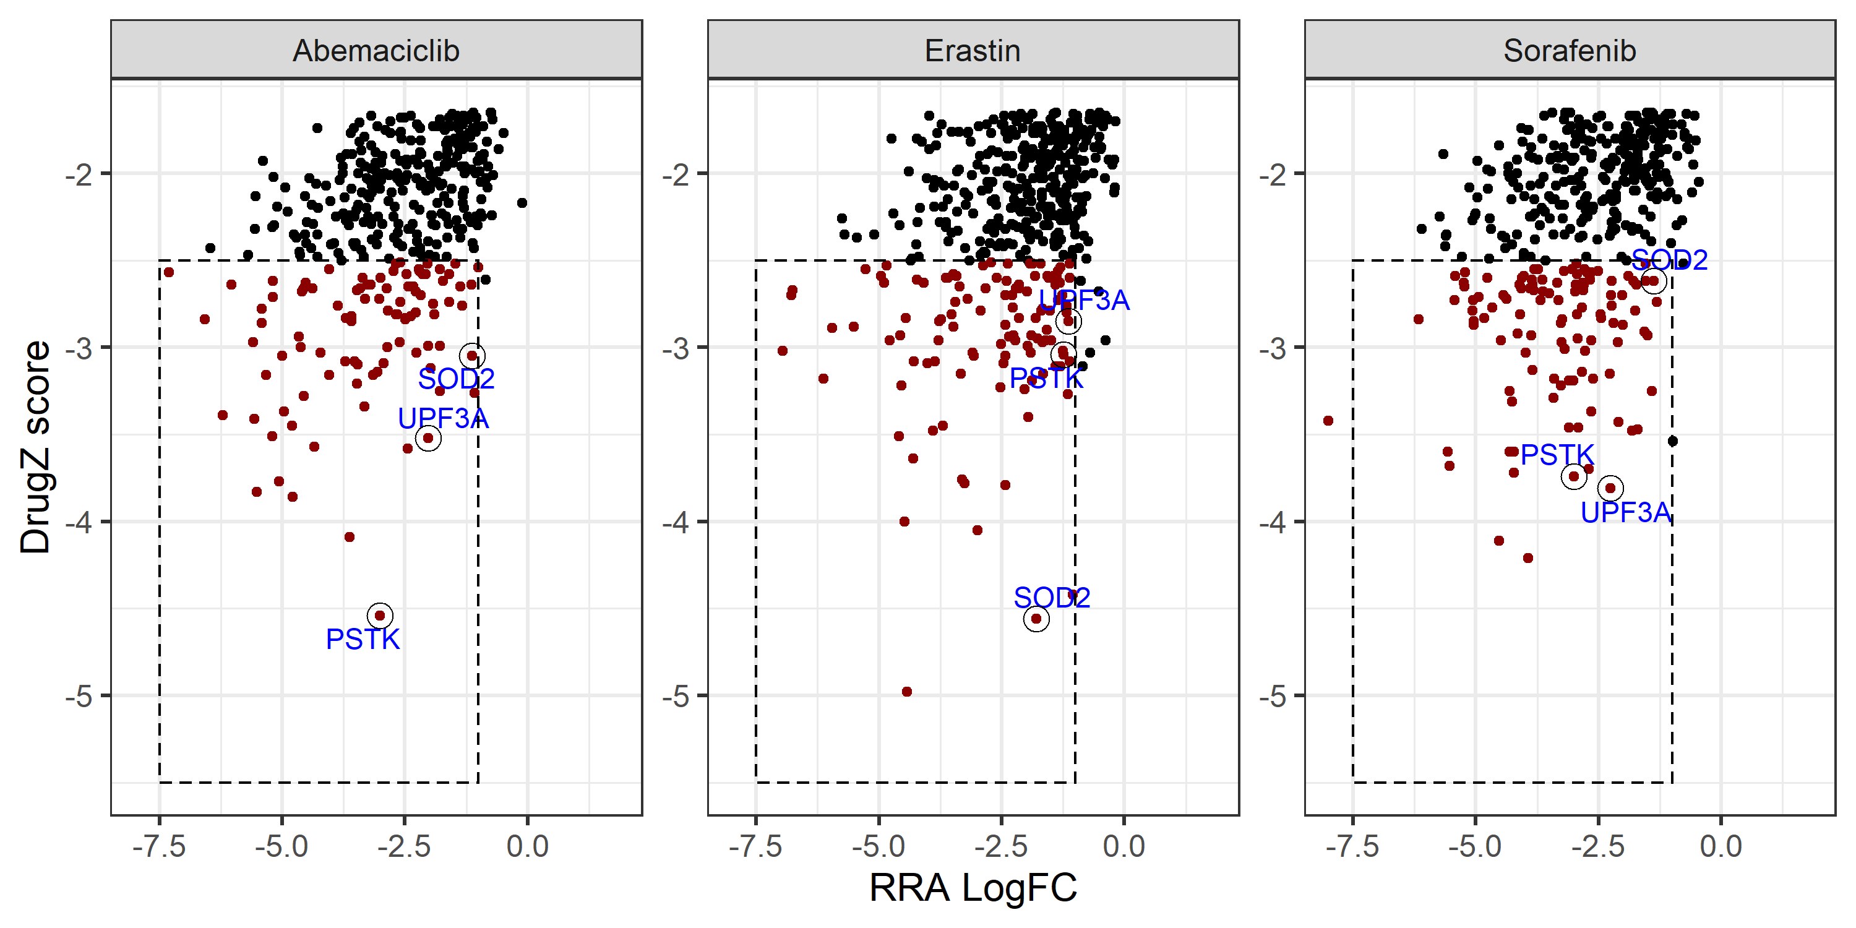
Hep3B Abemaciclib drugZ analysis – novel genes
这些novel genes的 inhibitor，有可能与Abemaciclib 有synergistic effect
RRA lfc < -2, z-score < -2.5
联合3组用药数据，获取可能与resistance协同的genes
PSTK，SOD2，UPF3A (RRA lfc < -1, z-score < -2.5) 在三种药物的作用下均出现depletion
Notes:
感觉RRA lfc会给出太多的假阳性结果，normZ则不会；
normZ小于0的lfc基本上小于0；而lfc<0的，normZ则不一定

