Slide 1
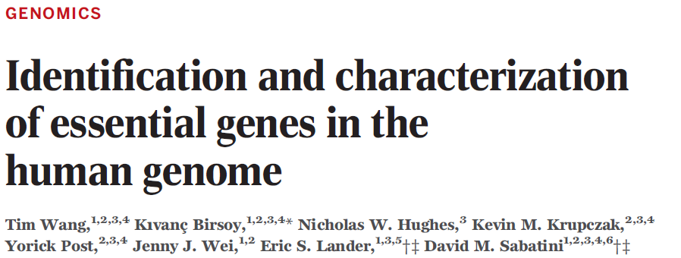
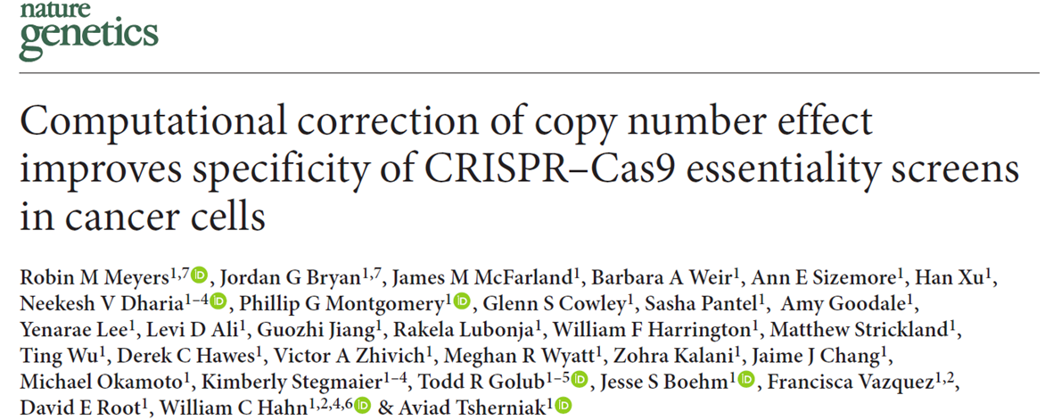
Essential genes in cancer

Slide 2
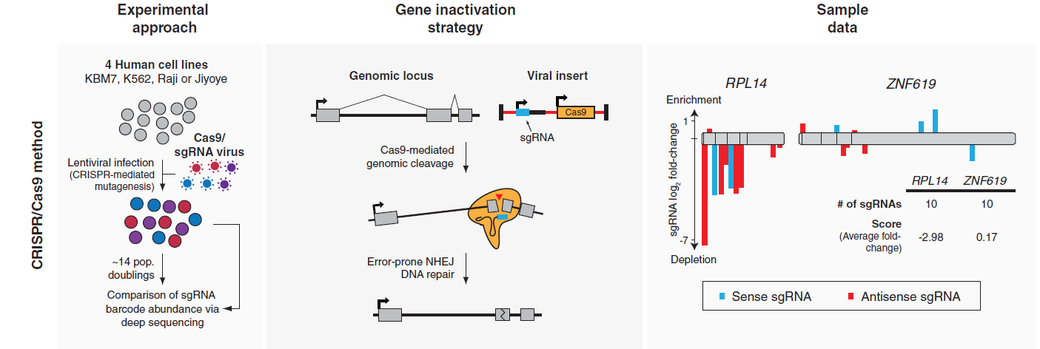
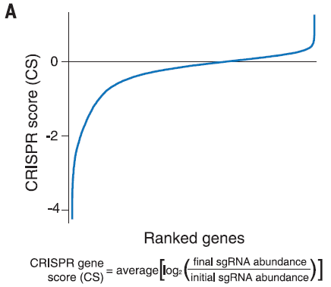
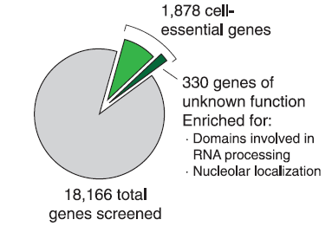
Identification and characterization of essential genes in the human genome
Whole genome CRISPR/Cas9 screens to identify essential genes
Validation by the gene-trap and Yeast dataset
对330个unknown function的基因进行3个基因的试验验证
为essential genes
定位在nucleus
MASS分析发现，其与spliceosome，ribonuclease有interaction
CS值越低，genes越是essential
Notes:
Genes with a CS < -0.1 and corrected p< 0.05 in the KBM7 cell line were defined as cell essential in downstream analyses
2015, Identification and characterization of essential genes in the human genome

Slide 3
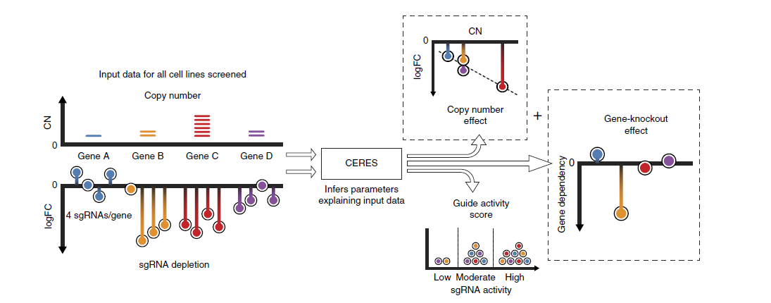
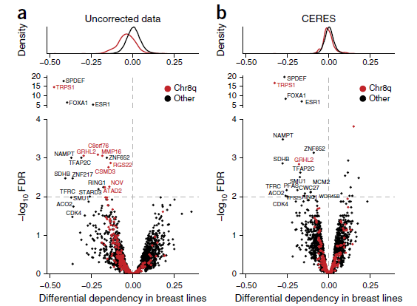
Computational correction of copy number effect improves specificity of CRISPR–Cas9 essentiality screens in cancer cells
在之前science分析的基础上，考虑到了CNV数据对CRISPR结果的影响，开发了CERES流程进行分析，得到了相关的essential genes 和non-essential genes
Notes:
Nonessentials.csv
common_essentials.csv
Screens across 342 cancer cell lines

