Slide 1

UNIT 4 - JOBS
LISTENING

Slide 2

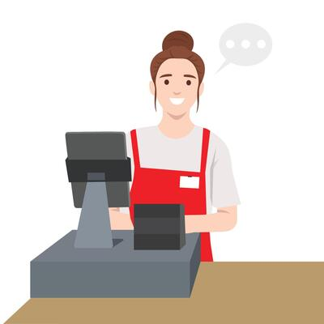

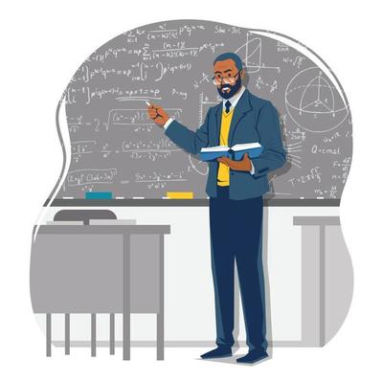
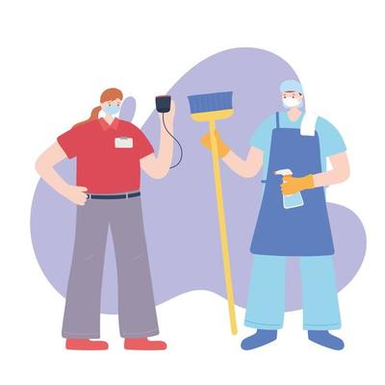



UNIT 4 - JOBS
police officer
teacher
shop assistant
nurse
doctor
dentist
cleaner
pilot

Slide 3
UNIT 4 - JOBS
1. Fill in the gap to complete the sentences
1. Speaker A works as a __________________.
2. Speaker B works as a __________________.
3. Speaker C works as a __________________.
4. Speaker D works as a __________________.
5. Speaker E works as a __________________.

Slide 4
UNIT 4 - JOBS
2. Multiple choices
1. Does speaker A enjoy his job?
A. Yes
B. Sometimes
C. No

Slide 5
UNIT 4 - JOBS
2. Multiple choices
2. When does speaker A work?
A. When he is at university
B. Weekends
C. Summer holidays

Slide 6
UNIT 4 - JOBS
2. Multiple choices
3. When does speaker B work?
A. Weekdays
B. Weekends and holidays
C. Summer holidays

Slide 7
UNIT 4 - JOBS
2. Multiple choices
4. What does speaker B say tourists love doing?
A. Visiting universities
B. Taking a boat trip
C. Swimming in the river

Slide 8
UNIT 4 - JOBS
2. Multiple choices
5. Does speaker C like his job?
A. Yes
B. Sometimes
C. No

Slide 9
UNIT 4 - JOBS
2. Multiple choices
6. What does speaker D say is difficult about being a pilot?
A. Travelling to many countries
B. Learning many languages
C. Flying planes in bad weather

Slide 10
UNIT 4 - JOBS
2. Multiple choices
7. What does speaker D say is the best thing about his job?
A. Visiting different places
B. Meeting different people
C. The different weather

Slide 11
UNIT 4 - JOBS
2. Multiple choices
8. What does speaker E not like about her job?
A. The doctors
B. The sick people
C. The uniform

Slide 12
UNIT 4 - JOBS
WRITING

Slide 13
UNIT 4 - JOBS
Write a passage at least 60 words about the job of a person you know, use the tips below.
(- Who is the person?)
- What does his/her job?
- Where does he/she work?
- When does he/she work?
- Can you describe his/her work?
- Does he/she love his/her job?
- Do you love that job?
...

