Slide 1

UNIT 4 - JOBS
LISTENING

Slide 2



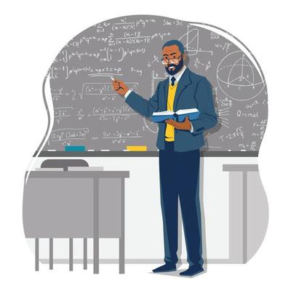
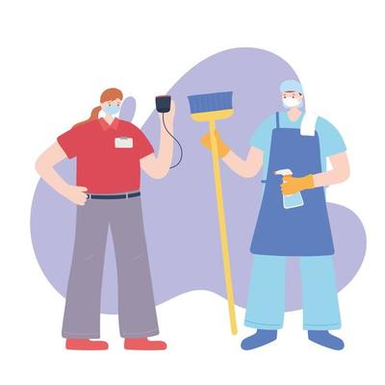
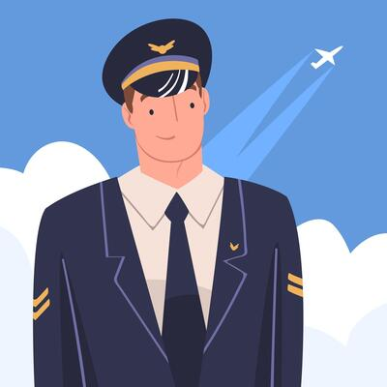


UNIT 4 - JOBS
police officer
teacher
shop assistant
nurse
doctor
dentist
cleaner
pilot

Slide 3
UNIT 4 - JOBS
1. Fill in the gap to complete the sentences
1. Speaker A works as a __________________.
2. Speaker B works as a __________________.
3. Speaker C works as a __________________.
4. Speaker D works as a __________________.
5. Speaker E works as a __________________.

Slide 4
UNIT 4 - JOBS
2. Multiple choices
1. Does speaker A enjoy his job?
A. Yes
B. Sometimes
C. No

Slide 5
UNIT 4 - JOBS
2. Multiple choices
2. When does speaker A work?
A. When he is at university
B. Weekends
C. Summer holidays

Slide 6
UNIT 4 - JOBS
2. Multiple choices
3. When does speaker B work?
A. Weekdays
B. Weekends and holidays
C. Summer holidays

Slide 7
UNIT 4 - JOBS
2. Multiple choices
4. What does speaker B say tourists love doing?
A. Visiting universities
B. Taking a boat trip
C. Swimming in the river

Slide 8
UNIT 4 - JOBS
2. Multiple choices
5. Does speaker C like his job?
A. Yes
B. Sometimes
C. No

Slide 9
UNIT 4 - JOBS
2. Multiple choices
6. What does speaker D say is difficult about being a pilot?
A. Travelling to many countries
B. Learning many languages
C. Flying planes in bad weather

Slide 10
UNIT 4 - JOBS
2. Multiple choices
7. What does speaker D say is the best thing about his job?
A. Visiting different places
B. Meeting different people
C. The different weather

Slide 11
UNIT 4 - JOBS
2. Multiple choices
8. What does speaker E not like about her job?
A. The doctors
B. The sick people
C. The uniform

Slide 12
UNIT 4 - JOBS
WRITING

Slide 13
UNIT 4 - JOBS
Write a passage at least 60 words about the job of a person you know.
My idol 1nG, who was born in 1997, is an indie singer and song writer. He wrote some good ballad songs about love and friendship. Although he is not famous like other mainstream singers, he is very talented in writing songs and sing them. Most of the time, he works at his home and sometimes at studios. He loves music a lot and he loves his job too. He is a promising singer with his great high voice. He took part in the first season of King of Rap but failed to be the winner of that show. I always dream of being a singer like him in the future. I love music and I think it's a great job that suits me.

