Slide 1
VOCABULARY

Slide 2

What is your job?

Slide 3

She is an _________

Slide 4
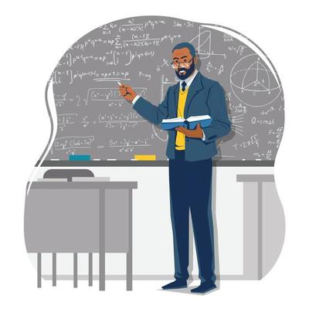
He is a ____________

Slide 5
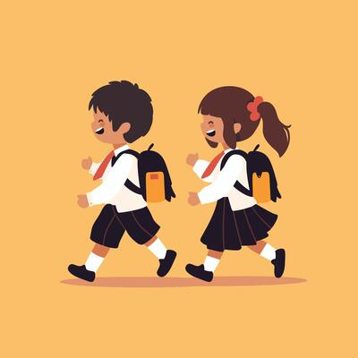
They are ________________

Slide 6

This man is a _________________

Slide 7

She is a _______________

Slide 8

They are ___________________

Slide 9
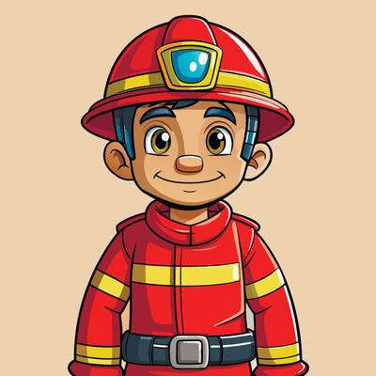
He is a ________________

Slide 10

She is a _____________

Slide 11

He is a ______________

Slide 12
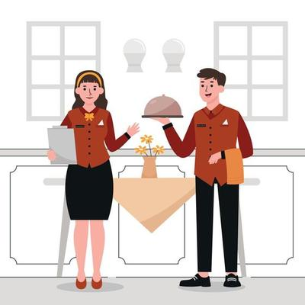
The girl is a ___________
The man is a _____________

Slide 13

He is a _________________

Slide 14

She is an ___________________

Slide 15

They are _____________________

Slide 16

She is a _______________

Slide 17

She is a ___________________

Slide 18

They are ______________________

Slide 19

He is a _______________________________

Slide 20
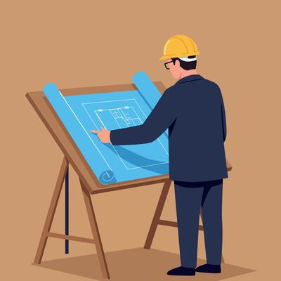
He is an _____________________

Slide 21

She is a ____________________

Slide 22

He is a ________________

Slide 23
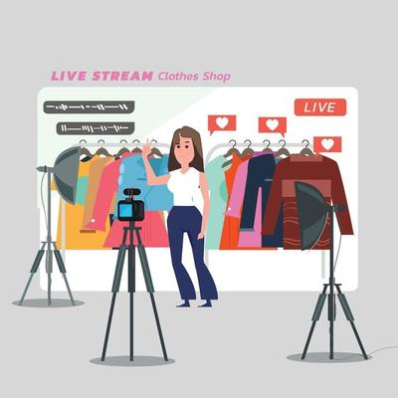
She is an ____________________

Slide 24

He is a graphic ________________

Slide 25

He is a school bus _______________

Slide 26

He is a _________________

Slide 27

He is a _________________

Slide 28

Job-Related Verbs

Slide 29

I want to ___________the position of headhunter at a company.

Slide 30

The company want to _________ a new CEO.

Slide 31

My boss decides to __________ me.

Slide 32

I want to ___________ after 10 years working at this company.

Slide 33
Job-Related Nouns

Slide 34
I will do my job interview /ˈɪntərvjuː/ next week.

Slide 35

The average monthly ____________ for an unskilled worker is $550.

Slide 36

I have over ten years’ ____________ as a teacher.

Slide 37

She plans to pursue a ____________ in medicine.

Slide 38
SPEAKING

Slide 39
1. What job do you want to do in the future?
2. What job does your parents do?
3. Do you think your job will be easy or difficult? Why?
4. Is it better to work in the city or in the countryside
5. What job do you think is fun?
6. Do you like to work on computers?
7. Do you like to work at a big company or at home?
8. Would you rather have a job that is fun
or that is makes a lot of money?

